Slide 1
Iraq humanitarian response Centre and south Sub-National Shelter Cluster Coordination meeting
Baghdad
May 15th, 2019

Slide 2
AGENDA
Review of action points from minutes of previous meeting;
Key issues and Partners to update on their planned, ongoing and completed interventions:
Interactive dashboard for the Housing Rehabilitation Interventions;
UNDP - 2019 Housing Rehabilitation Interventions in Centre & South Regions;
Partners - Housing Rehabilitation Interventions;
NFI - distributions in camps and out of camps;
Information Management
Planning of proposed trainings;
Update on 2019 assessments (planned, ongoing, completed);
ActivityInfo report & the new 4W for planning;
AOB

Slide 3
Review of action points from minutes of previous meeting
# | Action Points | Focal Point | Status
1 | Housing rehabilitation: Shelter Cluster to continuously follow up with partners, to support collecting their latest interventions details. Partners can reach out to the WDS IM Unit for support if needed (Emmanuel - im3.iraq@sheltercluster.org and Hoveen - hoveen.yaseen@un.org). | Shelter Cluster | Ongoing process
2 | Housing rehabilitation: UNHCR to share their housing and rehabilitation area-based approach once ready. | UNHCR – Baghdad | Follow up
3 | 2018/2019 winter response: Partners to share Lessons Learned from their respective winter response. | Partners | Follow up
4 | 2018/2019 winter response: Map & consolidated raw data on the winter response to be shared. | Shelter Cluster | Ongoing process
5 | 2018/2019 winter response: Workshop - Lessons Learned on winter response: to be discussed. | Shelter Cluster Partners | Follow up
6 | 2019 HRP prioritized districts / governorates: List of Shelter Cluster prioritized districts to be shared. | Shelter Cluster | Completed
7 | Assessments: Raw data of the Return Index - liaise with IOM/DTM to share relevant analysis related to shelter need in return areas. | Shelter Cluster IOM-DTM | Completed & Cluster to be sharing update
8 | 2019 Summer response plan: Support Partners summer response plan. to be discussed. | Shelter Cluster | Follow up
9 | Flood – preparedness & response: Follow up with concerned partners and OCHA to see how best, appropriate assistance can be provided as required. | Shelter Cluster | Completed
10 | Shelter Cluster ActivityInfo training: Tentative training plan (venue, date and time) to be shared with concerned partners. | Shelter Cluster | Completed – Training to be done on May 15th 2019
11 | SEVAT - Socio-Economic Vulnerability Assessment Tool: Interested partners to liaise with the Cluster Hub Coordinator for guidance. | Partners | Follow up
12 | Training Needs / Requests for Centre & South Hub: Draft training plan (venue, date and time) to be shared. | Shelter Cluster | To be finalized in this meeting

Slide 4
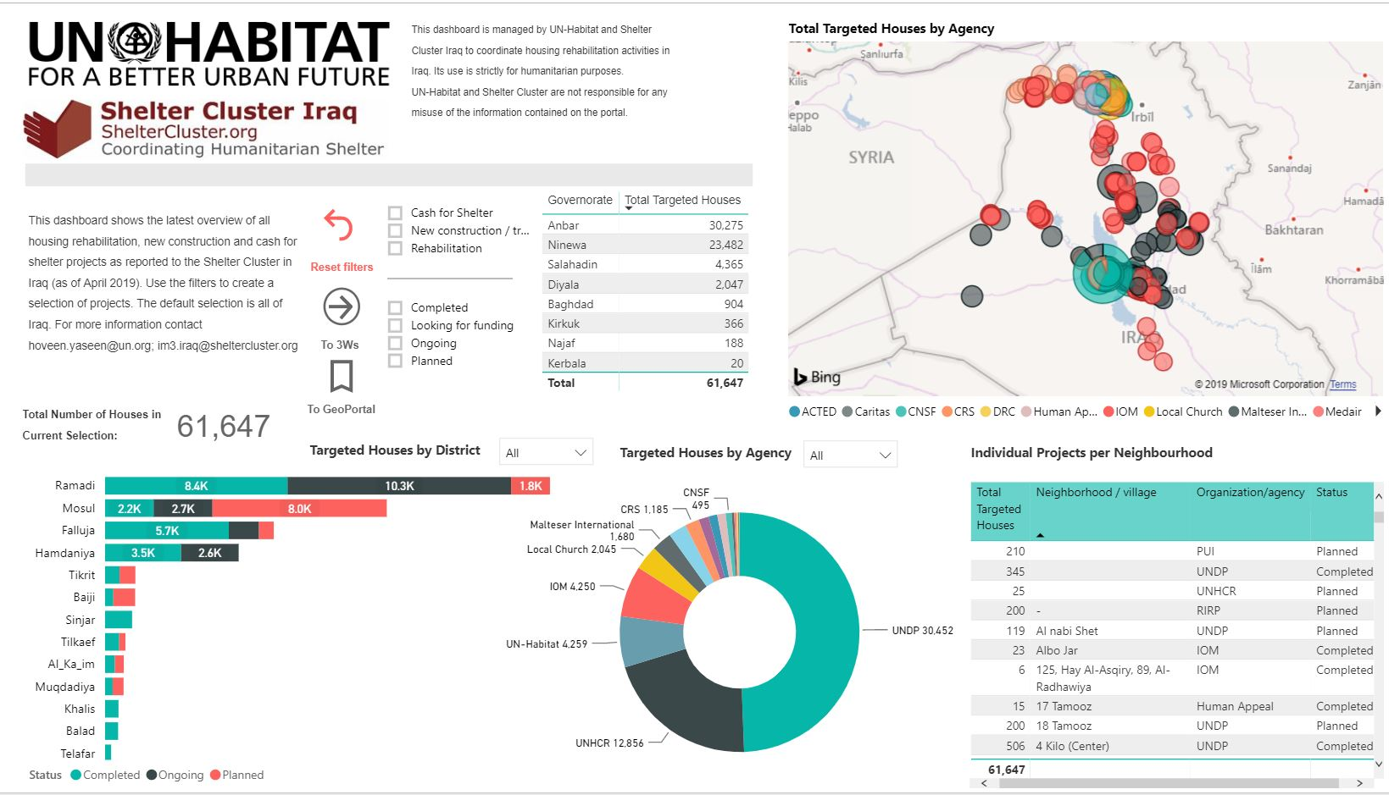
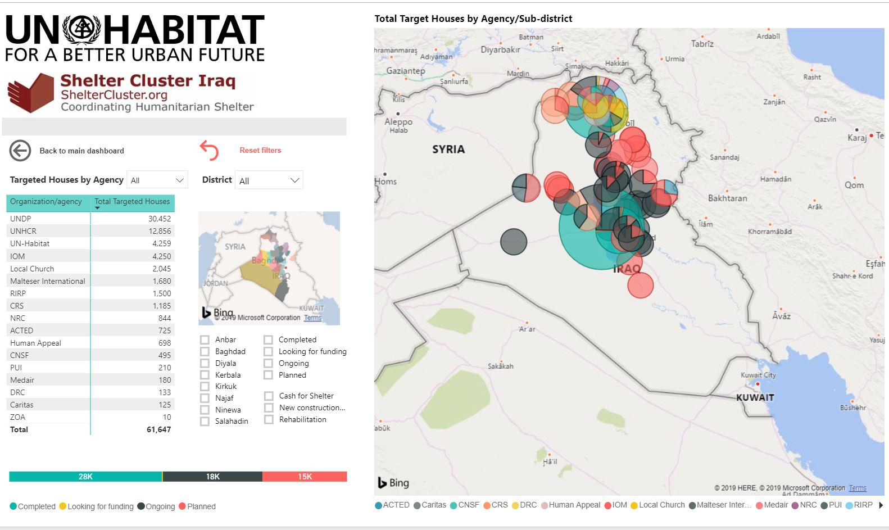
Key issues and Partners to update on their planned, ongoing and completed interventions:
Interactive dashboard for the Housing Rehabilitation Interventions – As of May 14th 2019;
https://app.powerbi.com/view?r=eyJrIjoiNWQzNDliZTItMTkxZi00NTUxLWIwY2YtM2Q3YTNiMjExM2M5IiwidCI6IjBmOWUzNWRiLTU0NGYtNGY2MC1iZGNjLTVlYTQxNmU2ZGM3MCIsImMiOjh9
Partners to provide feedback on the dashboard

Slide 5
Key issues and Partners to update on their planned, ongoing and completed interventions:
UNDP - 2019 Housing Rehabilitation Interventions in Centre & South Regions;
Governorate | Location | Area | Sector | Project (Case) Name | Modality | Damage level
Anbar | Karma | Khairat | Housing | Rehabilitation in Khairat | through contractor | cat. 1 & 2
Anbar | Haditha | Haqlaniya | Housing | Rehabilitation Housing Work in two villages (Khasfa & Zawia) | through contractor | cat. 1 & 2
Anbar | Haditha | Haqlaniya | Housing | Rehabilitation Housing Work in Al-Bohayat village | through contractor | cat. 1 & 2
Anbar | Haditha | Barawanh | Housing | Rehabilitation Housing Work in Al-Sumood | through contractor | cat. 1 & 2
Anbar | Haditha | Barawanh | Housing | Rehabilitation Housing Work in Al-Ata'a | through contractor | cat. 1 & 2
Anbar | Rawa | Rawa | Housing | Rehabilitation in Rawa | through contractor | cat. 1 & 2
Anbar | Qaim | Qaim | Housing | Rehabilitation in Qaim (Sikak, Resala & 12 Rabe Awal) | through contractor | cat. 1 & 2
Anbar | Ana | Sagrah | Housing | Rehabilitation in Sagrah village | through contractor | cat. 1 & 2
Anbar | Ana | Rehanna | Housing | Rehabilitation in Rehanna | through contractor | cat. 1 & 2
Anbar | Ana | Hasa | Housing | Rehabilitation in Hasa | through contractor | cat. 1 & 2
Salah al-Din | Baiji | TBC, in coordination with the Cluster | Housing | Rehabilitation | through contractor | cat. 1 & 2
Around 4,106 houses

Slide 6
Key issues and Partners to update on their planned, ongoing and completed interventions:
Partners - Housing Rehabilitation Interventions - as of May 14th 2019 ;
Please update on the following
Planned interventions
Ongoing interventions

Slide 7
Key issues and Partners to update on their planned, ongoing and completed interventions:
NFI - distributions in camps and out of camps;

Slide 8
Information Management
Planning of proposed trainings
Date, venue, time to be confirmed
More partners / participants to confirm their interest
Location | Training | Language | Partners | Participants | Date | Venue / Time / Comments
Baghdad | Use of the Cash Working Group socio-economic vulnerability assessment tool | Arabic | DRC, IOM, Caritas Iraq, UNHCR, UNDP, CRS, OXFAM | 22 | July 1st 2109 | Venue: UNHCR Office in RCC3 Time: from 10:30 am - 14:00 pm (max) # of participants may increase
Baghdad | Data Manager for Socio-Economic Vulnerability Assessment Tool | English | DRC, IOM, Caritas Iraq, UNHCR, UNDP, CRS, OXFAM | 14 | July 2nd 2019
Baghdad | WDS minimum standards and the use of BoQ | Arabic | DRC, IOM, Caritas Iraq, UNHCR, UNDP, CRS, OXFAM | 18 | July 3rd 2019

Slide 9
Information Management
Update on 2019 assessments (planned, ongoing, completed);
Table is from the online excel sheet - as of May 15th 2019 – Partners to update on the assessment status
Governorate | District | Sub-district | Village/neighborhood/camp | Targeted people | Lead agency | Title of the assessment | Type of assessment
Anbar | Haditha & Al-Qaim |  |  | Returnees, Host communities | PUI | assessment for the most vulnerable returnees
Anbar & Baghdad |  |  | HTC,AAF and Bzbz | formal and informal IDP camps | CRS/Caritas | NFI need assessment
Baghdad | Al-Mahmoudiya |  |  | Returnees | Caritas Iraq | Assessment for current sitauation of Shelter, Livelihood and PSS
Al-Najaf | Al-Najaf
Al-Anbar | Al-Falluja | Markaz Al-Falluja | Al Shuhadaa 2 | Returnees
Al-Anbar | Heet | Markaz Heet |  | All affected population | Caritas Czech Republic | Damage category 2,3 | War-damaged shelter technical assessment
Al-Anbar | Al-Ramadi | Al-Habbaniya | Jazirat Al Khaldiyah | All affected population | Caritas Czech Republic | Damage category 2,3 | War-damaged shelter technical assessment
Al-Anbar | Al-Falluja | Markaz Al-Falluja | Al Shuhadaa 2
Al-Anbar | Heet |  | Al Muhamdee | Returnees | PUI | Assesment for rehabilitation of war-damaged shelters | War-damaged shelter technical assessment
Al-Anbar | Al-Ka'im |  | Al Aubaidi Al Qadima | Returnees | PUI | Assesment for rehabilitation of war-damaged shelters | War-damaged shelter technical assessment
Al-Anbar | Heet |  | Al-Mashhad | Returnees | PUI | Assesment for rehabilitation of war-damaged shelters | War-damaged shelter technical assessment
Al-Anbar | Al-Ramadi |  | Al-Jazerah | Returnees | PUI | Assesment for rehabilitation of war-damaged shelters
Salah Al-Din | Tuz |  | Yangejah, Khasa Darli, Suleiman Beg | all affected population | Medair | WDS rehabilitation rapid assessment and CWG tool need assessment | War-damaged shelter technical assessment
Al-Anbar | Al-Falluja |  | Al Shuhadaa 2 | Returnees
Al-Anbar | Al-Falluja | AL-Saqllawya | #N/A | Returnees | Germany government | WDS rehabilitation rapid assessment | War-damaged shelter technical assessment

Slide 10
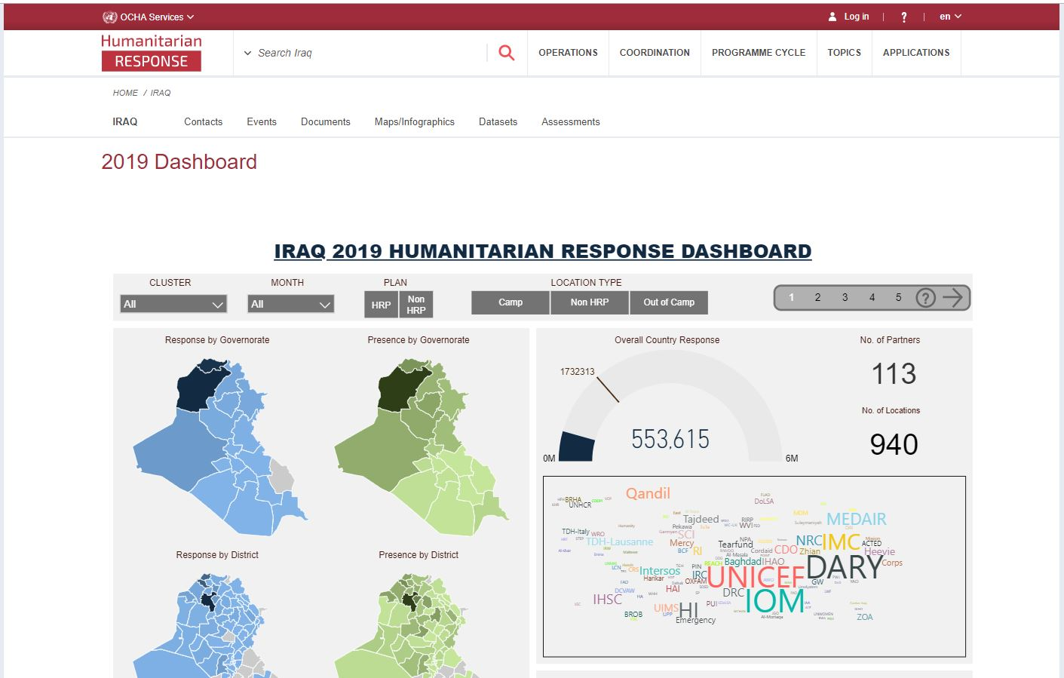

Information Management
ActivityInfo report & the new 4W for planning;
2
4
1st of a given month – 5th of following month
2019 Interactive dashboard
https://www.humanitarianresponse.info/en/operations/iraq/2019-dashboard
Timeframes for monthly reporting
Cluster IMOs / Cluster Coordinators liaise with partners on day to day basis to clean / adjust the data been reported in ActivityInfo
1
1st of a given month – 5th of following month
3
Reporting window of the given month is open.
Partners to report achievements / planning of the given month in ActivityInfo
Reporting window of a given month will be locked on 6th of the following month
Planning (new 4W) of the given month will help the sub-national Cluster Coordinators in their day to day coordination.
Partners will not be able to edit their own data of that given month – Final monthly Inter-Cluster achievements are presented to the ICCG.

Slide 11
AOB
Note: Next sub-national Cluster coordination meeting for Centre and South will be on June 12th, 2019;
Invitation will be sent out on due time.

Slide 12
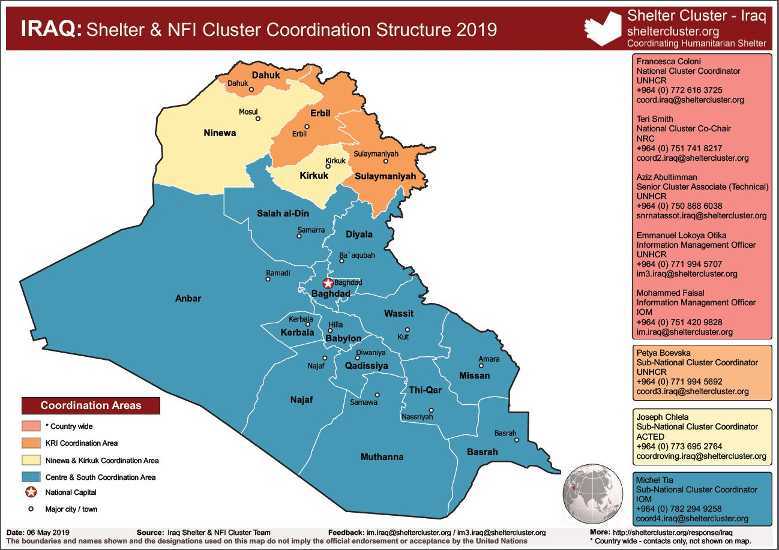
THANK YOU VERY MUCH

