Slide 1
Iraq humanitarian response Centre and south Shelter Cluster Hub Coordination meeting
Baghdad
June 12th, 2019

Slide 2
AGENDA
Review of action points from minutes of previous meeting;
Key issues and Partners to update :
Housing Rehabilitation Interventions;
Shelter Cluster position paper on Summer Assistance;
Tent replacement needs from FSMT & Camp profiling;
AAF inter cluster mission - findings;
Information Management
Update on 2019 assessments (planned, ongoing, completed);
Final Trainings Plan for Centre and South;
ActivityInfo reporting;
AOB

Slide 3
Review of action points from minutes of previous meeting
# | Action Points | Focal Point | Status
1 | Housing rehabilitation: Shelter Cluster to continuously follow up with partners, to support collecting their latest interventions details. Partners can reach out to the WDS IM Unit for support if needed (Emmanuel - im3.iraq@sheltercluster.org and Hoveen - hoveen.yaseen@un.org). | Shelter Cluster | Ongoing process
2 | Housing rehabilitation: UNHCR to share their housing and rehabilitation area-based approach once ready. | UNHCR – Baghdad | Follow up
3 | 2019 Summer response plan: Support Partners summer response plan. | Shelter Cluster | Completed – with Cluster position paper
4 | SEVAT - Socio-Economic Vulnerability Assessment Tool: Interested partners to liaise with the Cluster Hub Coordinator for guidance. | Partners | Completed – with upcoming Trainings
5 | Interactive dashboard on Iraq Housing Rehabilitation Interventions: Five partners volunteered to share feedback / comments to help the cluster IMOs improve the dashboard. | UNHCR, CRS, UNDP, OXFAM and IOM | Completed
6 | From the update been presented during the meeting, partners will be sharing the full details of their Housing Rehabilitation Interventions and RHU plans, with the SNFI Cluster & UN-Habitat IMOs in charge of the concerned database & platforms. | UNHCR, UNDP, CRS, DRC | Completed Ongoing process
7 | Update on 2019 assessments (planned, ongoing, completed): Since this point was not covered due to time, the Hub Coordinator will follow up with partners. | Cluster Hub Coordinator Medair, Caritas-Iraq, Caritas Czech Republic, PUI | Completed No feedback

Slide 4
Key issues and Partners to update :
Housing Rehabilitation Interventions – Tour de table
ACTED
Caritas
CRS
DRC
IOM
ICRC
PUI
UNDP
UNHCR
UN-Habitat
ZOA

Slide 5
Key issues and Partners to update :
Housing Rehabilitation Interventions – Tour de table – update from UNDP
Governorate | Area | Project (Case) Name | # of Units | Status
Anbar | Khairat | Rehabilitation 241 houses in Khairat | 241 | Assessment just starting
Anbar | Haqlaniya | Rehabilitation Housing Works of 214 Units in Haqlaniya in two villages (Khasfa and Zawia) Villages in Haditha | 214 | Under implementation
Anbar | Barawanh | Rehabilitation Housing Works of 187 Units in Barwanah District (Al-Sumood) | 187 | Under implementation
Anbar | Haqlaniya | Rehabilitation of Housing Works of 136 Units in Haqlaniya (Al-BoHayat) Village in Haditha | 136 | Under implementation
Anbar | Barawanh | Rehabilitation Housing Works of 137 Units in Barwanah District (Al-Ata'a) in Haditha | 137 | Under implementation
Anbar | Rawa | Rehabilitation of 600 houses units in Rawa (Two lots) |  | On hold for coordination purpose
Anbar | Qaim | Rehabilitation of 800 houses units in Qaim (Hay Seka, 12 Rabee Awal and Risala) | 800 | Assessment just starting
Anbar | Sagrah | Rehabilitation of 241 houses units in Sagrah village in Anah District | 241 | Under implementation
Anbar | Anah | Rehabilitation of 560 houses units in Anah |  | On hold for coordination purpose
Anbar | Rehanna | Rehabilitation 350 houses in Rehanna |  | On hold for coordination purpose
Anbar | Hasa | Rehabilitation 200 houses in Hasa | 200 | Assessment just starting
Salah Al-Din | Baiji | Rehabilitation of 1000 housing units in Baiji (Four lots) | 1,000 | Assessment just starting

Slide 6
Key issues and Partners to update :
Shelter Cluster position paper on Summer Assistance – Been shared with the HCT on 9th June 2019.
ADVOCACY WITH THE GOVERNMENT
Humanitarian partners have been supporting most vulnerable people affected by the recent conflict through the distribution of emergency summer non-food items (cool box, extra water jerry can and fans), which have proven useful during the very acute emergency phase of its response.
Mechanical cooling remains the best way to mitigate thermal discomfort during hottest months of the year.
Around 10,000 IDP families living in camps are in need of AWC. At a cost of around 150 USD/AWC, the budget to purchase those units would amount at 1,5 million USD. The SNFI Cluster therefore advocates that the GoI covers these needs out of their regular budget allocations for seasonal support.
As increased water supply and electricity are key to the function of mechanical cooling devices such as AWC, the SNFI Cluster supports CCCM actors and the GoI to ensure that adequate water is supplied for both drinking and AWC operation during summer months, and that electricity is available at least 8 hours per day.

Slide 7
Key issues and Partners to update :
Tent replacement needs from FSMT & Camp profiling
Camp profiling: Household data collection took place from 30 January till 27 February 2019.
In total, 4,248 households, composed of 21,135 individuals, were assessed across 49 camps.
A stratified random sampling methodology was used, to achieve representativeness at a 95% level of confidence and 10% margin of error, at the camp level.
FSMT: Data collection took place from 15 – 23 May 2019.
In total, 95 out of 97 formal camps completed the assessment. 83,346 households / 402,530 Individuals.

Slide 8
Key issues and Partners to update :
Tent replacement needs from FSMT

Slide 9
Key issues and Partners to update :
Tent replacement needs from FSMT

Slide 10
Key issues and Partners to update :
Tent replacement needs from FSMT – in Centre & South
# of MoMD tents: 2,067
# of UNHCR tents: 568
# of OTHER type of tents : 618

Slide 11
Key issues and Partners to update :
Ameriyat Al-Fallujah (AAF) inter cluster mission, findings
Facilitated by OCHA, on 30 April 2019
Clusters: CCCM, GBV, Health, Protection, SNFI and WASH
The mission met with the AAF Central Camp Management and visited the following sites:
AAF 1 - Al Nasr (MOMD tents): proposed to host populations coming from other sectors;
AAF 10 - Al Abaydh (UNHCR tents): proposed for closure/consolidation;
AAF 11 - Caravans 1: to verify questions raised on caravans in the IHF note for file;
AAF 22 - Zoba'a: to see the condition of the wood/plywood structures;
AAF 27 - Al Anbar: drive through to observe shelter conditions;

Slide 12
Key issues and Partners to update :
Ameriyat Al-Fallujah (AAF) inter cluster mission, findings
Shelter issues in AAF - from FSMT
Shelter Type | # of concerned sectors Out of the 31 sectors | Comments
Caravans | 7 | AAF11, AAF13, AAF16, AAF22, AAF23, AAF24 & AAF26
MoMD Tents | 26
UNHCR Tents | 2 | AAF10 & AAF15
RHU (Refugee Housing Unit) | 2 | AAF08 & AAF19
Constructed Structure (ex. constructed with blocks, fully upgraded) | 1 | AAF07
Other Tents |  | AAF20 & AAF21
Shelter Type | # of Installed Shelter | # of occupied plots | # of occupied plots and in need of replacement | # of occupied plots and in need of maintenance | # of occupied plots in need of Repl. & Maint.
Caravans | 746 | 641 | N/A | N/A | -
MoMD Tents | 2,689 | 2,083 | 622 | 660 | 1,282
UNHCR Tents | 16 | 16 | - | N/A | -
RHU | 367 | 221 | N/A | N/A | -
Other Tents | 64 | 64 | - | N/A | -
With at least two type of Shelters in each of the following 9 sectors (AAF10, 15, 16, 20, 21, 22, 23, 24 & 26)

Slide 13
Key issues and Partners to update :
Ameriyat Al-Fallujah (AAF) inter cluster mission, findings
S/NFI Recommendations:
Clarify the timeframe for camp closure by the Anbar Governorate and the Anbar GRC. There is a risk that the government would close the camp as was done with Kilo 18, Bzebiz and HCT. Noting that these camps have transformed into informal settlements, and their remaining residents continue to have high need for external support. Lessons learned from these closures should be applied to AAF.
Urgent need for replacing at least 1,600 shelters in critical conditions (especially MOMD tents and plywood houses). The use of tents not deployed in Jad’ah and Qayyarah camps (funded by the IHF reserve allocation) could be a last resort, although the S/NFI Cluster recommends finding more effective advocacy strategies with the government, to fulfill their mandate to protect their citizens.
Ultimately, the shelter that remain in camps should be the caravans (existing ones) and MOMD tents.
Tent replacement would be more resource-effective in conjunction with the camp consolidation process. Nonetheless, if this will take longer (i.e. not starting before winter 2019), tents should be replaced.
Enforce maintaining vacant caravans inside the camp, for highly vulnerable camp residents currently living in other shelter type.
Advocate with the Government for the continuous provision of AWC including the needed extra water and electricity, and kerosene for both heating and cooking purposes.
CCCM Recommendations:
CCCM Cluster to share the AAF Consolidation Plan (updated May 2019, updated with the latest AAF Camp Sweep and FSMT data) with OCHA for circulation to relevant clusters for feedback.
IOM to update AAF Consolidation Plan based on cluster feedback and develop sensitization and coordination plan to be shared with OCHA, Anbar GRC, CCCM and other relevant clusters in order to begin advocacy with local and national authorities to begin consolidation process in AAF camp.
IOM to coordinate with AAF partners to facilitate regular sharing of updated camp population data in order to inform partner interventions in an effort to reduce waste and possible diversion.
Ensure representative sampling for assessments (including MCNA, Camp Profiles, Intention survey, etc.) in AAF and other large camps with sub-camps (HTC and Jed’dah). CCCM Cluster to continue discussions over necessary resources with IHF. OCHA, AWG and IM colleagues to support CCCM Cluster in discussions and future sampling/assessment exercises with REACH (funded with IHPF funds).
IOM (keeping the CCCM Cluster informed) to work closely with Iraq WASH Cluster and AAF WASH partners to agree on joint action plan for addressing WASH gaps in AAF in line with AAF Camp Consolidation plan.
The Shelter Cluster, AAF Shelter partners, CCCM Cluster and IOM to agree on joint action plan for addressing Shelter conditions in AAF in line with AAF Camp Consolidation plan.
a. Recommend replacement of 1,600 shelters in critical condition.
Tent replacement should be done in close coordination with implementation of AAF Camp Consolidation Plan, but repair and replacement of critical shelters must commence as soon as possible.

Slide 14
Key issues and Partners to update :
Ameriyat Al-Fallujah (AAF) inter cluster mission, findings
OVERALL RECOMMENDATIONS
Misuse of aid/fraud: The role of the clusters in monitoring and reporting on diversion of aid is limited, with responsibility resting with the funding recipient and donor.
Minimum standards: Camp consolidation and closure of certain sectors in order to deliver strengthened services for remaining residents, while considering protection implications on camp residents if the process would not be in line with protection principles.
Governorate Return Committees (GRC) and Advocacy: Mission participants request high-level support to advocate consolidation/closure at GRC level and locally with authorities.
S-NFI Cluster
Based on FSMT data analysis and with the aim of reducing the shelter type used in AAF camps to only two (MOMD tents and caravans)
A total of 2,400 tents are needed in AAF
With urgent need for replacing at least 1,600 shelters in critical conditions

Slide 15
Information Management
Update on 2019 assessments (planned, ongoing, completed)
Great feedback from Medair, Caritas-Iraq, Caritas Czech Republic on their 2019 assessments.
ILA – IOM in currently carrying out ILA – phase 4 to collect detailed information on IDP (out of camps) and returnees households living in locations identified through the DTM Master List round 109. As of June 12th, 70% of locations have been assessed.
Governorate | Districts
Anbar | Ka'im
Anbar | Ana
Anbar | Haditha
Anbar | Heet
Ninewa | Ba'aj
Ninewa | Hatra
Salah Al-Din | Daur
Salah Al-Din | Baiji
Salah Al-Din | Balad
Salah Al-Din | Samarra
Salah Al-Din | Tuz
MCNA VII Data Collection, June-July 2019
Thanks to all Clusters that have encouraged partners to dedicate their data collection capacities to the Multi-Cluster Needs Assessment (MCNA) Round VII in 2019
However, some substantial gaps in coverage remain, particularly in Anbar, Ninewa and Salah Al-Din.
If your organization is interested to support the data collection exercise, please feel free to complete this form (https://ee.humanitarianresponse.info/x/#RsKMn5Qs) to indicate the geographic areas that the organization might be able to cover.

Slide 16
Information Management
Final Trainings Plan for Centre and South – with the objective of combining 9th &10th July Training on 9th July 2019
New deadline to register: 13th June 2019
Choose time for training | Choose from available training | Organisation | # of staff
10th July 2019 - 1:30pm to 4:00pm - English | Reporting tool for WDS repairs on the Shelter Cluster and UN-HABITAT platform | DRC | 1
10th July 2019 - 9:30am to 1:00pm - English | War Damaged Shelter Minimum Standards and the use of BoQ. | DRC | 1
 |  | IOM | 2
11th July 2019 - 1:30pm to 4:30pm | Use of the Socio Economic Vulnerability Assessment Tool (SEVAT) for Data Managers | DRC | 3
 |  | IOM | 1
11th July 2019 - 9:30am to 1:00pm | Use of the Cash Working Group Socio Economic Vulnerability Assessment Tool (SEVAT) | DRC | 3
 |  | IOM | 1
 |  | PUI | 1
9th July 2019 - 1:30pm to 4:00pm - Arabic | Reporting tool for WDS repairs on the Shelter Cluster and UN-HABITAT platform | caritas Iraq | 2
9th July 2019 - 9:30am to 1:00pm - Arabic | War Damaged Shelter Minimum Standards and the use of BoQ. | caritas Iraq | 2
 |  | CRS | 1
 |  | DRC | 1
 |  | IOM | 1
 |  | NRC | 1
Grand Total |  |  | 21

Slide 17
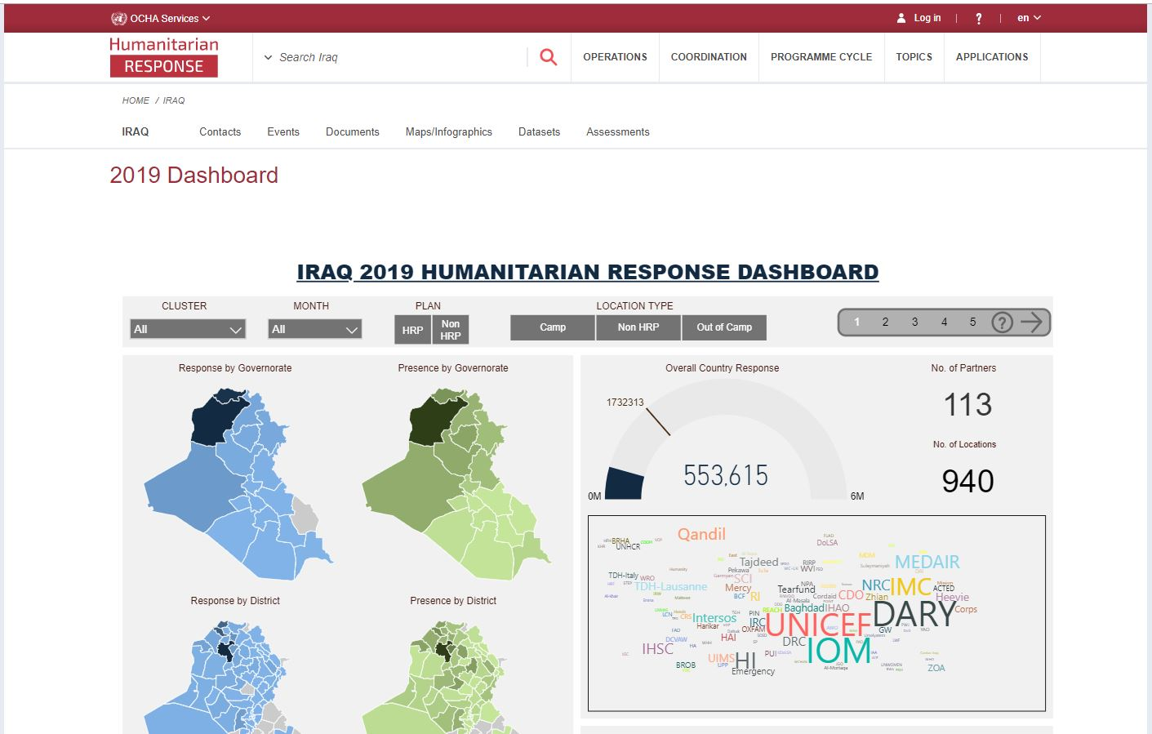

Information Management
ActivityInfo reporting
2
4
1st of a given month – 5th of following month
2019 Interactive dashboard
https://www.humanitarianresponse.info/en/operations/iraq/2019-dashboard
Timeframes for monthly reporting
Cluster IMOs / Cluster Coordinators liaise with partners on day to day basis to clean / adjust the data been reported in ActivityInfo
1
1st of a given month – 5th of following month
3
Reporting window of the given month is open.
Partners to report achievements / planning of the given month in ActivityInfo
Reporting window of a given month will be locked on 6th of the following month
Planning (new 4W) of the given month will help the sub-national Cluster Coordinators in their day to day coordination.
Partners will not be able to edit their own data of that given month – Final monthly Inter-Cluster achievements are presented to the ICCG.

Slide 18
AOB
Note: Next sub-national Cluster coordination meeting for Centre and South will be on July 10th, 2019;
Invitation will be sent out on due time.

Slide 19
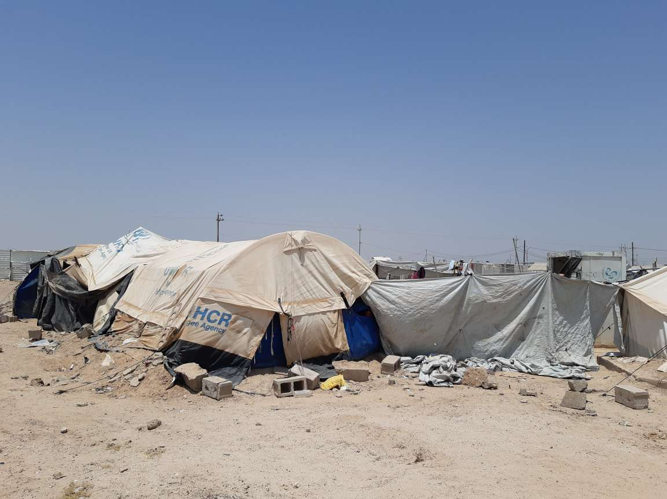
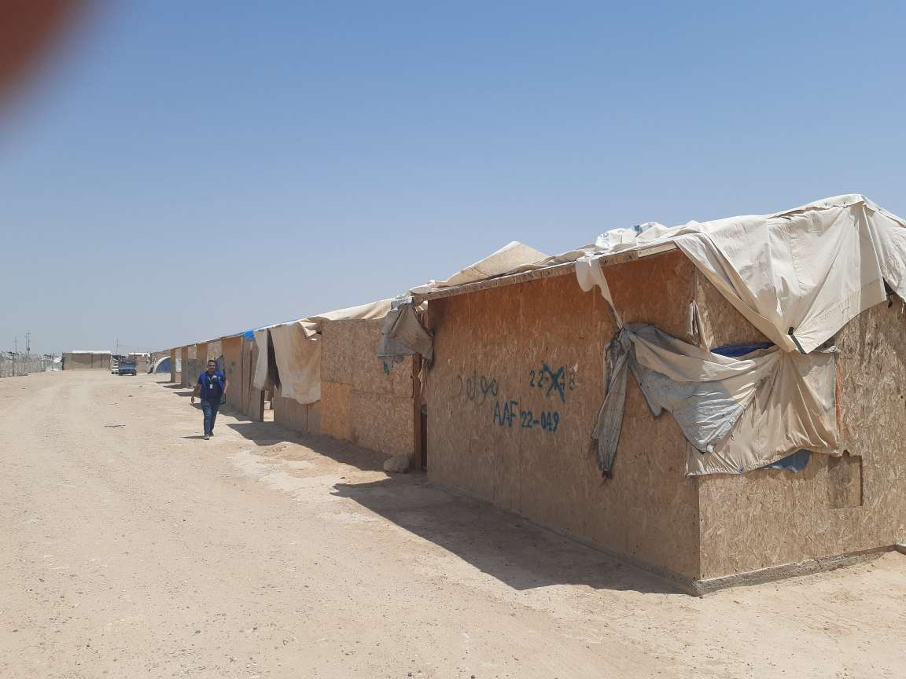
THANK YOU VERY MUCH FOR YOUR GREAT CONTRIBUTIONS
UNHCR tent in AAF
Plywood shelters in AAF

