Slide 1
Iraq humanitarian response Centre and south Shelter Cluster Hub Coordination meeting
Baghdad
July 10th, 2019

Slide 2
AGENDA
Review of action points from minutes of previous meeting;
Key issues and Partners to update :
Housing Rehabilitation Interventions – Tour de table;
Partners to update on their summer distributions – Tour de table;
Tents replacement / maintenance needs & Camps Closure / Consolidations problematics;
2019 IHF - Second Allocation;
Information Management
Update on 2019 assessments (planned, ongoing, completed) – Tour de table;
Update on trainings plan for Centre and South;
ActivityInfo reporting – Tour de table if any constraint;
AOB

Slide 3
Review of action points from minutes of previous meeting
# | Action Points | Focal Point | Status
1 | Housing rehabilitation: Shelter Cluster to continuously follow up with partners, to support collecting their latest interventions details. Partners can reach out to the WDS IM Unit for support if needed (Emmanuel - im3.iraq@sheltercluster.org and Hoveen - hoveen.yaseen@un.org). | Shelter Cluster | Ongoing process
2 | Housing rehabilitation: UNHCR to share their housing and rehabilitation area-based approach once ready. | UNHCR – Baghdad | Follow up
3 | Update on 2019 assessments (planned, ongoing, completed): Partners to always inform the Cluster on their assessments | Cluster Hub Coordinator | Follow up
4 | Full details of Housing rehabilitation interventions (not yet been shared) must be shared with the SNFI Cluster & UN-Habitat IMOs in charge of the concerned database & platforms. | All Shelter partners | Follow up

Slide 4
Key issues:
Housing Rehabilitation Interventions – 2019 plan for Centre & South
UNDP – current update
in Anbar – 3,333 houses of which
1,101 houses - ongoing rehabilitation
482 houses - ongoing assessment
800 houses - ongoing procurement
950 houses - on hold
UNDP – current update
in Salah al-Din – 1,000 houses
1,000 houses - BOQ development
Governorate | Location | Project (Case) Name | # of units | Status
Anbar | Karma | rehabilitation 241 houses in Khairat | 241 | Ongoing assessment
Anbar | Haditha | Rehabilitation Housing Works of 214 Units in Haqlaniya in two villages (Khasfa and Zawia) Villages in Haditha | 214 | Under Implementation
Anbar | Haditha | Rehabilitation Housing Works of 187 Units in Barwanah District (Al-Sumood) | 187 | Under Implementation
Anbar | Haditha | Rehabilitation of Housing Works of 136 Units in Haqlaniya (Al-BoHayat) Village in Haditha | 136 | Under Implementation
Anbar | Haditha | Rehabilitation Housing Works of 137 Units in Barwanah District (Al-Ata'a) in Haditha | 137 | Under Implementation
Anbar | Rawa | Rehabilitation of 600 houses units in Rawa (Two lots) | 600 | On hold
Anbar | Qaim | Rehabilitation of Housing works for 137 Units in Hay Sikak in Qaim City-Lot 1 | 137 | Procurement
Anbar | Qaim | Rehabilitation of 342 houses units in Hay 12 Rabee Awalin Qaim lot-2 | 342 | Procurement
Anbar | Qaim | Rehabilitation of 321 houses units in Hay Risala in Qaim (lots-3) | 321 | Procurement
Anbar | Ana | Rehabilitation of 241 houses units in Sagrah village in Anah District | 241 | Under Implementation
Anbar | Ana | Rehabilitation of 560 houses units in Anah | 241 | Ongoing assessment
Anbar | Ana | rehabilitation 350 houses in Rehanna | 350 | On hold
Anbar | Ana | Rehabilitation of 186 housing units in Hasa village in Ana city | 186 | Under Implementation
Salah al-Din | Baiji | Rehabilitation of 500 housing units in Baiji (Lots 2) | 500 | BoQ Development
Salah al-Din | Baiji | Rehabilitation of 500 housing units in Baiji (Lots 1) Risala neighbourhood | 500 | BoQ Development

Slide 5
Key issues:
Housing Rehabilitation Interventions – 2019 plan for Centre & South
UNHCR – current update
Rehabilitation of 1,250 houses (Cat 2) in Salah Al-Din governorate: ongoing with 46% of completion and potential changes of 2 locations.
Construction of 900 RHU for returnees (Cat 4), include
150 in Diyala,
75 in Anbar,
50 in Baghdad and
625 in Salah al-Din
Assessment & beneficiary’s selection completed. BOQ will be developed as soon as the bidding (or tender process) has been completed. Construction work will be starting around mid-July 2019
IOM – current update
Shelter rehabilitation programs
200 houses (returnees) in Ana district in Anbar: around 90% of completion. May be completed by next week.
215 houses (returnees) in AL-Khalis district in Diyala: around 50% of completion. However challenges remain on security / access issues
400 houses (IDPs) in Najaf district in Najaf: around 82% of completion. May be completed by next week.
Cash for Rent program in Anbar (168HHs) and Baghdad (218 HHs), 6 months Cash for Rent allocation / US $200 /HH/month.
The third payment (for July & August). Completed, PDM should be planned very soon.
Cash for SOK programs
600 IDP households living in critical shelter in Kerbala: assessment completed / distribution completed last week / US $ 240.00.
New Shelter construction (for Cat 3 or 4)
75 houses (returnees) in AL-Khalis district in Diyala: assessment completed / but project location may be changed due to security issues.

Slide 6
Key issues:
Housing Rehabilitation Interventions – 2019 plan for Centre & South
PUI – current update
Shelter rehabilitation (cat. 2): PUI has targeted
173 houses (cat 1 & 2), in Raihana village, Ana district in Anbar: 100% of completion,
Planned Assessment to Qa’im district and all villages around (Obaidi, Dughaima, Rumanah,etc.): Tentative date – 15th August 2019
DRC – current update
Shelter rehabilitation (cat. 2): tender process completed – Work will be handed over to the contractor in around 2 weeks
48 houses in Fallujah & Saqlawiyah district in Anbar
35 houses in Muqdadiyah district in Diyala, and
80 houses in Baiji district in Salah al Din
Customized Shelter kits (CSK): Distribution has been completed.
150 HHs in Anbar, 100 HHs in Diyala and
150 HHs in Baiji in Salah al Din.
The eligible beneficiaries selected the items based on needs but also up to an average cost of US $200 to US $230 per household
PDM helped to identify households who needed DRC technical support to rehabilitate their shelters. Cash for work (US $40 / day / skilled worker) is an option DRC could proceed with.

Slide 7
Key issues:
Housing Rehabilitation Interventions – 2019 plan for Centre & South
CRS - current update
Shelter repairs through Cash - 100 houses (returnees) in Fallujah/Anbar:
phase#1: 20 houses – have been Completed
phase#2: 40 houses – ongoing with 80% completion; payment will be completed within next 10 days.
phase#3: 40 houses – Technical assessment will be done next week.
Shelter upgrade - 100 house (IDPs) in Abu-Ghraib/Baghdad and in Falluja/Anbar:
phase#1 and phase#2: 48 houses (23 houses in Abu-Ghraib and 25 houses in Fallujah) have been completed
phase#3, Ongoing technical assessment for around 40 houses in Abu Ghraib district and 30 houses in Falluja.
The initial project target (100 houses) has been exceeded based on CRS current capacity and availability. Achievements 138 houses.
Challenges
Shelter repairs through Cash – Progress of work varies from one beneficiaries to another
Still gap in Cat 1 & 2 rehabilitation in Fallujah.

Slide 8
Key issues:
Housing Rehabilitation Interventions – 2019 plan for Centre & South
UNDP
UNHCR
IOM
PUI
DRC
CRS / Caritas
ICRC
ACTED
UN-Habitat
ZOA

Slide 9
Key issues:
Partners to update on their summer distributions – Tour de table
IOM – Plan
*Cash for NFI - unconditional but restricted cash vouchers
For protracted IDPs and returnees
IOM – Plan
*In Kind Basic NFI Kits –
returnees and vulnerable IDP households that have not received NFI assistance outside of camps. Assessments are ongoing in the below areas and NFIs are planned to be distributed by the end of July
Governorate | District/Area | Location
Kirkuk | Kirkuk | Hay Al-Nasir 2
 |  | Hay Al Nassir
 | Hawija | Hay Al-Nedaa
 |  | Hay Al-Hurriyah
Ninewa | West Mosul | Al-smood
 | East Mosul | Nabi Younis
 |  | Ninewa Sharqiya
 | Tilhaif | Tilkaif Center
 |  | Sada
SAD | Tooz | Markaz Tooz-Hay Al Askari
Governorate | District | Village
Ninewa | Tilkaif | Beban, Nasiriah, Tallsquf
 | Sinjar | Hay Yarmok, Rozh Halat, Hay Al Shuhada
Diyala | Muqdadiyah | Al Qalaa Village, Al-Gawam Village, Hembes Village, Sinsil Al Wasat Village
Anbar | Al-Ka'im | Al-Amen, Hay 12 Rabee Alawal, Hay Al Rashid, Hay Al Sham, Hay Al-Andalus, Hay Al-Salam, Hay Al-Yarmook
 | Al-Rutba | Al Askaree, Al Hara, Al Intesar, Al Wadi, Hay Abira, Hay Al Mattar, Hay Al Meethagh, Hay Gharb Al Wadi
 | Ana | Al bor (Shishan), Al Tadamon, Hay Al Nasir, Hay Al Qadissiyah
 | Heet | Al Baghdadi, Al Baker, Al Dawarah Al Gharbiyah, Al Hay Al Sakani, Al-Mamora, , Al-Qalqalah, Al-shuhda'a, Al-Sikak, Hay Al-Zuhoor, Hay Amina, Jubbah, Mujama' Al-Hay Al-Sakani, Qaryat Al-Dolab
Salah al-Din | Al-Shirqat | Tulul Baq
 | Baiji | Al Bu Tu'mah, Al Hajaj, Al Hamra village, Al Mazraa Village, Al_Siniah, Mohammed Al Musa village, Qaryat Al Sareen
 | Samarra | Al Jibariya Mahala 316, Al Jubairiyah Al Thalitha, Al-Jamiaa Area, Hay Al Dhubbat-Mahalla 334, Hay Al Mutasim-Mahala 105, Hay Al Muthanna-Mahalla 312, Hay Al Rasheed-Mahalla 326, Hay Al Wathiq-Mahala 314, Hay Al-Khathraa Mahala 322, Hay Salah Al-Din(Mahala 302)
 | Tikrit | (Al Qadissiya)-218-500, Al Auja Village, Al Karama Village, Al Mahzam Village, Al Namah Al Janobiyah Village, Al Namah Al Shamaliyah Village Al Shaheed Hamad Shaab village, Al-Khanag Village, Al-Muskarat, Al-Safia Village, Al-Shahama Village, Hay Al Anwaa-Mahalla 420, Hay Al Arbaeen-Mahalla 414, Hay Al Shuhdaa Mahala 204, Hay Al Zihoor – 426, Hay Al Zihoor -1, Hay Al-Firdous, Hay Alkahrbaa, Hay Alqalaa, , Hay Al-Sikak, Hay Al-Suqoore, Hay Shishin - 412 Qadissiya 2, Qdisiyah1-Mahalla 214, Sadayrat Abo Ajeel, Uwainat

Slide 10
Key issues:
Partners to update on their summer distributions – Tour de table
IOM – Completed basic NFI kits distributions
200 HHs (Returnee) assisted in Khanaqin – Al-Tajneed Neighborhood
200 HHs (Returnee) assisted in Al-Tarmiya
OXFAM - Basic NFI kits – May update
More locations in Anbar areas will also be assessed for NFI distributions.
CRS / Caritas – current update
NFI – Summer kit distributions – in Fallujah
Urge discrepancy in list received from Camp Manager (1,550 HHs) and IOM (less than 1,000 HHs) for targeted area in AAF camps. So the partner will be doing tent by tent verification in coming week to confirm/finalise list of beneficiaries.
DRC – current update
Ongoing NFI distributions – in Anbar, Diyala and Salah al-Din – details can be found in ActivityInfo 4W form.

Slide 11
Key issues:
Tents replacement / maintenance needs & Camps Closure / Consolidations problematics - Open discussion
Agreed points
UNHCR has a plan for tents replacement and RHU in camps.
Remaining tents from the IHF 1st allocation can be considered (if possible) for tents replacement in AAF. This is to be discussed and well-coordinated with IOM.
However, this has to be in line with the ongoing camp consolidation / closure.

Slide 12
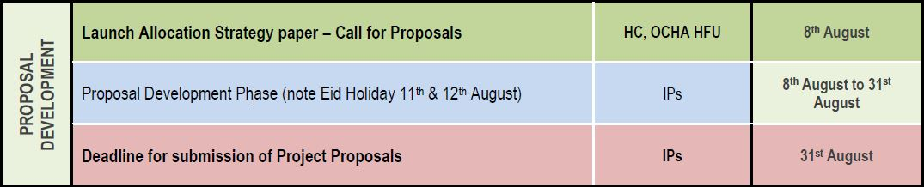
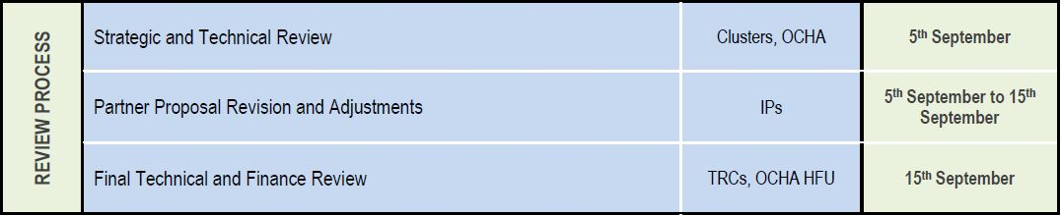
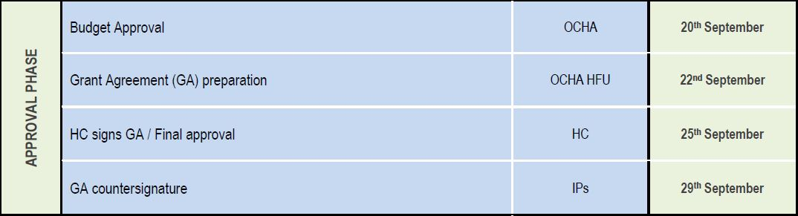
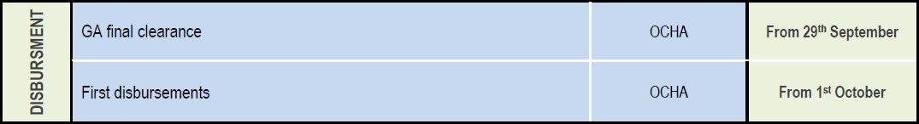
Key issues:
2019 IHF - Second Allocation - The timeline as endorsed by the HC
July 14th – August 8th : ALLOCATION PRIORITY & STRATEGY DEVELOPMENT
1
2
3
4

Slide 13
Key issues:
2019 HRP - Funding progress as of July 10th, 2019 – from FTS
S-NFI 2019 HRP : 17 approved projects from 16 Partners
 | Required (US $ m) | Funded (US $ m) | Coverage (%)
TOTAL | 74.4 | 28.4 | 38.2%
Destination org. | Funded Projects codes | Sum of Amount (US$)
Agency for Technical Cooperation and Development | HIRQ19-SHL-154743-1 | 2,544,618
Danish Refugee Council | HIRQ19-SHL-154837-1 | 963,054
International Organization for Migration | HIRQ19-SHL-154503-1 | 15,709,825
TEARFUND | HIRQ19-SHL-153813-1 | 601,964
United Nations Children's Fund | HIRQ19-SHL-154446-1 | 1,596,387
United Nations High Commissioner for Refugees | HIRQ19-SHL-154792-1 | 7,011,250
TOTAL |  | 28,427,098

Slide 14
Information Management
Update on 2019 assessments (planned, ongoing, completed) – Tour de table
IOM :
Completed ILA – phase 4 assessment which aims to collect detailed information on IDP and returnee families living in locations out of camps identified through the DTM Master Lists Round 109 (Mar-Apr 2019):
The unit of reference of this assessment is the location,
ILA4 covered more than 3,000 locations hosting at least 5 or more IDP and/or returnee families across the country.
Hopefully, The findings and results of this assessment will be published at the end of July 2019.
MCNA
IOM is currently supporting REACH in conducting MCNA in Anbar, Basra and Baghdad governorates
UNHCR is supporting REACH in conducting MCNA in Salah al-Din governorate

Slide 15
Information Management
Update on Trainings Plan for Centre and South
July 9th, 2019: War Damaged Shelter Minimum Standards and the Use of BoQ. Completed
Cash Working Group Socio Economic Vulnerability Assessment Tool (SEVAT). Date to be confirmed

Slide 16
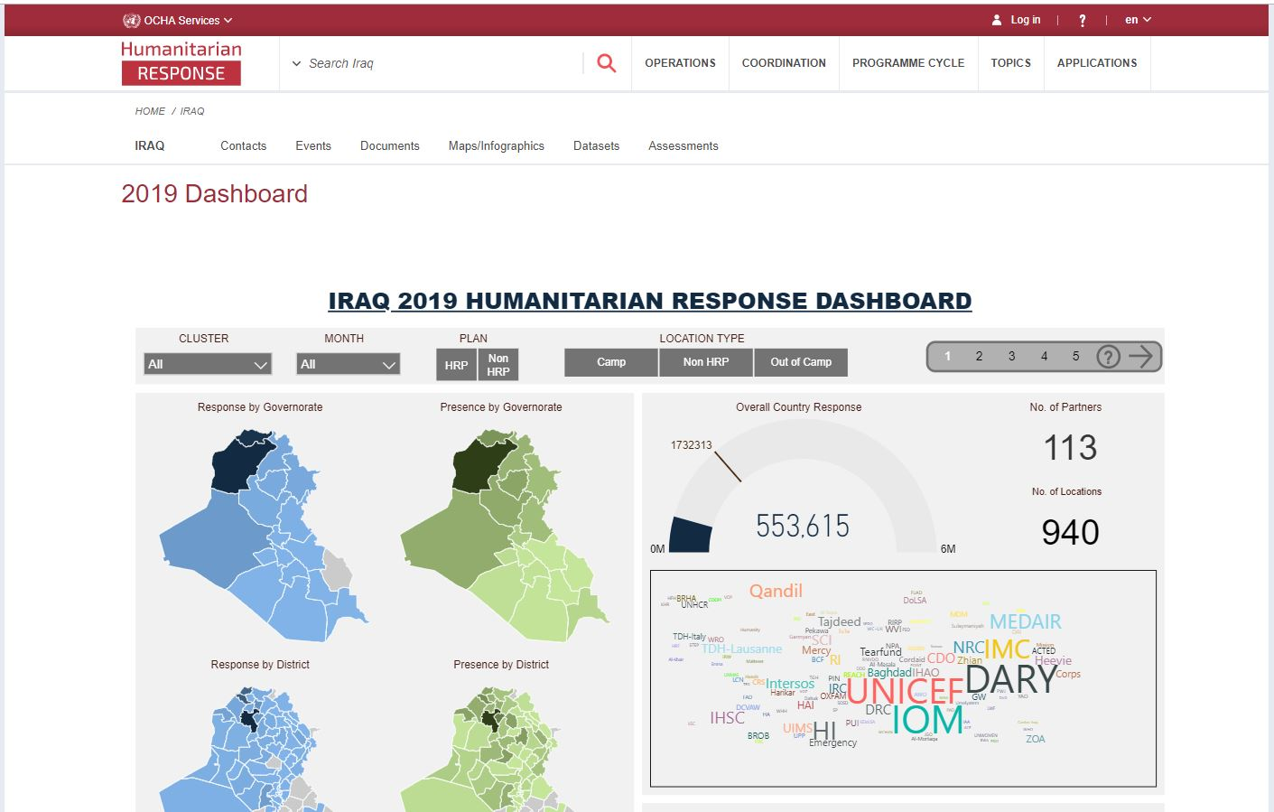

Information Management
ActivityInfo reporting
2
4
1st of a given month – 5th of following month
2019 Interactive dashboard
https://www.humanitarianresponse.info/en/operations/iraq/2019-dashboard
Timeframes for monthly reporting
Cluster IMOs / Cluster Coordinators liaise with partners on day to day basis to clean / adjust the data been reported in ActivityInfo
1
1st of a given month – 5th of following month
3
Reporting window of the given month is open.
Partners to report achievements / planning of the given month in ActivityInfo
Reporting window of a given month will be locked on 6th of the following month
Planning (new 4W) of the given month will help the sub-national Cluster Coordinators in their day to day coordination.
Partners will not be able to edit their own data of that given month – Final monthly Inter-Cluster achievements are presented to the ICCG.

Slide 17
AOB
Note: Next sub-national Cluster coordination meeting for Centre and South will be on August 7th, 2019;
Invitation will be sent out on due time.

Slide 18
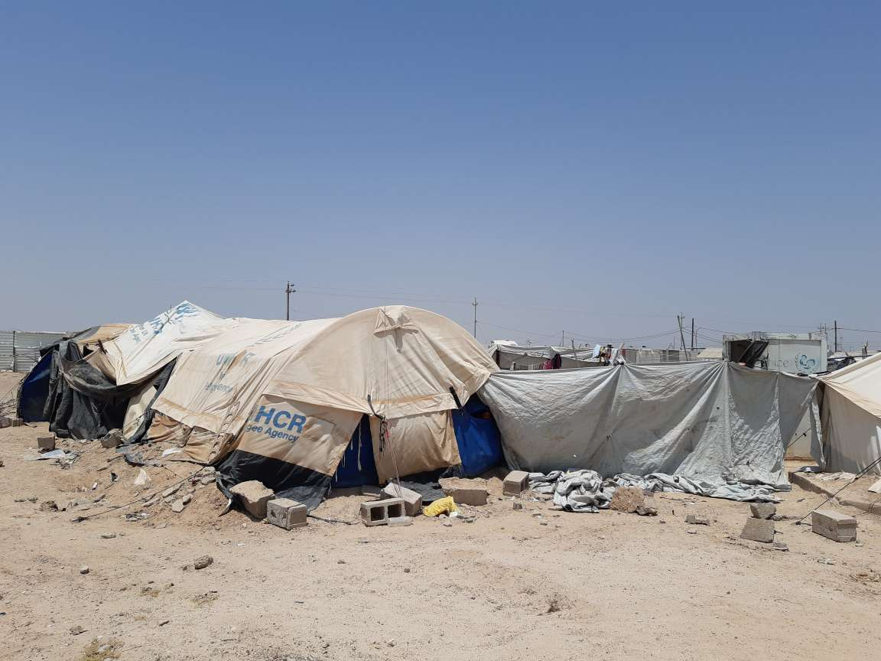
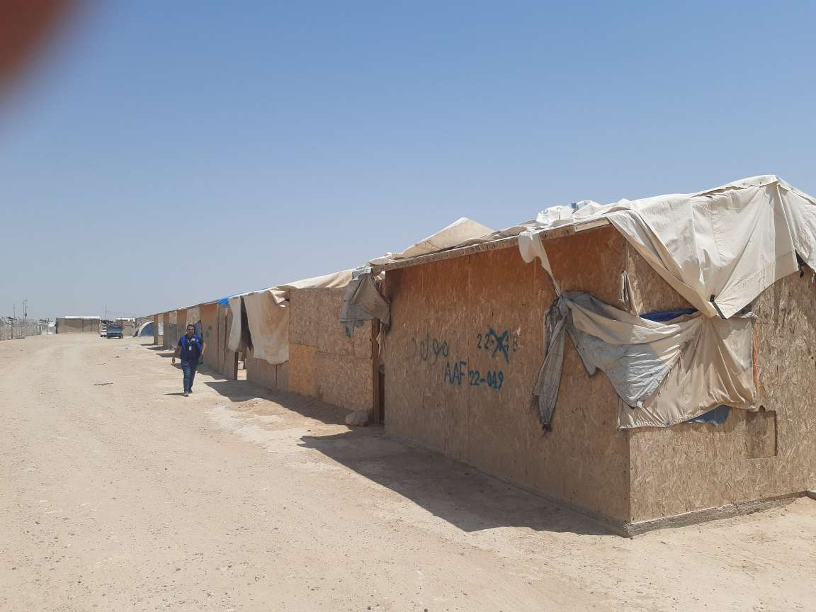
THANK YOU VERY MUCH FOR YOUR GREAT CONTRIBUTIONS
UNHCR tent in AAF
Plywood shelters in AAF

