Slide 1
Iraq humanitarian response Centre and south Shelter Cluster Hub Coordination meeting
Baghdad
August 07th, 2019

Slide 2




Current Cluster Team Structure Since June, 2019
Francesca Coloni - UNHCR National Cluster Coordinator +964 (0) 772 616 3725 coord.iraq@sheltercluster.org Mohammed Faisal - IOM Information Management Officer National +964 (0) 0751-420-9828 im.iraq@sheltercluster.org Michel Tia - IOM Sub National Cluster Coordinator Centre and South * +964 (0) 782 294 9258 coord4.iraq@sheltercluster.org Recruitment ongoing Sub National Cluster Coordinator Kirkuk and Ninewa * | Teri Smith - NRC National Cluster Co-Chair +964 (0) 751-741-8217 coord2.iraq@sheltercluster.org Emmanuel Otika - UNHCR Associate Information Management Officer National +964 (0) 771 994 5707 im3.iraq@sheltercluster.org Petya Boevska - UNHCR Sub National Cluster Coordinator KRI * +964 (0) 771 965 2984 coord3.iraq@sheltercluster.org Aziz Abultimman - UNHCR Senior Cluster Associate National +964 (0) 750 868 6038 snrnatassot.iraq@sheltercluster.org
* For more details check
https://www.sheltercluster.org/iraq/documents/iraq-shelter-cluster-sub-national-areas-coordination-a0
https://www.sheltercluster.org/response/iraq

Slide 3
AGENDA
Review of action points from minutes of previous meeting;
Key issues and Partners to update :
Housing Rehabilitation Interventions – Tour de table;
Partners to update on their summer distributions & Tents replacement/maintenance interventions – Tour de table;
Update on the 2019 IHF - Second Allocation;
Information Management
New databases in ActivityInfo;
Cluster Interactive Dashboard;
Updated & Available useful datasets for your consideration;
Recap. on trainings;
AOB

Slide 4
Review of action points from minutes of previous meeting
# | Action Points | Focal Point | Status
1 | Housing rehabilitation: Shelter Cluster to continuously follow up with partners, to support collecting their latest interventions details. Partners can reach out to the WDS IM Unit for support if needed (Emmanuel - im3.iraq@sheltercluster.org and Hoveen - hoveen.yaseen@un.org). | Shelter Cluster | Ongoing process
2 | Housing rehabilitation: UNHCR to share their housing and rehabilitation area-based approach once ready. | UNHCR – Baghdad | Follow up
3 | Update on 2019 assessments (planned, ongoing, completed): Partners to always inform the Cluster on their assessments | Cluster Hub Coordinator | Follow up
4 | Full details of Housing rehabilitation interventions (not yet been shared) must be shared with the SNFI Cluster & UN-Habitat IMOs in charge of the concerned database & platforms. | All Shelter partners | Follow up

Slide 5
Key issues:
Housing Rehabilitation Interventions – 2019 plan for Centre & South
UNDP – August update: in Anbar – 3,493 houses and in Salah al-Din – 1,000 houses
Location | Project (Case) Name | Major Category - Status | Comment
1-4-Haditha | Rehabilitation Housing Works of 214 Units in Haqlaniya in two villages (Khasfa and Zawia) Villages in Haditha | 3- Under Implementation | Work recently started and going well.
1-4-Haditha | Rehabilitation Housing Works of 135 Units in Barwanah District (Al-Ata'a) in Haditha | 3- Under Implementation | This project has just recently been completed, it is pending a few final checks in order to officially terminate works.
1-4-Haditha | Rehabilitation Housing Works of 187 Units in Barwanah District (Al-Sumood) | 3- Under Implementation | Work recently started and going well.
1-4-Haditha | Rehabilitation of Housing Works of 136 Units in Haqlaniya (Al-BoHayat) Village in Haditha | 3- Under Implementation | Work going well, approx. 10% complete
1-7-Rawa | Rehabilitation of 600 houses units in Rawa (Two lots) | 1- BoQ Development | This project is funding dependent. There are also significant EH challenges in Rawa residential areas. Currently there are 36 units with clear EH contamination potentially more.
1-8-Ka’im | Rehabilitation of Housing works for 137 Units in Hay Sikak in Ka’im City-Lot 1 | 2- In Service Centre | Currently being procured, work to start in about 6-8 weeks
1-8-Ka’im | Rehabilitation of 550 houses (x4 lots) in Ka’im | 1- BoQ Development | Pending further needs-based assessments and funding
1-8-Ka’im | Rehabilitation of 342 houses units in Hay 12 Rabee Awalin Ka’im lot-2 | 2- In Service Centre | Currently being procured, work to start in about 6-8 weeks
1-8-Ka’im | Rehabilitation Housing works of 323 units in Hay Al Resala South and North Neighborhoods in Ka’im (lots-3) | 2- In Service Centre | Currently being procured, work to start in about 6-8 weeks
1-9-Anah | Rehabilitation of 241 houses units in Sagrah village in Anah District | 3- Under Implementation | Work is underway but being slow-rolled due to a very slow rate of returns to the area.
1-9-Anah | Rehabilitation of 92 houses units Al Obour in Anah | 2- In Service Centre | Currently being procured, work to start in about 2 months.
1-9-Anah | rehabilitation 350 houses in Rehanna | 1- BoQ Development | Pending house by house assessments, it has been noted that there are now many other NGOs working on shelter in Rehanna.
1-9-Anah | Rehabilitation of 186 housing units in Hasa village in Anah city | 2- In Service Centre | Currently being procured, work to start in about 2 months

Slide 6
Key issues:
Housing Rehabilitation Interventions – 2019 plan for Centre & South
UNHCR – July update
Rehabilitation of 1,250 houses (Cat 2) in Salah Al-Din governorate: ongoing with 46% of completion and potential changes of 2 locations.
Construction of 900 RHU for returnees (Cat 4), include
150 in Diyala,
75 in Anbar,
50 in Baghdad and
625 in Salah al-Din
Assessment & beneficiary’s selection completed. BOQ will be developed as soon as the bidding (or tender process) has been completed. Construction work will be starting around mid-July 2019
IOM – July update
Shelter rehabilitation programs
200 houses (returnees) in Ana district in Anbar: around 90% of completion. May be completed by next week.
215 houses (returnees) in AL-Khalis district in Diyala: around 50% of completion. However challenges remain on security / access issues
400 houses (IDPs) in Najaf district in Najaf: around 82% of completion. May be completed by next week.
Cash for Rent program in Anbar (168HHs) and Baghdad (218 HHs), 6 months Cash for Rent allocation / US $200 /HH/month.
The third payment (for July & August). Completed, PDM should be planned very soon.
Cash for SOK programs
600 IDP households living in critical shelter in Kerbala: assessment completed / distribution completed last week / US $ 240.00.
New Shelter construction (for Cat 3 or 4)
75 houses (returnees) in AL-Khalis district in Diyala: assessment completed / but project location may be changed due to security issues.

Slide 7
Key issues:
Housing Rehabilitation Interventions – 2019 plan for Centre & South
PUI – July update
Shelter rehabilitation (cat. 2): PUI has targeted
173 houses (cat 1 & 2), in Raihana village, Ana district in Anbar: 100% of completion,
Planned Assessment to Ka’im district and all villages around (Obaidi, Dughaima, Rumanah,etc.): Tentative date – 15th August 2019
DRC – July update
Shelter rehabilitation (cat. 2): tender process completed – Work will be handed over to the contractor in around 2 weeks
84 houses in Fallujah & Saqlawiyah district in Anbar
35 houses in Muqdadiyah district in Diyala, and
80 houses in Baiji district in Salah al Din
Customized Shelter kits (CSK): Distribution has been completed.
150 HHs in Anbar, 100 HHs in Diyala and
150 HHs in Baiji in Salah al Din.
The eligible beneficiaries selected the items based on needs but also up to an average cost of US $200 to US $230 per household
PDM helped to identify households who needed DRC technical support to rehabilitate their shelters. Cash for work (US $40 / day / skilled worker) is an option DRC could proceed with.

Slide 8
Key issues:
Housing Rehabilitation Interventions – 2019 plan for Centre & South
CRS - August update - The project target has been increased
Shelter repairs through Cash - 111 houses (returnees) in Fallujah/Anbar.
20 houses in phase#1 – have been Completed
41 houses in phase#2 – ongoing with 80% completion; the second tranche of payment was been completed for 34 houses. The remaining 6 houses will soon receive once they reach 80% completing.
50 houses in phase#3 – Technical assessment will be starting after Eid holiday.
Shelter upgrade for IDPs in Abu-Ghraib/Baghdad and in Falluja/Anbar.
The phase#1 and phase#2: 68 houses (40 houses in Abu-Ghraib and 28 houses in Fallujah) have been completed;
Phase#3, the Technical assessment has been completed for 40 houses in Abu Ghraib district and 30 houses in Falluja. Final target, 38 houses in Abu Ghraib district and 30 houses in Falluja.
The total achievement till now is 136 houses in Baghdad and Anbar.
Planned: 50-60 houses in Abu Ghraib will be added to the total target. The rapid assessment has been completed and the technical assessment will be starting after Eid holiday.

Slide 9
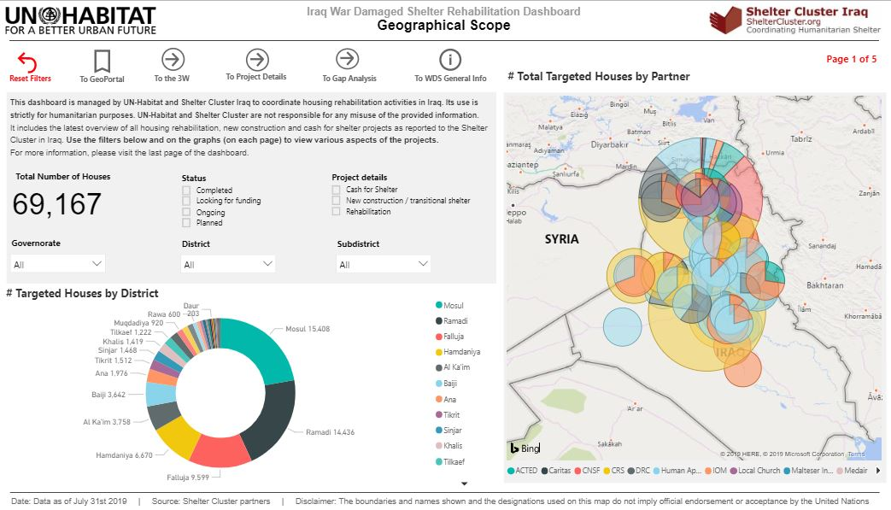
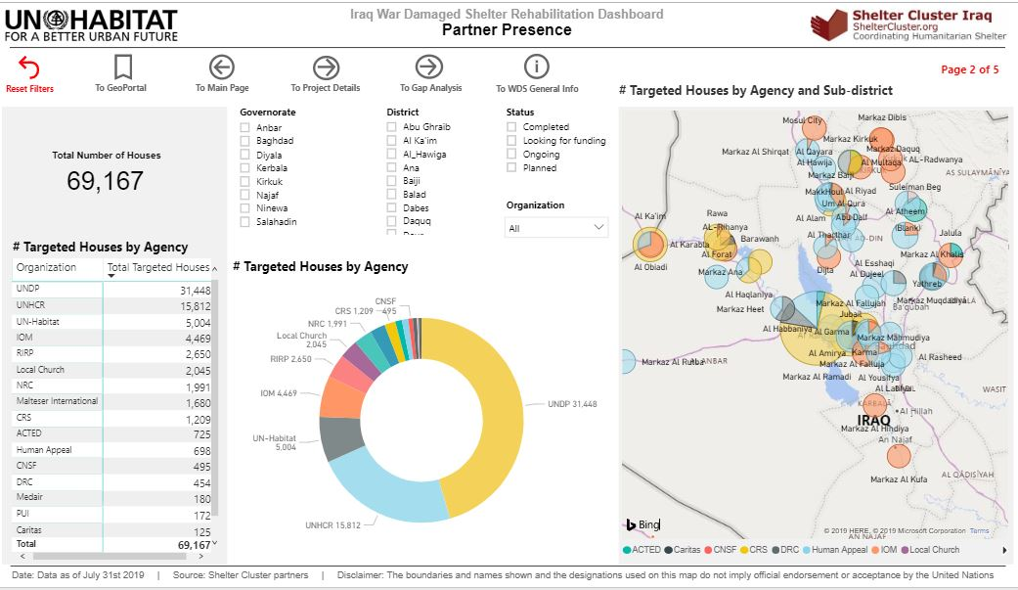
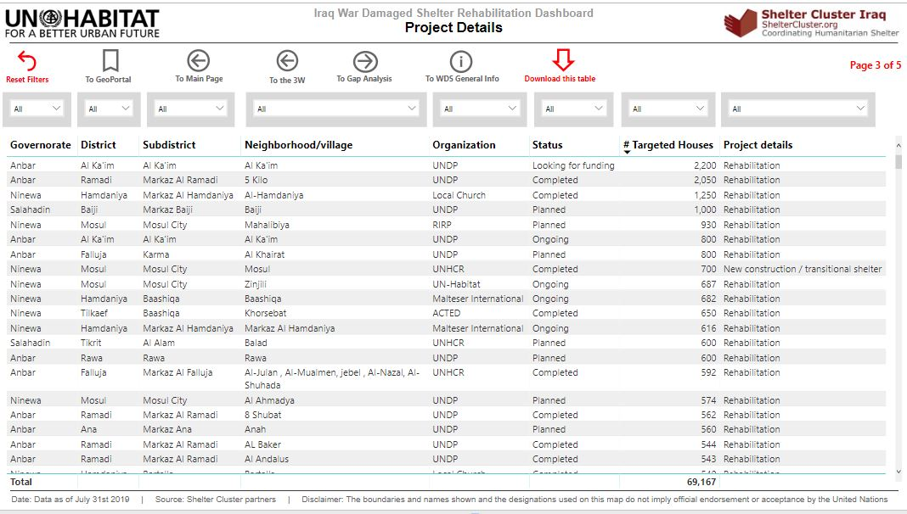
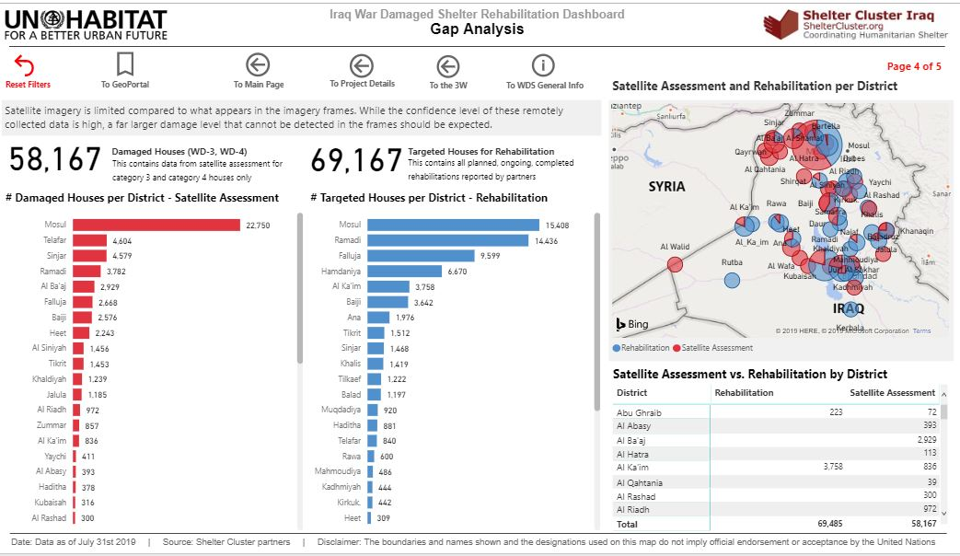
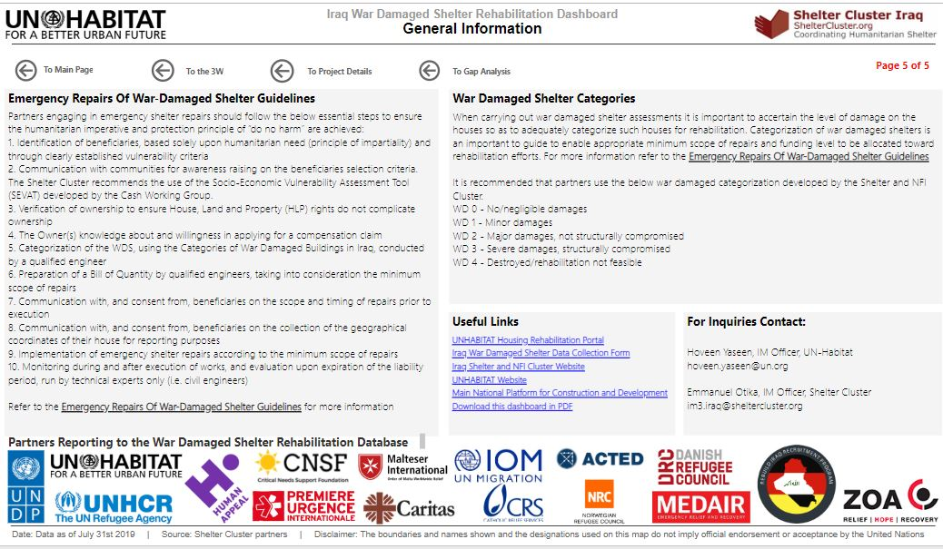
Key issues:
Housing Rehabilitation Interventions – Interactive Dashboard
Page 1 – Geographical Scope
Page 2 – Partner Presence
Page 3 – Project Details
Page 4 – Gap Analysis
Page 5 – General Information
http://bit.ly/SNFI_2019_IRD

Slide 10
Key issues:
Partners to update on their summer distributions & Tents replacement/maintenance interventions– Tour de table

Slide 11
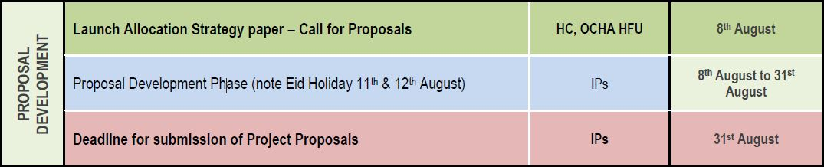
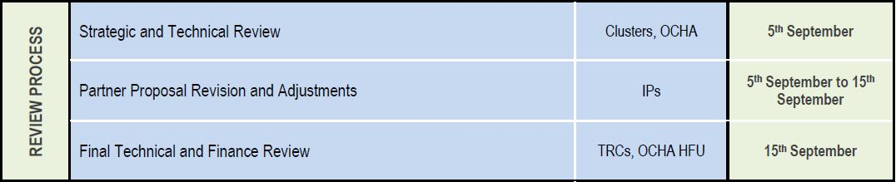
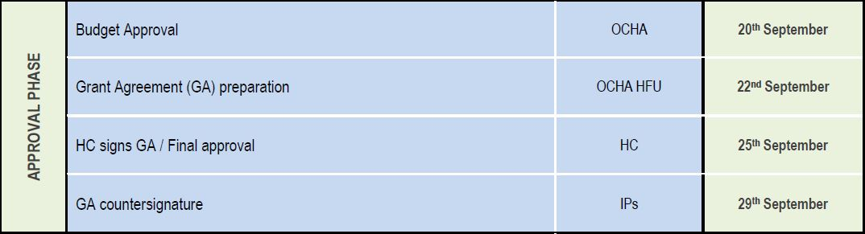
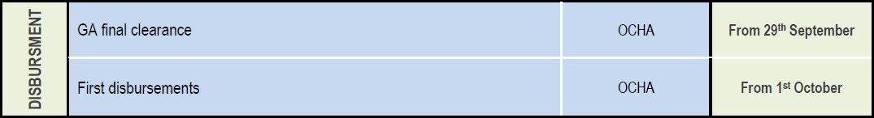
Key issues:
2019 IHF - Second Allocation - The timeline
July 14th – August 8th : ALLOCATION PRIORITY & STRATEGY DEVELOPMENT
1
2
Strategic and Technical Review by SNFI Cluster SAG | 2nd September
3
4

Slide 12
Key issues:
2019 IHF - Second Allocation - Main eligibility criteria / Priority needs/gaps
Main eligibility criteria for Partners to submit proposals
An already approved OPS project under the 2019 HRP which is underfunded at mid-year;
Not benefitted from funding during the last two IHF allocations (first 2019 and reserve);
Proven record of reporting in platforms (Activity Info and the SNFI and UN-HABITAT WDS reporting tool);
Access to the proposed geographical areas, or the possibility to expand presence with minimum investment;
Commit to use the Socio-Economic Vulnerability Assessment Tool (SEVAT) for identification of beneficiaries.
Priority needs/gaps | Locations | Prioritized activities
1,500 HHs | Dahuk: Sumel (Fayda, Markaz Sumel) Zakho (Markaz Zakho, Rizgari) | Shelter support through Sealing Off Kits and cash-based interventions for rehabilitation of critical shelter, rental subsidies and NFI distributions (in-kind). Beneficiaries to be identified using the SEVAT tool to select the most vulnerable families.
1,377 HHs | Anbar: Fallujah (Al-Amirya)
3,476 HHs | Salah al-Din: Tikrit (Al-Alam, Markaz Tikrit, Dijla) Samarra (Markaz Samarra)
1,266 HHs | Kirkuk: Daquq (Laylan, Taza Khurmatu) Kirkuk (Markaz Kirkuk)

Slide 13
Key issues:
2019 HRP - Funding progress as of August 7th, 2019 – from FTS
S-NFI 2019 HRP : 17 approved projects from 16 Partners
 | Required (US $ m) | Funded (US $ m) | Coverage (%)
TOTAL | 74.4 | 28.4 | 38.2%
Destination org. | Funded Projects codes | Sum of Amount (US$)
Agency for Technical Cooperation and Development | HIRQ19-SHL-154743-1 | 2,544,618
Danish Refugee Council | HIRQ19-SHL-154837-1 | 963,054
International Organization for Migration | HIRQ19-SHL-154503-1 | 15,709,825
TEARFUND | HIRQ19-SHL-153813-1 | 601,964
United Nations Children's Fund | HIRQ19-SHL-154446-1 | 1,596,387
United Nations High Commissioner for Refugees | HIRQ19-SHL-154792-1 | 7,011,250
TOTAL |  | 28,427,098

Slide 14
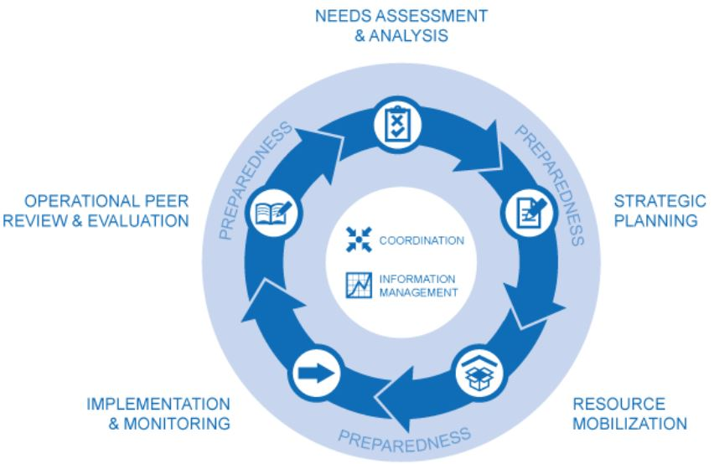
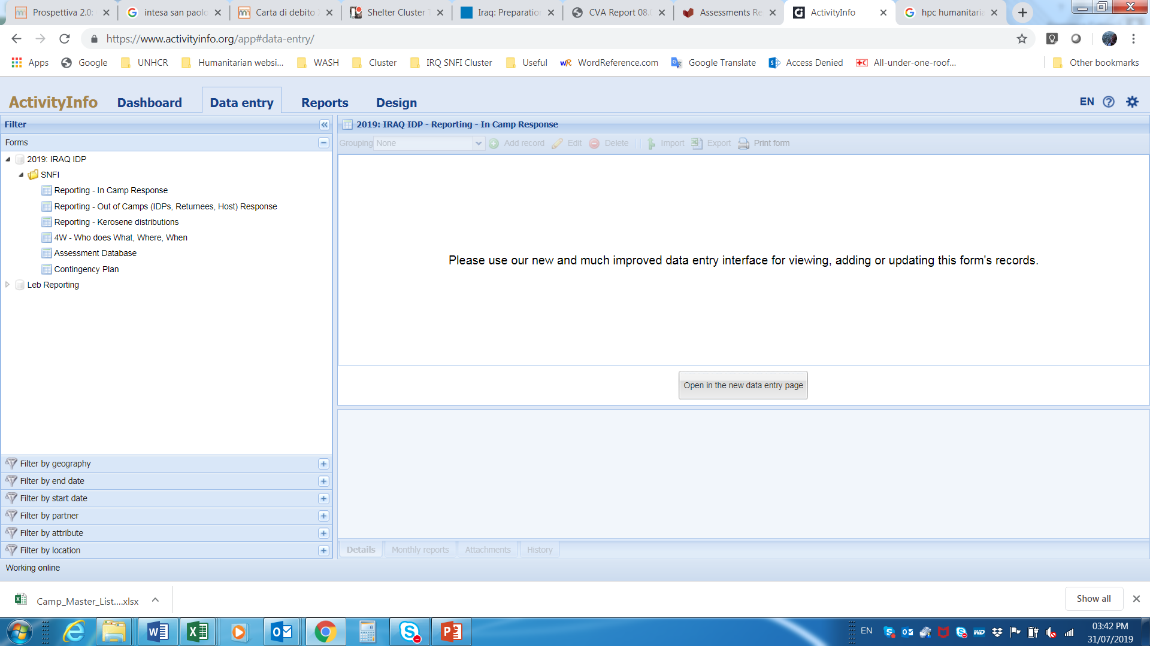
Information Management - latest initiatives developed by the SNFI Cluster
New databases in ActivityInfo
Additional databases have been added on Activity Info to capture core information across all the Humanitarian Programme Cycle phases.
https://www.sheltercluster.org/response/iraq

Slide 15
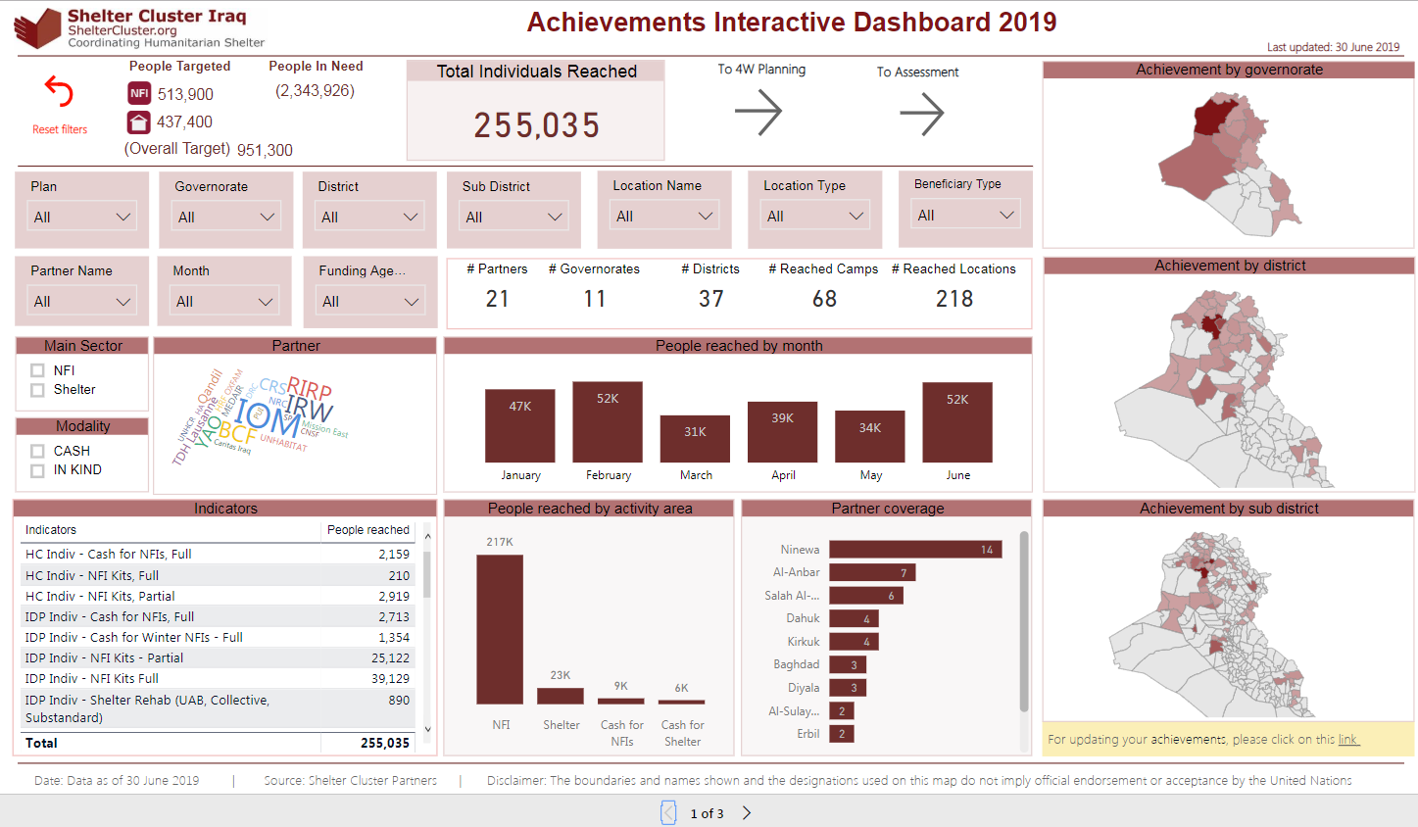
Information Management - latest initiatives developed by the SNFI Cluster
Cluster Interactive Dashboard
Interactive dashboards from AI: https://bit.ly/317gLgO
All interactive: play with the selection to see figures appearing
3 pages for now:
Achievements
4W
Assessments
4th page - coming soon:
Emergency Preparedness

Slide 16
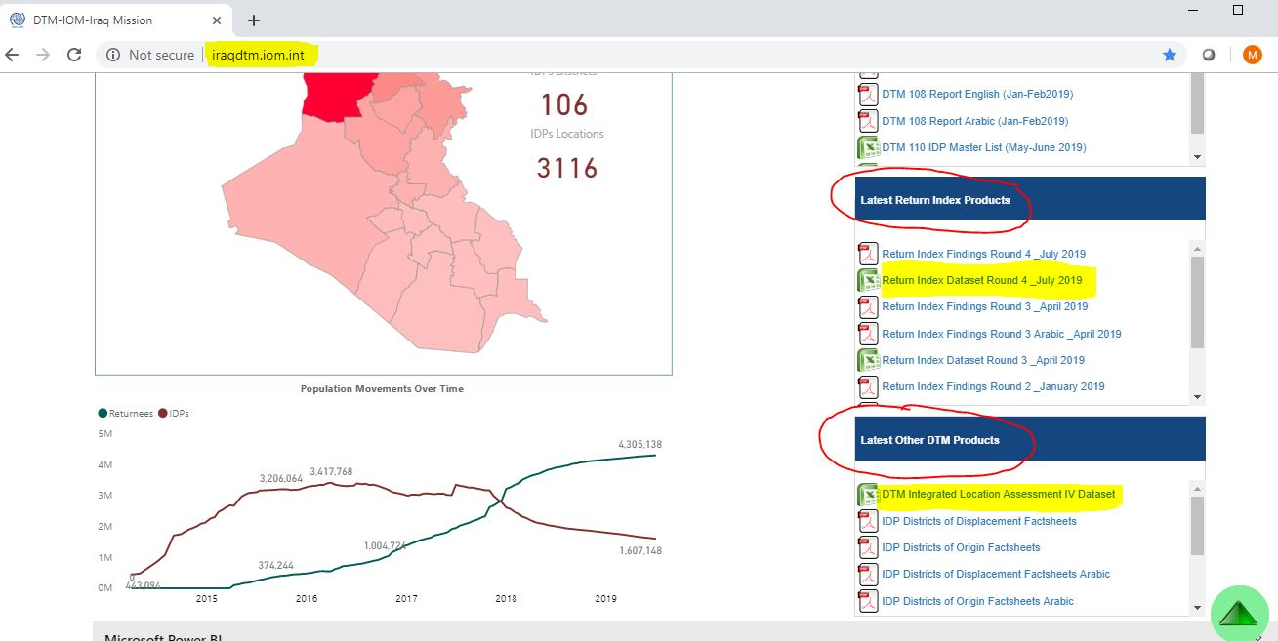
Information Management
Updated & Available useful datasets for your consideration
Most recent updated datasets been published by IOM / DTM.
The ILA – round 4 and
The Return Index – round 4,
Two datasets that can help you in your planning for the Housing Rehabilitation for returnees, but also for the Critical shelter rehabilitation for IDPs out of Camps.

Slide 17
Information Management
Recap. on trainings
SNFI Trainings June-July 2019
Achievements
Activity Info reporting for SNFI Partners
Use of the Socio-Economic Vulnerability Tool (SEVAT)
Reporting Tool for War-Damaged Shelter Repairs
War-Damaged Shelter Minimum Standards and use of BoQ
Assessments and the use of the Common Database of Indicators (CDI)
17 trainings conducted in Erbil, Dahuk and Baghdad
Facilitators from SNFI Cluster, CwG and UN-HABITAT
268 participants trained – 85% local staff
27 international and local organizations (ACTED, BCF, CAOFISR, Caritas Cz, Caritas Iraq, CRS, Dijla, DRC, Future Keys, HRF, Human Appeal, ICRC, IOM, Kurds, Medair, Mission East, NRC, PU-AMI, PUI, PWJ, Qandil, Samaritan’s Purse, UNDP, UN-HABITAT, UNHCR, UNOPS and YAO)
2 government agencies (BRHA and MoMD)

Slide 18
AOB – The Area-Based Coordination Approach
Reinforce the Centre and South Hub Coordination through Area-Based Coordination Approach.
Diyala - Volunteer ??
Salah al-Din – DRC
West Anbar - Volunteer ??
Note: Next sub-national Cluster coordination meeting for Centre and South will be on September 4th, 2019;
Invitation will be sent out on due time.
https://www.sheltercluster.org/response/iraq

Slide 19











AOB – The New SAG of the SNFI Cluster
A new Strategic Advisory Group (SAG) of 11 members was selected in June 2019, to serve in their roles for 1 year, from June 2019 to June 2020.
Congratulations and thank you to our Strategic Advisory Group Members!
https://www.sheltercluster.org/response/iraq

Slide 20
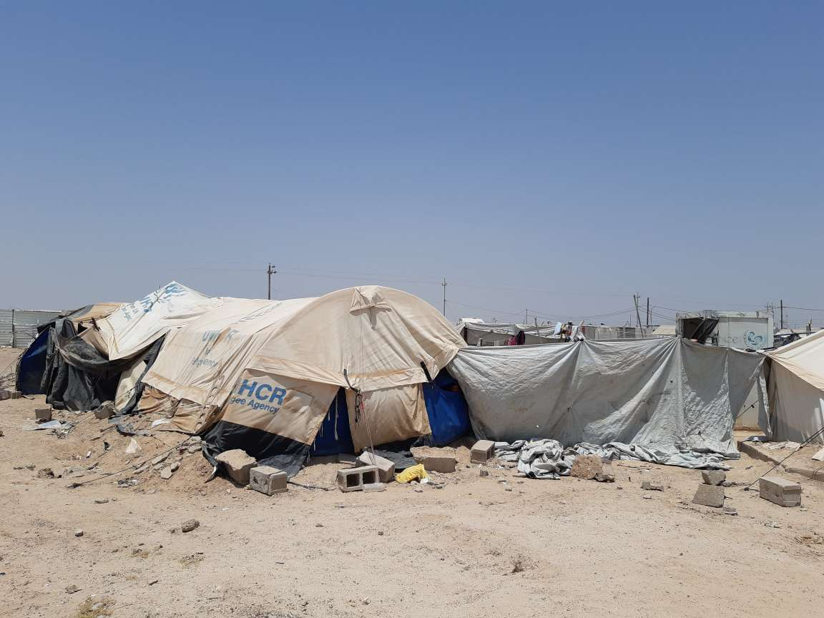
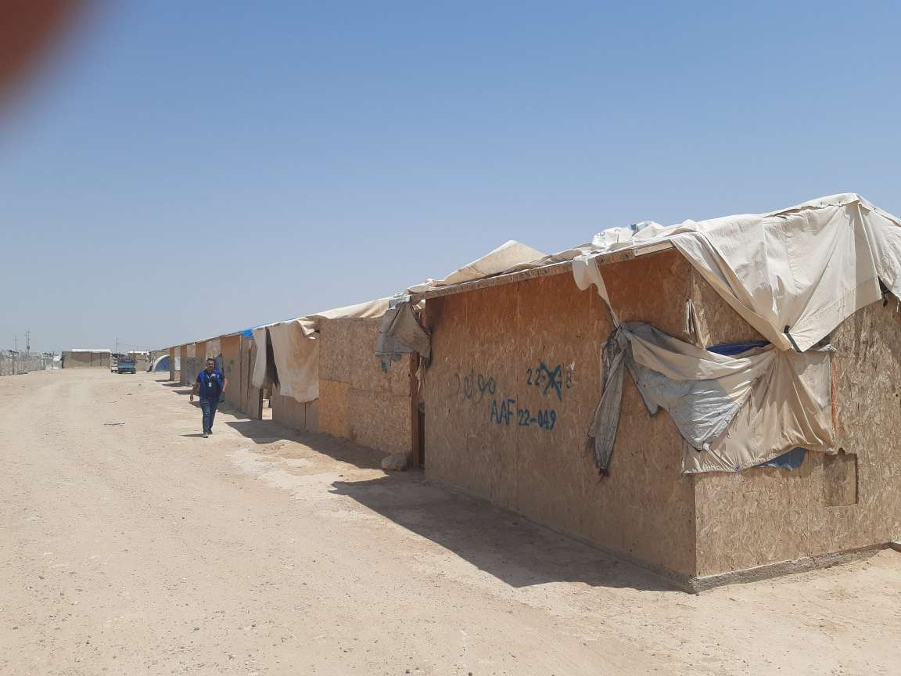
THANK YOU VERY MUCH FOR YOUR GREAT CONTRIBUTIONS
UNHCR tent in AAF
Plywood shelters in AAF

