Slide 1




Current Cluster Team Structure Since June, 2019
Francesca Coloni - UNHCR National Cluster Coordinator +964 (0) 772 616 3725 coord.iraq@sheltercluster.org Mohammed Faisal - IOM Information Management Officer National +964 (0) 0751-420-9828 im.iraq@sheltercluster.org Michel Tia - IOM Sub National Cluster Coordinator Centre and South * +964 (0) 782 294 9258 coord4.iraq@sheltercluster.org Recruitment ongoing Sub National Cluster Coordinator Kirkuk and Ninewa * | Teri Smith - NRC National Cluster Co-Chair +964 (0) 751-741-8217 coord2.iraq@sheltercluster.org Emmanuel Otika - UNHCR Associate Information Management Officer National +964 (0) 771 994 5707 im3.iraq@sheltercluster.org Petya Boevska - UNHCR Sub National Cluster Coordinator KRI * +964 (0) 771 965 2984 coord3.iraq@sheltercluster.org Aziz Abultimman - UNHCR Senior Cluster Associate National +964 (0) 750 868 6038 snrnatassot.iraq@sheltercluster.org
* For more details check
https://www.sheltercluster.org/iraq/documents/iraq-shelter-cluster-sub-national-areas-coordination-a0
https://www.sheltercluster.org/response/iraq

Slide 2
Iraq humanitarian response Centre and south Shelter Cluster Hub Coordination meeting
Baghdad
September 04th, 2019

Slide 3
AGENDA
Review of action points from minutes of previous meeting;
Key issues and Partners to update :
Cluster capacity to handle current emergency – Anbar & Salah al-Din;
Housing Rehabilitation Interventions – Tour de table;
Summer distributions & Tents replacement/maintenance interventions – Tour de table;
2019 IHF - Second Allocation: update on Anbar and Salah al-Din submissions;
Preparation of winter plans;
Information Management
Cluster reporting;
Trainings opportunities;
AOB

Slide 4
Review of action points from minutes of previous meeting
# | Action Points | Focal Point | Status
1 | Housing rehabilitation: Shelter Cluster to continuously follow up with partners, to support collecting their latest interventions details. Partners can reach out to the WDS IM Unit for support if needed (Emmanuel - im3.iraq@sheltercluster.org and Hoveen - hoveen.yaseen@un.org). | Cluster partners & C&S Hub Coordinator | Ongoing process
2 | Partners to keep updating their 2019 assessments (planned, ongoing, completed) using ActivityInfo reporting platform | Cluster partners & C&S Hub Coordinator | Ongoing process
3 | Partners to keep updating their 2019 Interventions (planned, ongoing, completed) using ActivityInfo reporting platform | Cluster partners & C&S Hub Coordinator | Ongoing process
4 | 2019 IHF - Second Allocation: Share the final Allocation Priority & Strategy once available. | C&S Hub Coordinator | Done
5 | Reinforce the Area Based Coordination - for Anbar. Continue bilateral discussion with potential partners | C&S Hub Coordinator | Done
6 | Cluster reporting tool: AI training for CAOFISR. Date, Venue & Time to be confirm | CAOFISR & C&S Hub Coordinator | Done

Slide 5
Key issues:
Cluster capacity to handle current emergency – Anbar & Salah al-Din
Forced IDPs movements from Ninewa camps to Salah al – Din & Ambar
Need assessment / Update from Blumont & Mercy Hands on 2-Sep-2019
Salah al-Din
CCCM partners in Al Karama and Basateen camps are sharing update on IDPs population and their needs
Anbar
Update from CCCM & DTM
______________________________________________________________________
IOM & UNHCR are potential partners with response capacity with available NFI & Tents stocks.
However, the Shelter Cluster is seeking a clear inter-cluster common approach for a concerted response / action.

Slide 6
Key issues:
Housing Rehabilitation Interventions – 2019 plan for Centre & South
UNDP – September update
Ongoing shelter rehabilitation program (Cat 1 & 2);
Governorate Name | Location | Project (Case) Name | # of units | Status | Comments
Anbar | Karma | rehabilitation 303 houses in Khairat (Shortan Village). | 241 | Procurement | Additional 30 Units included as the original target was 241
Anbar | Haditha | Rehabilitation Housing Works of 214 Units in Haqlaniya in two villages (Khasfa and Zawia) Villages in Haditha | 214 | Under Implementation
Anbar | Haditha | Rehabilitation Housing Works of 187 Units in Barwanah District (Al-Sumood) | 187 | Under Implementation
Anbar | Haditha | Rehabilitation of Housing Works of 136 Units in Haqlaniya (Al-BoHayat) Village in Haditha | 136 | Under Implementation
Anbar | Haditha | Rehabilitation Housing Works of 137 Units in Barwanah District (Al-Ata'a) in Haditha | 137 | Completed
Anbar | Rawa | Rehabilitation of 600 houses units in Rawa (Two lots) | 600 | On hold
Anbar | Qaim | Rehabilitation of Housing works for 137 Units in Hay Sikak in Qaim City-Lot 1 | 137 | Procurement
Anbar | Qaim | Rehabilitation of 342 houses units in Hay 12 Rabee Awalin Qaim lot-2 | 342 | Procurement
Anbar | Qaim | Rehabilitation of 321 houses units in Hay Risala in Qaim (lots-3) | 321 | Procurement
Anbar | Anah | Rehabilitation of 241 houses units in Sagrah village in Anah District | 241 | Under Implementation
Anbar | Anah | Rehabilitation of 460 houses units in Anah | 241 | Procurement
Anbar | Anah | rehabilitation 350 houses in Rehanna | 350 | On hold
Anbar | Anah | Rehabilitation of 186 housing units in Hasa village in Anah city | 186 | Procurement
Anbar | Anah | Rehabilitation of 92 houses units in Obour Neighborhood in Anah | 92 | Procurement
Salah al-Din | Baiji | Rehabilitation of ??? housing units in Baiji Tal Alza’atar Neighborhood |  | Assessment
Salah al-Din | Baiji | Rehabilitation of 174 housing units in Baiji Askary1 Neighborhood | 374 | Procurement
Salah al-Din | Baiji | Rehabilitation of 364 housing units in Baiji Risala neighborhood | 500 | Procurement

Slide 7
Key issues:
Housing Rehabilitation Interventions – 2019 plan for Centre & South
UNHCR – Early August update
Rehabilitation of 1,250 houses (Cat 2) in Salah Al-Din governorate: ongoing with 60% of completion as early July 2019. However, UNHCR field unit is working on changes of location of 237 houses. Further details will be shared with the Cluster on due time.
Construction of 900 RHU for returnees (Cat 4), this include 150 in Diyala, 75 in Anbar, 50 in Baghdad and 625 in Salah al-Din. Assessment & beneficiary’s selection - completed. The tender process is almost completed and the BOQs are yet to be developed.
Cluster to follow up with UNHCR to get their September update.

Slide 8
Key issues:
Housing Rehabilitation Interventions – 2019 plan for Centre & South
DRC – September update
Shelter rehabilitation (cat. 2): tender process completed – Work will be handed over to the contractor in around 2 weeks
84 houses in Fallujah & Saqlawiyah district in Anbar - according to the workplan all rehabilitations will be completed on the 30 September.
35 houses in Muqdadiyah district in Diyala - according to the workplan all rehabilitations will be completed on the 26 September.
80 houses in Baiji district in Salah al Din
Customized Shelter kits (CSK): Distributions have been completed
150 HHs in Anbar – Completed. 14HHs asked for their CSK installations. PDM is currently ongoing
100 HHs in Diyala – Completed
150 HHs in Baiji in Salah al Din – Completed but few more to be distributed.
Anbar
Rehabilitation of Saqlawiyah Health Centre to start in September /
DRC is planning to start shelter assessments in two new areas of Falluja (New Distribution Area, Al Namiya)
Diyala
Rehabilitation of Public Library in Baquba city, to start in September
Vulnerability assessments starting in September in Diyala, in North Muqdadiya, North-East Muqdadiya and Centre Muqdadiya. If partners have some referrals of shelter needs or previous shelter assessments done in those areas they are welcome to contact DRC.

Slide 9
Key issues:
Housing Rehabilitation Interventions – 2019 plan for Centre & South
CRS – Early August update - The project target has been increased
Shelter repairs through Cash - 111 houses (returnees) in Fallujah/Anbar.
20 houses in phase#1 – have been Completed
41 houses in phase#2 – ongoing with 80% completion; the second tranche of payment was been completed for 34 houses. The remaining 6 houses will soon receive once they reach 80% completing.
50 houses in phase#3 – Technical assessment will be starting after Eid holiday.
Shelter upgrade for IDPs in Abu-Ghraib/Baghdad and in Falluja/Anbar.
The phase#1 and phase#2: 68 houses (40 houses in Abu-Ghraib and 28 houses in Fallujah) have been completed;
Phase#3, the Technical assessment has been completed for 40 houses in Abu Ghraib district and 30 houses in Falluja. Final target, 38 houses in Abu Ghraib district and 30 houses in Falluja.
The total achievement till now is 136 houses in Baghdad and Anbar.
Plan: 50-60 houses in Abu Ghraib will be added to the total target. The rapid assessment has been completed and the technical assessment will be starting after Eid holiday.
Cluster to follow up with CRS to get their September update

Slide 10
Key issues:
Housing Rehabilitation Interventions – 2019 plan for Centre & South
PUI – September – planned project
Rehabilitation of 108 shelters located in Dghima village (Sub-District: Al Rummaneh– Governorate: Anbar).
Exact housing point to be confirmed once the selection is completed
IOM – September update /
Shelter rehabilitation programs - double check and confirm with IOM if below inputs are households or houses ??
200 houses (returnees) in Ana district in Anbar: 100% of completion.
215 houses (returnees) in AL-Khalis district in Diyala: 100% of completion.
400 houses (IDPs) in Najaf district in Najaf: 100% of completion.
Cash for Rent program in Anbar (168HHs) and Baghdad (218 HHs), 6 months Cash for Rent allocation / US $200 /HH/month.
The third payment (for July & August). Completed, PDM should be planned very soon.
Cash for SOK programs
600 IDP households living in critical shelter in Kerbala: assessment completed / distribution completed last week / US $ 240.00.
New Shelter construction (for Cat 3 or 4)
75 houses (returnees) in AL-Khalis district in Diyala: assessment completed / but project location may be changed due to security issues. New location to be confirm with IOM.

Slide 11
Key issues:
Housing Rehabilitation Interventions – Table exported from WDS database
http://bit.ly/SNFI_2019_IRD

Slide 12
Key issues:
Summer distributions & Tents replacement/maintenance interventions – Tour de table
IOM continues to assist vulnerable IDPs/Returnees in different locations;
UNHCR covers few Collective Centres and camps with NFI distributions and tents replacement interventions;

Slide 13
Key issues:
2019 IHF - Second Allocation : update on Anbar and Salah al-Din submissions;
Shelter and Non-Food Items Allocation - $3,327,060
Priority needs/gaps | Locations | Prioritized activities
1,500 HHs | Dahuk: Sumel (Fayda, Markaz Sumel) Zakho (Markaz Zakho, Rizgari) | Shelter support through Sealing Off Kits and cash-based interventions for rehabilitation of critical shelter, rental subsidies and NFI distributions (in-kind). Beneficiaries to be identified using the SEVAT tool to select the most vulnerable families.
1,377 HHs | Anbar: Fallujah (Al-Amirya)
3,476 HHs | Salah al-Din: Tikrit (Al-Alam, Markaz Tikrit, Dijla) Samarra (Markaz Samarra)
1,266 HHs | Kirkuk: Daquq (Laylan, Taza Khurmatu) Kirkuk (Markaz Kirkuk)
8th – 31st Aug. 2019
Submissions: 5 Proposals
Partners: UN-Habitat, Medair, HRF, SZOA, CCR
Total budget: US $ 5,094,574
2nd Sept. 2019: Strategic and Technical Review by SNFI Cluster, SAG & IHF
Partners will be informed on SAG decision.
5th – 15th Sept. 2019: Partner Proposal Revision and Adjustments.

Slide 14
Key issues:
Preparation of winter plans
IOM has a plan to provide winter assistance to IDPs (in and out of Camps) and Returnees in different governorates.
UNHCR is planning to cover their managed camps.

Slide 15
Information Management
Cluster reporting
Trainings opportunities
https://www.sheltercluster.org/response/iraq

Slide 16
AOB – The Area-Based Coordination Approach
Reinforce the Centre and South Hub Coordination through Area-Based Coordination Approach.
Diyala – UNHCR / Focal point will soon be nominated.
Salah al-Din – DRC / Lottie Mccarthy (lottie.mccarthy@drciraq.dk)
Anbar – PUI / Nicoletta Roccabianca (ira.csi.deputy-areacoo-prog@pu-ami.org)
Note: Next sub-national Cluster coordination meeting for Centre and South will be on October 9th, 2019;
Invitation will be sent out on due time.
https://www.sheltercluster.org/response/iraq

Slide 17
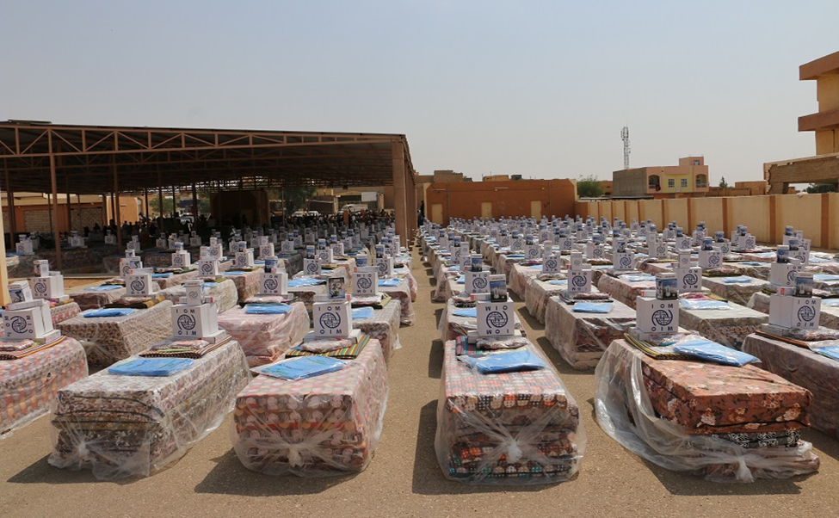
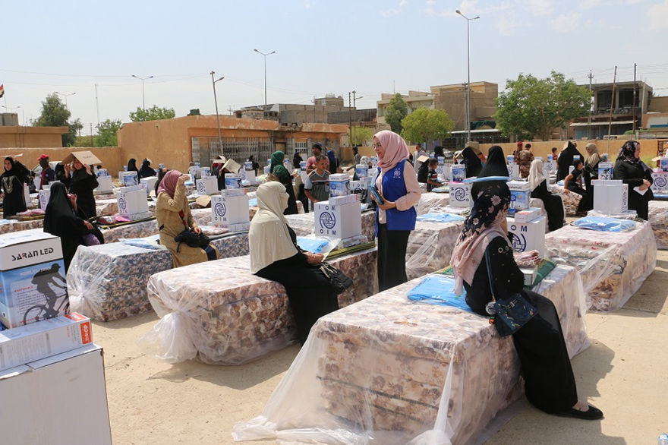
THANK YOU
IOM - August 2019 NFIs Distribution in Al-Ka’im
Anbar
IOM - August 2019 NFI Distribution in Heet & Al-Baghdadi
Anbar

