Slide 1




Michel Tia - IOM
Sub National Cluster Coordinator for Centre and South
+964 (0) 782 294 9258
coord4.iraq@sheltercluster.org
Centre and south Shelter Cluster Hub Coordination Structure
Nicoletta Roccabianca - PUI
Deputy Area Coordinator – Centre and South
Shelter Cluster Focal Point for Anbar Governorate
+964 (0) 783 306 1031
ira.csi.deputy-areacoo-prog@pu-ami.org
Lottie McCarthy - DRC
Shelter and Infrastructure Programme Manager – Tikrit
Shelter Cluster Focal Point for Salah ad-Din Governorate
+ 964 (0) 772 997 2314
lottie.mccarthy@drc.ngo
Yet to be nominated - UNHCR
Shelter Cluster Focal Point for Diyala Governorate
https://www.sheltercluster.org/response/iraq

Slide 2
Iraq humanitarian response Centre and south Shelter Cluster Hub Coordination meeting
Baghdad
October 9th, 2019

Slide 3
AGENDA
Review of action points from minutes of previous meeting;
Key issues and Partners to update :
Update on Housing Rehabilitation Interventions (Planned / Ongoing) – Tour de table;
Partners confirmed winter plans and ongoing summer response – Tour de table;
Update on recent population movements and S-NFI Cluster response capacity;
Information Management
2020 HNO and HRP: S-NFI Cluster Severity and PIN;
Trainings and field visit in Salah al-Din - 21-23 Oct. 2019;
AOB

Slide 4
Review of action points from minutes of previous meeting
# | Action Points | Focal Point | Status / Deadline
1 | Cluster capacity to handle recent population movements and camp closures / camp consolidations: Advocate and mobilize resources for the contingency stocks and for appropriate response in concerned locations; | C&S Hub Coordinator | Ongoing
2 | ICRC to confirm with EcoSec Relief Response, if any available stock to support Emergency in SAD and Anbar; | ICRC | ICRC to update
3 | Housing rehabilitation: Bilateral follow up with relevant partners will be conducted to better address the discrepancies and update accurately the WDS respective datasets & platforms; | Cluster partners, C&S Hub Coordinator | Done
4 | UNHCR will be sharing with SAD Shelter focal point, more detailed information on their Shelter rehab program in SAD; | UNHCR & SAD Shelter FP | UNHCR to update
5 | Double check with the IM unit, on which reporting platform, partners can report achievements of their Quick Impact Projects; | C&S Hub Coordinator | Done
6 | Work closely on the winter response preparation for a better coverage of relevant areas; | IOM, UNHCR and the Shelter Cluster | Ongoing
7 | Shelter Cluster to share the winter need based on the MCNA-VII dataset; | C&S Hub Coordinator | Done
8 | Finalized and share the trainings sessions plan to be conducted in Salah al-Din; | SAD Shelter FP C&S Hub Coordinator | Done
9 | Partners to keep updating their 2019 Interventions (planned, ongoing, completed) using ActivityInfo reporting platform; | Cluster partners | Ongoing

Slide 5
Key issues:
Cluster Update on Housing Rehabilitation Interventions (Planned / Ongoing) – Tour de table
UNDP – Early October update:
in Anbar – 2,298 houses
In Salah al-Din – 963 houses
# | Project Name | Governorate | # of Units in the Project | Project Status | Progress
1 | Rehabilitation Housing Works of 214 Units in Haqlaniya in two villages (Khasfa and Zawia) Villages in Haditha | Anbar/ Haditha | 214 | Ongoing | 70%
2 | Rehabilitation Housing Works of 187 Units in Barwanah District (Al-Sumood) | Anbar/ Haditha | 187 | Completed | 100%
3 | Rehabilitation Housing Works of 136 Units in Haqlaniya (Al-BoHayat Village) | Anbar/ Haditha | 136 | Completed | 100%
4 | Rehabilitation Housing Works of 137 Units in Barwanah District (Al-Ata'a) | Anbar/ Haditha | 137 | Completed | 100%
5 | Rehabilitation of 241 houses units in Sagrah village in Anah District | Anbar/ Ana | 241 | Ongoing | 70%
6 | Rehabilitation houses in Ana (Hasaa) | Anbar/ Ana | 186 | Awarded | 0%
7 | Rehabilitation houses in Ana (Alobour) | Anbar/ Ana | 92 | Awarded | 0%
8 | Rehabilitation houses in Al Ka’im (Al Sikak) | Anbar/ Ka’im | 137 | Awarded | 0%
9 | Rehabilitation houses in Al Ka’im (12 Rabee Al Awal) | Anbar/ Ka’im | 342 | Awarded | 0%
10 | Rehabilitation houses in Al Ka’im (Al Risala (South&North)) | Anbar/ Ka’im | 323 | Procurement
11 | Rehabilitation houses in Al Garma (Shortan Al-khairat) | Anbar/ Karma | 303 | Procurement
12 | Rehabilitation houses in Salah al-Din / Baiji (Al Resala neighborhoods) | Salah al-Din / Baiji | 364 | Procurement
13 | Rehabilitation houses in Salah al-Din / Baiji (Al askari neighborhoods) | Salah al-Din / Baiji | 174 | Assessment Complete
14 | Rehabilitation houses in Salah al-Din / Baiji (Tal Zaatar neighborhoods) | Salah al-Din / Baiji | 425 | Assessment Complete
Few other projects are still waiting for fund confirmation - assessments will be starting as soon as possible in multiple neighborhoods

Slide 6
Key issues:
Cluster Update on Housing Rehabilitation Interventions (Planned / Ongoing) – Tour de table
UNHCR – Early October update: Shelter Rehabilitation
In Salah al-Din – 1,250 houses
# | Gov. | Dist. | Sub Dist. | No. of Shelter | Activity Status | Progress | GPS “Project data for areas”
1 | Salah al-Din | Balad | Yathrib | 140 | Ongoing | 53% | 33.994682° | 44.365797°
2 |  | Beiji | Al Sikak, Al Zaatar, Zaytoon & Albu Jarad | 299 | Completed | 100% | 34.917725° | 43.456898°
3 |  |  | Hay Al Taa'meem, Al Askari, Al Asri & Al Baraka | 350 | Completed | 100% | 34.927354 | 43.480531
4 |  |  | Al Musahak & Al Zwiyah | 104 | Completed | 100% | 35.185346° | 43.401941°
5 |  | Tikreet | Al bu Ajeel | 82 | Completed | 100% | 34.596155 | 43.726141
6 |  |  | Tikreet Center | 38 | Completed | 100% | 34.481724° | 43.743165°
7 |  |  | Al bu Ajeel (Jwezrat area replacement) | 237 | Ongoing | 81% | 34.602056° | 43.721026°
8 |  |  | Al Bu Hayazea (Jwezrat area replacement) |  |  |  | 34.622231° | 43.707565°
Total |  |  |  | 1,250

Slide 7
Key issues:
Cluster Update on Housing Rehabilitation Interventions (Planned / Ongoing) – Tour de table
UNHCR – Early October update: RHU
In Diyala – 150 houses
In Baghdad – 50 houses
In Anbar – 75 houses
In Salah al-Din – 625 houses
# | Gov. | Dist. | Sub Dist. | No. of RHU | Status | Progress
1 | Diyala | Al-Khalis | Al-Adhaim | 150 | Ongoing | 22%
2 | Baghdad | Abu-Ghraib | Al-Nessir wa Salam | 50 | Ongoing | 26%
3 | Anbar | Ramadi | Markaz Al-Ramadi | 50 | Ongoing | 64%
4 |  | Al-Garma | Al-Khayrat | 25 | Ongoing | 78%
5 | SAD | Beiji | Baiji Centre | 625 | Ongoing | 12%
6 |  |  | Al-Siniyah
7 |  | Balad | Al-Duloeyah

Slide 8
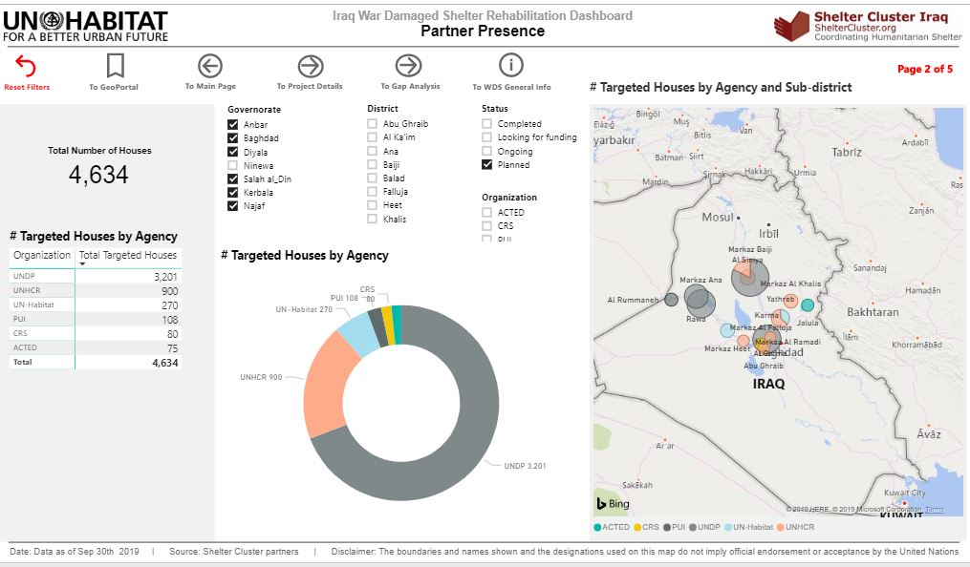
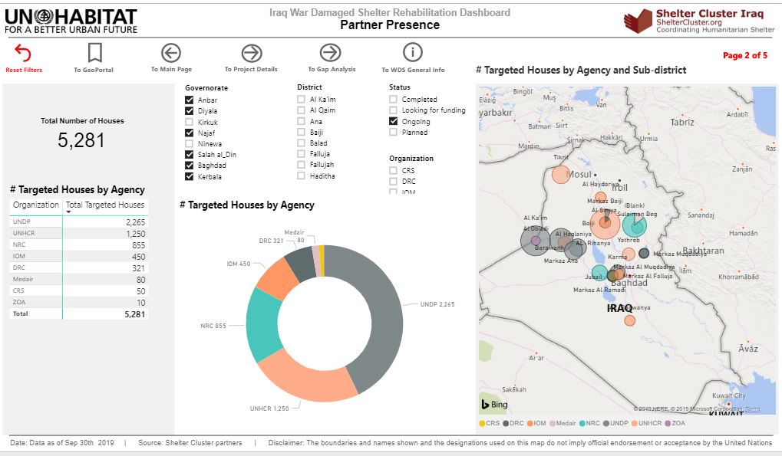
Key issues:
Cluster Update on Housing Rehabilitation Interventions (Ongoing / Planned) – Online dashboard – as of 8 Oct. 19
WDS - Planned in C&S
WDS - Ongoing in C&S
http://bit.ly/SNFI_2019_IRD

Slide 9
Key issues:
Partners confirmed winter plans and ongoing summer response – Tour de table
IOM has a plan to provide winter assistance to IDPs (in and out of Camps) and Returnees in different governorates. Around 10,000 winter kits have been planned
UNHCR is planning to cover their managed camps with Cash for Winter (US $200) distributions across the country. Around 1,300 HHs have been enrolled so far in Centre & South areas; This target may be increased if needed.

Slide 10
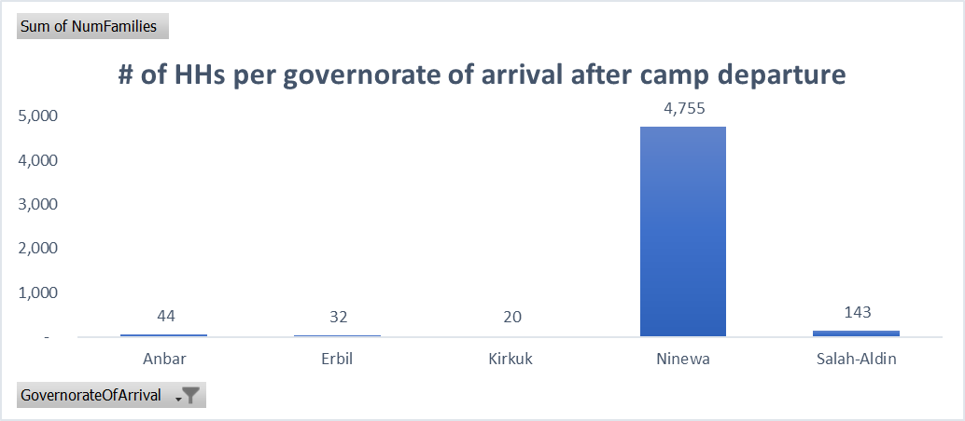
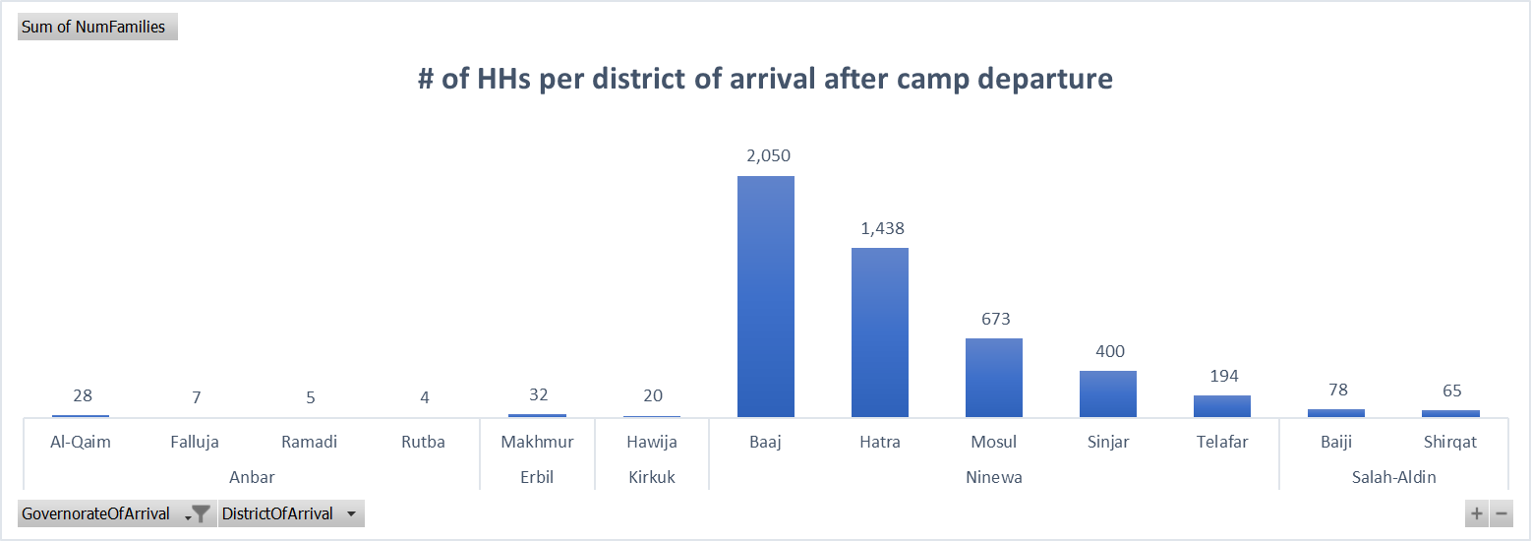
Key issues:
Update on recent population movements and S-NFI Cluster response capacity – 15 Aug-29 Sep 2019 – IOM/DTM
Summary Arrivals to non-camp: 4,994 HHs
Including 187 HHs in Anbar and Salah al-Din.
With details on Sub-districts & Location of Type

Slide 11
Key issues:
Update on recent population movements and S-NFI Cluster response capacity – Tour de table
The Shelter Cluster will continue to Advocate and mobilize resources for the contingency stocks and for appropriate response in concerned locations;
NFI
IOM: New caseload to be considered (confirmed)
UNHCR: Cash for Winter (US $200) distributions across the country. People been enrolled will be assisted in spite of their current locations (returned to original areas or out of camps IDPs) – (Confirmed).
New caseload to be considered.
Shelter
partners have ongoing shelter rehab programs in Al-Shirqat & Baiji districts
New caseload to be considered.

Slide 12
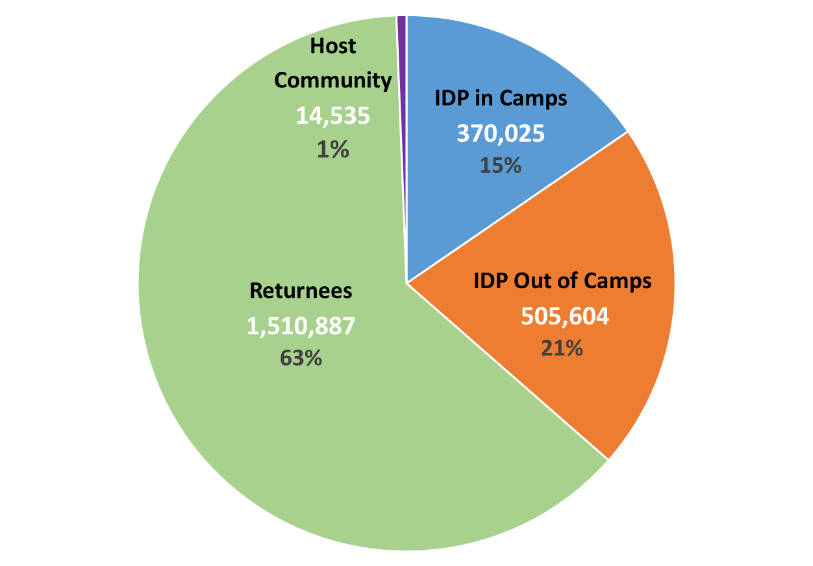
Information Management
2020 HNO and HRP: S-NFI Cluster Severity and PIN
PEOPLE IN NEED BY CATEGORY
IDPs in-camp | Out-of-Camp IDPs | Host Communities | Returnees | Total | Acute PIN
370,025 | 505,604 | 14,535 | 1,510,887 | 2.4M | 1.4 M
Acute PIN refers to severity levels 4 and 5 out of the overall PIN
Refer to Severity Scale Description & Indicators thresholds
BY AGE
CHILD | ADULT | ELDERLY
41% | 56% | 3%
TREND: PIN by year
2018 | 2019 | 2020
4.1M | 2.1M | 2.4M
https://www.sheltercluster.org/response/iraq

Slide 13
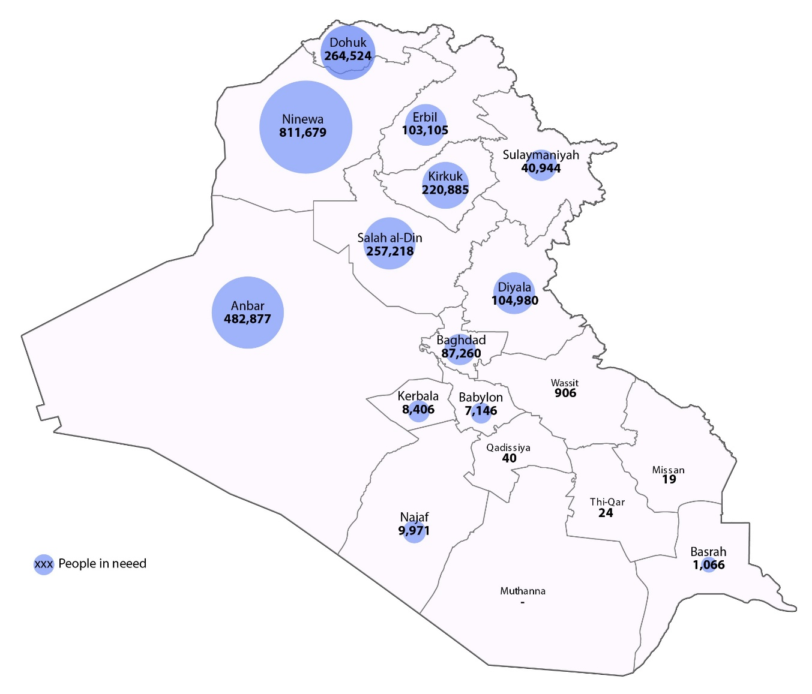
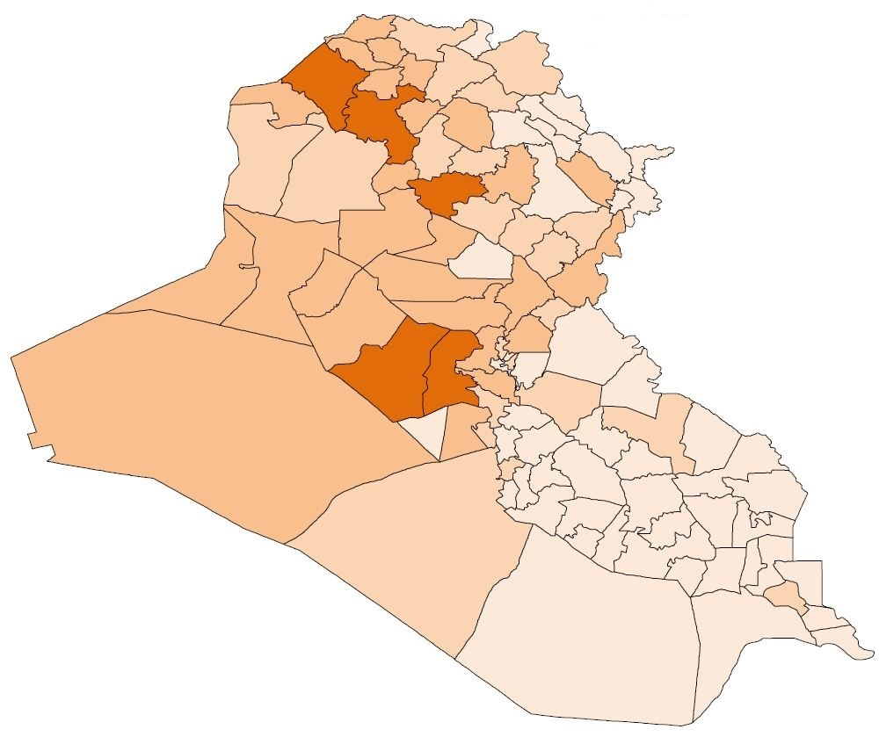
Information Management
2020 HNO and HRP: S-NFI Cluster Severity and PIN
PIN MAP
Priority districts by PIN: Al-Mosul (301,124), Telafar (228,279), Al-Ramadi (181,701), Sumail (155,308), Al-Falluja (154,294)
Extreme severity:
IDP OoC: 57% in Al-Kaim and Balad*, 56% Al-Baaj, 53% Al-Mahmoudiya, 49% in Baquba
Returnees: 64% in Balad, 61% in Al-Hawiga, 58% in Al-Kaim, 57% in Al-Khalis, 52% in Al-Baaj
https://www.sheltercluster.org/response/iraq

Slide 14
Information Management
Trainings and field visit in Salah al-Din - 21-23 Oct. 2019
Trainings | Date: October 21st
War Damaged Shelter Minimum Standards and the use of BoQ | 12PM - 2:30PM - DRC office / SAD
 | Date: October 22nd
1 - Reporting tool for WDS repairs on the Shelter Cluster and UN-HABITAT platform 2 - ActivityInfo reporting | 10:30AM - 2PM - DRC office / SAD
 | Date: October 23rd
Joint Field visit - WDS repairs program. Work closely with relevant partners to identify project to be visited. Discussion on field trip findings | 10:00AM - 1:30PM (times to leave and arrive back to Tikrit). 1.30PM - 2PM
Registration form : https://enketo.unhcr.org/x/#EdlulE9L
https://www.sheltercluster.org/response/iraq

Slide 15
AOB
Note: Next sub-national Cluster coordination meeting for Centre and South will be on November 6th, 2019;
Invitation will be sent out on due time.
https://www.sheltercluster.org/response/iraq

Slide 16
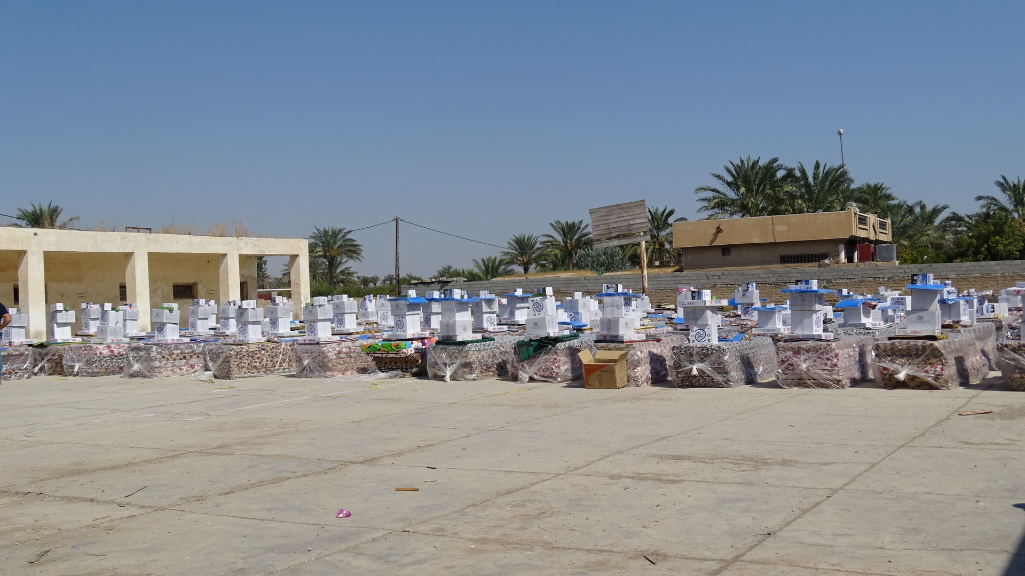
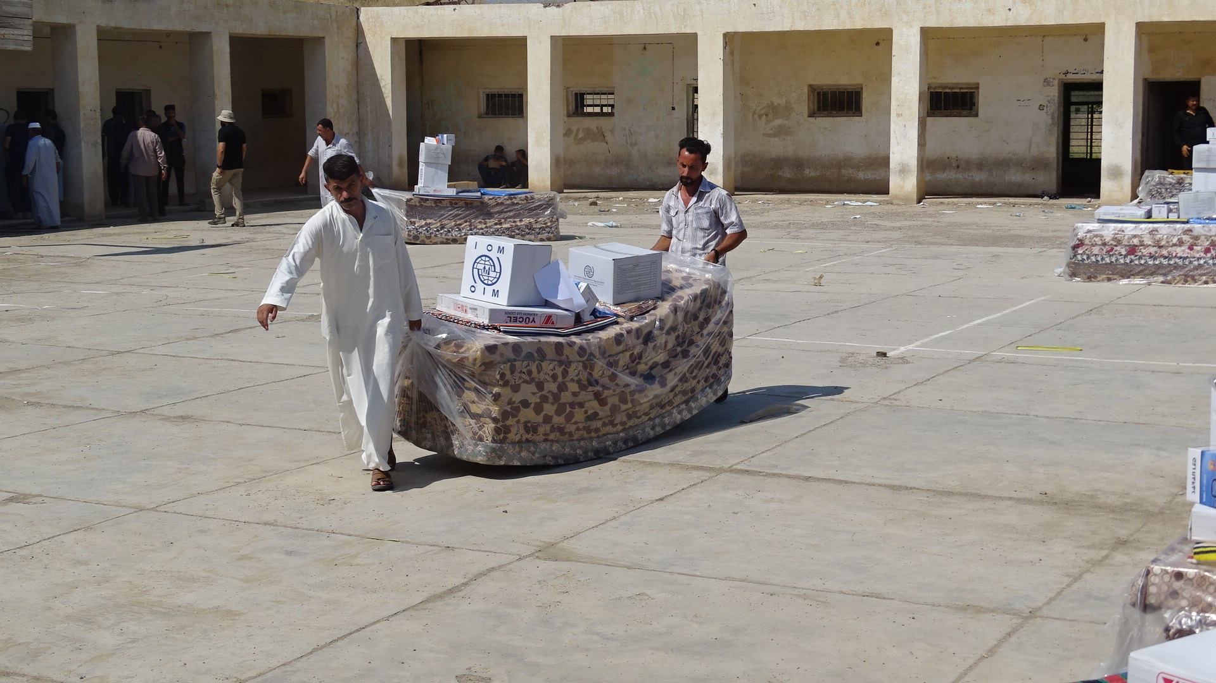
THANK YOU
IOM - NFIs distribution in Diyala – Muqdadiyah on 5 August 2019

