Slide 1




Michel Tia - IOM
Sub National Cluster Coordinator for Centre and South
+964 (0) 782 294 9258
coord4.iraq@sheltercluster.org
Centre and south Shelter Cluster Hub Coordination Structure
Nicoletta Roccabianca - PUI
Deputy Area Coordinator – Centre and South
Shelter Cluster Focal Point for Anbar Governorate
+964 (0) 783 306 1031
ira.csi.deputy-areacoo-prog@pu-ami.org
Lottie McCarthy - DRC
Shelter and Infrastructure Programme Manager – Tikrit
Shelter Cluster Focal Point for Salah ad-Din Governorate
+ 964 (0) 772 997 2314
lottie.mccarthy@drc.ngo
Yet to be nominated - UNHCR
Shelter Cluster Focal Point for Diyala Governorate

Slide 2
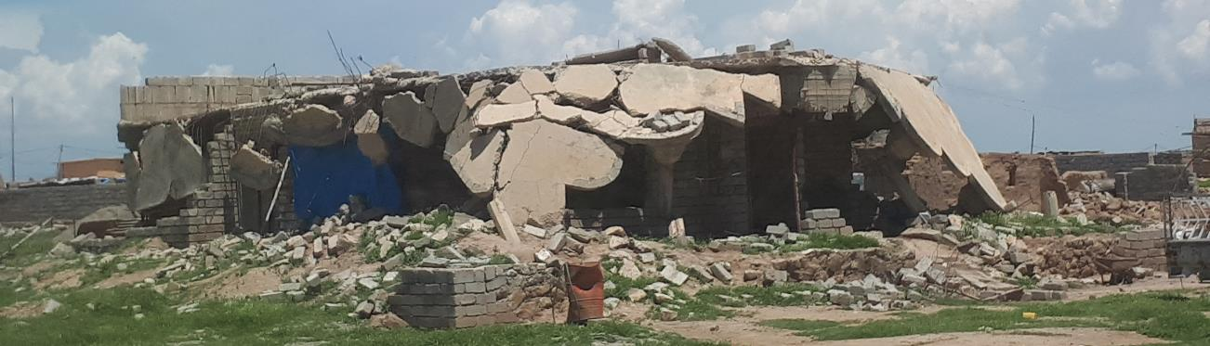
Iraq humanitarian response Centre and south Shelter Cluster Hub Coordination meeting
Baghdad
December 18th , 2019

Slide 3
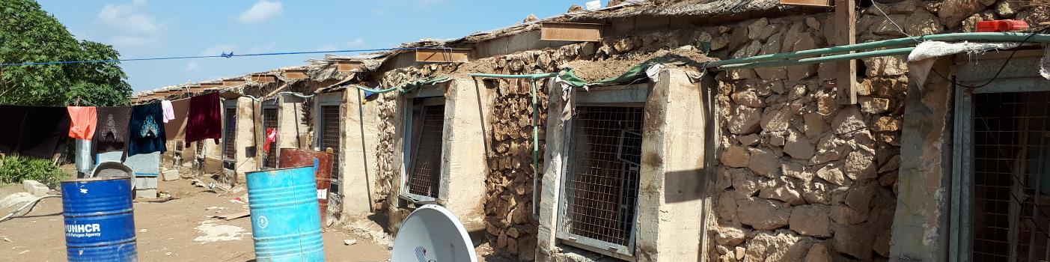
AGENDA
Review of action points from minutes of previous meeting;
Key issues
Housing Rehabilitation: ongoing/planned interventions & reported challenges;
Ongoing winter response and tents replacement;
2020 HRP: update on Cluster target, priority districts and ABC;
Information Management
2019 HRP: Overview on the Cluster response: PMR & Traffic light;
AOB
Inhabited chicken farm in Falluja, 2/2018

Slide 4
Review of action points from minutes of previous meeting;
# | Action Points | Focal Point | Status / Deadline
1 | Housing rehabilitation: Bilateral follow up with relevant partners will be conducted to better address the discrepancies and update accurately the WDS respective datasets & platforms; | Cluster partners C&S Hub Coordinator | Till 27 Sept 2019 - COB
2 | Key challenges in Housing rehabilitation programme and solutions/recommendations on way forward; | Cluster partners | ASAP
3 | Cluster to share the Winter response plan. | Shelter Cluster | ASAP
4 | Partners to keep updating their 2019 Interventions (planned, ongoing, completed) using ActivityInfo reporting platform; | Cluster partners | Ongoing process

Slide 5
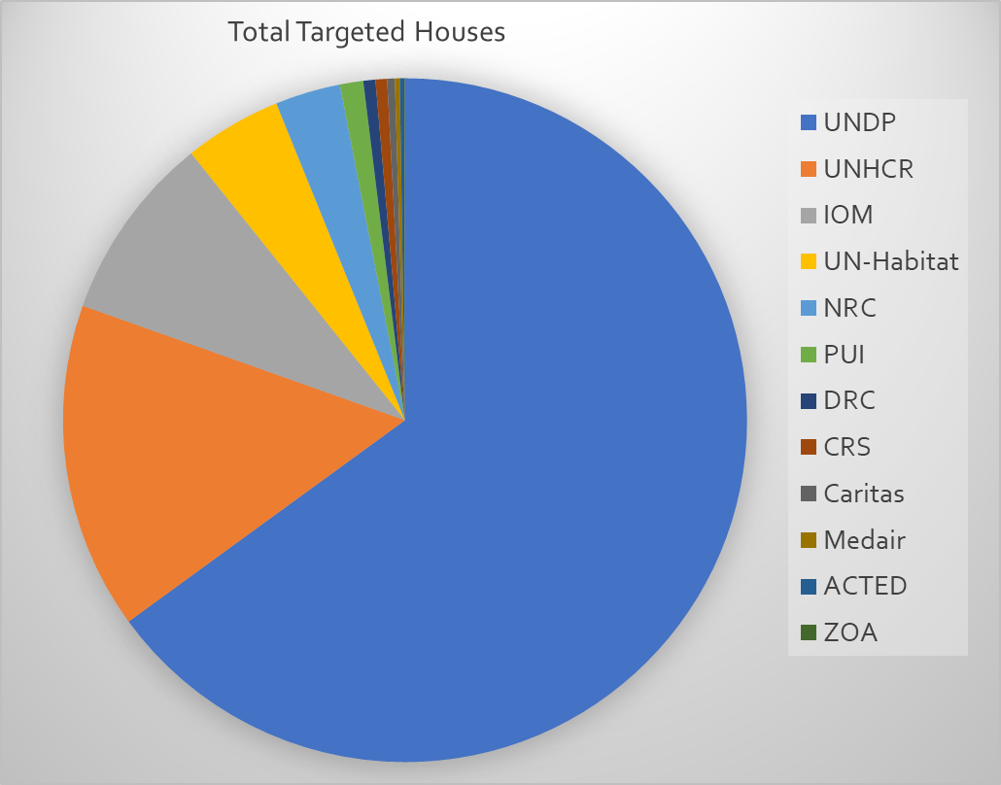
Key issues and Partner’s updates
Housing Rehabilitation: Overview, ongoing & planned interventions & reported challenges
Overview
Country wide / Target
68,044 houses
In Centre & South
34,787 houses (51% of target)
In Centre & South

Slide 6
Key issues and Partner’s updates
Housing Rehabilitation: Overview, ongoing & planned interventions & reported challenges

Slide 7
Key issues and Partner’s updates
Ongoing winter response and tents replacement
Partners’ achievements only for IDPs
(1st November – 12th December 2019)
Based on the HRP 2019: winter needs amount at 10.5 MUSD to cover around 60,000 IDP HHs in 38 prioritized districts.
Based on recent MCNA data, 25,000 IDP HHs are missing winter items, with highest needs reported in the following districts: Kirkuk, Mosul, Sulaymaniyah, Sumail and Zakho.
23,800 HHs out of camps and
1,200 HHs in camp settings, based on the declared needs for winter heaters, through MCNA VII
However
Several partners have secured funds and have plans in place to cover 81,700 IDP families including
29,300 HHs out of camps
52,400 HHs in camps
CRS, IOM, IRW, Mission East, and UNHCR.
UNICEF will be able to cover 50,500 children with winter clothing
Partners have provided winter support to 20,022 IDP households
18,541 HHs out of camp have been reached
1,481 HHs in Camps have been reached
38,290 children (0-14 years) have been assisted with winter clothing
UNHCR, IOM ,CRS, UNICEF, Tearfund
IOM & TdH to cover AAF and HTC (Falluja)
IOM & ZOA to cover BzBz

Slide 8
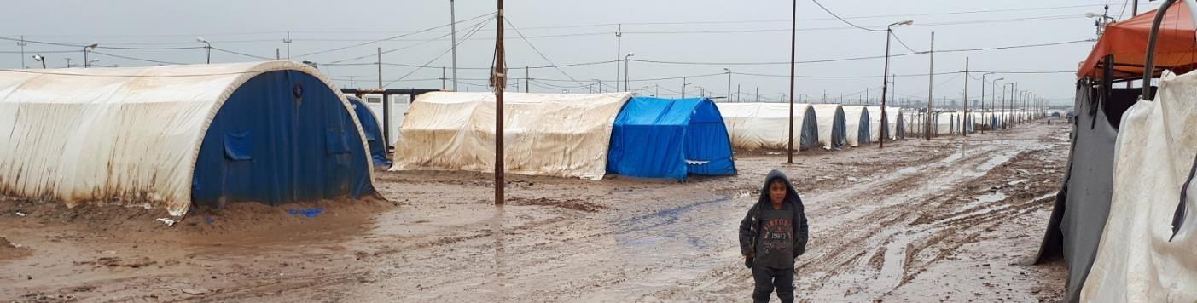
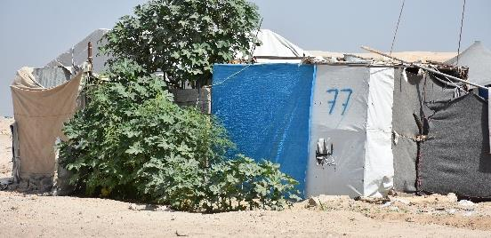
Key issues and Partner’s updates
2020 HRP: update on Cluster target, priority districts and ABC
Cluster PIN / Target
 | BY CATEGORY
 | IDPs in-camp | Out-of-Camp IDPs | Host Communities | Returnees | Total | Acute PIN
PEOPLE IN NEED | 370,025 | 505,604 | 14,535 | 1,510,887 | 2.4M | 1.4 M
TARGET | 164,530 | 201,830 | 0 | 158,390 | 524,750
Qayyarah-Jad'ah 5 camp, 4/2019
Makeshift shelter in Anbar, 2/2018

Slide 9
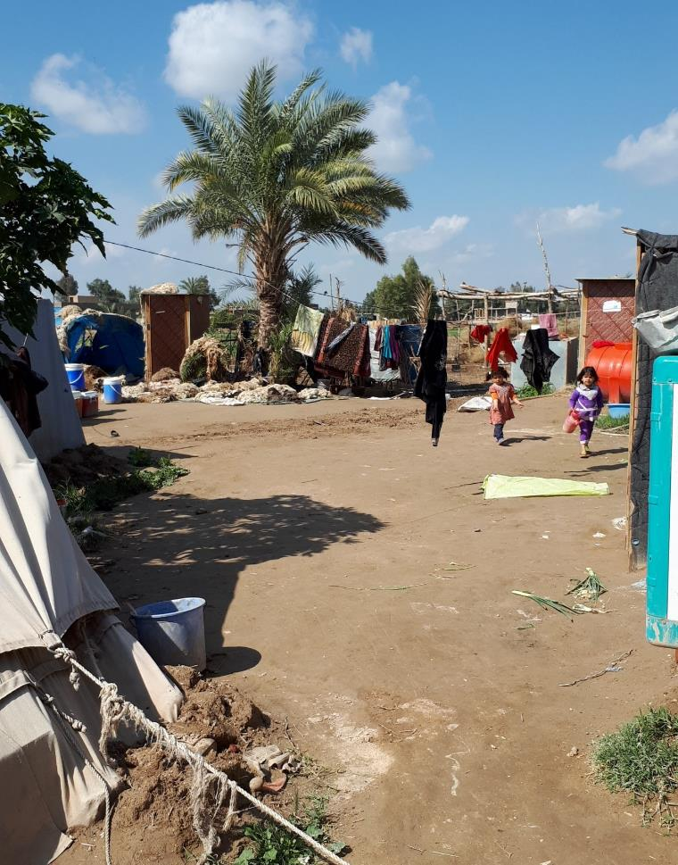
Key issues and Partner’s updates
2020 HRP: update on Cluster target, priority districts and ABC
Geographic Prioritization: 34 priority districts in 9 Governorates
ABC
Falluja, 2/2018

Slide 10
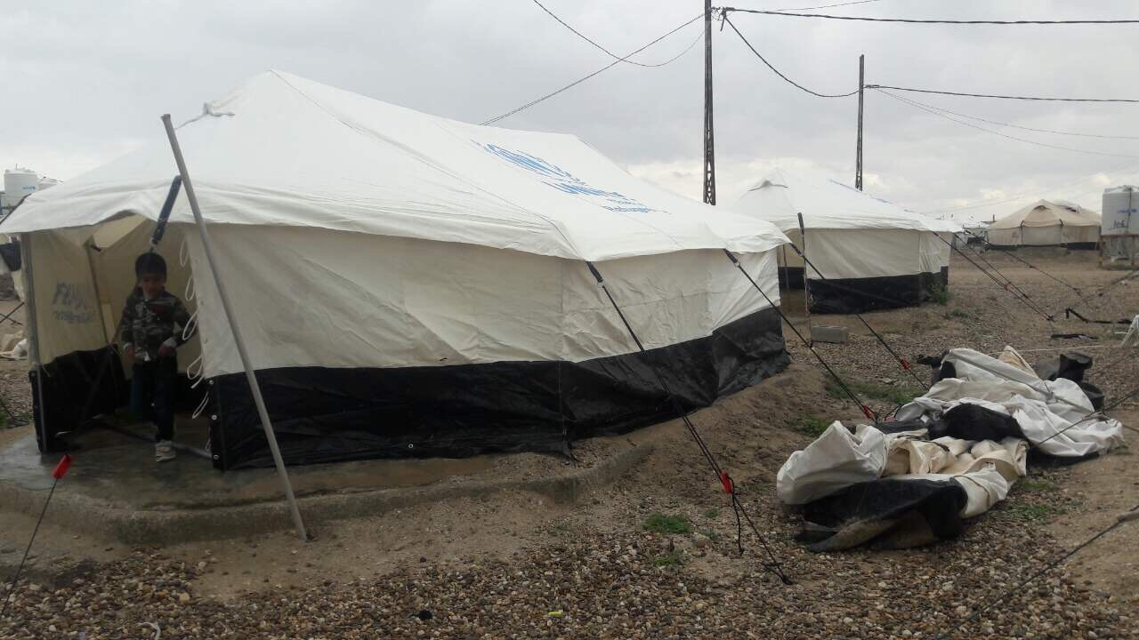
Information Management
2019 HRP: Overview on the Cluster response / PMR & Traffic light – 30 November 2019
Activity | 2019 target | HRP achievement |  | Non HRP achievement |  | Total HRP & non-HRP achievements
NFI | 513,900 | 247,020 | 48% | 139,590 | 27% | 386,610 | 75%
Shelter | 347,750 | 92,576 | 27% | 39,898 | 11% | 132,474 | 38%
Eprep | 20,000 | 0 | 0% | - | 0% | 0 | 0%
Total | 881,650 | 339,596 | 39% | 179,488 | 20% | 519,084 | 59%

Slide 11
Information Management
2019 HRP: Overview on the Cluster response / PMR & Traffic light – 30 November 2019

Slide 12
Information Management
2019 HRP: Overview on the Cluster response / PMR & Traffic light – 30 November 2019

Slide 13
Information Management
2019 HRP: Overview on the Cluster response / PMR & Traffic light – 30 November 2019

Slide 14
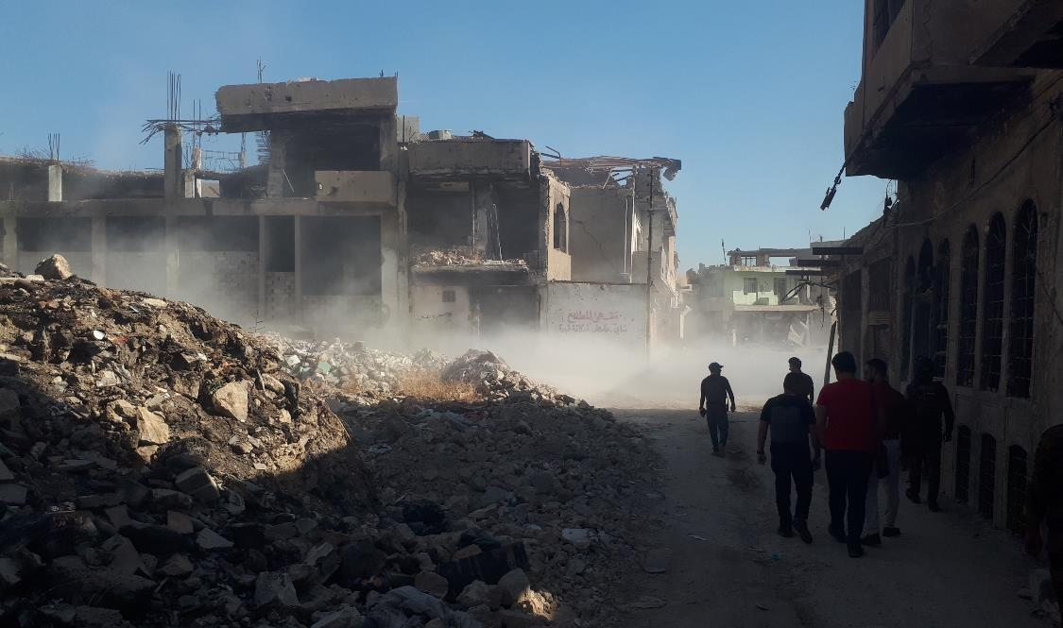
Information Management
2019 HRP: Overview on the Cluster response / PMR & Traffic light
17 projects submitted by 16 partners
Requirement: USD 74,354,054
11 projects funded (partially or fully)
Funding status: USD 46,509,537 (63% of requirement)
Unmet: USD 27,844,517

Slide 15
AOB

