Slide 1
CCCM update
Needs:
At least 129,754 people are sheltering in 129 sites across Manica (20); Sofala (101); Tete (5) and Zambezia (3); as of 4 April, according to INGC.
In Sofala, DTM operations started to assess sites in Dondo (6 sites assessed so far) and sites in Beira previously not covered in previous round. Displacement Tracking Matrix (DTM) identified nearly 19,000 displaced people in sites in Beira, who need assistance. Coverage of Sofala is expected to be completed by 7th April, excluding areas accessible from South. In Manica, a DTM and INGC team visited Chimoio yesterday, identification of locations for assessments to be completed by 10th April. Preparation ongoing for Zambezia and Tete.
Expansion of CCCM support to sites covered by DTM and INGC.
Women reportedly make up at least half of the population in the sites, and they are at heightened risk of gender-based violence due to the overcrowding in the sites and the fact that families are sleeping in open spaces with no separation.
Residents of EPC Chota site in Beira, were under pressure to relocate yesterday due pressure in the community. There is a need to balance approaches in assisting IDPs and host communities, currently all experiencing important difficulties.
Cluster has identified needs related to site planning, site improvement, identification of sites, organizing temporary management, pre-departure support when moving to different site, support to mapping and tracking distributions in sites, joint work with DTM, Health and WASH for cholera prevention, joint work with Education, Protection and national authorities to plan movements from school locations, establishment of alternative sites.
WASH problems reported in sites, especially in terms of sanitation and toilets. Situation in Picoco 1 singled out as particularly bad.

Slide 2
Response: (Please add any update on activities for today)
As of 4 April, DTM identified 26 sites still open in Beira, including two newly established sites, with an estimated 3,300 people in the new sites.
DTM assessments initiated in Dondo and expanding to other parts of Sofala. Preparatory discussions in Manica took place yesterday. Expansion to Zambezia and Tete in preparation.
Specific discussion with IDPs originally from Buzi took place at one of the Beira sites, to identify concerns and intentions.
CCCM teams increasing established presence, including in Picoco 1 (Beira). Picoco 1 reports issues related to proximity to road, and adjustments to ensure safety.
WASH works ongoing in Sao Pedro Claver to install WASH facilities. Technical problems with equipment delayed the initial plan. IFP Inhamizua also having WASH improvements.
ESF is expected to establish electricity supply two sites between today and tomorrow.
Discussion with Ministry of Education solved problems that could have been difficult, for IDPs.

Slide 3
Gaps & Constraints:
WASH facilities dire and need urgent action in Picoco 1.
Parallel identification of resources for DTM and follow up with CCCM support, to newly identified locations.
Heavy workload with direct support to sites, including on site planning and other operational aspects related to mobility and support in distributions.
CCCM support to cholera referrals, problems with accommodation sites in education facilities and consolidation of sites

Slide 4
02. Shelter Cluster Targets
Ryan Smith
Roving Cluster Coordinator (Duhok) - Zone 2 Focal Point
Catholic Relief Services
+964 (0) 751 755 8451
coordroving.iraq@sheltercluster.org
80,000 HH is current target (about 2/3 of need) 112,000 HH currently affected, according to information from the field Owner driven reconstruction and recovery through essential kits, assets and technical assistance Cash will be a big help, but this is a longer term issue that is being addressed/discussed
http://sheltercluster.org/response/mozambique-tropical-cyclone-idai-2019

Slide 5
04. Shelter Kit l Non Food Items (NFI) Priority Needs
Ryan Smith
Roving Cluster Coordinator (Duhok) - Zone 2 Focal Point
Catholic Relief Services
+964 (0) 751 755 8451
coordroving.iraq@sheltercluster.org
Shelter Kit = 2 Tarpaulins + Shelter Tool Kit IFRC – EMERGENCY SHELTER KIT - TOOLS AND MATERIALS (APPROVED BY INGC) What Can I do with a shelter kit?
http://sheltercluster.org/response/mozambique-tropical-cyclone-idai-2019

Slide 6
Why distribute Shelter Kits?
Ryan Smith
Roving Cluster Coordinator (Duhok) - Zone 2 Focal Point
Catholic Relief Services
+964 (0) 751 755 8451
coordroving.iraq@sheltercluster.org
http://sheltercluster.org/response/mozambique-tropical-cyclone-idai-2019

Slide 7
Why distribute Shelter Kits?
Ryan Smith
Roving Cluster Coordinator (Duhok) - Zone 2 Focal Point
Catholic Relief Services
+964 (0) 751 755 8451
coordroving.iraq@sheltercluster.org
1 Shelter Kit = 60 CHF = 60 USD = 3,800 MZN + Shipment IFRC Shelter Kit Guidelines
http://sheltercluster.org/response/mozambique-tropical-cyclone-idai-2019

Slide 8
Shelter Kit = 2 Tarpaulins + 1 Shelter Tool Kit
Ryan Smith
Roving Cluster Coordinator (Duhok) - Zone 2 Focal Point
Catholic Relief Services
+964 (0) 751 755 8451
coordroving.iraq@sheltercluster.org
http://sheltercluster.org/response/mozambique-tropical-cyclone-idai-2019

Slide 9
What is the content of 1 Shelter Tool Kit?
Ryan Smith
Roving Cluster Coordinator (Duhok) - Zone 2 Focal Point
Catholic Relief Services
+964 (0) 751 755 8451
coordroving.iraq@sheltercluster.org
http://sheltercluster.org/response/mozambique-tropical-cyclone-idai-2019

Slide 10
Ryan Smith
Roving Cluster Coordinator (Duhok) - Zone 2 Focal Point
Catholic Relief Services
+964 (0) 751 755 8451
coordroving.iraq@sheltercluster.org
http://sheltercluster.org/response/mozambique-tropical-cyclone-idai-2019

Slide 11
Ryan Smith
Roving Cluster Coordinator (Duhok) - Zone 2 Focal Point
Catholic Relief Services
+964 (0) 751 755 8451
coordroving.iraq@sheltercluster.org
http://sheltercluster.org/response/mozambique-tropical-cyclone-idai-2019

Slide 12
Ryan Smith
Roving Cluster Coordinator (Duhok) - Zone 2 Focal Point
Catholic Relief Services
+964 (0) 751 755 8451
coordroving.iraq@sheltercluster.org
http://sheltercluster.org/response/mozambique-tropical-cyclone-idai-2019

Slide 13
Ryan Smith
Roving Cluster Coordinator (Duhok) - Zone 2 Focal Point
Catholic Relief Services
+964 (0) 751 755 8451
coordroving.iraq@sheltercluster.org
http://sheltercluster.org/response/mozambique-tropical-cyclone-idai-2019

Slide 14
04. Shelter Kit l Non Food Items (NFI) Priority Needs
Ryan Smith
Roving Cluster Coordinator (Duhok) - Zone 2 Focal Point
Catholic Relief Services
+964 (0) 751 755 8451
coordroving.iraq@sheltercluster.org
In line with identified needs and available stocks in Beira, we are proposing a rolling priority pipeline for emergency shelter assistance, in the following order: Shelter Tool Kits Kitchen Sets Family Kits (blankets, matts, jerry cans, etc.) Other items (solar kits, etc) to be targeted
http://sheltercluster.org/response/mozambique-tropical-cyclone-idai-2019

Slide 15
05. Training tools and DRR
Ryan Smith
Roving Cluster Coordinator (Duhok) - Zone 2 Focal Point
Catholic Relief Services
+964 (0) 751 755 8451
coordroving.iraq@sheltercluster.org
In line with identified needs and available stocks in Beira, we are proposing a rolling priority pipeline for emergency shelter assistance, in the following order: Sharing tools that exist with National Institutions l GoM Sharing tools on established good practice l Shelter Cluster Rolling out awareness and open training (e.g. How to use the Shelter kit, Tarpaulin reuse and fixing, Building Back Safer techniques, PSEA) Providing ad hoc guidance on pressing or arising issues (e.g. House, Land and Property rights, Inclusion of persons with disabilities, Distributions and GBV, Site planning and GBV, Community and settlement approaches, Environmental impact in emergencies – Cyclone Idai, Asbestos in emergencies)
http://sheltercluster.org/response/mozambique-tropical-cyclone-idai-2019

Slide 16
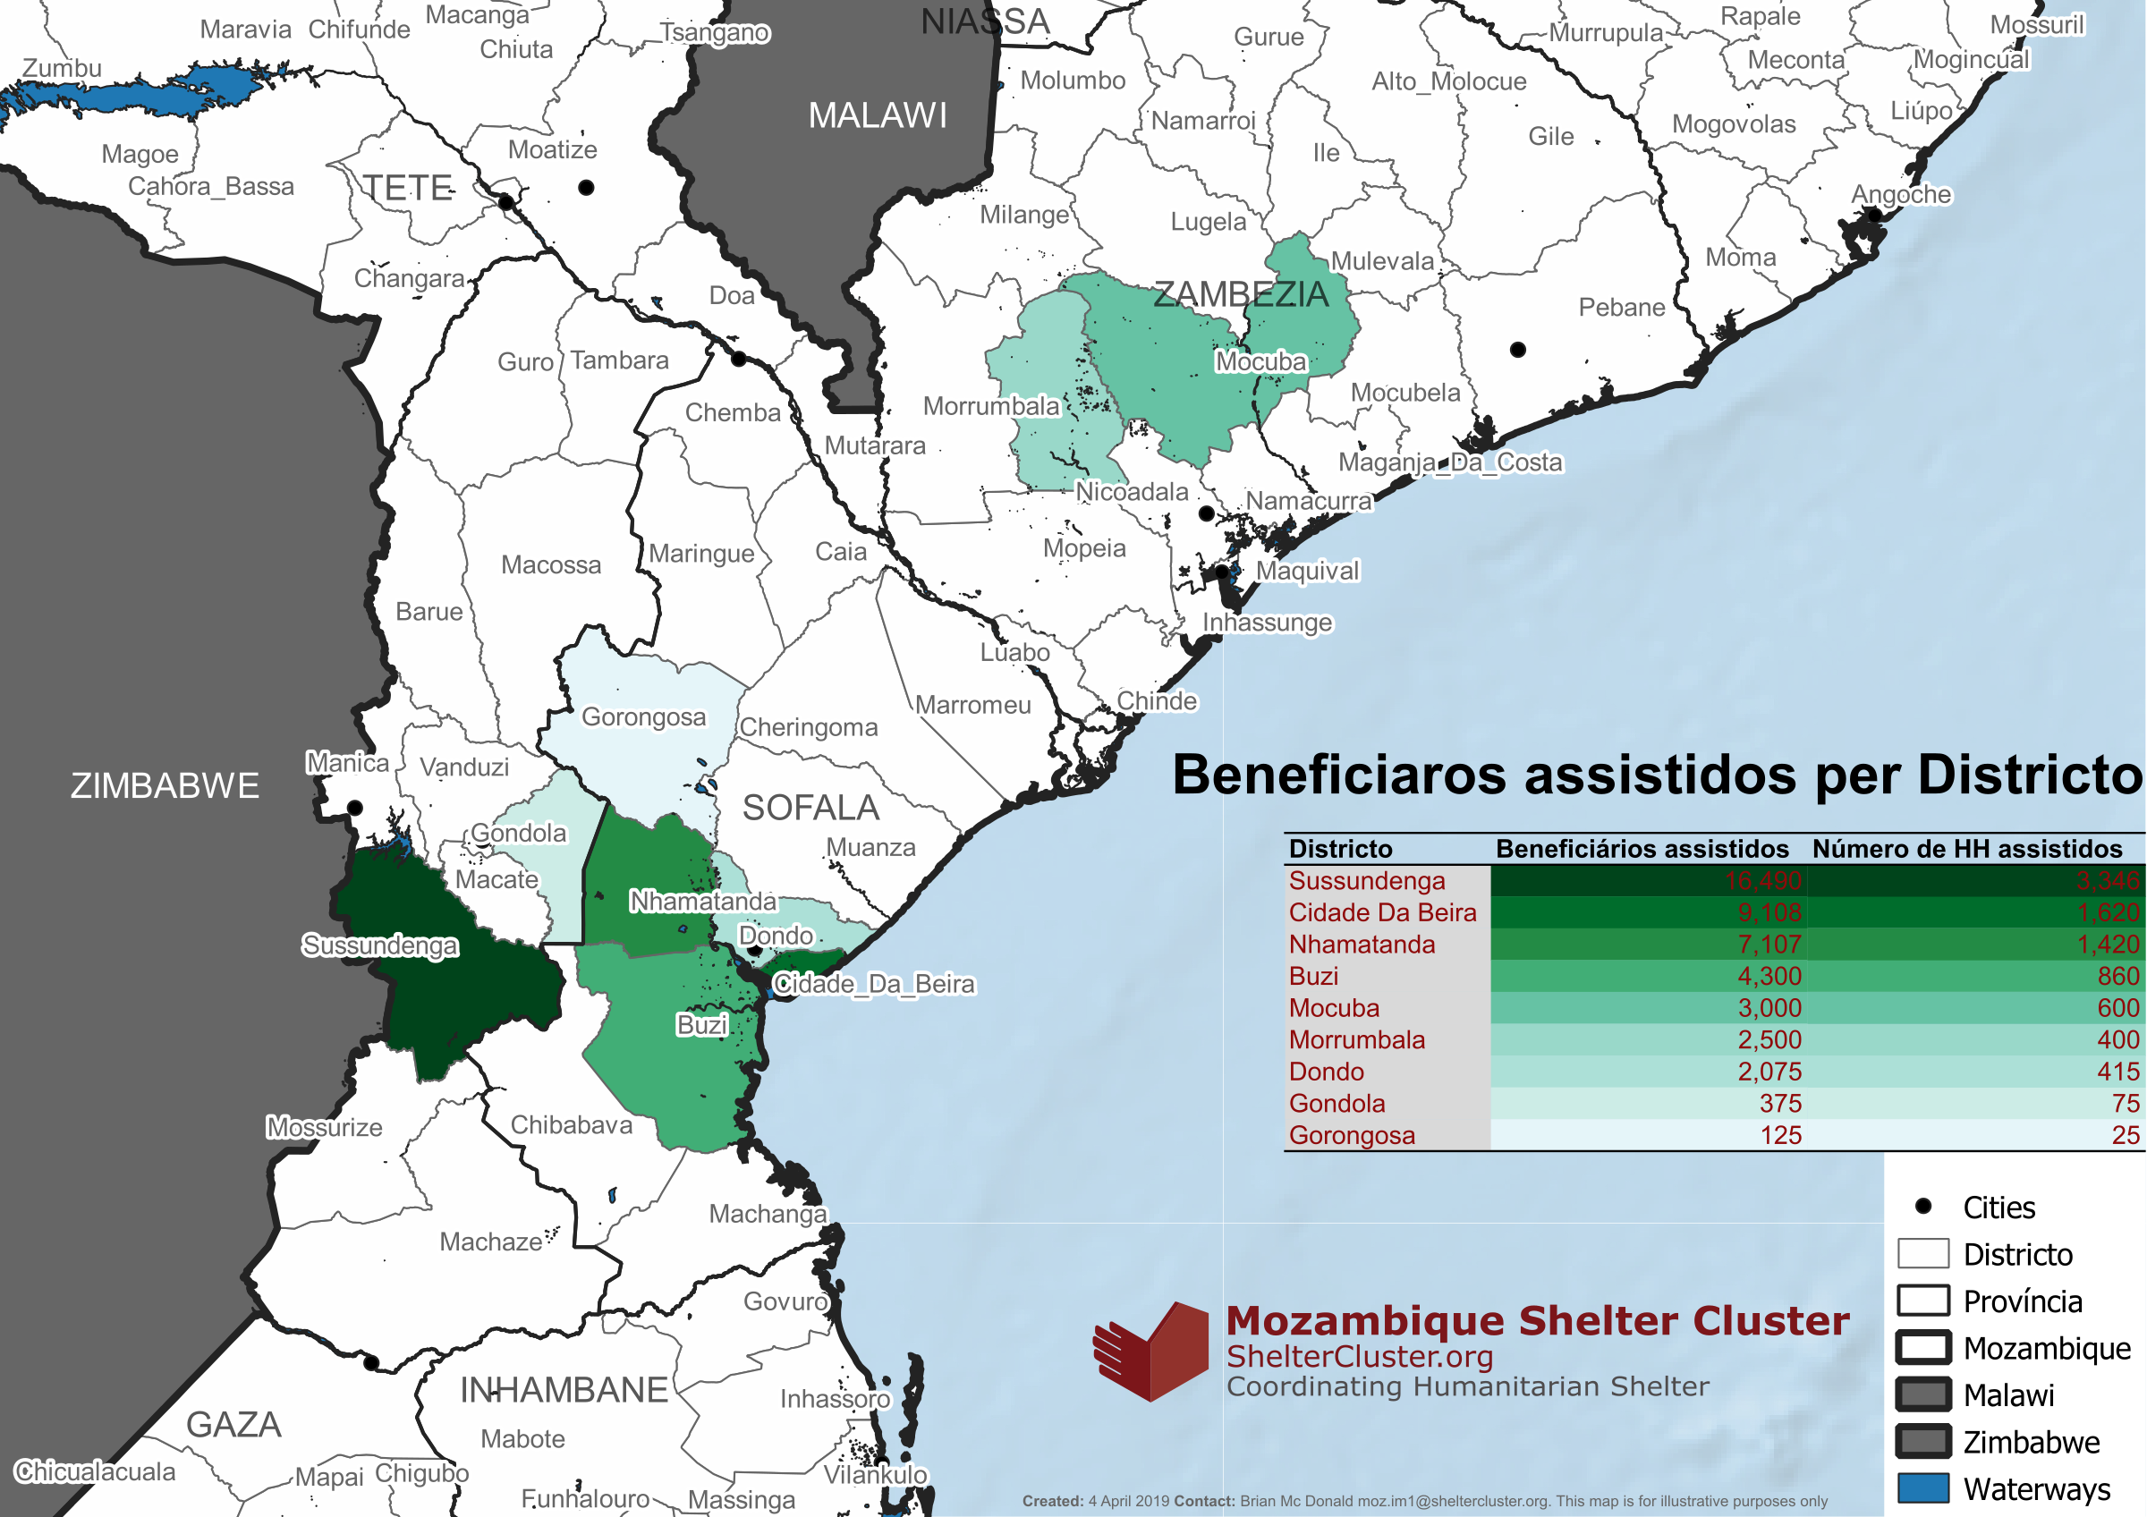

Slide 17
