Slide 1
GSC meeting 2019
Geneva 9 - 10 October

Slide 2
Progress since last meeting
Implementing Strategy 2018-2022

Slide 3
Since our last meeting…
4 new clusters activated in: NW/SW Cameroon, Mozambique, Zimbabwe, Venezuela
New crises in Indonesia and Burkina Faso
3 system-wide L3 emergencies/Scale-up:
Syria
Yemen
Mozambique

Slide 4
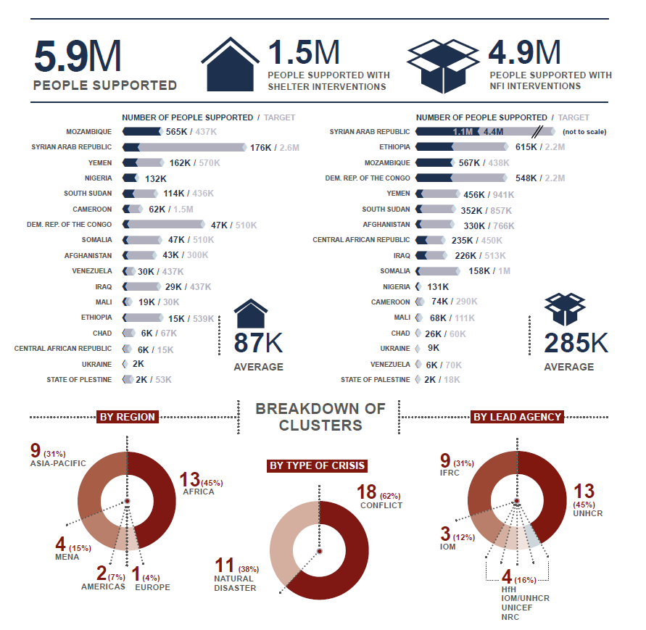
mid-year 2019

Slide 5






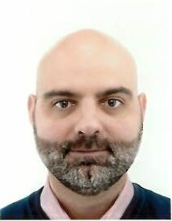









GSC support team
Global Cluster Coordinators
Deputy Coordinators
Information Management
Ela Serardoglu
Natural Disasters IFRC
Brett Moore
Conflict UNHCR
Miguel Urquia
Conflict UNHCR
Hannoa Guillaume
IMO UNHCR
Pablo Medina
Natural Disasters IFRC
Neil Bauman
GFP IFRC/CanRC
Global Focal Points for Coordination
Sr Roving Tech Coord
Coordination Officer
Angel Pascual
GFP UNHCR
Tom Bamforth
GFP IFRC
Renee Wynveen
GFP UNHCR
Cecilia Braedt
IFRC/Lux RC
Shirin Narymbaeva
Coordination Officer IFRC
Regional Focal Points
GFP - HLP
Roving Coordinator and Roving IMO
Robbie Dobs
Pacific
IFRC
Federica Lisa
Asia Pacific
IFRC
Ibere Lopes
IOM / NRC
Vacant
UNHCR/ IMPACT
Vacant
UNHCR/ IMPACT
Lilia Blades
Americas
Canadian Red Cross
Notes:
More on what this team does can be found here:
http://sheltercluster.org/what_we_do
http://www.sheltercluster.org/global_support_team_activities

Slide 6
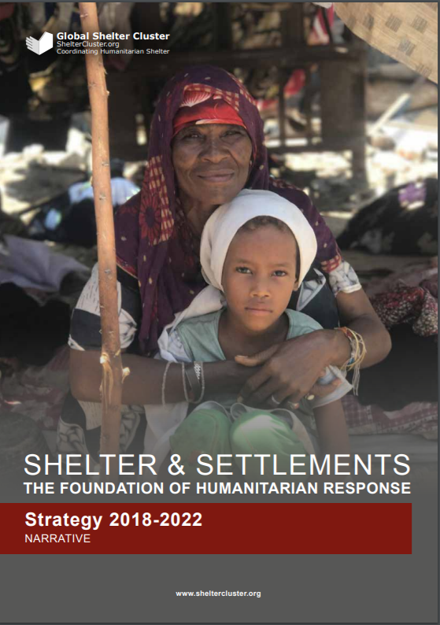
GSC Strategy 2018-2022
Progress 2018-2019

Slide 7
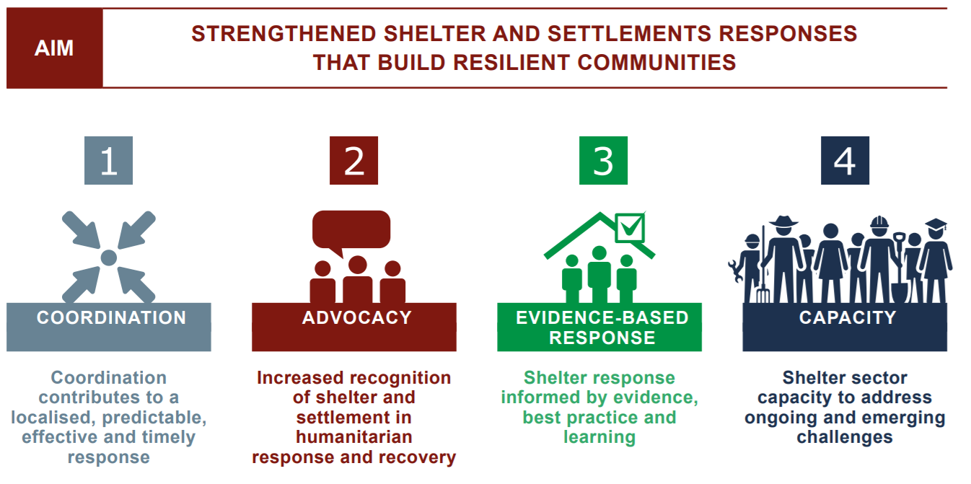


Slide 8
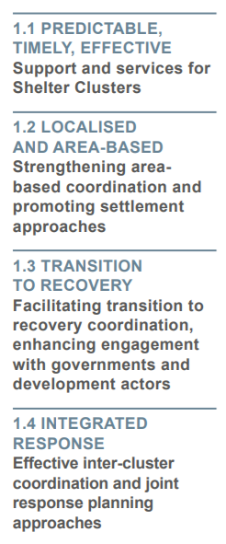
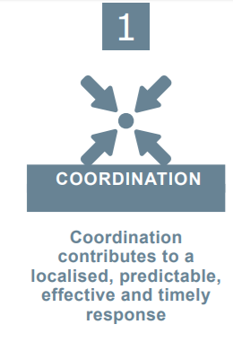
Strategic Aim 1
Coordination
Notes:
1. For next year, which one of these results is more of a priority under pillar 1 Coordination? (Choices: A. Predictable, Timely, and Effective support and services for country-level Shelter Clusters, B. Strengthening area-based coordination and promoting settlement approaches, C. Facilitating transition to recovery coordination, enhancing engagement with government and development actors, D. Effective inter-cluster coordination and joint response planning approaches)

Slide 9
Indicators
 | Baseline 2018 | Value 2019 | Target 2020
% of stakeholders satisfied with the performance of the Shelter Cluster | 90% | 86% | 90%
Average time in which a trained and experienced coordinator is deployed to newly activated country-level clusters | <72 hr | <72 hr | <72 hr
% of country-level clusters that undertake a cluster performance review with partners and implement the action plan recommendations at least once per year | 15% | 44% | 60%

Slide 10
Areas to advance
Notes:
James to talk about Area-Based

Slide 11
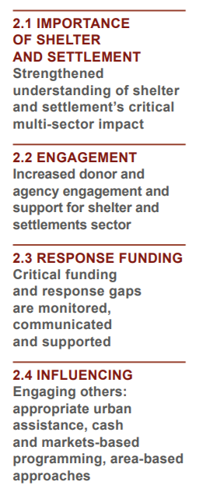

Strategic Aim 2
Advocacy

Slide 12
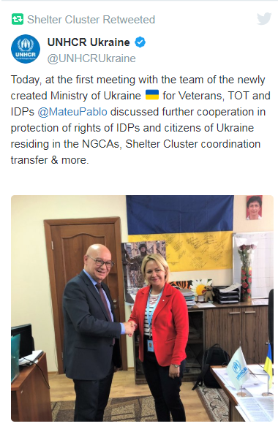
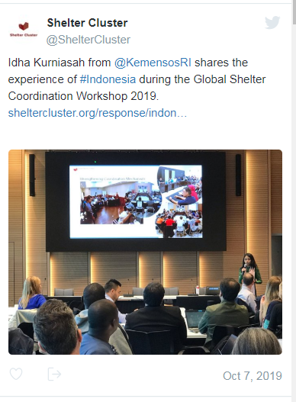
Key advocacy activities
Cash Advocacy
Internal advocacy within agencies: event on standards at UNHCR-NGO Consultation
Advocacy with Governments.
Diaspora Working Group
Notes:
Leeanne to talk about advocacy on disability

Slide 13
Indicators
 | Baseline 2018 | Value 2019 | Target 2020
% of the total humanitarian funding received that is allocated to the Shelter Sector, disaggregated by region and crisis type | 3.7% | 1.5% | 4.7%
# of advocacy statements/positions established and regularly updated | 2 | 3 | 5
% of people assisted vs people targetted, disaggregated by region and crisis type | 57% | 33% | 65%

Slide 14
Areas to advance

Slide 15
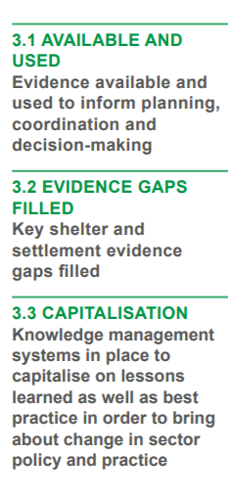

Strategic Aim 3
Evidence-based response

Slide 16
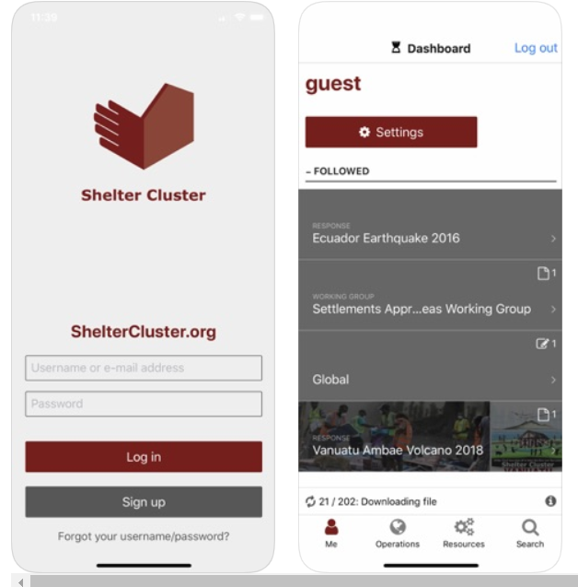
Progress so far
Assessment in Venezuela
Shelter Vulnerability Classification WG
New GSC App
Shelter Project workshops
Long-term research
Academic Practitioner forum
Notes:
Hilmi to speak about link with Universities.
Neil about the app

Slide 17
Indicators
 | Baseline 2018 | Value 2019 | Target 2020
% of cluster partners reporting that response strategies are “appropriate” based upon the existing evidence | 62.5% | 68% | 68%
Summary of shelter lessons learned is regularly collected and disseminated | 1 | 1 | 3
% of shelter cluster coordinators and partners reporting that they have access and use evidence, learning and best practice | >90% | 93% | >90%

Slide 18
Areas to advance

Slide 19
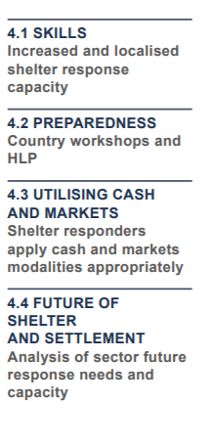
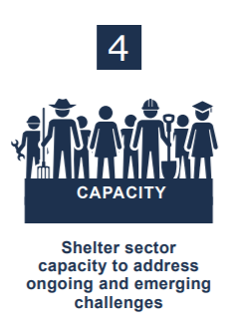
Strategic Aim 4
Capacity
Notes:
Ibere to share some of his work. Seki to talk about Cash Champions

Slide 20
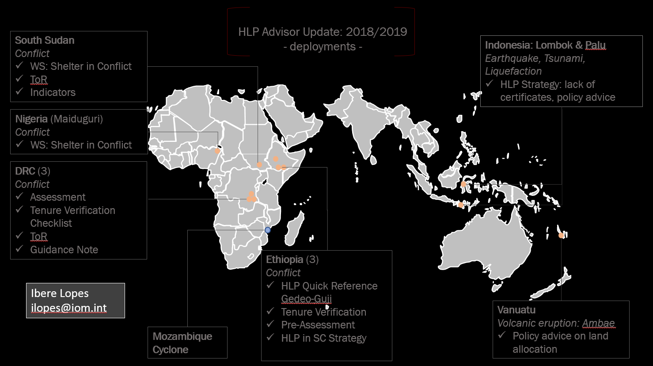
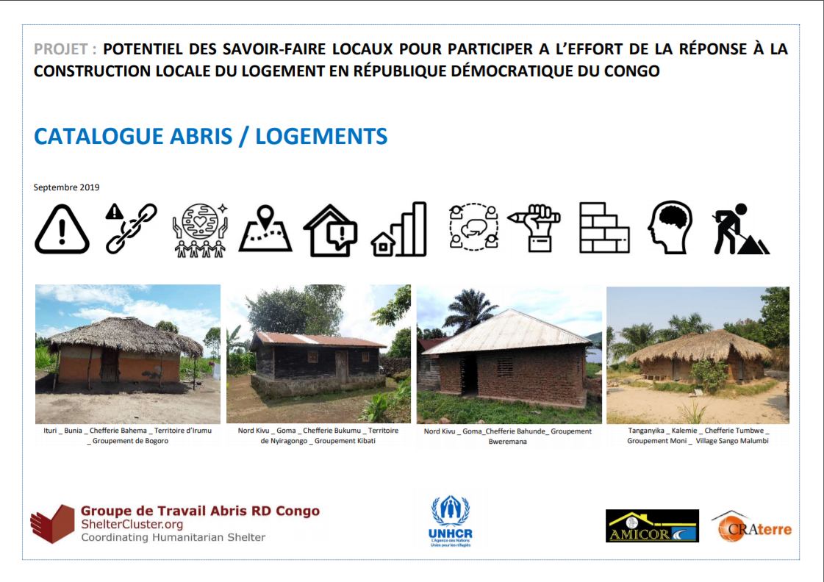
Progress so far
HLP Advisor
Cash Champions: Moz
CashCap deployment
Country preparedness workshops: coming up
Local building practices country profiles: DRC
Notes:
Ibere to share some of his work. Seki to talk about Cash Champions, Olivier about Country proflies

Slide 21
Indicators
 | Baseline 2018 | Value 2019 | Target 2020
% of cluster coordination team members who feel prepared/have access to tools to address ongoing and emerging challenges | 57.5% | 56% | 70%
# of people trained in key cluster coordination roles during the reporting period | 43 | 45 | 60
# of people trained in coordination trainings who are deployed in deputy/ junior coordination roles to country-level clusters during the reporting period | 0 | 3 | 5
Notes:
Question: Please rank the results of this pillar in order putting first the one that needs more attention in your opinion: Predictable, timely and effective coordination services for shelter clusters, strengthened area-based coordination and promoting settlement approaches, facilitating transition to recovery, enhancing engagment with government and development actors, effective inter-cluster coordination and joint response planning approaches.

Slide 22
Areas to advance
Notes:
Question: Please rank the results of this pillar in order putting first the one that needs more attention in your opinion: Increased and localised shelter response capacity, country workshops and HLP, Shelter responders apply cash and markets modalities appropriately, analysis of the sector future response needs and capacity.

Slide 23


Good Shelter Programming
Disability WG
Statement on single use plastic
Environmental assessments and CoP
Notes:
Ask Kelly on Environmen CoP on their progress

Slide 24
Thank you!
More info:
www.sheltercluster.org
Twitter: @sheltercluster

