Slide 1




Michel Tia - IOM
Sub National Cluster Coordinator for Centre and South
+964 (0) 782 294 9258
coord4.iraq@sheltercluster.org
Centre and south Shelter Cluster Hub Coordination Structure
Nicoletta Roccabianca - PUI
Deputy Area Coordinator – Centre and South
Shelter Cluster Focal Point for Anbar Governorate
+964 (0) 783 306 1031
ira.csi.deputy-areacoo-prog@pu-ami.org
Lottie McCarthy - DRC
Shelter and Infrastructure Programme Manager – Tikrit
Shelter Cluster Focal Point for Salah ad-Din Governorate
+ 964 (0) 772 997 2314
lottie.mccarthy@drc.ngo
Layth Al-Azzawi - UNHCR
Snr. Field Associate – CCCM & Shelter-NFI - Centre and South
Shelter Cluster Focal Point for Diyala Governorate
+964 (0) 780 195 3136
alazzawi@unhcr.org

Slide 2
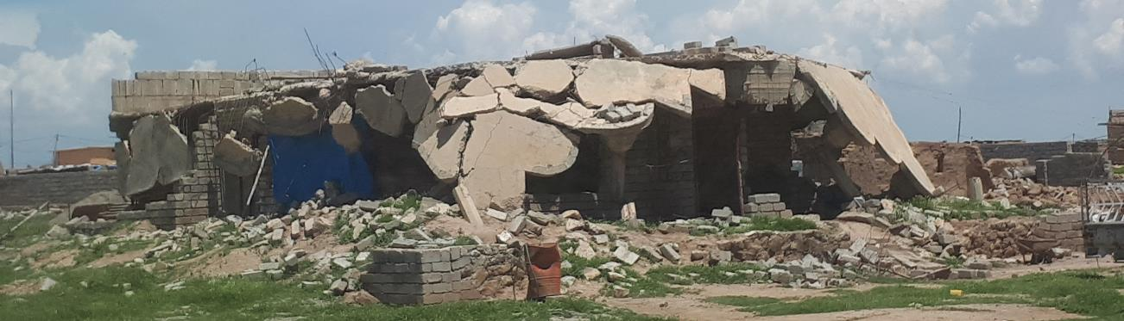
Iraq humanitarian response
Centre and south Shelter Cluster Hub Coordination meeting
Baghdad
February 5th, 2020

Slide 3
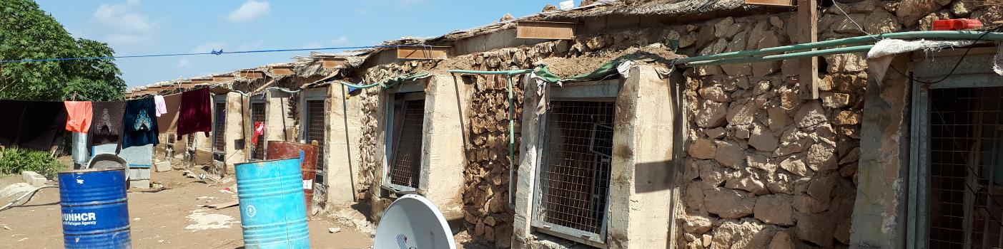
AGENDA
Review of action points from minutes of previous meeting;
Key issues
  2020 Activity Plan;
  Housing Rehabilitation interventions (ongoing/planned);
  Update on the ongoing winter response;
  Tents replacement;
Information Management
  2019 HRP / Non-HRP achievements – as of 31 December 2019;
  2020 ActivityInfo training plan;
AOB
Inhabited chicken farm in Falluja, 2/2018

Slide 4
Review of action points from minutes of previous meeting
# | Action Points | Focal Point | Status / Deadline
1 | Housing rehabilitation: Shelter Cluster Team (SAD Focal Point & C&S Coordinator) to follow up with partners (OXFAM, NRC, MEDAIR, DRC & Mercy Corps) to update their WDS data on the platform: https://www.sheltercluster.org/iraq/iraq-war-damaged-shelter-rehabilitation-interactive-dashboard; | Cluster partners C&S Hub Coordinator | Ongoing process
2 | Housing rehabilitation: Shelter Cluster to prepare and share 2019 WDS achievements. | Cluster IM Unit | ASAP
3 | Pending action point: The Cluster partners will be sharing key challenges they have been facing in their housing rehabilitation programme, solutions and/or recommendations on way forward. | Cluster partners | Ongoing process
4 | Winter response: find alternative areas for IOM to distribute available 930 winter kits; liaise with UNHCR/ZOA to cover identified new areas in BzBz; coordinate with DRC any potential winter distributions in Baiji to avoid overlapping; | Cluster partners C&S Hub Coordinator | Completed
5 | CCCM & Shelter Cluster to jointly prepare the 2020 meeting plan and share with partners. | CCCM & Shelter Cluster Coordinators | Completed

Slide 5
Key issues and Partner’s updates
  2020 Activity Plan
IOM – Shelter plan
Project | Donor | Target | Status | Locations | # houses
Rehabilitation (Cat2 houses) Cash modality | OFDA | 1,700 Shelter units including 1,050 Shelter units in Centre & South | Project just started Assessment phase Using SEVAT | Anbar - Heet | 250
 |  |  |  | Anbar - Karma | 350
 |  |  |  | Salah al-Din | 150
 |  |  |  | Diyala | 300
Rehabilitation (Cat2 houses) |  | 150 Shelter units | Expecting SEVAT result from PUI | Anbar – Kaim (Al-Rummanah) | 150
Critical Shelter | ECHO | 300 Shelter unit | Planned | TBC
Critical Shelter | GERMAN | 300 Shelter unit | Planned | TBC

Slide 6
Key issues and Partner’s updates
  2020 Activity Plan
Planned Activities | Target | Modality | Targeted Location | Details
Full Basic NFI Kits | 450 | In-kind | Salah Al-Din , Shirqat center | Targeting both camps and out of camps.
 | 750 | In-kind | Anbar, Al-Qaim, Habaniyah Tourist City
 | 300 | In-kind | Ninawa , Mosul, Hamam Aleel
 | 500 | In-kind | Ninawa, Shora, Makhmor
Full Basic NFI Kits | 800 | Voucher | Baghdad | Target, Abu Ghraib, Yousfiya and Al-Taji
 | 1,100 | Voucher | Diyala | Target: Baquba, Al-Khalis, Muqdadiya and Khanaqin
 | 1,100 | Voucher | Salah Al-Din | Target: Samara, Balad and Al-Dour
 | 200 | Voucher | Anbar | Target: Falluja
 | 250 | Voucher | Kirkuk | Target: Daquq
 | 550 | Voucher | Ninawa | Target: Talafar and Tilkaif
Partial NFI Kits (for replacement) | 1,650 | Voucher | Anbar | Target: Fallujah, Heet & Ramadi
 | 2,650 | Voucher | Salah Al-Din | Target: Tikrit, Samara, Tooz, Balad, Baiji & Al-Dour
 | 500 | Voucher | Baghdad | Target: Abu Ghraib & Latifiya
 | 500 | Voucher | Diyala, Al-Khalis | Target: Al-Khalis & Muqdadiya
 | 1,750 | Voucher | Kirkuk | Target: Hawija, Center & Daquq
 | 4,950 | Voucher | Ninawa | Target: Akre, Sheikan, Mosul, Tilkaif, Sinjar & Talafar
 | 18,000
 | 8,300 | Kits for Kirkuk and Ninewa
 | 9,700 | Kits for Centre & South
IOM – NFI plan
Funded by OFDA
Distribution will be starting after completion of SEVAT

Slide 7
Key issues and Partner’s updates
  2020 Activity Plan
UNDP – Fund to be confirmed
1,500 Shelter units (Cat 1&2) in Falluja & in Ramadi (in four neighborhoods)
500 Shelter units (Cat 1&2) in Baiji in Salah al-Din
Demining & Reconstruction of the apartments complex in Ramadi
UNHCR – to be confirmed
NFI replacement in all managed Camps
770 RHU (Cat4 damaged houses)
770 Shelter units (Cat2)
Potential location: Anbar, Baghdad, Diyala, Salah al-Din
CRS – confirmed
150 Shelter units (Cat2)
Potential location: Falluja/Anbar - Jubail neighborhood (except in sector 212) & Hay Al Wilda neighborhood and Hay Al Shuhadaa including the new distribution area

Slide 8
Key issues and Partner’s updates
  Housing Rehabilitation interventions (ongoing/planned) – for only Centre & South – without Ninewa & Kirkuk
UNPD - Completed / on hold - 2019 Shelter rehabilitation projects
Governorate | Location | 2019 - Project (Case) Name | # of units | Status
Anbar | Haditha | Rehabilitation Housing Works of 214 Units in Haqlaniya in two villages (Khasfa and Zawia) Villages in Haditha | 214 | Completed
Anbar | Haditha | Rehabilitation Housing Works of 187 Units in Barwanah District (Al-Sumood) | 187 | Completed
Anbar | Haditha | Rehabilitation of Housing Works of 136 Units in Haqlaniya (Al-BoHayat) Village in Haditha | 136 | Completed
Anbar | Haditha | Rehabilitation Housing Works of 137 Units in Barwanah District (Al-Ata'a) in Haditha | 137 | Completed
Anbar | Qaim | Rehabilitation of Housing works for 137 Units in Hay Sikak in Qaim City-Lot 1 | 137 | Completed
Anbar | Qaim | Rehabilitation of 342 houses units in Hay 12 Rabee Awalin Qaim lot-2 | 342 | Completed
Anbar | Anah | Rehabilitation of 241 houses units in Sagrah village in Anah District | 241 | Completed
Anbar | Anah | Rehabilitation of 186 housing units in Hasa village in Anah city | 186 | Completed
Anbar | Anah | Rehabilitation of 92 houses units in Obour Neighborhood in Anah | 92 | Completed
 |  |  | 1,672
Governorate | Location | 2019 - Project (Case) Name | # of units | Status
Anbar | Anah | rehabilitation 350 houses in Rehanna | 350 | On hold
Anbar | Rawa | Rehabilitation of 600 houses units in Rawa (Two lots) | 600 | On hold
 |  |  | 950

Slide 9
Key issues and Partner’s updates
  Housing Rehabilitation interventions (ongoing/planned) – for only Centre & South – without Ninewa & Kirkuk
UNPD - Ongoing 2019 Shelter rehabilitation projects
Governorate | Location | 2019 - Project (Case) Name | # of units | Status
Anbar | Qaim | Rehabilitation of 321 houses units in Hay Risala in Qaim (lots-3) | 321 | Ongoing
Salah al-Din | Baiji | Rehabilitation of 174 housing units in Baiji Askary1 Neighborhood | 374 | Ongoing
Salah al-Din | Baiji | Rehabilitation of 364 housing units in Baiji Risala neighborhood | 500 | Ongoing
 |  |  | 1,195
Governorate | Location | 2019 - Project (Case) Name | # of units | Status
Anbar | Karma | rehabilitation 303 houses in Khairat (Shortan Village). | 241 | Procurement
Salah al-Din | Baiji | Rehabilitation of 426 housing units in Baiji Tal Alza’atar Neighborhood | 426 | Procurement
 |  |  | 667
PUI - Ongoing 2019 Shelter rehabilitation project
108 Shelter units (Cat2)
Location: Al-Rummanah sub district in AL-Kaim district / Anbar
SEVAT has been completed
Contractor has been selected
Technical assessment will be starting around the second week of February 2020

Slide 10
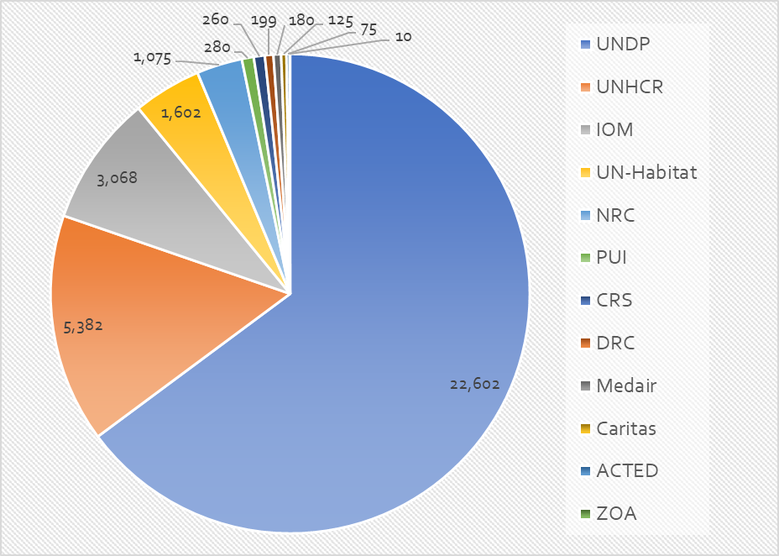
Key issues and Partner’s updates
  Housing Rehabilitation interventions (ongoing/planned) – for only Centre & South – without Ninewa & Kirkuk
Details on locations & Partners
Country wide / Target In Centre & South
70,734 houses 34,858 houses (49% )

Slide 11
Key issues and Partner’s updates
  Update on the ongoing winter response
Have we reached all vulnerable people in camps (formal or informal) with our winter response ?
Governorate | District | Formal Camps | # HHs | Status
Anbar | Fallujah | AAF (21 Camps) | 882 | In-kind distribution
Anbar | Ramadi | HTC (5 Camps) | 589 | In-kind distribution
Baghdad | Al-Mahmoudiya | Latifiya 1 & 2 | 49 | Cash for winter ($200)
Baghdad | Al-Mada’in Al-Kadhmiyah Al-Risafa | Al-Nabi Younis Al-Ahel Zayona | 63 94 105 | Need Cash for winter ($200) Need
Diyala | Khanaqin | Al-Wand 1 Al-Wand 2 Qoratu | 601 199 200 | Cash for winter ($200) Cash for winter ($200) Cash for winter ($200)
Diyala | Baquba | Muskar Saad | 118 | Need
Kerbela | Al-Hinidya | Al-Kawthar | 104 | Need
Salah Al-Din | Tikrit | Al Karama | 202 | In-kind distribution
What about the informal Camps in Anbar, Baghdad, Missan & Qadissiya ?
Have we covered them ?

Slide 12
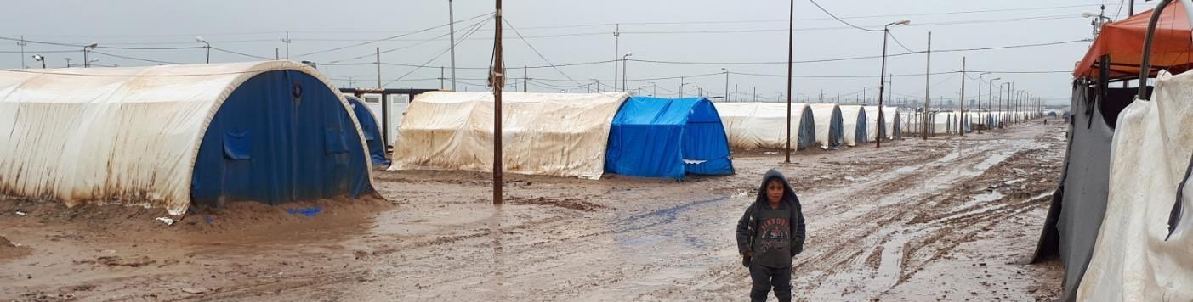
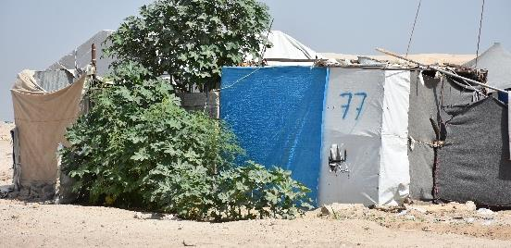
Key issues and Partner’s updates
  Tents replacement
Anbar
UNHCR - HTC 29 tents completed
Tahrir 1: 6 tents
Tahrir 2: 11 tents
Central tahrir: 12 tents
IOM - ongoing
AAF & BzBz: 150 IHF tents
Salah al-Din
UNHCR/IOM - completed
Al-Karama: 70 IHF tents
Baghdad
UNHCR - need
Latifiya 1 & 2: 40 tents are needed (MoMD type)
Diyala
UNHCR - need
Al-Wand 1 & 2: around 250 to 300 tents are needed
For Al-Wand 1 & 2 and Latifiya 1 & 2 camps, UNHCR through the CCCM Cluster is closely working with the local authorities on options and appropriate support to be provided.
Qayyarah-Jad'ah 5 camp, 4/2019
Makeshift shelter in Anbar, 2/2018

Slide 13
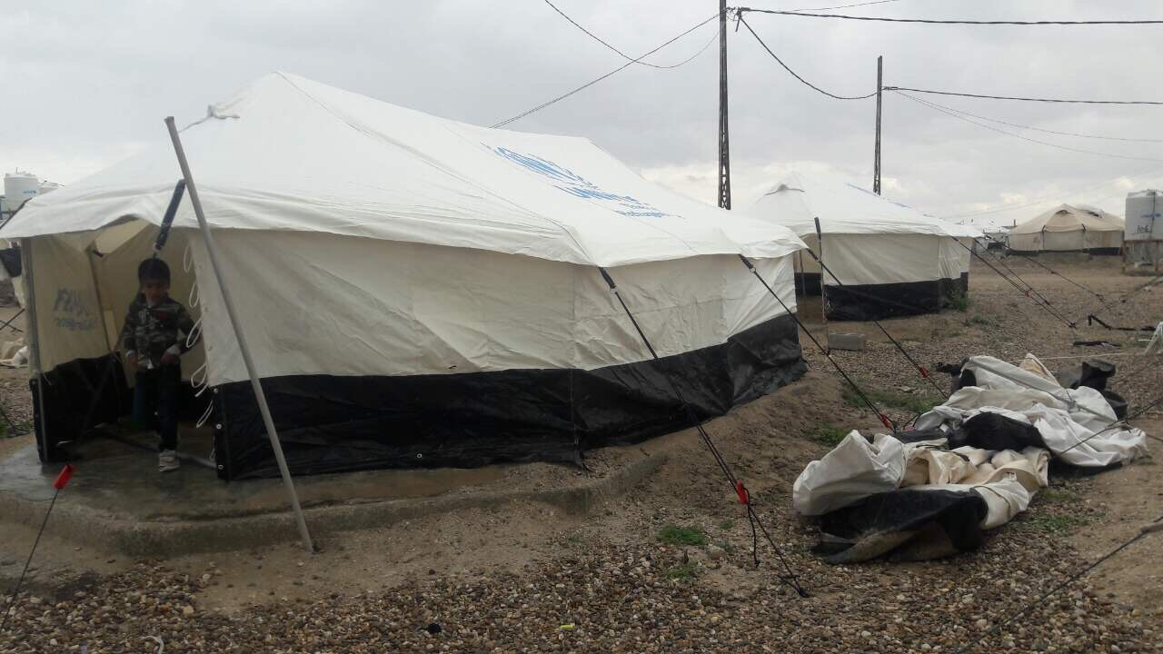
Information Management
  2019 HRP / Non-HRP achievements – as of 31 December 2019
Activity | 2019 target | HRP achievement |  | Non HRP achievement |  | Total HRP & non-HRP achievements
NFI | 513,900 | 347,278 | 68% | 114,799 | 22% | 462,077 | 90%
Shelter | 347,750 | 121,657 | 35% | 28,330 | 8% | 149,987 | 43%
Eprep | 20,000 | 0 | 0% | - | 0% | 0 | 0%
Total | 881,650 | 468,935 | 53% | 143,129 | 16% | 612,064 | 69%
29 Partners have reported their 2019 achievements in Activity info.
13 partners operating in KR-I
29 partners operating in Centre & South

Slide 14
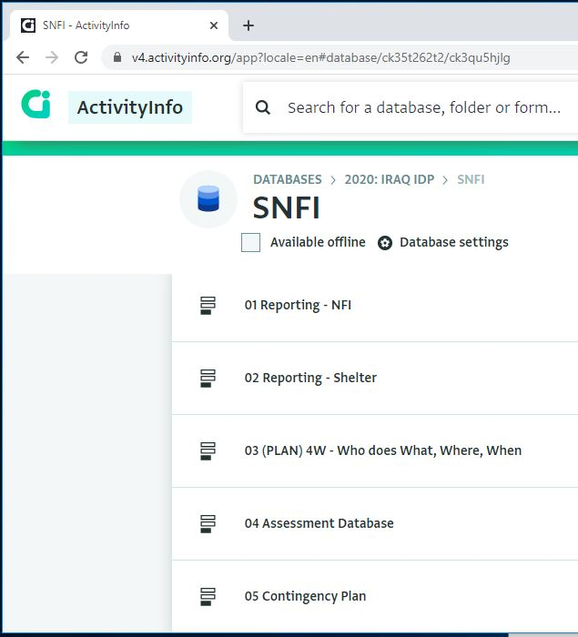
Information Management
  2020 ActivityInfo training plan
The training sessions will be delivered in English, with a capacity to clarify in Kurdish and/or Arabic
Dahuk (17th Feb. 20)
  Venue: UNHCR conference room
  Time: 09:30 am – 12:30 pm
Erbil ( 18th & 19th Feb. 20)
  Venue: NCCI meeting room
  Time: 02:00 pm – 05:00 pm
Baghdad (26th Feb. 20)
  Venue: UNHCR CSC office (Dawoodi area, Baghdad)
  Time: 10:30 am – 01:30 pm

Slide 15
AOB
Shelter & CCCM Clusters up coming events in Baghdad
February 26th, 2020
Baghdad (Activity Info Training Session)
  Venue: UNHCR CSC office (Dawoodi area, Baghdad)
  Time: 10:30 am – 01:30 pm
March 25th, 2020
Sub-national Cluster coordination meeting for Centre and South
Invitation will be sent out on due time.
April 22nd, 2020
Sub-national Cluster coordination meeting for Centre and South
Invitation will be sent out on due time.

