Slide 1



Michel Tia - IOM
Sub National Cluster Coordinator for Centre and South
+964 (0) 782 294 9258
coord4.iraq@sheltercluster.org
Centre and south Shelter Cluster Hub Coordination Structure
Osama Luay Seddiq - DRC
Shelter and Infrastructure Officer - Tikrit
Shelter Cluster Focal Point for Salah ad-Din Governorate
+964 (0) 773 489 1375
osama.seddiq@drc.ngo
Layth Al-Azzawi - UNHCR
Snr. Field Associate – CCCM & Shelter-NFI - Centre and South
Shelter Cluster Focal Point for Diyala Governorate
+964 (0) 780 195 3136
alazzawi@unhcr.org
Name - Agency - To be nominated
Function
Shelter Cluster Focal Point for Anbar
Contact details (phone & mail)

Slide 2
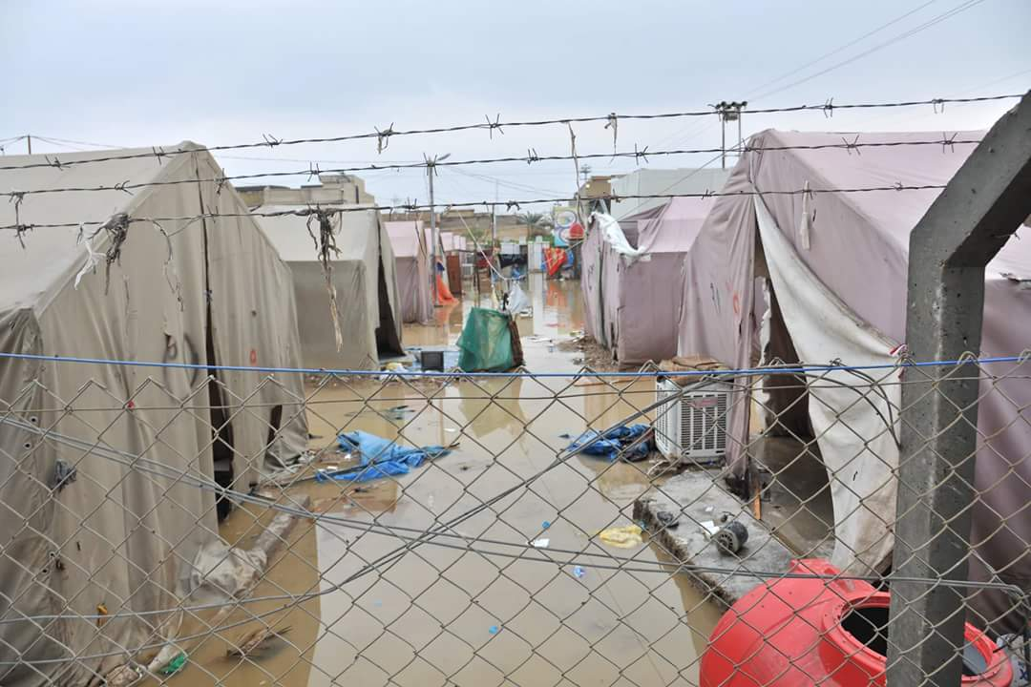
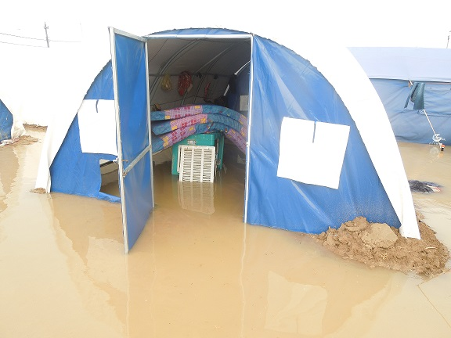
Centre and south Shelter Cluster Hub Coordination meeting
Baghdad
October 07th, 2020

Slide 3
AGENDA
Key issues
  Partners reporting status - from Activity Info and Iraq War Damaged Shelter Rehabilitation Database;
  Partners progress on ongoing/planned NFI responses in and out of Camps (related or not to COVID-19);
  Partners progress on Housing and Rehabilitation (planned and ongoing interventions);
  IHF projects - Critical Shelter repairs in Anbar &Salah al-Din Governorates and PDM;
AOB

Slide 4
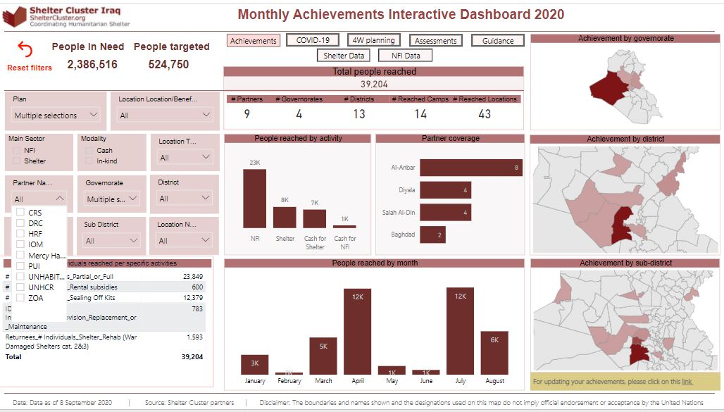
Key issues
  Partners reporting status - from Activity Info and Iraq War Damaged Shelter Rehabilitation Database

Slide 5
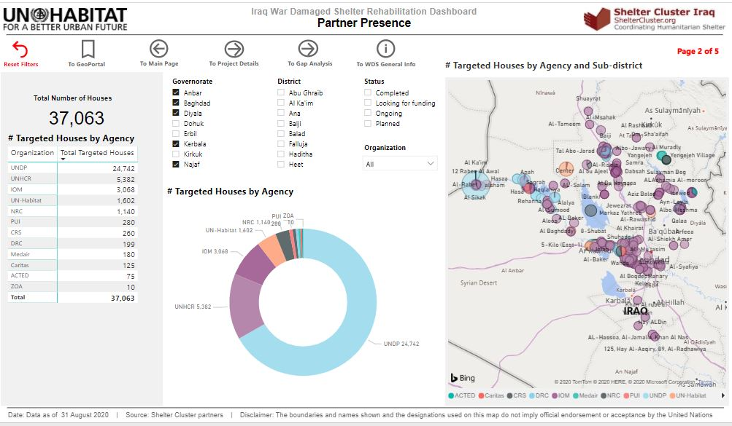
Key issues
  Partners reporting status - from Activity Info and Iraq War Damaged Shelter Rehabilitation Database

Slide 6
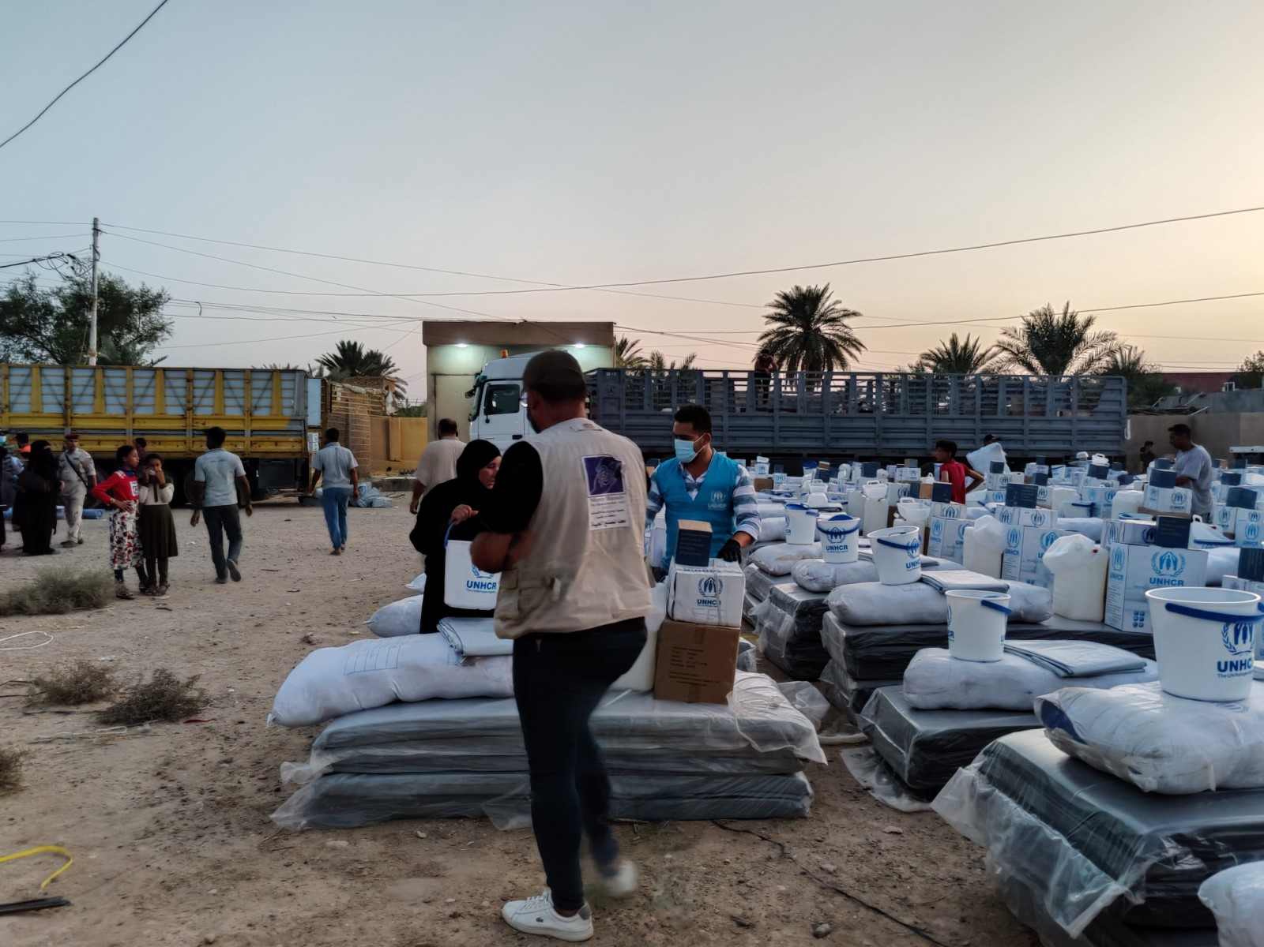
Key issues
  Partners progress on ongoing/planned NFI responses in and out of Camps (related or not to COVID-19) - Tour de table - Partners
UNHCR
Returnees: 263 HHs in Al-Qaim DC, Al-Rummanah sub-district

Slide 7
Key issues
  Partners progress on ongoing/planned NFI responses in and out of Camps (related or not to COVID-19) - Tour de table - Partners
IOM
Out of 18,000 NFIs Kits planned for this year, over 8,400 (4,800 vouchers+ 3,600 in-kind) have been distributed.
9,600 in-kind to be distributed before end of Oct this year.
In addition 600 NFIs (cash + voucher) to be distributed Ninewa (likely Baiij, Sinjar,) and Anbar before end of December.

Slide 8
Key issues and Partner’s updates
  Partners progress on Housing and Rehabilitation (planned and ongoing interventions)- Tour de table - Partners
IOM – 2020 Shelter rehabilitation projects – Ongoing
Governorate | Location | 2020-Project | Units | Families | Status | Donors | Status2
Anbar | Heet | Rehabilitation of Cat2 houses in Baghdady | 101 | 252 | ongoing | OFDA | 65%
Anbar | Haditha | Rehabilitation of Cat2 houses in Albohayat | 21 | 52 | ongoing | OFDA
Anbar | Faluja-Garma | Rehabilitation of CAT2 houses in Luhaib village | 92 | 373 | ongoing | OFDA | 38.12%
Salah al-Din | Beji | Rehabilitation od CAT2 houses in siniya | 45 | 98 | ongoing | OFDA | 41%
Diyala | Khanaqin and Muqdadya | Rehabilitation od CAT2 houses in center of Sadiya and Muqdadya | 228 | 400 | ongoing | OFDA | 80.30%
Anbar | Faluja-Garma | Reahabilitaion of CAT3 Houses in Luhaib village | 10 | 50 | ongoing | German | 0%
Salahadin | Tooz-Sulaiman Beg | Rehabilitation of CAT3 and CAT2 houses | 60 | 84 | ongoing | German | 0%
Anbar | Ana | Reahabilitaion of CAT3 Houses | 8 | 23 | ongoing | German | 0%
Notes:
Only for C&S, 1,173 CAT 2 has been achieved and additional 750 (CAT2 and 3) are in plan until end of the year.

Slide 9
Key issues and Partner’s updates
  Partners progress on Housing and Rehabilitation (planned and ongoing interventions)- Tour de table - Partners
UNPD - 2019 Shelter rehabilitation projects
UNPD – 2020 Shelter rehabilitation projects
1,500 Shelter units (Cat 1&2) in Falluja & in Ramadi (in four neighborhoods)
500 Shelter units (Cat 1&2) in Baiji in Salah al-Din
Demining & Reconstruction of the apartments complex in Ramadi
Last Update: | 13-Aug-2020 12:22 AM
Region |  | # | Project Name | # of Units in the Project | Project Status | Achievement Percentage | # of Units Completed
Anbar | Al Garma | 33 | Shortan-Al Khairat | 303 | Procurment | 0% | 0
Salah Al-Din | Baiji | 2 | Al-Askary1 | 174 | Ongoing | 18% | 34
Salah Al-Din | Baiji | 3 | Tal Al-Za'atar | 426 | Procurement | 0% | 0
 |  |  |  | 903 |  |  | 34

Slide 10
Key issues and Partner’s updates
  Partners progress on Housing and Rehabilitation (planned and ongoing interventions)- Tour de table - Partners
PUI - Ongoing 2019 Shelter rehabilitation project – Ongoing
108 Shelter units (Cat2) has been increased up to 125 shelter units
Location: Al-Rummanah sub district in AL-Kaim district / Anbar
SEVAT has been completed
Contractor has been selected
Technical assessment will be starting around the second week of February 2020

Slide 11
Key issues and Partner’s updates
  Partners progress on Housing and Rehabilitation (planned and ongoing interventions)- Tour de table - Partners
UNHCR – to be confirmed
NFI replacement in all managed Camps
770 RHU (Cat4 damaged houses)
2,700 Shelter units (Cat2)
Potential location: Anbar, Baghdad, Diyala, Salah al-Din
CRS – confirmed
150 Shelter units (Cat2)
Technical assessment for the 150 targeted WD shelters in Falluja Jubail neighborhood (except in sector 212) & Hay Al Shuhadaa;

Slide 12
Key issues and Partner’s updates
  IHF projects - Critical Shelter repairs in Anbar &Salah al-Din Governorates and PDM - Tour de table - Partners
UN-HABITAT – 2020 Shelter rehabilitation projects – Ongoing
Distribution of SOK in Anbar, in Markaz Fallujah, Saqlawiyah, and Karma:
Distribution of SOK items via Vouchers with an amount of 270 USD to 1,014 pre-identified households. 927 households have been assisted as follows:
  772 households in Markaz Fallujah.
  96 households in Saqlawiyah.
  59 households in Karma.

Slide 13
Key issues and Partner’s updates
  IHF projects - Critical Shelter repairs in Anbar &Salah al-Din Governorates and PDM - Tour de table - Partners
UN-HABITAT – 2020 Shelter rehabilitation projects – Ongoing
Rehabilitation of Houses in Anbar
  Socio-economic survey for whole Al-Baker neighborhood, Heet district, Anbar / Completed
  Technical assessment for 177 damaged house in Al-Baker neighborhood, Heet district, Anbar / Completed
  Rehabilitation of 8 damaged houses (Category 2 and 3) in Al-Baker neighborhood, Heet district, Anbar / Completed
  Rehabilitation of 169 Houses (Category 1, 2 and 3) in Al-Baker neighborhood, Heet district, Anbar / Under procurement

Slide 14
Key issues and Partner’s updates
  IHF projects - Critical Shelter repairs in Anbar &Salah al-Din Governorates and PDM - Tour de table - Partners
UN-HABITAT – 2020 Shelter rehabilitation projects – Ongoing
Rehabilitation of Houses in Salah al-Din
  Socio-economic survey for whole Yathrib subdistrict, Balab district, Salah al-Din / Ongoing
  Technical assessment for 200 damaged house in Yathrib subdistrict, Balab district, Salah al-Din / Completed
  Rehabilitation of 7 damaged houses (Category 2 and 3) in Yathrib subdistrict, Balab district, Salah al-Din / Completed
  Rehabilitation of 52 damaged houses (Category 2 and 3) in Yathrib subdistrict, Balab district, Salah al-Din / Under procurement

Slide 15
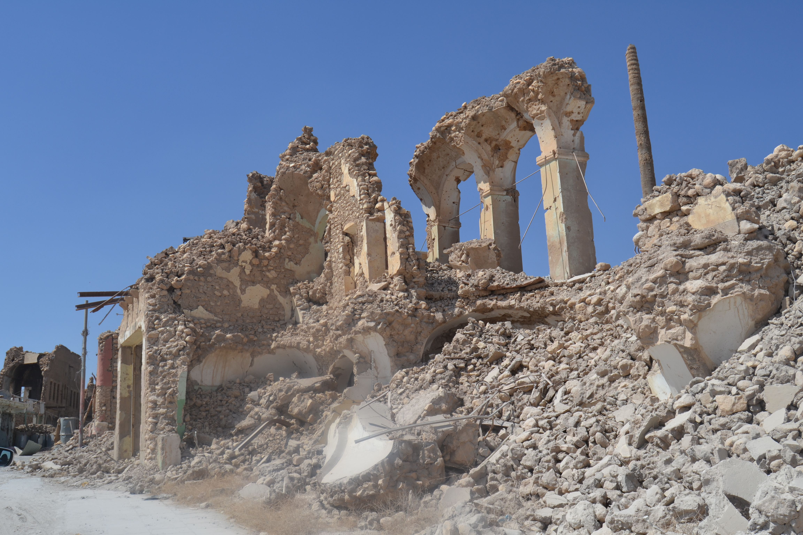
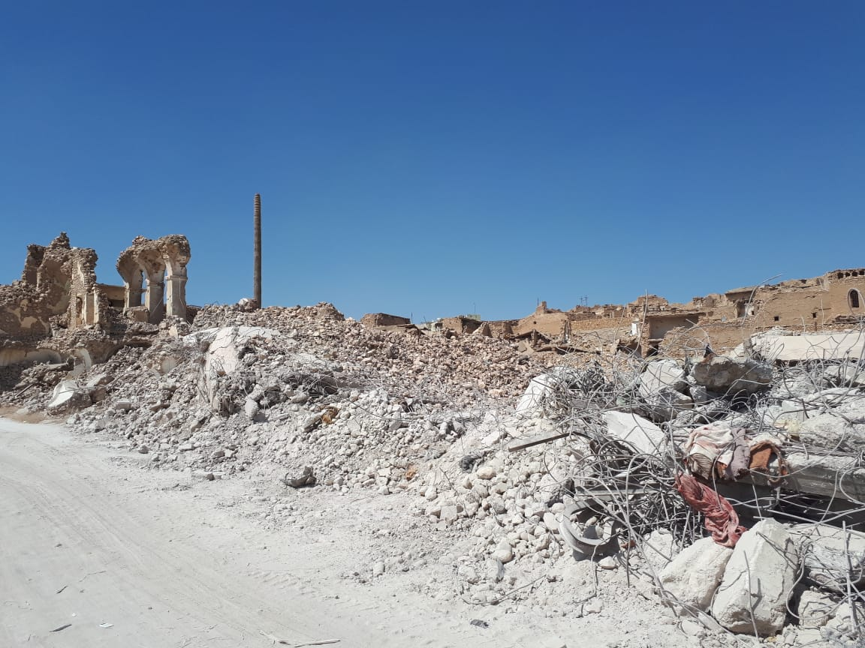
AOB – Shelter Cluster

