Slide 1



Michel Tia - IOM
Sub National Cluster Coordinator for Centre and South
+964 (0) 782 294 9258
coord4.iraq@sheltercluster.org
Centre and south Shelter Cluster Hub Coordination Structure
Osama Luay Seddiq - DRC
Shelter and Infrastructure Officer - Tikrit
Shelter Cluster Focal Point for Salah ad-Din Governorate
+964 (0) 773 489 1375
osama.seddiq@drc.ngo
Layth Al-Azzawi - UNHCR
Snr. Field Associate – CCCM & Shelter-NFI - Centre and South
Shelter Cluster Focal Point for Diyala Governorate
+964 (0) 780 195 3136
alazzawi@unhcr.org
Name - Agency - To be nominated
Function
Shelter Cluster Focal Point for Anbar
Contact details (phone & mail)

Slide 2
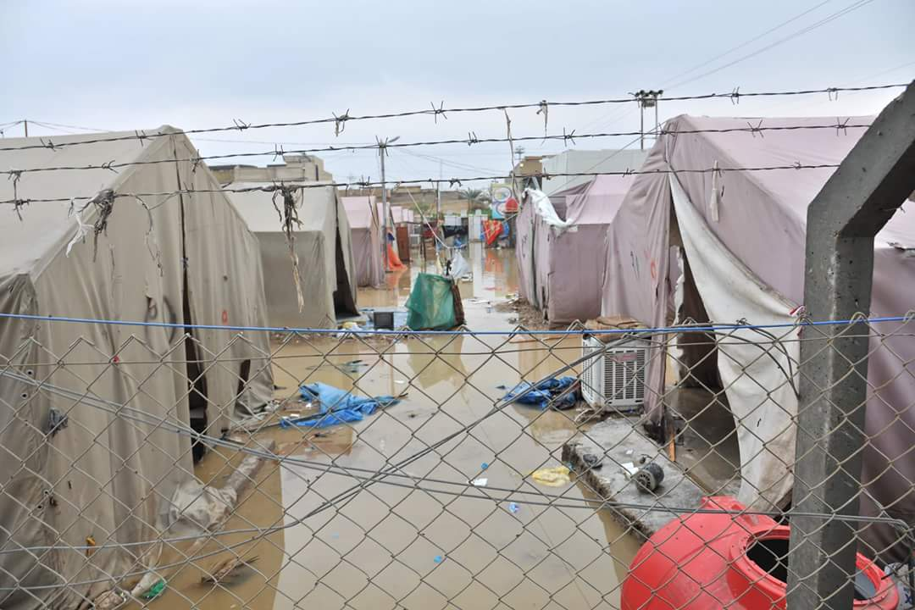
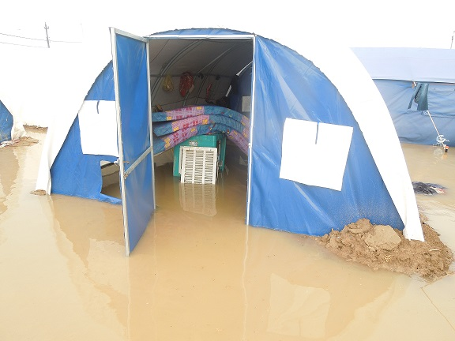
Centre and south Shelter Cluster Hub Coordination meeting
Baghdad
November 18th , 2020

Slide 3
AGENDA
Key issues
Review of action points from previous meeting;
2021 HNO / HRP;
IHF projects - Cost Extension;
Emergency: potential needs due to movement of IDPs from camps;
Partners progress on NFI / Winter responses (ongoing/planned interventions);
Partners progress on Housing and Rehabilitation (ongoing/planned interventions);
AOB

Slide 4
Key issues
Review of action points from previous meeting
# | Action Points | Focal Point | Status / Deadline
1 | Partners to make sure all their respective achievements are reported (in Activity Info and/or WDS) and well reflected in Cluster existing dashboards; | Partners | work in progress
2 | Partners to share their respective planned / ongoing assessments but also reports / key findings; | Partners | work in progress
3 | Vulnerability Criteria 2021: SEVAT / Partners Assessment Form. | Cluster | work in progress

Slide 5
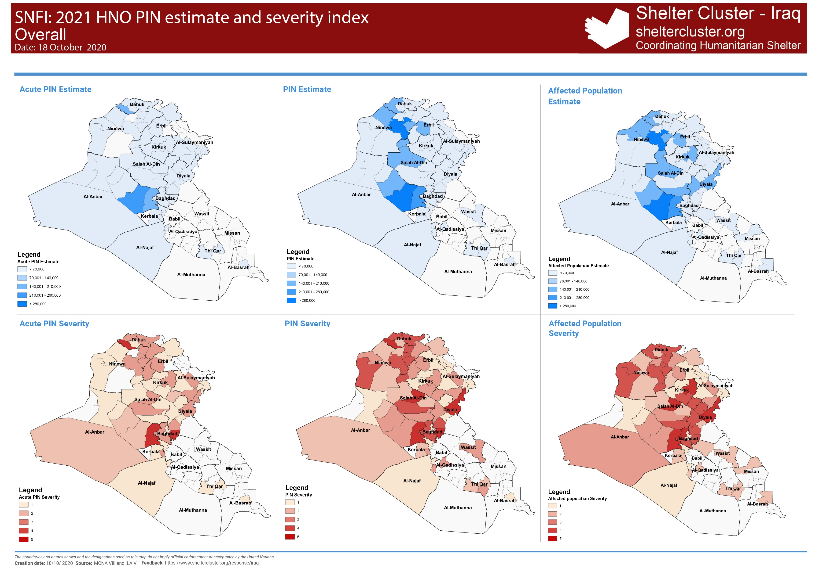
Key issues
2021 HNO / HRP
PEOPLE IN NEED BY CATEGORY
IN-CAMP IDPs
256,861
OUT OF CAMP IDPs
365,741
ACUTE PIN
934,136
PIN
2,562,495
RETURNEES
1,939,893
Notes:
Nearly 2.6 million individuals remain in need of shelter and NFI support, seven per cent higher than in 2019.
SNFI used the two indicators below for the intersectoral PIN analysis. Data on these indicators came out of the two nationwide assessments of MCNA VIII and ILA V.
% HHs reporting at least 2 shelter improvements to achieve adequacy of living standard, and
% of people living in critical shelter (tents, unfinished and abandoned structures, make-shift shelter, non-residential, public and religious buildings)

Slide 6
Key issues
2021 HNO / HRP
2021 HRP - Target estimation :
PIN & Acute PIN at district level
2020 achievements projected till end of year
Partners presence & capacity across district / Funding
Camp closure / Camp consolidation Vs IDPs areas of origin
Contextual knowledge / expert judgement : SNCC and Area based coordinators

Slide 7
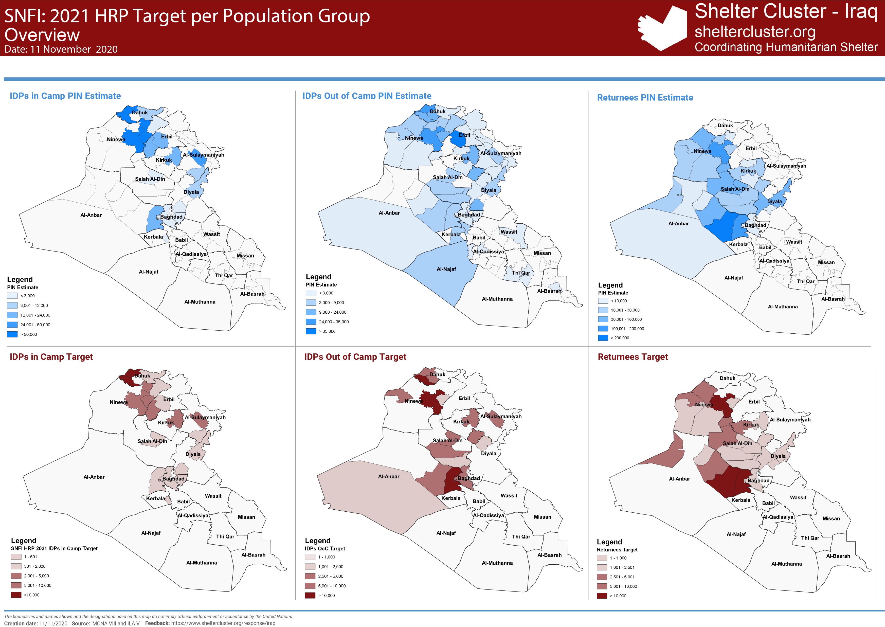
Key issues
2021 HNO / HRP
Al-Anbar | Al-Falluja
Al-Anbar | Al-Kaim
Al-Anbar | Al-Ramadi
Al-Anbar | Al-Rutba
Al-Anbar | Haditha
Al-Anbar | Heet
Baghdad | Al-Kadhmiyah
Baghdad | Al-Karkh
Baghdad | Al-Mahmoudiya
Baghdad | Al-Risafa
Diyala | Al-Khalis
Diyala | Al-Muqdadiya
Diyala | Baquba
Diyala | Khanaqin
Diyala | Kifri
Salah Al-Din | Al-Daur
Salah Al-Din | Al-Shirqat
Salah Al-Din | Balad
Salah Al-Din | Beygee
Salah Al-Din | Samarra
Salah Al-Din | Tikrit
Salah Al-Din | Tooz Khurmato

Slide 8
Key issues
IHF projects - Cost Extension
Partners | Location | Activity | 2020 Target (HHs) | 2020 Funding required
HRF | Kirkuk | SOK + Critical shelter repairs + Rental subsidies in Kirkuk | 1,000 | 593,700
CCR | Dahuk & Anbar | SOK + Critical shelter repairs + Rental subsidies in Dahuk; Critical shelter repairs house for 500 most vulnerable houses in Fallujah (Markaz Fallujah, Al-Garma and Al-Saqlawiyah sub-districts) | 1,500 | 1,268,700
ZOA | Anbar | SOK + Critical shelter repairs for 750 most vulnerable houses in BzBz informal settlement, | 750 | 639,750
 |  | 2020 IHF Tentative budget (extension) | 3,250 | 2,502,150

Slide 9
Key issues
Emergency: potential needs due to movement of IDPs from camps
Governorate Of Departure | District of Departure | DTM - Location Name of Departure | Sum of Num Families | Sum of # Individual
Baghdad | Abu Ghraib | Al Shams Complex | 102 | 612
 |  | Al-Ahel | 69 | 414
 | Mada'in | Al-Nabi Younis | 54 | 267
Baghdad Total |  |  | 225 | 1293
Kerbala | Al-Hindiya | Al-Kawthar | 85 | 519
Kerbala Total |  |  | 85 | 519
Anbar | Falluja | HTC | 151 | 735
 |  | AAF | 21 | 85
Anbar Total |  |  | 172 | 820
Diyala | Baquba | Muskar Saad | 100 | 445
 | Khanaqin | Al Wand 2 | 36 | 216
 |  | Al Wand 1 | 179 | 771
Diyala Total |  |  | 315 | 1432
Ninewa | Mosul | Hamam Al Alil 2 | 1594 | 7706
 |  | Qayyarah-Jad'ah 1 | 658 | 2773
 |  | Qayyarah-Jad'ah 5 | 160 | 612
 | Al-Hamdaniya | Khazer M1 | 5 | 26
Ninewa Total |  |  | 2417 | 11117
Kirkuk | Daquq | Yahyawa | 329 | 1974
Kirkuk Total |  |  | 329 | 1974
Salah al-Din | Balad | Eshaqi Complex | 45 | 443
Salah al-Din Total |  |  | 45 | 443
Grand Total |  |  | 3,588 | 17,598
Summary – Departures
As of 15 Nov. 20

Slide 10
Key issues
Emergency: potential needs due to movement of IDPs from camps
Status | Governorate of Arrival | District of Arrival | Sum of Num Families | Sum of # Individual
IDP | Anbar | Falluja | 38 | 187
 |  | Ramadi | 25 | 137
 |  | Al-Ka'im | 12 | 81
 | Anbar Total |  | 75 | 405
 | Baghdad | Mada'in | 10 | 53
 |  | Thawra2 | 5 | 19
 |  | Abu Ghraib | 40 | 219
 | Baghdad Total |  | 55 | 291
 | Kerbala | Kerbala | 56 | 339
 | Kerbala Total |  | 56 | 339
 | Diyala | Baquba | 57 | 203
 |  | Khanaqin | 102 | 603
 |  | Kifri | 2 | 12
 | Diyala Total |  | 161 | 818
 | Salah al-Din | Al-Shirqat | 14 | 88
 |  | Balad | 45 | 443
 | Salah al-Din Total |  | 59 | 531
IDP Total |  |  | 406 | 2,384
Summary – Arrivals
As of 15 Nov. 20
Status | # of Families
IDP | 504
RET | 1024
Grand Total | 1,528
DTM Camp Closure matrix 15Nov.20

Slide 11
Key issues
Partners progress on NFI / Winter responses (ongoing/planned interventions) -Tour de table
IOM - NFI
Emergency Cash for camp displacement USD 320
Governorates | # HHs
Anbar | 184
Diyala | 143
Baghdad | 50
Total | 377
Completed Nov 2020
Governorates | Basic Kits | Replacement Kits
Anbar | 550 | 1,400
Diyala | 301 | 500
Baghdad | 627 | 500
Salah al Din | 378 | 2,650
Total | 1,856 | 5,050

Slide 12
Key issues
Partners progress on NFI / Winter responses (ongoing/planned interventions) -Tour de table
UNHCR - NFI
NFI distributions - from 18 - 29 October 2020
Location Governorate | Location District | Location Sub District | Location Location/Beneficiary Type | Location Location Name | # HH_NFI_Kits_ Partial_or_Full | # Individuals_NFI_Kits_ Partial_or_Full
Al-Anbar | Al-Falluja | Al-Amirya | IDP in Camp | Fallujah camp 7 - HTC | 505 | 3,030
Al-Anbar | Al-Ramadi | Markaz Al-Ramadi | Informal Sites | K-09 site | 39 | 234
Al-Anbar | Al-Ramadi | Markaz Al-Ramadi | Informal Sites | Al Karamah Site - K-18 | 93 | 558
Al-Anbar | Al-Falluja | Al-Amirya | IDP in Camp | Al Tahrer Central | 4 | 24
Baghdad | Al-Mahmoudiya | Al-Latifya | IDP in Camp | Latifiya 1 | 50 | 300
Diyala | Khanaqin | Markaz Khanaqin | IDP in Camp | Al-Wand 1 | 680 | 4,080
Diyala | Khanaqin | Markaz Khanaqin | IDP in Camp | Al-Wand 2 | 7 | 7
Diyala | Khanaqin | Markaz Khanaqin | IDP in Camp | Al-Wand 1 | 7 | 49
Diyala | Al-Muqdadiya | Markaz Al-Muqdadiya | Returnee | Al Aali Village | 502 | 3,012
Salah Al-Din | Balad | Al-Esshaqi | Informal Sites | Ishaqi camp | 62 | 372
Salah Al-Din | Tikrit | Um Al-Qura | IDP in Camp | Al Karamah | 172 | 1,032
Salah Al-Din | Balad | Yathreb | IDP Out of Camp | Balad station | 73 | 438
Salah Al-Din | Al-Shirqat | Markaz Al-Shirqat | Returnee | Al-Ayitha Village | 332 | 1,980
 |  |  |  |  | 2,526 | 15,116
Notes:
2,526 CRI kits from (18_29) October 2020.
_ 1674 plastic mat
_ 18 CRI IDPs for camps
_ 834 CRI kits for returnees in SAD and DIY.

Slide 13
Key issues
Partners progress on Housing and Rehabilitation (ongoing/planned interventions) -Tour de table
IOM – Shelter programme
From Jan. – Sept 2020, IOM has completed 485 Shelter units in Anbar, Diyala & SAD, for returnees
Donor | Assistance Status | Governorate | District | Village | Start Date | End Date | Target Population | Total Units | Unit type | Progress Percentage | Total Families
German | Finalized | Anbar | Ana | Markaz Ana-Al bor (Shishan) | 10/1/2020 | 12/31/2020 | Returnee | 4 | Damaged Houses | 15% | 11
German | Finalized | Anbar | Ana | Markaz Ana-Hay Al Nasir | 10/1/2020 | 12/31/2020 | Returnee | 2 | Damaged Houses | 15% | 7
German | Finalized | Anbar | Ana | Markaz Ana-Hay Al Qadissiyah | 10/1/2020 | 12/31/2020 | Returnee | 2 | Damaged Houses | 15% | 8
German | Finalized | Anbar | Ana | Markaz Ana-Rayhana | 10/1/2020 | 12/31/2020 | Returnee | 3 | Damaged Houses | 15% | 9
German | Finalized | Anbar | Falluja | Shortan | 10/1/2020 | 12/31/2020 | Returnee | 11 | Damaged Houses | 100% | 55
German | Finalized | Salah al-Din | Tuz Khurmatu | Suleiman Beg-Sulayman Beg sub district center | 10/1/2020 | 12/31/2020 | Returnee | 64 | Damaged Houses | 15% | 90
German | Finalized | Salah al-Din | Tuz Khurmatu | Markaz Tooz-Yangija Village | 10/1/2020 | 12/31/2020 | Returnee | 37 | Damaged Houses | 15% | 48
Totals |  |  |  |  |  |  |  | 123 |  |  | 228

Slide 14
Key issues
Partners progress on Housing and Rehabilitation (ongoing/planned interventions) -Tour de table
IOM – 2021 Shelter programme
IOM Shelter projects Overview – Centre and South Governorates 2021
Donor | Assistance Status | Governorate | District | Start Date | End Date | Target Population | Total Units | Unit type | Progress Percentage | Total Families
OFDA | HOLD | Anbar | Heet | 1/1/2021 | 9/30/2021 | IDPs | N/A | Critical Shelter | N/A | 60
OFDA | Vulnerability Assessment stage | Baghdad | Abu Gharib-Nahrawan-Radhwaniya | 1/1/2021 | 9/30/2021 | IDPs | N/A | Critical Shelter | N/A | 300
OFDA | Vulnerability Assessment stage | Salah Al-Din | Baiji | 1/1/2021 | 9/30/2021 | IDPs | N/A | Critical Shelter | N/A | 200
OFDA | Vulnerability Assessment stage | Diyala | Baquba-Khanaqin | 1/1/2021 | 9/30/2021 | IDPs | N/A | Critical Shelter | N/A | 300
 |  |  |  |  |  |  |  |  |  | 860

Slide 15
Key issues
Partners progress on Housing and Rehabilitation (ongoing/planned interventions) -Tour de table
CRS – Ongoing Shelter programme
50 Shelter units (category 2) been completed. In Fallujah (Al Shuhada’a and Jubil neighborhoods)
Beneficiaries selection and technical assessments completed for a new 50 Shelter units (category 2), the 1st tranche of cash distribution will be conducted next week in Fallujah (Al Shuhada’a and Jubil neighborhoods).
Beneficiaries selection and technical assessments for another 50 Shelter units (category 1&2) will be starting coming week. In Fallujah (Al Shuhada’a and Jubil neighborhoods)
CRS partner Caritas Iraq Assessing new eligible neighborhoods in Fallujah to be targeted next period for WDS repairs.

Slide 16
Key issues
Partners progress on Housing and Rehabilitation (ongoing/planned interventions) -Tour de table
UN-Habitat – Ongoing Shelter programme
In Heet, Anbar Gov, UN-Habitat is currently rehabilitating 49 war-damaged houses in the neighbourhood of Al Baker, and is in the process of awarding another batch of 63 houses in the same location.
Also in Heet, an additional 60 houses are going through procurement process for the eastern part of Al-Baker neighbourhood.
By March-April 2021, it will have rehabilitated a total of 180 houses in Al Baker, spanning between Damage Levels 2 and 3.

Slide 17
Key issues
Partners progress on Housing and Rehabilitation (ongoing/planned interventions) -Tour de table
UN-Habitat – Ongoing Shelter programme
In Yathrib Sub-District, Balad District, SAD Gov, UN-Habitat is currently rehabilitating 52 war damaged houses spanning Damage Levels 2 and 3, and is working with 21 identified vulnerable households to develop an appropriate concept and design for the realisation of low-cost core housing units to be built in situ.
In Yathrib Sub-District, UN-Habitat has also secured a small funding for urgent shelter assistance to 85 extremely vulnerable returnee households to be identified through a SEVAT survey. Assistance will be provided through in-kind and/or voucher-based SOKs and 15 shelter rehabilitation interventions.
Additional funding will be sought to support the sustainable return of the remaining households in need and those who could not settle in their properties because of the level of destruction of their homes.

Slide 18
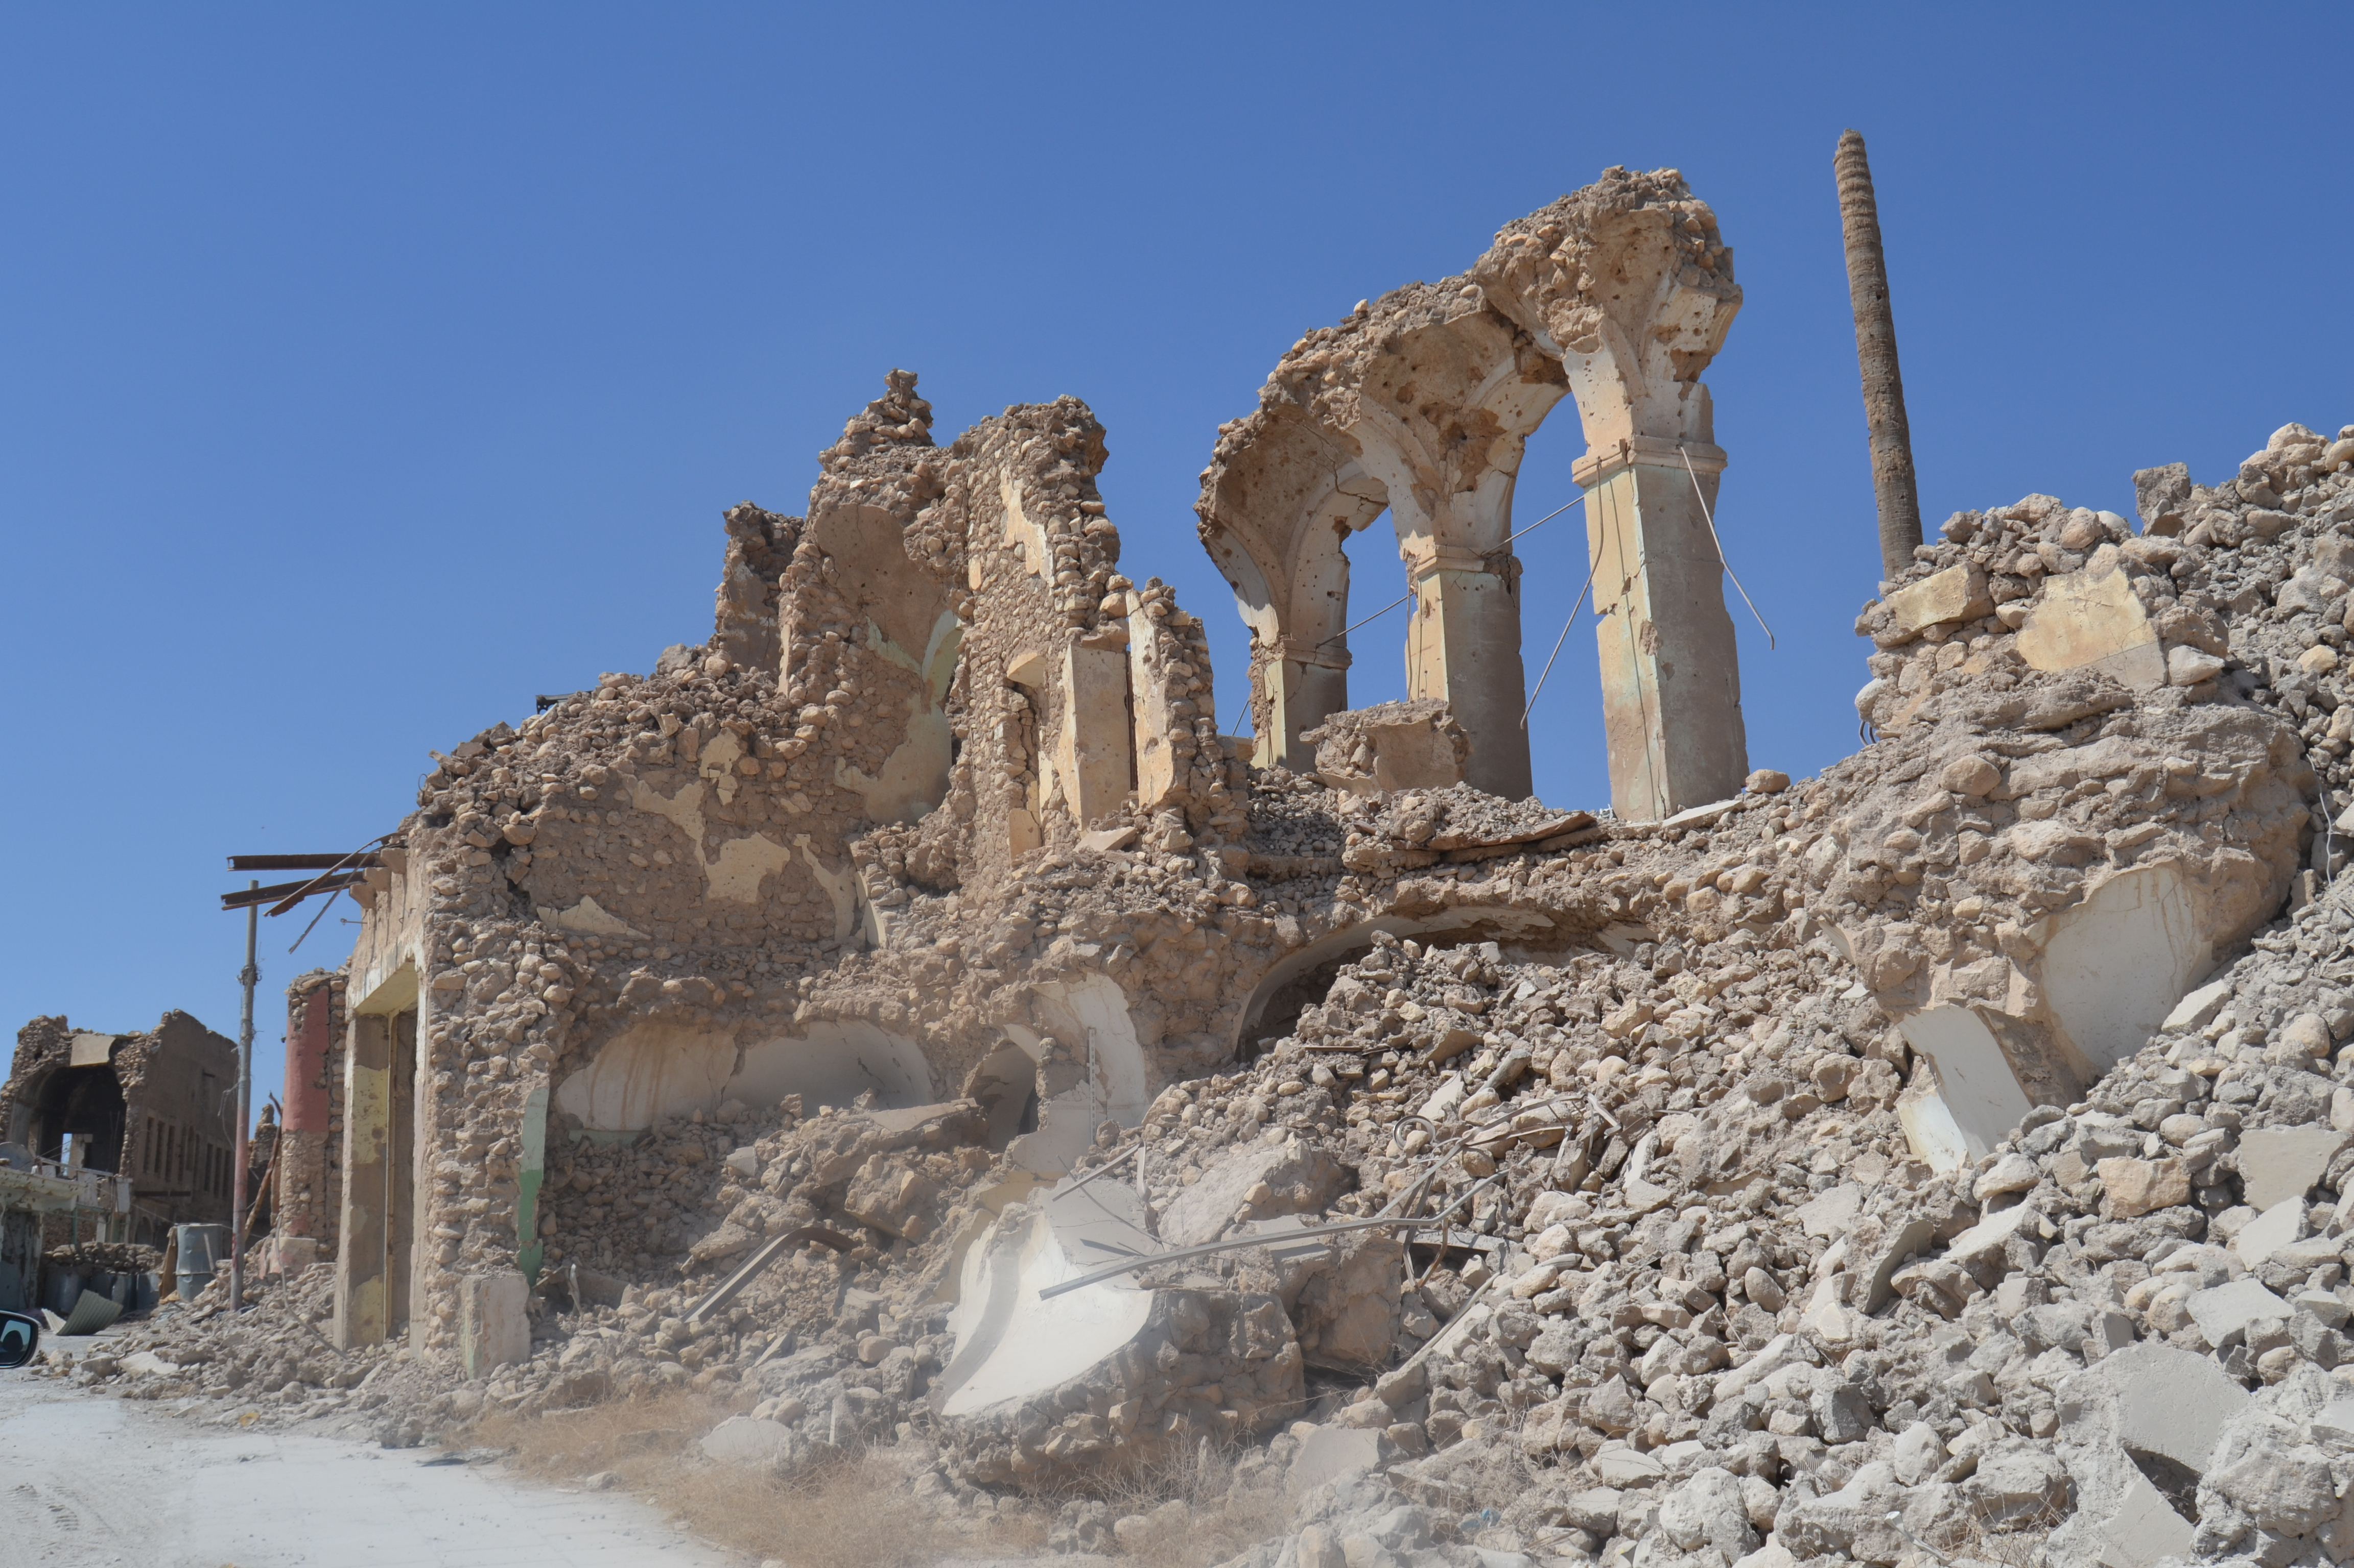
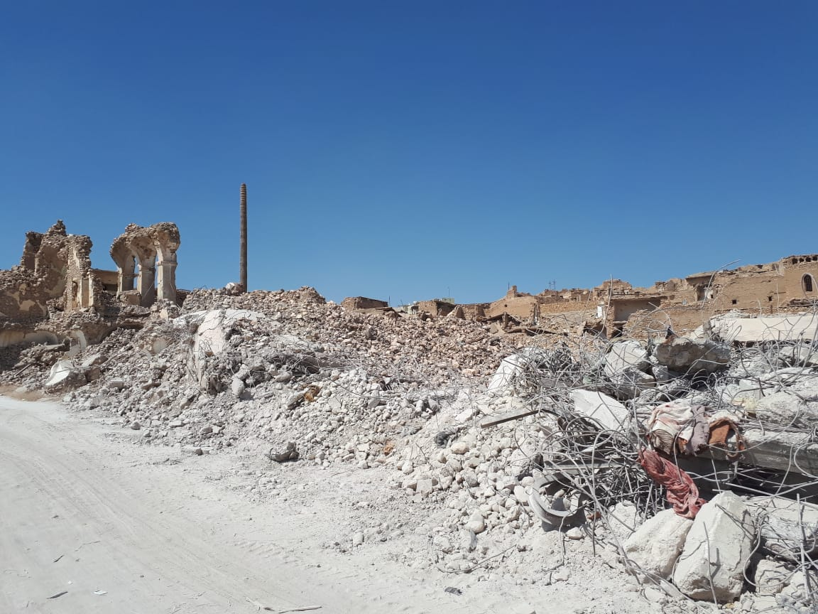
AOB – Shelter Cluster

