Slide 1



Michel Tia - IOM
Sub National Cluster Coordinator for Centre and South
+964 (0) 782 294 9258
coord4.iraq@sheltercluster.org
Centre and south Shelter Cluster Hub Coordination Structure
Osama Luay Seddiq - DRC
Shelter and Infrastructure Officer - Tikrit
Shelter Cluster Focal Point for Salah ad-Din Governorate
+964 (0) 773 489 1375
osama.seddiq@drc.ngo
Layth Al-Azzawi - UNHCR
Snr. Field Associate – CCCM & Shelter-NFI - Centre and South
Shelter Cluster Focal Point for Diyala Governorate
+964 (0) 780 195 3136
alazzawi@unhcr.org
Name - Agency - To be nominated
Function
Shelter Cluster Focal Point for Anbar
Contact details (phone & mail)

Slide 2
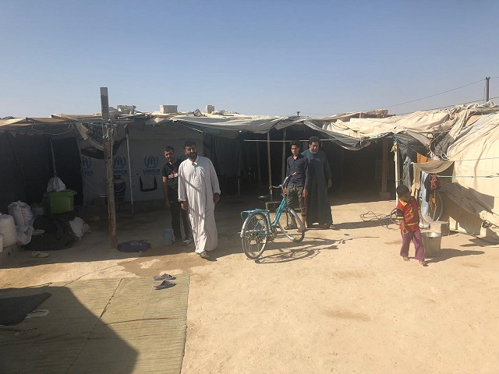
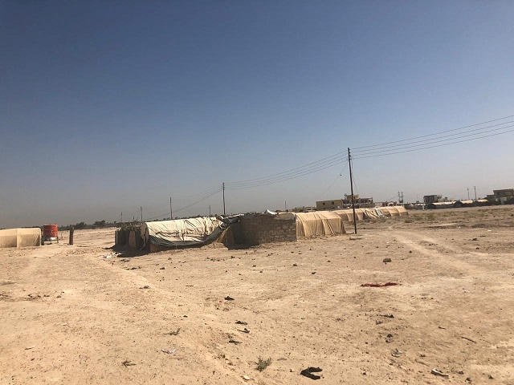
Centre and south Shelter Cluster Hub Coordination meeting
Baghdad
December 23rd, 2020

Slide 3
AGENDA
Key issues
2021 HNO / HRP, revised ABC and Vulnerability criteria;
2020 IHF: 2nd Reserve Allocation - Shelter component;
Partners progress on NFI / Winter responses (ongoing/planned interventions);
Partners progress on Housing and Rehabilitation (ongoing/planned interventions);
AOB

Slide 4
Key issues
2021 HNO / HRP, revised ABC and Vulnerability criteria
PEOPLE IN NEED BY CATEGORY
TARGET BY CATEGORY
25 Districts have been targeted in Centre and South
IN-CAMP IDPs
256,861
IN-CAMP IDPs
74,000
OUT OF CAMP IDPs
365,741
OUT OF CAMP IDPs
90,887
RETURNEES
1,939,893
RETURNEES
208,491
Total PIN
2,562,495
Total Target
373,378
ACUTE PIN
934,136
Notes:
Nearly 2.6 million individuals remain in need of shelter and NFI support, seven per cent higher than in 2019.
SNFI used the two indicators below for the intersectoral PIN analysis. Data on these indicators came out of the two nationwide assessments of MCNA VIII and ILA V.
% HHs reporting at least 2 shelter improvements to achieve adequacy of living standard, and
% of people living in critical shelter (tents, unfinished and abandoned structures, make-shift shelter, non-residential, public and religious buildings)

Slide 5
Key issues
2021 HNO / HRP, revised ABC and Vulnerability criteria
No. | Activity | Min Unit Cost | Max Unit Cost | Most commonly found Unit Cost | Total Cost | Remarks
1 | Non-Food Item (NFI) Kit Distribution | $250 | $517 | $310 | $403 | The unit cost includes the cost of the NFI + winter kit. The value of the NFI kit is 250 US$, the value of the winter kit ranges from 63 US$ to 200 US$, plus children winter clothing at 67$. The total cost includes the cost of the items as well for the staff required to assess needs and distribute the kits, plus the relevant support costs. This can include both in-kind and cash-based modalities.
2 | Sealing-Off Kit (SOK) Distribution | $210 | $500 | $500 | $650 | The total cost includes the cost of the kit as well as the staff required to assess needs and distribute the kits, plus the relevant support costs. This can include both in-kind and cash-based modalities.
3 | Critical Shelter Upgrades | $1,000 | $1,500 | $1,200 | $1,560 | This cost is variable, with a Cluster-set average of $1,200. However, the exact cost is dependent on the status of the structure to be upgraded/repaired, the size of the HH, proximity to specialized markets, availability of skilled labour and what is necessary to reach minimum standards. The total cost includes the staffing necessary to conduct detailed technical assessments and Bills of Quantity preparation, as well as the relevant support costs for the program.
4 | Cash for Rent | $300 | $1,200 | $1,200 | $1,560 | This cost is based on a Cluster-set average of $200 per month for 6 months, also in line with the most recent assessment of the SMEB run by the Cash WG. Rental cost covers as well utility costs (water, electricity). However, this should be understood to be an average, as exact prices will depend on the area, the HH size, the quality of the structure, and the length of the program. Total costs include the staff necessary to conduct detailed vulnerability assessments and provide support to HHs and landowners, as well as the necessary support costs.
5 | In-camp shelter maintenance | $120 | $200 | $140 | $182 | This cost is based on a Cluster-set guideline and the total cost includes the costs for transport, installation and necessary support costs. It does NOT include the cost of tent procurement (both for tent covers &/or metal frames) or slab replacement, which would require additional costs.
 | Indirect and Support Cost | 25% | 35% | 30% | 30% | A higher cost may be considered for stand-alone projects, and/or to establish partners’ presence in new locations
Notes:
Nearly 2.6 million individuals remain in need of shelter and NFI support, seven per cent higher than in 2019.
SNFI used the two indicators below for the intersectoral PIN analysis. Data on these indicators came out of the two nationwide assessments of MCNA VIII and ILA V.
% HHs reporting at least 2 shelter improvements to achieve adequacy of living standard, and
% of people living in critical shelter (tents, unfinished and abandoned structures, make-shift shelter, non-residential, public and religious buildings)

Slide 6
Key issues
2021 HNO / HRP, revised ABC and Vulnerability criteria
For 2021, the Shelter Cluster still recommends the use of SEVAT to the extent possible.
Considering that SEVAT is a household-level face-to-face assessment, in light of the risk of spreading COVID-19, sudden camp closures and the increased movement of people in need,
Shelter Cluster partners can prioritize beneficiaries based on the following criteria, coupled with the specific shelter and NFI needs. Such as families living in sub-standard shelters
Criteria
Families in overcrowded settings
Large families
Female-headed households
Families with persons with disabilities
Families with persons at greater risk of COVID-19 (older persons, those with chronic, cardiovascular and lung diseases, cancer, etc.)
Vulnerable families who cannot return to their property due to secondary occupation
Families who cannot afford a rent
Families at risk of evictions
Marginalized groups
Notes:
Nearly 2.6 million individuals remain in need of shelter and NFI support, seven per cent higher than in 2019.
SNFI used the two indicators below for the intersectoral PIN analysis. Data on these indicators came out of the two nationwide assessments of MCNA VIII and ILA V.
% HHs reporting at least 2 shelter improvements to achieve adequacy of living standard, and
% of people living in critical shelter (tents, unfinished and abandoned structures, make-shift shelter, non-residential, public and religious buildings)

Slide 7
Key issues
2020 IHF: 2nd Reserve Allocation - Shelter component;
Partners | Location | Activity | Target (HHs) | Funding required (USD)
 | Anbar | SOK, Critical shelter upgrades, Rental subsidies and NFI | 162 | 195,286
 | Diyala | SOK, Critical shelter upgrades, Rental subsidies and NFI | 709 | 815,737
 | Salah al-Din | SOK, Critical shelter upgrades, Rental subsidies and NFI | 205 | 251,225
 | Kirkuk | SOK, Critical shelter upgrades, Rental subsidies and NFI | 420 | 491,010
 | Ninewa | SOK, Critical shelter upgrades, Rental subsidies and NFI | 1,337 | 1,496,781
TOTAL |  |  | 2,833 | 3,250,039

Slide 8
Key issues
Partners progress on NFI / Winter responses (ongoing/planned interventions) -Tour de table
IOM – NFI 2021 planning
Targets
1,200 in kind basic kits
1,800 Cash for NFI basic kits
5,000 Cash for NFI replacement items
Current potential locations
Diyala – Baquba center and Khanaqin Center
Baghdad – Latifiya, Al Rasheed, Adhamia
Salah Al Din – Tuz Khormatu
Kirkuk- Kirkuk Center

Slide 9
Key issues
Partners progress on NFI / Winter responses (ongoing/planned interventions) -Tour de table
UNHCR – NFI
38 NFI Kits been distributed in Salah al-Din in Balad Train Station - informal IDP settlement.
190 plastic sheeting been distributed in AAF camp (two sheets per family)
65 HHs in AAF19-Al-Matin (RHU) and
30 HHs in AAF08-AL-Saada Camp (RHU))

Slide 10
Key issues
Partners progress on Housing and Rehabilitation (ongoing/planned interventions) -Tour de table
UNDP – Shelter programme
Salah al-Din : Tal Alzatar Neighborhood still in procurement
Anbar (Ana): 248 units for Rayhana in procurement.
Anbar – Khayrat – Shortan: 23% progress.

Slide 11
Key issues
Partners progress on Housing and Rehabilitation (ongoing/planned interventions) -Tour de table
IOM – Shelter programme
Location | Shelter Units | Type of population | Type of damage | status | Timeline
Anbar / Garma-Luhaib | 55 | Returnees | Cat2 and Cat3 | Completed | 30-Dec-20
Anbar / Ana | 35 | Returnees | CAt3 | Ongoing | 30-Dec-20
Salah al-Din / Tooz, Sulaiman Beg and Yengejeh | 138 | Returnees | Cat2 and Cat3 | Ongoing | 30-Dec-20
Kirkuk Center | 210 | IDPs | Critical Shelter | Planned | 31-SEP-2021
Kirkuk / Daquq | 92 | IDPs |  | Planned | 31-SEP-2021
Diyala / Khanaqeen, Baquba. | 300 | IDPs |  | Planned | 31-SEP-2021
Salah al-Din / Baiji | 200 | IDPs |  | Planned | 31-SEP-2021
Baghdad / Abu Gharib, Al-Nasir, Al-Salam, Abu minisir | 255 | IDPs |  | Planned | 31-SEP-2021
Abu Gharib, Al-Nasir, Al-Salam, Al-Hetaween | 30 | IDPs |  | Planned | 31-SEP-2021
Abu Gharib, Agarguf, Bani Tameem | 15 | IDPs |  | Planned | 31-SEP-2021
 | 1,330

Slide 12
Key issues
Partners progress on Housing and Rehabilitation (ongoing/planned interventions) -Tour de table
CRS – Ongoing Shelter programme
Beneficiaries selection and technical assessments completed for a new 50 Shelter units (category 2), the 1st tranche of cash distribution will be conducted next week in Fallujah (Al Shuhada’a and Jubil neighborhoods).
Beneficiaries selection and technical assessments for another 50 Shelter units (category 1&2) will be starting coming week. In Fallujah (Al Shuhada’a and Jubil neighborhoods)
CRS partner Caritas Iraq Assessing new eligible neighborhoods in Fallujah to be targeted next period for WDS repairs.

Slide 13
Key issues
Partners progress on Housing and Rehabilitation (ongoing/planned interventions) -Tour de table
ZOA – Ongoing Shelter programme - IHF cost extension project - plan for early January 2021
Tender procedure in order to select vendors
SEVAT assessment to assess vulnerability and needs
For the Rapid Response proposal, Assessment will be starting very soon.

Slide 14
Key issues
Partners progress on Housing and Rehabilitation (ongoing/planned interventions) -Tour de table
CCR – Ongoing Shelter programme - IHF cost extension project
CCR is starting partnership with Sabe'a Sanabul Organization for Relief & Development (SSORD) who will start Socio Economic Vulnerability Assessment after Christmas in Merkez Falluja, Al Saqlawiyah and Al Garma sub-districts.
CCR is targeting 475 of most vulnerable HHs (mainly new returnees and IDPs living in informal settlements) with emergency shelter repairs.
Cash for shelter modality will be used.

Slide 15
Key issues
Partners progress on Housing and Rehabilitation (ongoing/planned interventions) -Tour de table
UN-Habitat
Heet district, Heet town, Al-Baker neighbourhood, west and east: 172 war-damaged houses currently undergoing rehabilitation, spanning damage category 2 to category 3. UN-Habitat is not only repairing war damage, but also increasing the living area of the targeted homes to ease overcrowding and upgrading WASH infrastructure to help mitigate COVID, this goes alongside extension of water networks to houses that are not connected.
Potential activity starting early 2021: shelter and NFI support in Balad district, Salah al-Din.
Yathrib Sub-District, Balad District, Salah al-Din: UN-Habitat is currently rehabilitating 52 war damaged houses spanning Damage Levels 2 & 3; and has worked with 21 identified vulnerable households to develop an appropriate concept and replicable design for the realisation of low-cost core housing units to be built in situ. The tendering of this project will be launched in early January

Slide 16
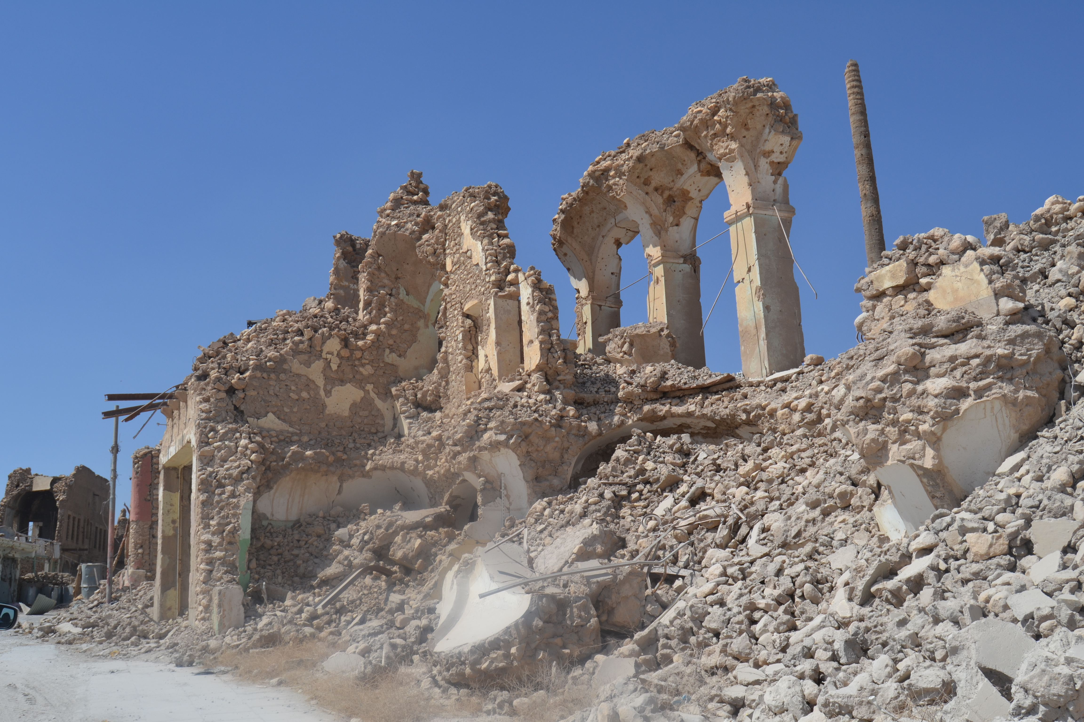
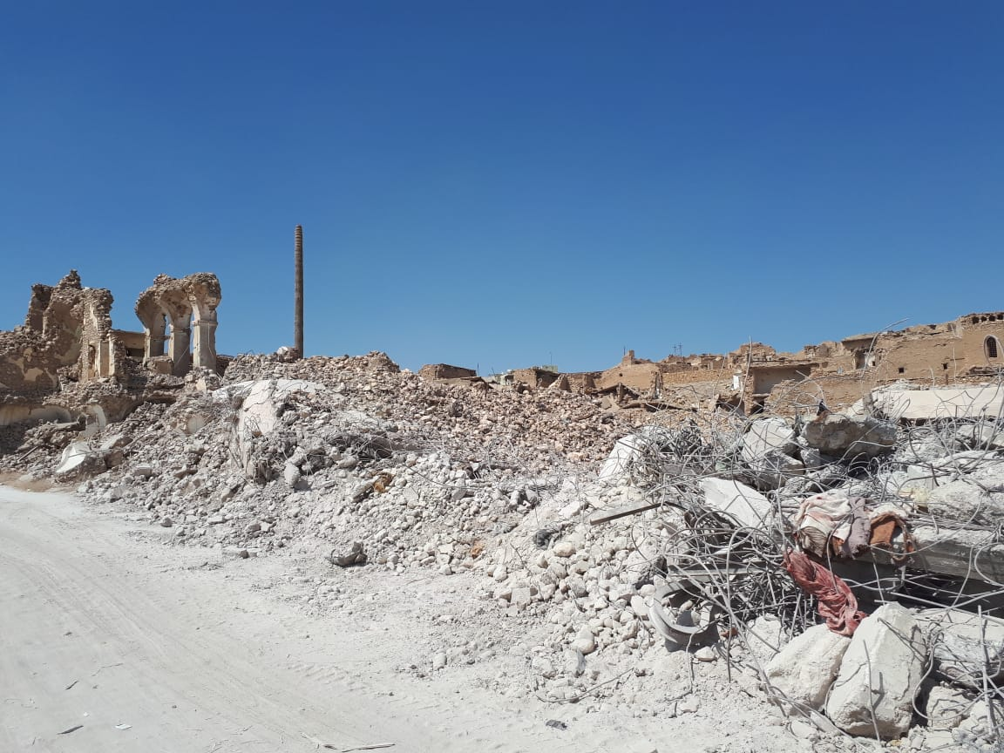
AOB

