Slide 1
Shelter Cluster Burkina Faso Rainy season
June 26, 2020

Slide 2
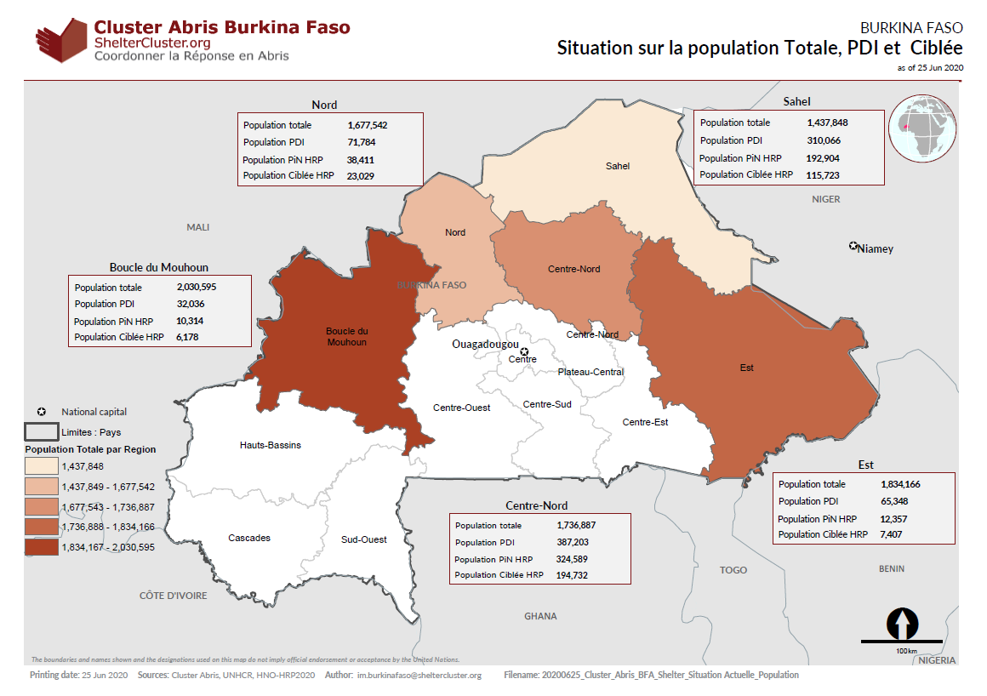
Displaced population, host and target

Slide 3
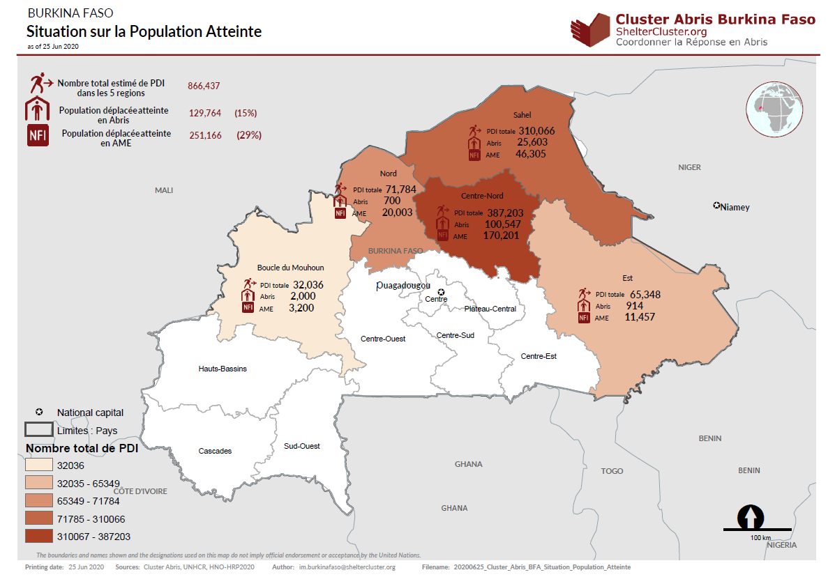
Reached population and gap

Slide 4
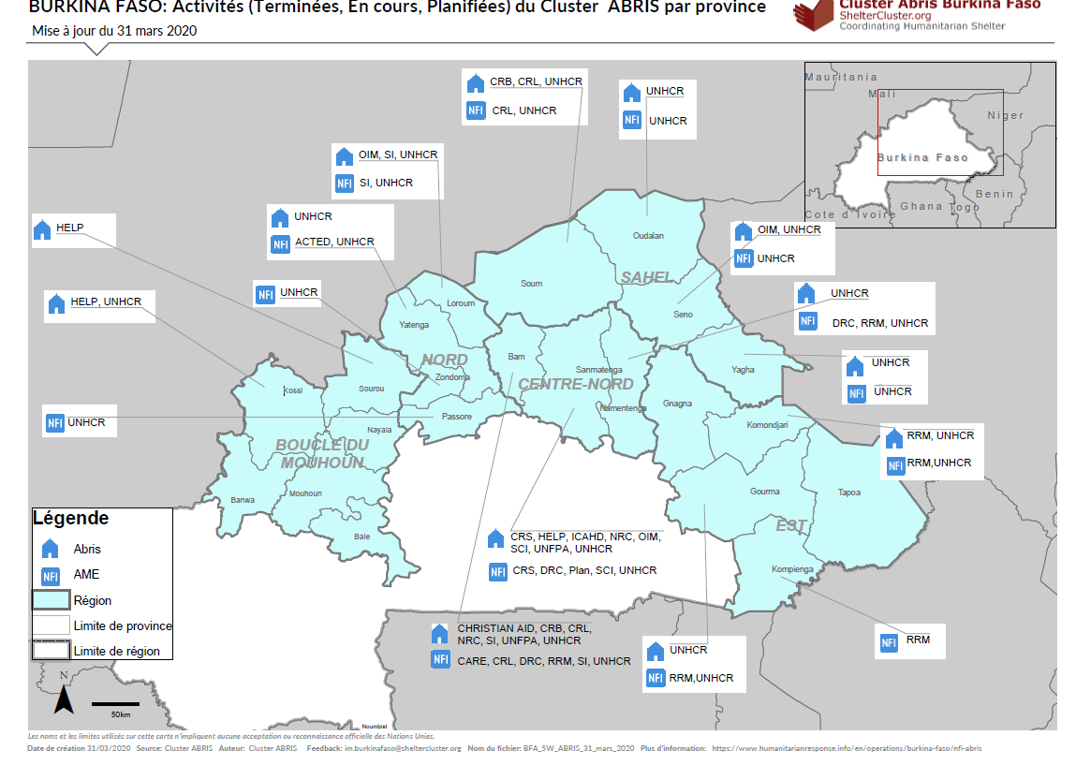
Geographical presence

Slide 5
Floods (April and Juin 2020)
Kongoussi. April 2020
5 injured people
72 destroyed shelters
235 flooded and/or damaged shelters
Other material lost
Kongoussi, Pensa and Barsalogho. June, 5
14 injured people
669 flooded and/or damaged
56 tons of food damaged by the water
Namissiguima. June, 7
Strong winds. Damage report on process.
Kongoussi, Pensa, Dori, Kaya, Tougouri and Barsalogho. June 17
Strong winds and heavy rains. Damage report on process.

Slide 6
Floods and land needs
Key regions in terms of land needs due to floods:
SAHEL: 1593 HH in flood prone areas (and 597 HH in agricultural land)
CENTRE NORD: 8.369 HH in flood prone areas
EST: estimation in progress
NORD + Boucle de Mouhoun: not flooding although strong winds have also had an impact in the shelters

Slide 7
Shelter response technical revision
Technical revision on going at regional level, but there have been already shared the revision of their current shelter responses by UNHCR, NRC and Croix-Rouge Lux
Key recommendations:
Consider longer term shelter responses
Improve ventilation in shelter responses
Reinforce the perimeter in order to protect from flooding and rodents
Improve the isolation of the shelter

