Slide 1
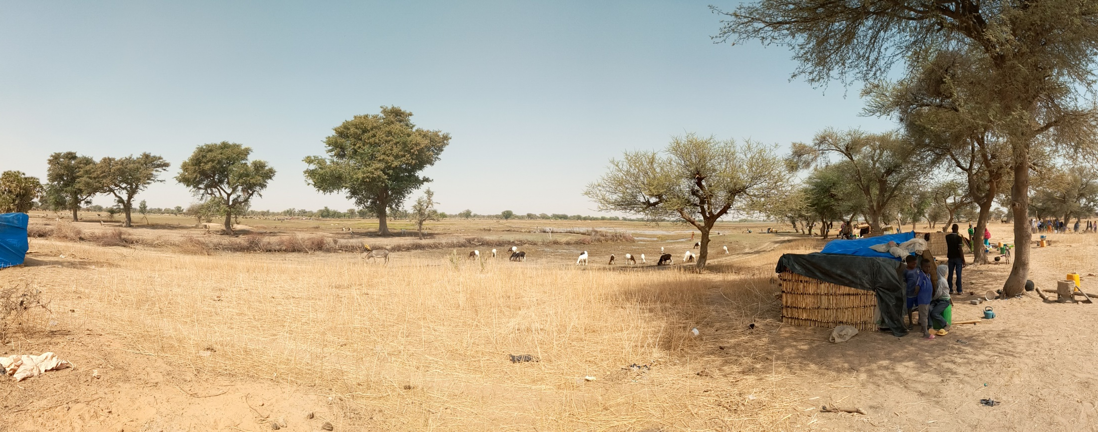
Shelter Cluster Burkina Faso Global Shelter Cluster. Annual Meeting.
October 12, 2020

Slide 2
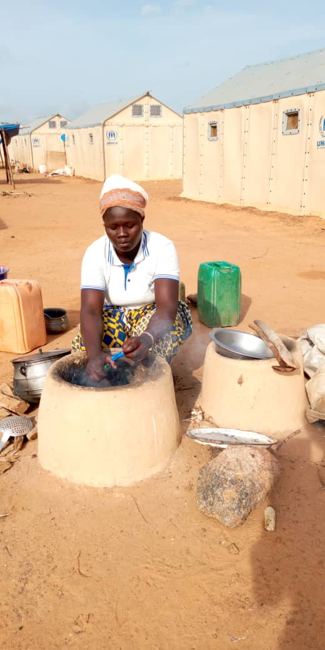
Agenda
Context characteristics
Shelter & NFIs response
Challenges
Emergency inside the emergency
5. Next steps and key priorities

Slide 3
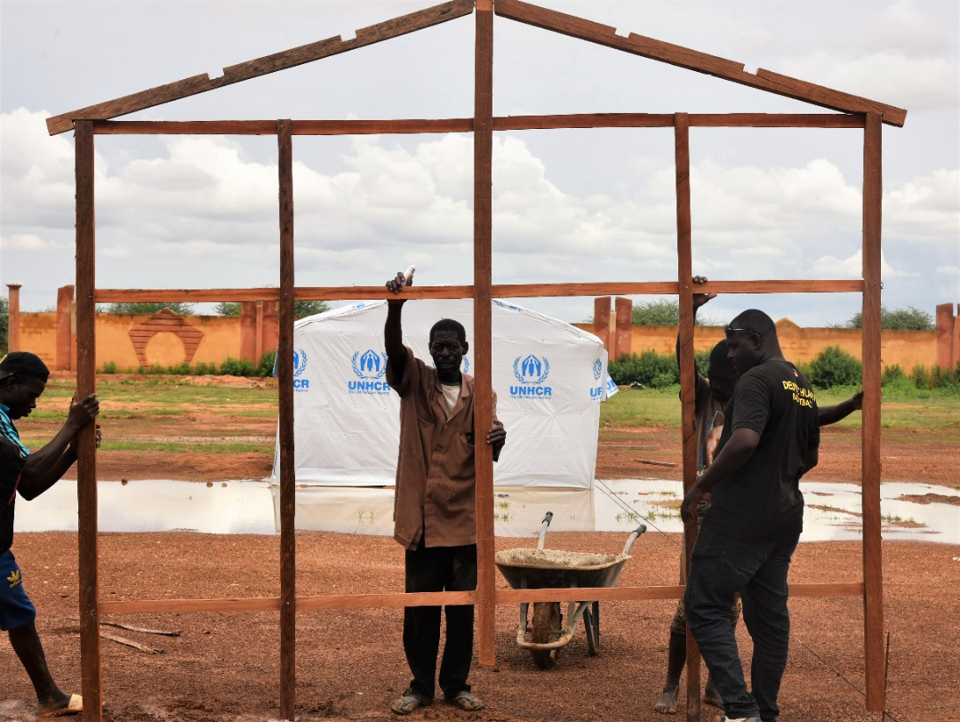
1. Context characteristics

Slide 4
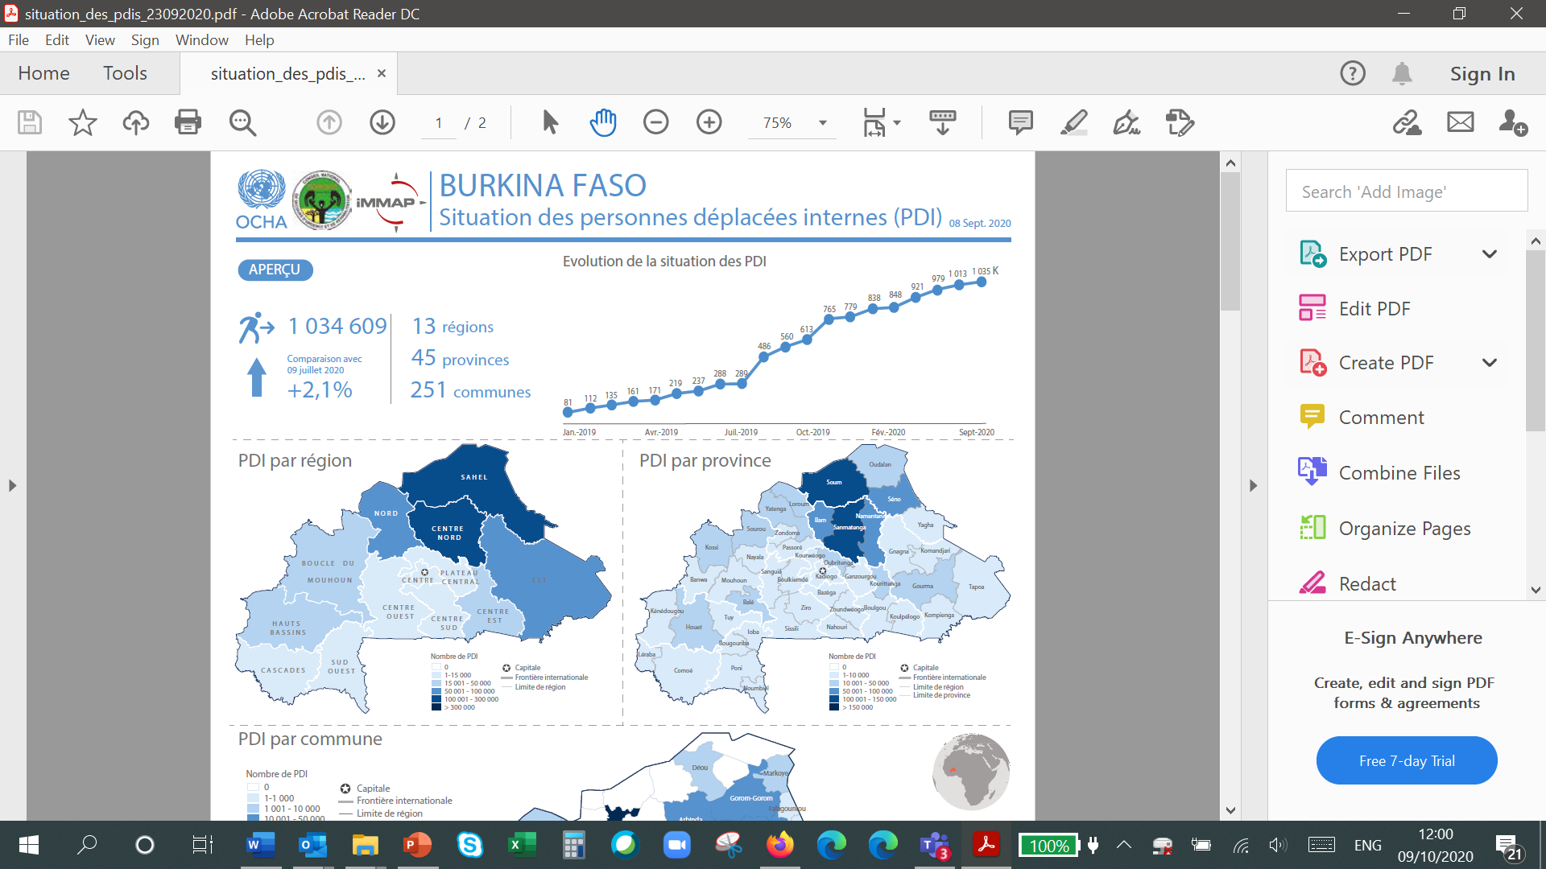
The humanitarian situation continues to deteriorate rapidly.
Growing insecurity and climate shocks have led to the worst food crisis in a decade, with 15 percent of the population in phase 3 to 5 according to the July 2020 Harmonized Framework data.
Source: OCHA BF, 2020
Strong progressive increase of the displaced population due to a worsening of the security situation, from 81.000 people in January 2019 to 1.034.609 in September 2020 (almost 12 times folded)

Slide 5
Originally, 5 regions were the most affected by the displacements but currently the number of displaced population registered in other regions is increasing.
Currently there are internally displaced people in 13 regions, 45 provinces, 251 municipalities
Source: OCHA BF, 2020

Slide 6
Funding situation
Humanitarian Response Plan (revision August 2020)
Shelter Response:
required $30.3 M, funded $4.8 M, coverage 16.0 % (FTS HRP 2020)
Planned to be funded in 2020: max 40 % according to the partners survey, including response out of the HRP)
Shelter response COVID-19:
Required $4 M, funded $0.1 M, coverage 1.4 % (FTS COVID-19)

Slide 7
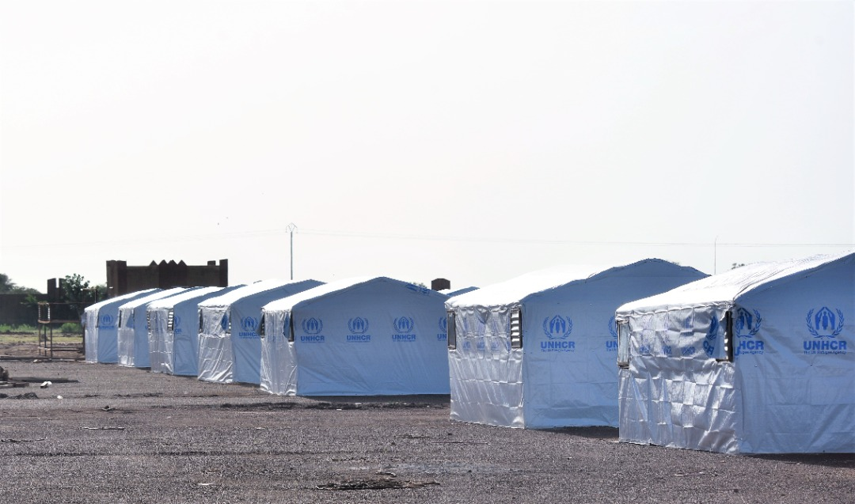
2. Shelter & NFIs response

Slide 8
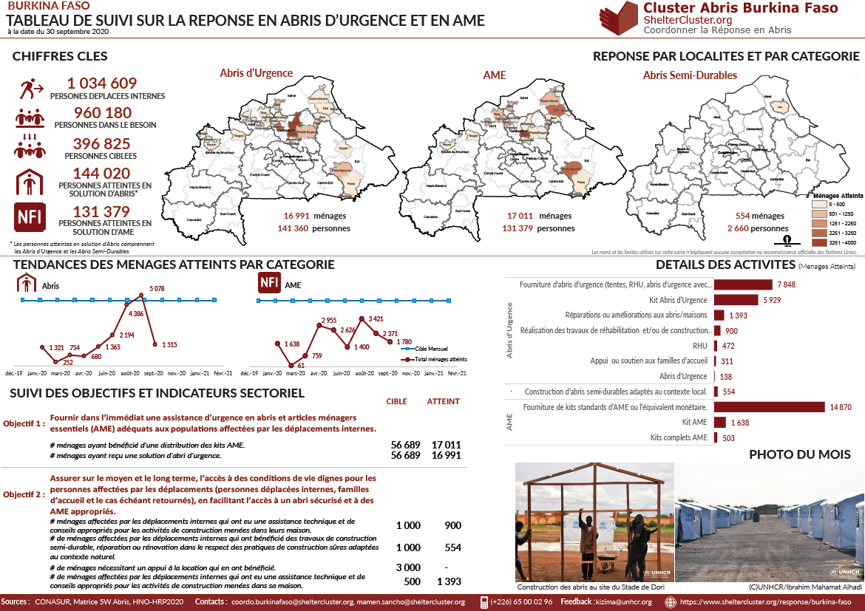

Slide 9
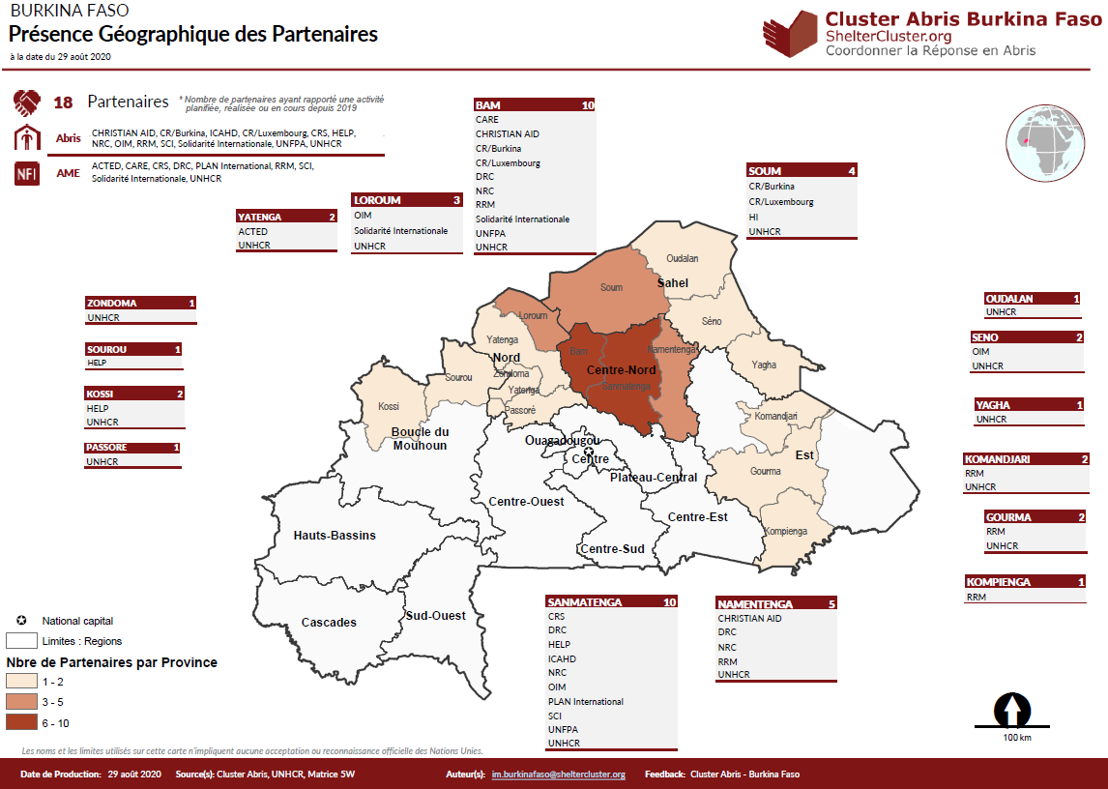
Geographical presence

Slide 10
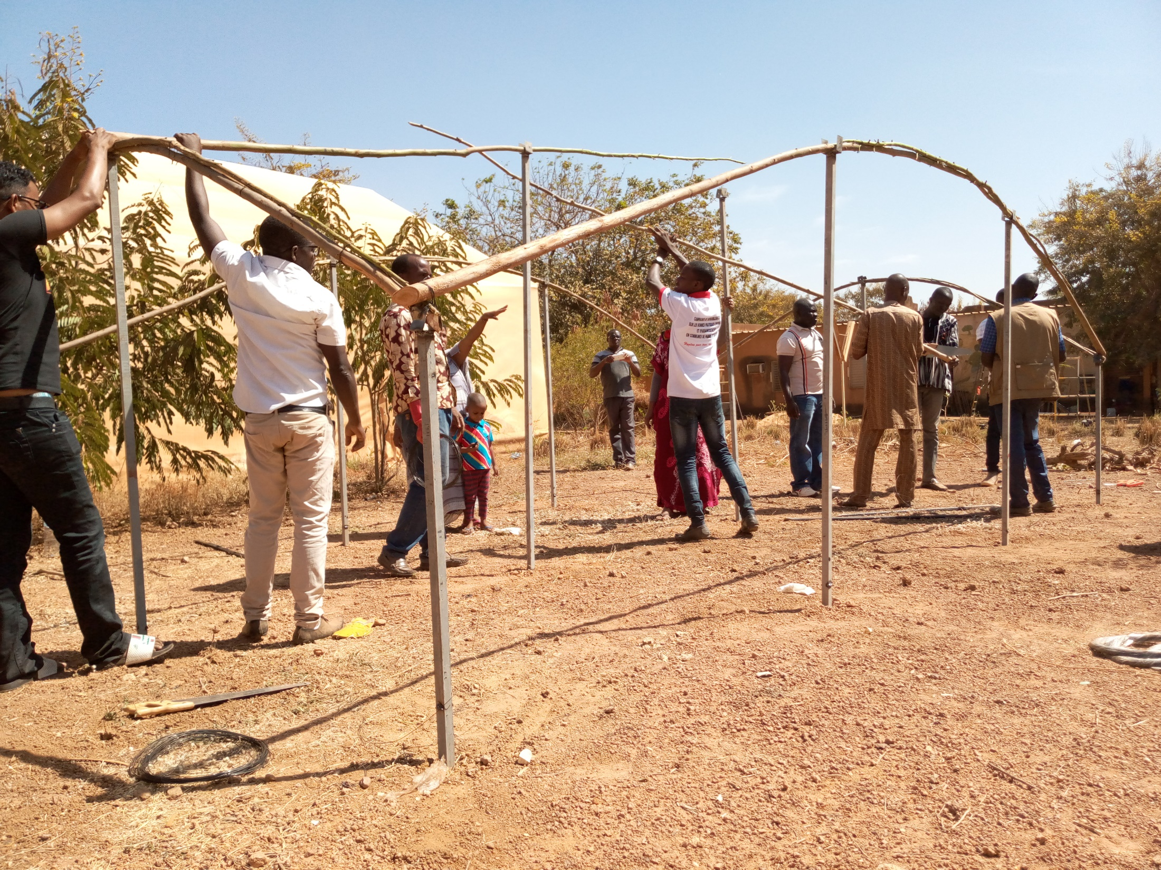
3. Challenges

Slide 11
Dealing with the challenges
Strengthen of the level of regional coordination through partners in place that act as Shelter Cluster Focal Points
Sahel regional synergies: Regular communication with the Shelter Clusters from the region: Mali and Niger and exchange of updates and tools
Partners Capacity Assessment
https://app.powerbi.com/view?r=eyJrIjoiZWU1NzIyNjMtOGFmMS00NjMyLTgzMTUtYmNkNWQyOTljYjI5IiwidCI6ImRiNTQzZjk3LWMwZjEtNGY5Ny04YzI0LWJjMmZlOWFhMWE2MyIsImMiOjh9
Technical revision of typologies in the shelter response. From the regional to the national level
Harmonisation of the beneficiary prioritization criteria based on vulnerability
Harmonisation of Rapid Needs Assessment and Post Distribution Monitoring tools

Slide 12
Dealing with the challenges
Strengthen of the level of regional coordination through partners in place that act as Shelter Cluster Focal Points
Sahel regional synergies: Regular communication with the Shelter Clusters from the region: Mali and Niger and exchange of updates and tools
Partners Capacity Assessment
https://app.powerbi.com/view?r=eyJrIjoiZWU1NzIyNjMtOGFmMS00NjMyLTgzMTUtYmNkNWQyOTljYjI5IiwidCI6ImRiNTQzZjk3LWMwZjEtNGY5Ny04YzI0LWJjMmZlOWFhMWE2MyIsImMiOjh9
Technical revision of typologies in the shelter response. From the regional to the national level
Harmonisation of the beneficiary prioritization criteria based on vulnerability
Harmonisation of Rapid Needs Assessment and Post Distribution Monitoring tools

Slide 13
Dealing with the challenges
Strengthen of the level of regional coordination through partners in place that act as Shelter Cluster Focal Points
Sahel regional synergies: Regular communication with the Shelter Clusters from the region: Mali and Niger and exchange of updates and tools
Partners Capacity Assessment
https://app.powerbi.com/view?r=eyJrIjoiZWU1NzIyNjMtOGFmMS00NjMyLTgzMTUtYmNkNWQyOTljYjI5IiwidCI6ImRiNTQzZjk3LWMwZjEtNGY5Ny04YzI0LWJjMmZlOWFhMWE2MyIsImMiOjh9
Technical revision of typologies in the shelter response. From the regional to the national level
Harmonisation of the beneficiary prioritization criteria based on vulnerability
Harmonisation of Rapid Needs Assessment and Post Distribution Monitoring tools

Slide 14
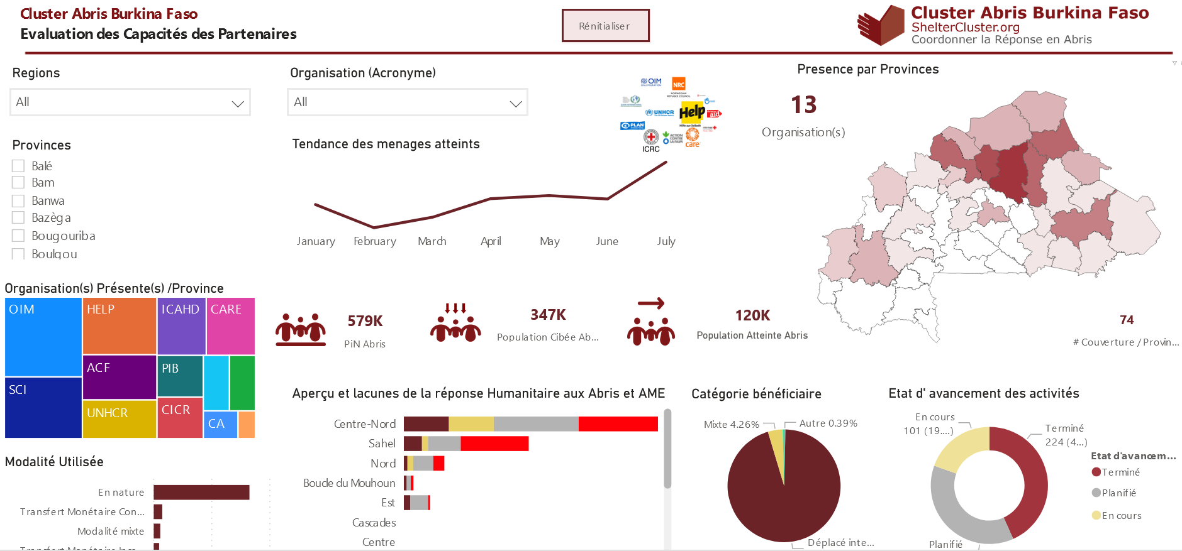
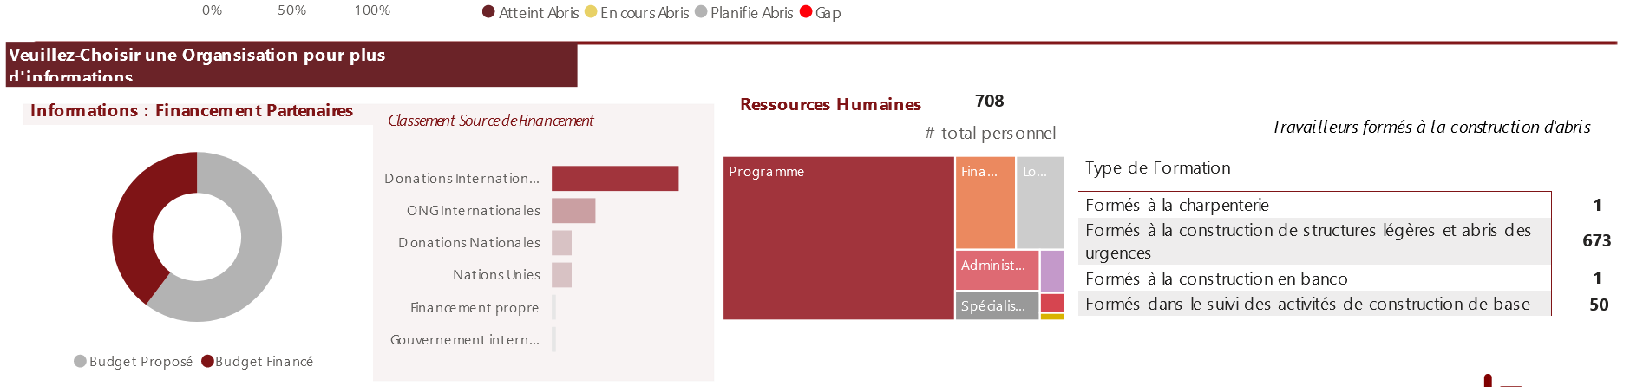

Slide 15
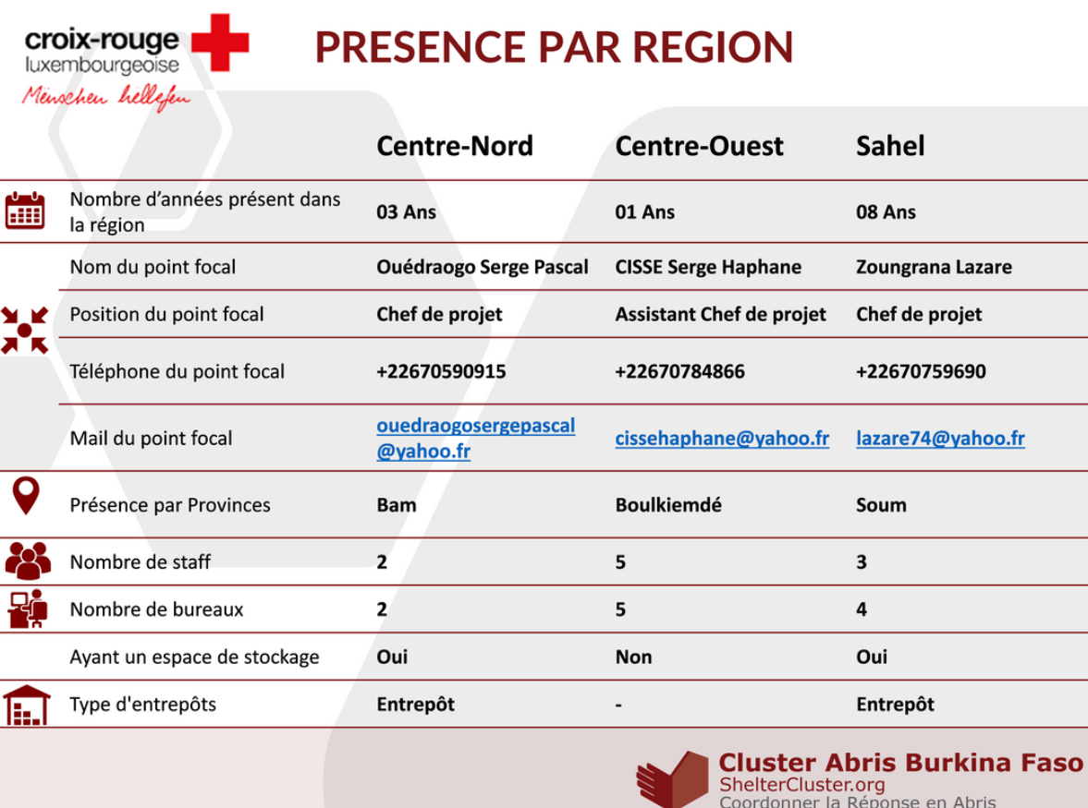

Slide 16
Dealing with the challenges
Strengthen of the level of regional coordination through partners in place that act as Shelter Cluster Focal Points
Sahel regional synergies: Regular communication with the Shelter Clusters from the region: Mali and Niger and exchange of updates and tools
Partners Capacity Assessment
https://app.powerbi.com/view?r=eyJrIjoiZWU1NzIyNjMtOGFmMS00NjMyLTgzMTUtYmNkNWQyOTljYjI5IiwidCI6ImRiNTQzZjk3LWMwZjEtNGY5Ny04YzI0LWJjMmZlOWFhMWE2MyIsImMiOjh9
Technical revision of typologies in the shelter response. From the regional to the national level
Harmonisation of the beneficiary prioritization criteria based on vulnerability
Harmonisation of Rapid Needs Assessment and Post Distribution Monitoring tools

Slide 17
Consultations with the population conducted by the SC regional focal points in the 5 regions on the level of acceptance, problems observed, recommendations for the typologies they had
Technical reflections on a parallel level with the shelter technical working group in order to improve the design currently in use
Information sheet of each type summarizing the most relevant aspects to be considered for each typology

Slide 18
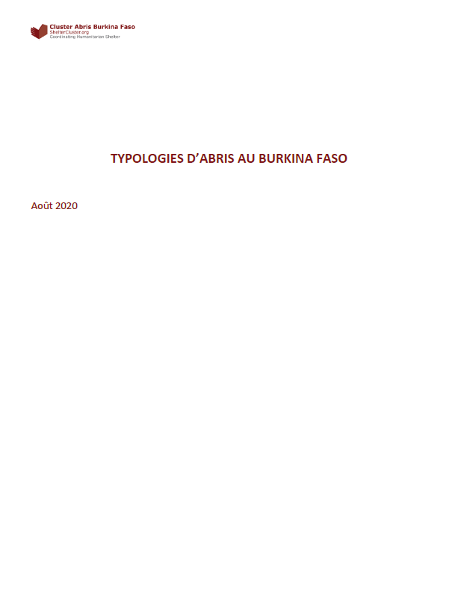
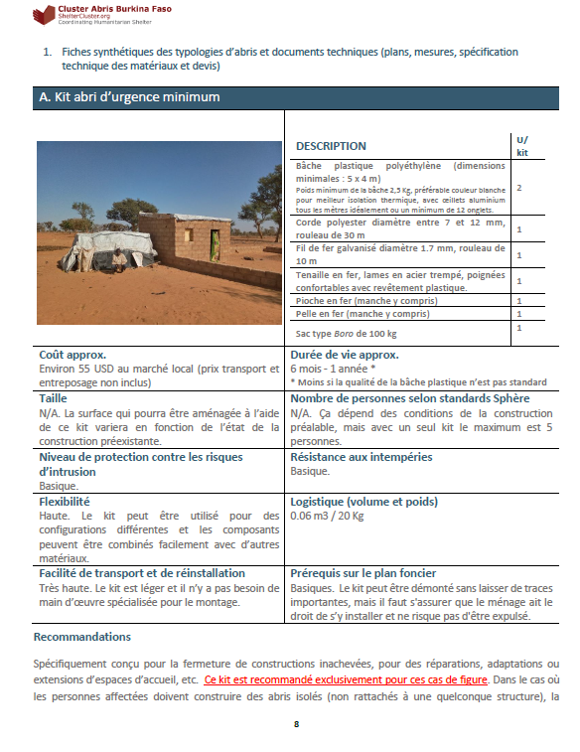
https://www.sheltercluster.org/burkina-faso/documents/typologie-des-abris

Slide 19
Dealing with the challenges
Strengthen of the level of regional coordination through partners in place that act as Shelter Cluster Focal Points
Sahel regional synergies: Regular communication with the Shelter Clusters from the region: Mali and Niger and exchange of updates and tools
Partners Capacity Assessment
https://app.powerbi.com/view?r=eyJrIjoiZWU1NzIyNjMtOGFmMS00NjMyLTgzMTUtYmNkNWQyOTljYjI5IiwidCI6ImRiNTQzZjk3LWMwZjEtNGY5Ny04YzI0LWJjMmZlOWFhMWE2MyIsImMiOjh9
Technical revision of typologies in the shelter response. From the regional to the national level
Harmonisation of the beneficiary prioritization criteria based on vulnerability
Harmonisation of Rapid Needs Assessment and Post Distribution Monitoring tools

Slide 20
Dealing with the challenges
Strengthen of the level of regional coordination through partners in place that act as Shelter Cluster Focal Points
Sahel regional synergies: Regular communication with the Shelter Clusters from the region: Mali and Niger and exchange of updates and tools
Partners Capacity Assessment
https://app.powerbi.com/view?r=eyJrIjoiZWU1NzIyNjMtOGFmMS00NjMyLTgzMTUtYmNkNWQyOTljYjI5IiwidCI6ImRiNTQzZjk3LWMwZjEtNGY5Ny04YzI0LWJjMmZlOWFhMWE2MyIsImMiOjh9
Technical revision of typologies in the shelter response. From the regional to the national level
Harmonisation of the beneficiary prioritization criteria based on vulnerability
Harmonisation of Rapid Needs Assessment and Post Distribution Monitoring tools

Slide 21
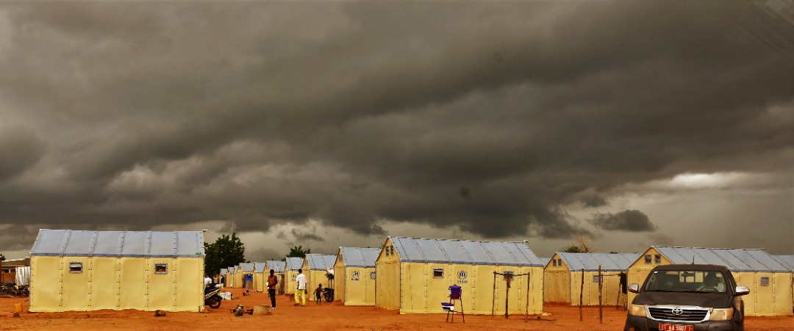
4. Emergency inside the emergency COVID-19 & Floods

Slide 22
Impact
COVID-19:
Data from 07 Octobre 2020 du Ministère de la Santé:
19 new cases, 28 healed et 01 death; for a cumulative of 2,241 confirmed cases, 1,506 healed et 60 deaths since the start of the pandemic.
The pandemic situation also hampered the capacity and speed of response of partners in the sector, leaving the affected population more exposed to the weather than usual.

Slide 23
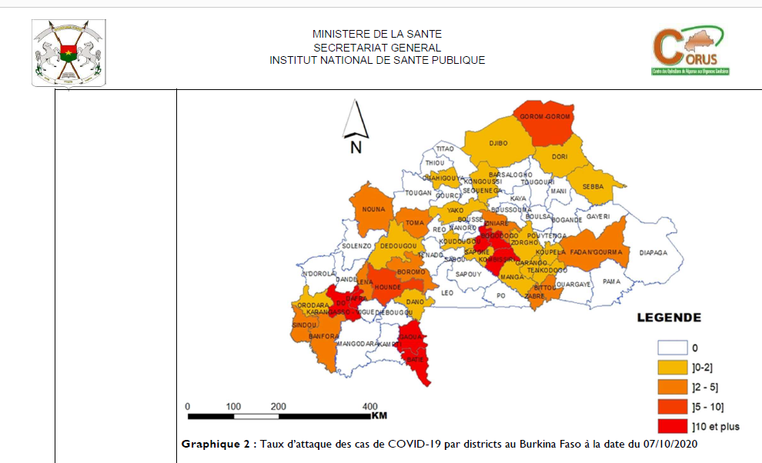
Impact

Slide 24
Impact
FLOODS:
Households and shelters affected by floods and high winds until September 2020, in the 5 regions prioritized in the humanitarian response:
Central North: more than 400 displaced and host households affected by the rains of September 5 and 7, in addition to more than 520 affected in June among 8,369 households identified as being settled in flood-prone areas (10 communes, June 2020).
Sahel: 462 households affected by high winds and 22 shelters destroyed by the last rains in September, and 200 households in June, among 1,593 households identified as living in flood-prone areas (7 communes, June 2020).

Slide 25
Impact
North: 31 households affected by the last rains in September, but the majority of the displaced households are hosted by host households in Yatenga and Loroum, which so far have not been heavily affected by heavy flooding.
Boucle de Mouhoun: Some damage was reported to emergency shelters and also to host communities’ homes by the mostly high winds. It is estimated that 2/5 of the shelters were affected by the bad weather.
East: 857 households affected by the rains of September 5. Strong concern about the low presence of shelter actors in the region.

Slide 26
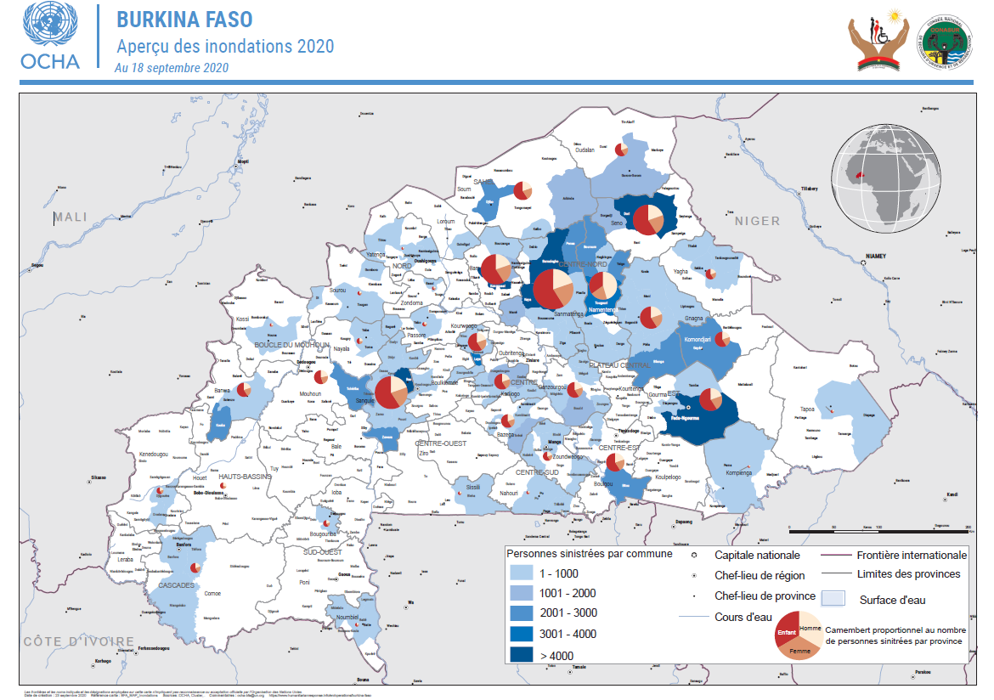

Slide 27
Preparedness
Humanitarian community and the authorities in the Sahel region have prepared a very relevant contingency plan.
Sites outside flood-prone areas were gradually identified for the relocation of affected households.
Typologies of emergency shelters less adapted to these bad weather conditions have been reviewed and reinforcement measures have been added to avoid its damage.

Slide 28
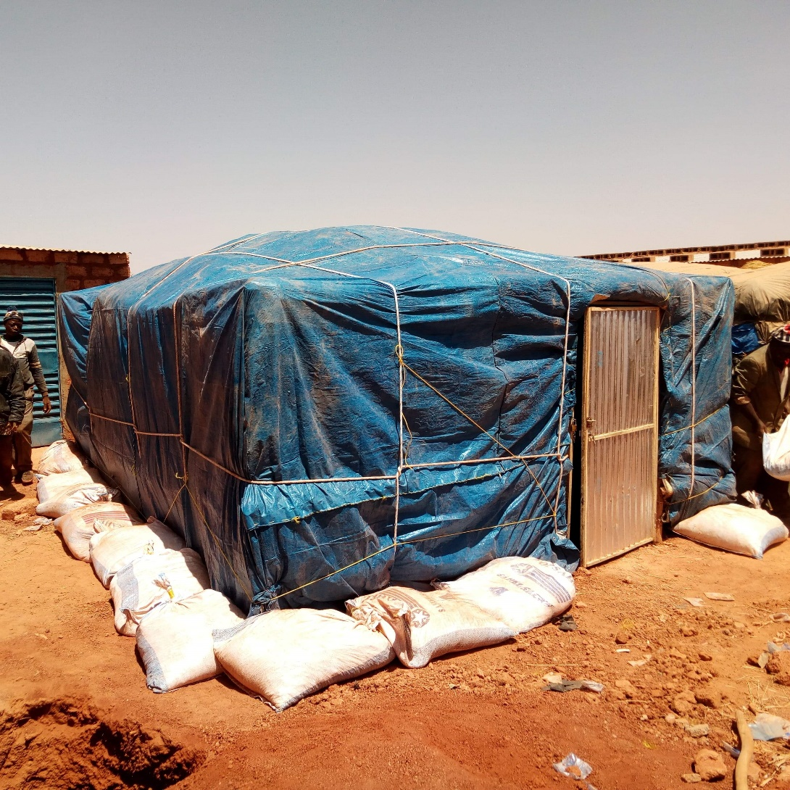
Solidarité International, North region, sept 2020

Slide 29
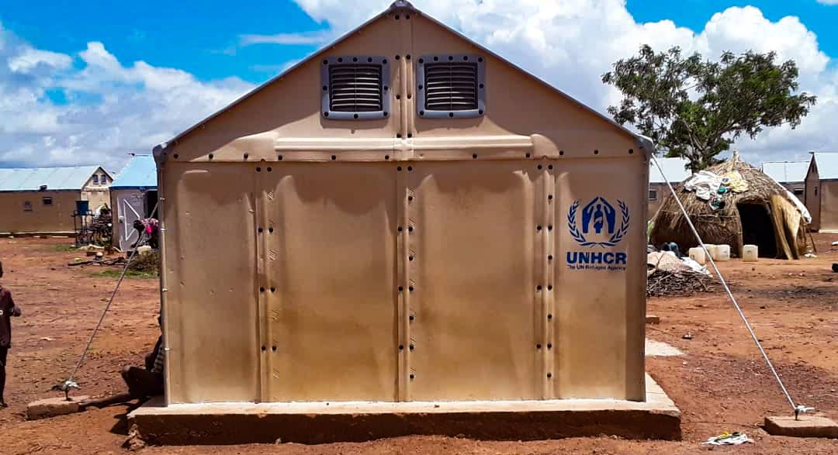
UNHCR, North region, sept 2020

Slide 30
Response
The relocation and construction of the new shelters took place in the two regions most affected by the rains and high winds, the Sahel and Central North regions:
Sahel:
977 shelters have already been finalized for household relocation, in a planned response for 1,000 households.
46 households have already been relocated.
Central North
More than 520 households have been relocated.
Additional distributions of NFIs have been done to replace those families that lost these items (more than 300 households in CN and 280 households in the East).
Initial creation of a humanitarian cell to strengthen operational coordination across sectors and with local authorities in Boucle de Mouhoun

Slide 31
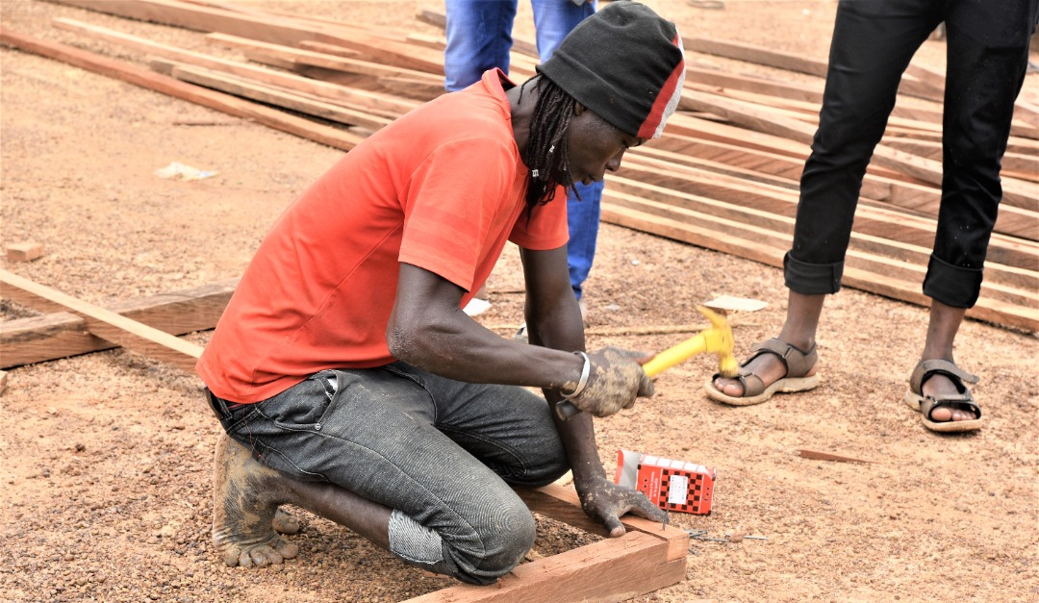
6. Next steps and key priorities

Slide 32
Transition from current emergency shelter responses to more durable shelter solutions
Advocacy for securing land for the displaced population
Continuation on the identification of adequate areas for new sites
Improvement of the site planning
Reinforcement of the emergency shelter contingency stock
Reinforcement of the regional shelter cluster coordination
Advocacy for additional support to the shelter response
Continuation with the sensitization of beneficiaries to ensure regular maintenance of shelters and sites
Reinforcement of the monitoring of the implementation of the shelter response

Slide 33
Questions ?

