Slide 1
2023 Global Shelter Cluster CCPM webinar
February 8 from 10.00- 11.00h am CET

Slide 2
Agenda
Introduction and 2022 CCPM remarks
Timelines for the new CCPM cycle
Particularities in CCPM for disaster related clusters
Updates for this new CCPM exercise
Data analysis update
Q&A
Case study: Sudan Shelter Cluster
Case Study Q&A

Slide 3
Introduction: CCPM is
A “mandatory” self-assessment of cluster performance against the 6 core cluster functions and Accountability to Affected Populations
A country-led process, supported by Global Clusters and OCHA
A process that can be applied by both Clusters and sectors
A process and tool to improve cluster performance
A pre-set “anonymous” questionnaire developed by OCHA with the GCCG that is the same for all clusters/sectors

Slide 4
Introduction: CCPM does NOT
Evaluate individual partners coordinators / coordination teams
Monitor response (service delivery)
Evaluate if/when Clusters should be deactivated, merged etc.
Exclude usage of other tools with the same purpose

Slide 5
Target Audience
The coordination team (Coordinators, Deputy coordinators, Co-chairs, Information Management Officers, Sub-national Coordinators, Technical Coordinators, etc)
Cluster partners
Other stakeholders (including national authorities, donors, private sector and others such as others cluster teams, ICCG, OCHA colleagues or HCT members).
Notes:
the coordination team (Coordinators, Deputy coordinators, Co-chairs, Information Management Officers, Sub-national Coordinators, Technical Coordinators, etc) and the cluster partners and other stakeholders including national authorities, donors, private sector and others such as others cluster teams, ICCG, OCHA colleagues or HCT members.

Slide 6
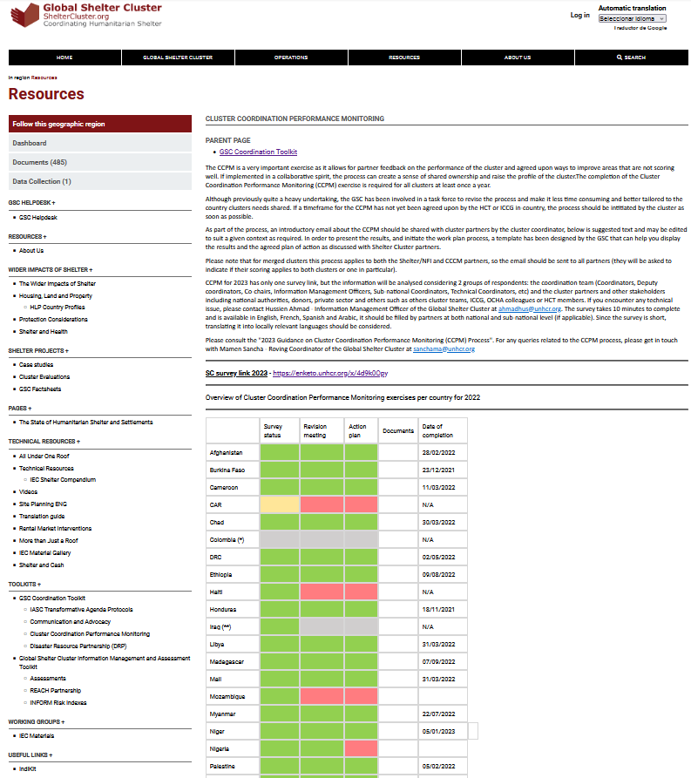
CCPM in the GSC website
https://sheltercluster.org/resources/pages/cluster-coordination-performance-monitoring

Slide 7
2022 CCPM remarks
85% country clusters (22) completed the CCPM in 2022
42% country clusters (11) completed the CCPM in the first quarter of 2022
15% (4) began the process but did not draft an action plan
CCPM process is only considered completed once the action plan is shared with the GSC

Slide 8
Timelines
General case
Clusters activated due to disasters
Clusters that finished CCPM Oct-Dec 2022

Slide 9
General case
CCPM Explanation to
SC Partners
Introductory Email and Online Survey
Sharing of the results and action plan
Results revision meeting and action plan
Follow-up and Monitoring of the action plan
January 2023
Before 31-Jan-23
January to March 23
Before 31-Mar- 23
September 2023
Notes:
HRP and preparedness

Slide 10
Cluster finished their CCPM Oct-Dec 2022
CCPM Explanation to
SC Partners
Introductory Email and Online Survey
Sharing of the results and action plan
Results revision meeting and action plan
Follow-up and Monitoring of the action plan
April 2023
Before 30-April-2023
April to June 23
Before 30-June- 23
December 2023

Slide 11
Particularities in CCPM for disaster related clusters
Disasters are primarily sudden-onset events
Disasters responses predominantly require rapid scale-up of operational capacity
Disaster responses are often short-term plans
In high-risk disaster-prone countries / regions disaster management process flows between mitigation, preparedness and response, and clusters are increasingly active all year round

Slide 12
Timelines
Clusters activated and deactivated in the same year Common scenario with short-term disaster response plans
CCPM process briefing to partners and survey conducted before deactivation - hand over to ICCG and GSC
Clusters active all year round, for disaster response, for preparedness or for a combination of both processes
Same as CCPM general case (steps adjusted to context) or when CCPM rolls out through Q4, adjusted dates apply

Slide 13
Updates for this new CCPM exercise
Only one link for all countries and target groups
Additional questions – guide the discussion to action points
The possibility to add also specific questions for your country cluster
The survey has been translated to all the languages you have requested during past year (available now in English, French, Spanish, Arabic, Burmese and Portuguese).
Not necessary the report, only the action plan
Notes:
Additional questions only when select the answers will be for shelter cluster or shelter and CCCM

Slide 14
Additional questions
What is the type of crisis?
What is the type of response?
To what extent are you satisfied with the frequency of Shelter Cluster meetings?
How satisfied are you with the content of the Shelter Cluster meetings?
What points would you like to see added to Shelter Cluster meeting agendas ? Please share your suggestions, particularly if you've responded unsatisfied or very unsatisfied to the previous question
What is your overall satisfaction with the level of information shared by the Shelter Cluster?
What other information would you like to receive from the Shelter Cluster? Please share your suggestions, particularly if you've responded unsatisfied or very unsatisfied to the previous question
How satisfied are you with the reporting process between partners and the Cluster (3/4/5W, ActivityInfo, other..)?
If not satisfied, what could the Shelter cluster do to improve the process?

Slide 15
Additional questions
How satisfied are you with the most recent process of assessing and identifying humanitarian shelter needs to inform humanitarian planning ?
If not satisfied, what could the Shelter cluster do to improve the process?
How satisfied are you with the process of preparation of the most recent humanitarian shelter response plan ?
If not satisfied, what could the Shelter cluster do to improve the process?
How would you describe the project submission for the appeal/response plan?
How satisfied are you with the current active TWIGs of the Shelter Cluster?
What technical issues, if any, are currently not being addressed by the cluster through TWIGs or other resources?
Does the SC provide sufficient space to partners for knowledge exchange (lessons learned, best practices, case study presentations, and other)
How would you rate the SC performance in addressing GBV?
Please explain

Slide 16
Additional questions
How would you rate the SC performance in addressing PSEA?
Please explain
How would you rate the SC performance in addressing mainstreaming the environment?
Please explain
In your view, what are the main strengths of the Shelter cluster?
In your view, what are the main areas for improvement of the Shelter cluster?

Slide 17
Data analysis update
We’ll provide you with an excel tool summarizing the analysis of CCPM data for your country, in addition to the extracted dataset from kobo, including:
Detailed analysis and overall findings on the core functions performance aggregated and disaggregated by partners / coordination team
Detailed analysis on additional questions
Additional information included in the survey
Comments can be extracted from the dataset itself
Dashboard on the CCPM page of the website, for an overview of overall findings across different countries

Slide 18
Questions?

Slide 19
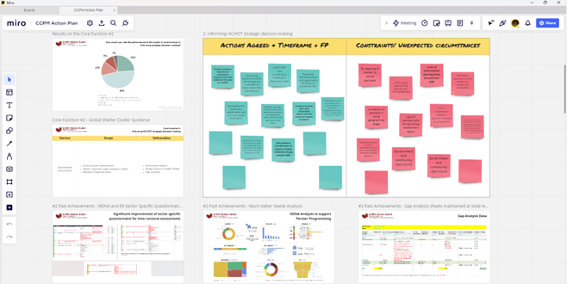
Case study: Sudan SC
Iva Vavic, Sudan SC coordinator

Slide 20
Advantages
Miro tool is intuitive, simple and easy to use. No sign-up is necessary; participants just need to click the board link and they are good to go.
The online workshop approach is inclusive as it overcomes distance and movement restrictions and allows for broad participation.
It also ensures equality since all meeting attendees participate at the same time. This gives a voice to introverts or those who are normally too shy to speak up and no one feels left out. This increases the ownership of the Action Plan document.
It’s anonymous, which allows participants to share honest feedback and speak freely without being judged.
It is also fun, interactive and comes with a sense of novelty, which increases user engagement.

Slide 21
Advantages
Participants can see what others are doing in real time, get inspired and piggyback off each other’s inputs.
Besides the core functionality, Miro has lots of helpful features. Frame feature allows for seamless transitions between a PowerPoint-like experience to group work/workshop-like experience. Bring to me feature keeps all participants on the same board. Vote feature allows participant to agree on which inputs to prioritize for inclusion into the final Action Plan doc. Etc.
Discussions on results, what each core cluster function entails and good practice/cluster achievements were educational for partners and helped solicit relevant and useful workshop results (suggestions on improvements and challenges to overcome).
With Miro board remaining active even after the workshop has ended (with locked sticky notes/ inputs), there is an opportunity for those that couldn’t attend the workshop to add their inputs later on.

Slide 22
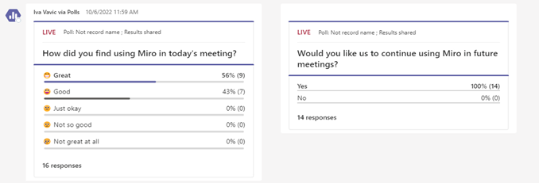
Disadvantages
Connectivity issues.
Participants with limited digital literacy may be excluded from participating if they can’t find their way around the tool.

Slide 23
Let's have a look at it!
https://miro.com/app/board/uXjVPqFCU3k=/?share_link_id=820034254869

Slide 24
Questions?

Slide 25
Key links
The survey can be accessed at: https://enketo.unhcr.org/x/4d9k0Opy
2023 CCPM Guideline in ENGLISH
2023 CCPM Guía en ESPANOL
2023 CCPM Guide en FRANCAIS
Again
February 15 from 16.00 h to 17.00h CET

