Slide 1
Shelter Sector Türkiye
Earthquake Response
16 February 2023

Slide 2
Agenda
Situation overview
Coordination architecture
UNDAC update
Shelter and setttlements challenges
Shelter and settlements programming options
Technical Resources
Plenary discussion
AOB

Slide 3
Situation overview
Earthquakes measuring 7.7 and 7.6 M in Kahramanmaraş on February 6, 2023
11 provinces declared as disaster areas (Elazig added yesterday)
36,187 deaths (16 Feb – AFAD)
216,347 people have been evacuated from quake-hit areas (16 Feb – AFAD)

Slide 4
Situation overview
AFAD (Disaster and Emergency Management Presidency) leads the Government response to shelter needs.
AFAD Disaster Sheltering Group: 3,264,985 blankets, 283,410 tents (172,225 erected), and 54,297 containers (Feb. 16).
Ministry of Environment, Urbanization and Climate Change is carrying out damage assessments:
224,923 independent units in 50,576 buildings have been destroyed or are heavily damaged requiring demolition.
71,174 independent units in 11,114 buildings were moderately damaged, 640,131 independent units in 99,300 buildings were slightly damaged.

Slide 5
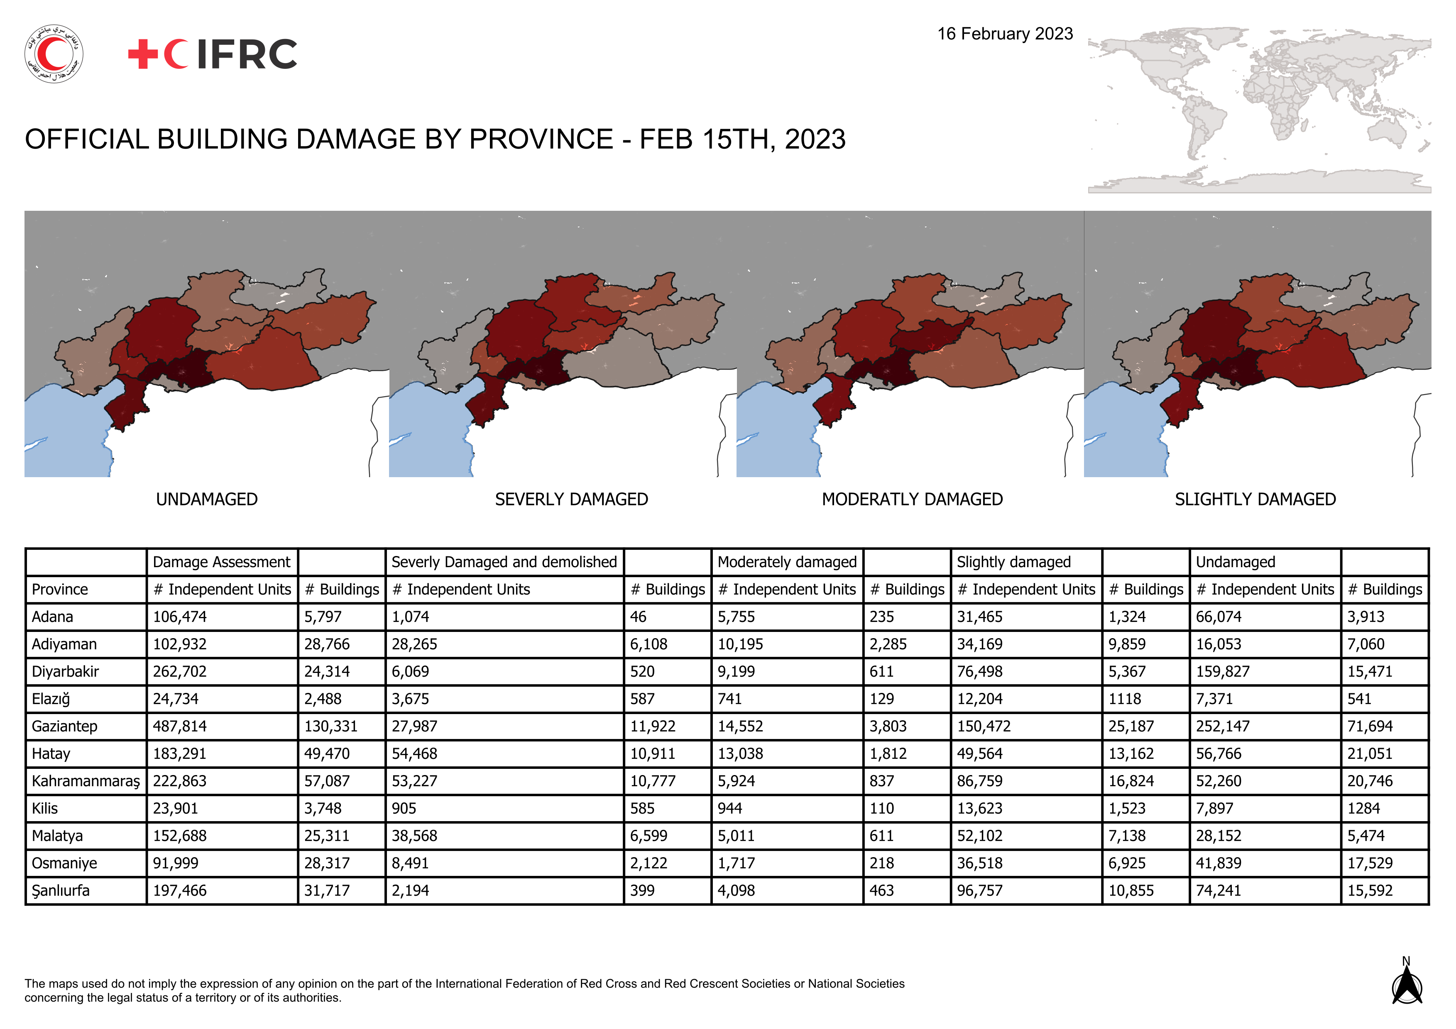

Slide 6
Coordination Architecture DRAFT
Humanitarian System-Wide Scale up Activation
“...we will coordinate the earthquake response through the existing coordination mechanisms in the region...”
Country Team in Ankara with sector-based coordination
5 area-based coordination hubs
Flash-Appeal

Slide 7
Shelter and Settlements Challenges
Low temperatures, winterization, thermal protection
Fuel / Heating solutions (and ventilation)
Fire risk / fire proofing in temporary settlements
Rubble removal
Housing, Land and Property (compensation, renters,...)
Environment/Waste management (tent disposal,...)
Housing safety, fear
Urban response
Information, communication, outreach
Inward and outward movement, safe provinces
Registration of organizations

Slide 8
Shelter and Settlements Programming Options (1)
There is no one size fits for all solution
Support affected population’s own coping mechanisms
Sheltering as a process
Distribution of tents and temporary shelter solutions
Improvement of collective centres
Winterization kits
Distribution of household items (mats, blankets, kitchen sets, heaters,...)

Slide 9
Shelter and Settlements Programming Options (2)
Support to host families
Rental support programmes
Top-up grants
Improvement of settlement conditions, community and public infrastructure
Information and community outreach
House repairs (in-kind or cash, mostly rural)
Urban profiling

Slide 10
Technical Resources
https://sheltercluster.org/response/turkiye-earthquake-2023
ALNAP Lessons Learnt: Responding to Earthquakes
ALNAP Relevant learning for the earthquake response in Türkiye and Syria
ODI Earthquakes in Turkey: reflections from past experience
Shelter Compendium: IEC materials

