Slide 1
GAZA SHELTER CLUSTER
06 October 2024

Slide 2
AGENDA
Introductions
Coordination update
IM update
Partner Updates
AOB

Slide 3
NEXT MEETINGS
National Shelter Cluster Meeting (Online)
Wednesday 16 October, 10:30 – 12:00
Gaza Shelter Cluster meeting
Sunday 13 Oct, 10:30 – 12:00, Location: JHC

Slide 4
COORDINATION UPDATE
  Thanks to all those who participated in the technical workshop
  Al Nuseirat, Al Bureij – “forced relocation” orders – if you’re hearing anything, or planning an assessment or response, please let us know. Even if we can’t assist, the more information we know the better
  New map for North Gaza – not forced relocations yet, but we can expect it in the next few days.
  Welcome points being discussed – where joint services are provided. Shelter not but we need to understand where people are
  You will also have seen the extension of the so-called “humanitarian zone” east by a couple of blocks towards Salah Al Din
  We are getting a few donated shelter items (flour bags, tarps, tents) from various sources to be distributed by the shelter cluster. Discussing with SAG on how to share with partners fairly.

Slide 5
COORDINATION UPDATE
  UNICEF tarps – last week 6500 were shared between NRC and Ma’an as UNICEF and cluster partners. Thanks to all who helped with that! There may be more.
  Pipeline – OCHA are working with CLA and Southern Command on a winterization plan. We have shared the summary of the pipeline with OCHA team:
    703,200 tarps – 351,600 families
    6517 SOKs
    18312 tents
      This equates to 376,429 families = 1.9 m people
    4400 toolkits
    6715 bedding sets
    34490 Blankets
    21685 Mattresses
      This equates to 15,000 families = 75,000 people

Slide 6
COORDINATION UPDATE
  HF – no updates on fast track
  Monitoring visits schedules received

Slide 7
FLASH APPEAL
Will cover all of 2025
NOT an HNO/HNRP. This is a Resource Mobilisation Document, not a Plan
We will give two figures – what we could achieve if we could work at full capacity, and what is realistic in the current operating conditions
The cluster is currently working on outlining the activities – this will be much the same as 2024
Mostly emergency, allowing for some early recovery, etc
Please start conversations in your organisation as timeline will be date

Slide 8
FLASH APPEAL
Timeline:
  Shelter cluster to share spreadsheet and process by 8 October
  Responses from partners needed by 16 October
  One week for collation and follow up with partners before submission to OCHA
  Cluster work with OCHA early November for feedback

Slide 9
FENCE ROAD
  Partners must submit their SRFs and truck details as usual to Logs Cluster
  Partners must submit their fence road truck details by TUESDAY AM for the following week so that the Logs cluster can collate and share with the ICCG.
  Last week we prioritized 30 trucks for Shelter – Tarps and Tents only!
    11 offloaded successfully
    10 no pre-approval
    Remainder rejected
  We added 3 trucks of tarps
  Please share what tarps/tents you have for this week asap.
  We’ve got a schedule of items longer in advance
  Please make sure logs colleagues are aware of this process, SC has to be involved.

Slide 10
IM UPDATE

Slide 11
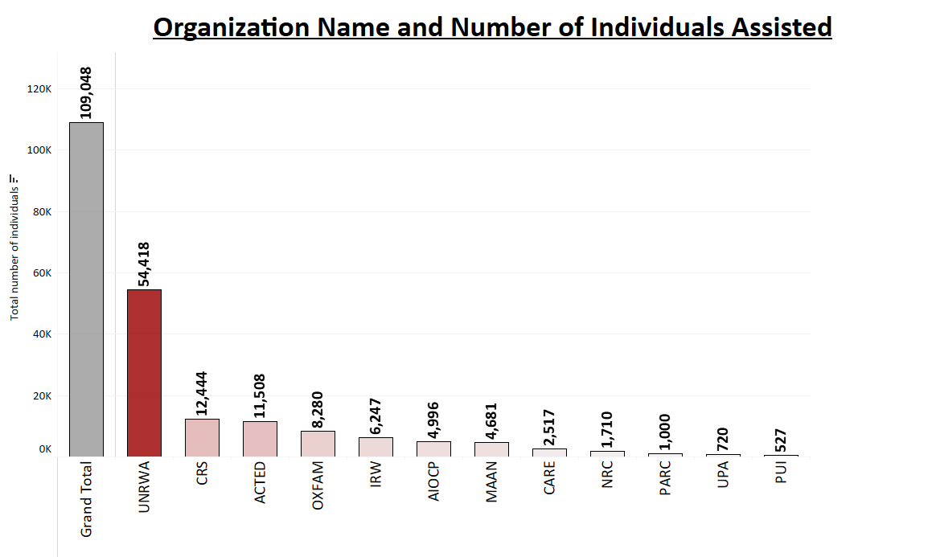
IM Updates- 5Ws Analysis (Aug-Sep)2024

Slide 12
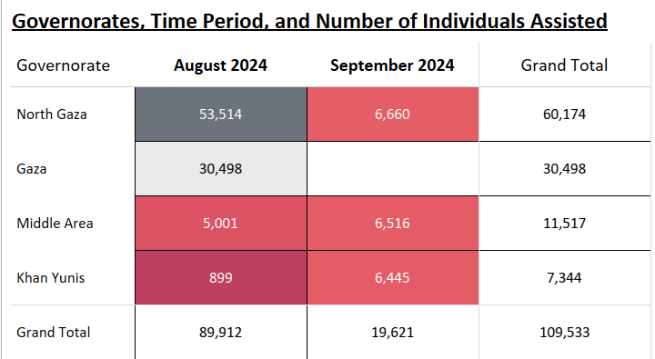

IM Updates- 5Ws Analysis (Aug-Sep)2024

Slide 13
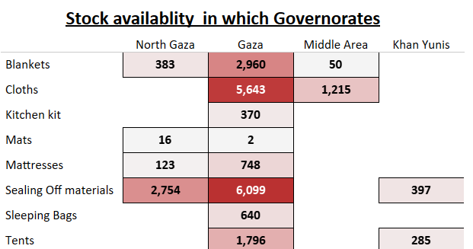
IM Updates- Stock Analysis 2024

Slide 14
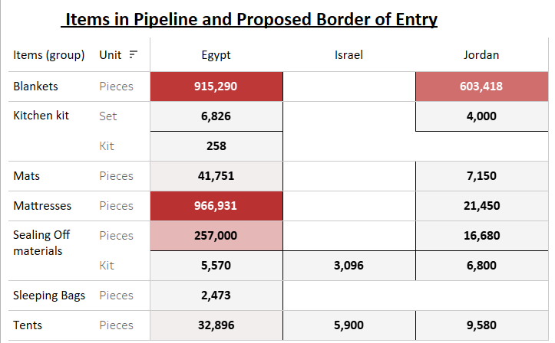
IM Updates- Pipeline Analysis 2024

Slide 15
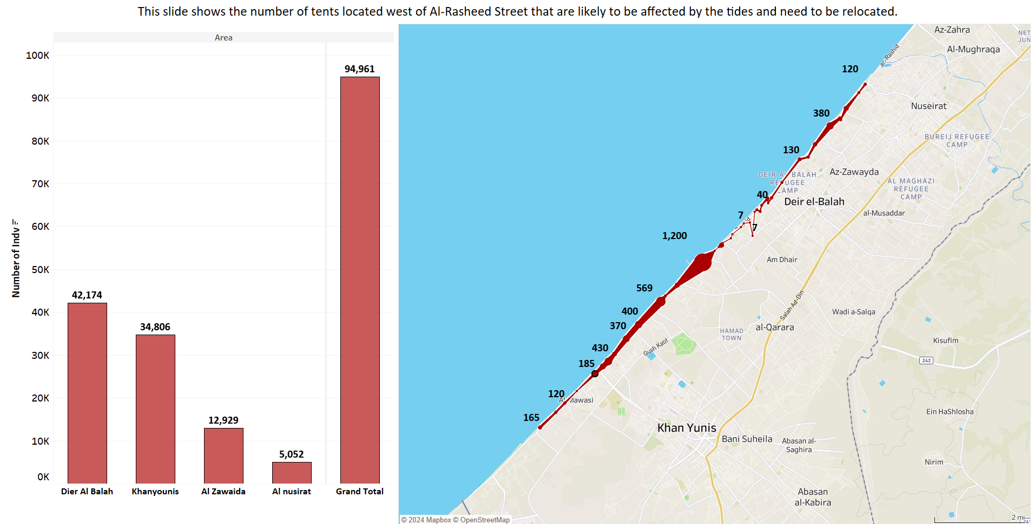
This slide shows the number of tents located west of Al-Rasheed Street that are likely to be affected by the tides and need to be relocated.

Slide 16
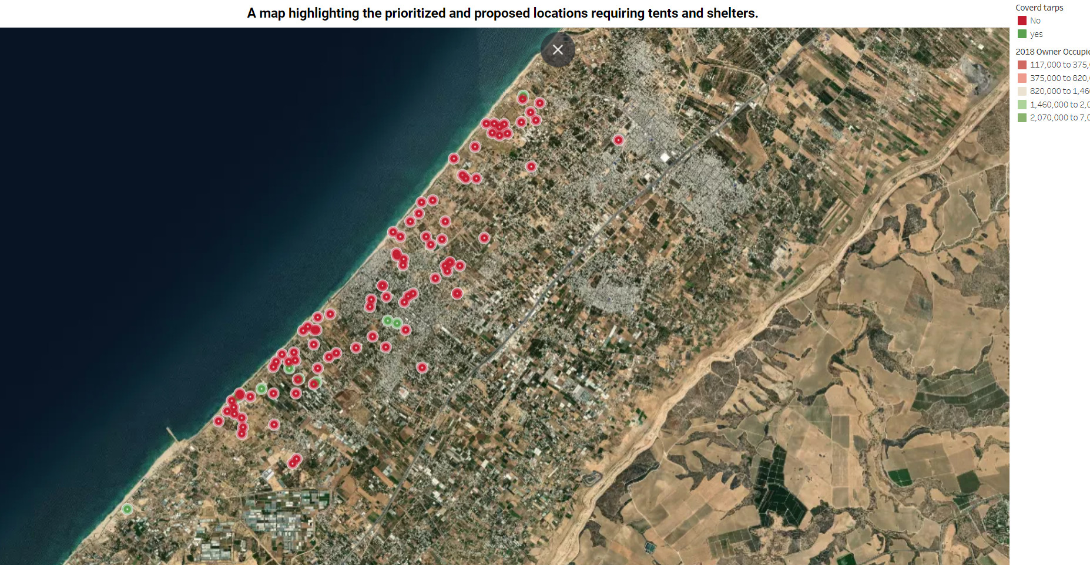

Slide 17
DISCUSSION
Targeting and identifying vulnerabilities
Blanket coverage within a site?
Technical vulnerability?
Contingency?!

Slide 18
AOB
Any presentations, achievements, etc, please share in this meeting

