Slide 1
Permanent Shelter Option for Kegalle District Landslide Victims
Anuruddha Vijekumara
Scientist

Slide 2
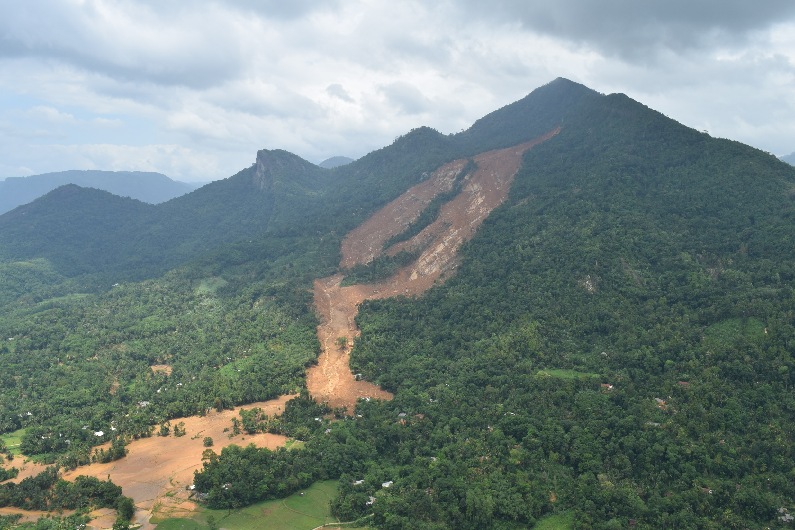
Permanent Shelter Option for Kegalle District Landslide Victims
INTRODUCTION
DS Division | Affected |  | Deaths Reported | Missing people | Houses Damaged
 | Families | People |  |  | Fully | Partially
Aranayake | 756 | 2401 | 31 | 96 | 72 | 285
Bulathkohupitiya | 1271 | 5033 | 15 | 2 | 9 | 42
Dehiowita | 2982 | 9857 | 5 | 1 | 7 | 104
Deraniyagala | 286 | 1145 | 0 | 0 | 0 | 67
Yatiyanthota | 970 | 3703 | 0 | 0 | 24 | 265
Ruwanwella | 1541 | 6336 | 0 | 0 | 9 | 30
Galigamuwa | 429 | 1624 | 0 | 0 | 4 | 28
Warakapola | 476 | 1789 | 0 | 0 | 7 | 273
Mawanella | 465 | 1723 | 0 | 0 | 21 | 298
Rambukkana | 52 | 185 | 0 | 0 | 1 | 12
Kegalle | 755 | 2325 | 1 | 0 | 14 | 226
Total | 9983 | 36121 | 52 | 99 | 168 | 1631
Source: Disaster Management Center – Kagalle district (2016.10.03)

Slide 3
Permanent Shelter Option for Kegalle District Landslide Victims
THE RESETTLEMENT PROCESS
Beneficiary Selection for the resettlement programme
Directly affected families of the landslide events of May 2016 in Kegalle District
Indirectly affected families whose houses became high risk due to extreme rainfall in the district in May 2016 and identified by NBRO

Slide 4
Permanent Shelter Option for Kegalle District Landslide Victims
THE RESETTLEMENT PROCESS
Objectives of the Resettlement Programme
To complete the core-house for the beneficiaries with the Government financial assistance
To ensure a disaster resilient house is constructed

Slide 5
Permanent Shelter Option for Kegalle District Landslide Victims
THE RESETTLEMENT PROCESS
Concept
The concept is to construct the ‘Core–House’ with the Government assistance and to ensure the use of public money (Government Assistance) in the housing construction under the Resettlement Programme to The Build Back Better Concept.

Slide 6
Permanent Shelter Option for Kegalle District Landslide Victims
THE RESETTLEMENT PROCESS
“Core House” features
Minimum floor area of 650 sq. ft.
Resilient foundation and a superstructure (As directed by NBRO)
Two bedrooms
A kitchen
A permanent roof and
A water seal toilet and the septic tank

Slide 7
Permanent Shelter Option for Kegalle District Landslide Victims
HOME OWNER DRIVEN HOUSING CONSTRUCTION PROGRAMME
Implementation arrangement
District Secretary
NBRO – Technical Assistance
Divisional Secretaries
Technical and other Officers

Slide 8
Permanent Shelter Option for Kegalle District Landslide Victims
THE RESETTLEMENT PROCESS
Operational procedure
Land Selection
Designing of blocking out plans by Department of Survey
The minimum block size is 10 perch
NBRO evaluate the block out plans in terms of land subdivision regulations, storm water management and NBRO regulation on subdivisions in hilly areas.
Land preparations (clearing of land, laying of road and drainage network, etc.) were taken place with the NBRO recommendations

Slide 9
Permanent Shelter Option for Kegalle District Landslide Victims
THE RESETTLEMENT PROCESS
House Plan
House plans designed by NBRO and approved by the Cabinet are recommended for housing construction. Beneficiaries also could have their own house plans with the approval of NBRO.
NBRO designed three type plans with the concept of “Disaster Resilient Housing Construction”
Three type plans were designed to;
- meet relevant national and international standards,
- be culturally and climatically appropriate,
- durable and easy to maintain,
- allow for future adaptation
NBRO guided donors to integrate resilient features in their plans as well

Slide 10
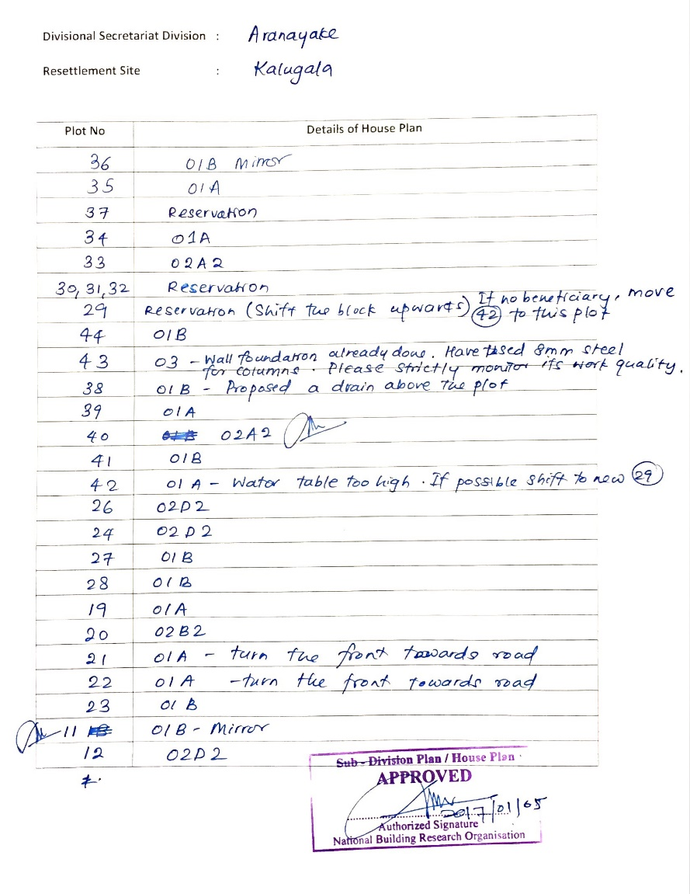
On-site plan recommendation
Plan recommendation form

Slide 11
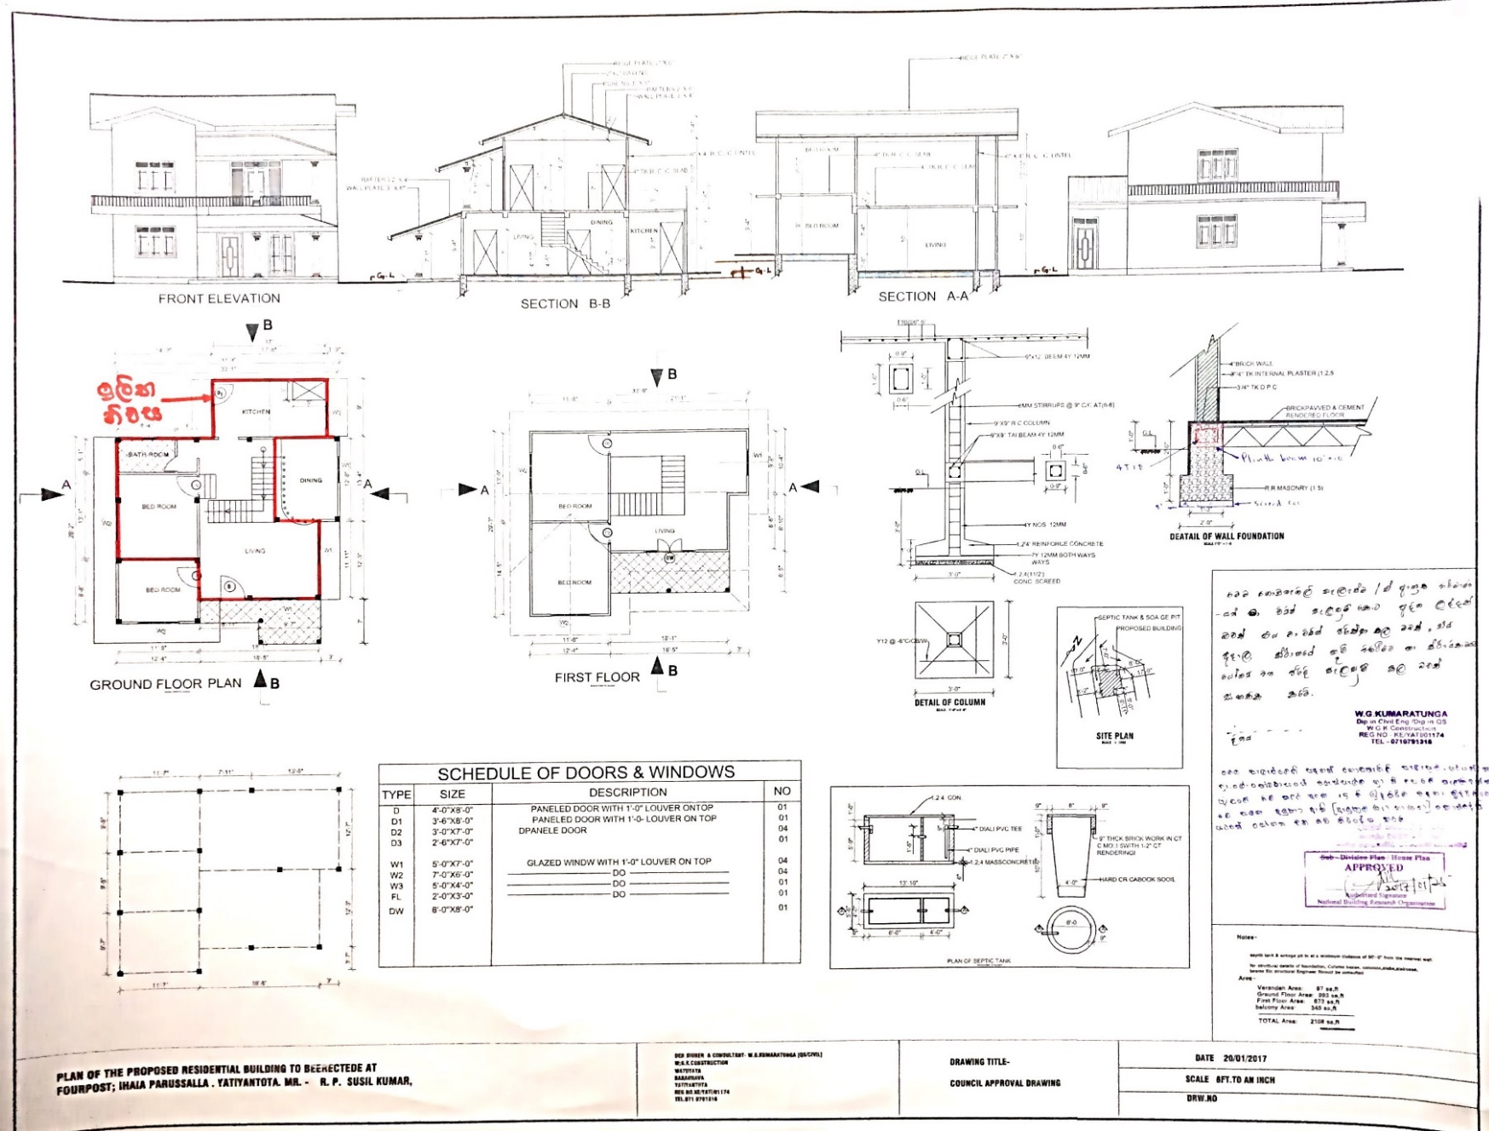
On-site plan approval

Slide 12
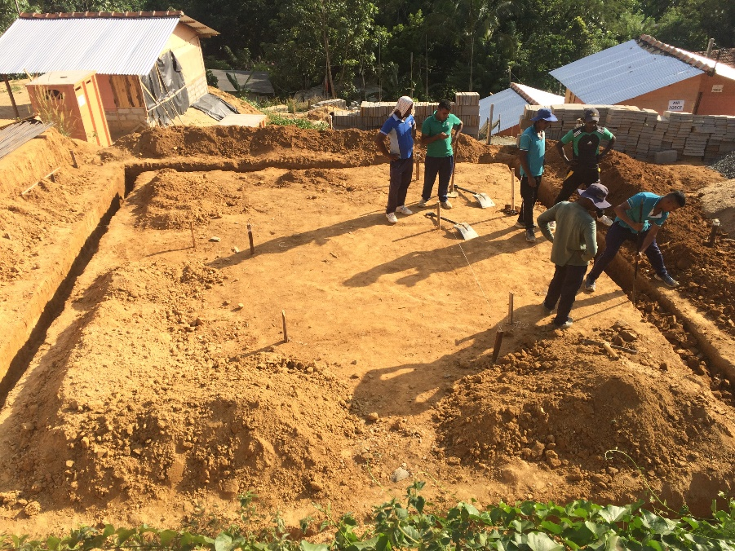
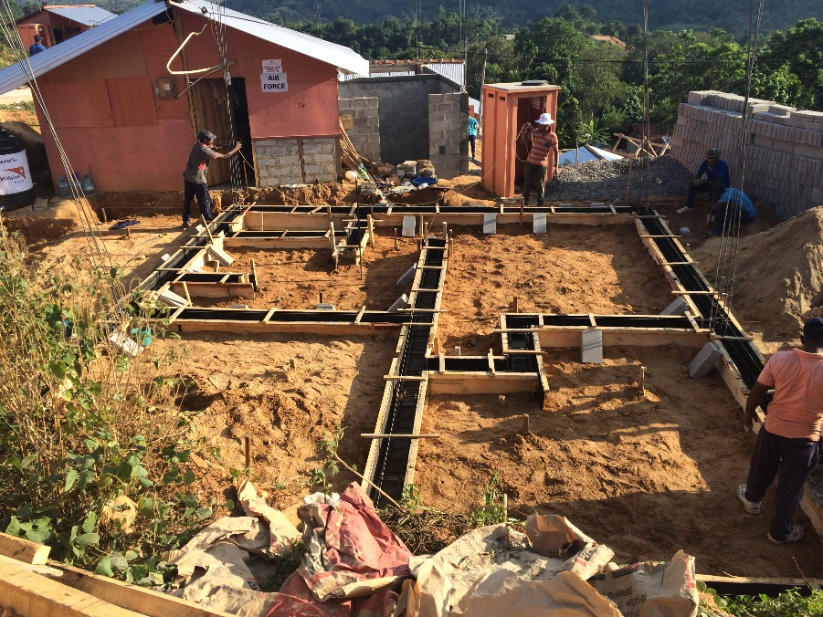
Permanent Shelter Option for Kegalle District Landslide Victims
THE RESETTLEMENT PROCESS
CONSTRUCTION
Method of implementation
As the Kegalle district resettlement programme is not a single site housing programme, different methods of implementation had to be taken.
The Resettlement Programme offers two options.
Option I - Donor Driven Housing Construction
Option II - Home Owner Driven Housing Construction

Slide 13
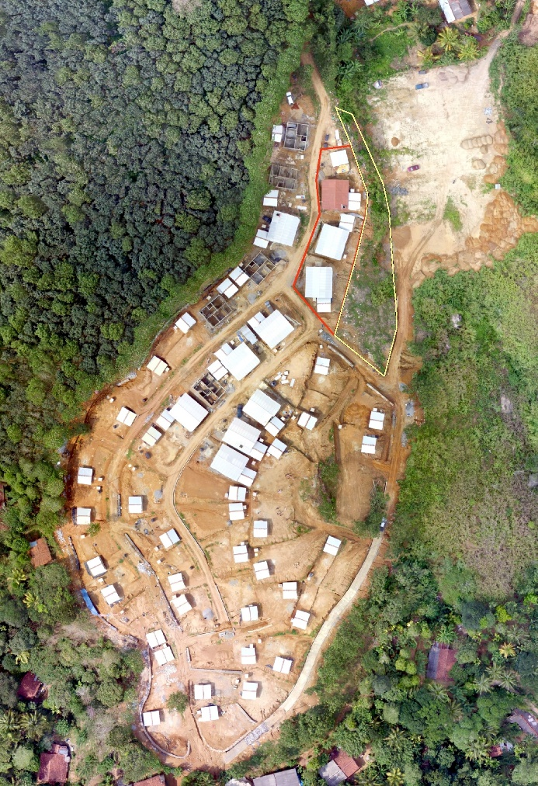
Permanent Shelter Option for Kegalle District Landslide Victims
THE RESETTLEMENT PROCESS
CONSTRUCTION
“Donor driven method for housing construction”
Houses are constructed by donors with the material and labor supply
Donor for Kegalle Resettlement Programme
Habitat for Humanity
Rhino Roofing Pvt. Ltd.
“Senehe Siyapatha” foundation led by Dialog Axiata Pvt Ltd.
Plantation Human Development Trust (PHDT)
Individual donors

Slide 14
Permanent Shelter Option for Kegalle District Landslide Victims
THE RESETTLEMENT PROCESS
Home Owner Driven Housing Construction
Option 01:
Beneficiaries will be granted Rs. 1.2 Mn for house construction in five (05) installments based on the stage of completion with a land plot of approximately 10 perches from the government.
Option 02:
Beneficiaries who have obtained the approval for Individual Resettlement Sites (IRS) will be granted a lump sum of Rs. 0.4 Mn to acquire land for house construction in addition to the Rs. 1.2 Mn for house construction.

Slide 15
Permanent Shelter Option for Kegalle District Landslide Victims
HOME OWNER DRIVEN HOUSING CONSTRUCTION PROGRAMME
Funding Release Plan for Government Cash Grant
Installment | Stage | Installment Amount (Rs)
1 | Land Preparation and Excavation | 40,000.00
2 | Completion of foundation | 110,000.00
3 | Completion of wall up to roof level including door window frames | 300,000.00
4 | Completion of roof and door window (sashes) | 450,000.00
5 | Completion of Core-house –Plastering, Finishing, Painting, Toilet and Electrical connection | 300,000.00
Total |  | 1,200,000.00

Slide 16
Permanent Shelter Option for Kegalle District Landslide Victims
HOME OWNER DRIVEN HOUSING CONSTRUCTION PROGRAMME
Construction, monitoring and fund releasing
Technical Officers of relevant Divisional Secretariats monitor the house construction and recommend to release the stage completion installment.
Technical officers of the DSD are responsible for the following;
Inspection of housing construction and recommending the release of stage completion installment.
Provision of technical assistance for the construction of resilient core house.
Programme monitoring and required expert technical assistance will be provided by NBRO
Collaborating with NBRO to conduct training and awareness to beneficiaries in order to successfully complete the housing construction

Slide 17
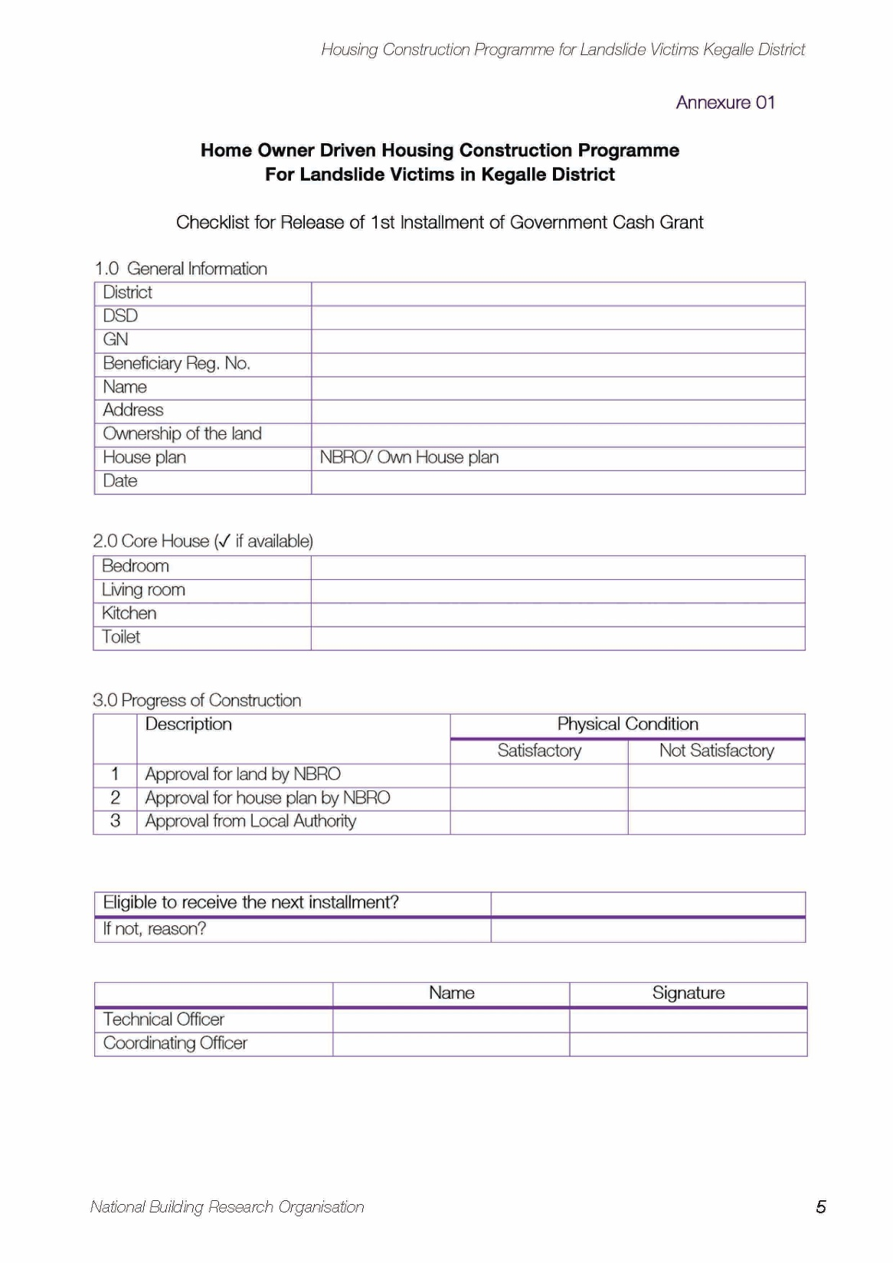
Permanent Shelter Option for Kegalle District Landslide Victims
HOME OWNER DRIVEN HOUSING CONSTRUCTION PROGRAMME
Fund releasing checklist

Slide 18
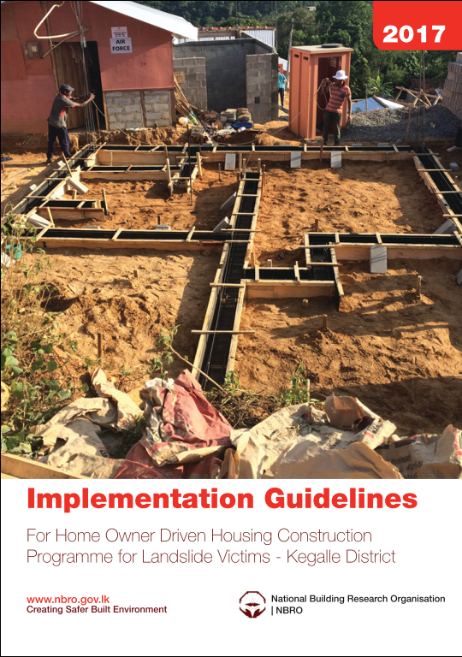
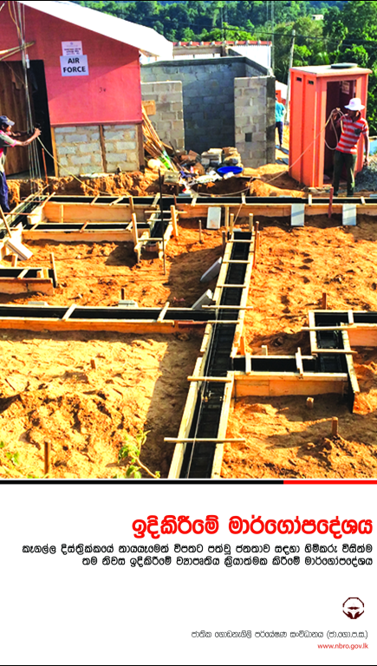
Resettlement Implementation Guidelines - Owner Driven

Slide 19
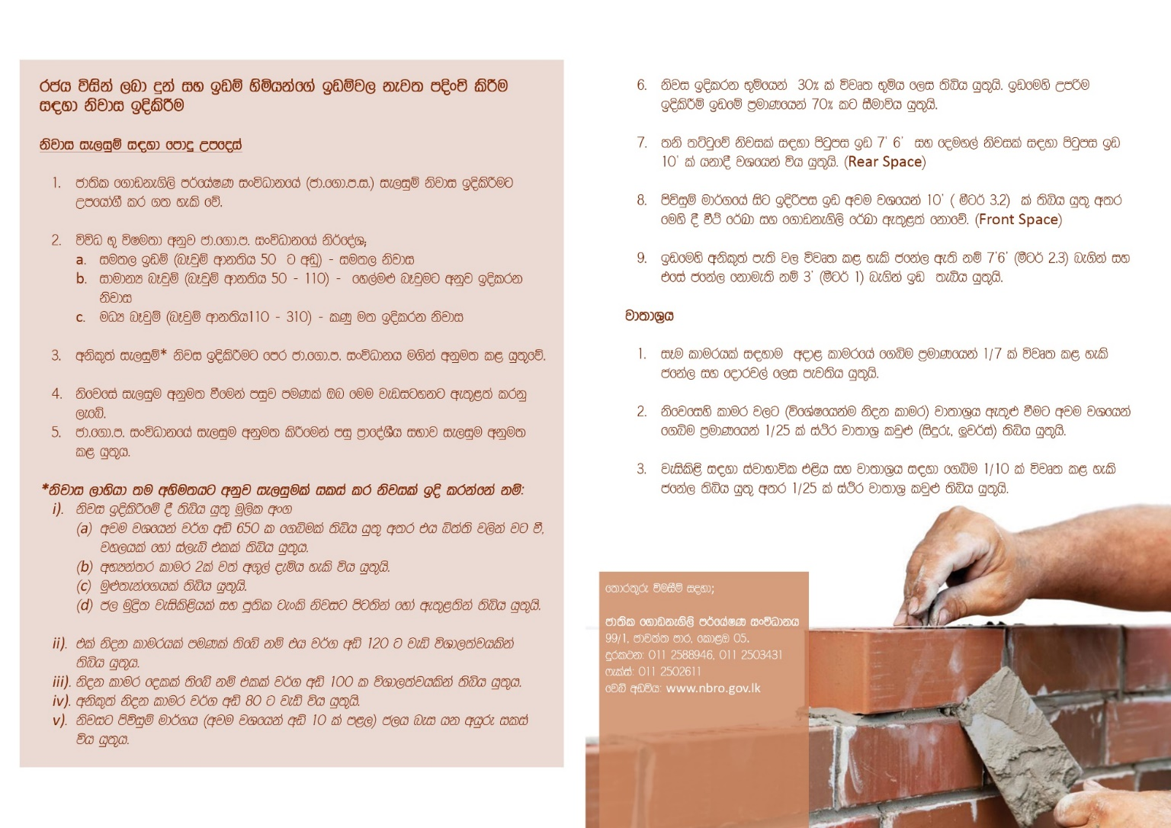
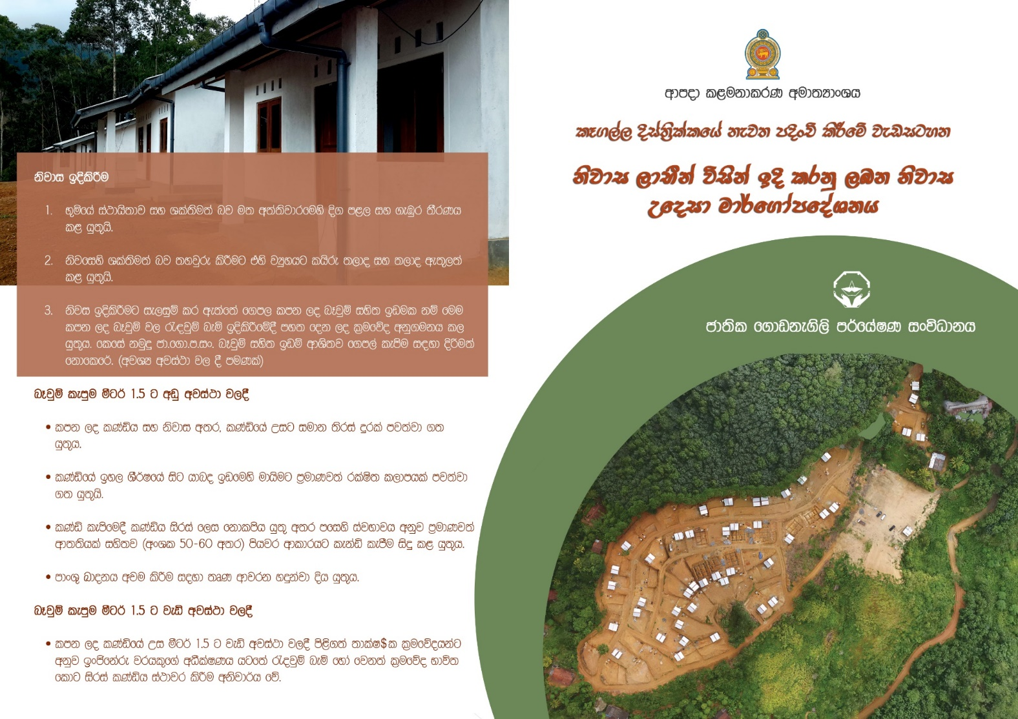
Community awareness
Leaflet

Slide 20
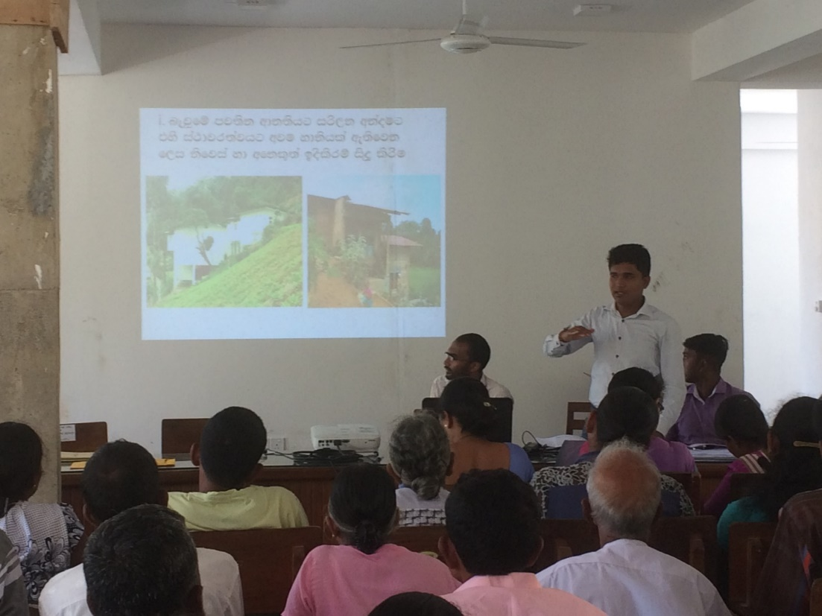
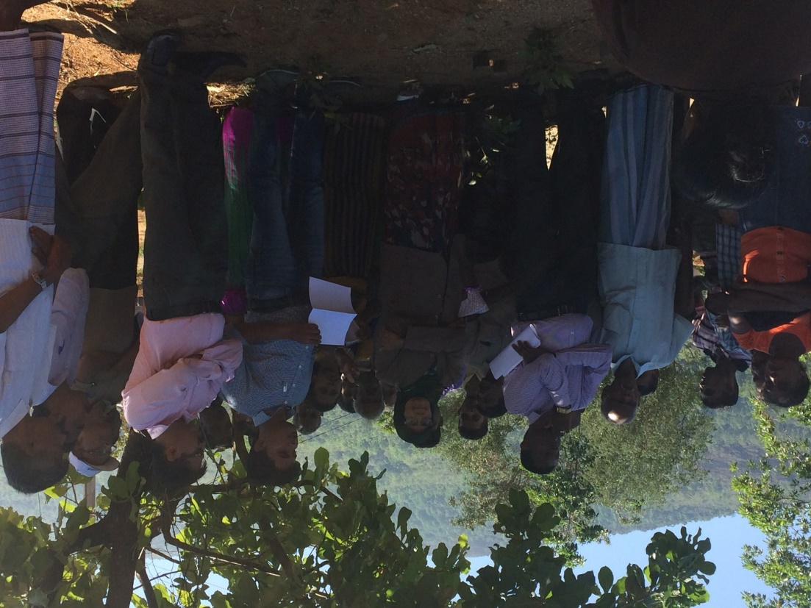
Community awareness

Slide 21
Permanent Shelter Option for Kegalle District Landslide Victims
THE RESETTLEMENT PROCESS
CONSTRUCTION
Construction Management
District secretary and divisional secretaries manage funds
NBRO has been assigned to manage the quality of construction and supervision of construction

Slide 22
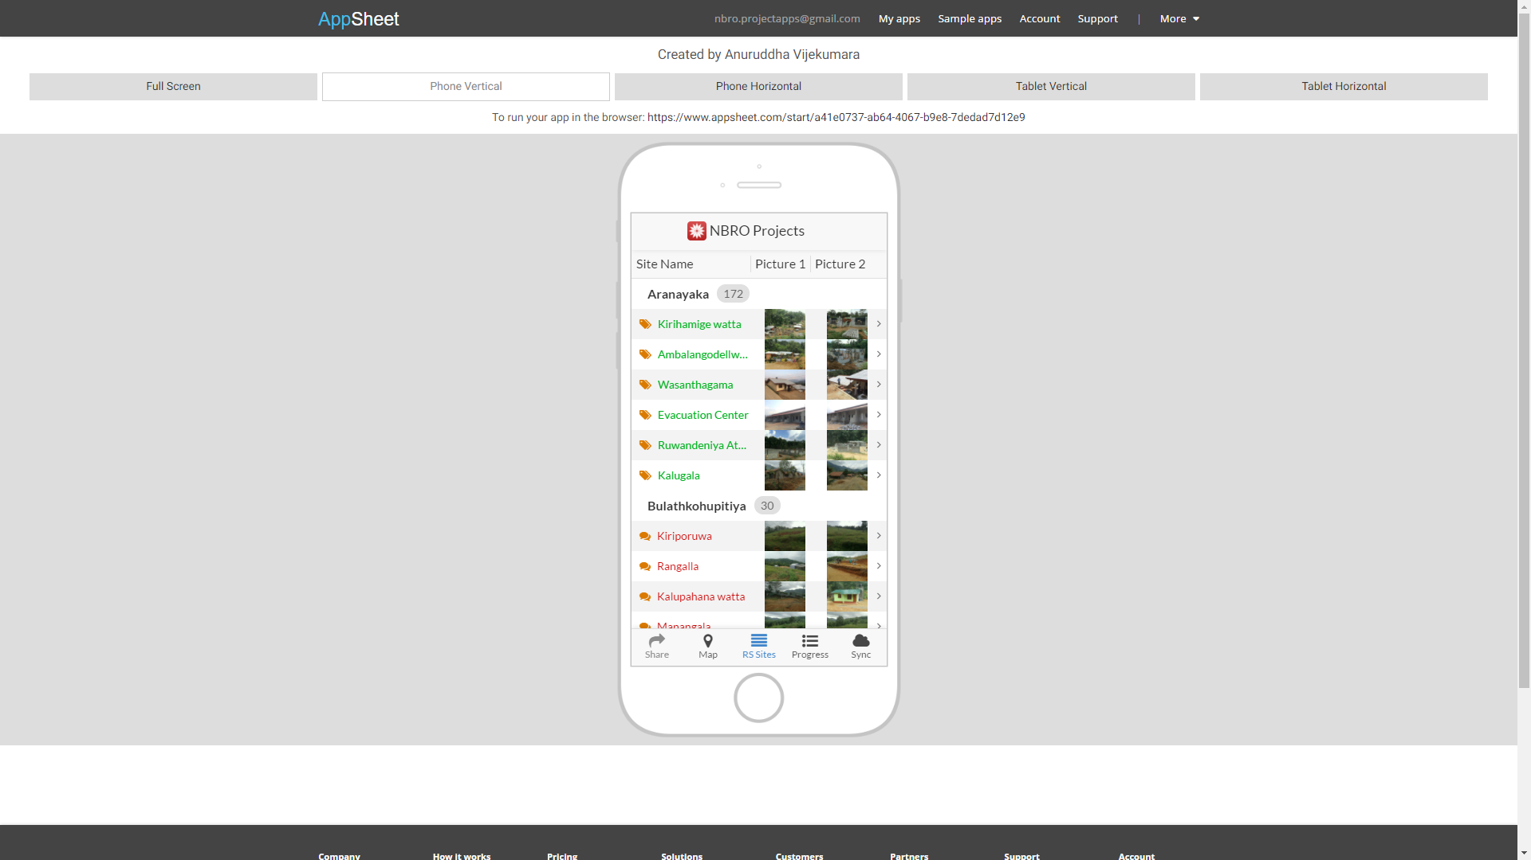
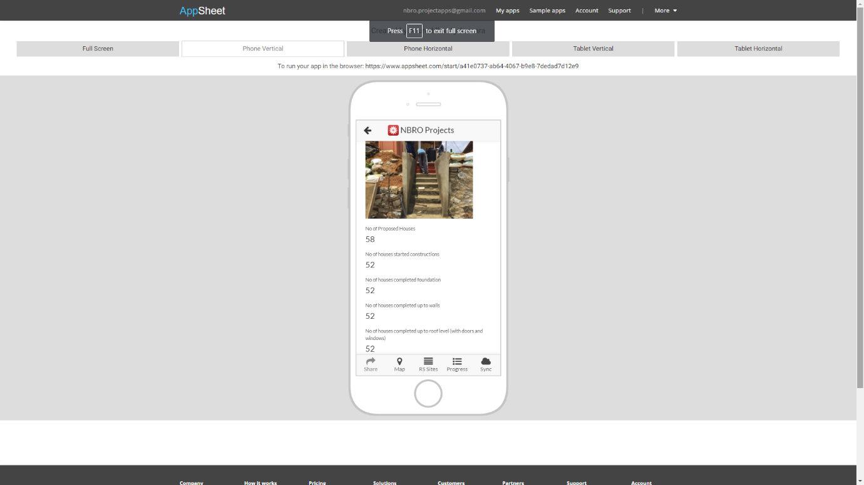
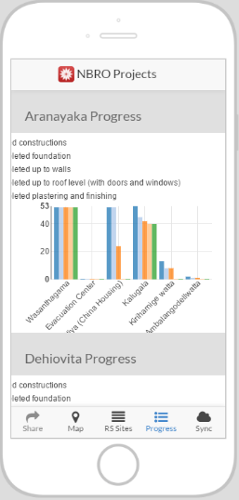
DATABASE FOR MONITORING THE PROGRESS OF RESETTLEMENT SITES

Slide 23
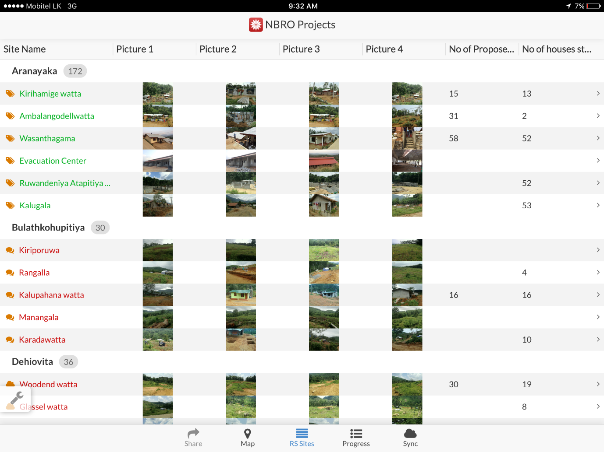
DATABASE FOR MONITORING THE PROGRESS OF RESETTLEMENT SITES

Slide 24
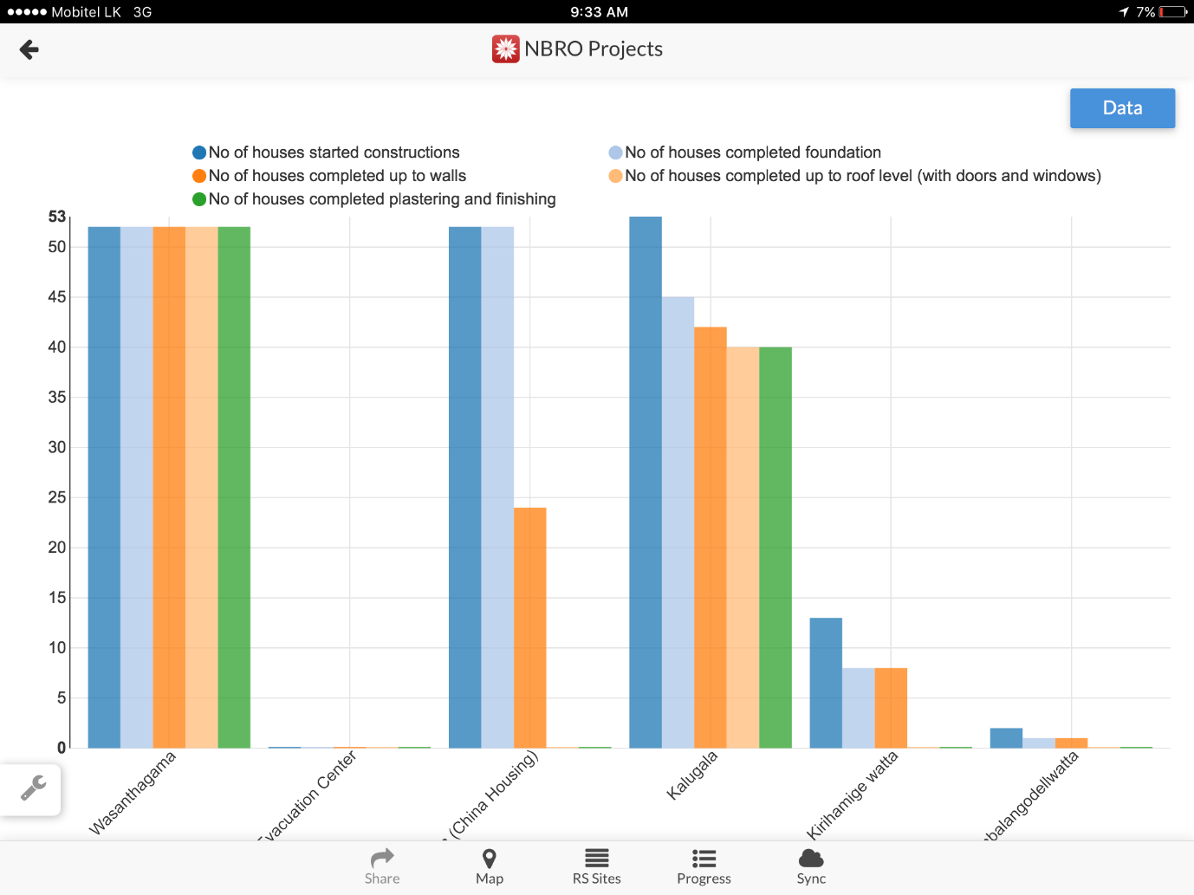
DATABASE FOR MONITORING THE PROGRESS OF RESETTLEMENT SITES

Slide 25
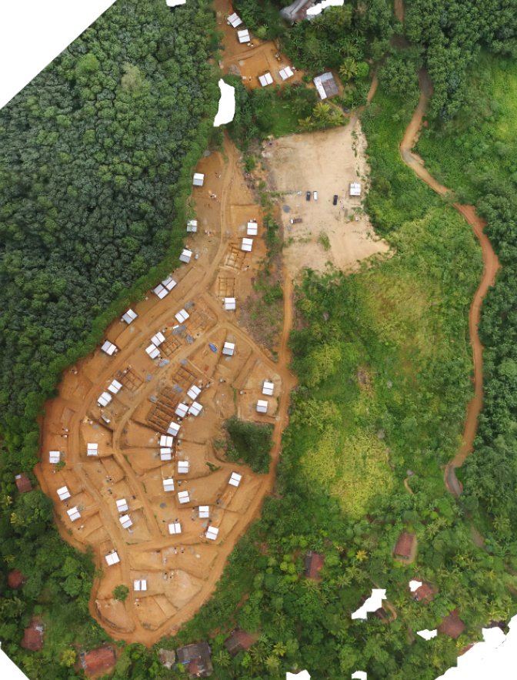
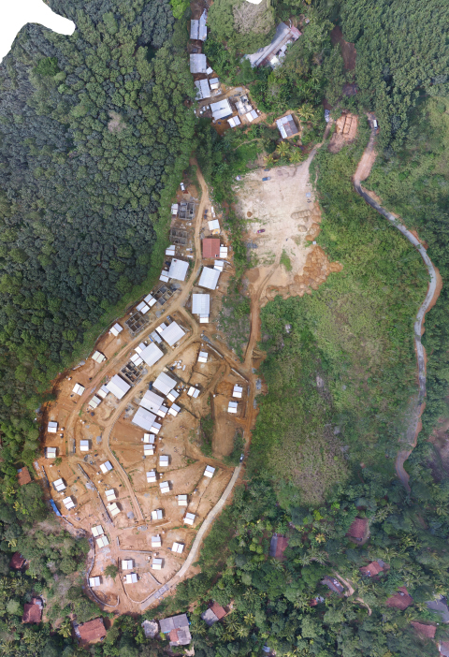

Slide 26
Permanent Shelter Option for Kegalle District Landslide Victims
THE RESETTLEMENT PROCESS
Construction of Permanent Houses

Slide 27
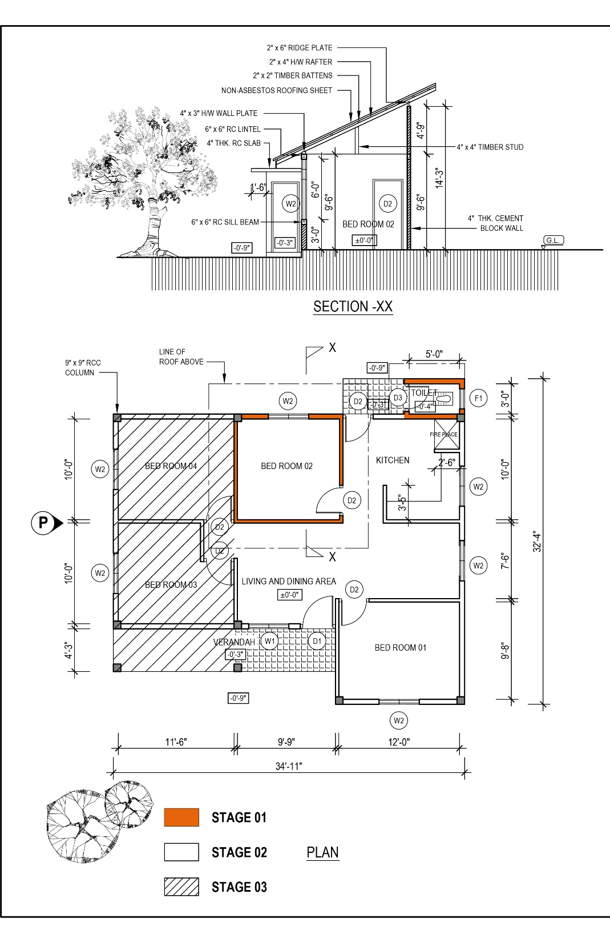
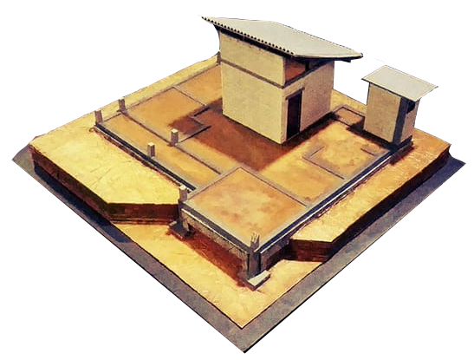
Construction of one room and toilet in first stage

Slide 28
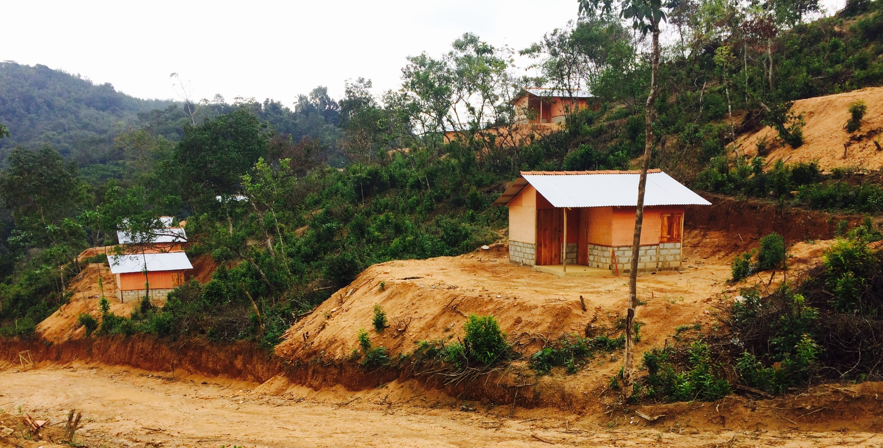
Permanent Shelter Option for Kegalle District Landslide Victims
Issues of Transition Shelter
Design

Slide 29
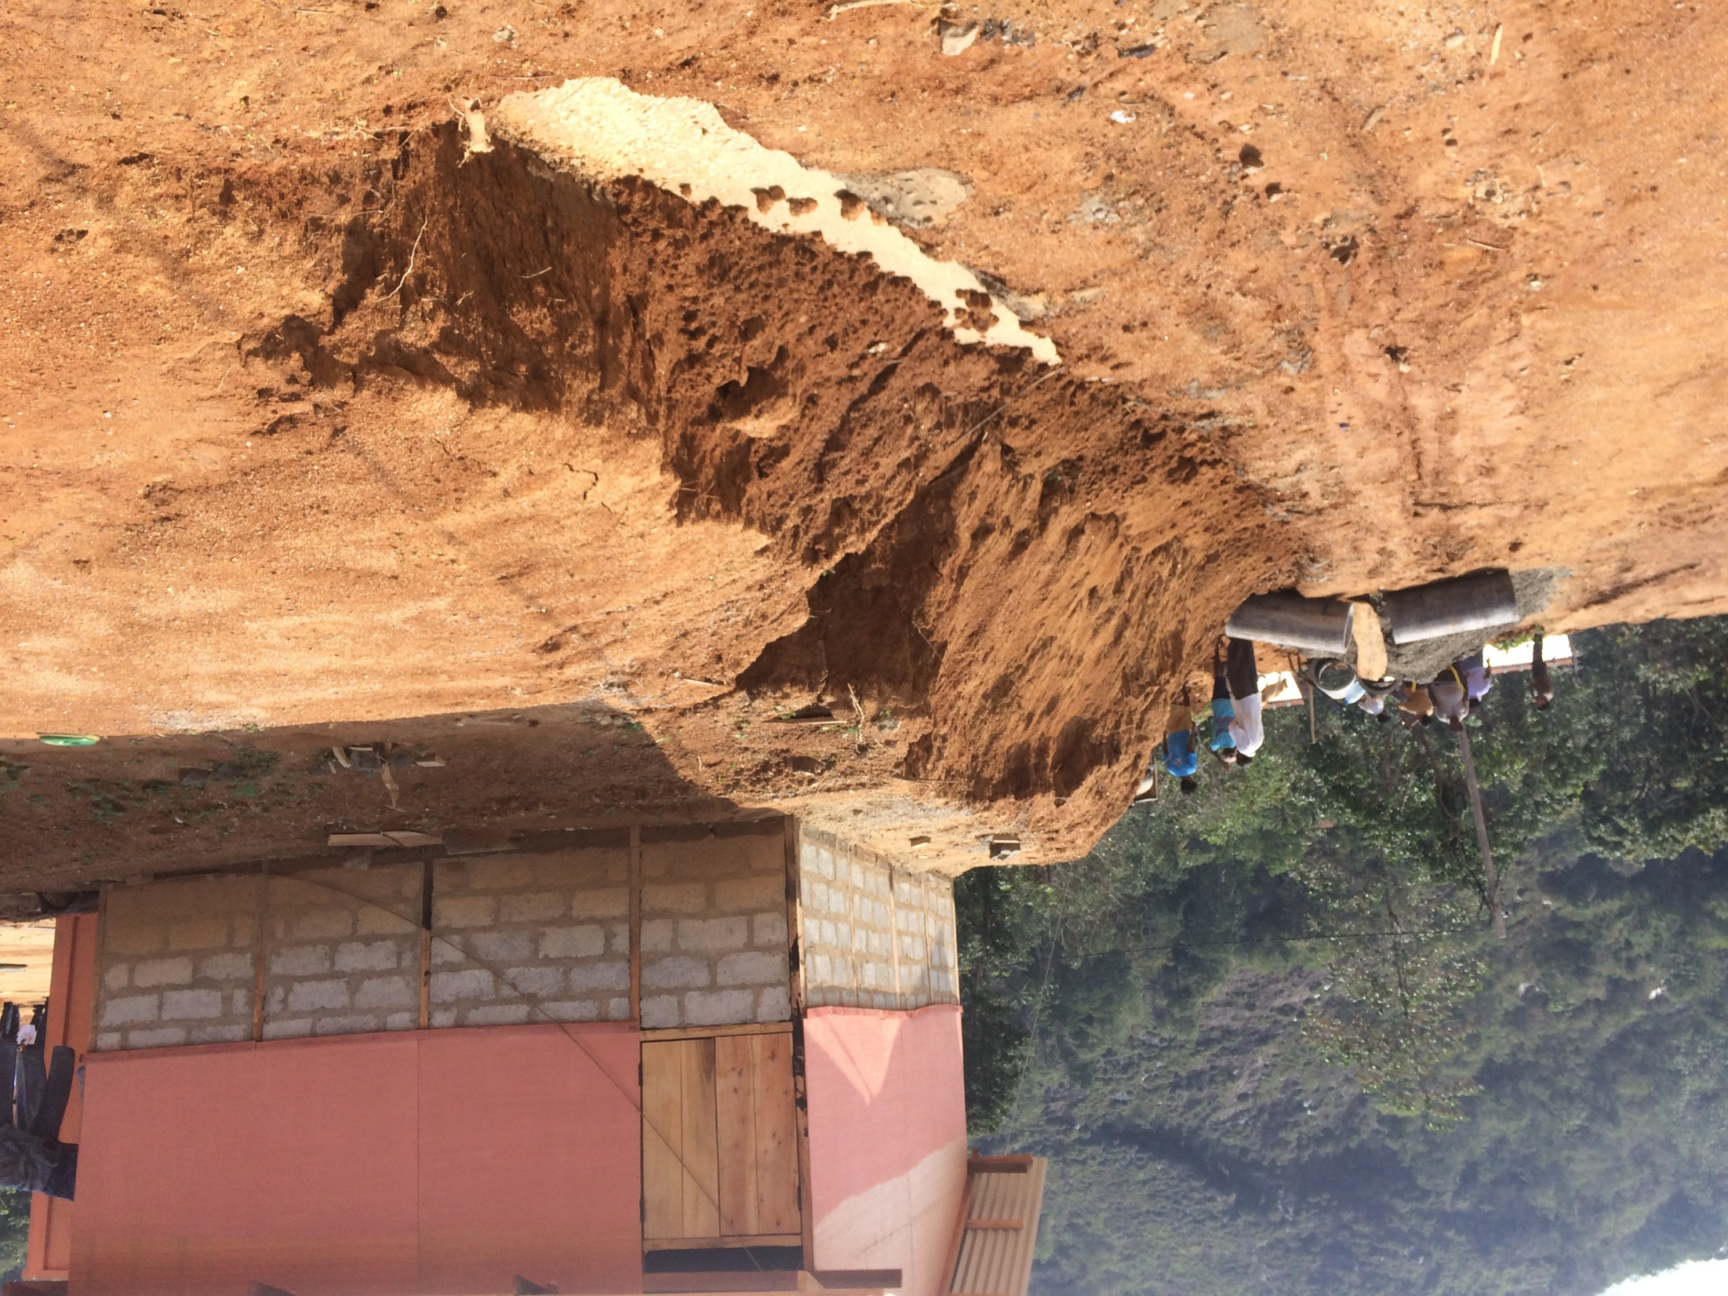

Slide 30
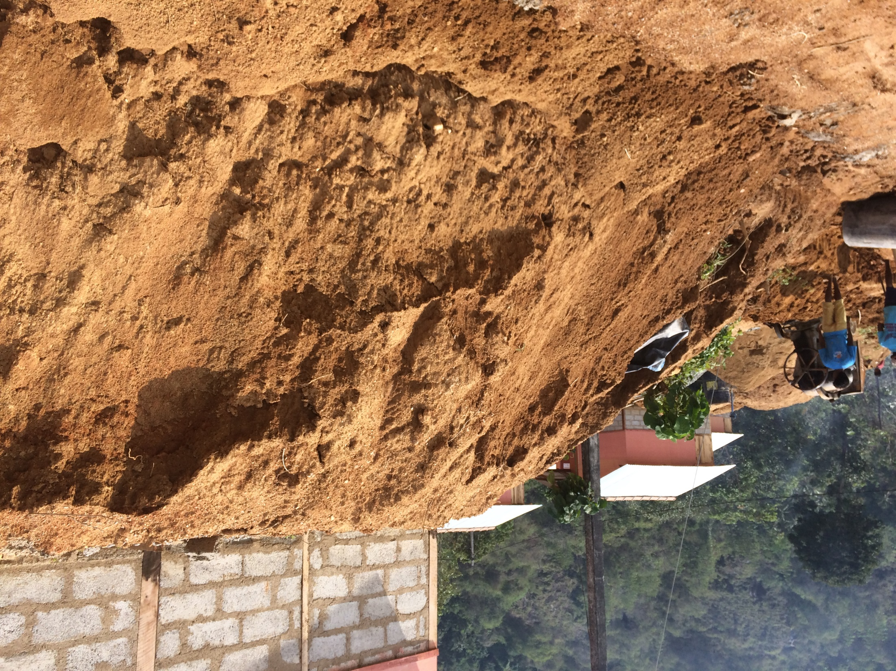

Slide 31
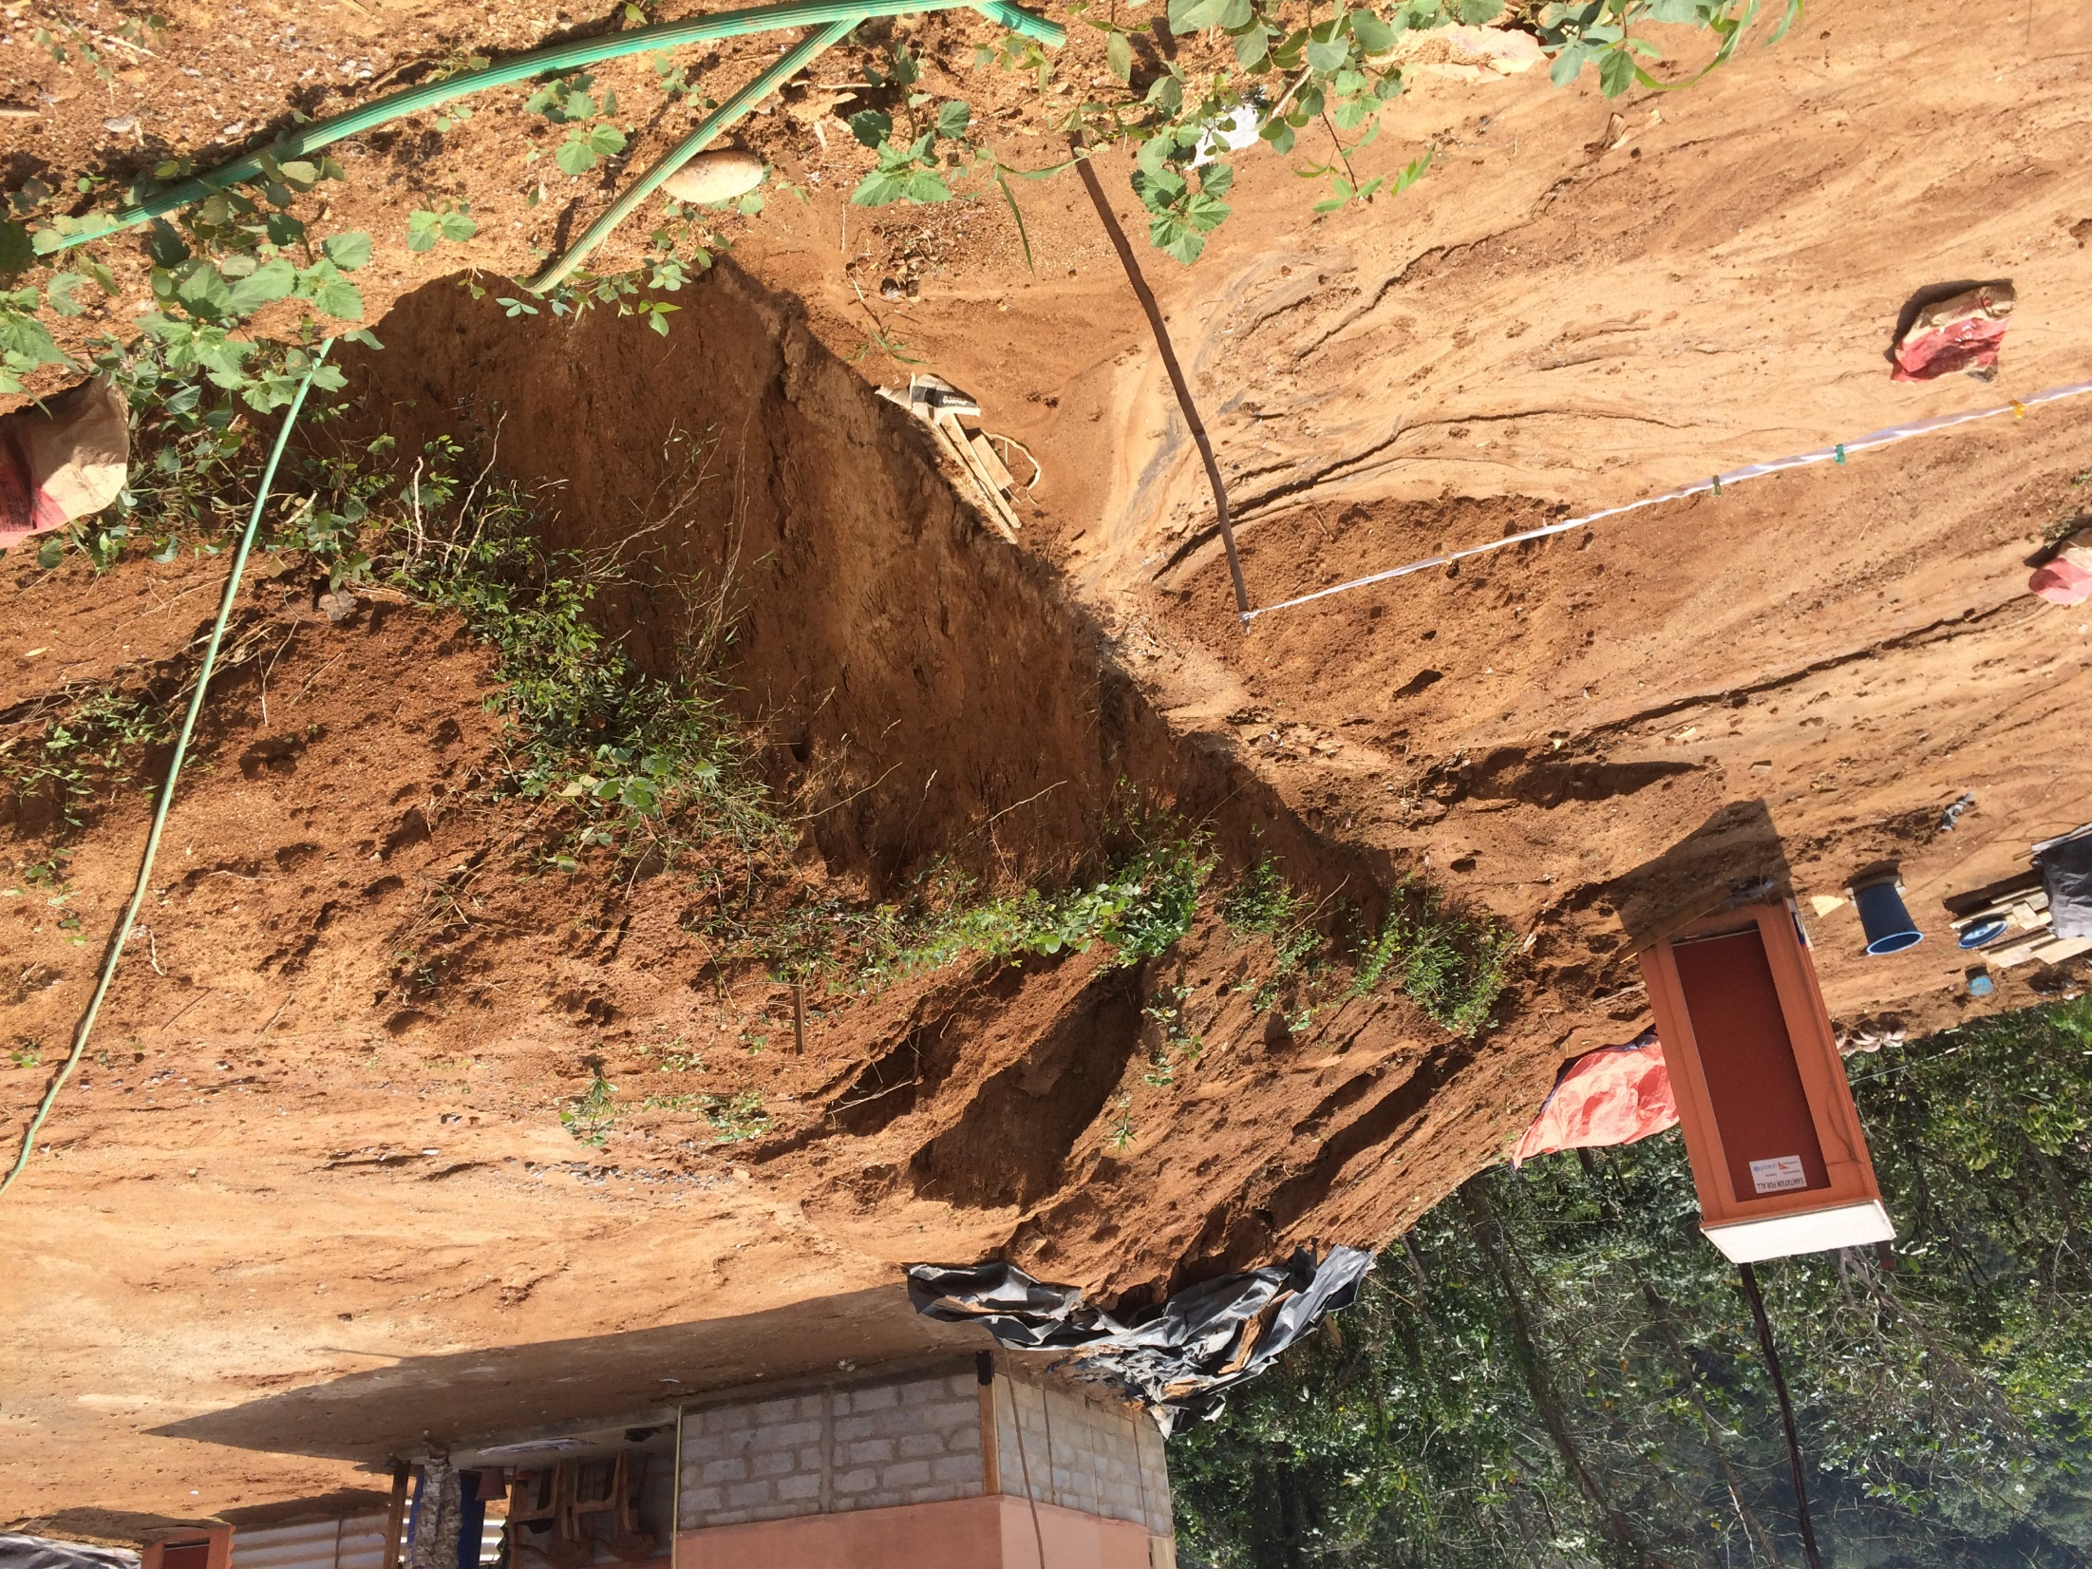

Slide 32
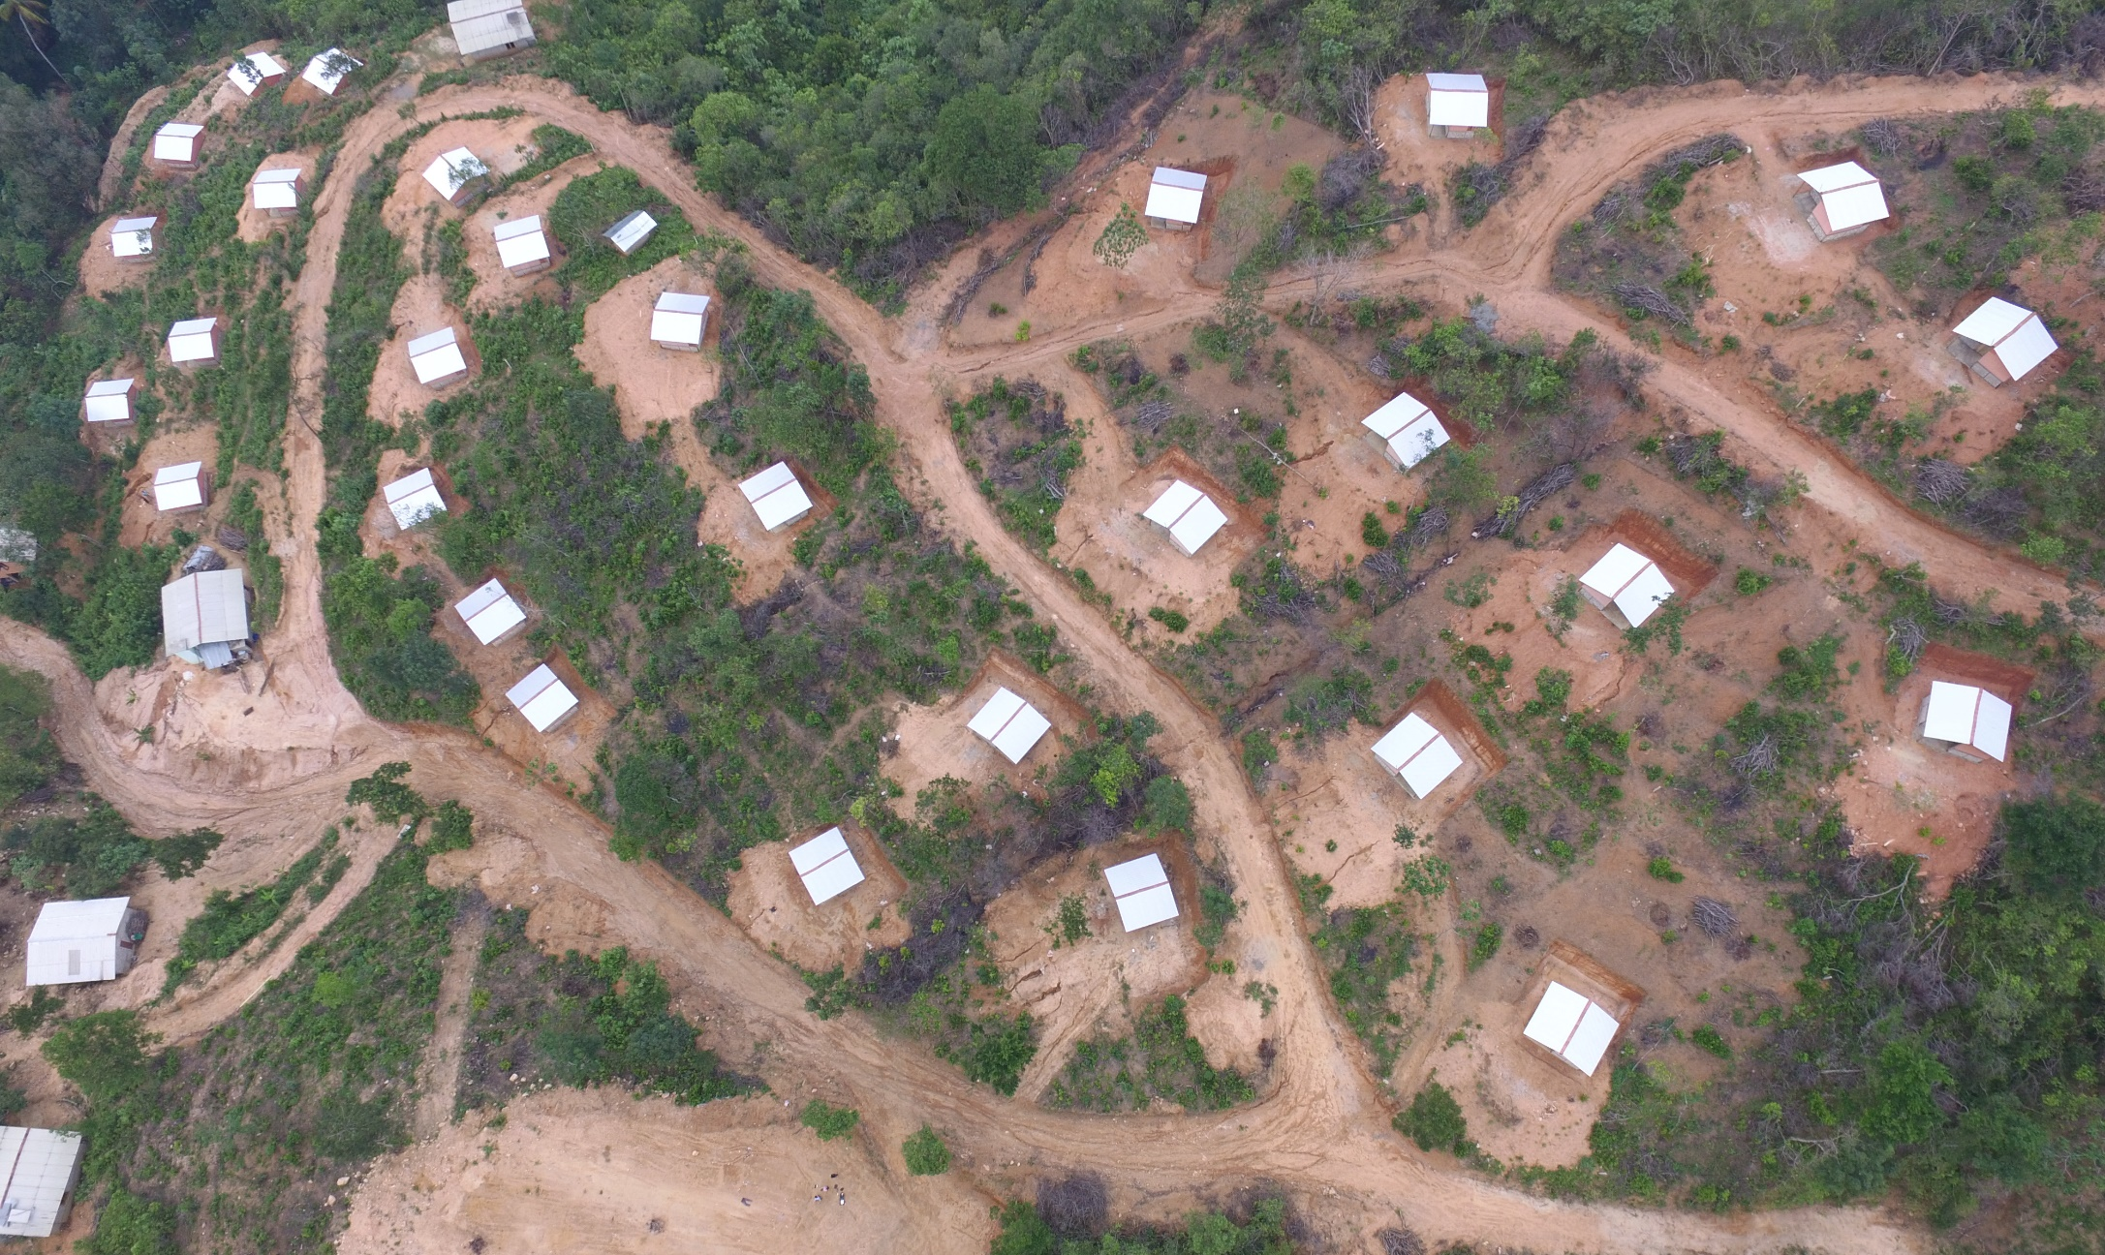
Permanent Shelter Option for Kegalle District Landslide Victims
Issues of Transition Shelter
2. Sitting

Slide 33
Permanent Shelter Option for Kegalle District Landslide Victims
Lessons Learnt
Need of strong institutional arrangement
Shared understanding among the stakeholders on project goals and objectives
Need of effective awareness creation on;
Land selection
Land subdivision
Land development
House construction
Need of development oriented resettlement planning

Slide 34
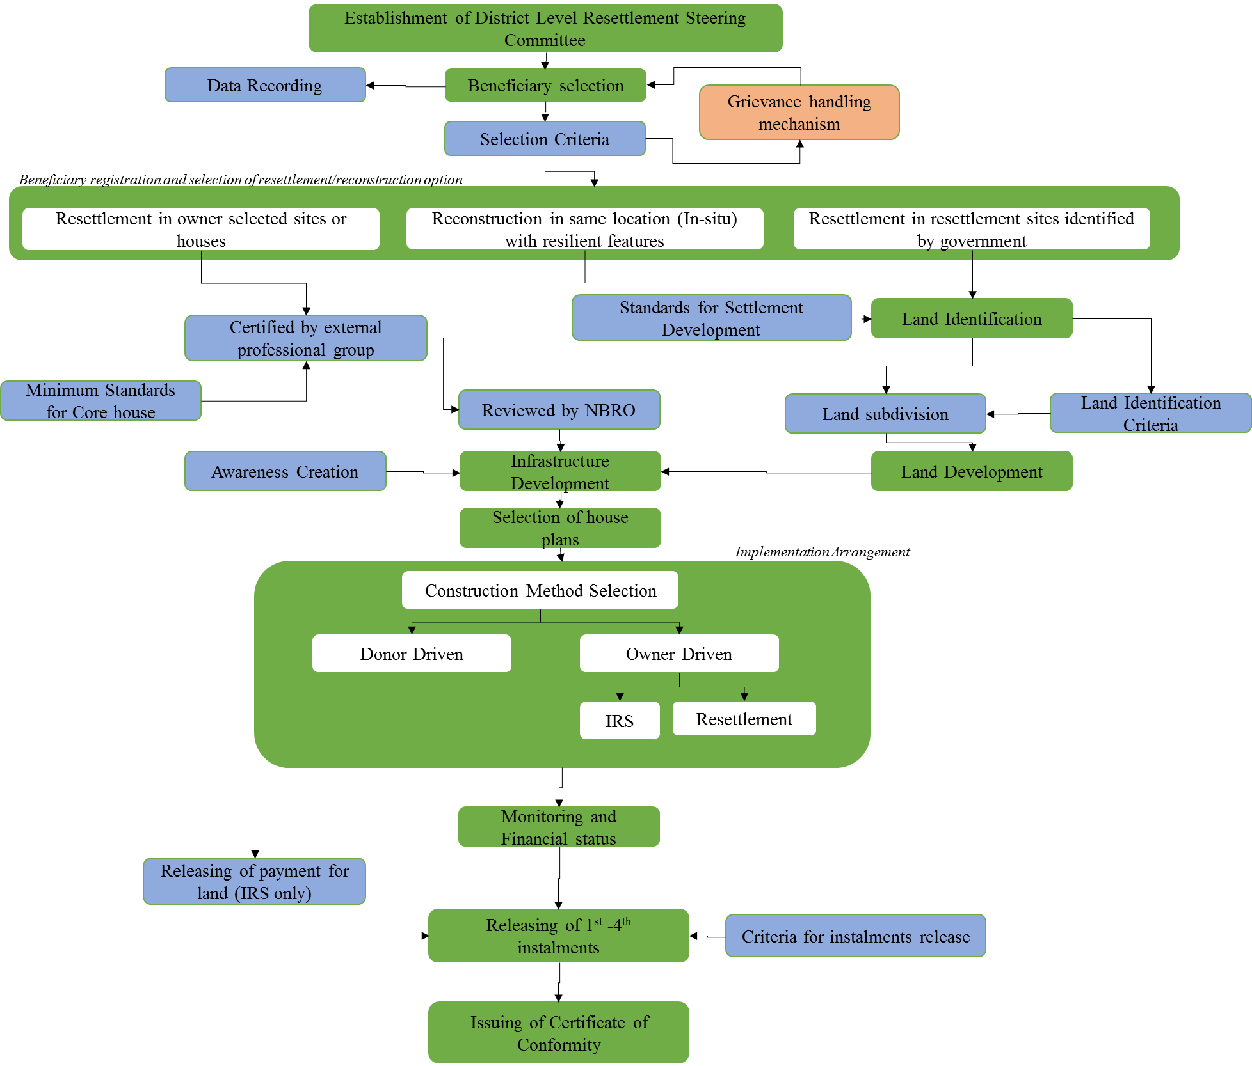
Resettlement Programme - 2017

Slide 35
THANK YOU…!

