Slide 1


Shelter & NFI Cluster
Coordination Meeting
MS Teams • Sudan • 29th May ‘23

Slide 2
Agenda
• Situation Update & Roundtable on Achievements/Operational Plans
• 5W Reporting (ActivityInfo) & Communications Materials
• HRP Project Revision Progress
• SHF Allocation – Update on Partner Selection
• AOB

Slide 3
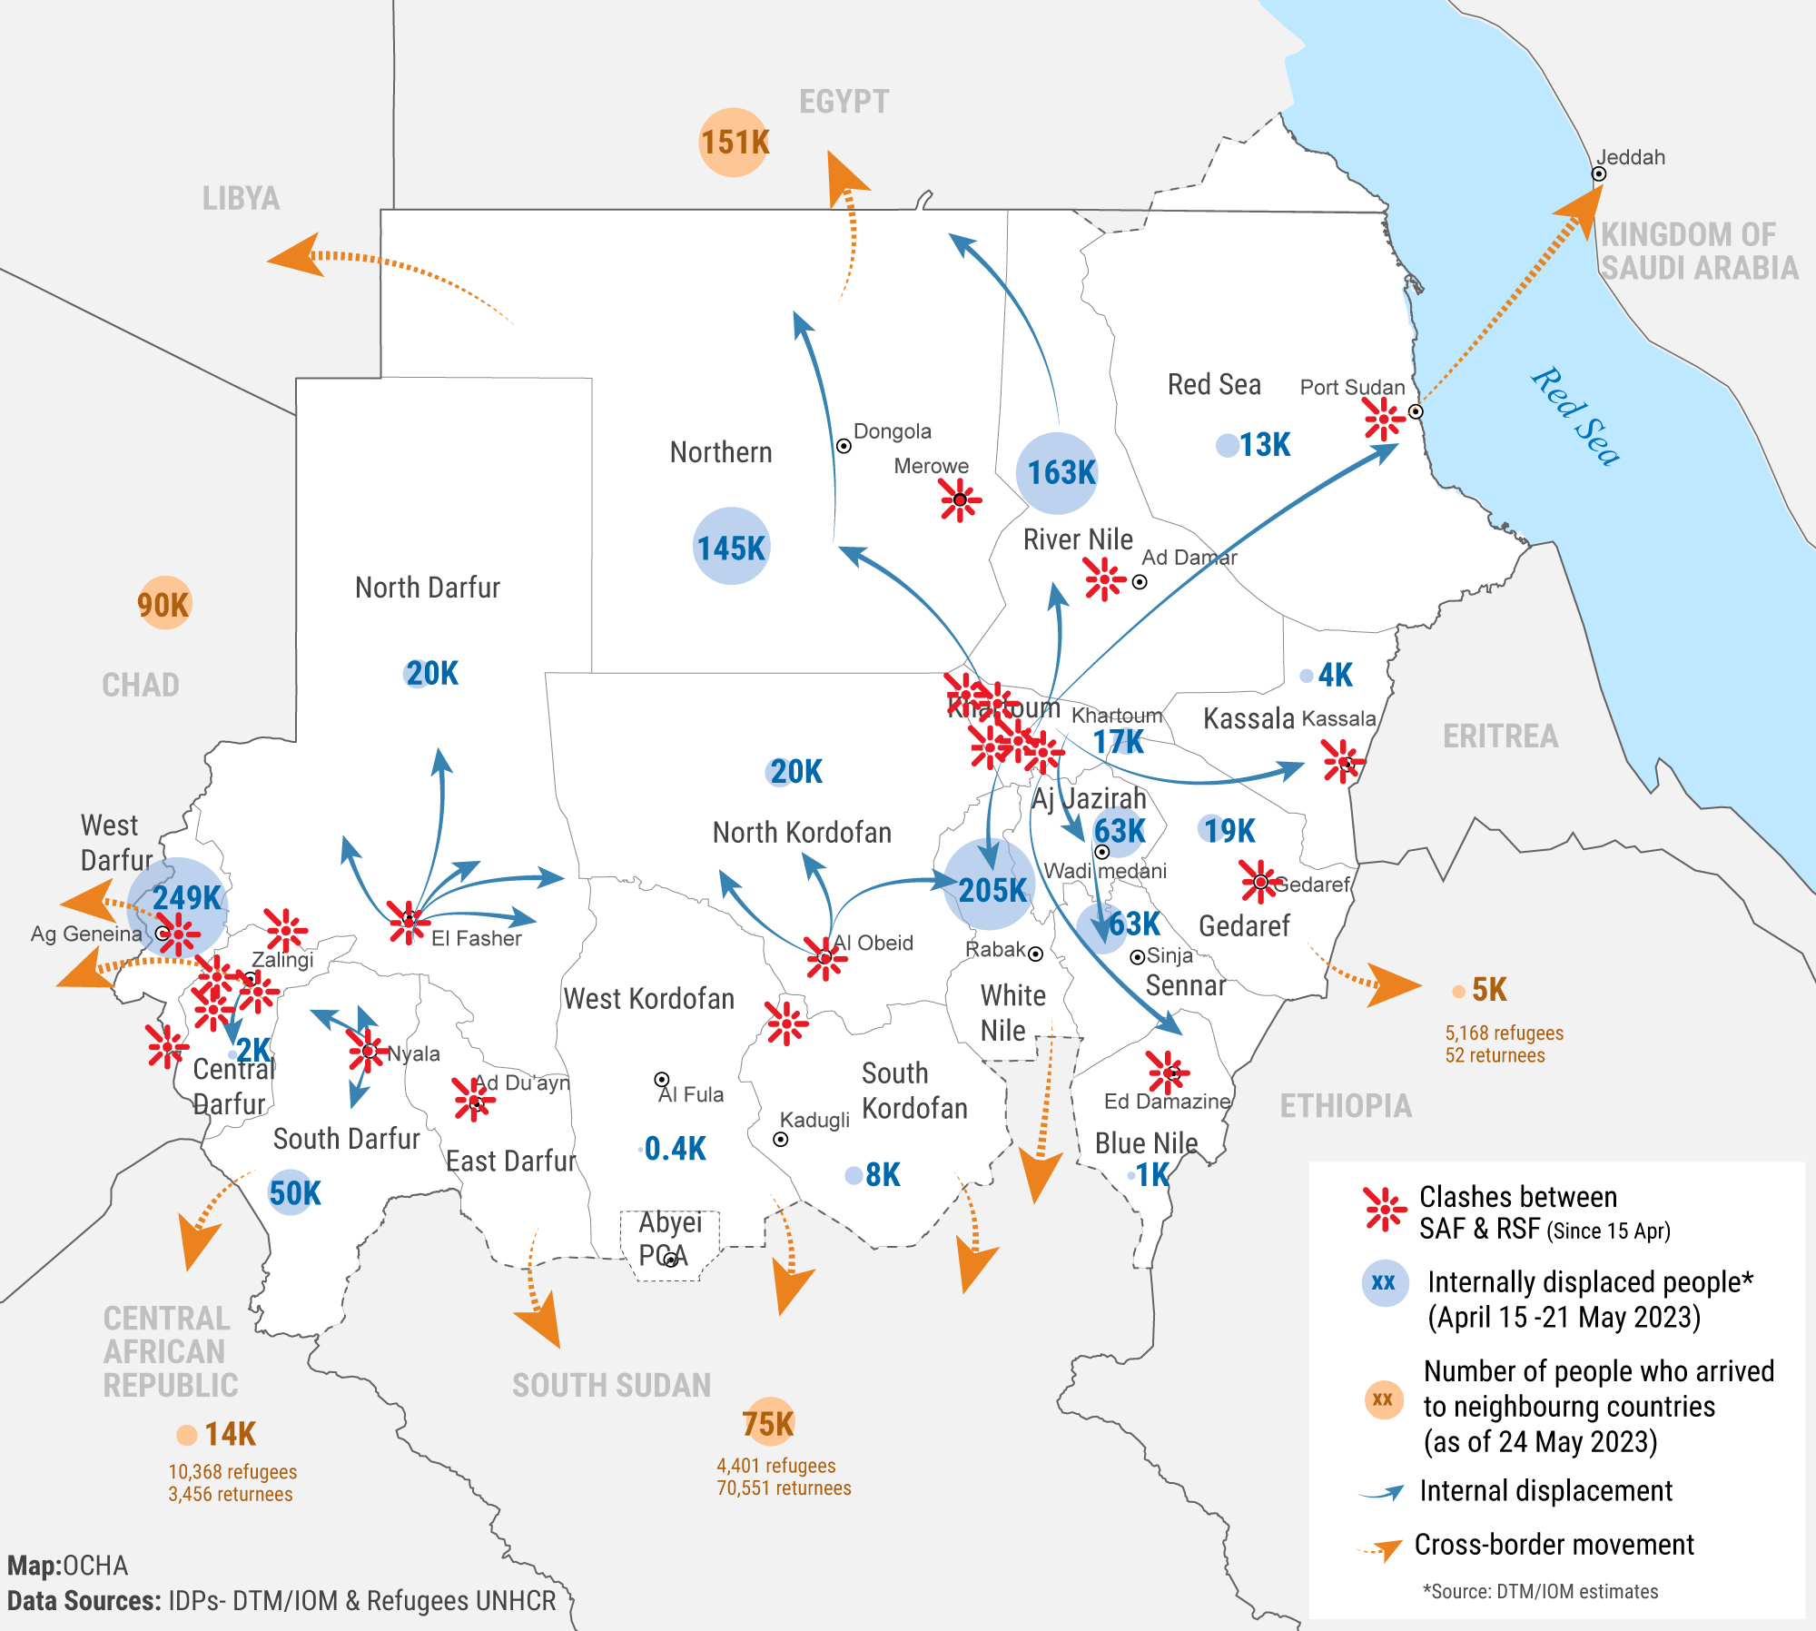
Situation Update
Nearly 1.4 million people have been forced to flee their homes since the conflict started on 15 April, with 1,042,114 individuals internally displaced according to IOM DTM as of May 21 and 345,000 people who have crossed into neighbouring countries according to UNHCR as of May 26.
The mapping of internal movements of refugees and asylum seekers reflects that 159,325 individuals have so far fled Khartoum, to White Nile (134,232), Port Sudan (16,000), Gedaref (6,021), Kassala (2,667), and Jazirah (405). Efforts continue to map the secondary movement of refugees and asylum seekers within the country, including to the Kordofan region not yet accounted for in the above.

Slide 4
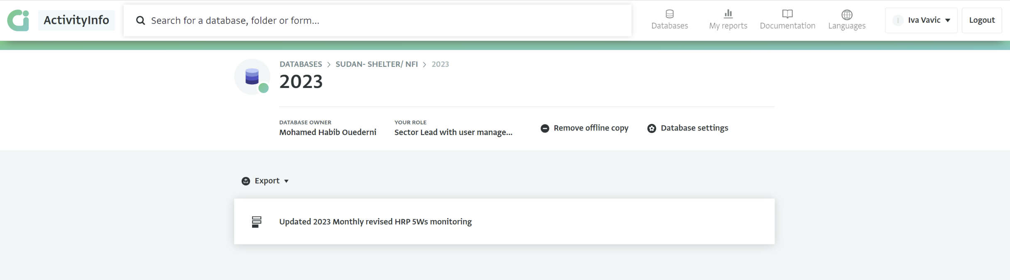
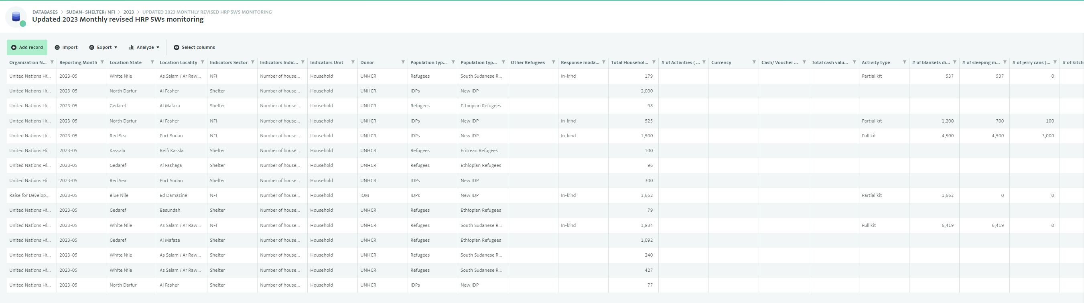
Achievements Reporting - ActivityInfo

Slide 5
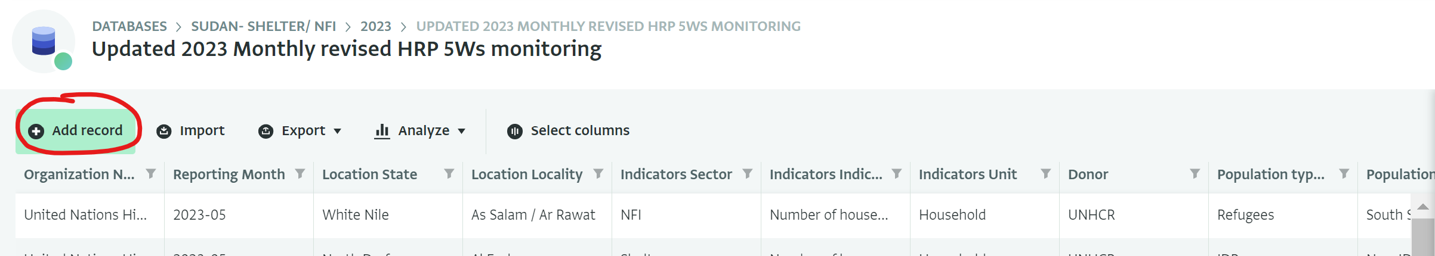
Achievements Reporting - ActivityInfo
2-4 reporting focal points can have access to the database per each organization
If you do not have access, you will not be able to report, and your achievements will not be recorded. This may reflect poorly on your organization, as it may appear that you do not have capacity to implement, hence you may lose out on future funding opportunities.
All organizations have been requested to update contact details of their reporting focal points. Organizations which already have access need to review the list of their reporting focal points and reflect any staffing changes, which organizations that do not have access need to submit contact information of 2-4 designated staff to record achievements of their organization country-wide.
The current list of reporting focal points with access to the SNFI Database in ActivityInfo has been shared with all cluster members through email, while it can be also found on this link:
https://docs.google.com/spreadsheets/d/184BWUgE4b6qV2EF3PfS5fJsmLrIgyvHXA1TCT-0XGjQ/edit?usp=sharing

Slide 6
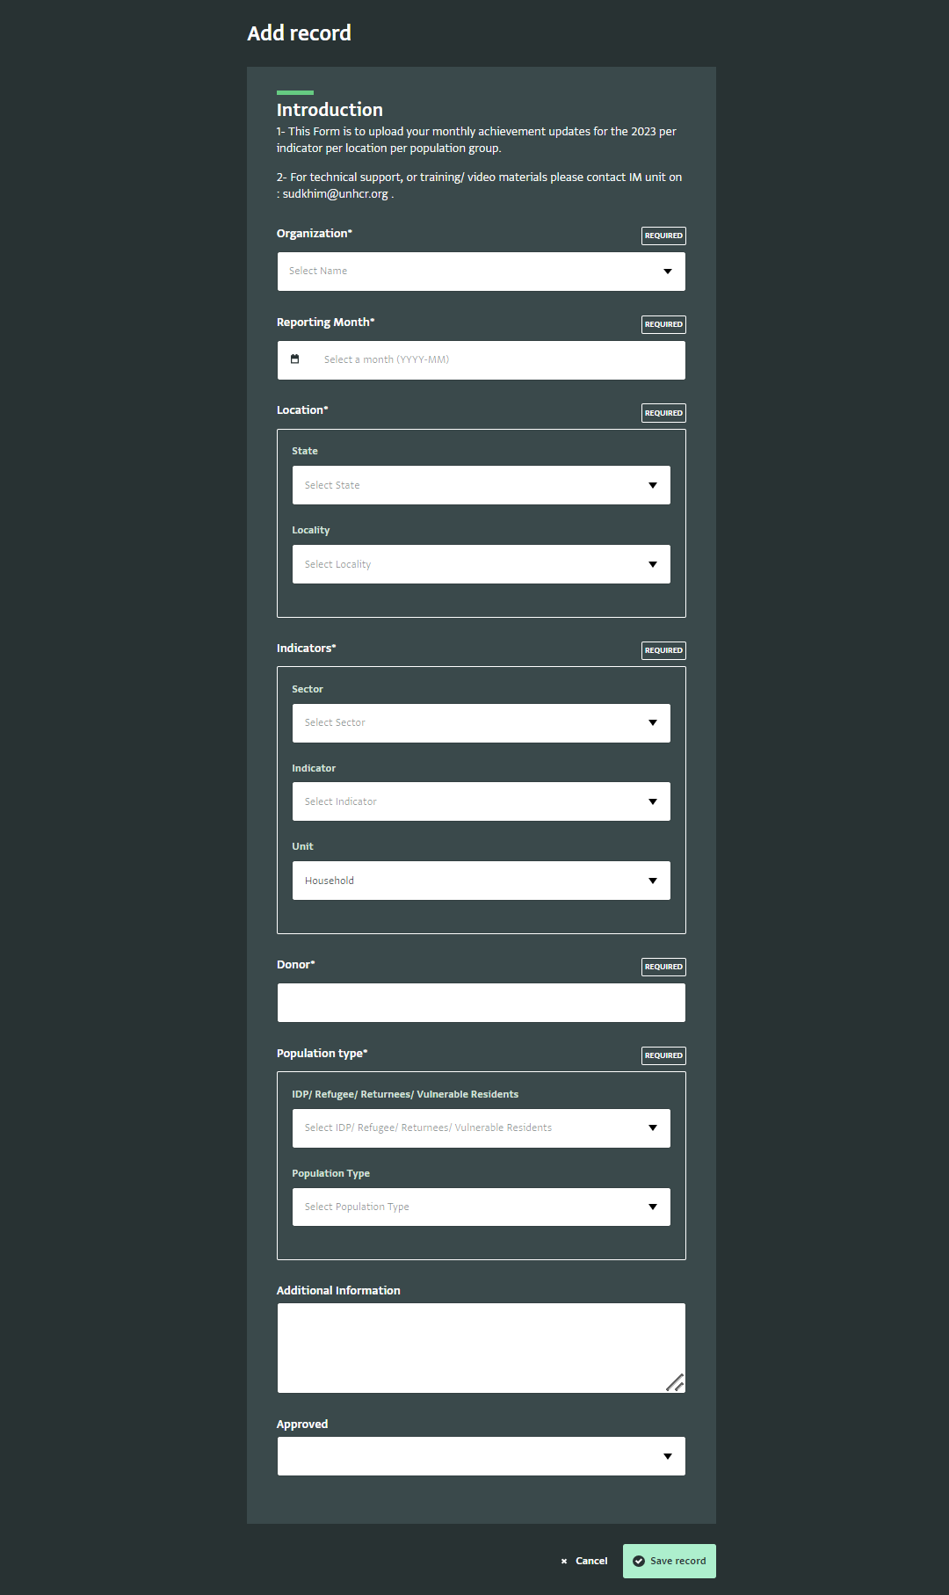
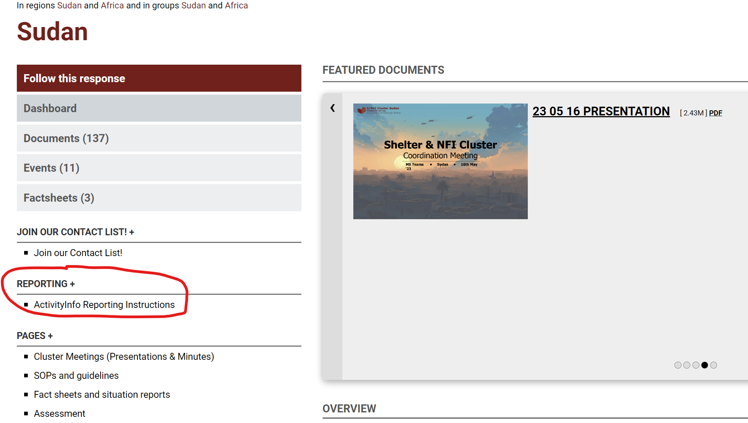
Achievements Reporting - ActivityInfo
Training video and PDF guidance on how to report in the Shelter & NFI database in ActivityInfo is available on the Sudan Page of the Global Shelter Cluster website here:
https://sheltercluster.org/sudan/pages/activityinfo-reporting-instructions

Slide 7

Achievements Public Dashboard

Slide 8

Achievements Public Dashboard

Slide 9
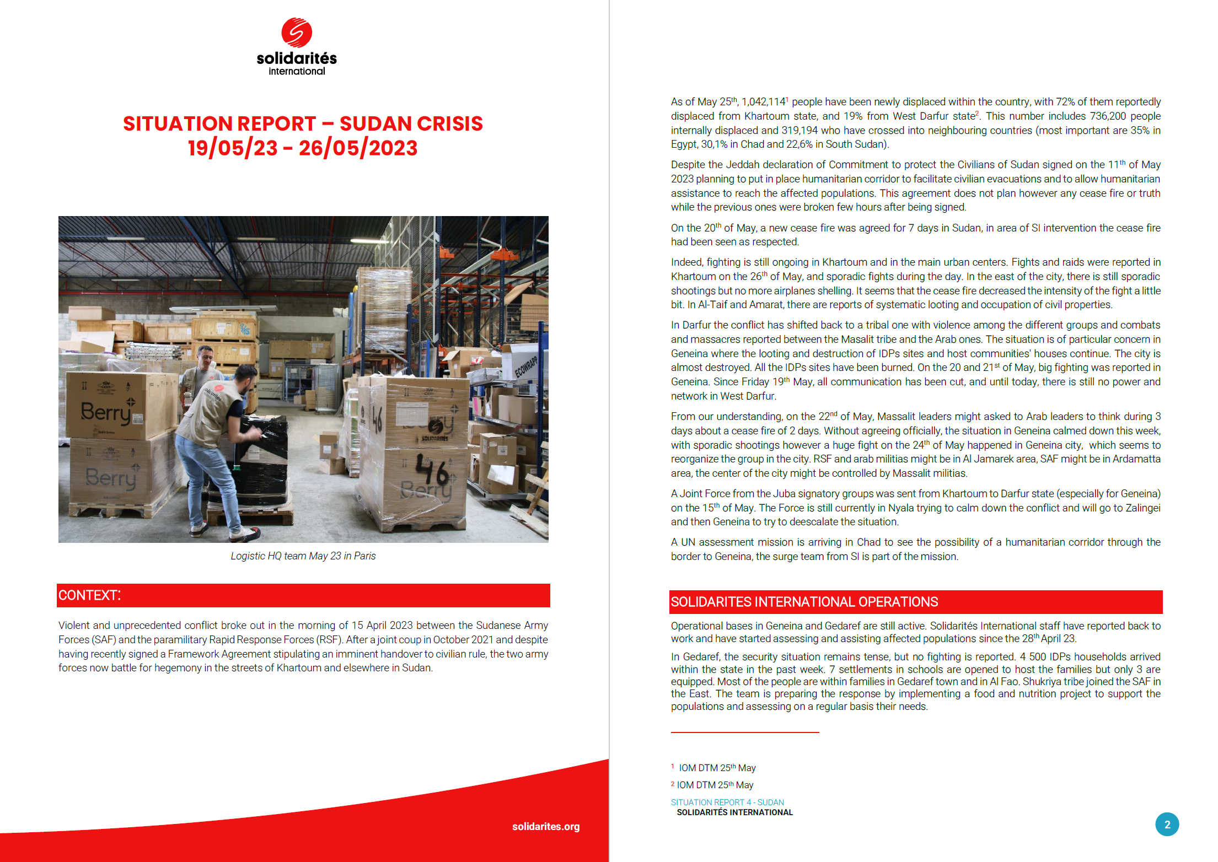
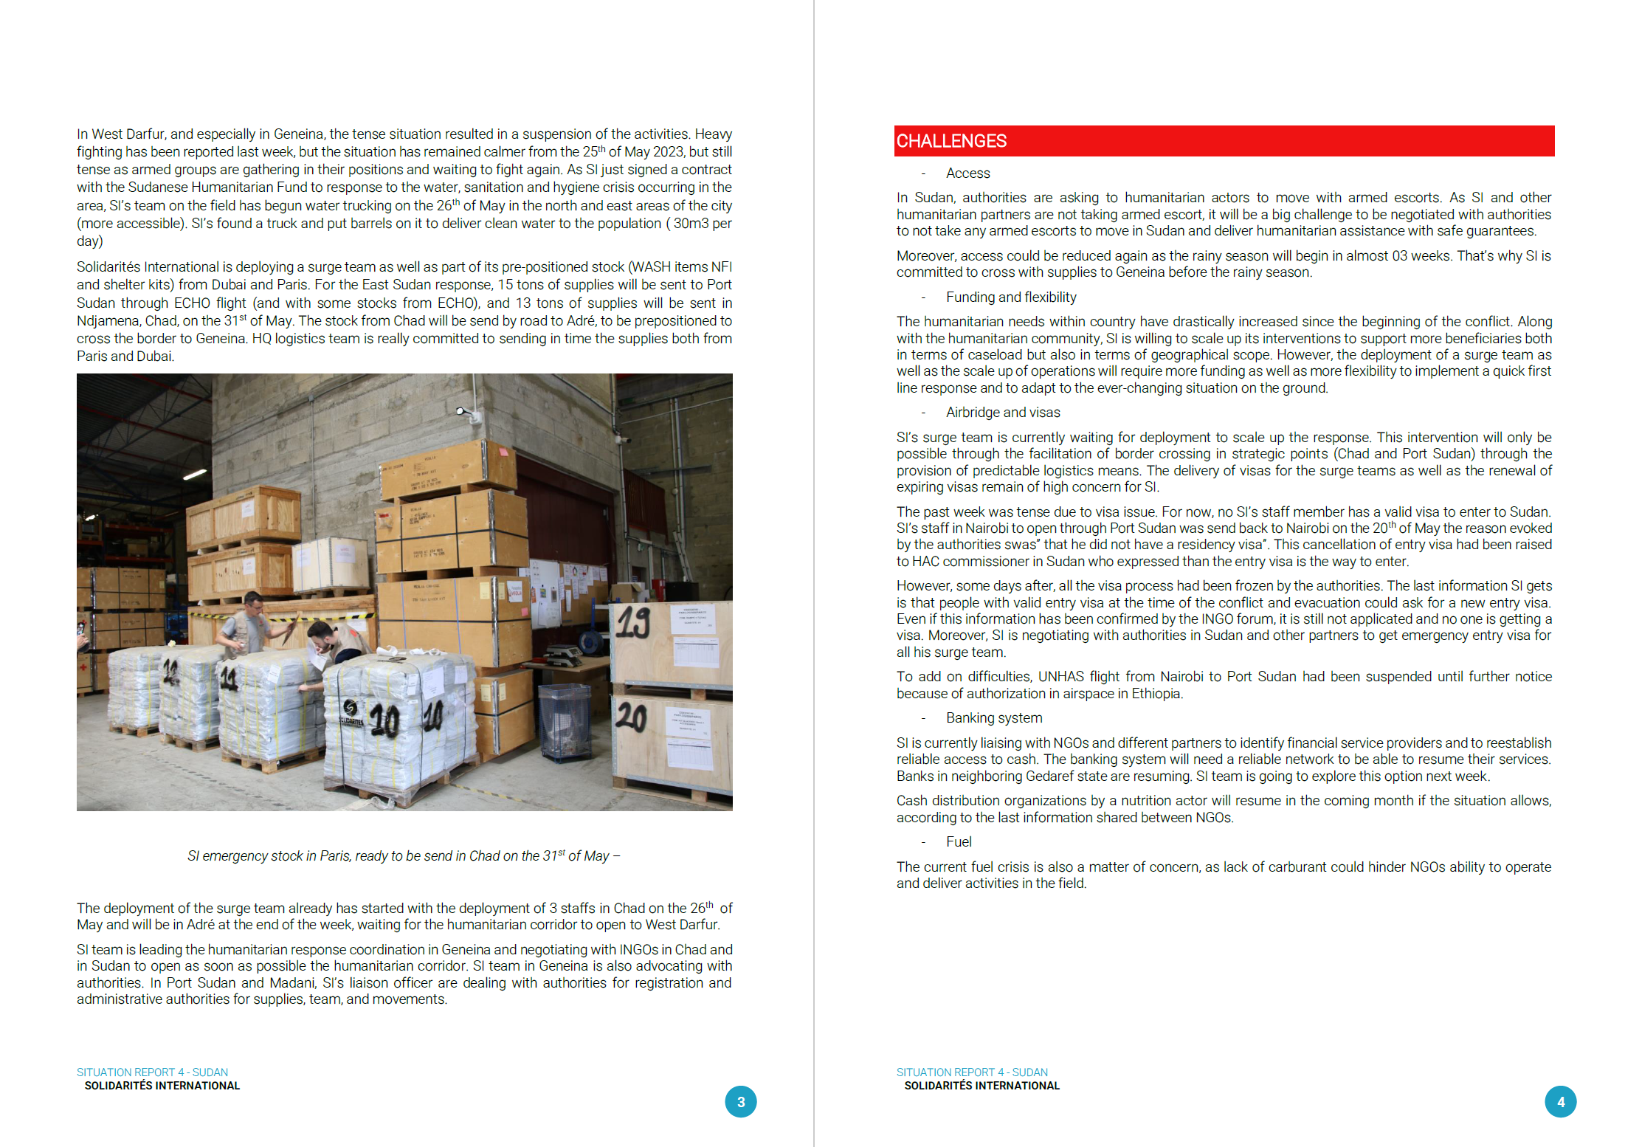
Achievements Reporting - Narrative
Partners are encouraged to submit narrative updates with pictures so that we can compile narrative report at Cluster level to inform HCT, donors and wider public.
You can share these updates directly through email, or we can create a KoBo form where you can upload a document.
WhatsApp group?

Slide 10
HRP Project Revision Progress
Organizations with an existing HRP project | Organizations without an HRP project that expressed interest to implement Shelter and NFI interventions in OCHA presence mapping
Adventist Development and Relief Agency (ADRA) | Agency for Technical Cooperation and Development (ACTED) |  | Legend
ALIGHT (formerly ARC) | Addition for Disaster assistance and Development (ADD)
Alshrooq Organisation for Social and Cultural Development (AOSCD) | African Relief Committee (ARC)
Concern Worldwide (CW) | Alsalam Organization for Rehabilitation and Development (AORD) |  | Revisions/new submissions in progress
Cooperazione Internazionale (COOPI) | Auttash Organization for Peace and Development (APD)
Danish Refugee Council (DRC) | Catholic Agency for Overseas Development (CAFOD)
Deutsche Welthungerhilfe (DWHH) | Collaborative for Peace in Sudan (CfPS) |  | Revised/new projects submitted
Elgossa Charity Organization for Rural Development (ECORD) | Catholic Relief Services (CRS)
Great Family Organization (GFO) | Child Rights Watch (CRW)
International Organization for Migration (IOM) | Elemar Charitable Development Organization (ECDO) |  | No action has been taken
Mercy Corps (MC) | Future Humanitarian Development Organisation (FHDO)
Norwegian Refugee Council (NRC) | Human Appeal - UK (HA)
Save the Children (SCI) | Global Organization for the Family and Child Welfare (GOFCW)
Triangle Génération Humanitaire (TGH) | Humanity for Development and Prosperity Organization (HDPO)
United Nations Development Programme (UNDP) | Läkarmissionen International (LM Int.)
United Nations High Commissioner for Refugees (UNHCR) | International Aid Services (IAS)
United Peace Organization (UPO) | International Rescue Committee (IRC)
World Vision International (WVI) | Islamic Relief Worldwide (IRW)
 | Jabal Marra Charity Organization for Rural Development (JMCO)
 | National Organization for Humanitarian Services (NOHS)
 | National Planning Organization (NPO)
 | Plan International (PI)
 | Practical Action (PA)
 | Raise for Development and Humanitarian Aid Organization (RAISE)
 | Sahari Organization for Development (SAHARI)
 | Sudanese Coalition for Education For All (SCEFA)
 | Sabah Al- Sudan for Development Organization (SDO)
 | Sudanese Hilef for Peace and Development (SHPDO)
 | Solidarités International (SI)
 | Sibro Organization for Development (SOD)
 | Sudanese Organisation for Relief and Recovery (SORR)
 | Voluntary Network for Rural Helping and Development (VNRHD)
 | ZOA

Slide 11
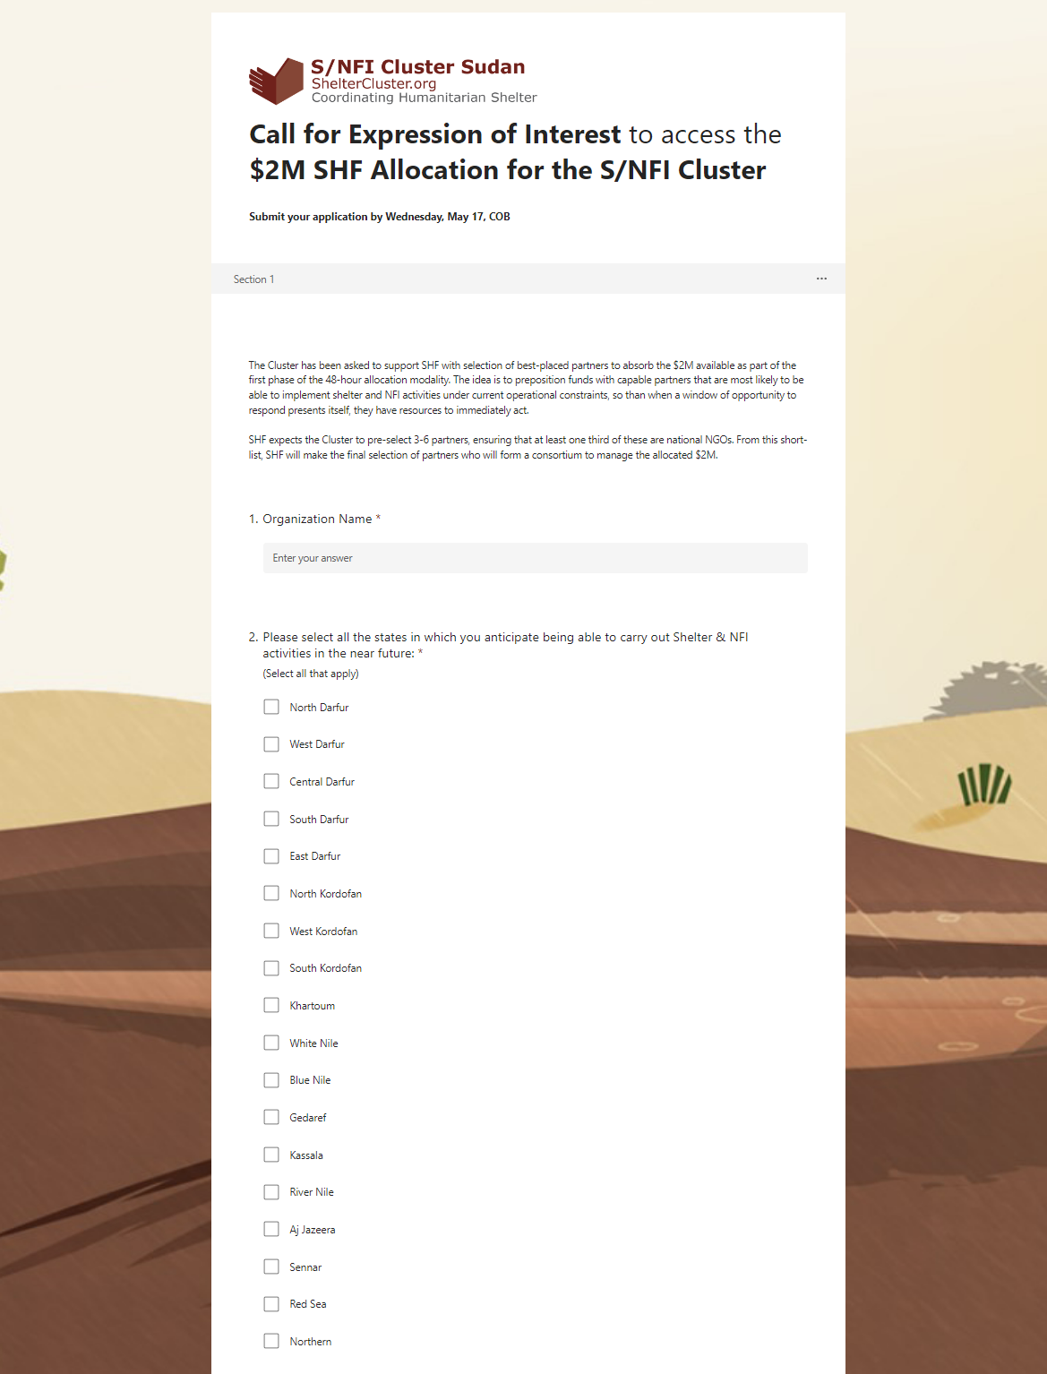
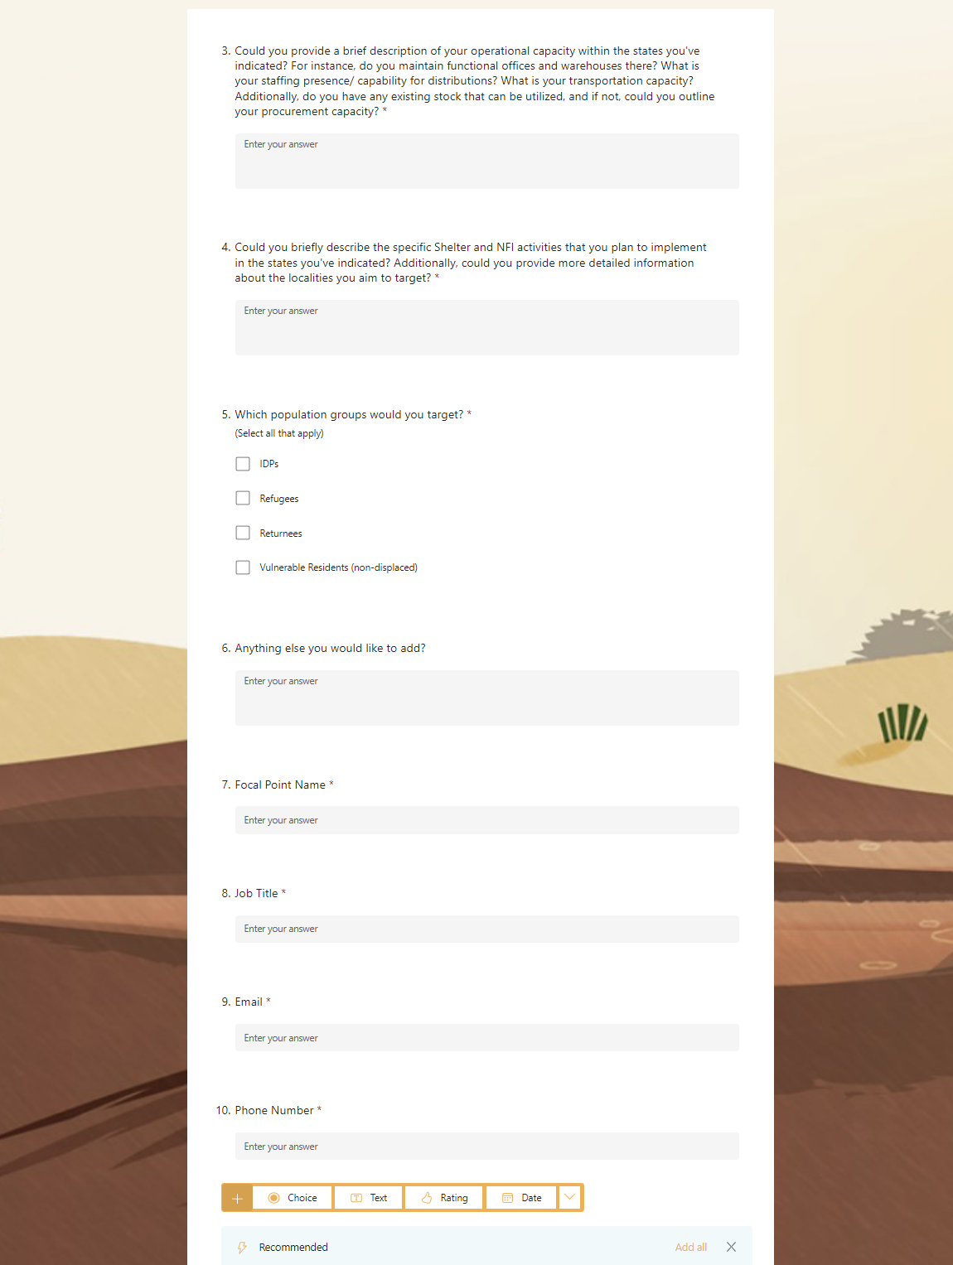
SHF 48 hrs – Partner Selection

Slide 12
SHF 48 hrs Allocation – Partner Selection
Selection Criteria
Geographical presence
(vis a vis current needs - e.g., ability to implement in Northern state where very few have presence is a huge advantage given the large number of new IDPs there)
Technical capacity to implement Shelter interventions
(capable shelter actors should have advantage - we are not just an NFI sector - and shelter plays a much bigger role in preserving health and lives than NFIs, especially now when millions are without a roof over their heads)
Technical capacity to implement NFI interventions
Operational capacity
(presence of staff, volunteer networks, offices, warehouses, vehicles, procurement capacity, etc. - as per the submitted application)
Relevance of proposed interventions
(as per the submitted application)
Organization | Geographical Presence | Technical capacity to implement Shelter Interventions | Technical capacity to implement NFI Interventions | Operational Capacity | Relevance of proposed interventions | Total | SAG Scoring Results
Sudanese Organization for Relief and Recovery (SORR) | 31 | 31 | 33 | 30 | 32 | 157 | Selected Consortium Partners
United Peace Organization (UPO) | 33 | 31 | 33 | 29 | 30 | 156
Adventist Development and Relief Agency (ADRA) | 30 | 31 | 32 | 28 | 32 | 153
Save the Children (SCI) | 32 | 28 | 31 | 29 | 27 | 147
Danish Refugee Council (DRC) | 20 | 31 | 32 | 29 | 31 | 143
Agency for Technical Cooperation and Development (ACTED) | 23 | 29 | 33 | 25 | 31 | 141
ZOA | 31 | 25 | 27 | 24 | 29 | 136 | Save the Children (SCI) has been selected as the consortium lead by SHF as they are designated as a low-risk partner, while at the same time they are selected as consortium leads for other Clusters – hence SHF would like to combine consortium leads across clusters to realize savings on operational costs.
Cooperazione Internazionale (COOPI) | 25 | 29 | 29 | 28 | 24 | 135
Norwegian Refugee Council (NRC) | 17 | 31 | 30 | 28 | 28 | 134
ALIGHT | 18 | 29 | 30 | 26 | 30 | 133
Triangle Génération Humanitaire (TGH) | 16 | 26 | 29 | 25 | 28 | 124
Concern Worldwide (CW) | 20 | 23 | 27 | 24 | 26 | 120
Solidarités International (SI) | 20 | 19 | 24 | 22 | 24 | 109
Africa Humanitarian Action (AHA) | 16 | 19 | 21 | 19 | 24 | 99
National Planning Organisation (NPO) | 21 | 14 | 20 | 17 | 19 | 91
Collaborative for Peace in Sudan (CfPS) | 25 | 14 | 18 | 15 | 18 | 90
Great Family Organization (GFO) | 13 | 16 | 18 | 15 | 21 | 83
Jabal Marra Charity Organization (JMCO) | 15 | 13 | 16 | 20 | 18 | 82
Child Rights Watch (CRW) | 13 | 13 | 11 | 13 | 11 | 61

Slide 13

SHF 48 hrs – Partner Selection

Slide 14
AOB

