Slide 1


Shelter & NFI Cluster
Coordination Meeting
MS Teams • Sudan • 5th June ‘23

Slide 2
Agenda
• Situation Update
• Internews Social Media Listening
• Roundtable on Achievements & Operational Plans
• Reporting
• HRP Project Revision Progress
• AOB

Slide 3
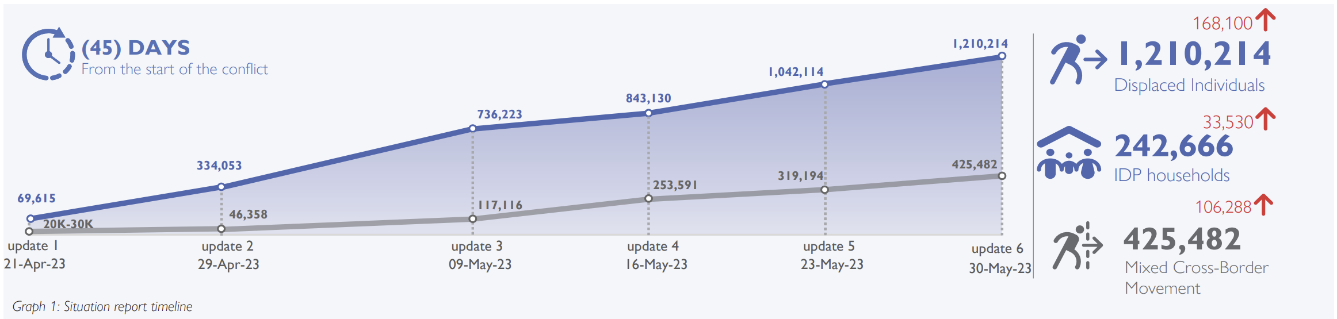
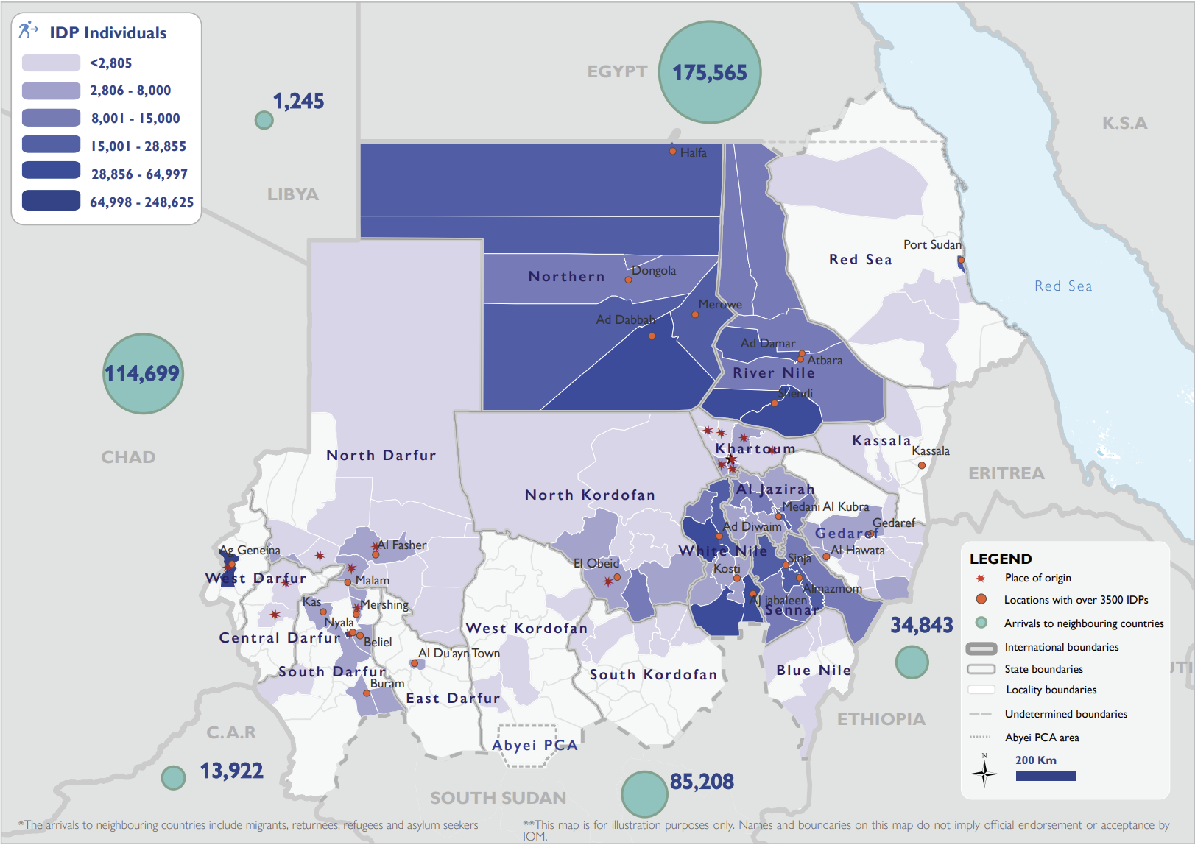
Situation Update
Over 1.6 million people have been forced to flee their homes since the conflict started on 15 April.
As of May 30, the estimated number of IDPs across Sudan is 1,210,214, with the highest proportions in West Darfur, White Nile, River Nile, and Northern states. The conflict has also caused mixed cross-border movements of 425,482 individuals into neighbouring countries. DTM Sudan estimates that approximately 7.63% of the IDP caseload are non-Sudanese nationals.
Heavy fighting continued to rage in Khartoum, North Kordofan, North, Central and West Darfur, the humanitarian situation continues to deteriorate with reports of malnutrition and measles outbreaks amid a lack of basic goods such as food and water.

Slide 4
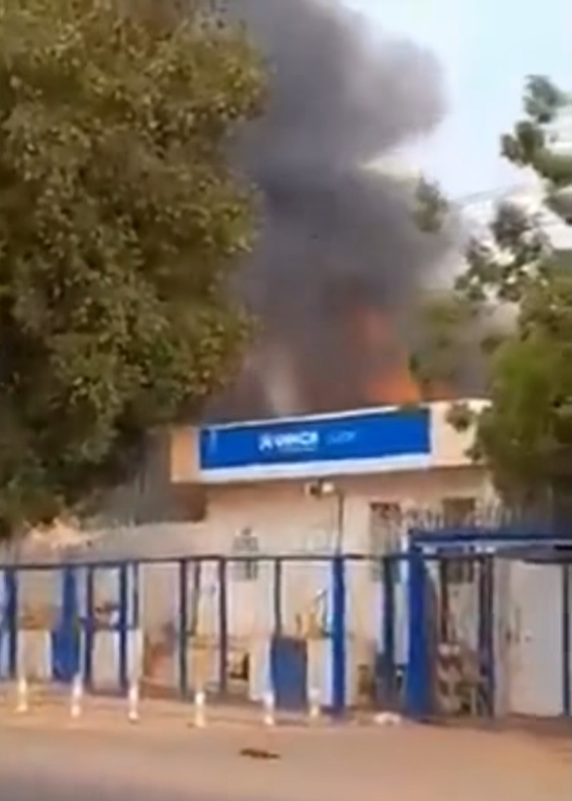
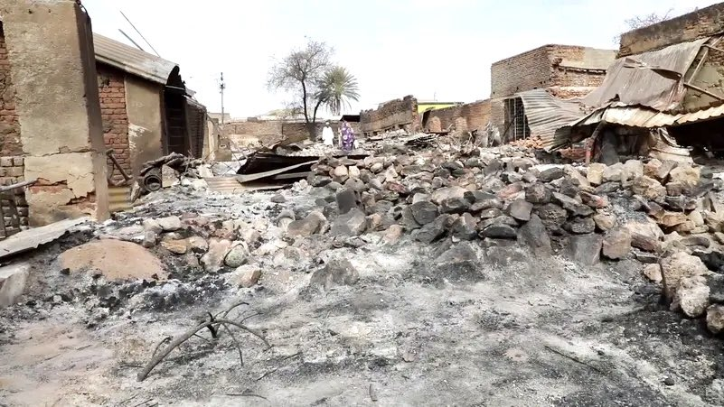
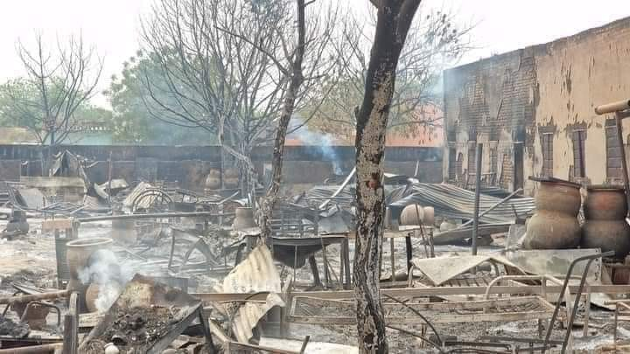
Situation Update
_Kutum_
_UNHCR Office in Khartoum_
_El Genina_

Slide 5
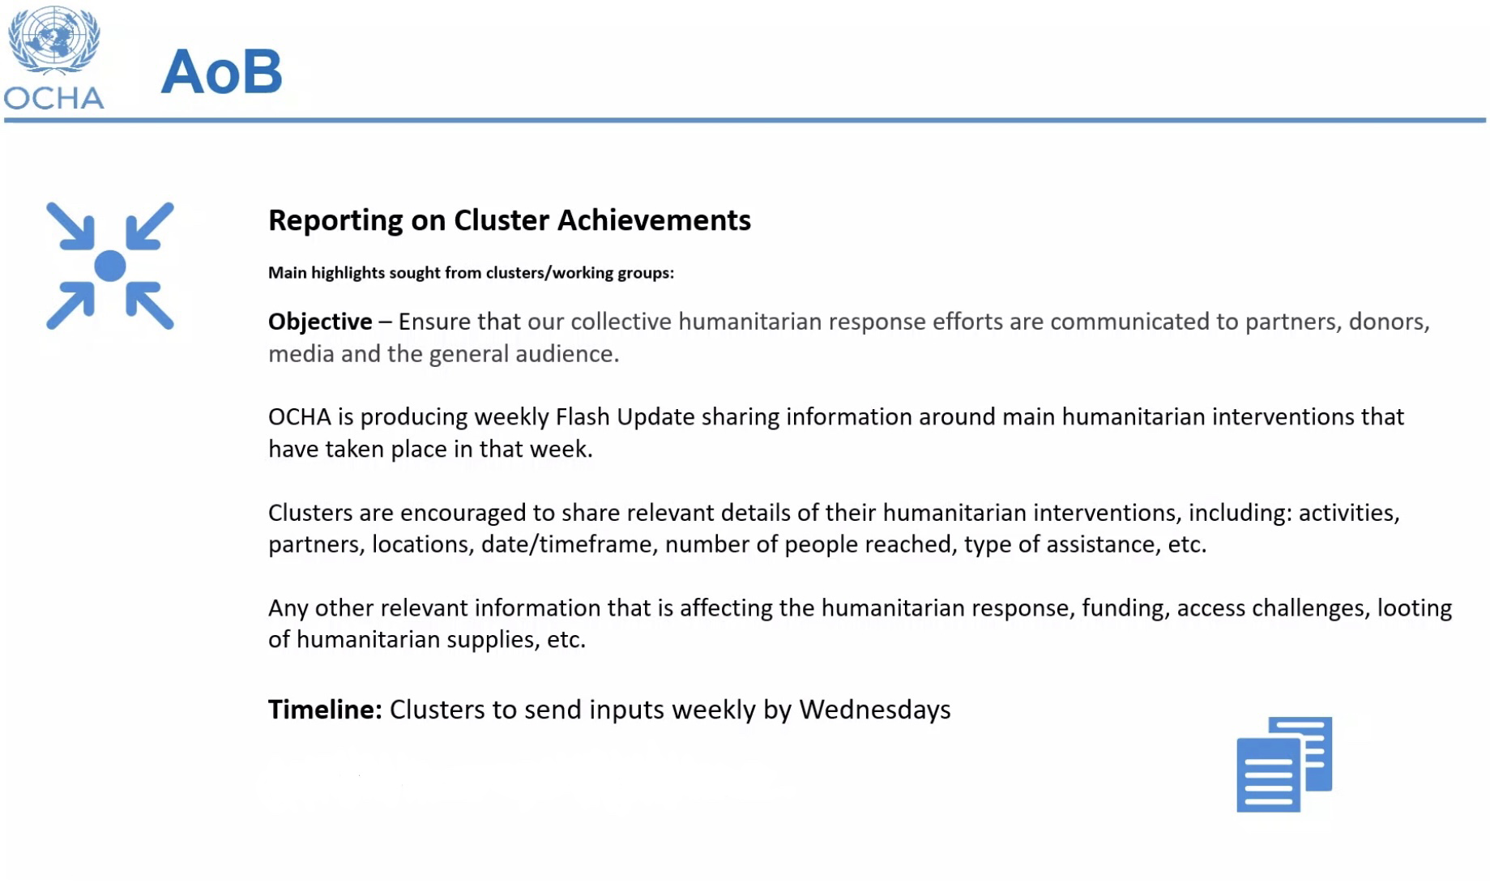
Roundtable – Achievements/Ops Plans

Slide 6
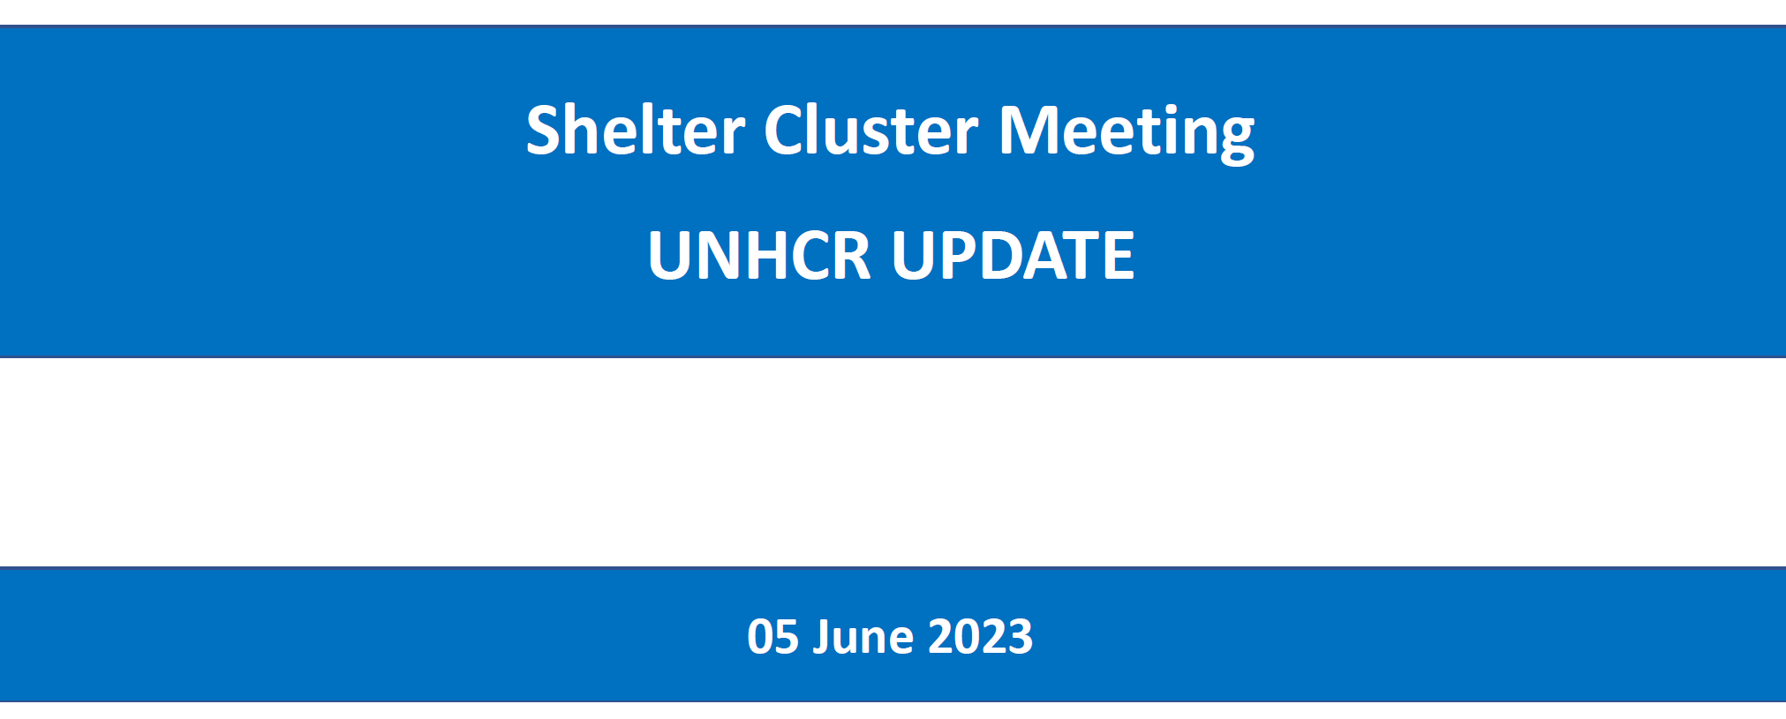
Update from UNHCR

Slide 7
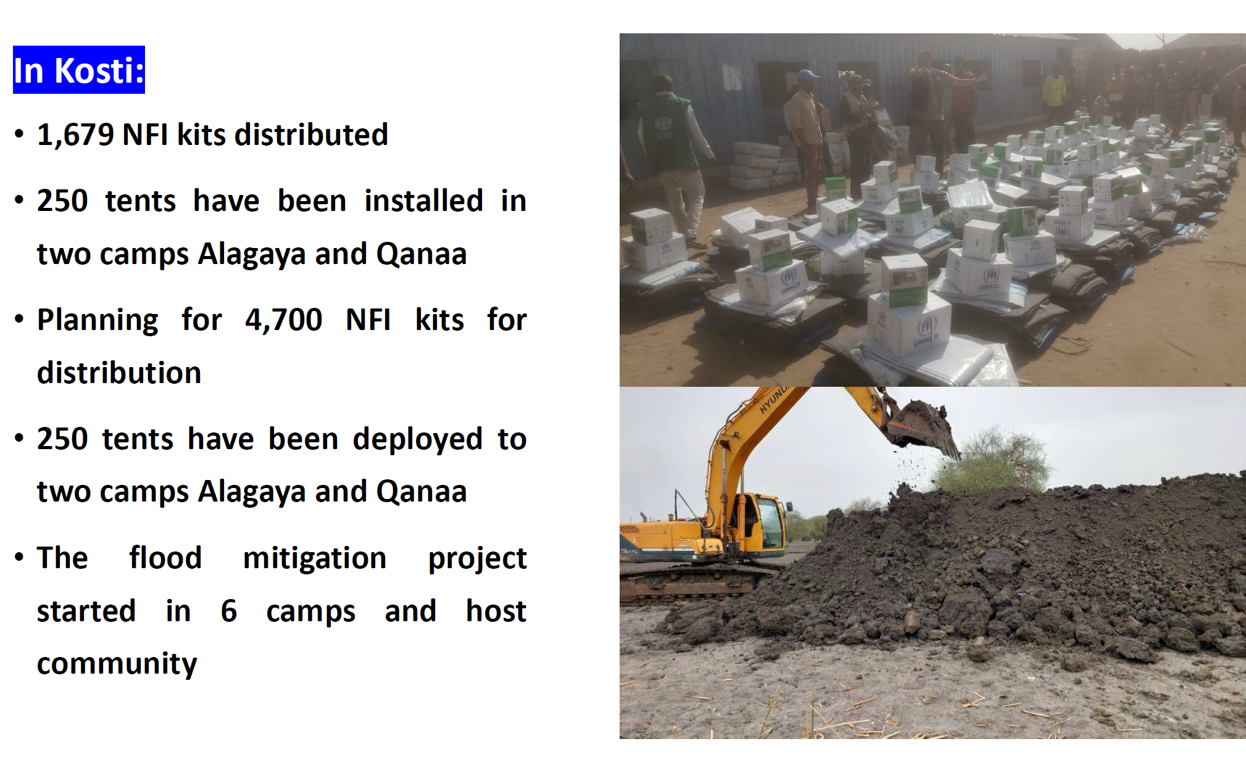
Update from UNHCR

Slide 8
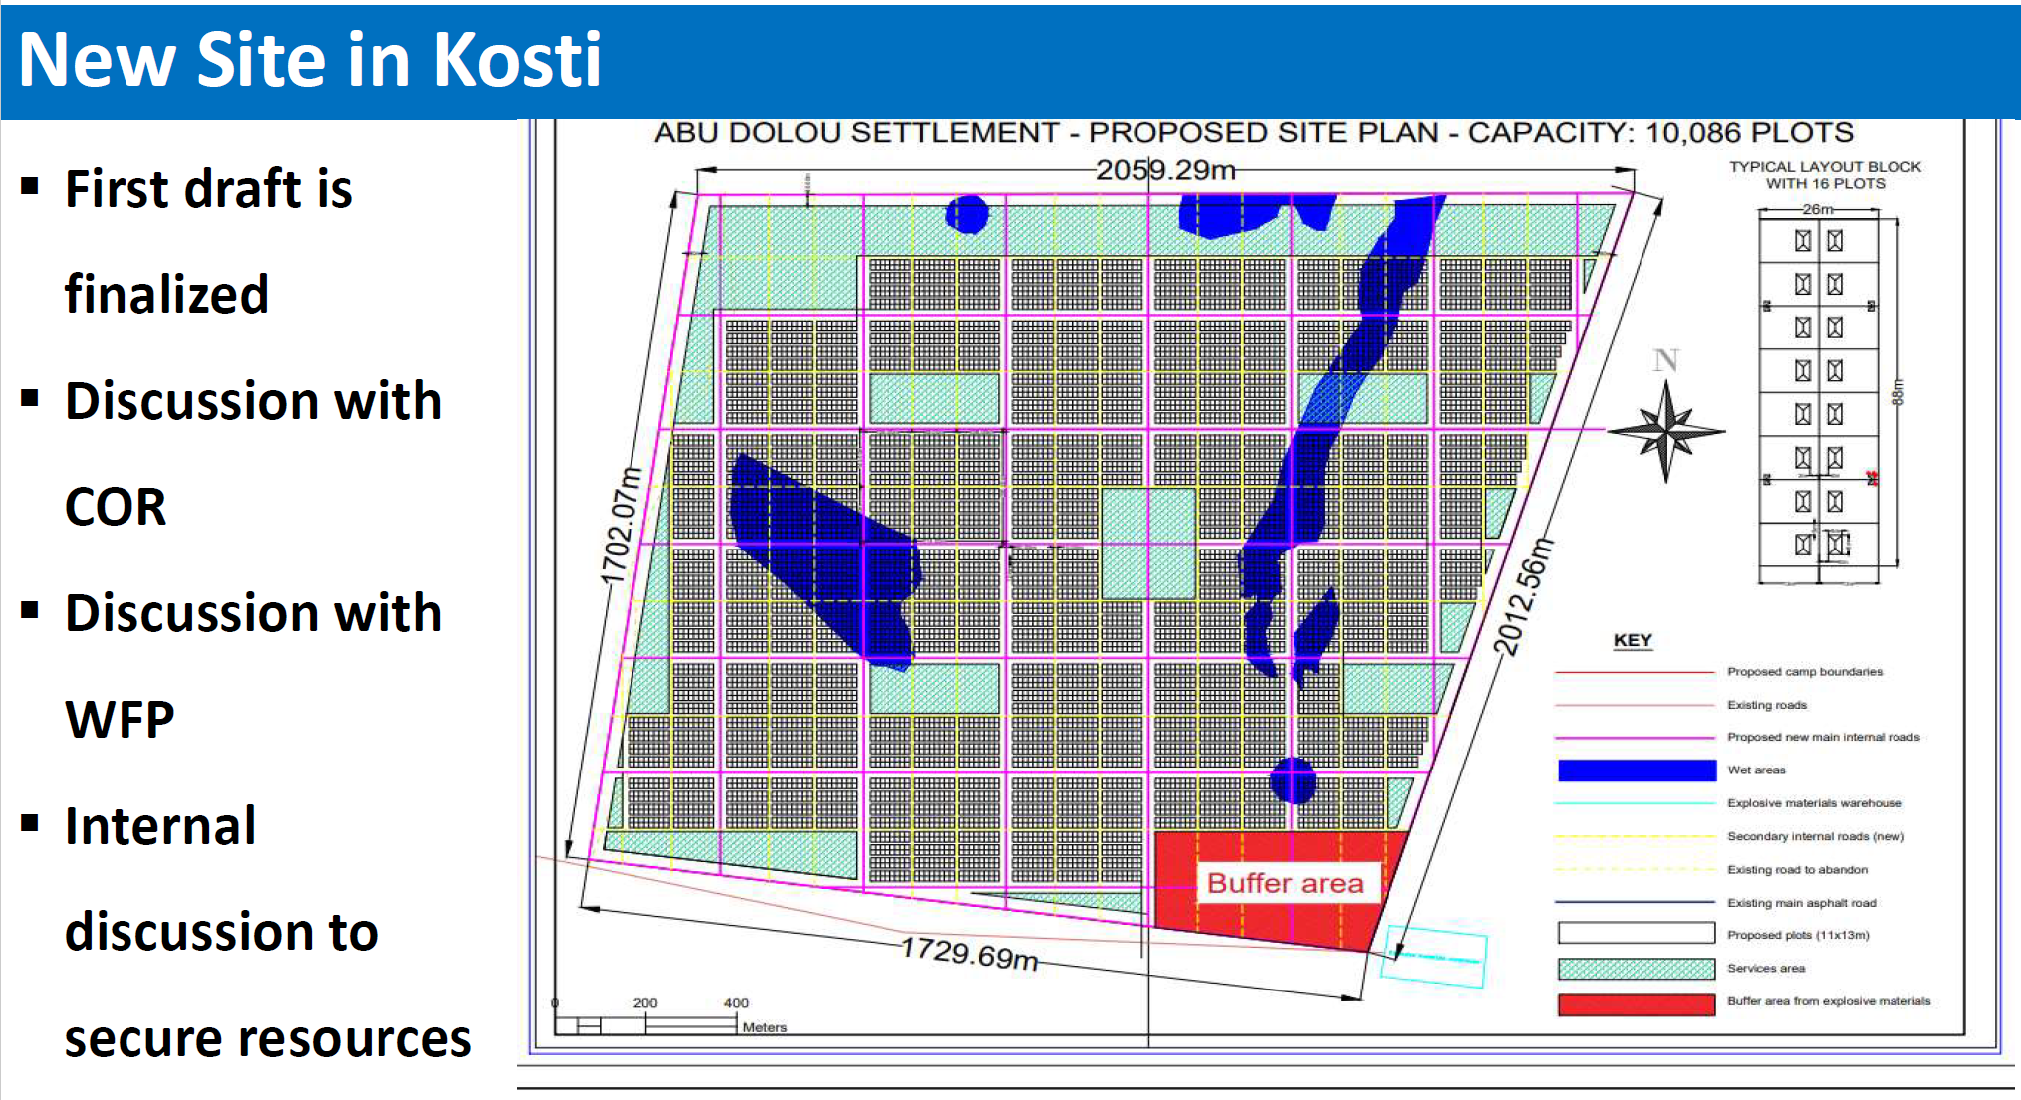
Update from UNHCR

Slide 9
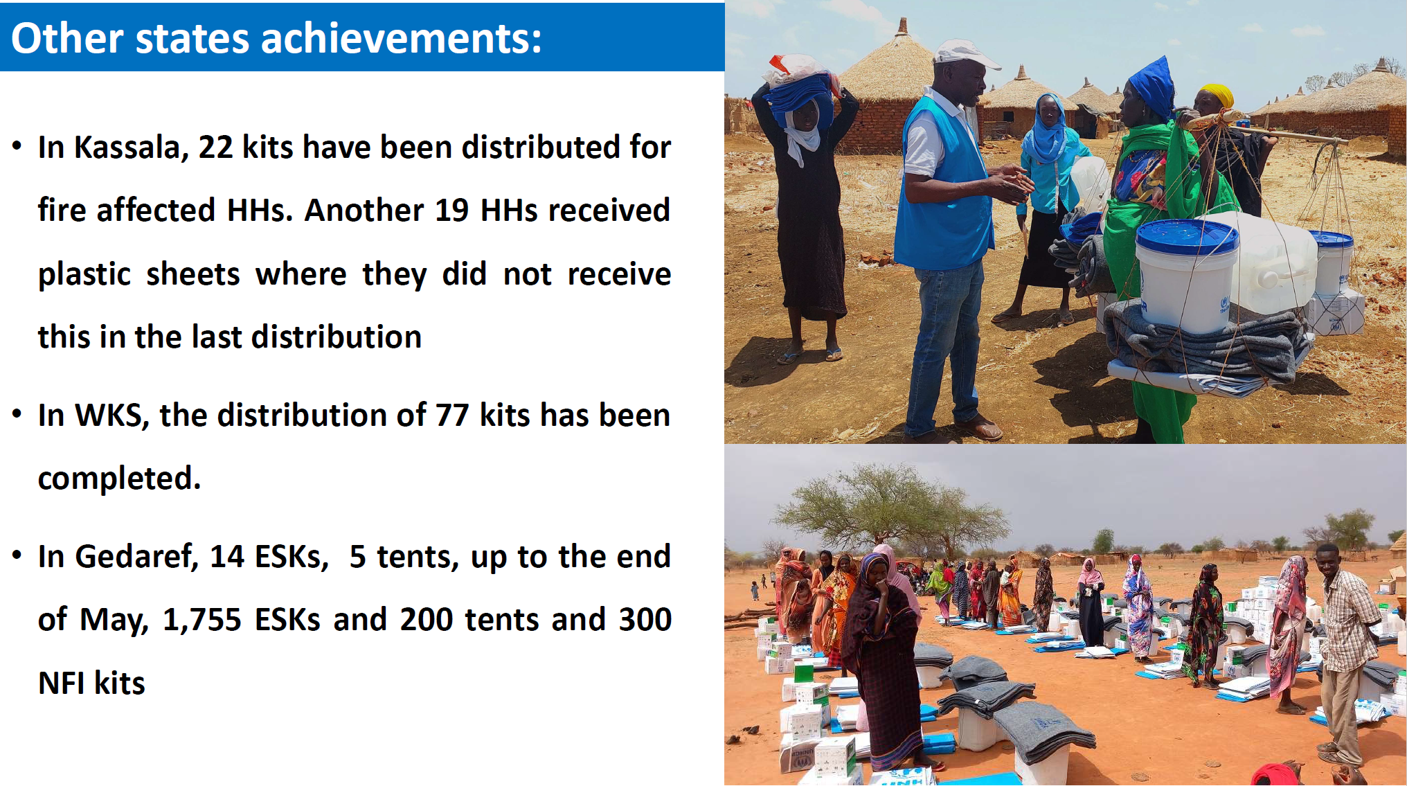
Update from UNHCR

Slide 10
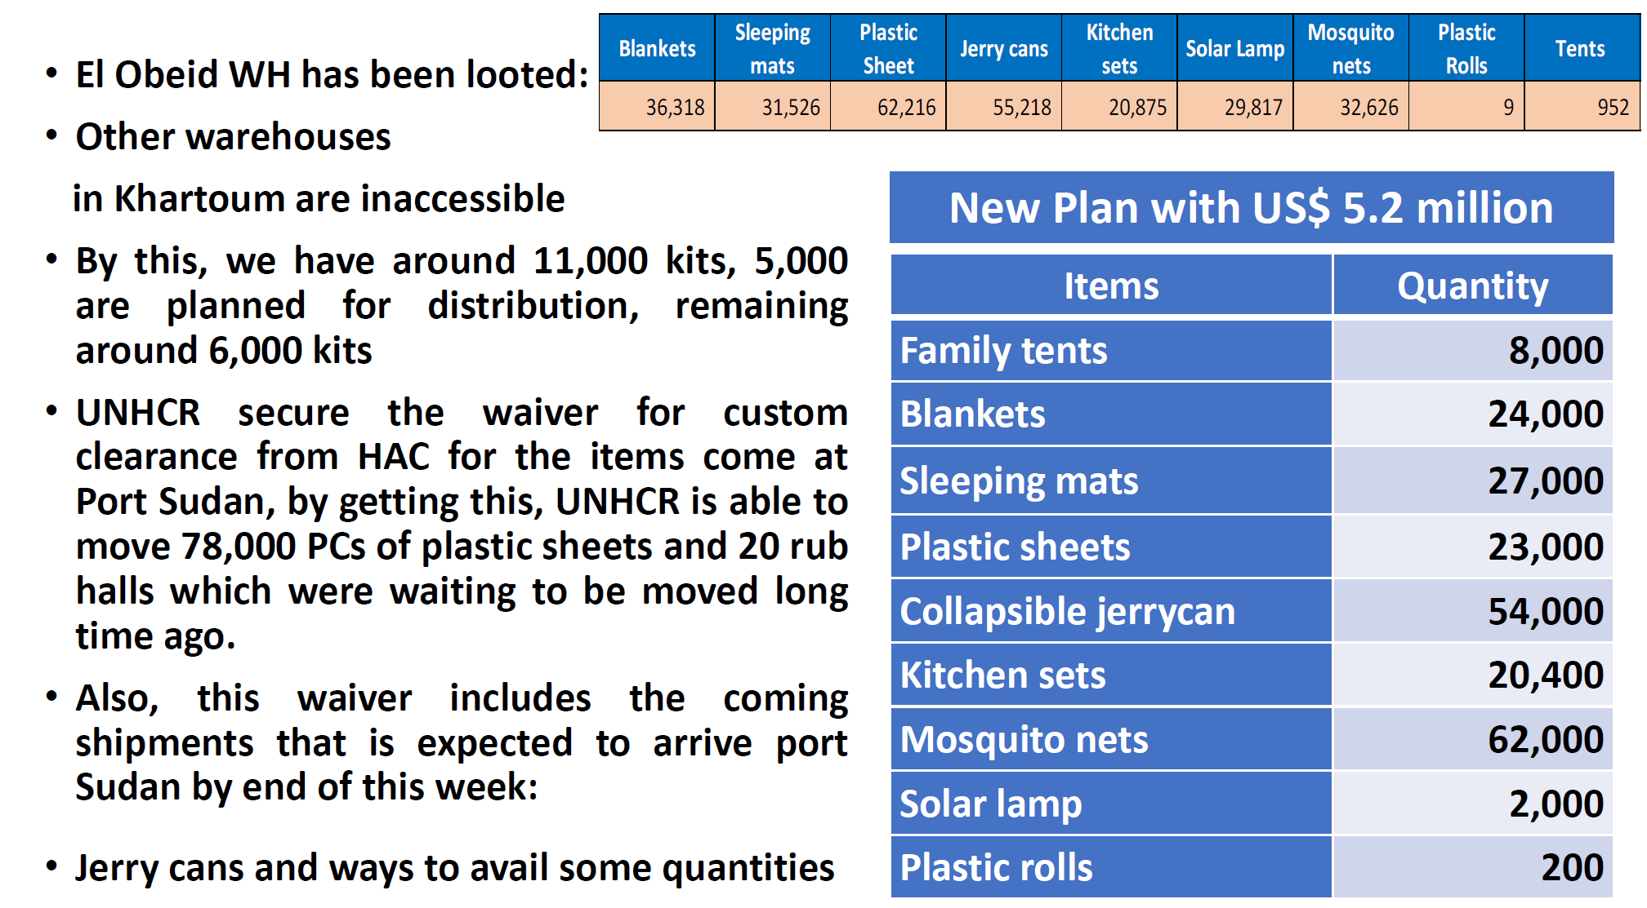
Update from UNHCR

Slide 11
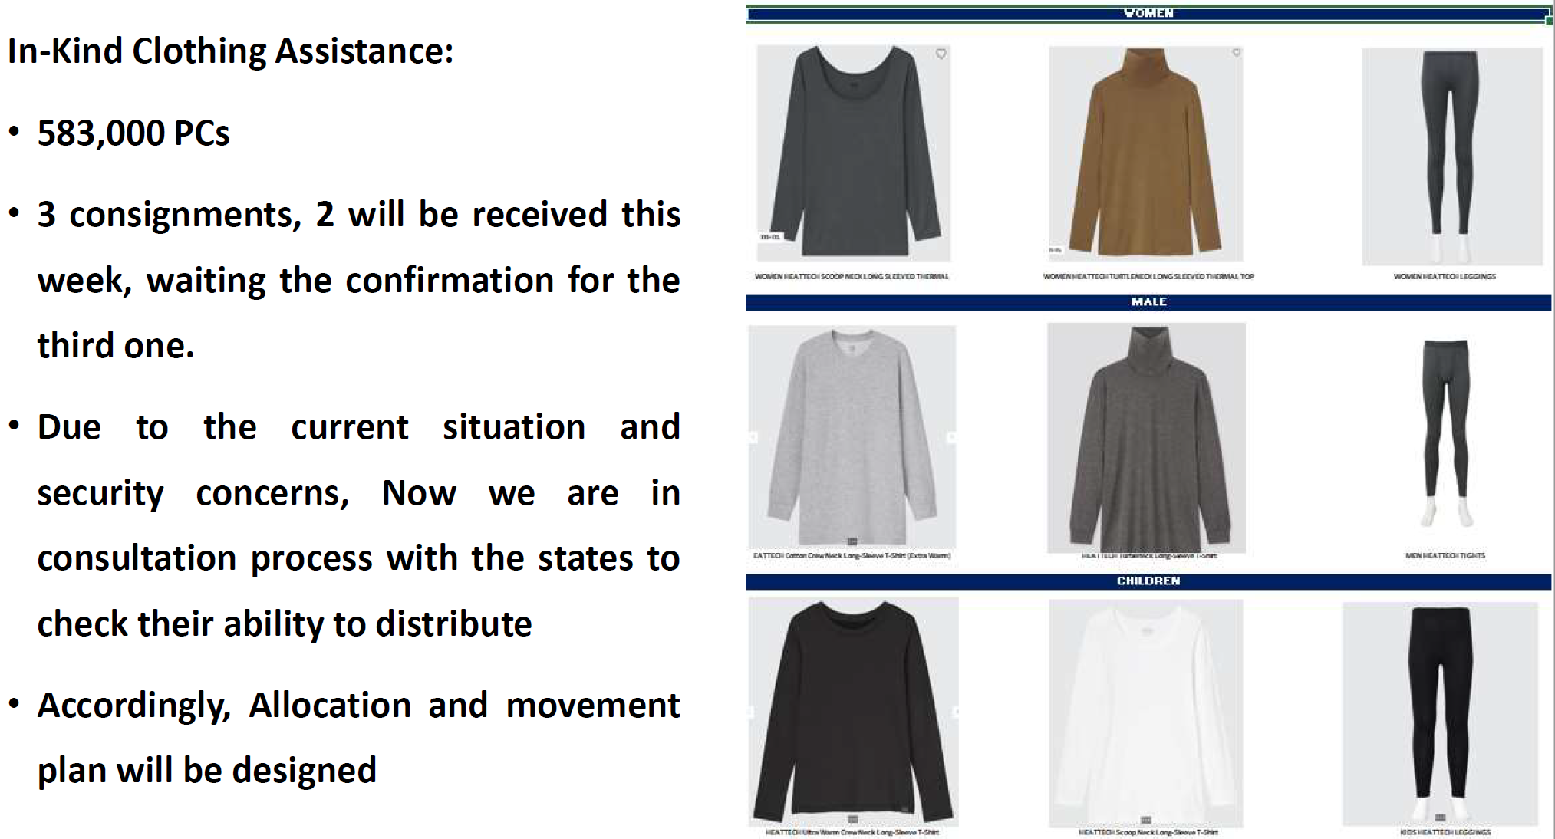
Update from UNHCR

Slide 12

Internews Presentation

Slide 13
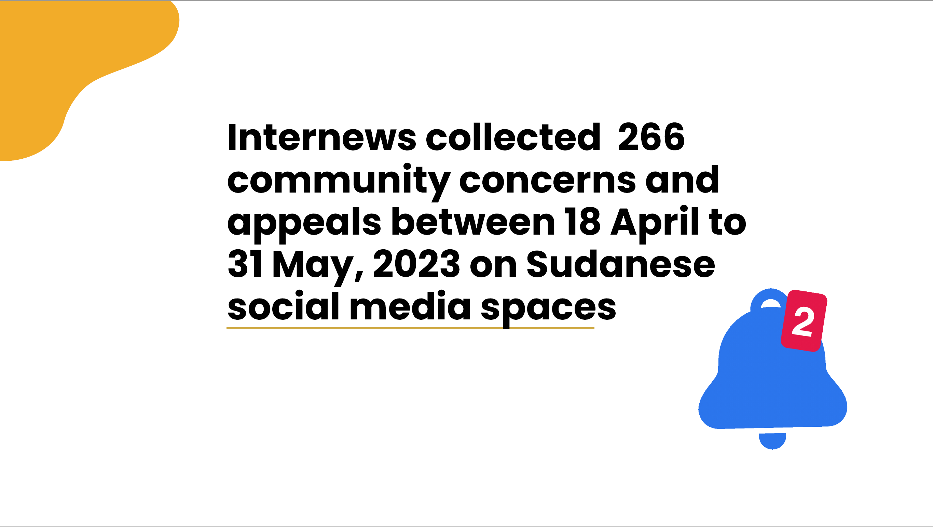
Internews Presentation

Slide 14
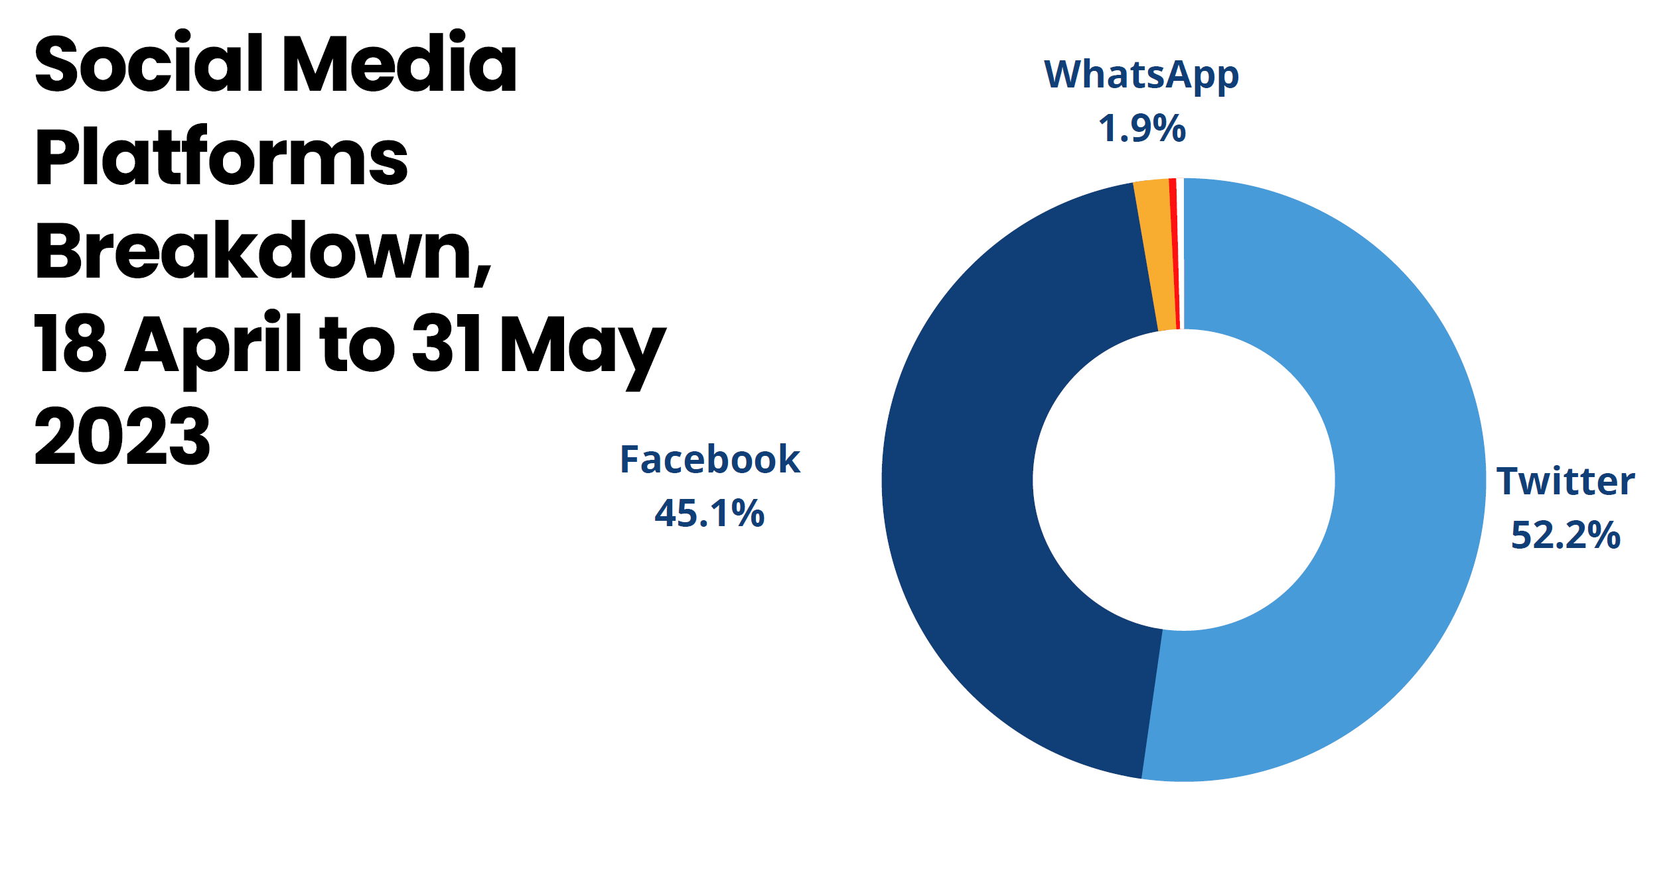
Internews Presentation

Slide 15
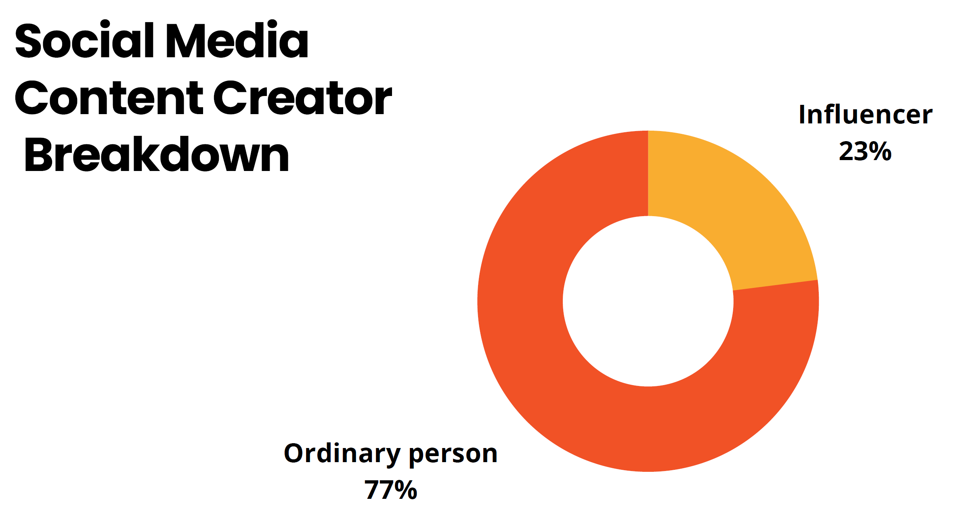
Internews Presentation

Slide 16
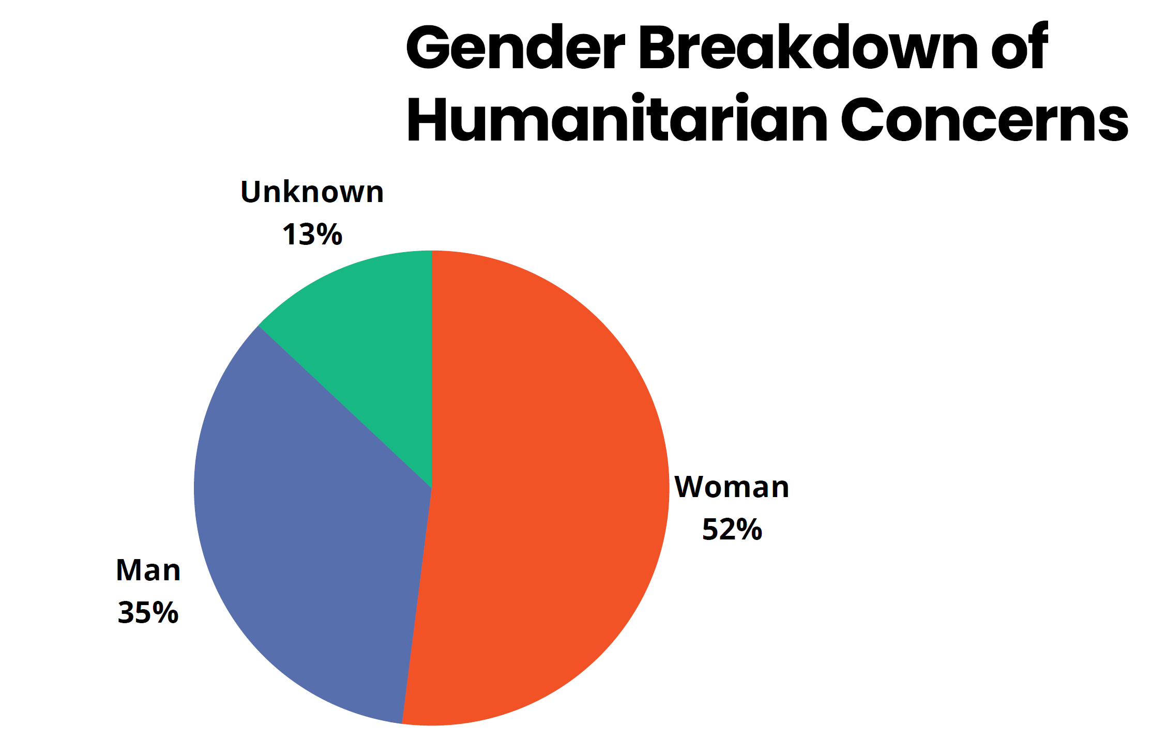
Internews Presentation

Slide 17
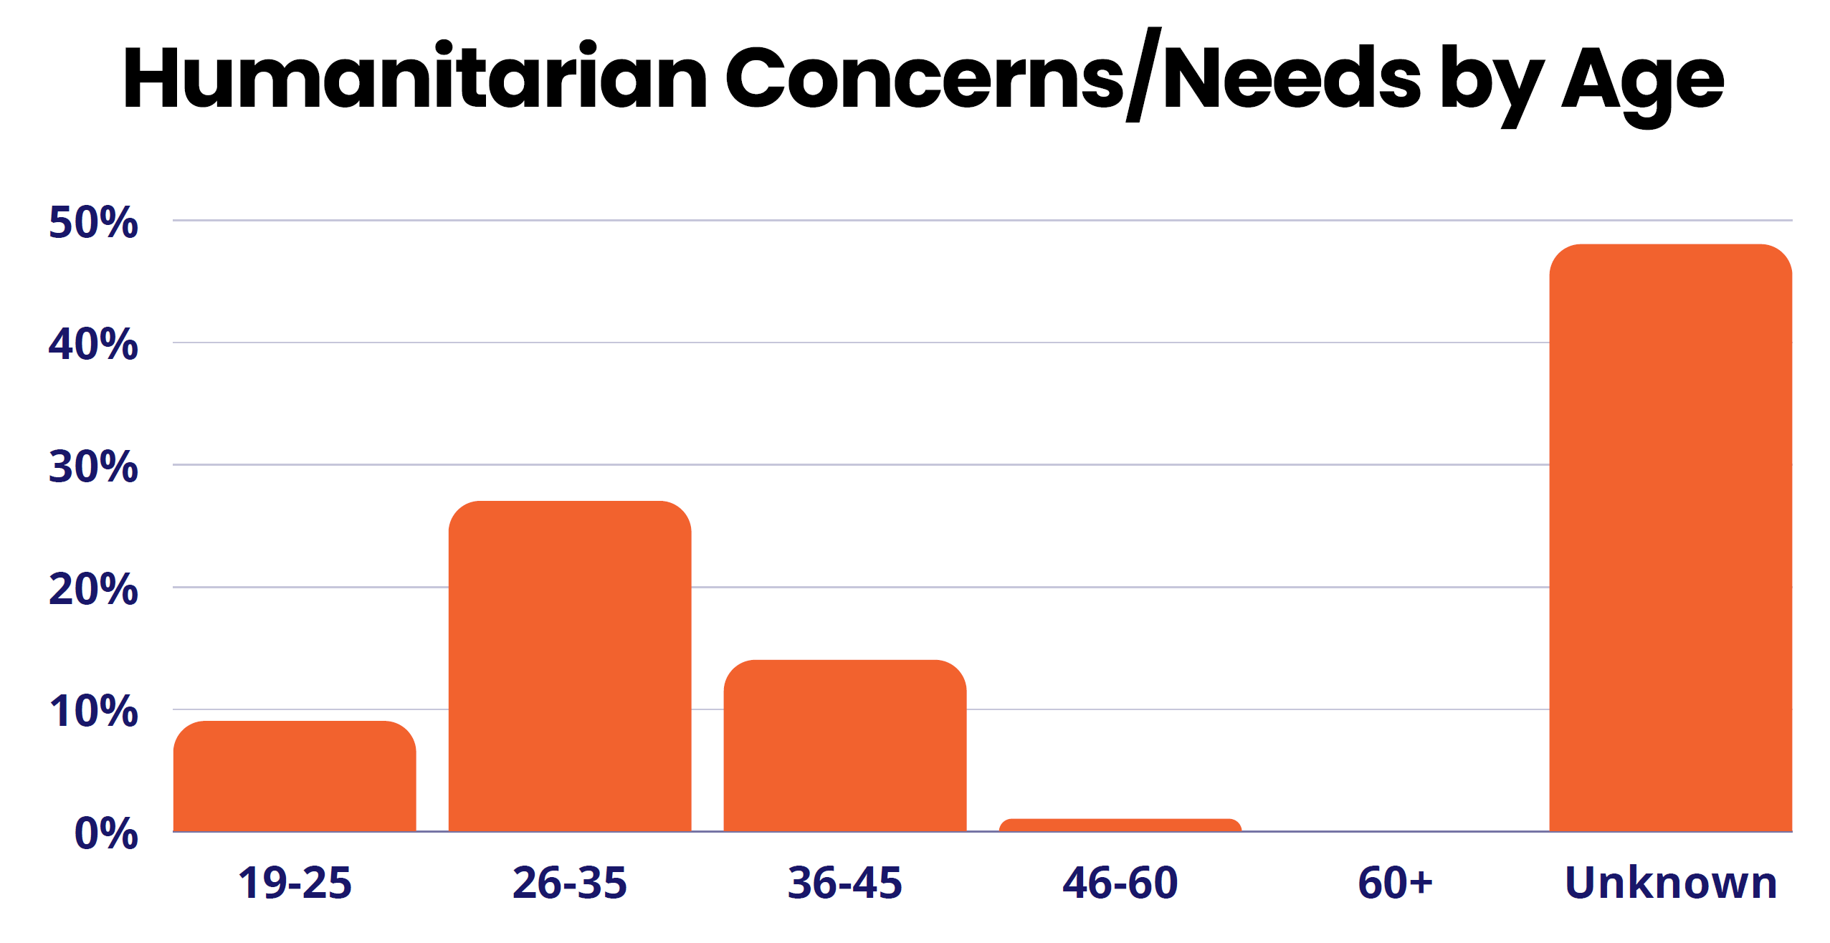
Internews Presentation

Slide 18
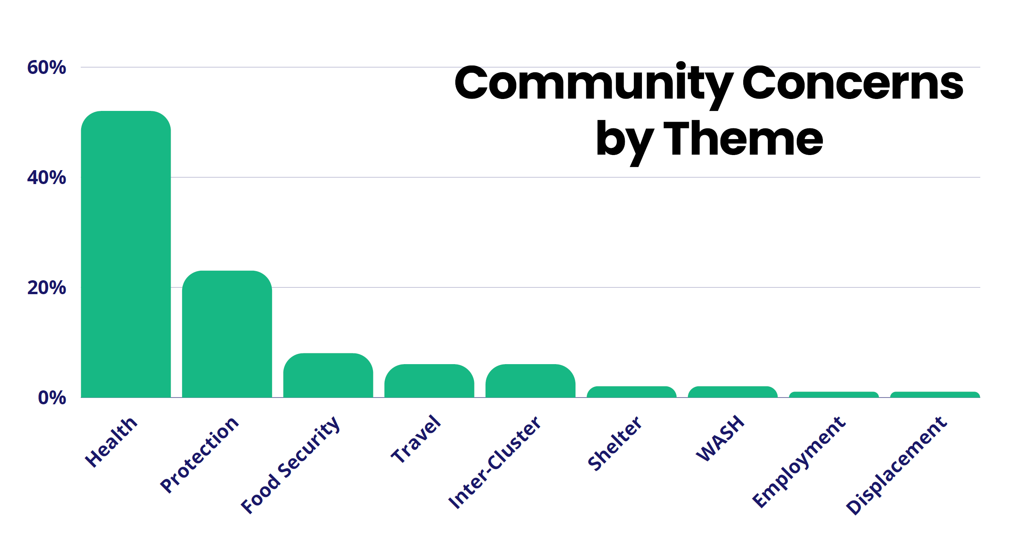
Internews Presentation

Slide 19
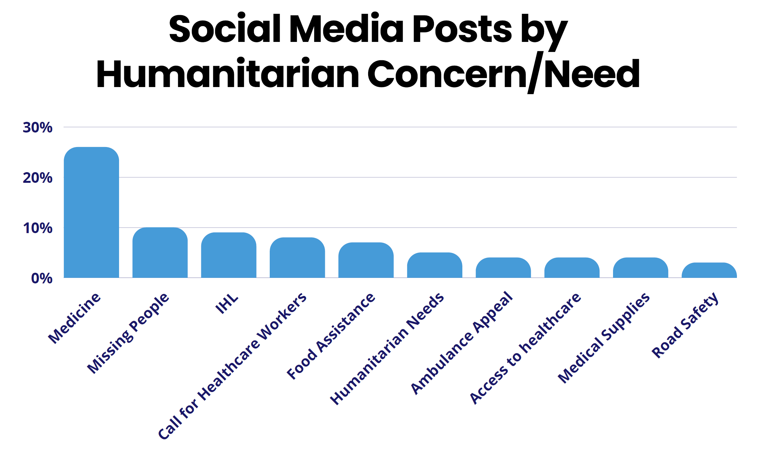
Internews Presentation

Slide 20
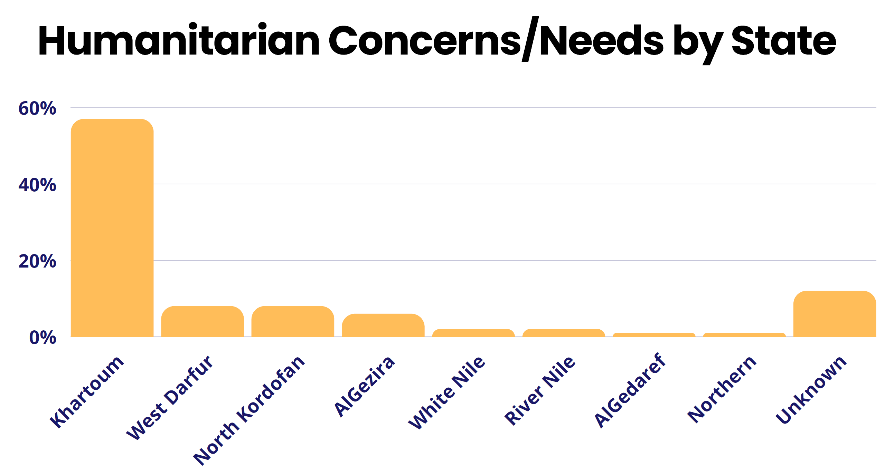
Internews Presentation

Slide 21
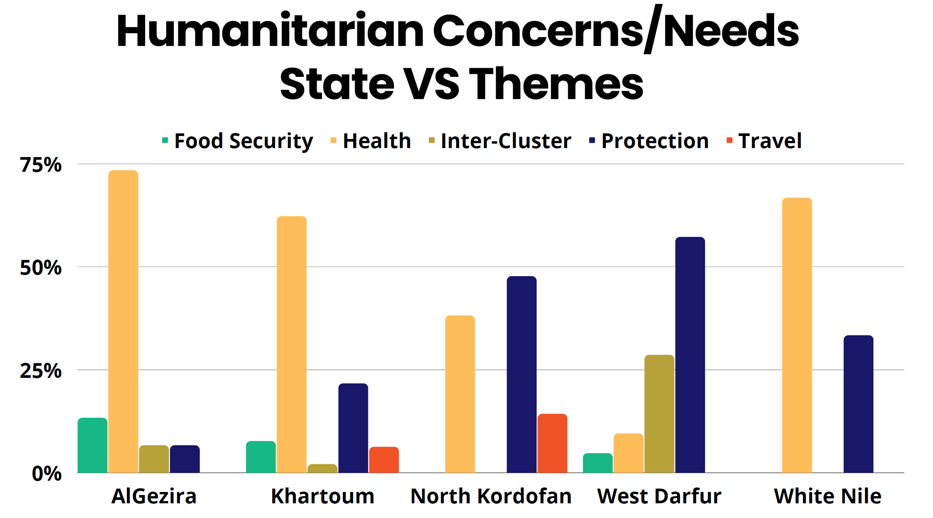
Internews Presentation

Slide 22
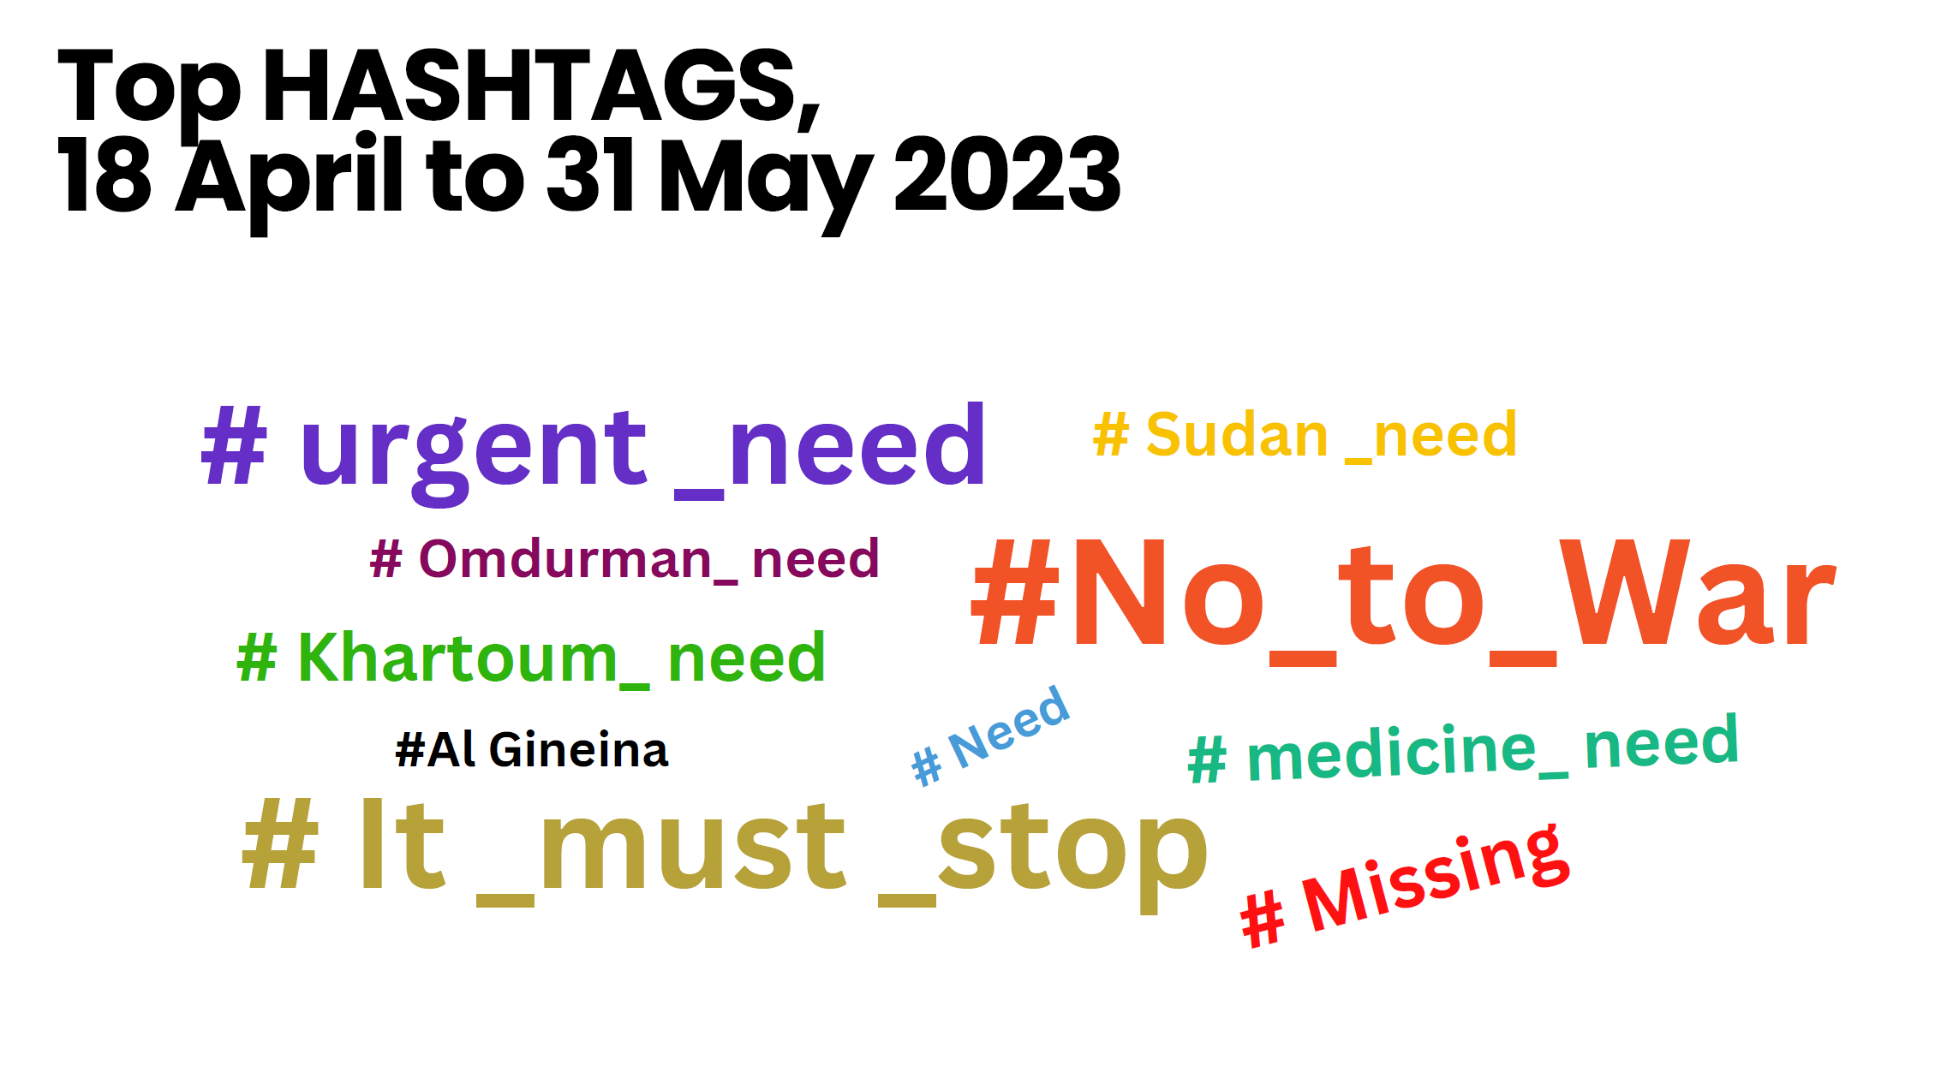
Internews Presentation

Slide 23
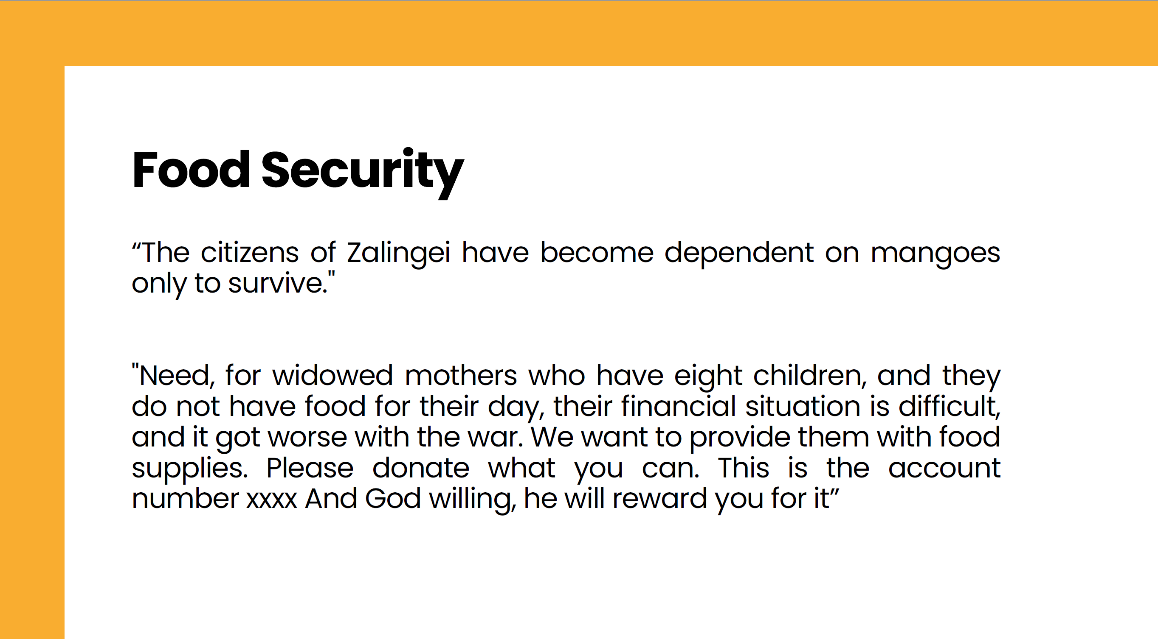
Internews Presentation

Slide 24
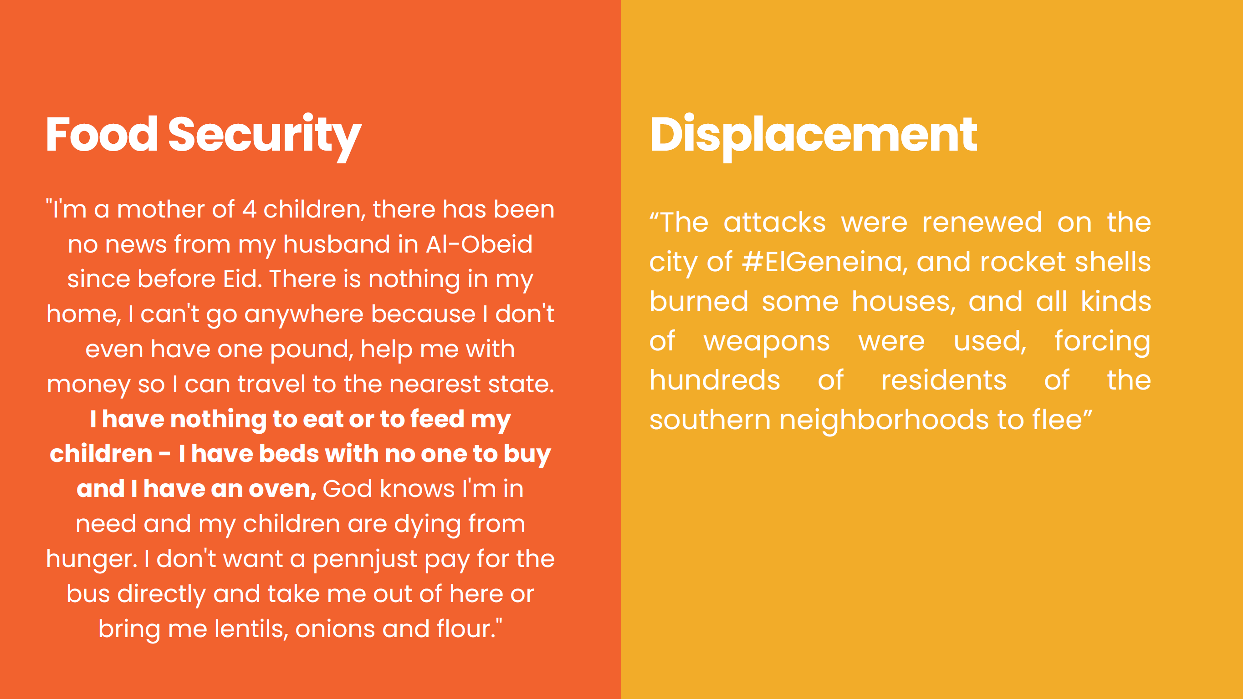
Internews Presentation

Slide 25
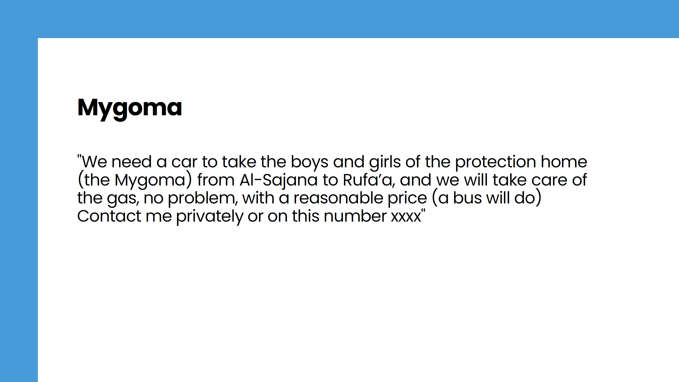
Internews Presentation

Slide 26
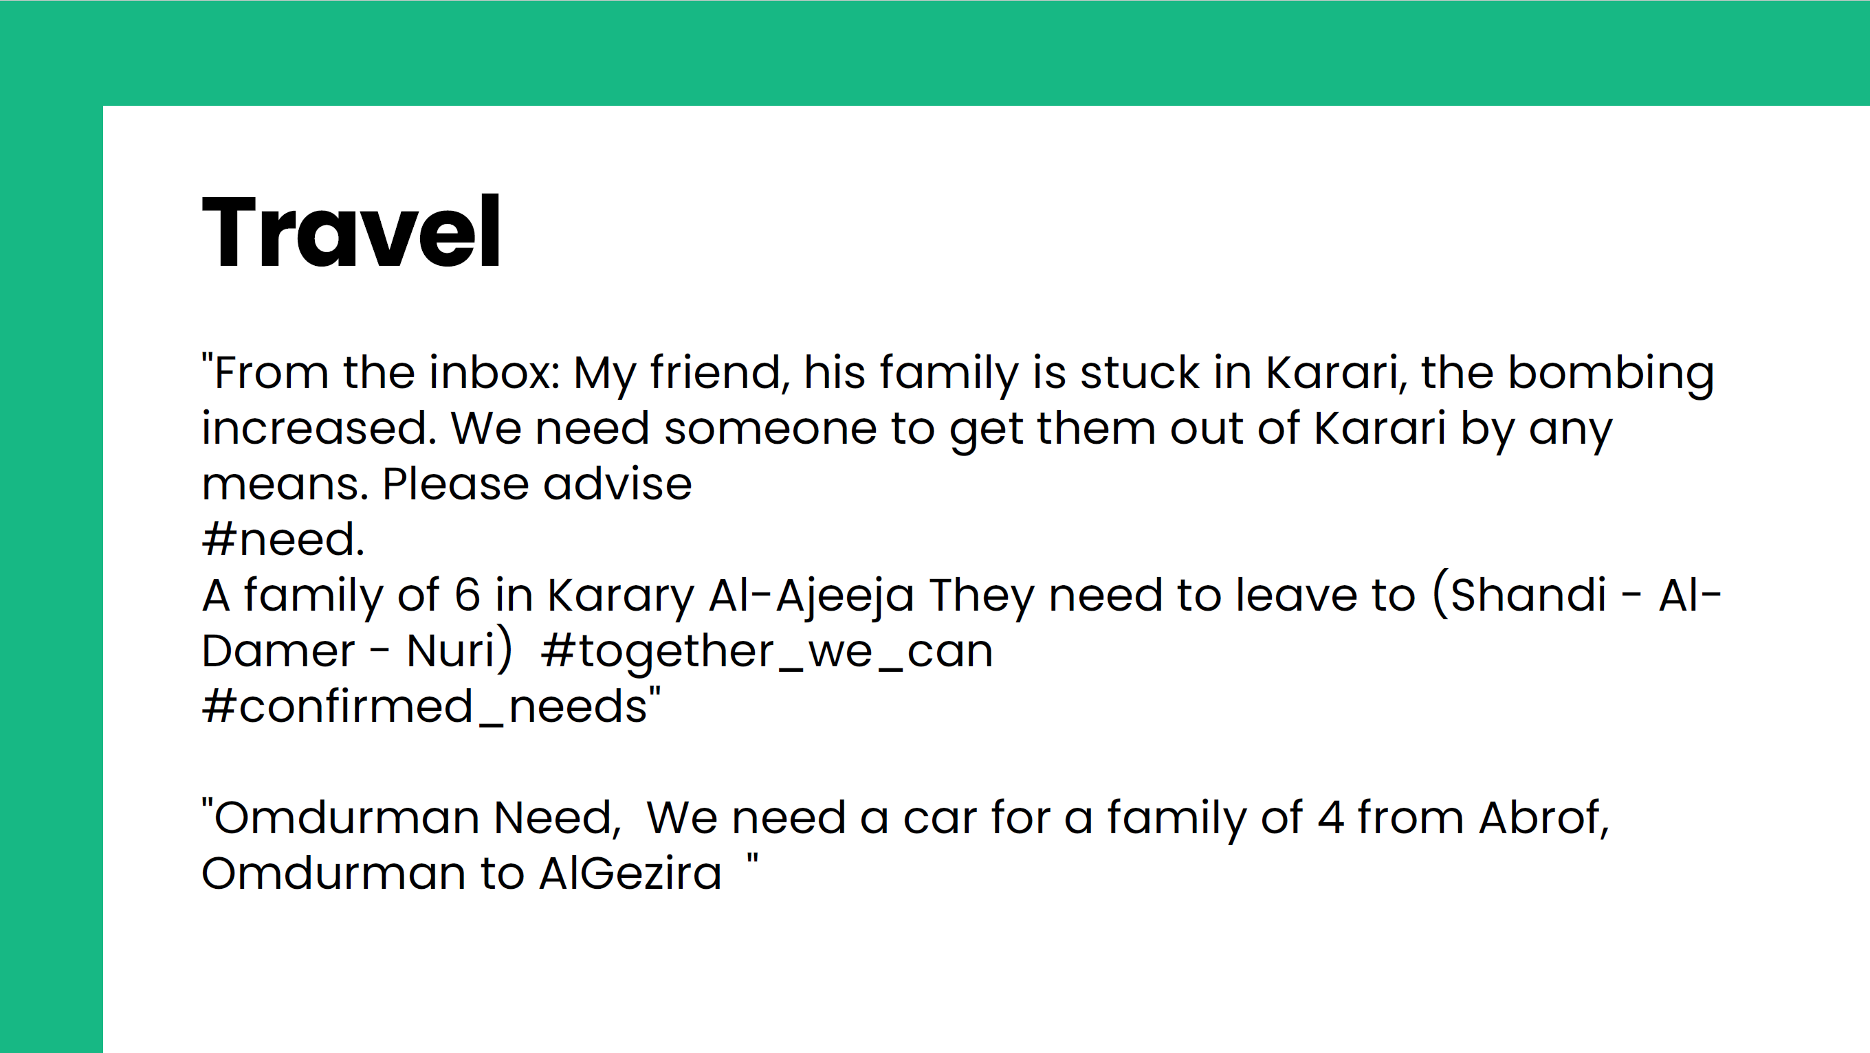
Internews Presentation

Slide 27
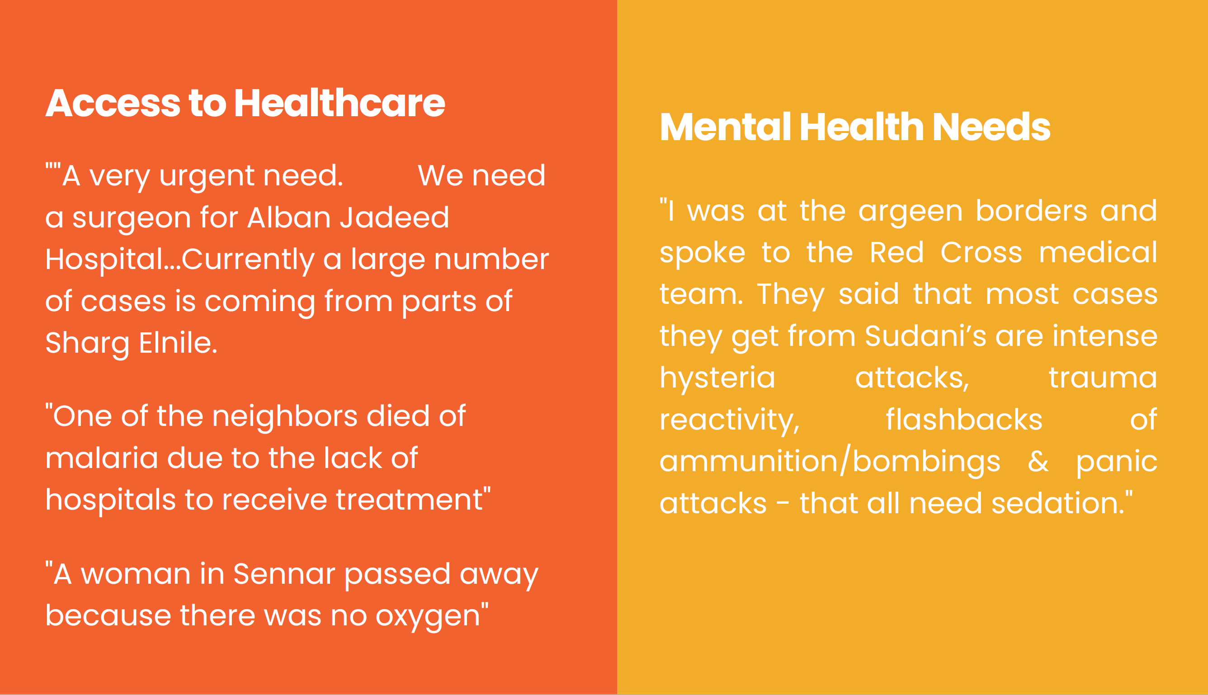
Internews Presentation

Slide 28
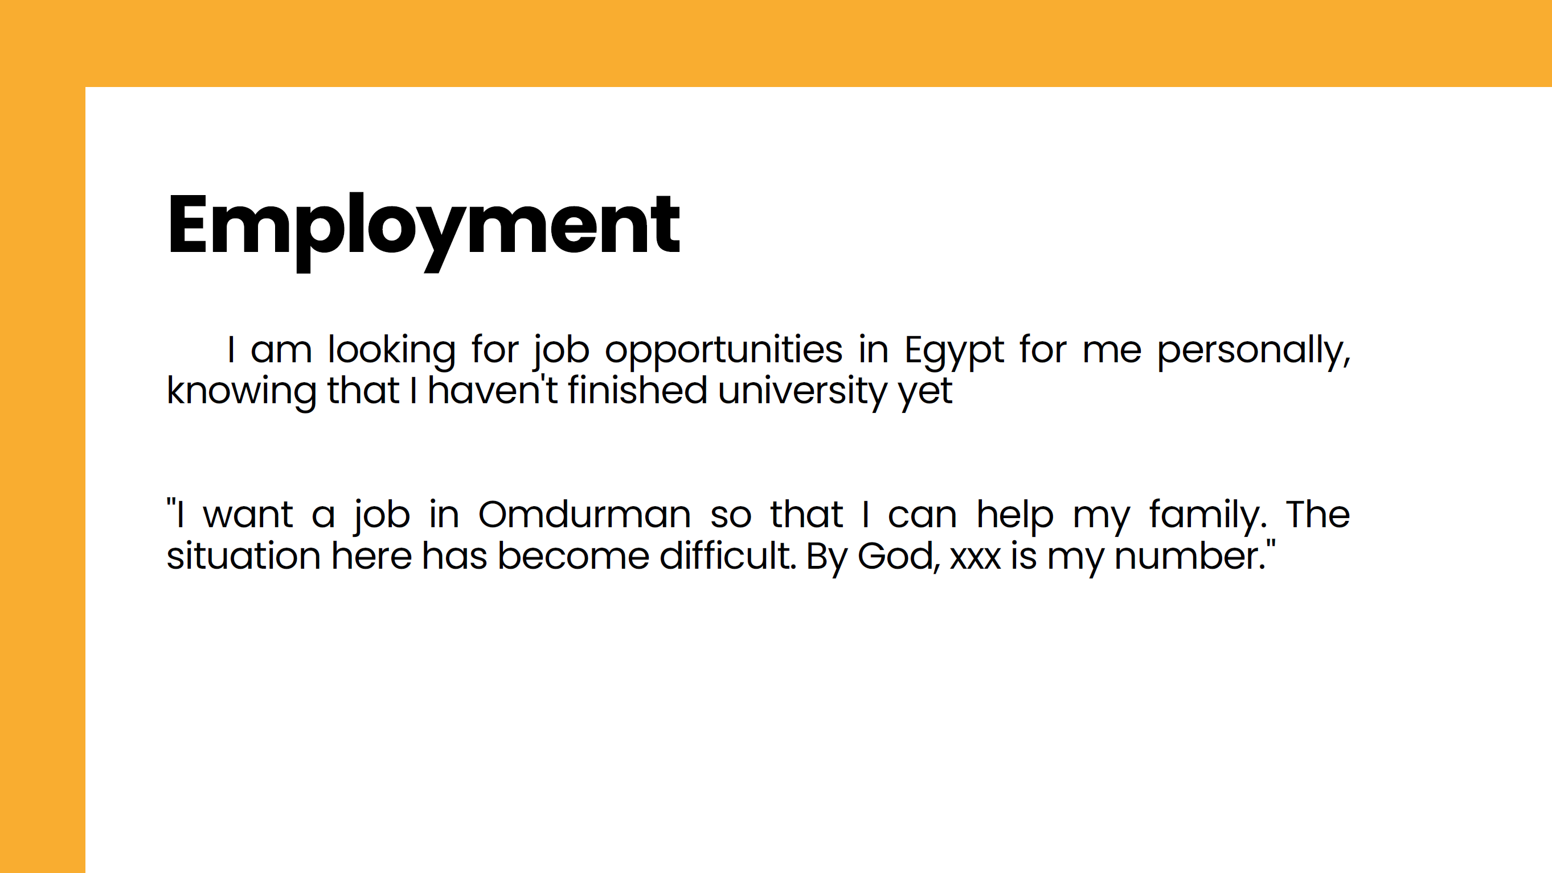
Internews Presentation

Slide 29
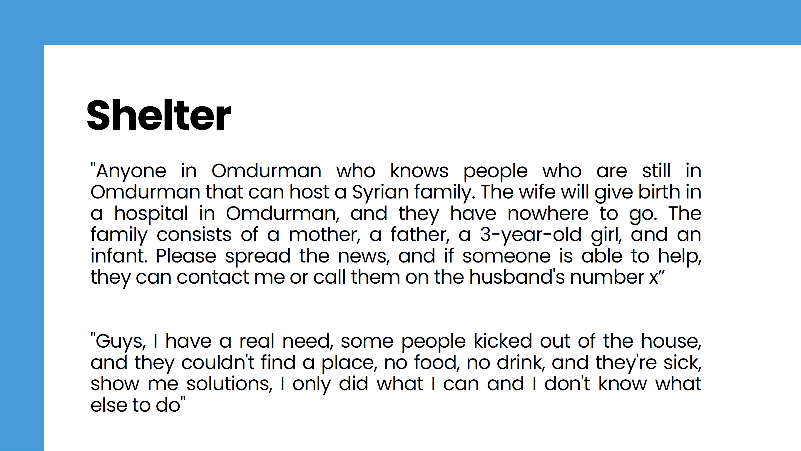
Internews Presentation

Slide 30

Internews Presentation

Slide 31
AOB
Owing to time constraints, largely because the engaging content from Internews' presentation extended beyond our anticipated schedule, the updates on Reporting—including aspects such as Operational Presence Mapping, the WhatsApp group, and the Online Form for Narrative Reports and Pictures upload—along with progress details on HRP Project Revision/Submission have been deferred.
We will ensure these important topics receive the necessary focus and discussion in our subsequent meeting.

