Slide 1
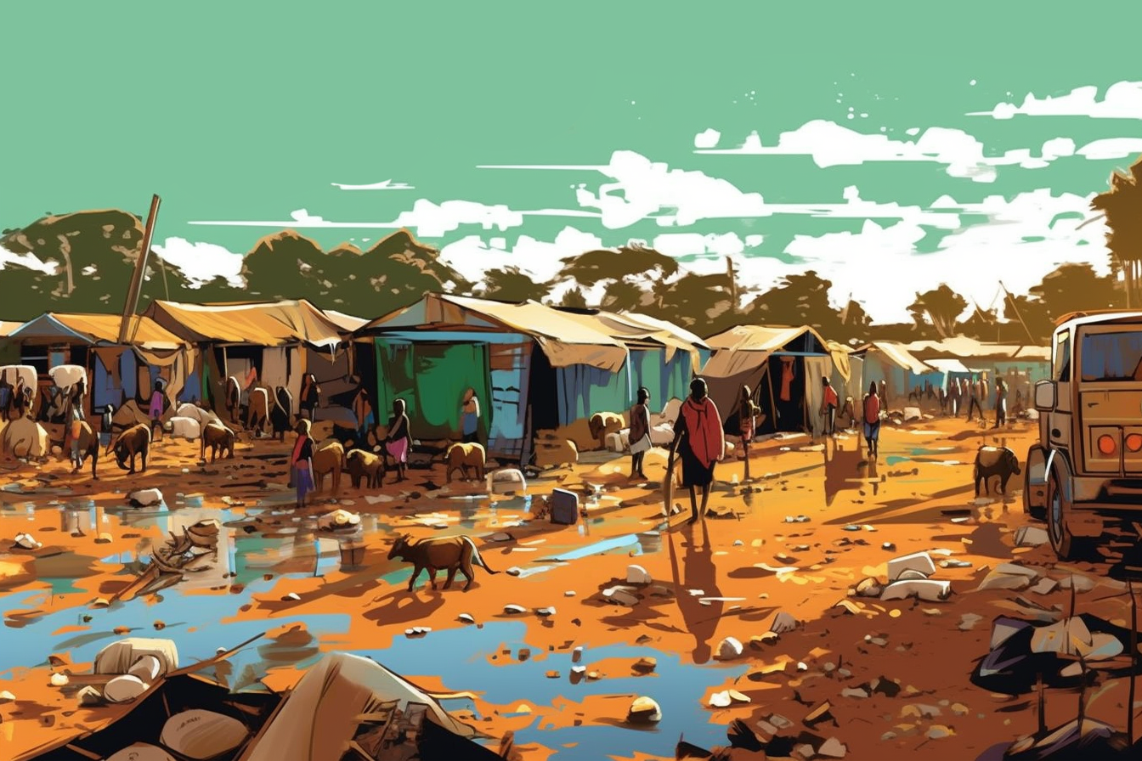

Shelter & NFI Cluster
Coordination Meeting
MS Teams • Sudan • 12th June ‘23

Slide 2
Agenda
• Situation Update
• Roundtable on Achievements & Operational Plans
• Reporting
• TWIG on ESKs
• HRP Project Revision Progress
• AOB

Slide 3
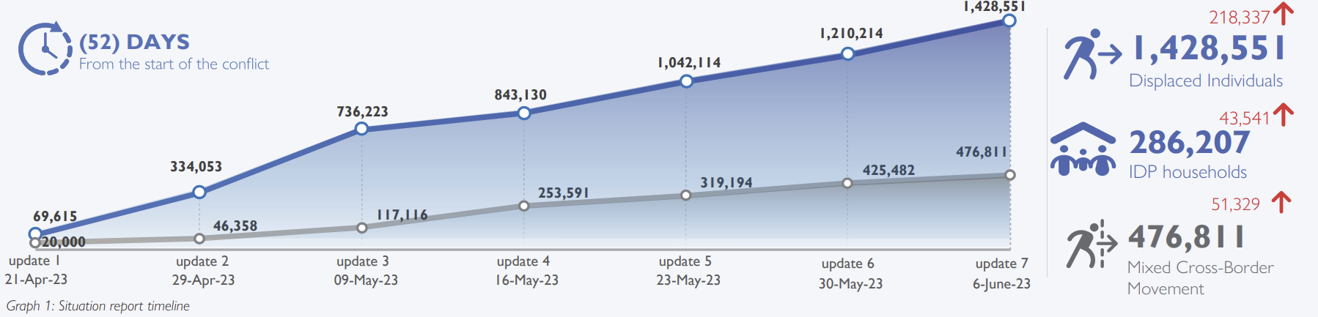
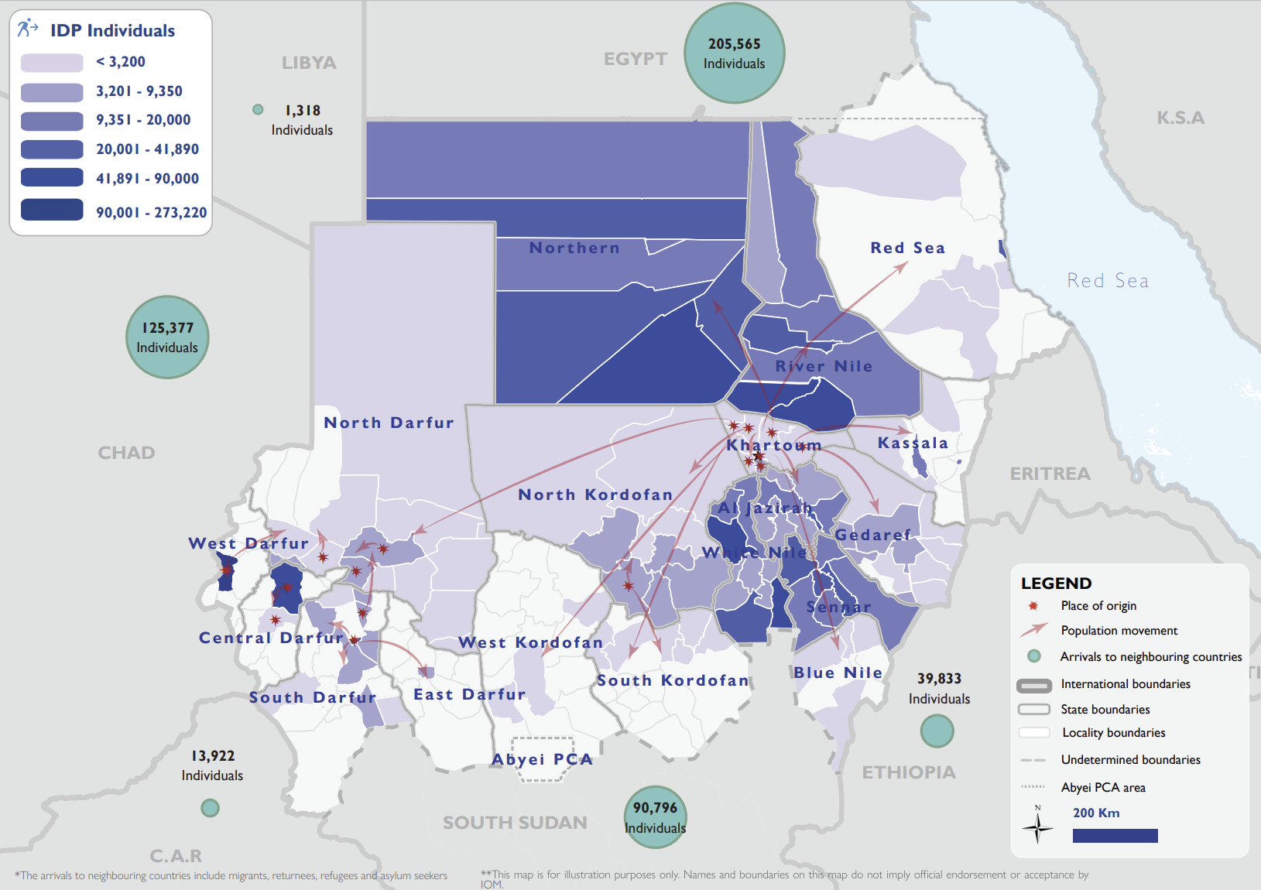
Situation Update
Over 1.9 million people have been forced to flee their homes since the conflict started on 15 April.
As of June 6, the estimated number of IDPs across Sudan is 1,428,551, with the highest proportions in West Darfur, White Nile, River Nile, and Northern states. The conflict has also caused mixed cross-border movements of 476,811 individuals into neighbouring countries. DTM Sudan estimates that approximately 7.63% of the IDP caseload are non-Sudanese nationals.
Over the past week, Sudan continues to be engulfed in escalating armed conflict, crime, and civil unrest. SAF and RSF clashes continue in Khartoum after the most recent 24hrs ceasefire brought a short respite in fighting. Armed militia is raging across Darfur while SPLM-N reportedly attacked and took control of SAF compounds in several villages of South Kordofan. In Port Sudan, locals demonstrating against the current economic and living conditions, while in the Northern state numbers of people are increasing due to additional visa constraints. On a positive note, power is back in parts of El Obeid, after a week of blackouts.

Slide 4
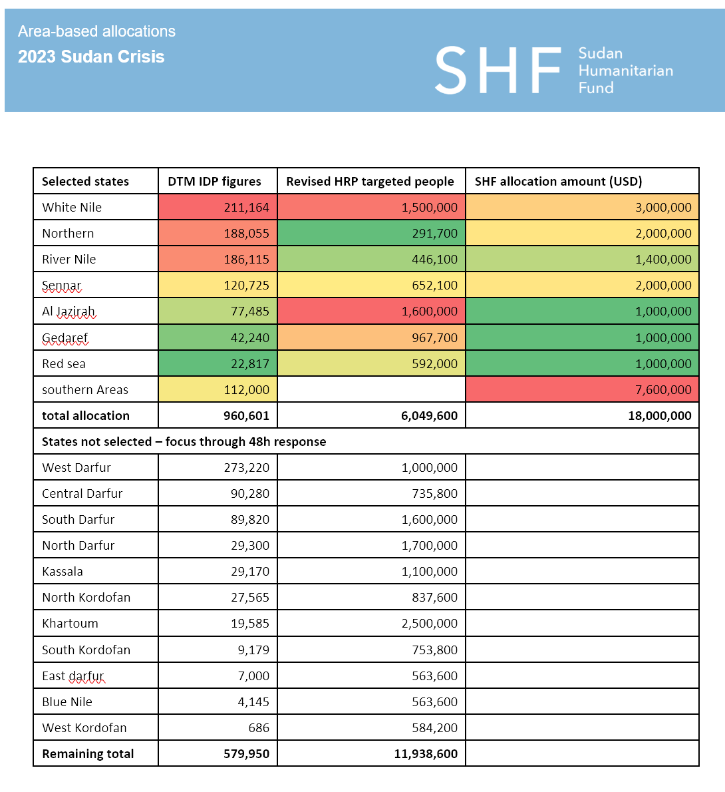
SHF – Reserve Allocation
Coordination entities
SHF’s emergency response allocations are programmed through the A-ICCGs. For areas that were previously not covered by A-ICCG coordination, OCHA has identified new groups.
The below table identifies, for the areas selected under this component of the allocation, the relevant A-ICCGs, or ICCG if there is no A-ICCG yet.
Selected states | Coordination entity | Status | Organization operational presence | Focal point (bold highlights will chair the meetings)
White Nile | A- ICCG | Active (To be formally activated by the HCT) | United Nations (8 UNAFP) INGOs: (5 organizations) NNGOs: (6 organizations) | G Lokuju Peter lokujup@un.org Nasir Abdalla abdalla42@un.org
Red sea | A-ICCG Red Sea | Active United Nations (8 UNAFP) INGOs: (5 organizations) | NNGOs: (2 organizations) | Dickson Aduwo aduwod@un.org Mohammed Gimish gimish@un.org
River Nile | ICCG |  |  | Giovanni Quacquarella quacquarella@un.org Ammar Miro miro2@un.org Mohammed Gimish gimish@un.org
Northern | ICCG |  |  | Giovanni Quacquarella quacquarella@un.org Mohammed Gimish gimish@un.org Ammar Miro miro2@un.org
Sennar | A-ICCG | Active | INGOs: (8 organizations) NNGOs: (TBC) | G Lokuju Peter lokujup@un.org Nasir Abdalla abdalla42@un.org
Al Jazirah | A-ICCG | Active (To be formally activated by the HCT) | United Nations (4 UNAFP) INGOs: (11 organizations) NNGOs: (2 organizations) | G Lokuju Peter lokujup@un.org Elsadig Khalid khalid7@un.org Ghada Nsreldeen nasreldeen@un.org
Gedaref | A-ICCG | Active | United Nations (9 UNAFP) INGOs: (11 organization) NNGOs: (6 organizations) | Dickson Aduwo aduwod@un.org Nasir Abdalla abdalla42@un.org
southern Areas | Covered by relevant parties

Slide 5
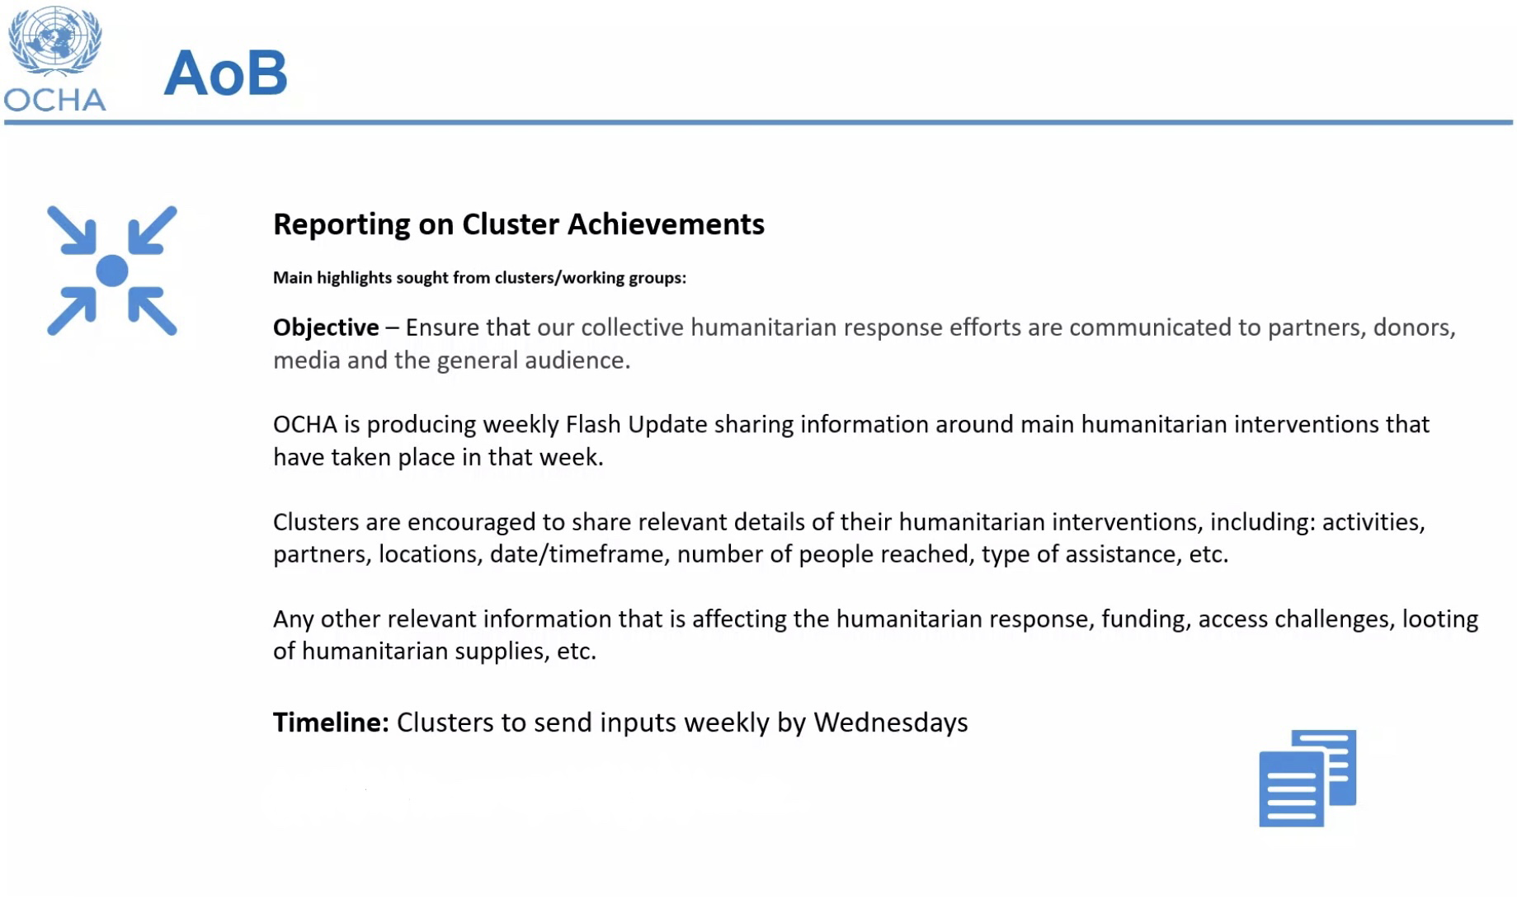
Roundtable – Achievements/Ops Plans

Slide 6
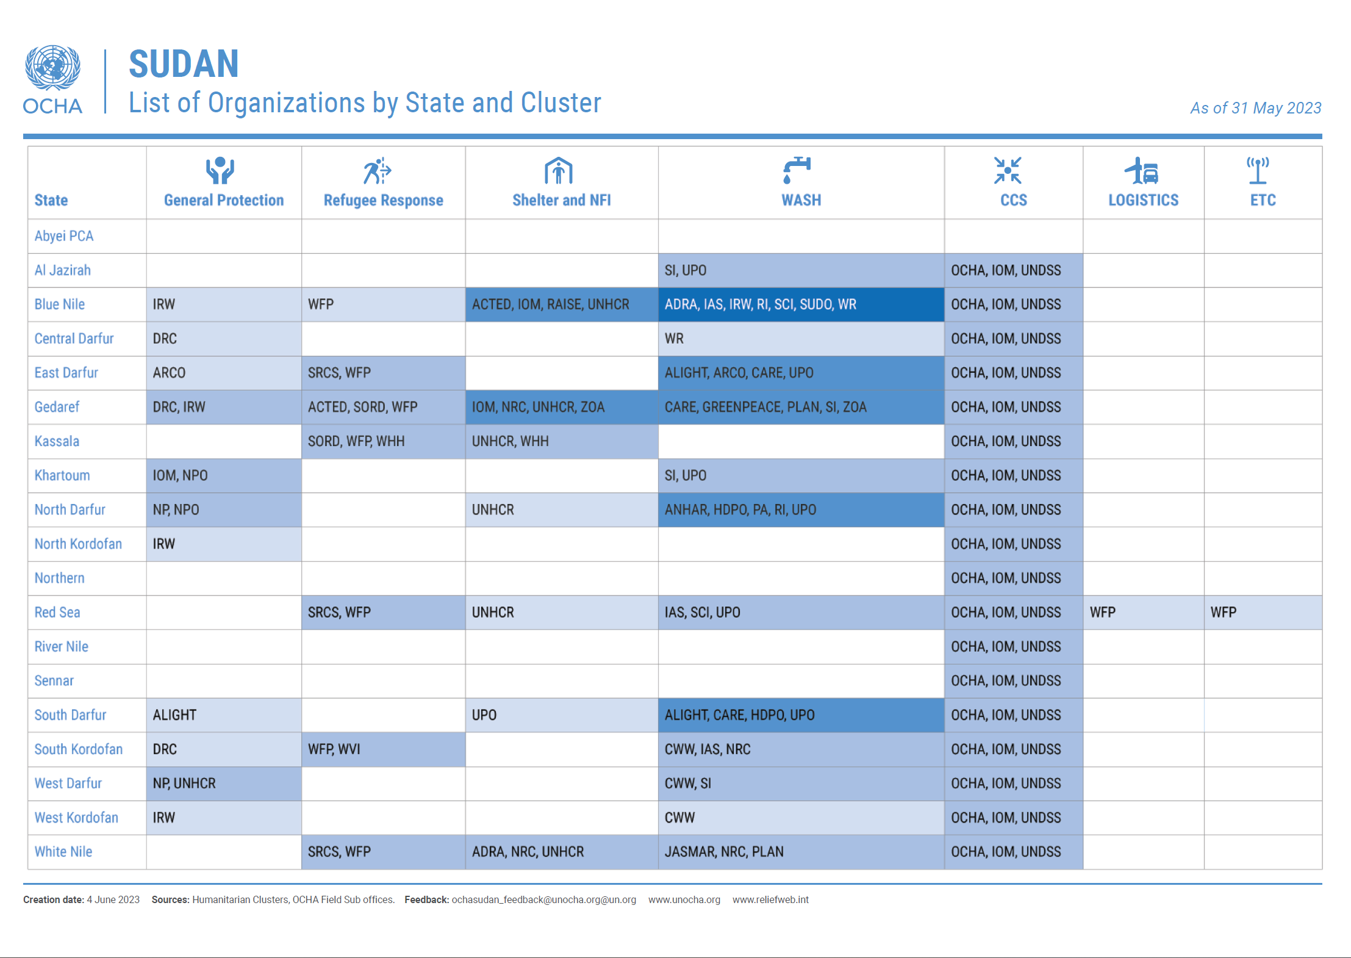
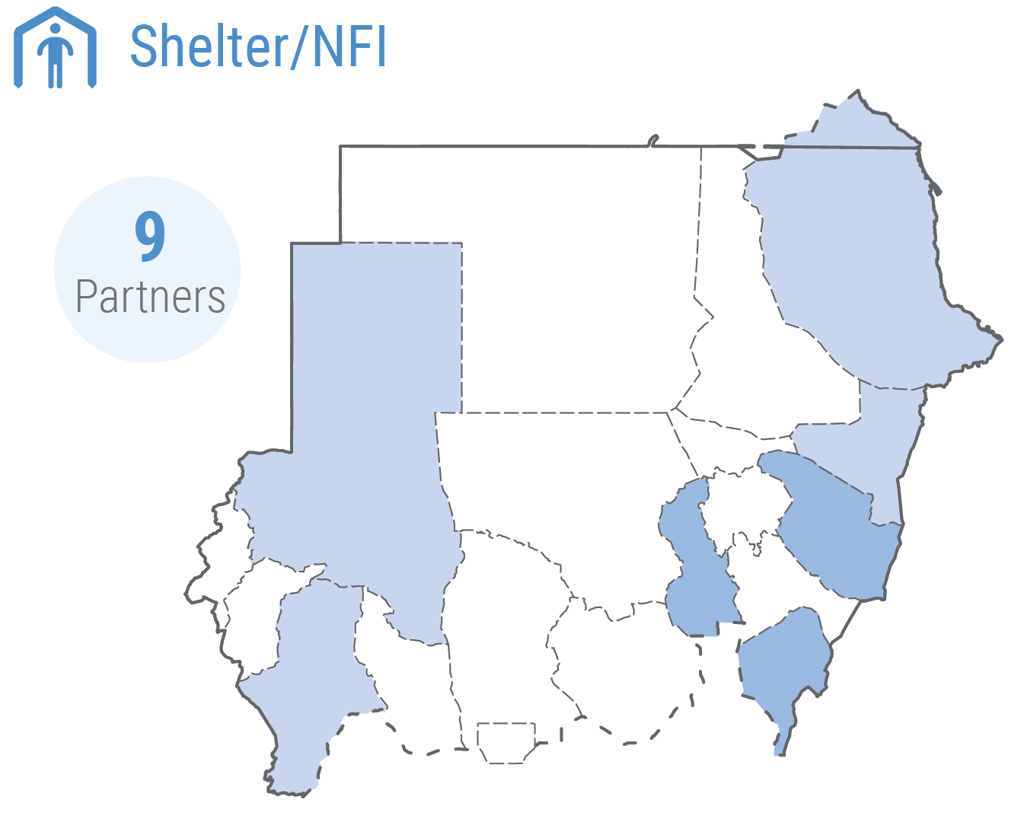
OCHA – Presence Map
Report regularly: https://www.activityinfo.org/ or send updates through Bulk Upload Form or WhatsApp
Update your Reporting Focal Points: 2-4 focal points can have access to the database per each organization: https://docs.google.com/spreadsheets/d/184BWUgE4b6qV2EF3PfS5fJsmLrIgyvHXA1TCT-0XGjQ/edit?usp=sharing
Training and guidance material on Shelter & NFI Cluster ActivityInfo reporting is available here: https://sheltercluster.org/sudan/pages/activityinfo-reporting-instructions

Slide 7

Achievements Public Dashboard

Slide 8
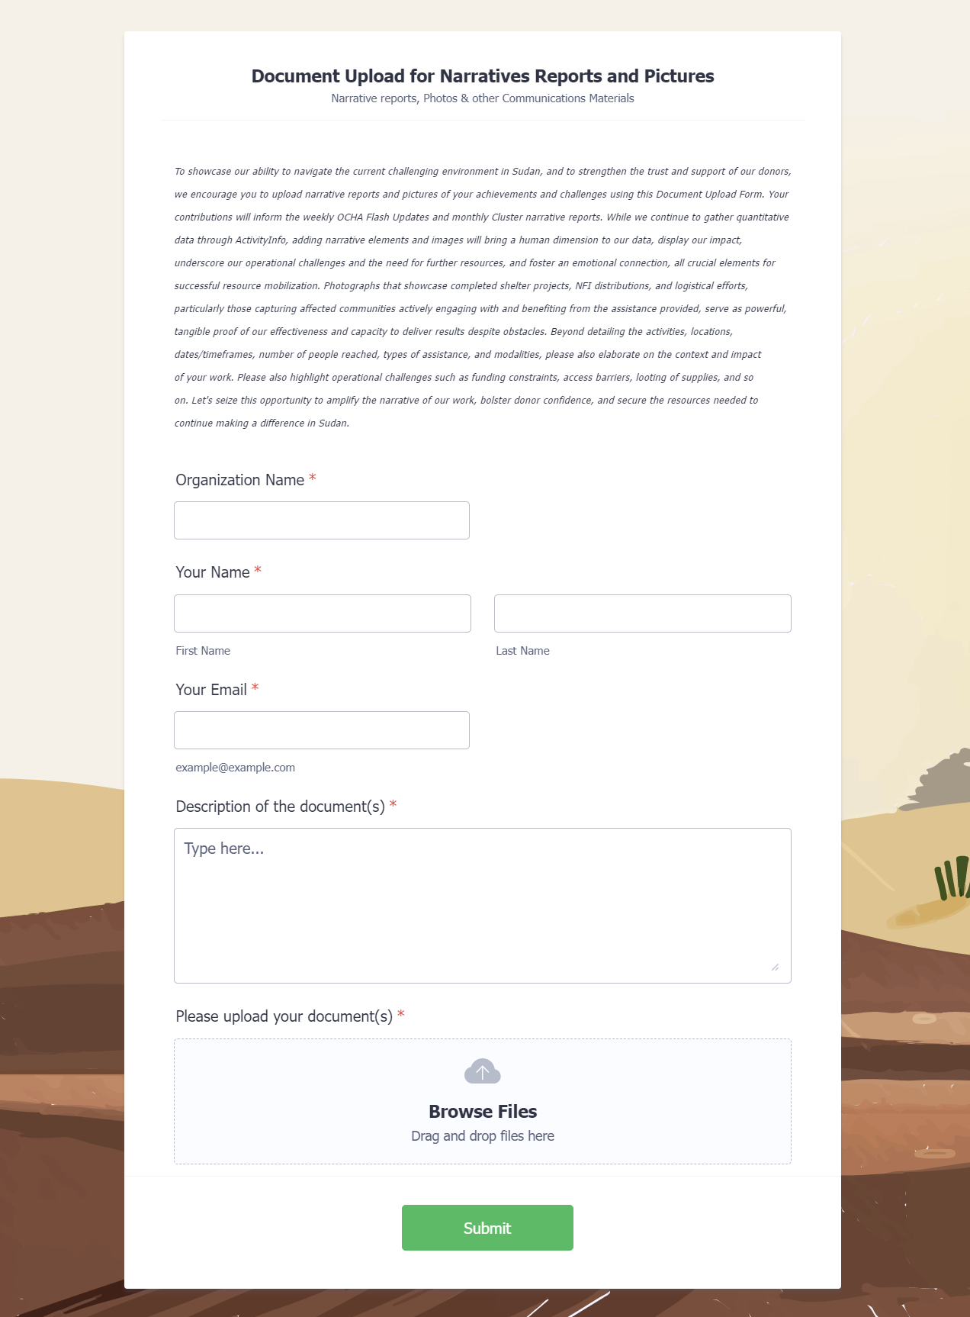
Reporting - Narrative & Pictures Upload Form
To showcase our ability to navigate the current challenging environment in Sudan, and to strengthen the trust and support of our donors, we encourage you to upload narrative reports and pictures of your achievements and challenges using this Document Upload Form.
Your contributions will inform the weekly OCHA Flash Updates and monthly Cluster narrative reports. While we continue to gather quantitative data through ActivityInfo, adding narrative elements and images will bring a human dimension to our data, display our impact, underscore our operational challenges and the need for further resources, and foster an emotional connection, all crucial elements for successful resource mobilization.
Photographs that showcase completed shelter projects, NFI distributions, and logistical efforts, particularly those capturing affected communities actively engaging with and benefiting from the assistance provided, serve as powerful, tangible proof of our effectiveness and capacity to deliver results despite obstacles.
Beyond detailing the activities, locations, dates/timeframes, number of people reached, types of assistance, and modalities, please also elaborate on the context and impact of your work. Please also highlight operational challenges such as funding constraints, access barriers, looting of supplies, and so on.
Let's seize this opportunity to amplify the narrative of our work, bolster donor confidence, and secure the resources needed to continue making a difference in Sudan.
https://form.jotform.com/231534447450352

Slide 9

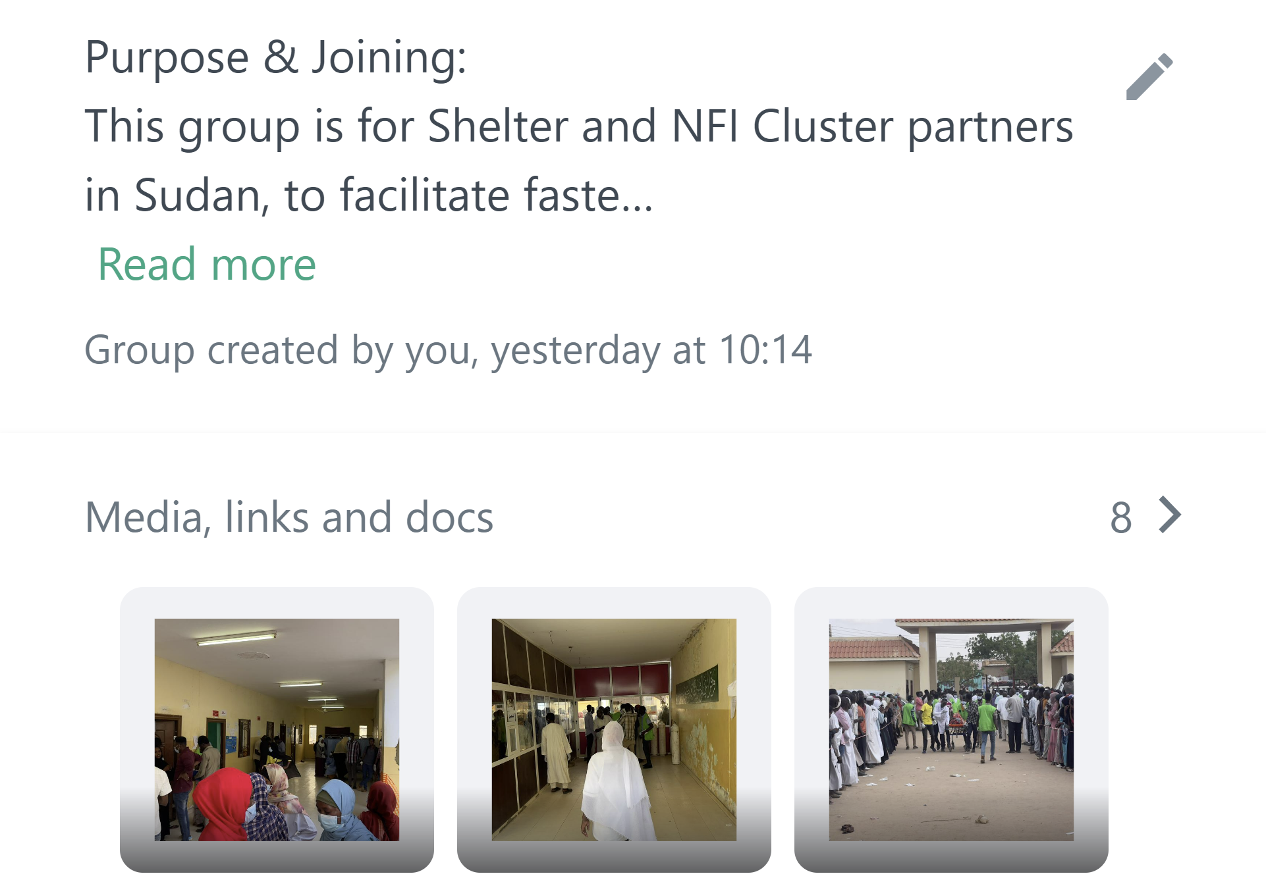
Reporting – WhatsApp Group
Purpose & Joining: This group is for Shelter and NFI Cluster partners in Sudan, to facilitate faster coordination during the current crisis and subsequent communications challenges. To join or invite others, use this link: https://chat.whatsapp.com/LAizFt8047oGd5EiYZSgNS
Introductions: New members, please share your name, organization, and job title to foster understanding and cooperation.
Content: Share relevant updates and information only, including:
Situation Updates: Numbers of people affected, plans for needs/market assessments, and reports of completed assessments.
Operational Updates: Number of people reached, activity type, modality, date/timeframe and location, including context and impact of your interventions, feedback from the affected populations, etc. Share both achievements and future plans.
Challenges: Access issues, looting of supplies, logistical problems, cash and market difficulties, etc.
Pictures: Photos showing project impacts and challenges, respecting privacy and dignity of depicted individuals.
Guidance & Opportunities: Technical guides, relevant lessons learned, good practices, and training opportunities.
Communication: Actively participate and feel free to ask for updates or pose questions to the group or the Cluster Coordination team.
Confidentiality: Respect the group's confidentiality. Do not share information with non-members without consent.
Remember to avoid off-topic discussions, spam, advertisements, and irrelevant content.

Slide 10
TWIG on ESKs
Given the dramatic change in context in Sudan, we are initiating a Technical Working Group (TWIG) on Emergency Shelter Kits (ESKs) to rethink the kit content.
To diversify response options amidst a constrained operating environment, the TWIG will:
Review and confirm the design and bill of quantities for the existing Emergency Shelter Kit (ESK) that relies solely on natural materials.
Formulate an alternative ESK option that incorporates the use of plastic sheeting for walling and roofing while retaining the pole structure from the existing design.
Investigate the viability of any third solution that may be appropriate and feasible given the current circumstances.
TWIG chaired by the Shelter & NFI Co-Coordinator.
Bi-weekly meetings online for a duration of 3 months.
Membership is open to individuals with technical backgrounds ideally, but others with relevant experience can join. Field experience and understanding of local context are beneficial, as well as the direct access to affected populations.
Expected commitment: minimum of 20 working days to TWIG activities.
Meeting minutes shared with TWIG members and posted on the Global Shelter Cluster website.
Final products submitted to the SAG for approval and circulated to Shelter Cluster partners.

Slide 11
TWIG on ESKs
Deliverables:
Technical drawings and specifications for diverse Emergency Shelter options.
Bills of Quantities (BoQ) for different Emergency Shelter options.
A Technical Guidance Note on the construction of Emergency Shelters, including safe shelter practices for risk mitigation.
Design Principles:
Market Availability: Easy sourcing through international or local procurement systems.
Climate Appropriate: Features ensuring thermal comfort, ventilation, and protection against weather conditions.
Safe & Dignified: Fire safety features, secure environment, privacy, and consideration of conflict sensitivity factors.
Culturally Appropriate: Involvement of affected populations in the design process.
Environmentally Friendly: Low impact material selection and waste minimization.
Cost-Effective: High reach, durability, and sustainability with low maintenance needs.
Practical: Easy storage, transport, and setup.
Scalable: Minimal need for specialized equipment or skilled labour.

Slide 12
HRP Project Revision Progress
Organizations with an existing HRP project | Organizations without an HRP project that expressed interest to implement Shelter and NFI interventions in OCHA presence mapping
Adventist Development and Relief Agency (ADRA) | Agency for Technical Cooperation and Development (ACTED) |  | Legend
ALIGHT (formerly ARC) | Addition for Disaster assistance and Development (ADD)
Alshrooq Organisation for Social and Cultural Development (AOSCD) | African Relief Committee (ARC)
Concern Worldwide (CW) | Alsalam Organization for Rehabilitation and Development (AORD) |  | Revisions/new submissions in progress
Cooperazione Internazionale (COOPI) | Auttash Organization for Peace and Development (APD)
Danish Refugee Council (DRC) | Catholic Agency for Overseas Development (CAFOD)
Deutsche Welthungerhilfe (DWHH) | Collaborative for Peace in Sudan (CfPS) |  | Approved revisions/submissions
Elgossa Charity Organization for Rural Development (ECORD) | Catholic Relief Services (CRS)
Great Family Organization (GFO) | Child Rights Watch (CRW)
International Organization for Migration (IOM) | Elemar Charitable Development Organization (ECDO) |  | No action has been taken
Mercy Corps (MC) | Future Humanitarian Development Organisation (FHDO)
Norwegian Refugee Council (NRC) | Human Appeal - UK (HA)
Save the Children (SCI) | Global Organization for the Family and Child Welfare (GOFCW)
Triangle Génération Humanitaire (TGH) | Humanity for Development and Prosperity Organization (HDPO)
United Nations Development Programme (UNDP) | Läkarmissionen International (LM Int.)
United Nations High Commissioner for Refugees (UNHCR) | International Aid Services (IAS)
United Peace Organization (UPO) | International Rescue Committee (IRC)
World Vision International (WVI) | Islamic Relief Worldwide (IRW)
 | Jabal Marra Charity Organization for Rural Development (JMCO)
 | National Organization for Humanitarian Services (NOHS)
 | National Planning Organization (NPO)
 | Plan International (PI)
 | Practical Action (PA)
 | Raise for Development and Humanitarian Aid Organization (RAISE)
 | Sahari Organization for Development (SAHARI)
 | Sudanese Coalition for Education For All (SCEFA)
 | Sabah Al- Sudan for Development Organization (SDO)
 | Sudanese Hilef for Peace and Development (SHPDO)
 | Solidarités International (SI)
 | Sibro Organization for Development (SOD)
 | Sudanese Organisation for Relief and Recovery (SORR)
 | Voluntary Network for Rural Helping and Development (VNRHD)
 | ZOA

Slide 13
AOB

