Slide 1


Shelter & NFI Cluster
Coordination Meeting
MS Teams • Sudan • 26th June ‘23

Slide 2
Agenda
• Situation Update
• Roundtable on Achievements & Operational Plans
• Internews Presentation
• REACH Presentation
• AOB

Slide 3
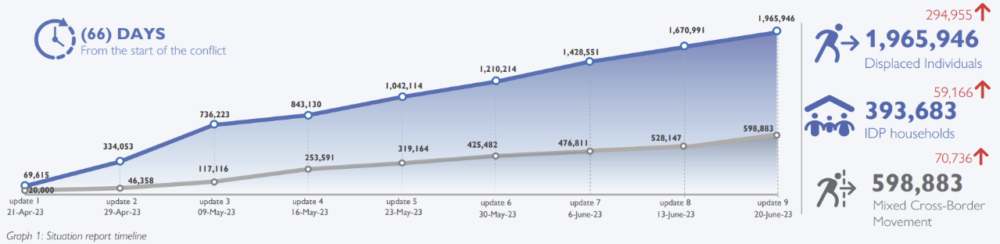
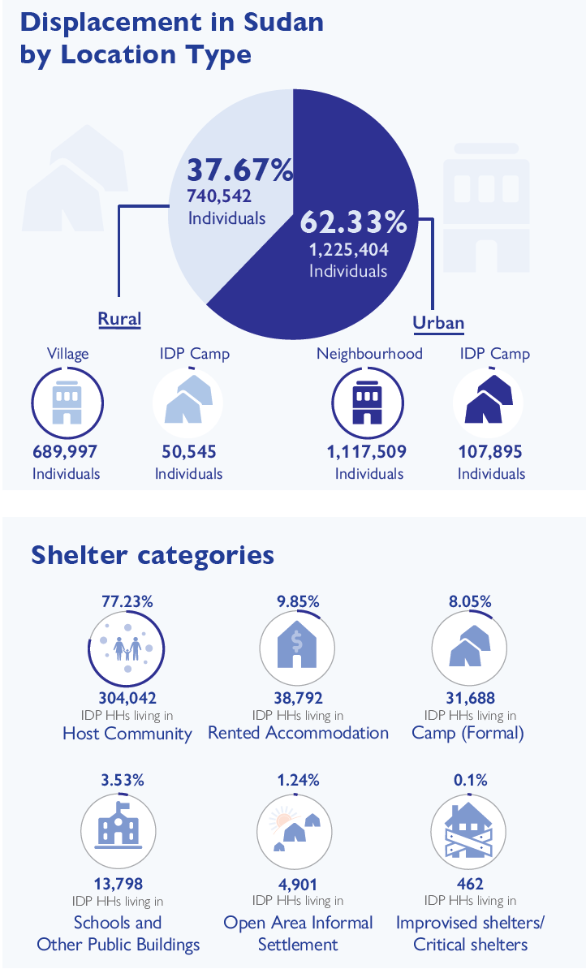
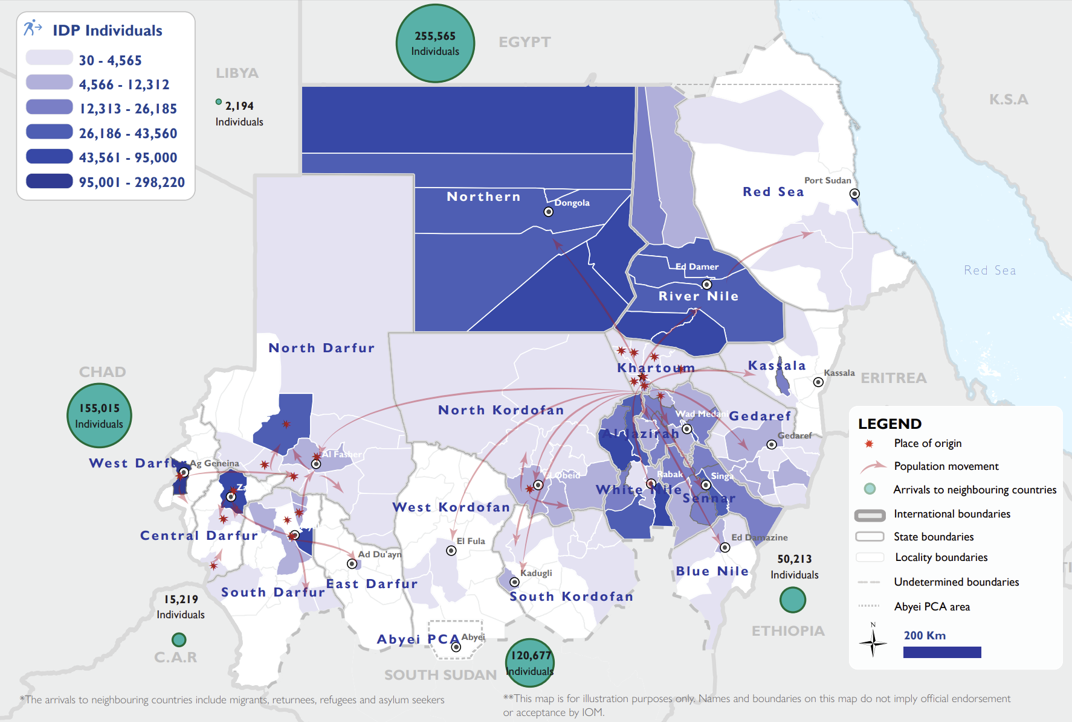
Situation Update

Slide 4
CERF – Rapid Response Allocation
New CERF Allocation – Rapid Response Allocation – decided in the HCT
Needs to be implemented within the next 3-4 months, so that the next RR allocation can be requested in August
UNHCR will use 1,2 million for Shelter/NFI, 500,000 for WASH for refugees and 300,000 for CCCM. Additionally, UNHCR has received 2 million from SHF for the prepositioning of NFIs.
 | UFE $18M | RR $22M allocated | total | SHF | total
WFP | $3,500,000 | $6,000,000 | $9,500,000 |  | $9,500,000
UNICEF | $4,000,000 | $5,500,000 | $9,500,000 |  | $9,500,000
UNHCR | $2,500,000 | $2,000,000 | $4,500,000 | $2,000,000 | $6,500,000
IOM | $4,500,000 | $1,500,000 | $6,000,000 |  | $6,000,000
WHO | $1,500,000 | $3,000,000 | $4,500,000 |  | $4,500,000
UNFPA | $1,500,000 | $1,000,000 | $2,500,000 |  | $2,500,000
FAO | $500,000 | $2,000,000 | $2,500,000 |  | $2,500,000
UNDSS | $0 | $1,000,000 | $1,000,000 |  | $1,000,000
UNDP | $0 | $0 | $0 |  | $0
UNMAS | $0 | $0 | $0 |  | $0
total | $18,000,000 | $22,000,000 | $40,000,000 | $2,500,000 | $42,000,000

Slide 5
SHF – Reserve Allocation
In addition to 3 million received under the 48-hour allocation for the consortium.
Out of the full 19 million under the Reserve Allocation – 22% is going to Shelter & NFI.
Health & Nutrition – 23%, WASH 21%, MPCA 16%, Protection 15%, CCCM 2%
Selected states | Localities | Amount | Partner
White Nile | Kosti, Rabak | 400,000 | ADRA
Red sea | /
River Nile | Shendi, Al Matami, Atbara | 400,000 | MHUN
Northern | Wadi Halfa + border crossing | 400,000 | UPO
Sennar | Sinja | 125,000 | SCI
Al Jazirah | /
Gedaref | Al Rahad, Madinat Gedaref | 400,000 | NRC

Slide 6
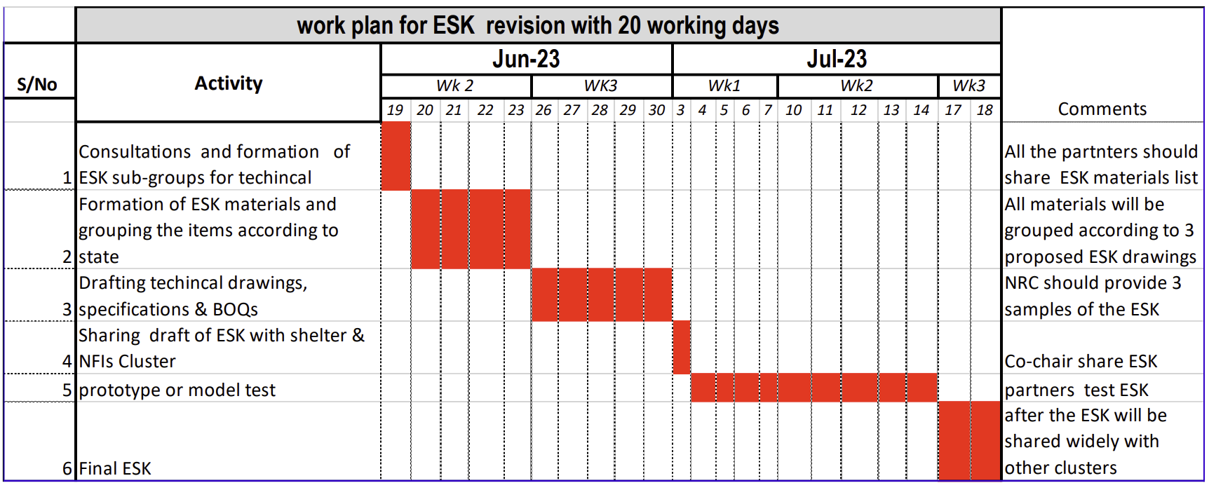
TWIG Update
First meeting was held on June 19; partners can register their interest to participate here: https://enketo.unhcr.org/x/cxbFLXq0.
With thanks to CRS for the agenda suggestion, the next meeting will feature:
Round of presentations from TWIG participants, including on presence and what each of the partners can offer
An excel sheet with the list of ESK materials, that can serve as the market assessment tool. Based on presence, TWIG members will split geographical areas and conduct market assessments accordingly, so that findings can be compared and compiled at national level to inform the content of the ESK.
The initial work plan will be revised to be more realistic.
In between bi-weekly meetings, the Cluster Co-Coordinator, and TWIG lead, will have bi-lateral meetings with TWIG members to ensure agreed outputs are delivered on time and to keep the group on track as per the workplan.

Slide 7
Roundtable – Achievements/Ops Plans
Objective: Ensure that our collective response efforts are well communicated to partners, donors, media and general audiences!
Achievements – type of interventions, HH reached, locations, timeframe, etc.
Challenges – looting of supplies, access challenges, etc.
Procurement – quantities of stocks arriving to the country, type of stocks, timeframe, where will the stocks be prepositioned – particularly given the incoming flood season.
Assessments – e.g., needs assessments outlining specifics with respect to Shelter and NFI needs as well as market assessments on NFIs, shelter materials, or Cash for Rent.
Context and impact of interventions – e.g., any successes with respect to cash for rent, how is sustainability achieved, what about tenure security?
Interventions in the host community – with 77% of the population staying in host community – what has been achieved so far? Cash for shelter for the families hosting IDPs can be an option, or preselecting landlords to improve their housing in order for them to subsidize rent for IDPs – this can include negotiating longer-term tenure security.
Etc.

Slide 8

Update from UNHCR

Slide 9
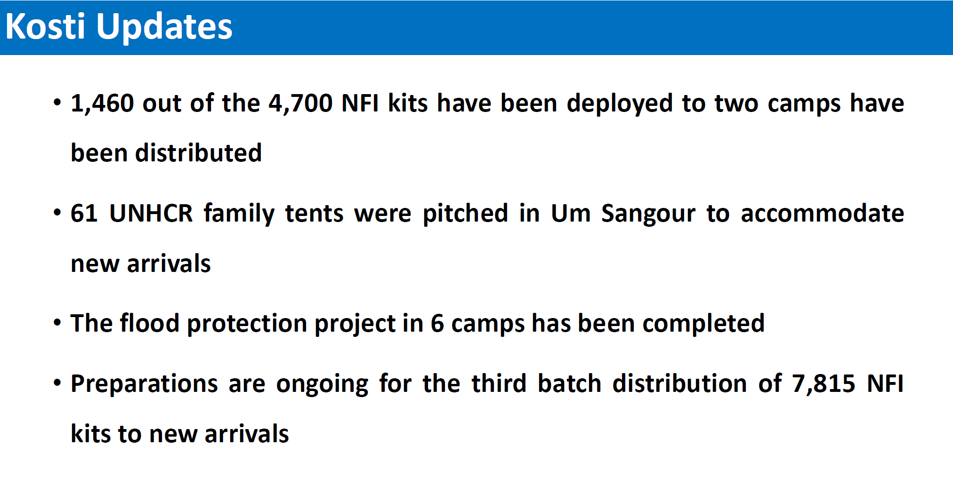
Update from UNHCR

Slide 10
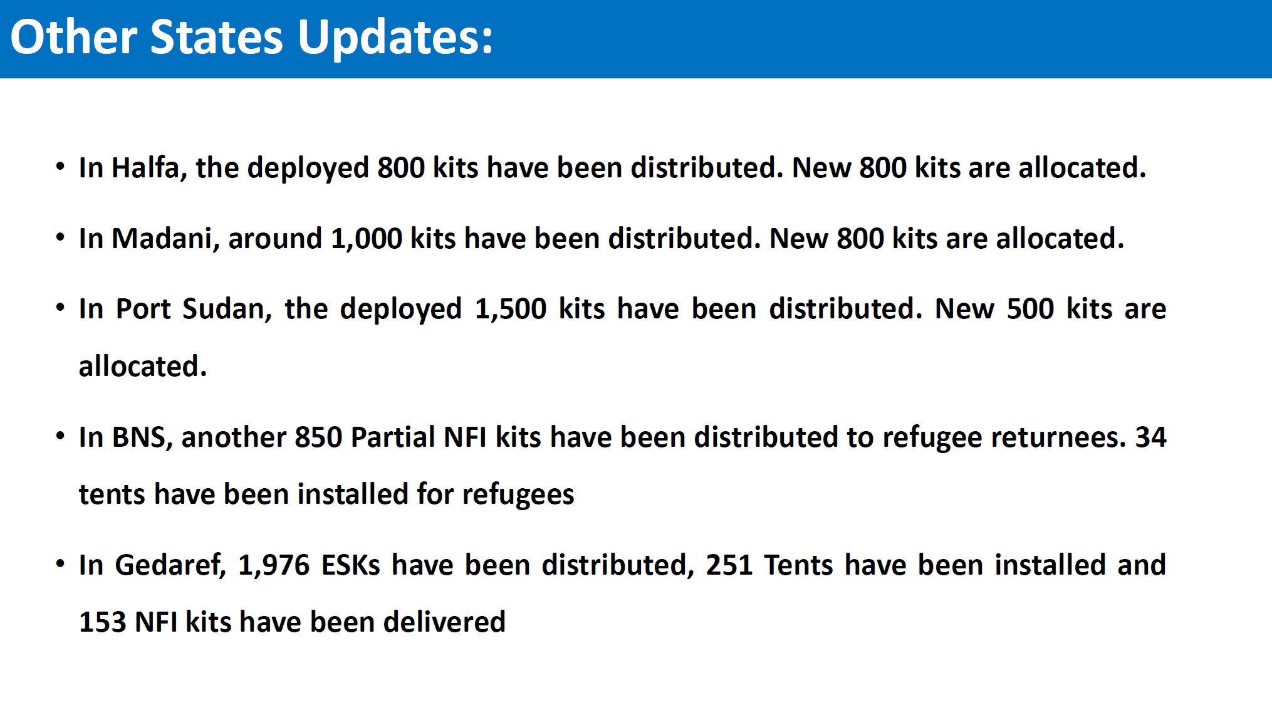
Update from UNHCR

Slide 11
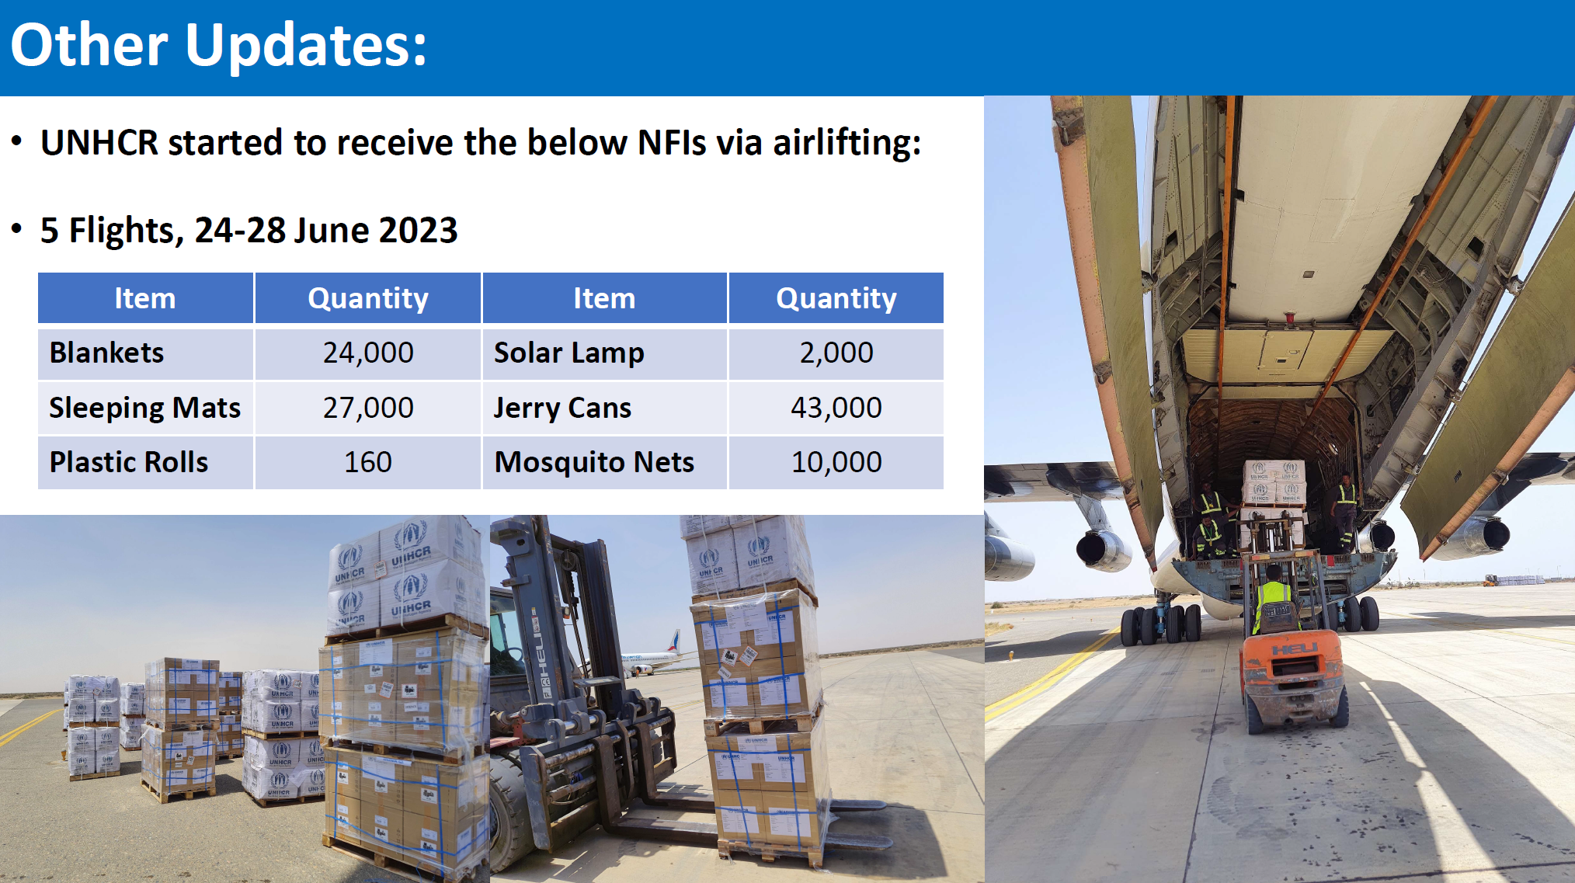
Update from UNHCR

Slide 12
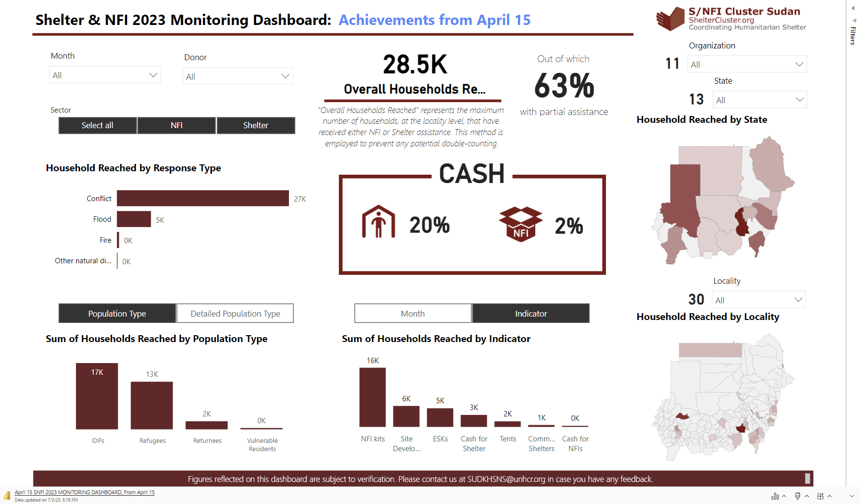
Achievements Public Dashboard

Slide 13

Internews Presentation

Slide 14

Internews Presentation

Slide 15
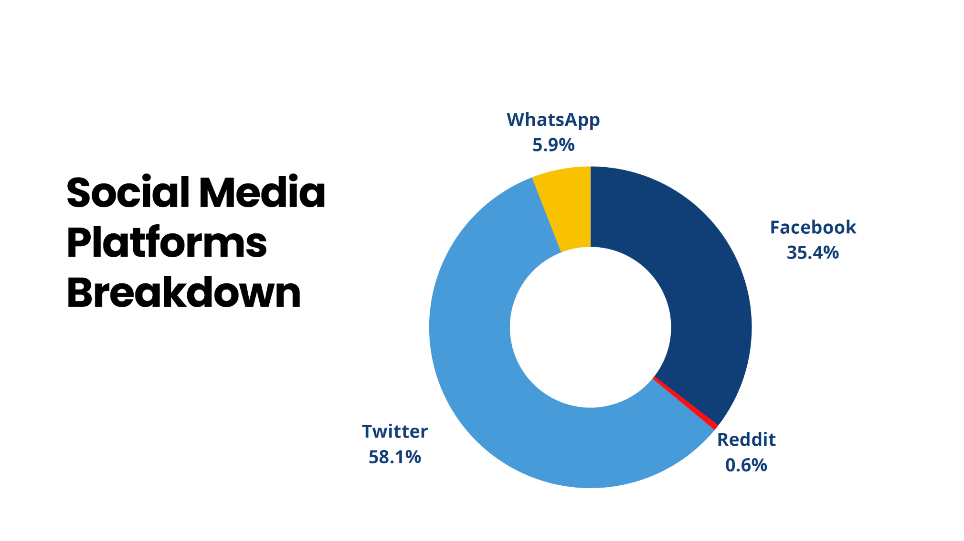
Internews Presentation

Slide 16
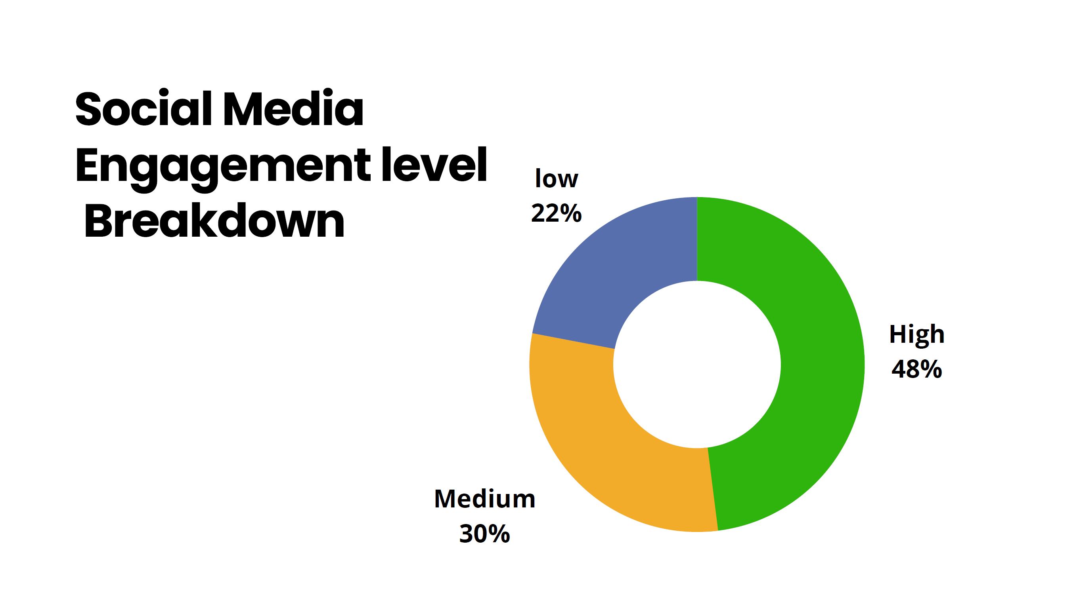
Internews Presentation

Slide 17
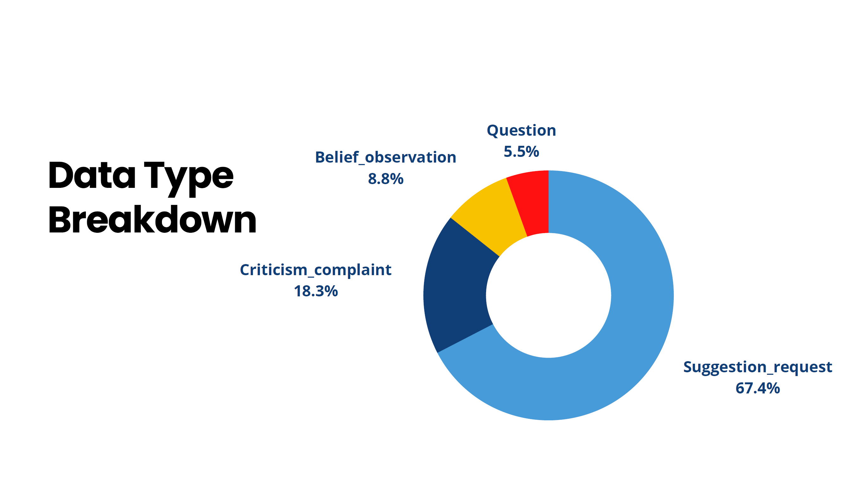
Internews Presentation

Slide 18
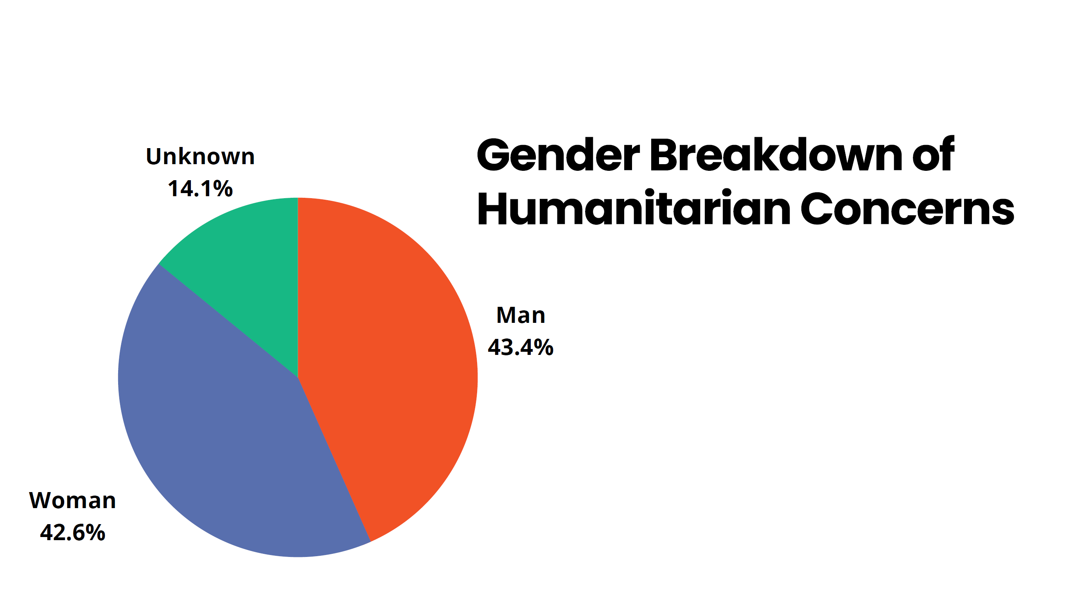
Internews Presentation

Slide 19
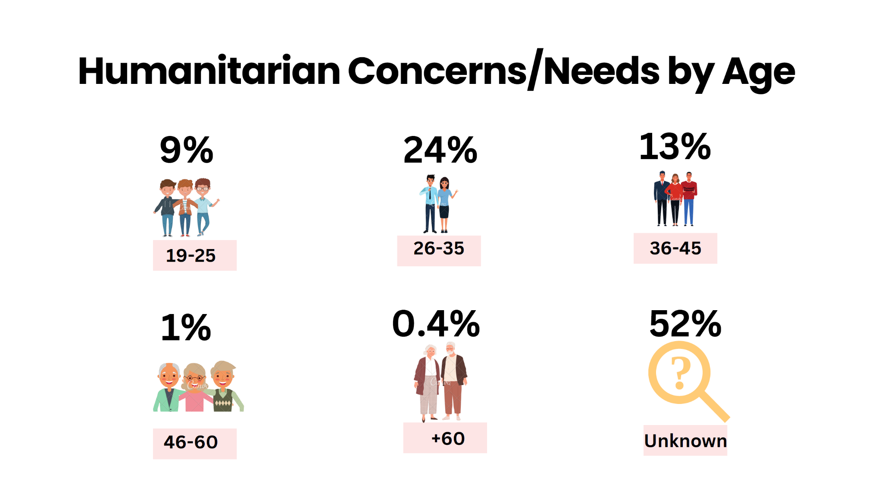
Internews Presentation

Slide 20
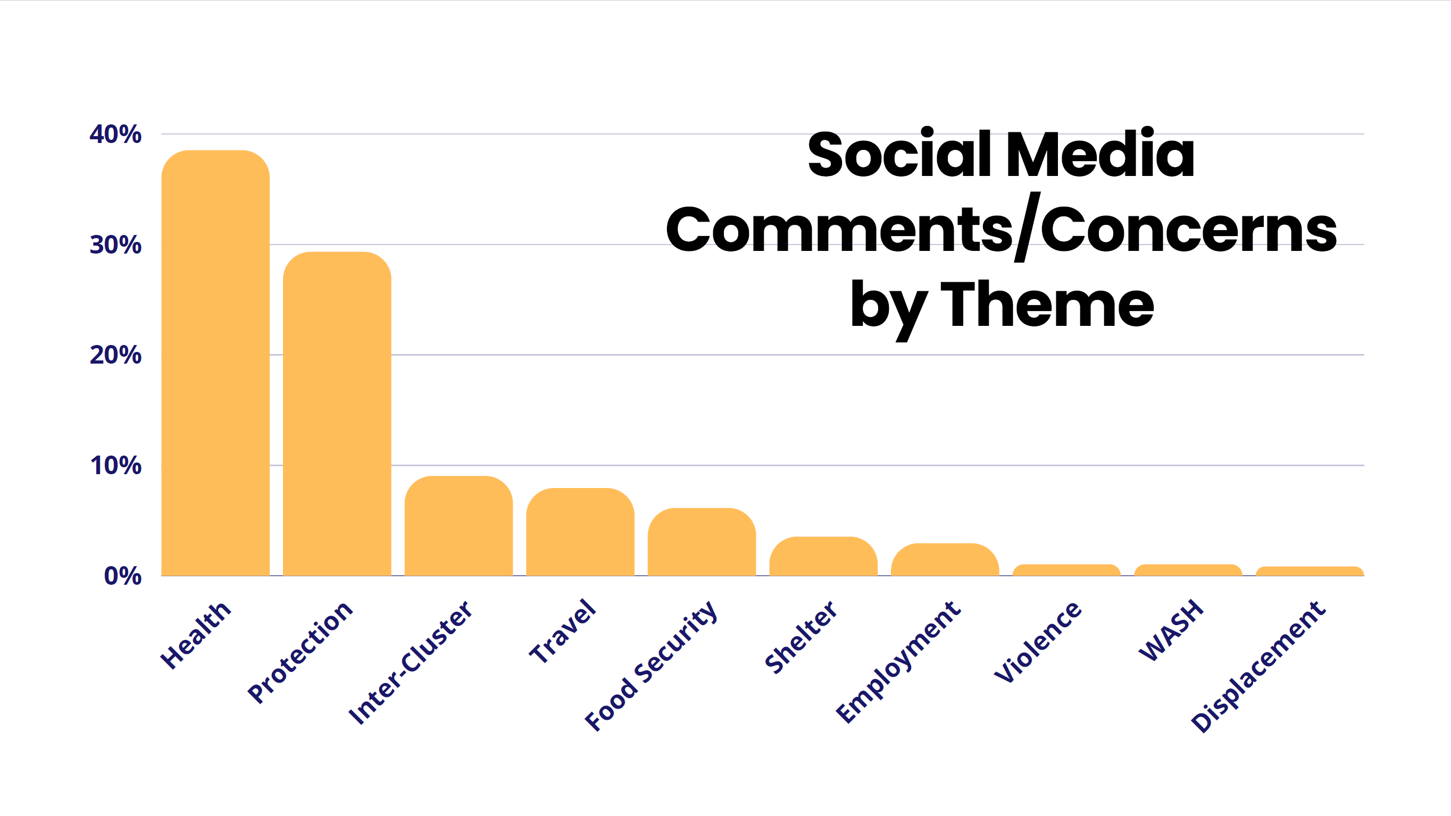
Internews Presentation

Slide 21
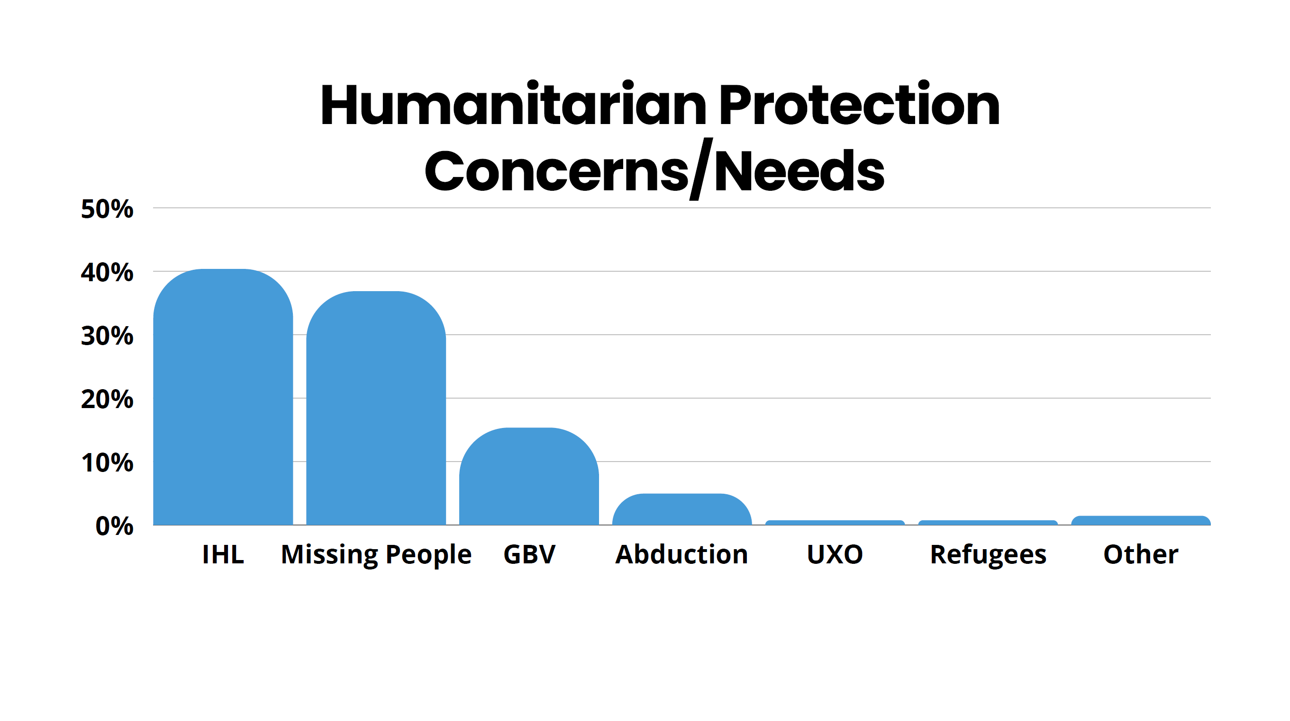
Internews Presentation

Slide 22
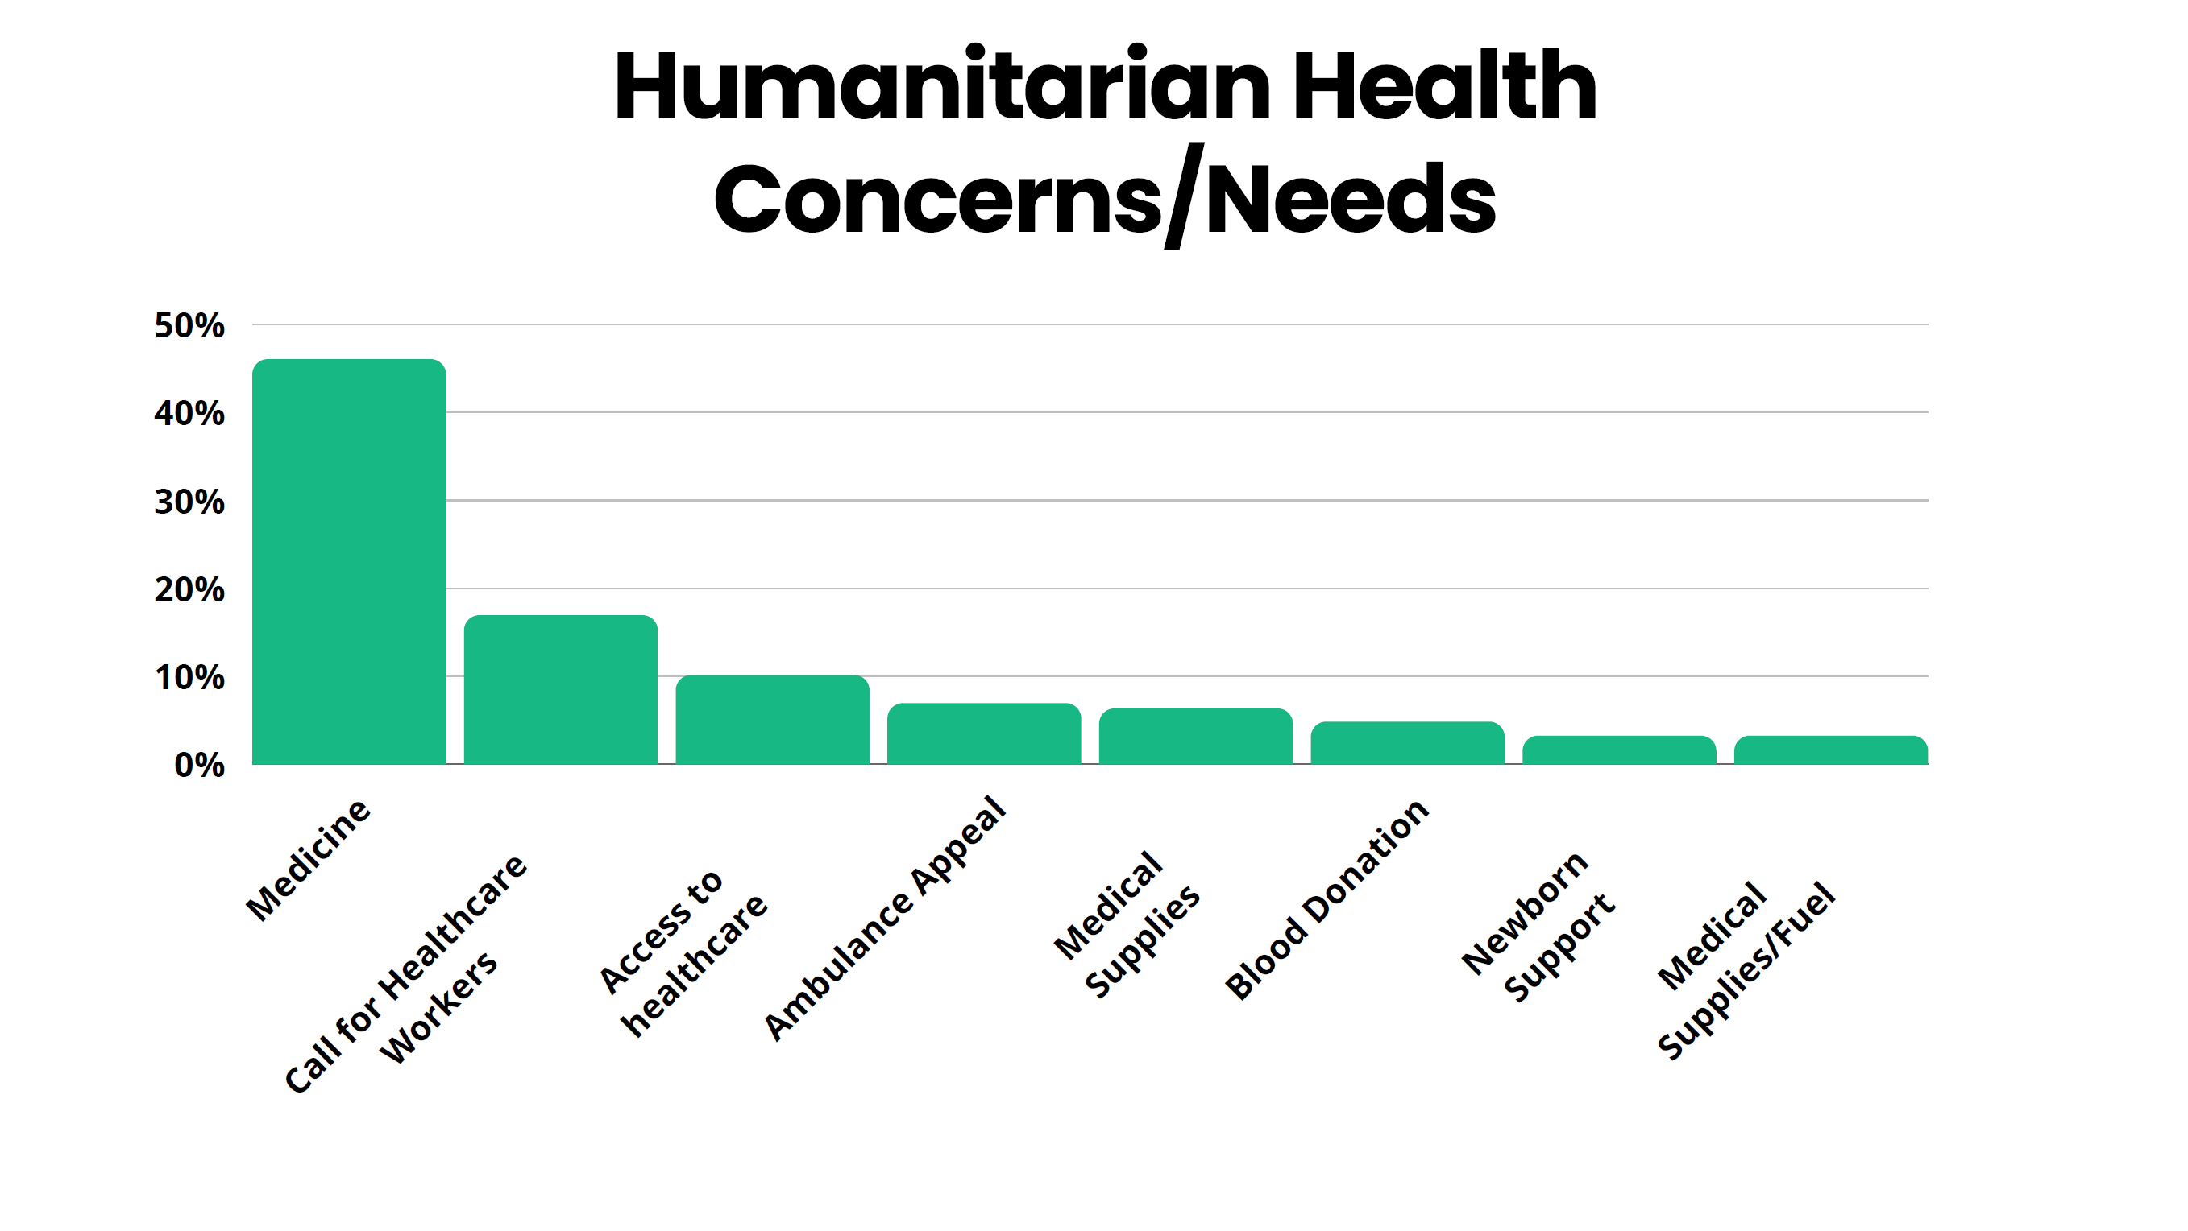
Internews Presentation

Slide 23
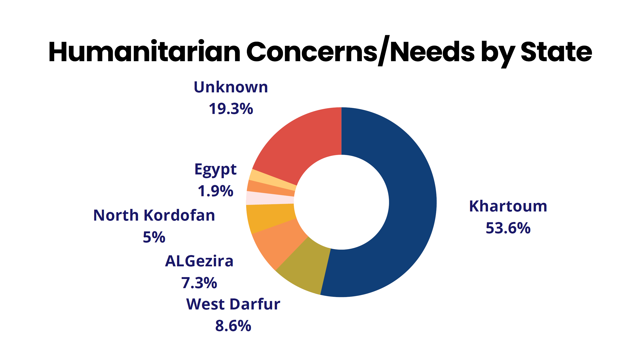
Internews Presentation

Slide 24
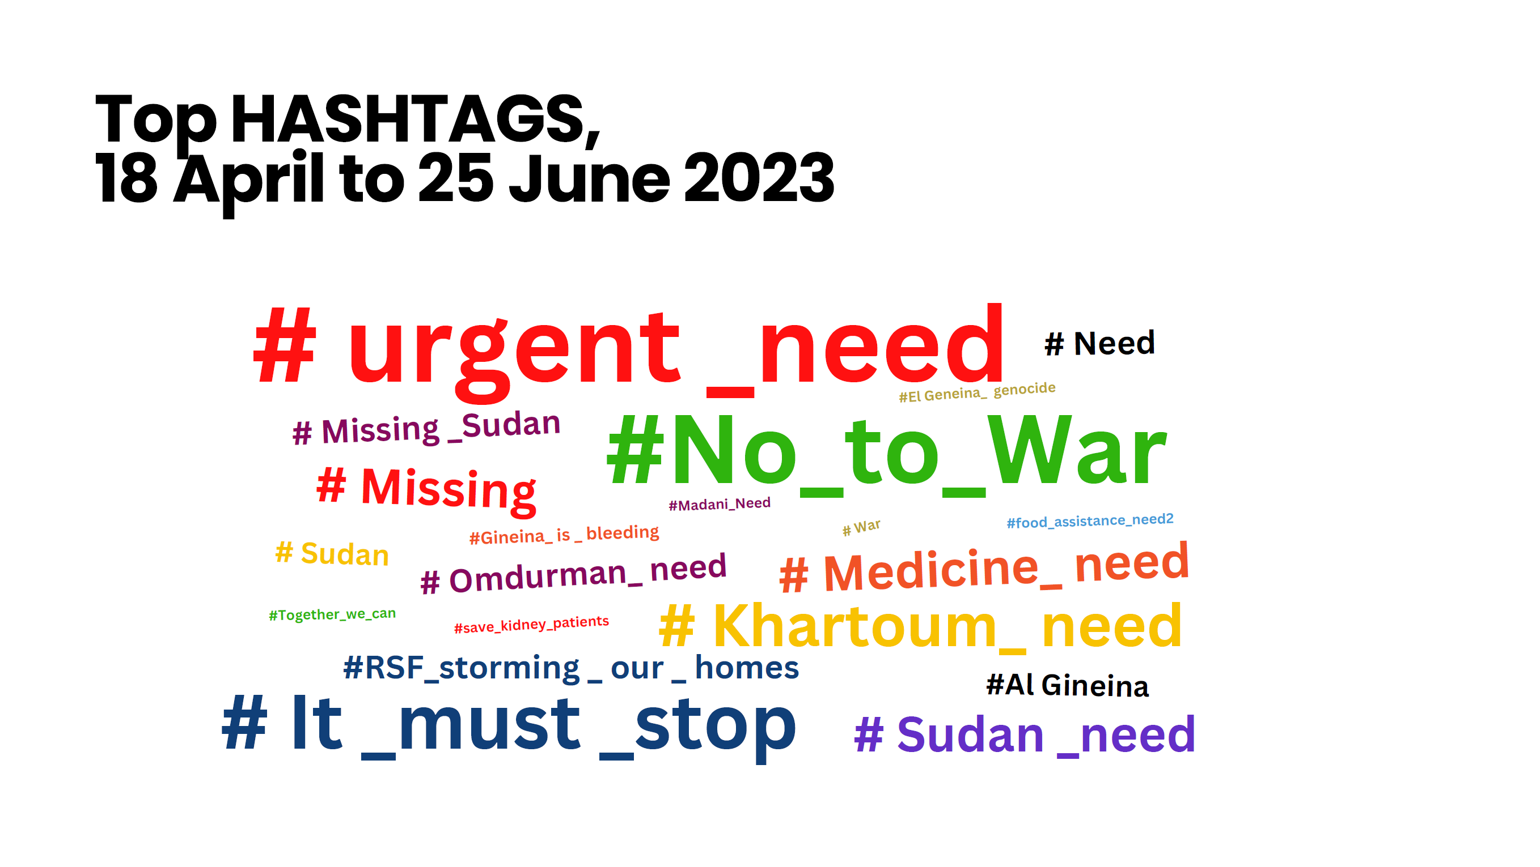
Internews Presentation

Slide 25
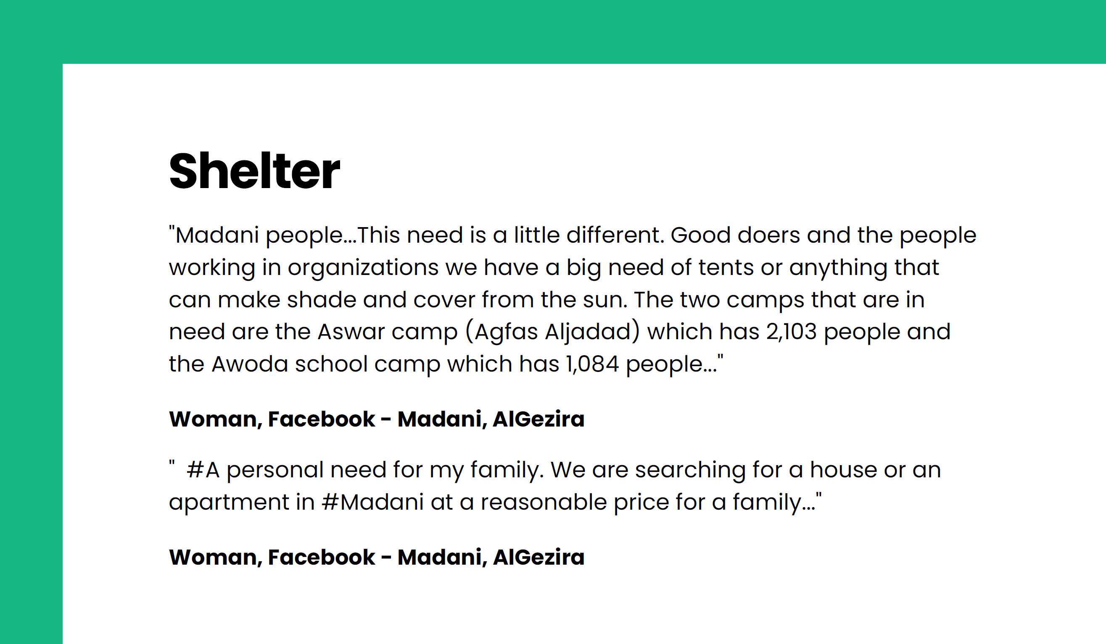
Internews Presentation

Slide 26
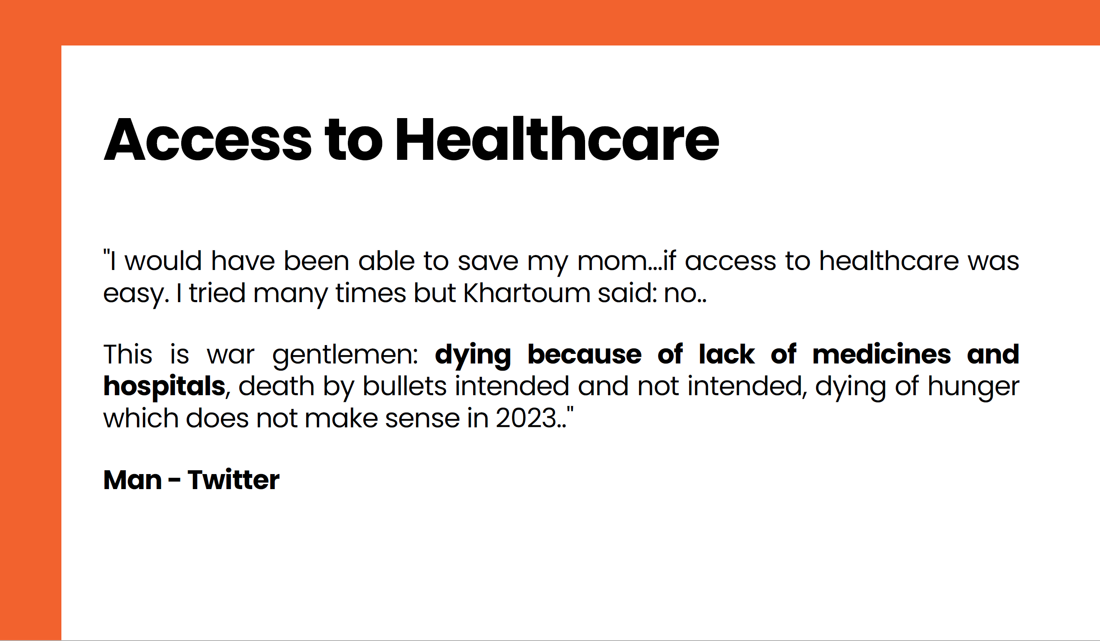
Internews Presentation

Slide 27
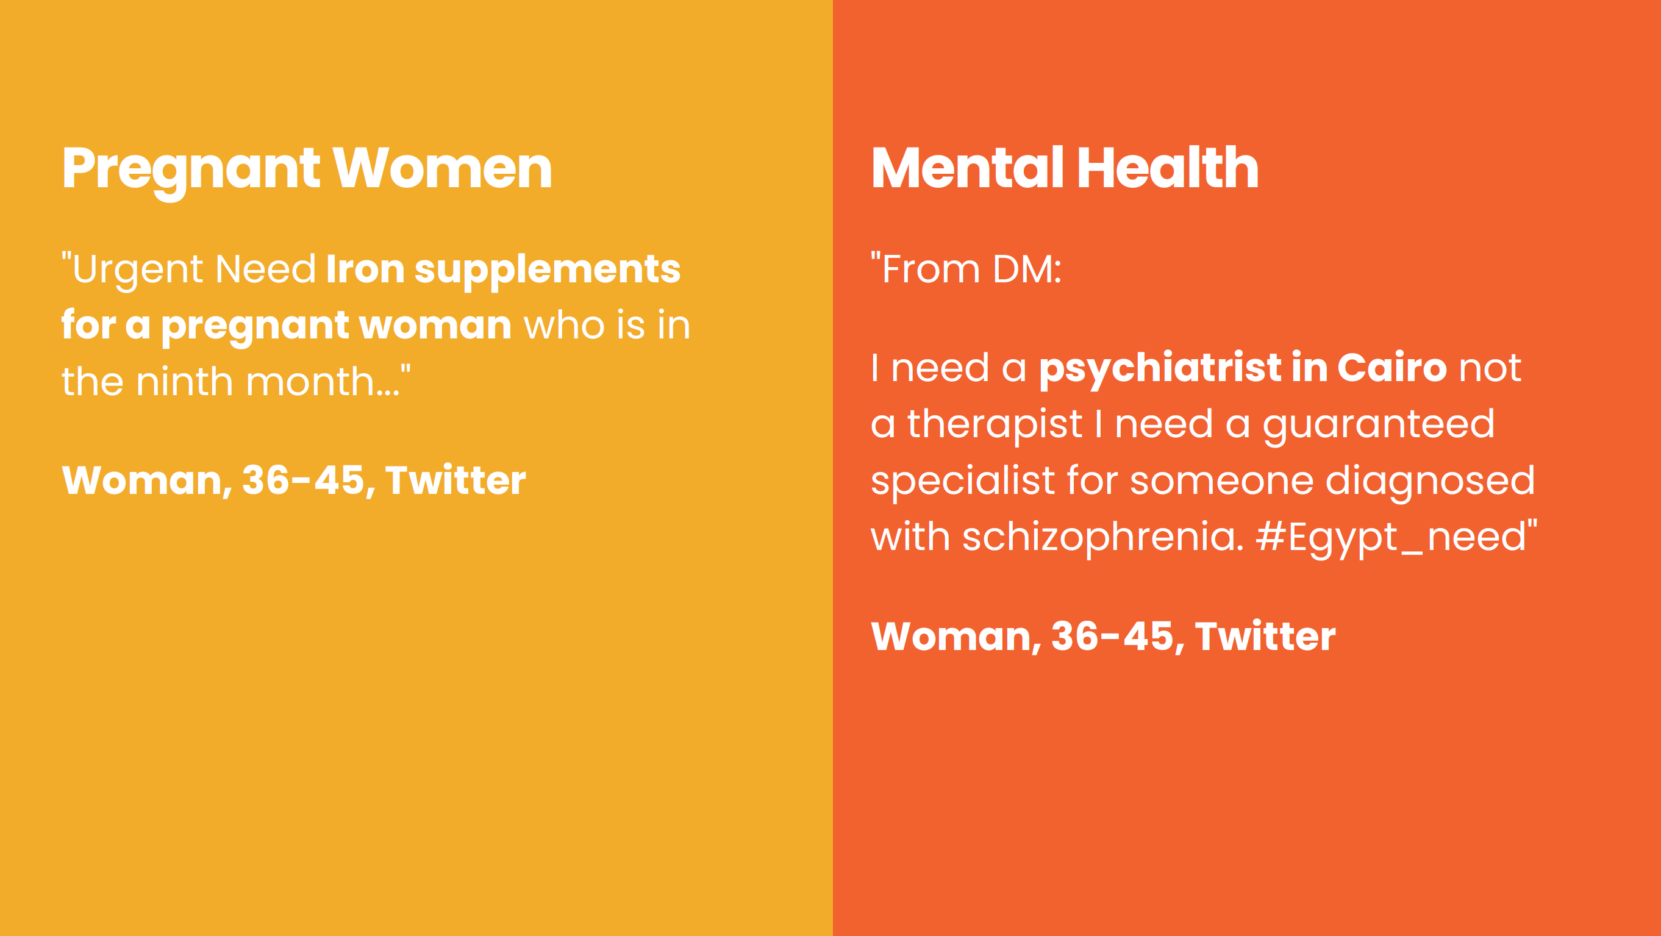
Internews Presentation

Slide 28
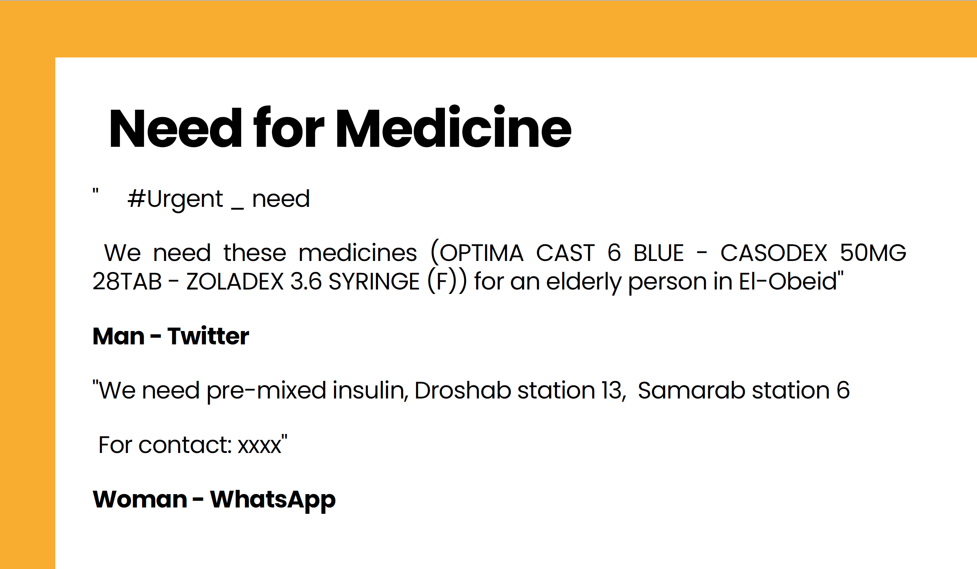
Internews Presentation

Slide 29
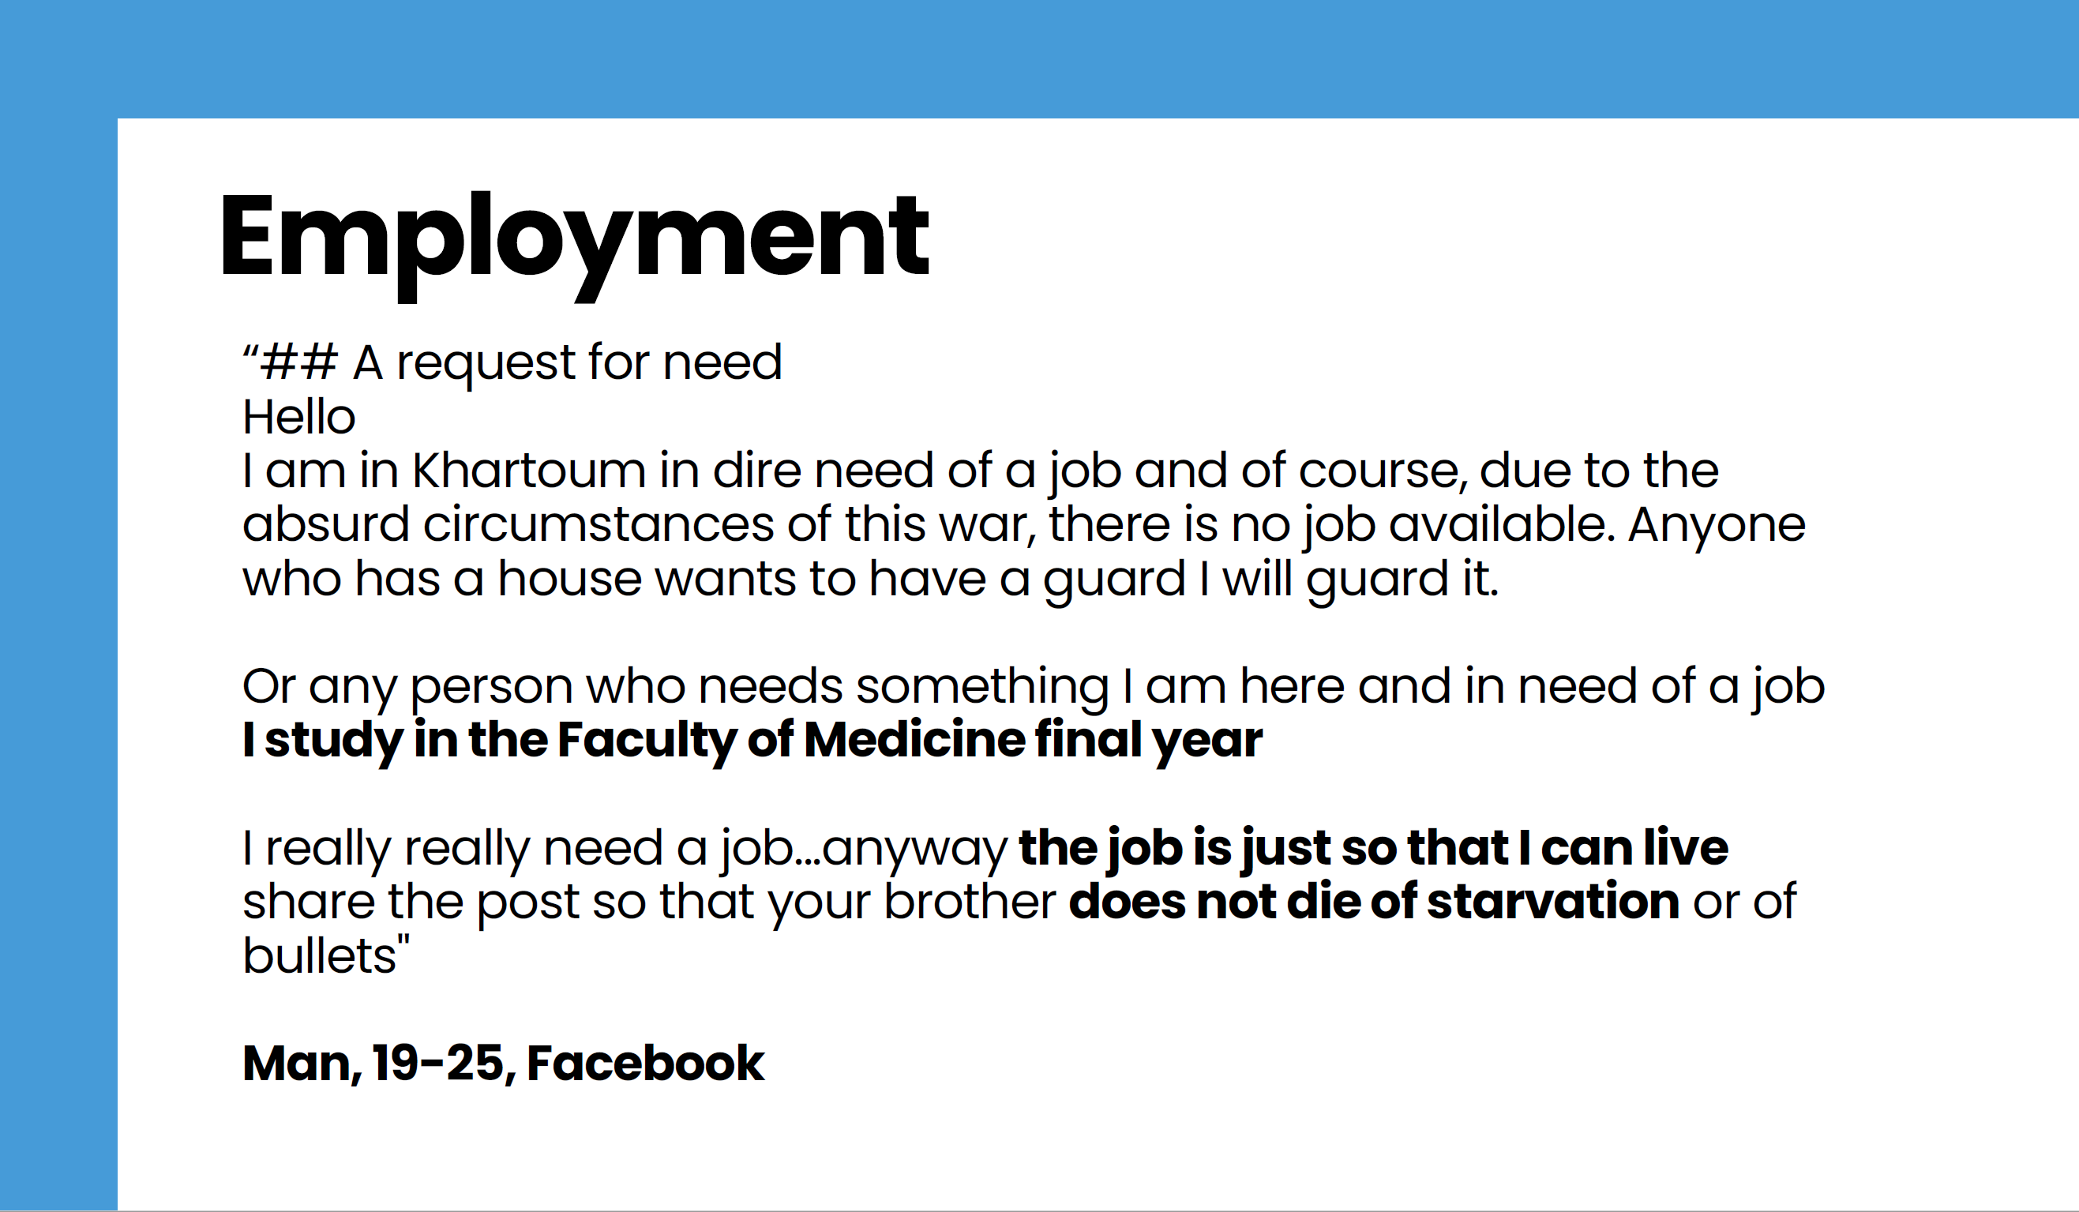
Internews Presentation

Slide 30
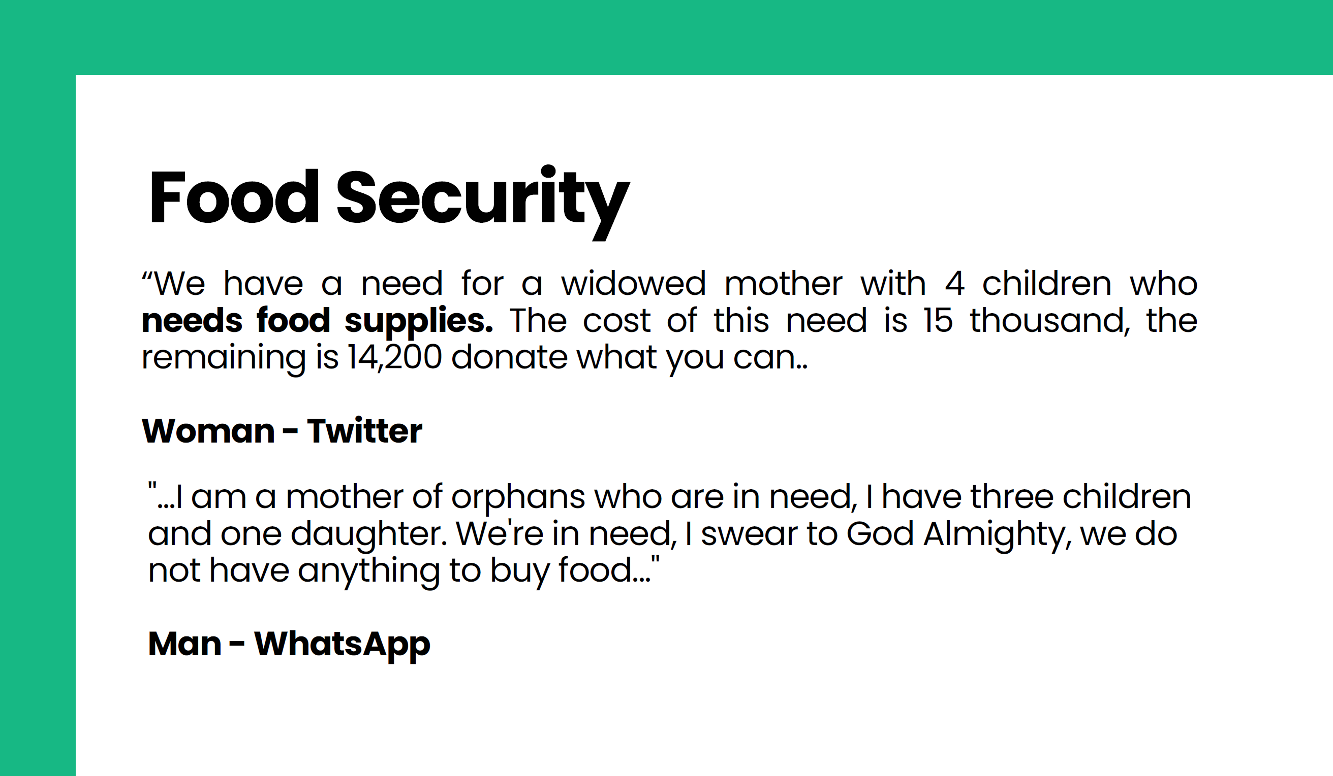
Internews Presentation

Slide 31
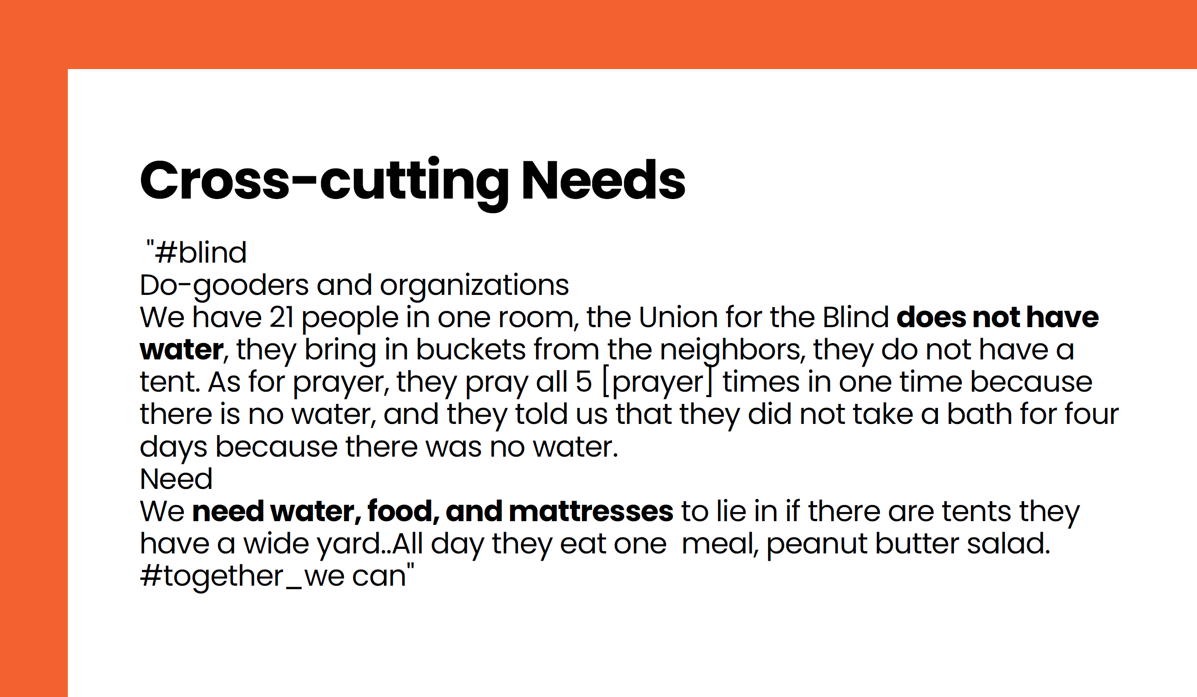
Internews Presentation

Slide 32
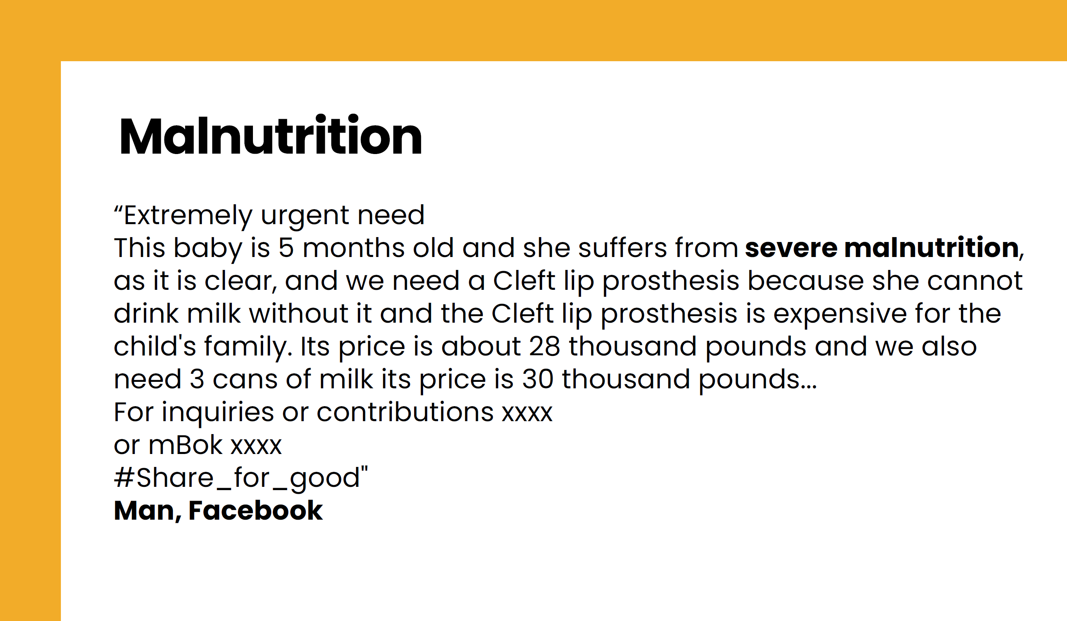
Internews Presentation

Slide 33

Internews Presentation

Slide 34

Internews Presentation

Slide 35
Presentation from REACH
NFI Joint Market Monitoring Initiative (JMMI)

Slide 36
AOB

