Slide 1


Shelter & NFI Cluster
Coordination Meeting
MS Teams • Sudan • 10th July ‘23

Slide 2
Agenda
• Situation Update
• Roundtable on Achievements & Operational Plans
• Nutrition Cluster Presentation on IYCF-E
• Presentation on the IOM Common Pipeline
• AOB

Slide 3
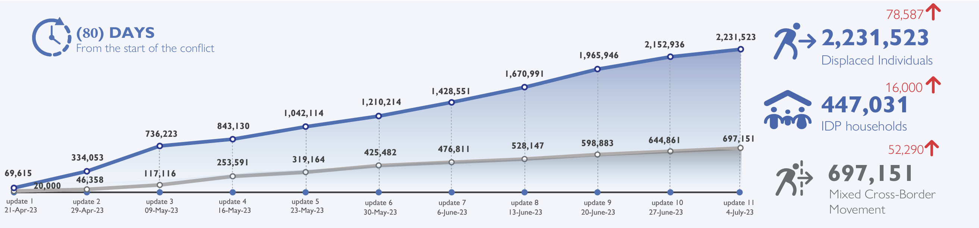
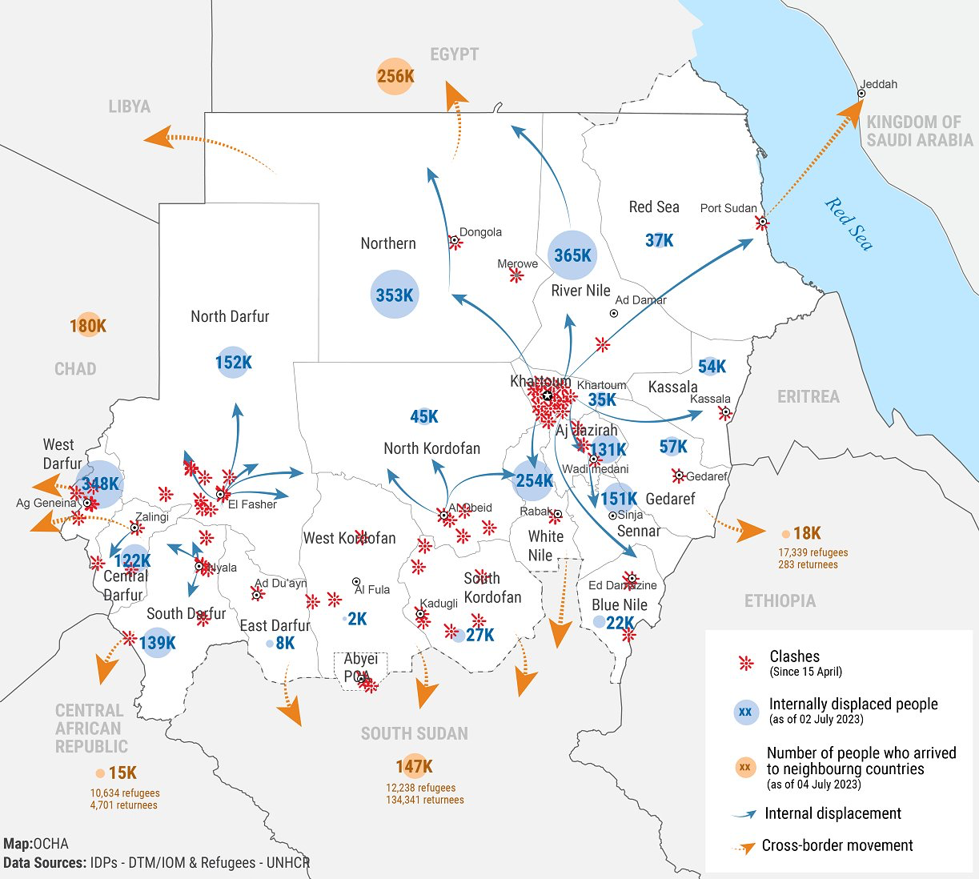
Situation Update
Two and a half months into the SAF-RSF conflict, more than 2.9 million people have been forced to flee their homes. Heavy clashes continue in Khartoum, particularly Omdurman, across Darfurs, particularly Central Darfur in the last few days, as well as in North Kordofan towns of El Obeid and Bara.
As of July 4, the estimated number of IDPs across Sudan is 2,231,523. The current assessment has observed the IDP caseload in all of Sudan’s 18 states. The highest proportions of IDPs have been observed in River Nile (16.36%), Northern (15.81%), White Nile (11.36%), and West Darfur (11.12%) states. It is interesting to note that out of all 18 states, West Darfur was the only state to experience the decrease in the number of IDPs (-52,975) indicating a massive outflow to Chad.
The IDP caseload is primarily urban (60%), originating overwhelmingly from Khartoum (70%), whereby the majority of IDPs are staying with friends and relatives in the host community (77%).
In addition to the internal displacement, the conflict caused the Mixed Cross-Border Movements of 697,151 individuals into neighbouring countries namely Egypt, Libya, Chad, Central African Republic, South Sudan and Ethiopia.

Slide 4

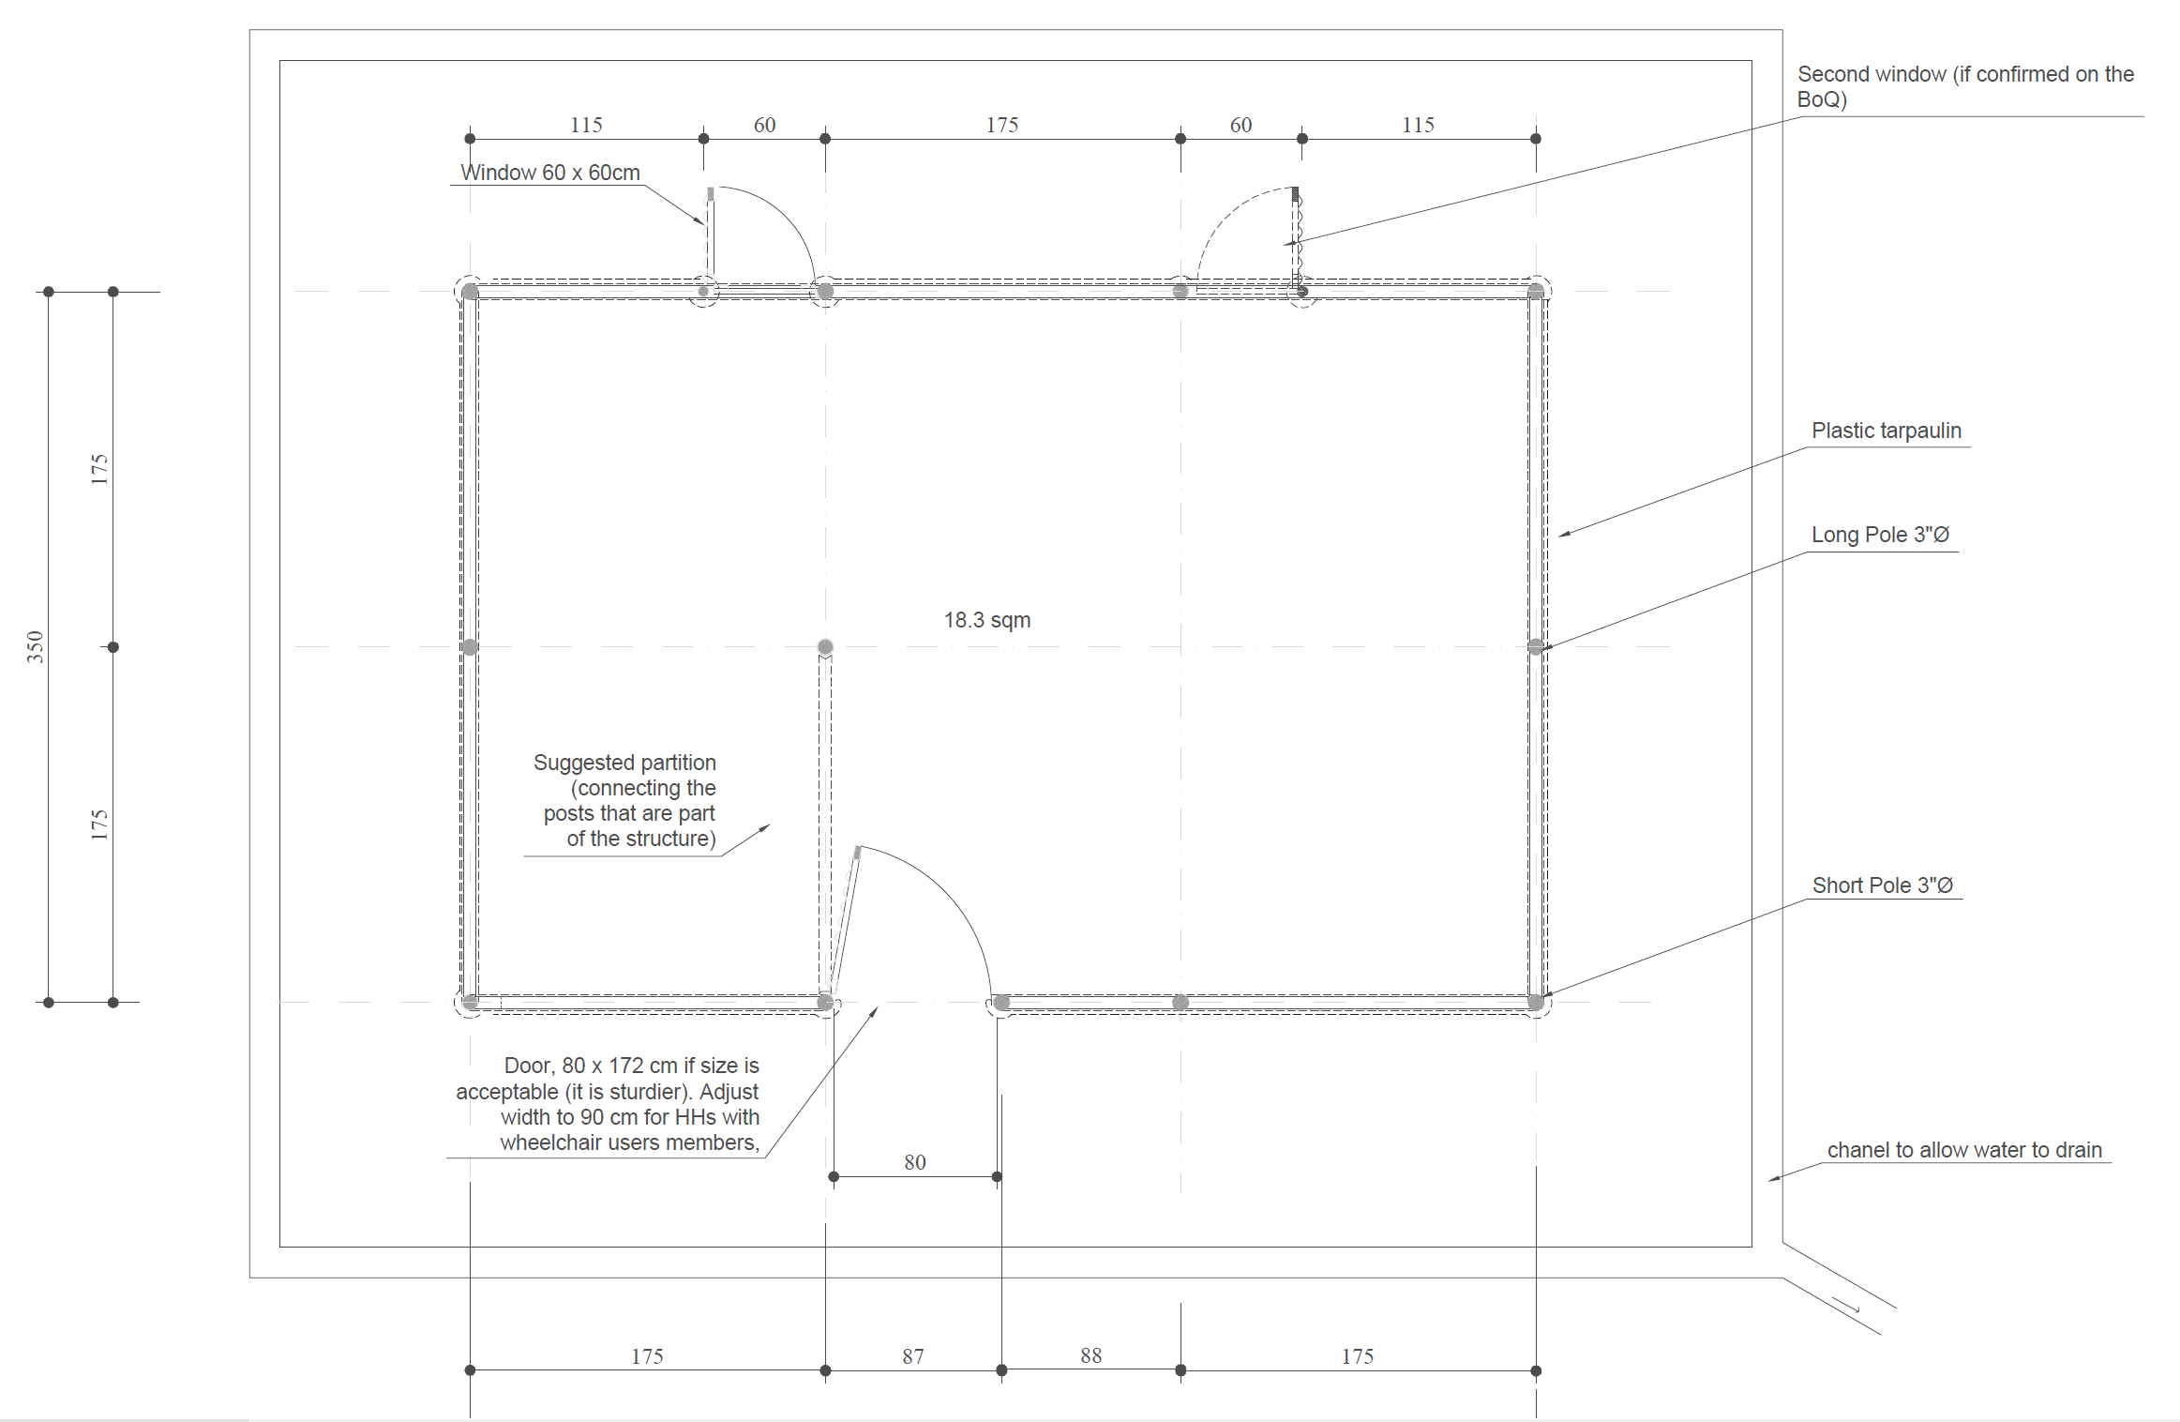
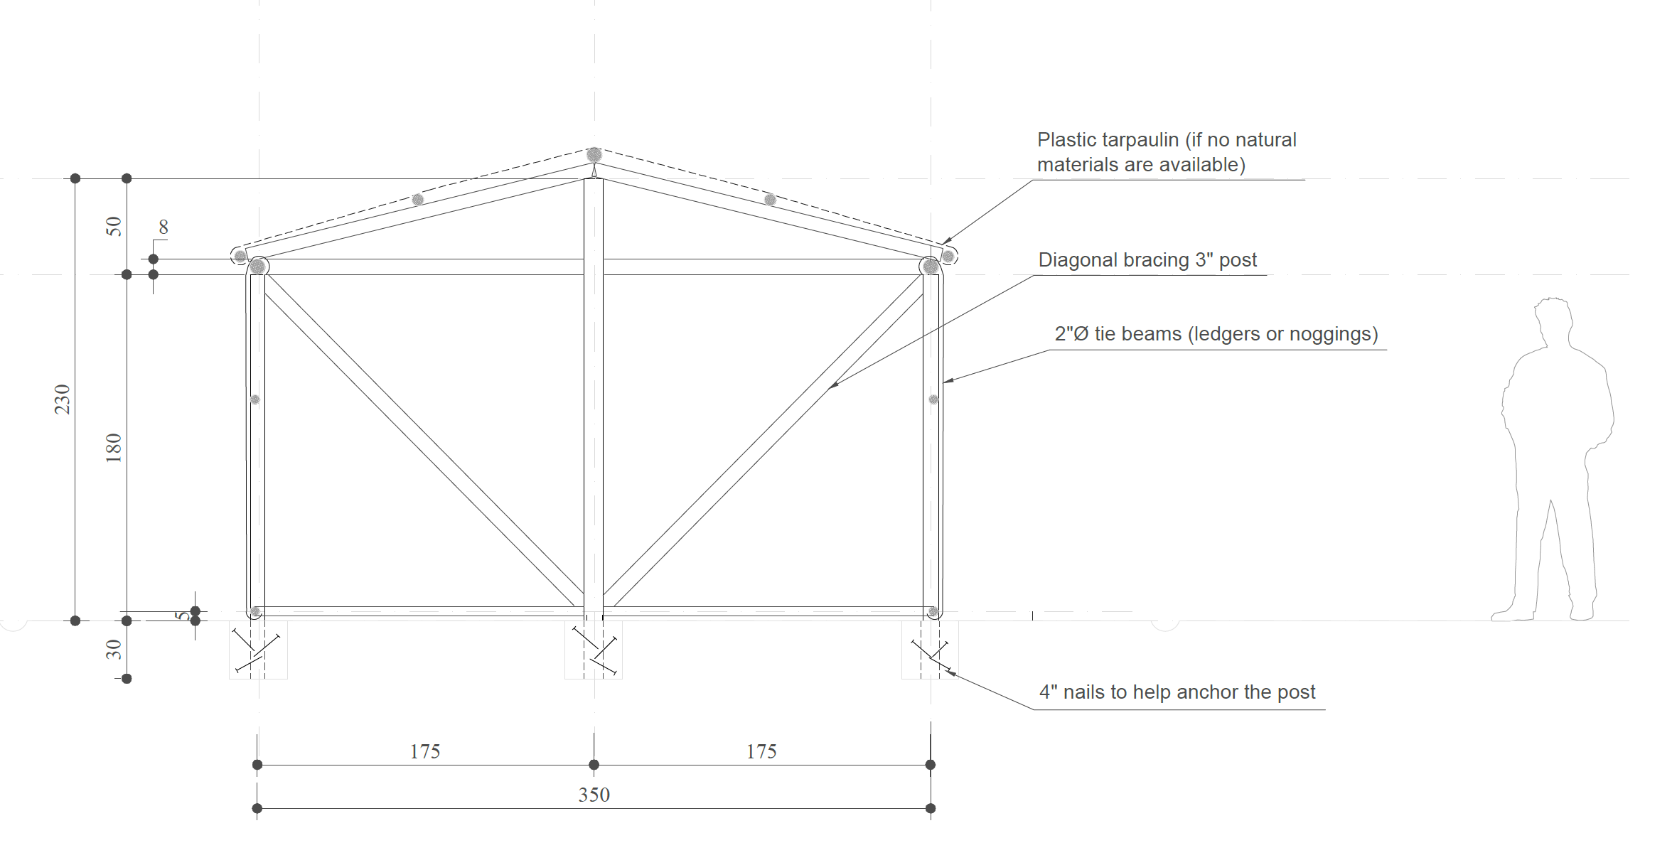
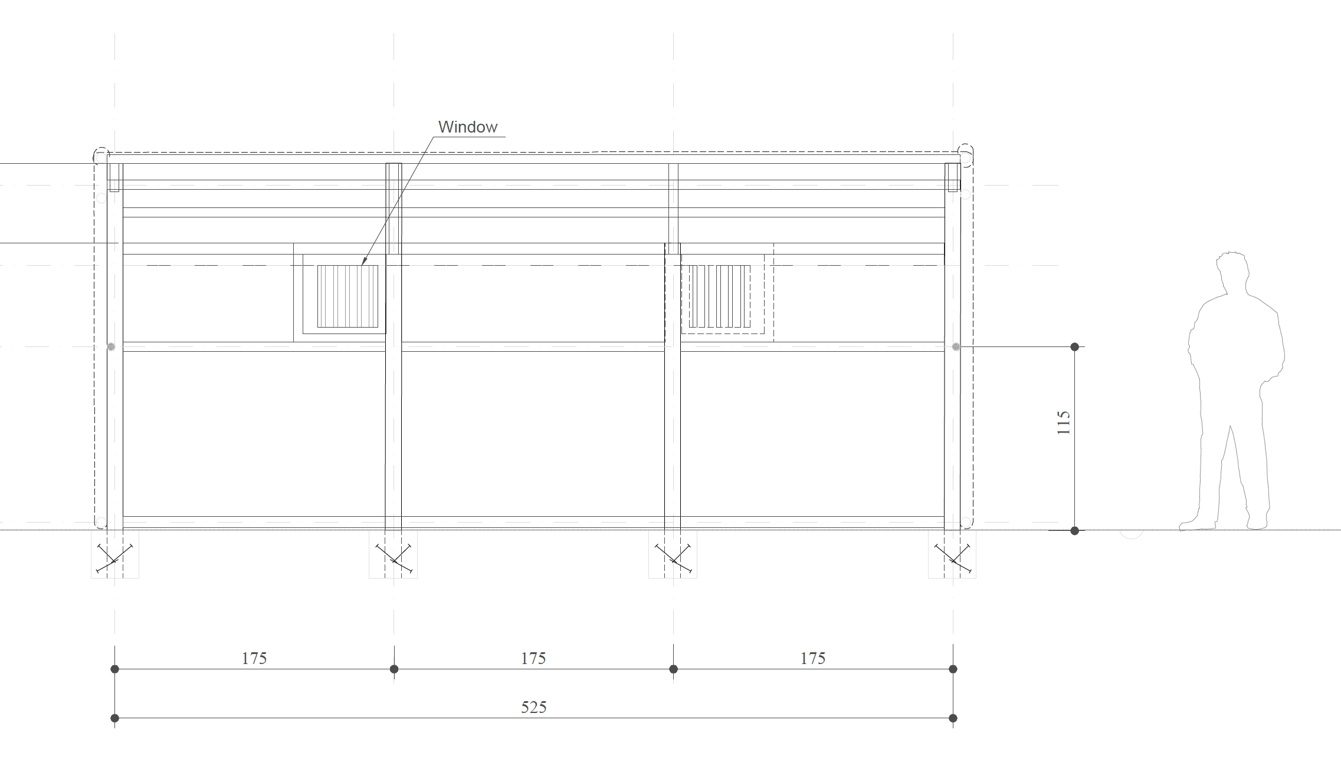
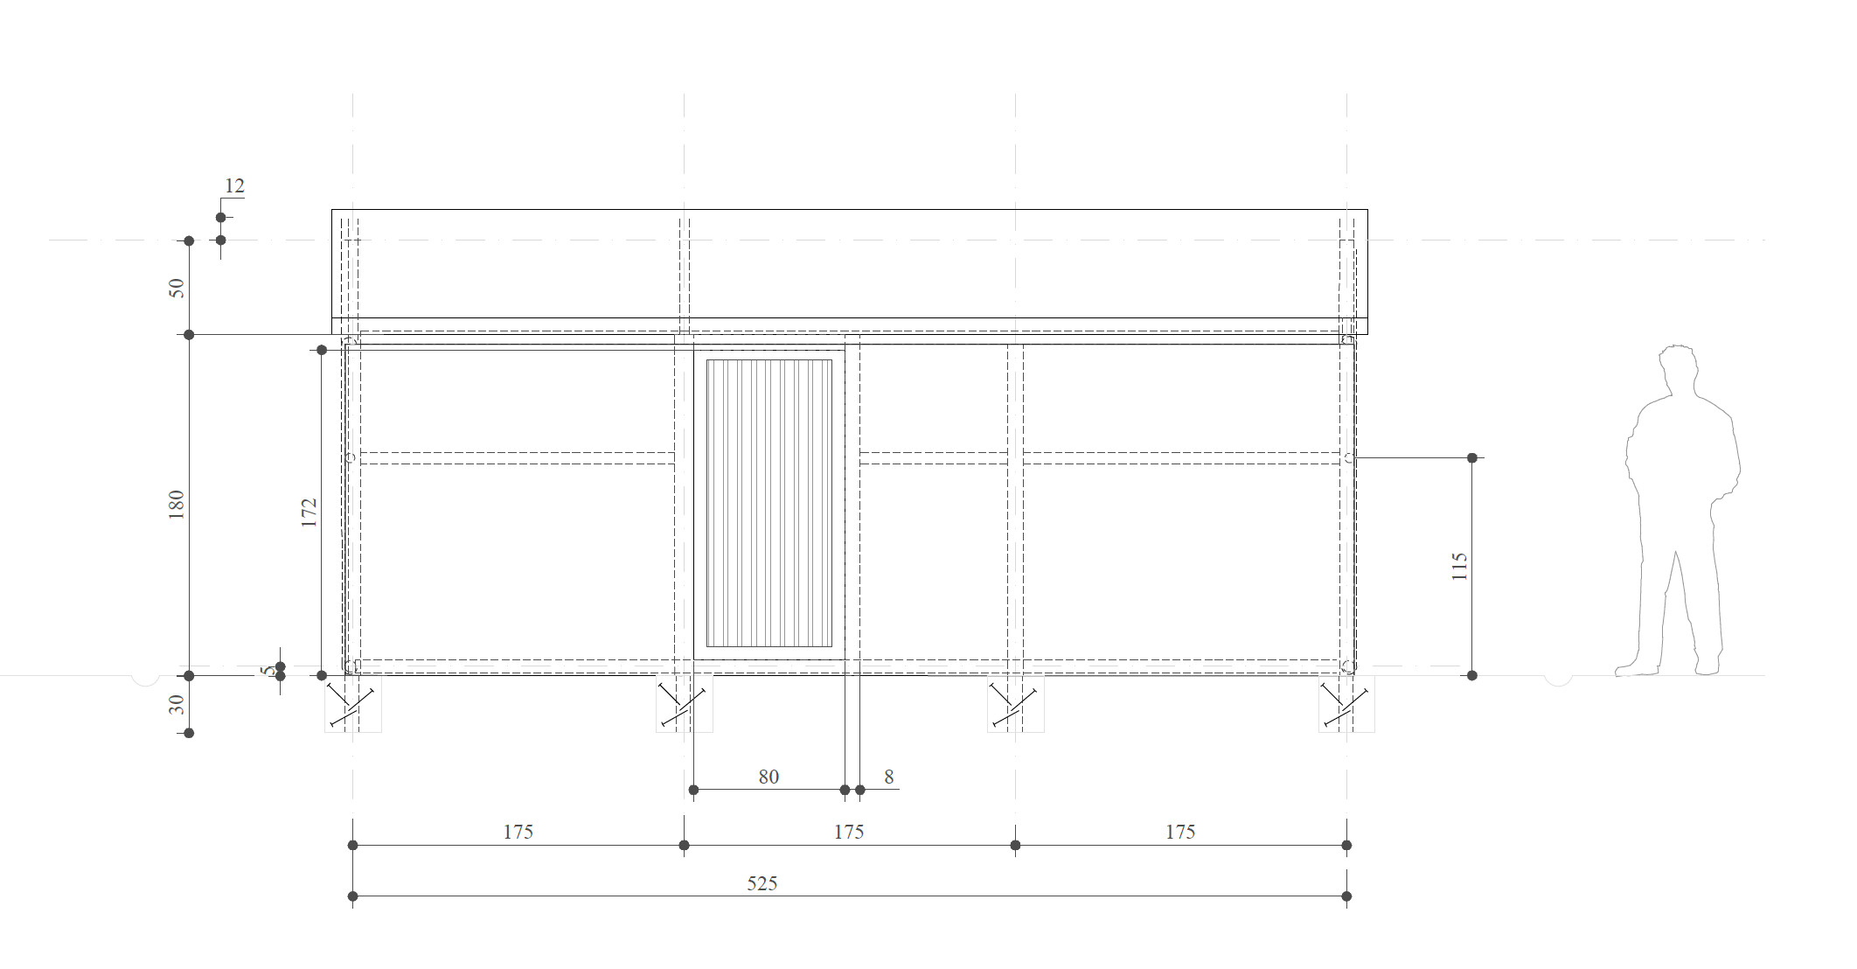
TWIG Update: ESK 1st draft by
This is the option with plastic sheeting, but we still need support from partners to fine tune the BoQ for both this version, and the version made from natural materials entirely. We will discuss this in the next slide on the ESK Market Assessment Tool.

Slide 5
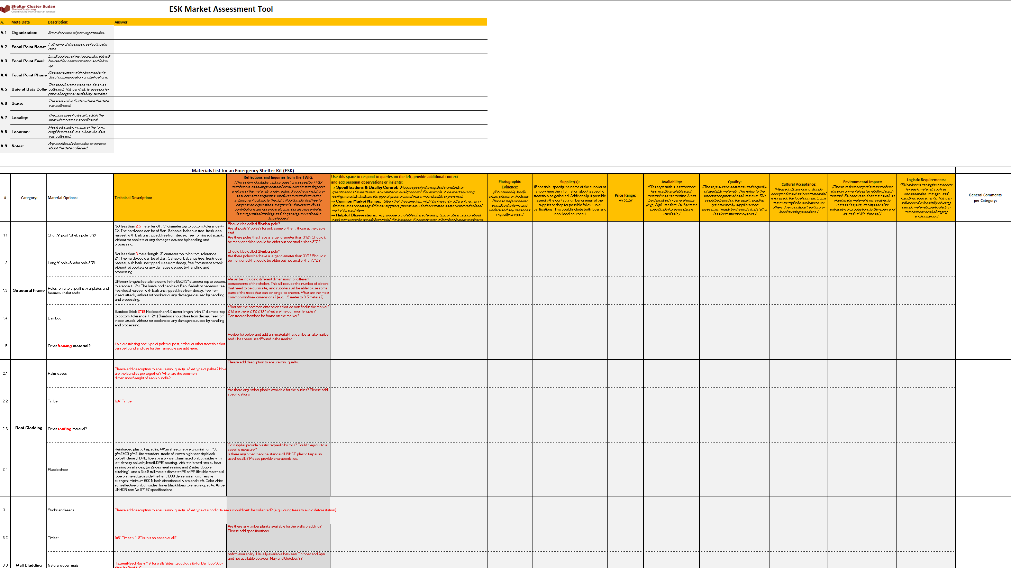
TWIG Update: ESK Market Assessment Tool
In order to finalize the BoQ and the ESK design, we need to engage all partners fully, to conduct a comprehensive market assessment. This involves confirming the availability, pricing, appropriateness and sustainability of various materials and structural elements.

Slide 6
TWIG Update: Pending Questions
If some materials are not available or the teams have other suggestions, it would be good to get some details (e.g. dimensions) to review the BoQ.
Are both, the long poles and short poles Y poles? Are these found in quantities? If we indicate Sheba pole what quality of wood would we receive? Is this specification in the BoQ helpful to establish good quality?
The specification is based on the old kit indicated “Ban, Sahab or Babanus tree” Is it okay to cut down these trees (in terms of deforestation/environmental concerns)?
How the different types of wood/trees compare to each other?
Are there other alternatives available? (e.g. 2” Ø bamboo)
From procurement perspective would it be useful to mix sheba poles (for the main structure) and bamboo for purlins and bottom tie? Would it be helpful for suppliers or is it best to keep one type of wood with different dimensions.
Since these are natural materials, would having poles of different diameters and lengths be beneficial for procurement purposes.
Are 3” Ø the wider poles that are used for posts? Can we find 3 1/2 “ or 4” Ø (even if only for the long poles and ridge). How does this compare in price and availability?
2” Ø is specified for the purlins, mid tie beams and sole/bottom plate. Could a pole that is thinner 1 ½” Ø be nailed without splitting?
As mentioned during the last TWIG, it would be ideal if the suppliers cut to size most of the pieces. Would this be possible?

Slide 7
TWIG Update: Pending Questions
Based on rough calculations for the Fixings (rope, nails and wire) we need to know the following:
How thick is the Jamica rope?
How many meters of Jamica rope are in a 2 Kg roll?
If possible, how many rounds we need per connection when using this rope?
What other twig or materials are used to tie connections or "stitch" the plastic sheeting together?
The BoQ of the old design indicated a 1 meter rod with 1.5 Ø. How was this rod used?
How many 4” or 10 cm nails are in a Kilo? – of the specific nails that are available in the market/supply chain where procurement is likely to take place
How many 2” or 4 cm nails are in a Kilo?
How many Umbrella nails are in a Kilo?
How many U nails are in a Kilo?

Slide 8
Roundtable – Achievements/Ops Plans
Objective: Ensure that our collective response efforts are well communicated to partners, donors, media and general audiences!
Achievements – type of interventions, HH reached, locations, timeframe, etc.
Challenges – looting of supplies, access challenges, etc.
Procurement – quantities of stocks arriving to the country, type of stocks, timeframe, where will the stocks be prepositioned – particularly given the incoming flood season.
Assessments – e.g., needs assessments outlining specifics with respect to Shelter and NFI needs as well as market assessments on NFIs, shelter materials, or Cash for Rent.
Context and impact of interventions – e.g., any successes with respect to cash for rent, how is sustainability achieved, what about tenure security?
Interventions in the host community – with 77% of the population staying in host community – what has been achieved so far? Cash for shelter for the families hosting IDPs can be an option, or preselecting landlords to improve their housing in order for them to subsidize rent for IDPs – this can include negotiating longer-term tenure security.
Etc.

Slide 9
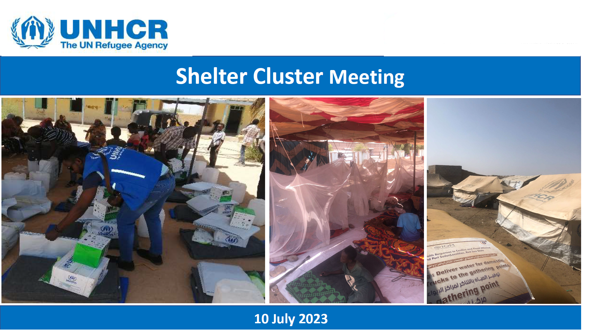
UNHCR Presentation

Slide 10
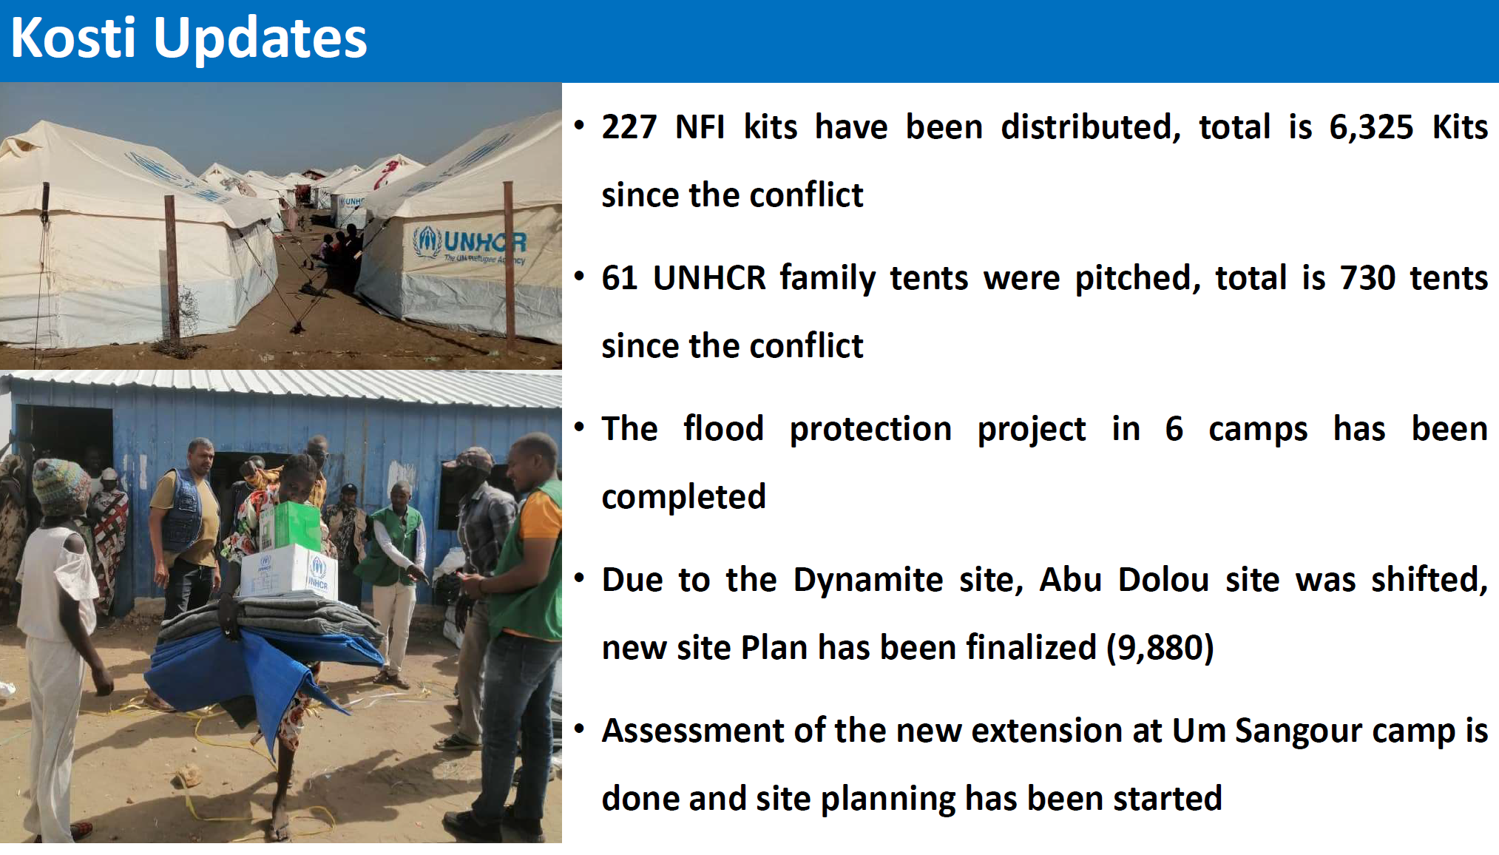
UNHCR Presentation

Slide 11
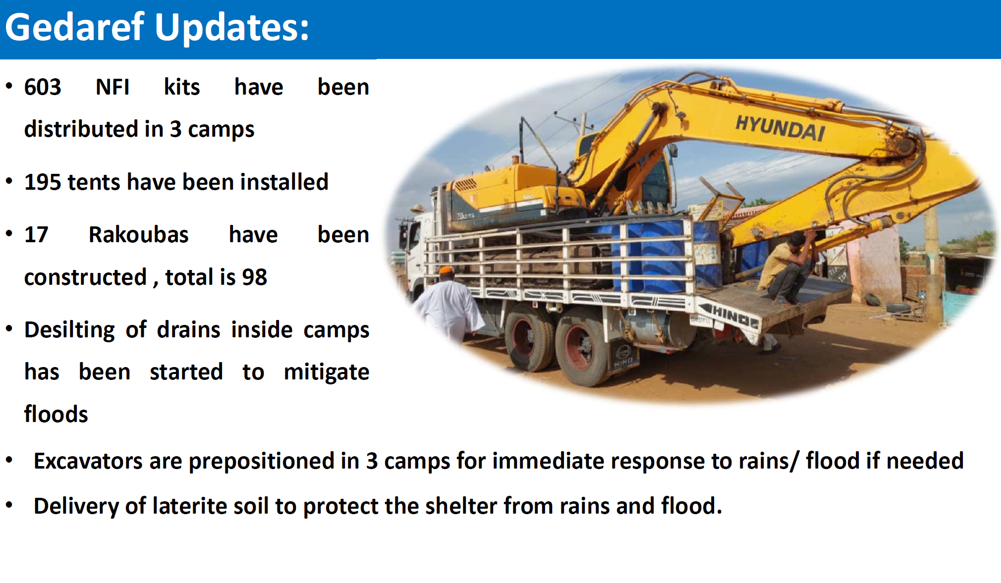
UNHCR Presentation

Slide 12
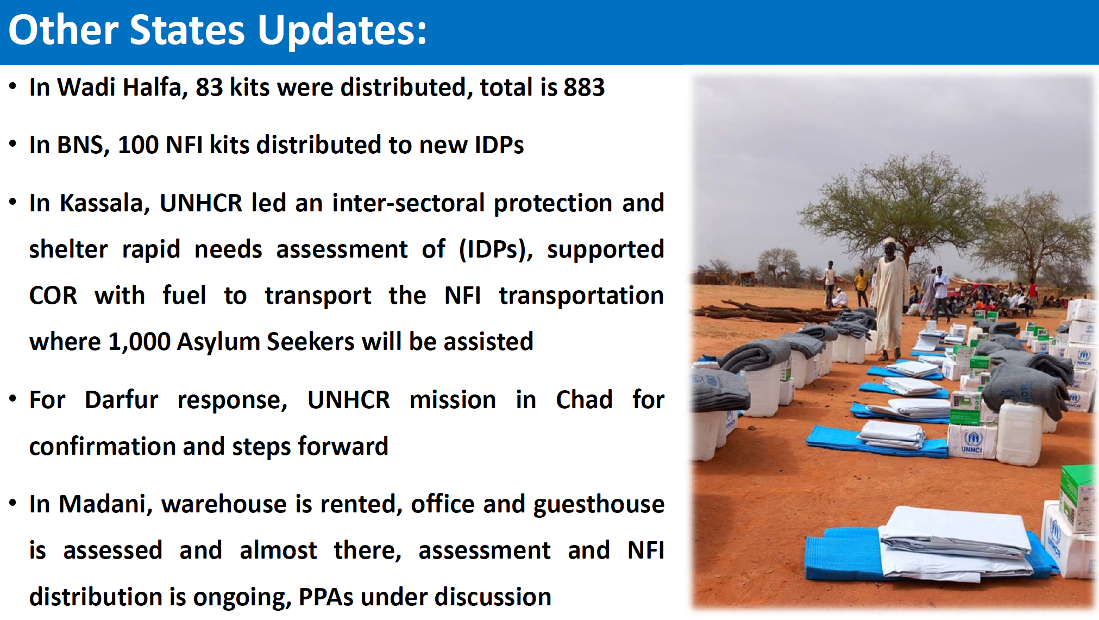
UNHCR Presentation

Slide 13
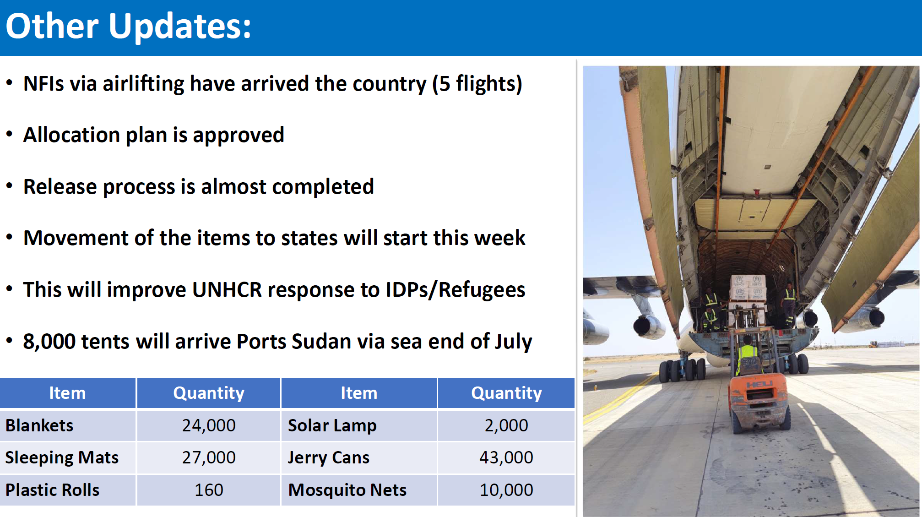
UNHCR Presentation

Slide 14
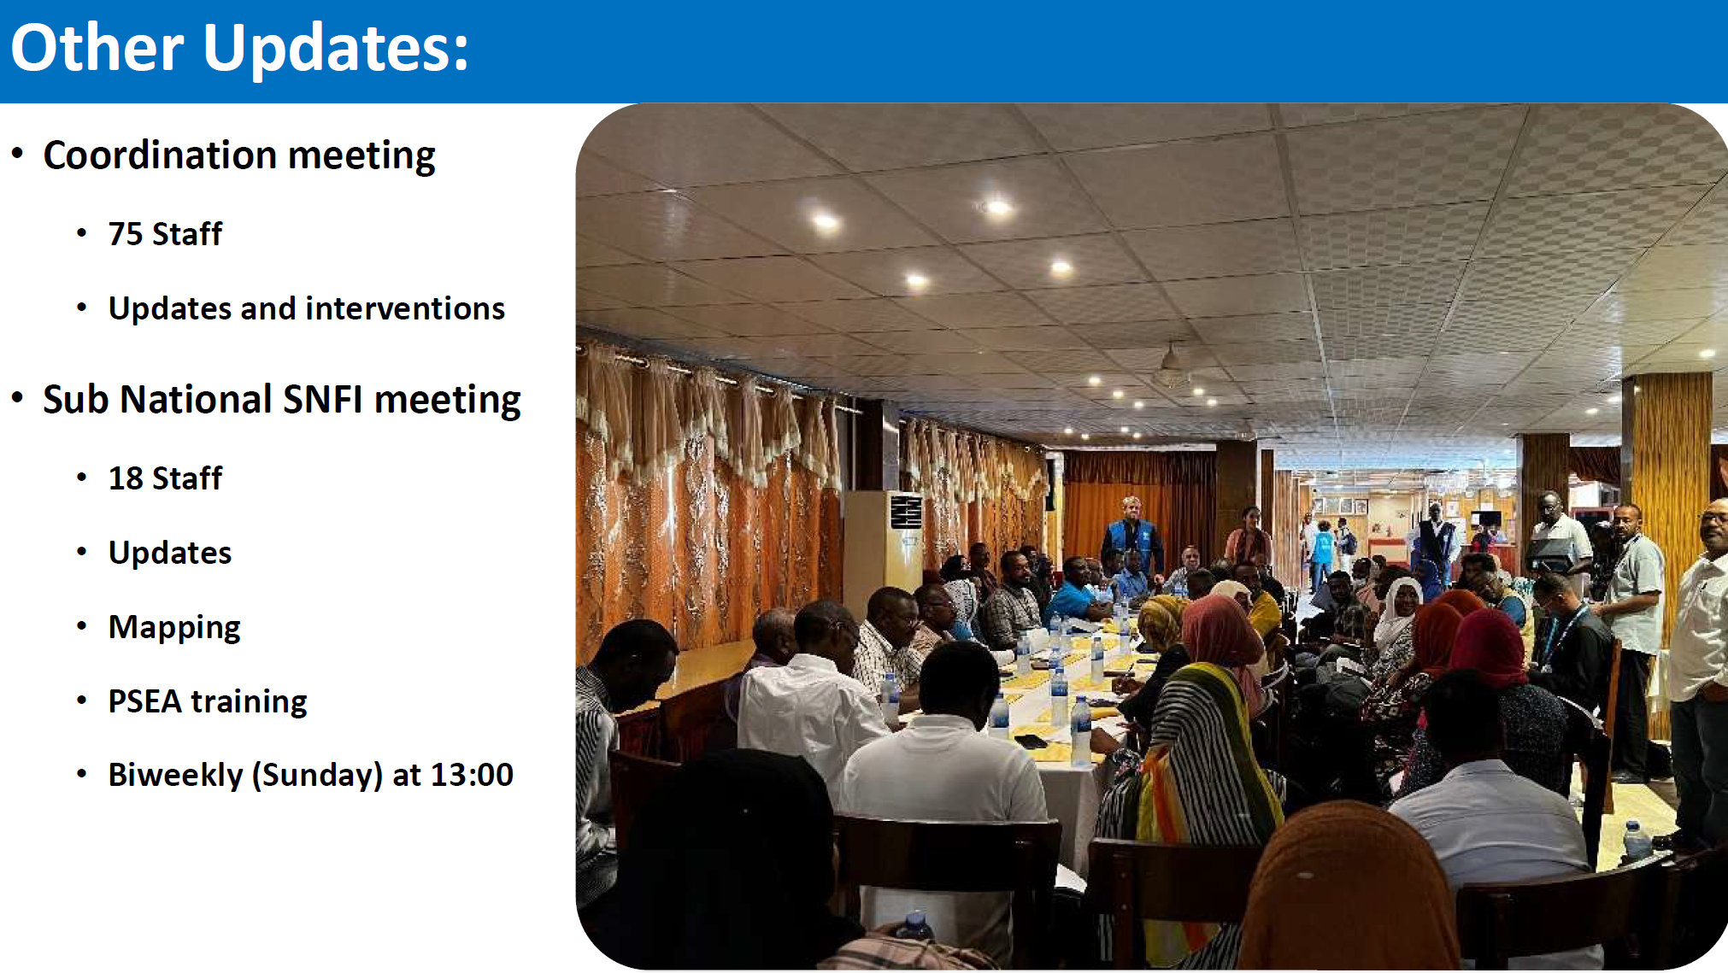
UNHCR Presentation

Slide 15
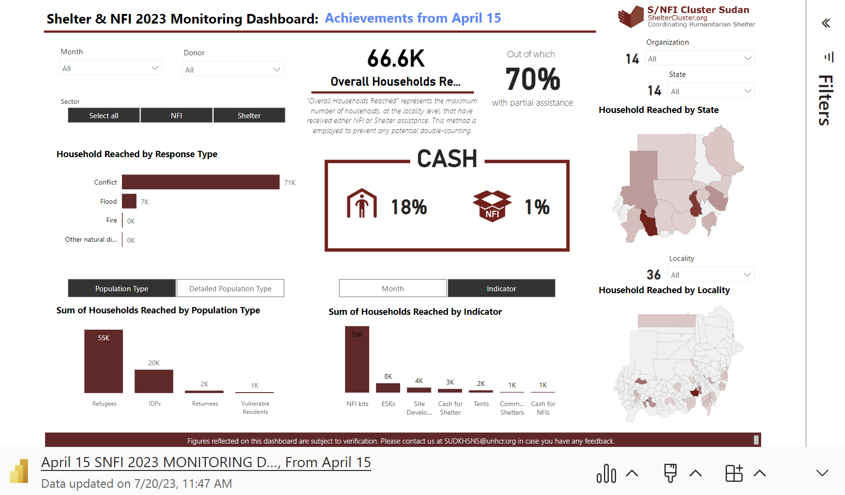
Achievements Public Dashboard

Slide 16
IOM Sudan Shelter & Settlement Sector Updates

Slide 17

Overview of IOM Common Pipeline Online System
Online system that allows rapid deployment of items to affected populations through preposition of NFI stocks in warehouses, and the distribution of these stocks to different IPs following an online request to provide support in affected areas where they have presence in.
Established in 2021 with funding support from BHA-USAID.
Prepositioning of NFI kits, Hygiene kits & Emergency Shelter materials.
International and Local Procurement of pipeline items.
Currently, funded by BHA, CERF & ECHO- excepting funding from Japan and additional funding from ECHO in the coming months.
Verification of Implementing Partners list and MOUs- What is the process and requirements?

Slide 18
Conti….
Sending requests through the pipeline, approval and distribution of items to Implementing Partners – Duration of the process?
Pipeline Dashboard- Who can access it? And How?
Warehousing- Port Sudan, Kassala, Gedaref, Kosti…..
Coordination, pipeline updates, guidelines, SOPs shared through the created mailing list system.
Complaints and feedback mechanism
Operations

Slide 19
Thank You

Slide 20

SUDAN
NUTRITION
SECTOR
Infant and Young Child Feeding in Emergencies
(IYCF-E)
Sudan Crisis Nutrition Response
Infant
0 – 11 m of age
Young child
12 – 23 m of age

Slide 21
Breastfeeding SAVES LIVES in emergencies all over the world and infants who are not breastfed are far more likely to get sick and die
Preventative interventions التدخلات الوقائية | Proportion of under 5 deaths prevented نسبة وفيات الأطفال الممكن تجنبها
Exclusive and continued breastfeeding until 1 year of age الرضاعة الطبيعية الخالصة وإستمرار الرضاعة الطبيعية لعمر سنة. | 13%
Insecticide treated materials الناموسيات المشبعة بالمبيدات | 7%
Appropriate complementary feeding التغذية التكميلية المثلى | 6%
Zinc - الزنك | 5%
Clean delivery - الولادة النظيفة | 4%
Hib vaccine - لقاح إلتهاب السحايا | 4%
Water, sanitation, hygiene - المياة والنظافة والإصحاح البيئي | 3%
Antenatal steroids –إعطاء السترويدات قبل الولادة | 3%
Newborn temperature management - معالجة الحرارة بالمواليد | 2%
Vitamin A - فيتامين أ | 2%
Lancet 2003

Slide 22
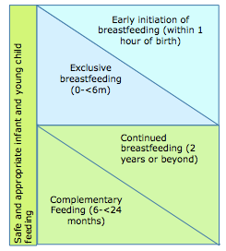
Recommended feeding practices for infants and young children
ONLY breastmilk
Other solids, semi-solids, liquids at 6 months with continued breastfeeding up to 2 years
Source: GNC IFE training 2011

Slide 23
Benefits of Breastfeeding
1. Optimal Nutrition
2. Improved Immunity. 3. Enhanced Brain Development
4. Reduced Risk of Chronic Diseases
5. Bonding
6. Convenient and Economical 7. Environmentally Friendly
8. Breast milk is always available at the right temperature and does not require any extra equipment or preparation.

Slide 24
Challenges of Breastfeeding during emergency
1. Emotional stress: Emergencies often result in emotional stress, anxiety, and trauma that can impact a mother's ability to breastfeed effectively or reduce her milk supply.
2. Separation: Separation from family members, displacement, or relocation can make it difficult for mothers to continue breastfeeding, as they may not have access to their infants or may be unable to maintain a stable breastfeeding routine.
3. Lack of privacy and support: Emergencies can disrupt the usual social and cultural support networks that mothers rely on, leading to a lack of privacy, emotional support, or practical assistance with breastfeeding.
4. Malnutrition: Mothers may become malnourished during emergencies, leading to a reduction in breast milk supply or quality.
5. Unsafe water, sanitation, and hygiene: Emergencies can damage infrastructure and disrupt water supply and sanitation services, leading to an increased risk of waterborne diseases and infections that can affect the health of both mothers and infants.
6. Lack of access to healthcare: Disruption of healthcare services and a lack of access to skilled breastfeeding support can make it difficult for mothers to address breastfeeding difficulties or access medication when needed.
7. Infant and young child feeding (IYCF) misinformation: Lack of knowledge, cultural beliefs, and unfounded rumors about breastfeeding and IYCF practices can be a significant barrier to effective breastfeeding during emergencies.

Slide 25
Another big challenge, artificial feeding (Infant formula)
Effect of artificial feeding on Breastfeeding
Negative health outcomes: (decreased immunity, delayed development, digestive issues, chronic diseases in adulthood)
Reduced milk production: Breastfeeding works on a demand and supply basis. When a baby suckles at the breast, it signals the body to produce more milk. Formula feeding decreases the frequency and intensity of breastfeeding, leading to a decline in milk production. This can lead to a decrease or cessation of milk production, making it difficult to return to exclusive breastfeeding.
Latch and suckling: Breastfeeding involves a complex interplay between the baby's ability to latch and suckle at the breast, and the milk-producing properties of the breast. Bottle feeding requires a different sucking technique. When babies are bottle-fed, they may have difficulty latching onto the breast and suckling effectively, leading to nipple confusion or refusal.
Hormonal regulation: Breastfeeding triggers the release of hormones such as oxytocin and prolactin, which play a vital role in milk production, bonding, and emotional regulation. The reduced or absent stimulation of these hormones when formula feeding can lead to negative emotional and physical effects on both the mother and baby.
Infrequent feeding: Formula-fed babies are often fed on schedule, whereas breastfed babies feed on demand. This can result in infrequent feeding and reduced stimulation of the breast, leading to decreased milk production over time.
Preference for BMS: If a baby is given BMS early on, they may develop a preference for the taste and convenience of bottle feeding, which may result in a reluctance to breastfeed.

Slide 26
How can NFIs Sector support infant feeding
Providing maternal and childcare kits: The NFI sector can provide maternal and childcare kits that contain items such as breastfeeding support items, and hygiene items. These kits can help ensure that mothers have access to the necessary items to initiate and maintain exclusive breastfeeding and maintain appropriate hygiene during emergency situations.
Providing materials for safe storage and preparation of food: The NFI sector can provide materials for the safe storage and preparation of food, such as cooking utensils, fuel-efficient stoves, and clean water containers. These materials can help ensure that caregivers can safely store and prepare food for their infants and young children, reducing the risk of food contamination.
Providing infant and young child feeding kits: The NFI sector can provide infant and young child feeding kits containing items such as cups and utensils. These kits can help mothers who are unable to breastfeed or need to supplement with formula.
Providing protection for breastfeeding mothers: The NFI sector can provide protection for breastfeeding mothers, such as breastfeeding cover-ups or secluded areas for breastfeeding. These items can help mothers feel more comfortable breastfeeding in public spaces or emergency shelters.
Prioritize pregnant and lactating mothers in NFI’s interventions
Monitor and report on any violations to the BMS code

Slide 27

International Code of Marketing of Breast Milk Substitutes
NO untargeted distribution of BMS

Slide 28
Monitoring BMS in Emergency Situations
NFIs partners to Report All violations to the Breast milk substitute code
Types of violation
Donations of the BMS/bottles/teats from agencies, government, donors, etc;
Accepting unsolicited donations of BMS/bottles/teats;
Blanket distribution of unsolicited or free supplies of BMS/bottles/teats;
Distribution of formula that has been properly procured other than to mothers and babies that have been professionally assessed as requiring formula
Donations of complementary food to children 0-5 months;
Distribution of milk products (incl. dried) that can be potentially used as BMS to general population;
Distribution of infant formula with less than 6 months shelf life;
Inadequate labelling (no health hazard warning, inappropriate language, no statement on BF superiority, no info on safe preparation, etc.)
Promotion of BMS at the distribution point (displays, logos, etc,);

Slide 29
SUDAN
NUTRITION
SECTOR
Thank You

Slide 30
AOB

