Slide 1


Shelter & NFI Cluster
Coordination Meeting
MS Teams • Sudan • 24th July ‘23

Slide 2
Agenda
• Situation Update
• Roundtable on Achievements & Operational Plans
• ADRA Presentation on KRT Market Assessment + WN/AJ Rental Assessment
• AOB

Slide 3
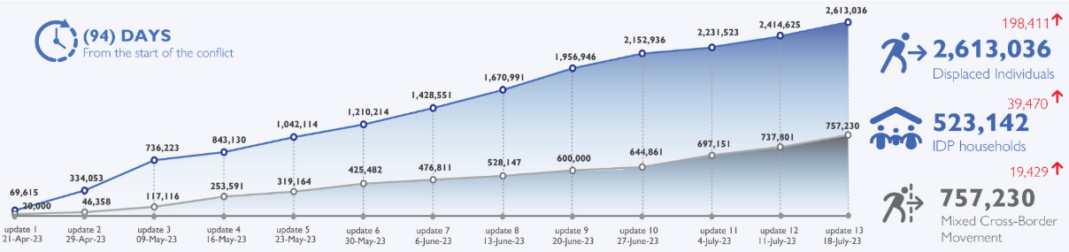
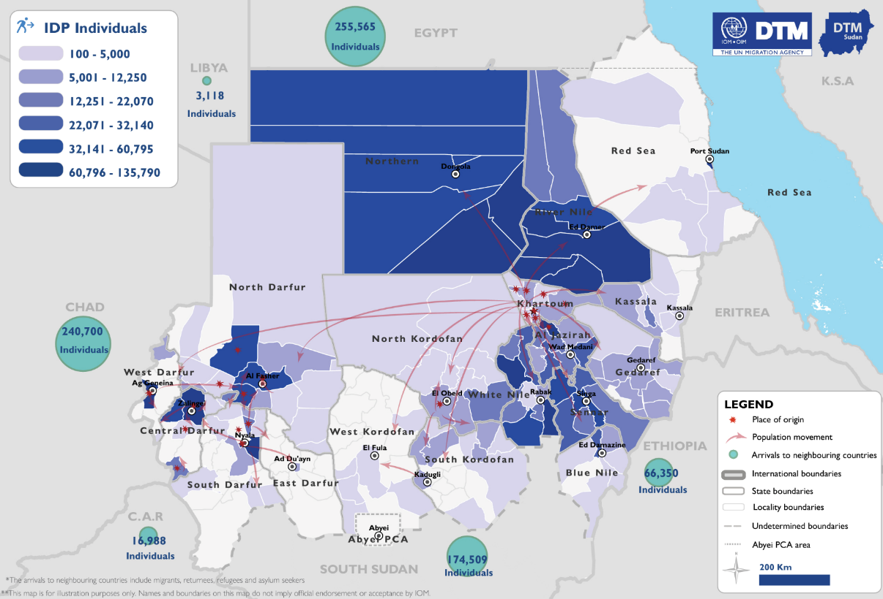
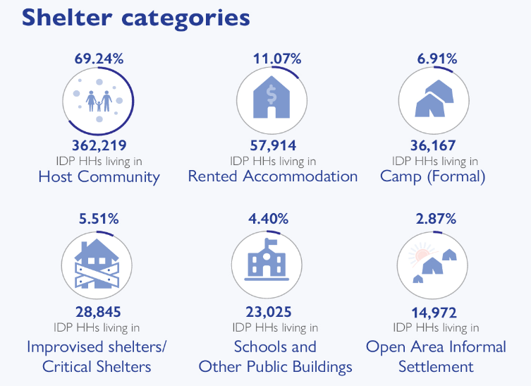
Situation Update
Three months into the SAF-RSF conflict, close to 3.4 million people have been forced to flee their homes, continuing the same upward trend.
Out of those, the estimated number of IDPs across Sudan is 2,6 million. The current assessment has observed the IDP caseload in all of Sudan’s 18 states. The highest proportions of IDPs have been observed in River Nile (16.38%), Northern (13.73%), White Nile (10.25%), and Sennar (8.08%) states.
West Darfur continues to experience the decrease in the number of IDPs (-45,235) indicating a massive outflow to Chad.

Slide 4

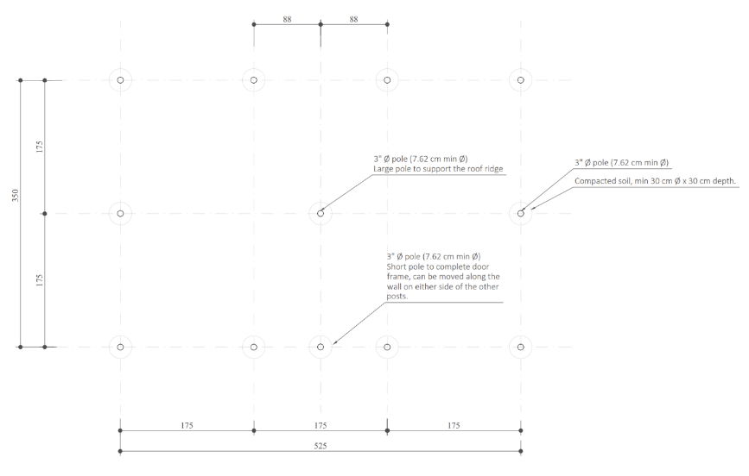
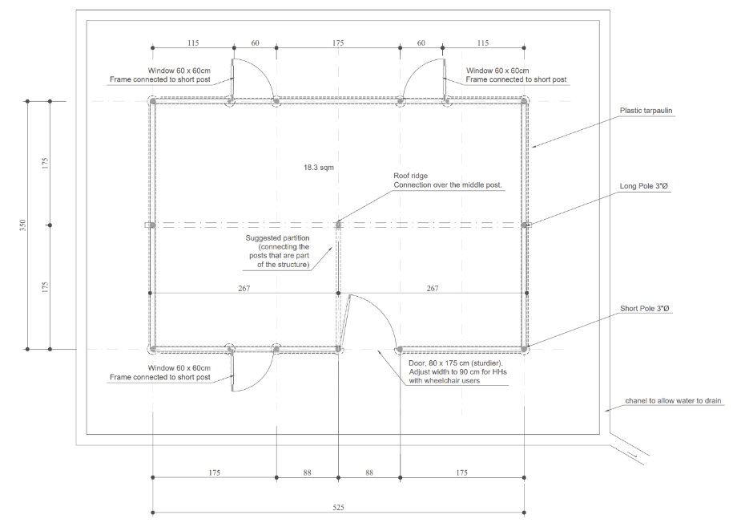
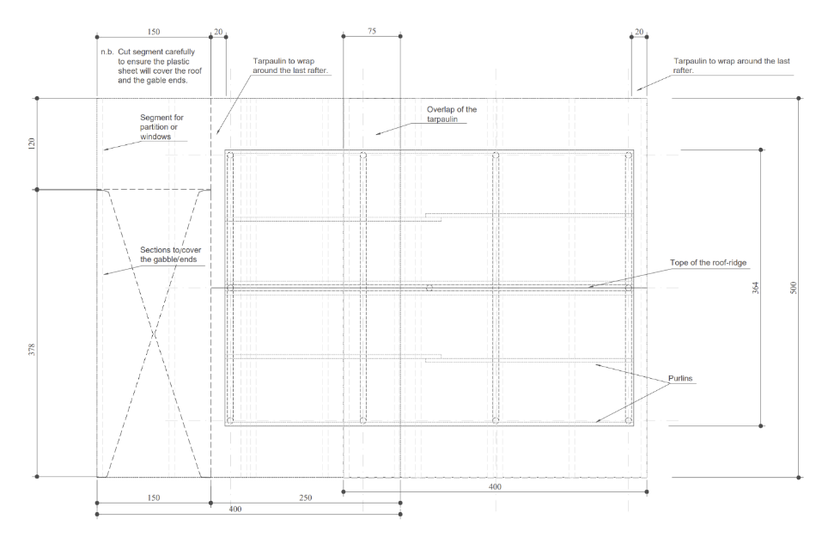
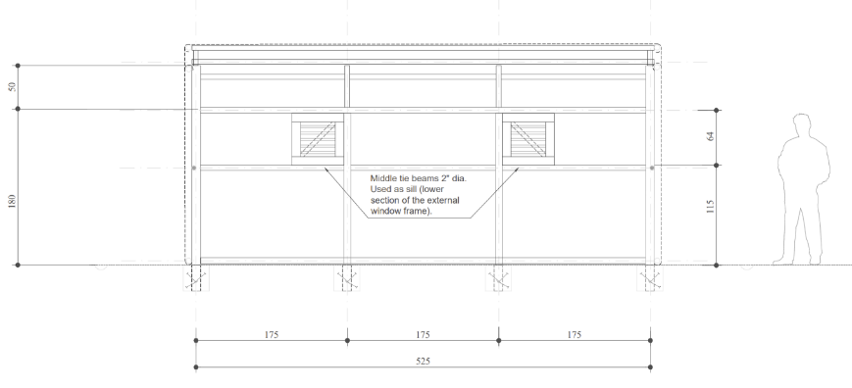
TWIG Update: ESK 2nd draft by
Foundation Plan
Plan
Longitudinal Section
Roof Plan

Slide 5
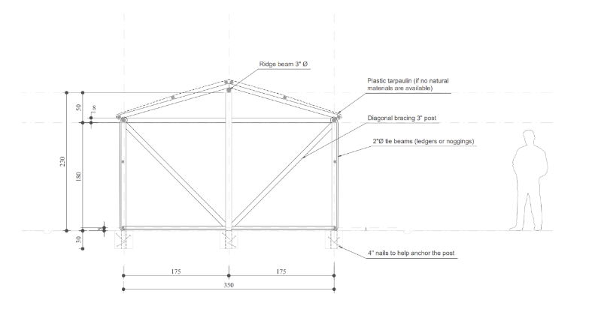
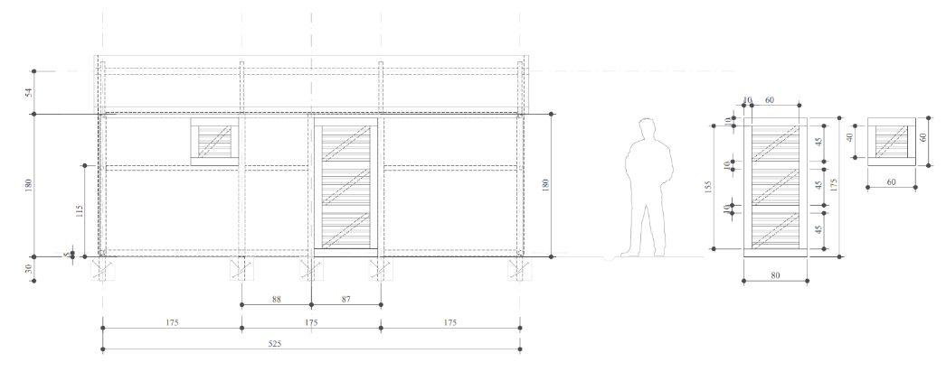
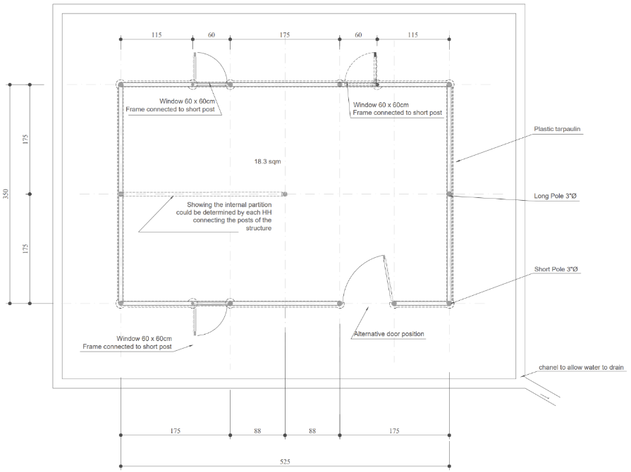
TWIG Update: ESK 2nd draft by
Sections
Partition Options

Slide 6
Roundtable – Achievements/Ops Plans
Objective: Ensure that our collective response efforts are well communicated to partners, donors, media and general audiences!
Achievements – type of interventions, HH reached, locations, timeframe, etc.
Challenges – looting of supplies, access challenges, etc.
Procurement – quantities of stocks arriving to the country, type of stocks, timeframe, where will the stocks be prepositioned – particularly given the incoming flood season.
Assessments – e.g., needs assessments outlining specifics with respect to Shelter and NFI needs as well as market assessments on NFIs, shelter materials, or Cash for Rent.
Context and impact of interventions – e.g., any successes with respect to cash for rent, how is sustainability achieved, what about tenure security?
Interventions in the host community – with 77% of the population staying in host community – what has been achieved so far? Cash for shelter for the families hosting IDPs can be an option, or preselecting landlords to improve their housing in order for them to subsidize rent for IDPs – this can include negotiating longer-term tenure security.
Etc.

Slide 7
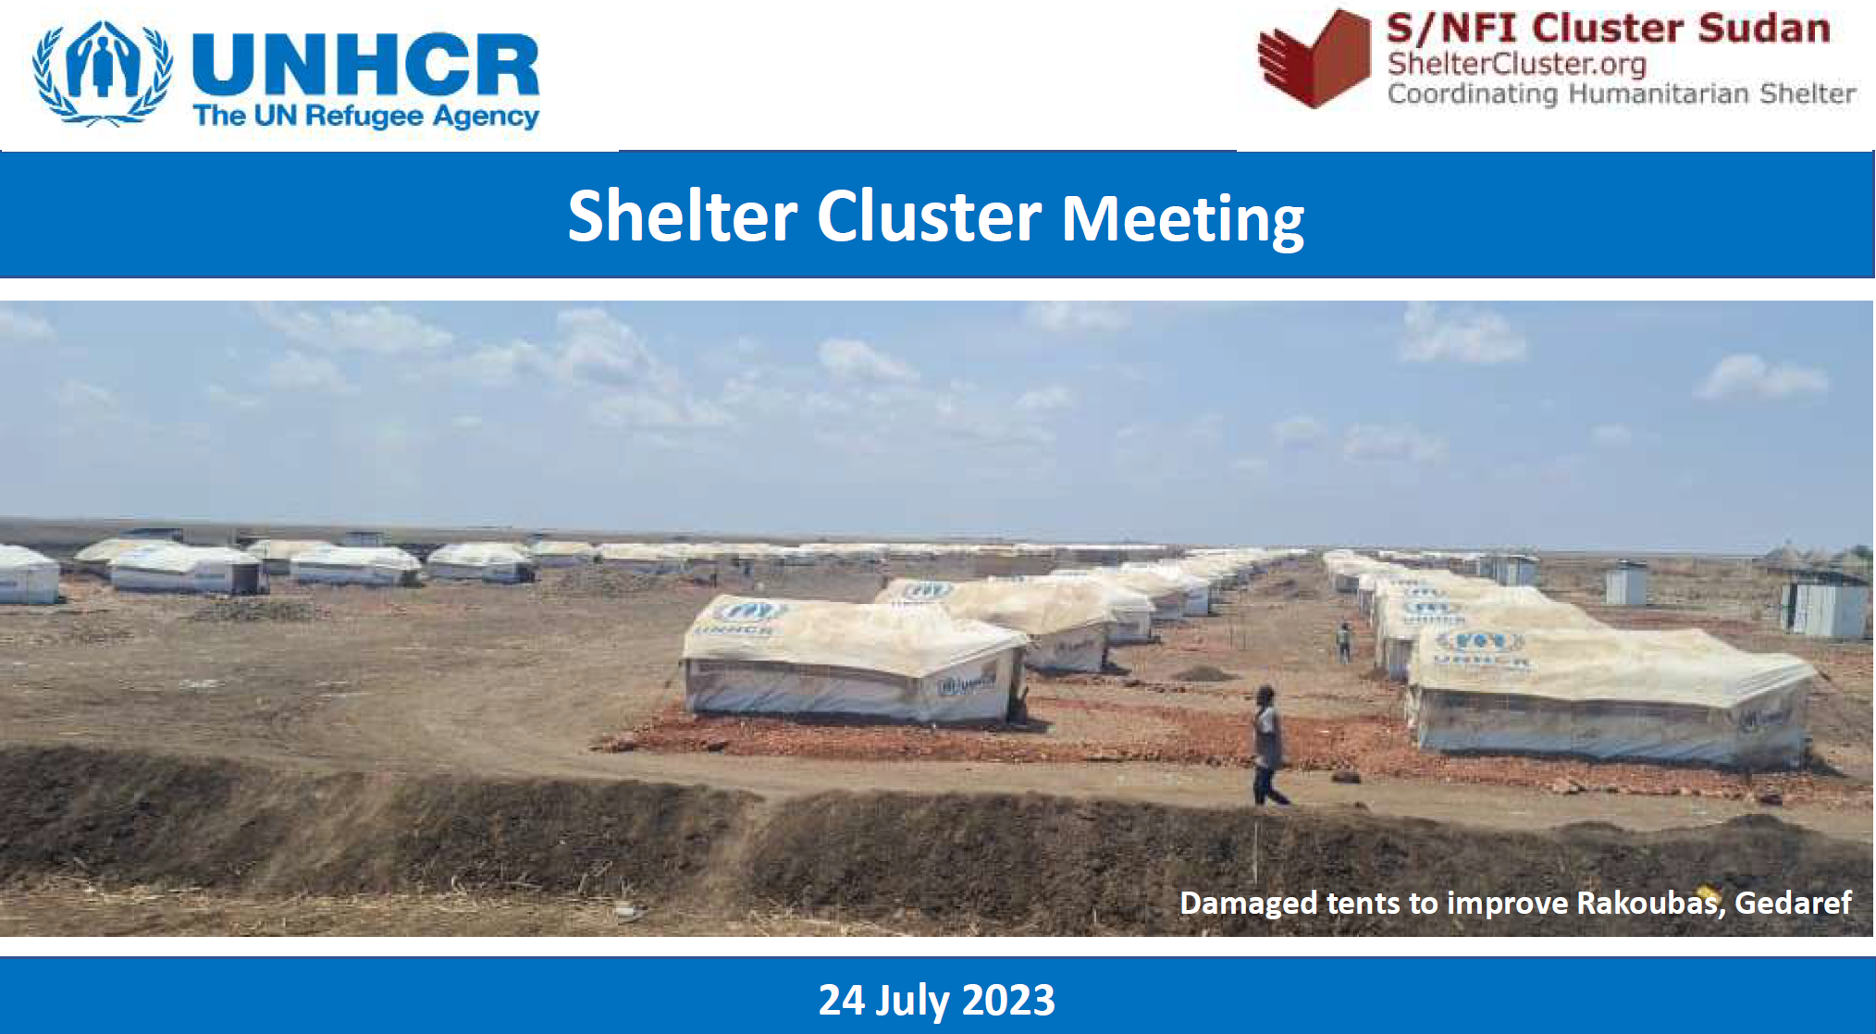
UNHCR Presentation

Slide 8
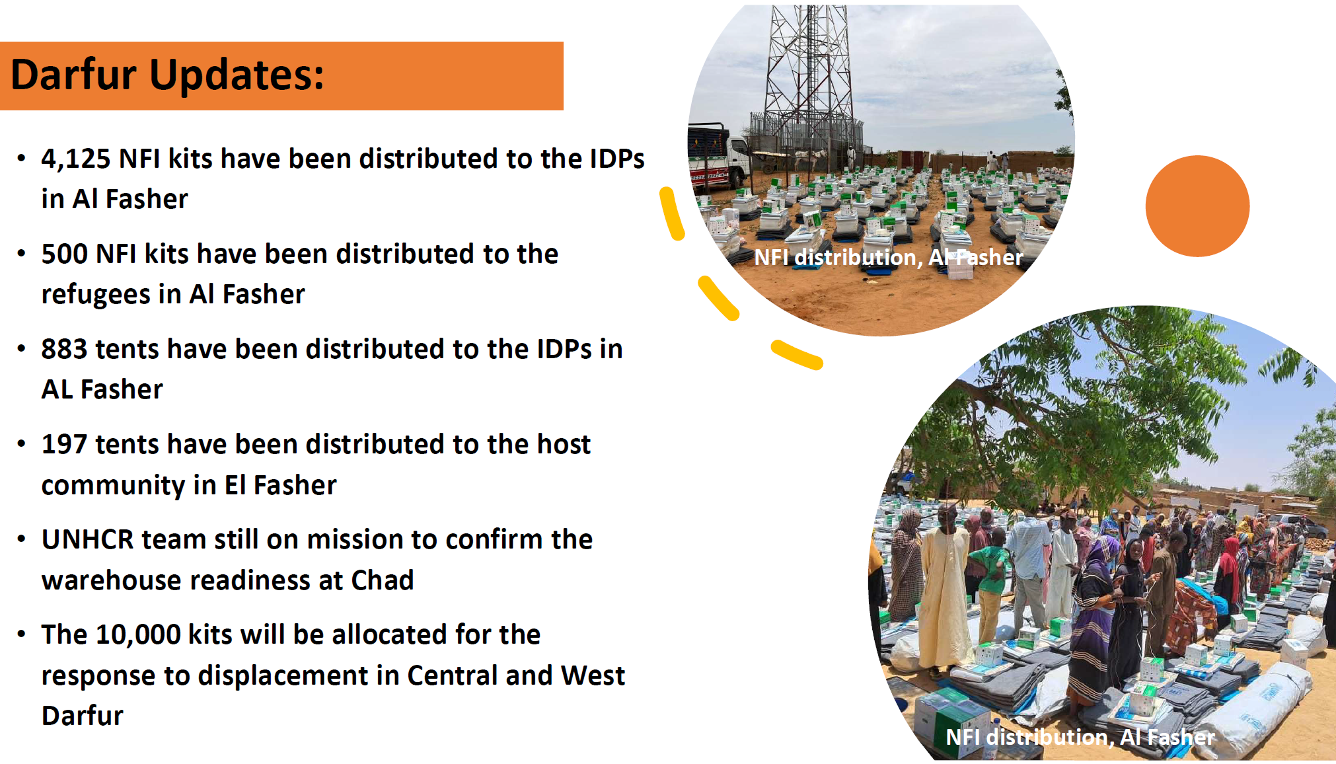
UNHCR Presentation

Slide 9
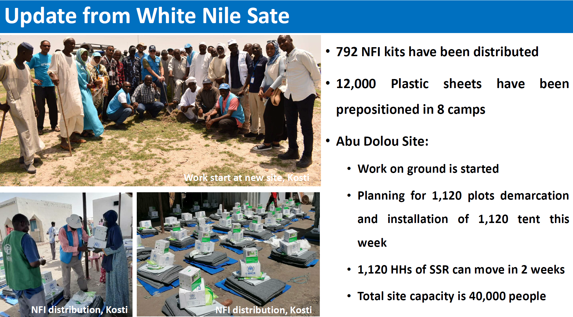
UNHCR Presentation

Slide 10
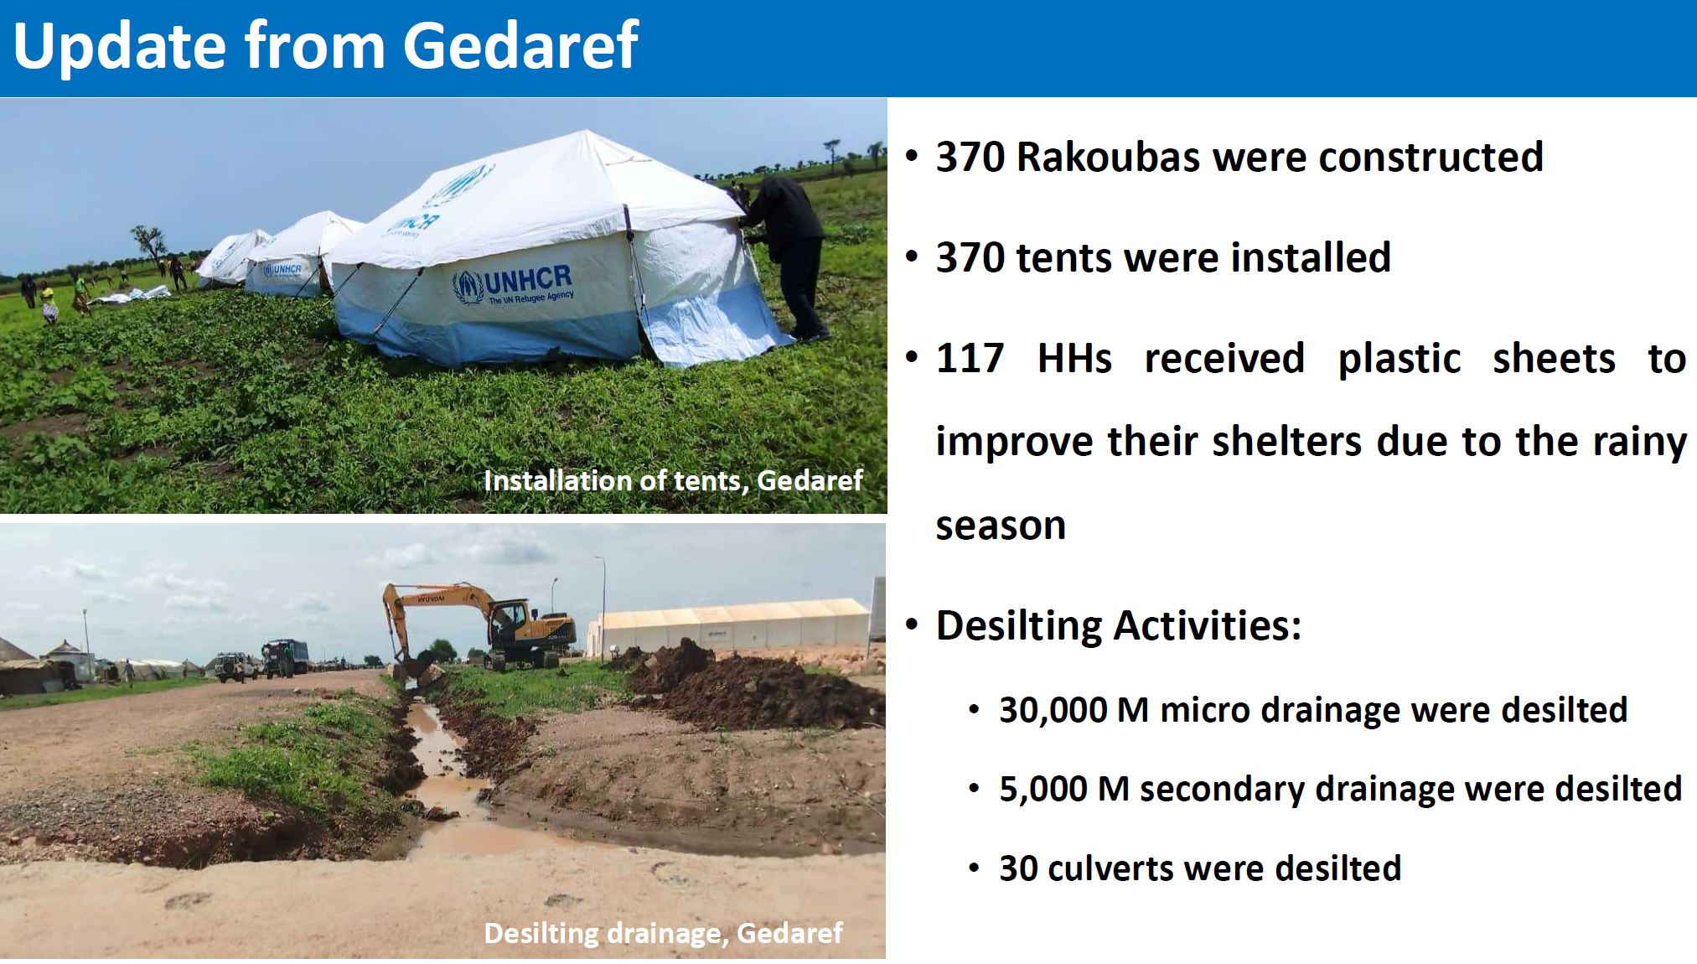
UNHCR Presentation

Slide 11
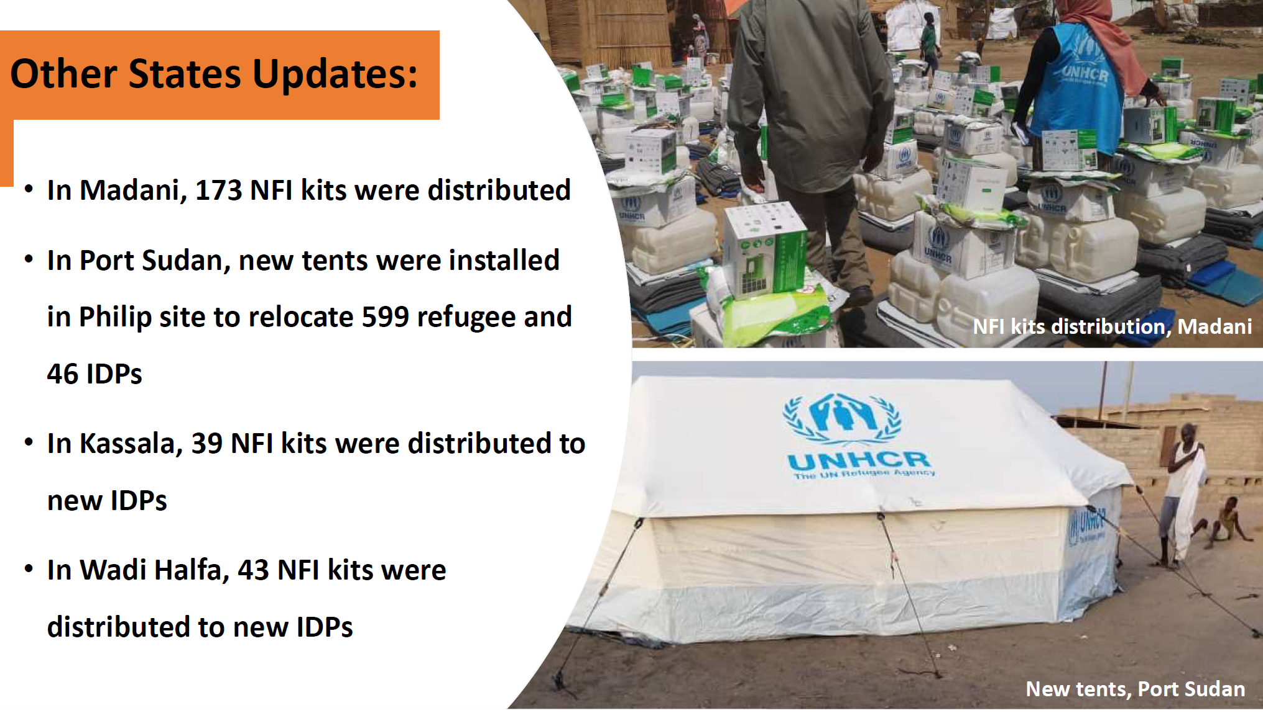
UNHCR Presentation

Slide 12
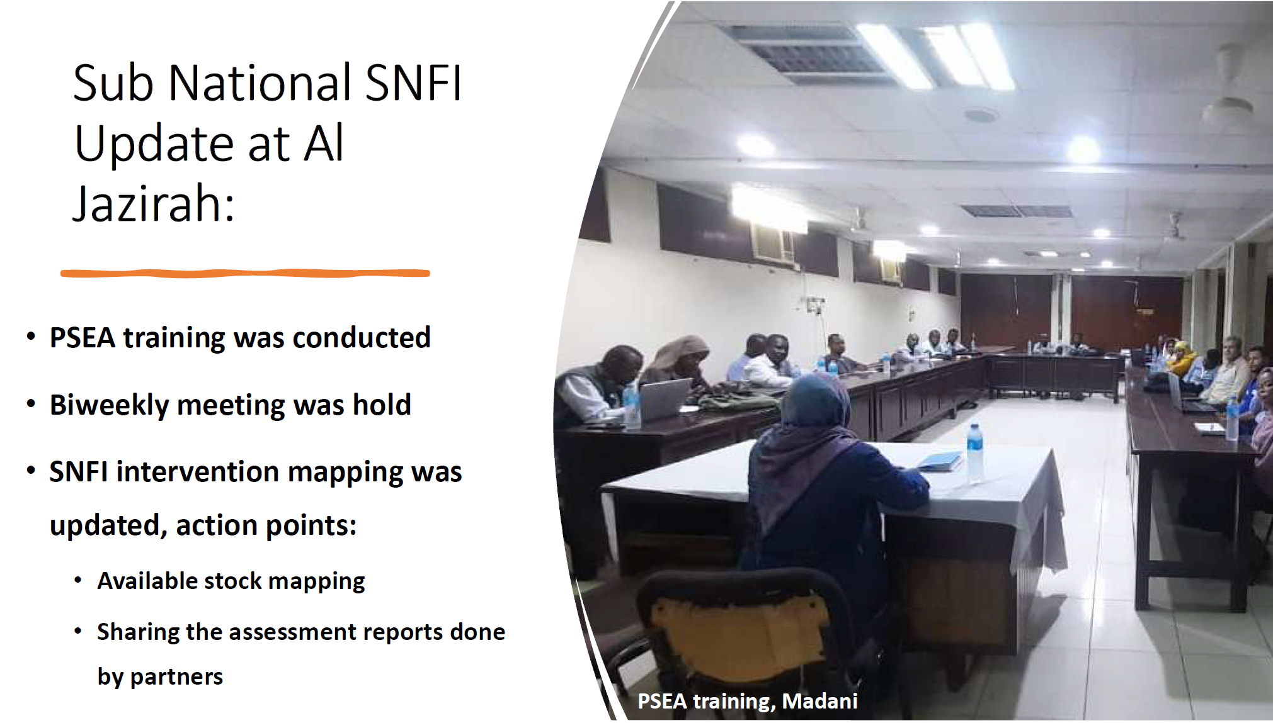
UNHCR Presentation

Slide 13
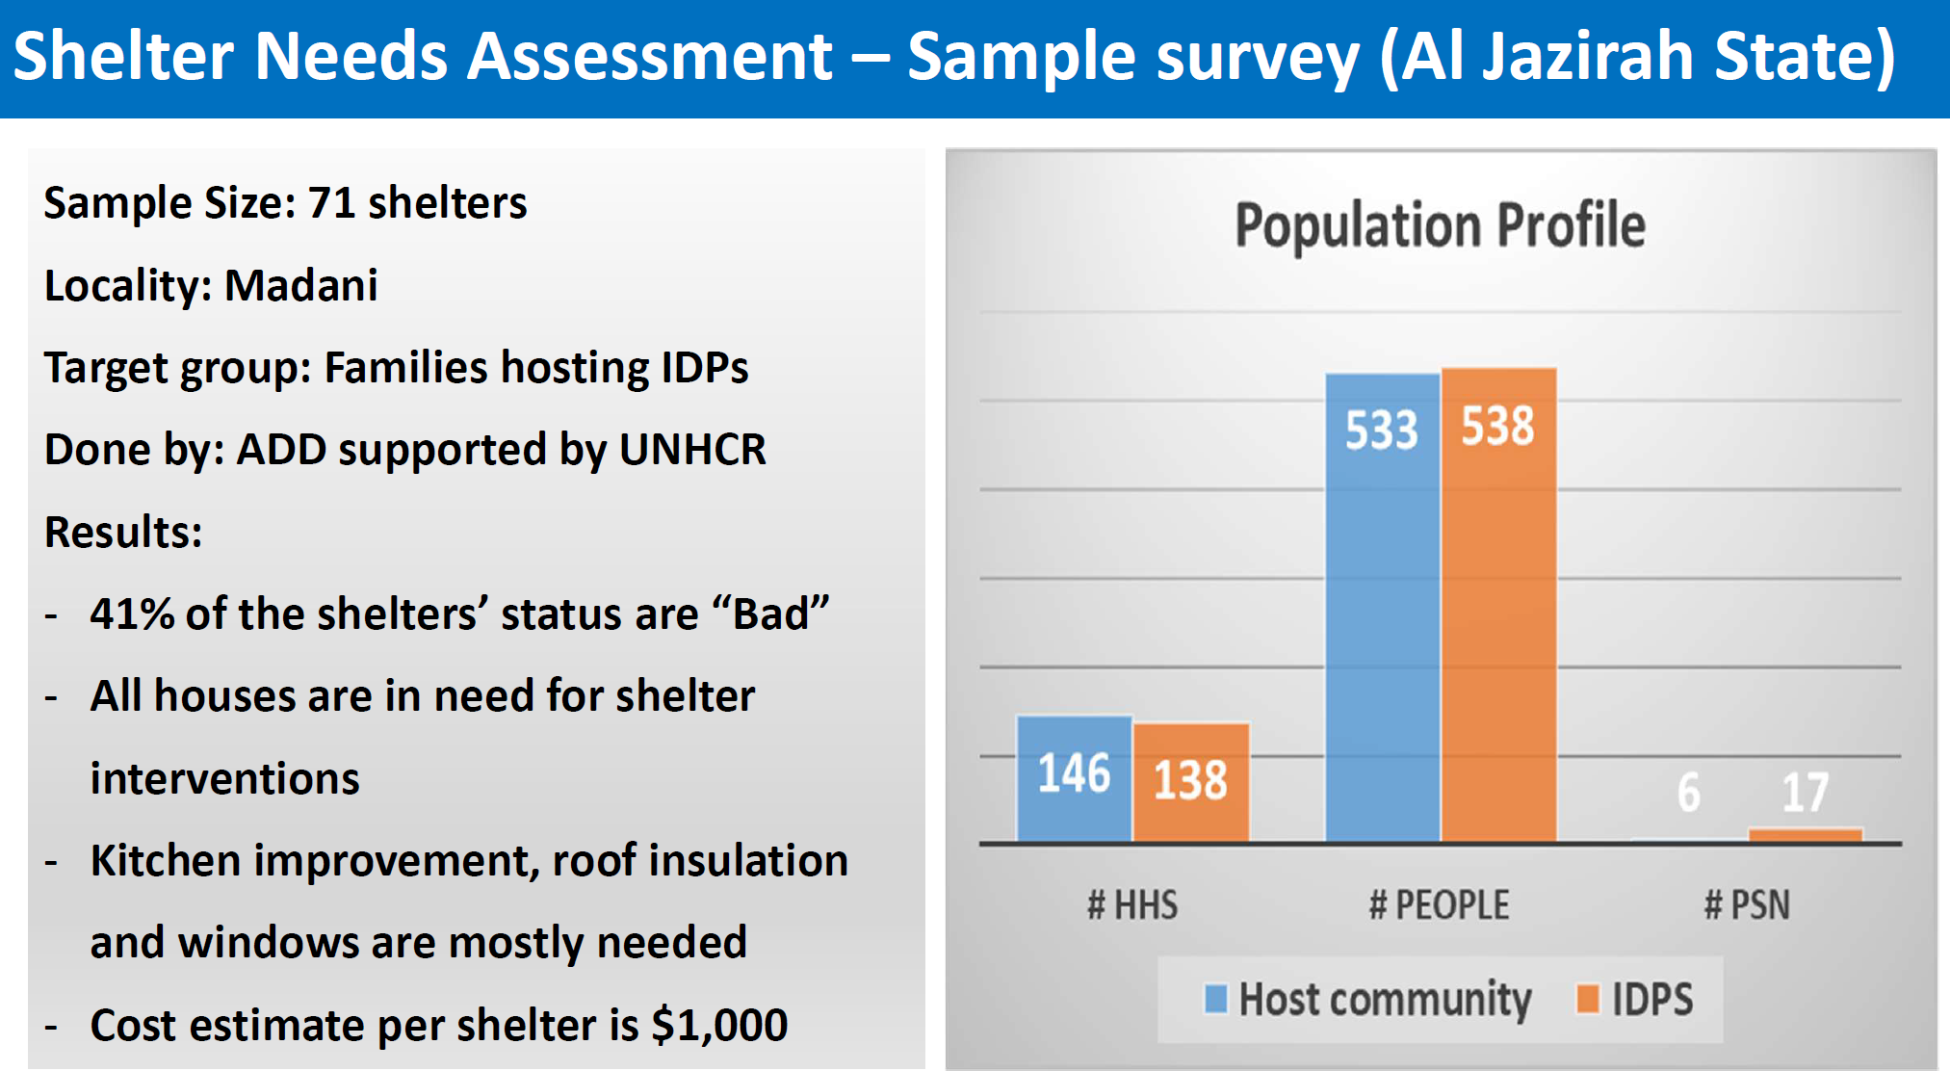
UNHCR Presentation

Slide 14
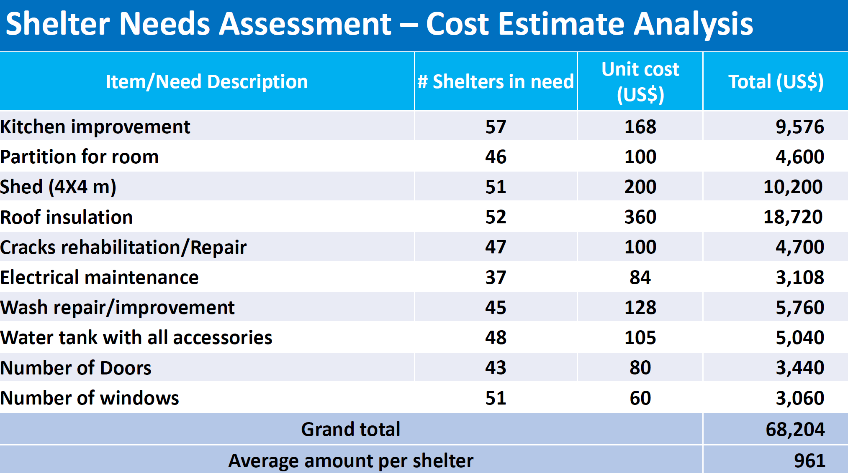
UNHCR Presentation

Slide 15
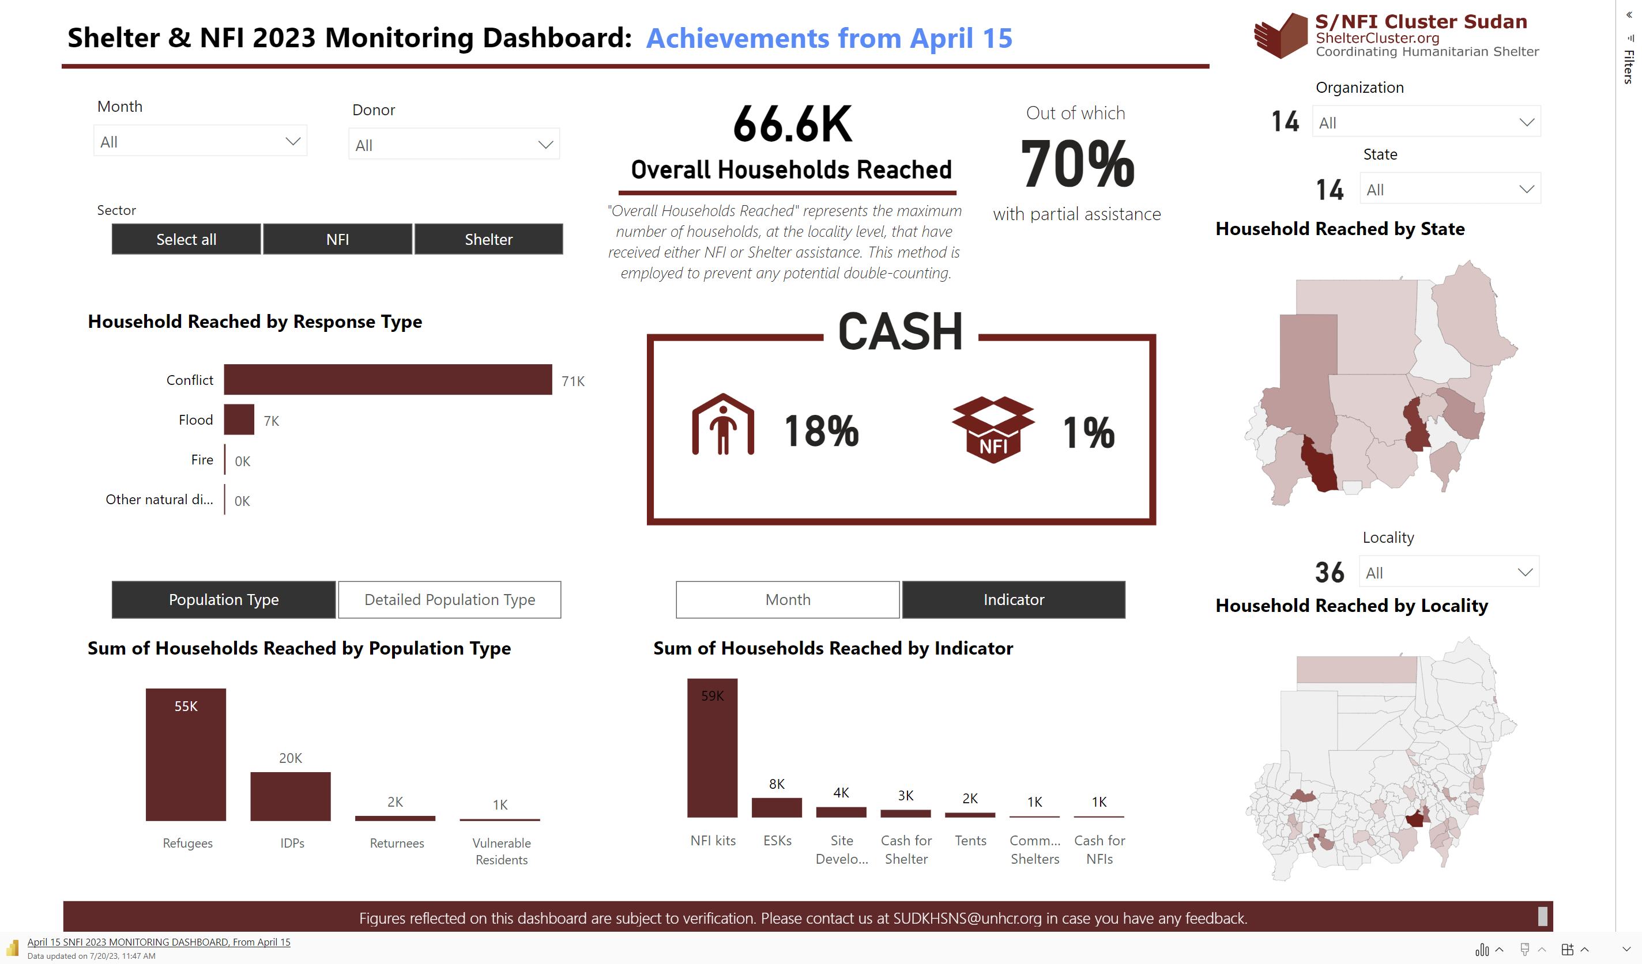
Achievements Public Dashboard

Slide 16
Presentation from ADRA
KRT Market Assessment & Rental Assessment in Jazirah & White Nile

Slide 17

Rental Assistance Feasibility Assessment
White Nile & ElGezira State

Slide 18
Overview and Parameters
White Nile and Elgazira, are two states collectively hosting 384, 559 IDPs as per the latest DTM reports shared by the 4th of July. According to the DTM reports for both locations, an average of displaced households are currently hosted by family and friends in both locations.
In order to understand the overall rental situation and in turn assist in formulating approaches and strategies that are fit for purpose. The three parameters explored under those assessments are:
Who are the actors in the rental housing market?
What are the rental housing practices in the area? (Overall costs depending, types and geographical locations, contractual arrangements and lease agreements)
How is the housing rental being affected in general terms by the crisis
What is the condition of the housing rental market, in terms of accessibility, availability, quality, price, demand and supply?
Information was collected through KIIs through structured interviews with both tenants, and landlords, as well as host and displaced households.
Notes:
Pressure on Host community.

Slide 19
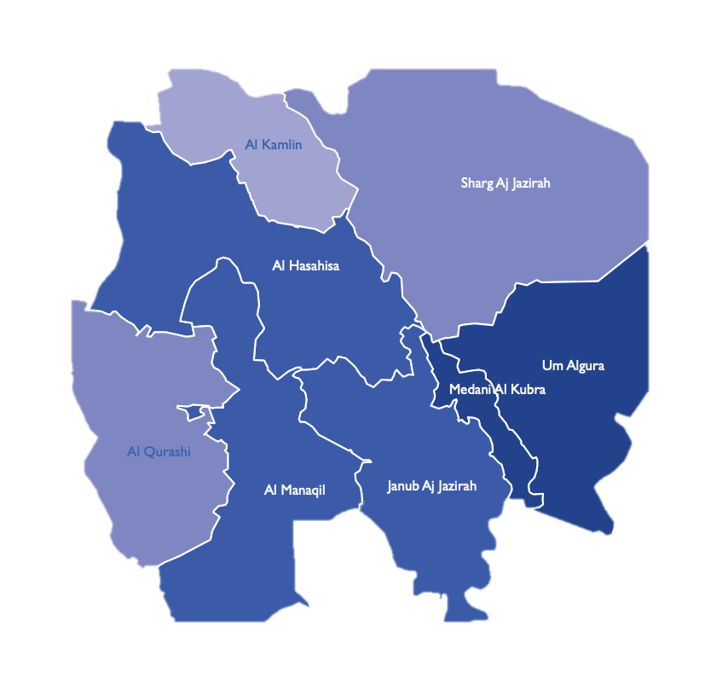

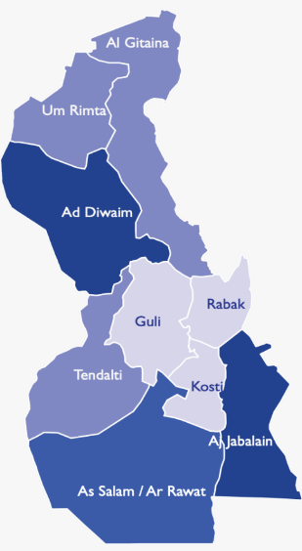

Sample and locations
Community Questionnaire targeted a total of 2 persons from each neighborhood and a total of three neighborhoods (representative) per locality. A total of 36 persons
Two land-lords per neighborhood.
Notes:
No ability to cover all areas due to financial capacity, fuel prices and other limitations for the study. Including the need to further triangulate and enhance the data. The assessment locations were guided by DTM areas of displacement.

Slide 20
Actors
IDPs in White Nile often preferred to relay on information from word of mouth to find rental accommodation meanwhile in Madani informal agents were used to find rental accommodation.
80% of host families in White Nile owned their houses, meanwhile the remaining were tenants/renting.
63% of host families in El Gezira owned their houses, meanwhile remaining were tenants. Highest number of host hh renting were in Madani El Kobra.
Notes:
No ability to cover all areas due to financial capacity, fuel prices and

Slide 21
Arrangements & Preferences
83% of respondents (both IDPs and Host) report that a written contract is signed between both parties. Clear variation between urban vs. rural areas, with majority in rural areas reporting verbal contracts as mode of agreement.
In El Gezira 67% of IDPs indicate that they prefer renting furnished housing despite additional costs. 87% of IDPs also indicate that they are more willing to pay additional costs for tap water and connected to the power grid.
White Nile; 43% of IDPs prefer renting furnished dwelling despite additional costs, in Aljabaleen and As salam this percentage was very low compared to Ad diwaim. 35% of IDPs indicate that they are more willing to pay additional costs for tap water and connected to the power grid.
In El Gezira average costs for water & electricity per household for IDPs is 55,000 -90,000 ( approx. 90 USD – 150 USD), when available however many complain of power and water cuts that last over one week. Host communities indicate an increase of 50% on average on overall consumption and costs.
In WNS average costs for water & electricity per household for IDPs is 65,000 -120,000 ( approx. 110 USD – 200 USD), when available however many complain of power and water cuts that last over one week. In As salam and Al jabaleen majority of the houses are not connected to the grid, and water is collected from water points/tap stands. Host communities indicate an increase of 100% on average on overall consumption and costs.
Notes:
No ability to cover all areas due to financial capacity, fuel prices and

Slide 22
Average Prices (White Nile) in SDG
 | One Bedroom Apartment (non furnished) | One Bedroom Apartment ( furnished) | Two Bedroom Apartment (non furnished) | Two Bedroom Apartment/house ( furnished)
Ad Diwaim | SDG 95,000.00 | SDG 150,000.00 | SDG 300,000.00 | SDG 500,000.00
Al salam | SDG 75,000.00 | SDG 120,000.00 | SDG 190,000.00 | SDG 240,000.00
Al Jabalain | SDG 100,000.00 | SDG 170,000.00 | SDG 190,000.00 | SDG 300,000.00
Notes:
No ability to cover all areas due to financial capacity, fuel prices and

Slide 23
Prices El- Gezira
 | One Bedroom Apartment (non furnished) | One Bedroom Apartment ( furnished) | Two Bedroom Apartment (non furnished) | Two Bedroom Apartment/house ( furnished)
Medani Elkobra | SDG 250,000.00 | SDG 500,000.00 | SDG 750,000.00 | SDG 1,500,000.00
Al Hasaisa | SDG 69,000.00 | SDG 150,000.00 | SDG 190,000.00 | SDG 340,000.00
Um Algura | SDG 70,000.00 | SDG 170,000.00 | SDG 260,000.00 | SDG 400,000.00
Notes:
No ability to cover all areas due to financial capacity, fuel prices and

Slide 24
Recommendations and way forward
It was noticed that when ADRA staff conducted the interviews some landlords would raise the prices and/or quote amounts in dollars instead of SDG.
The increase in the need for assistance to not only displaced households but households hosting IDPs.
Inclusion of rental subsidy assistance in MEB package especially for urban population and displacement.
Setting up of criteria for selection of beneficiaries and ensuring that there are clear exit strategies to the assistance. Criteria should be clearly defined and agreed upon between different actors.
Linking beneficiaries with multisectoral assistance especially protection and livelihood actors.
Ensuring that rental assistance does not cause inflation in overall housing market.
Notes:
No ability to cover all areas due to financial capacity, fuel prices and

Slide 25
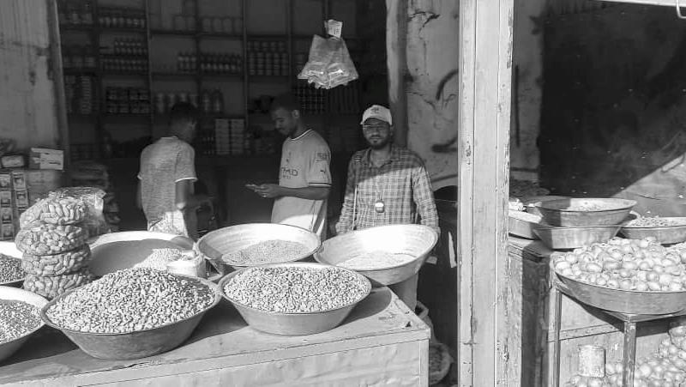
Khartoum Rapid Assessments of Markets
Sharg Alneel, Umdurman, Kerrari and Jabal Aulyia Localities.

Slide 26



Overview of Assessment and methodology
Community
MEB Price monitoring
Vendors

Slide 27
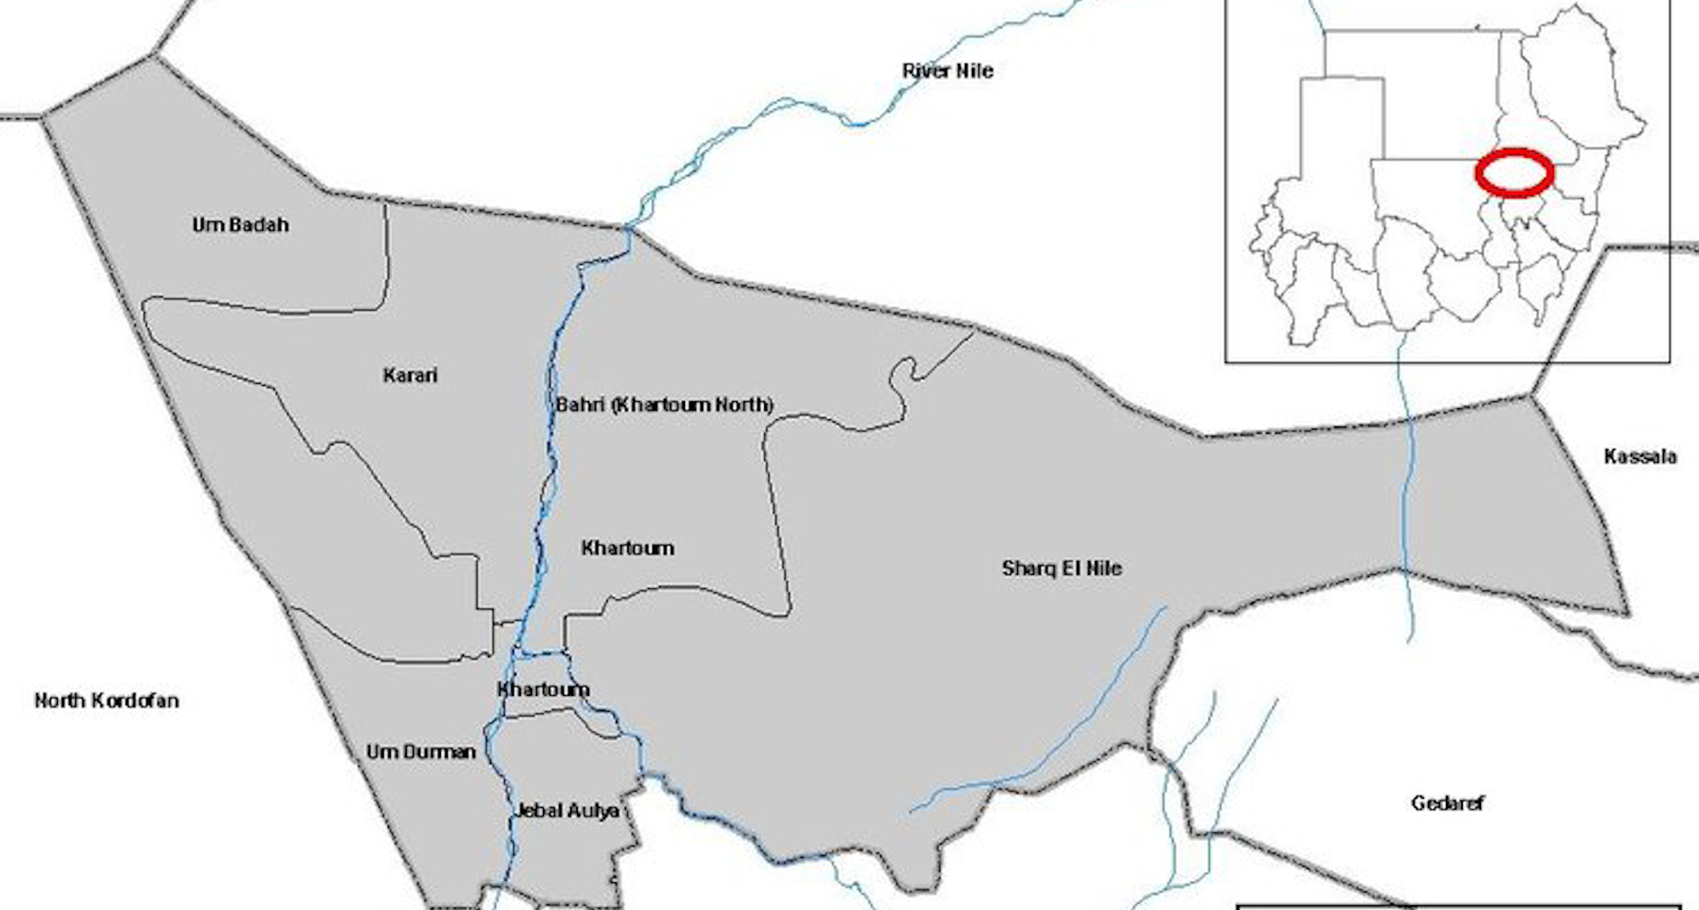
Notes:
Soug Sita Alwahda Market
Three vendors
Alkalkla Lafa Market
Two vendors
Hijilija Market
Three Vendors
Sabreen Market
Two Vendors

Slide 28
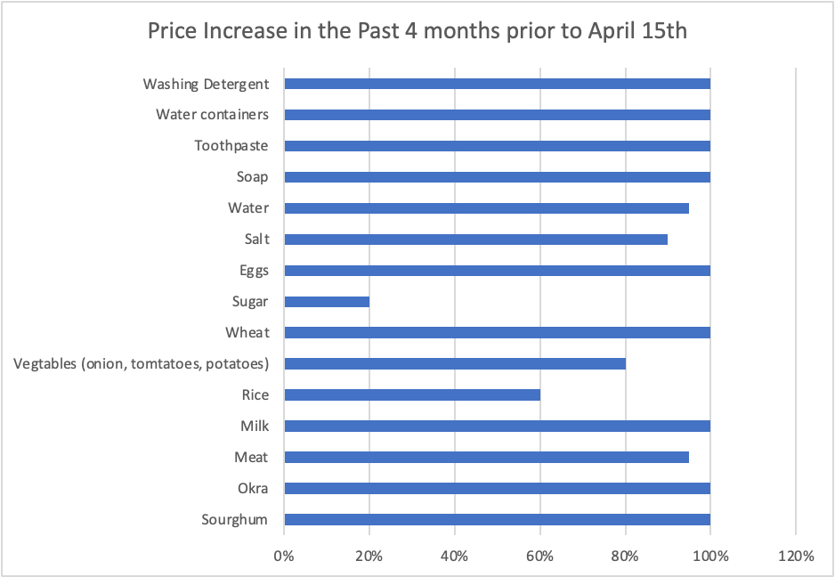
Shocks to Market
All vendors interviewed responded that the conflict has had a major impact in the markets in Khartoum.
Burning and looting of the markets as a result of the conflict has gravely impacted many of the markets.
Some of the vendors are employing some measures to avoid looting such as opening markets only during sunlight hours 8 am-4 pm (except for UmDurman Hajilla market, 9 am -2 pm).
When the fighting is more intense many vendors are also only stocking for the day, whereby they restock day by day and the remaining commodities they either stock at home or in small warehouses close by to their houses. As per Figure 1 below the average increase in the prices of basic commodities has increased by 100% or more in the past four months.
According to the 85% of the vendors interviewed, around 25% of the vendors and wholesale suppliers have left Khartoum as a result of the conflict. Moreover, at least 10% of traders are reported to have closed their business due to lack of sufficient capital to replenish their stores. This has also contributed to the scarcity of the items in the stores and markets.
Notes:
ADRA’s Market Monitoring between June and July also indicates a 20-25% increase in all basic commodities.
Jabal Aulya market.

Slide 29
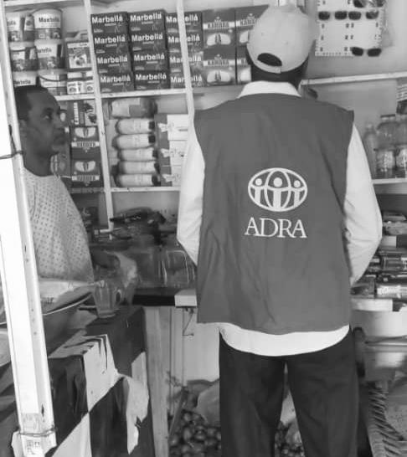
Market Demand and Supply
Price increases due to disruptions in supply.
Decrease in purchasing power for communities due to lack of steady income and displacement.
Pop-up of “Dagalo” Markets which consist of stolen goods and items (mainly NFI, but food items can also be found) that were looted both from houses and stores. The market offers very low prices for many of the items which is competitive to the official markets.
All interviewed community members report a decrease in their purchase of many items. The primary reason for this is the steep price increases and the lack of financial capacity as many have lost their sources of income. Other reasons for lack of capacity to purchase includes power issues affecting the storage of food items, as well as fear of looting and availability of items. Females also quoted the limitation of access to markets due to safety concerns.
Notes:
ADRA’s Market Monitoring between June and July also indicates a 20-25% increase in all basic commodities.
Jabal Aulya market.
Vendors interviewed also indicated that some vendors/suppliers are trying to replenish stocks through off-roads in Shargalneel (East Nile), while they also deem this to be a risky venture.

Slide 30
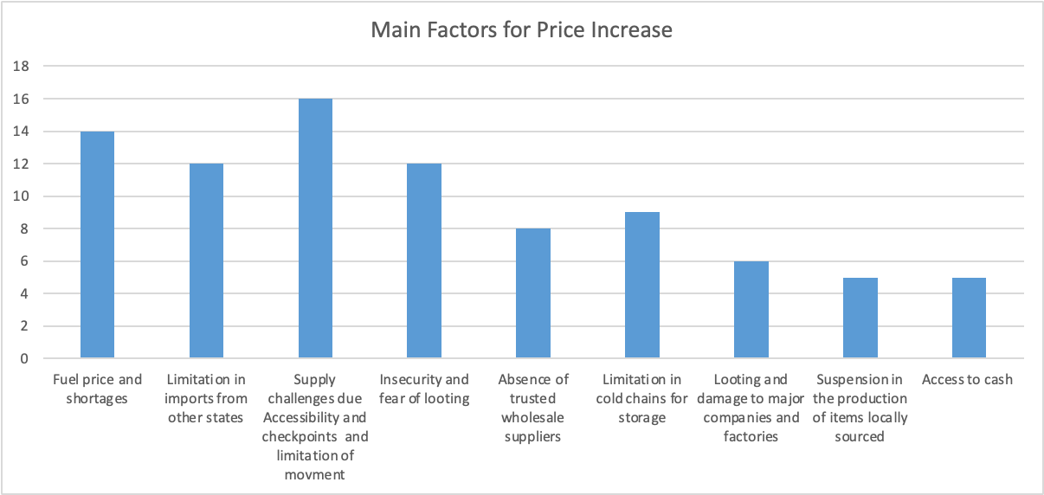
Main contributors to Price increase
Notes:
ADRA’s Market Monitoring between June and July also indicates a 20-25% increase in all basic commodities.
Jabal Aulya market.

Slide 31


Market Constraints
Insecurity. Especially female respondents expressed that although they can reach the market during morning hours, they prefer to go in groups. They almost always avoid going to the market after sundown, which can hamper their access especially as some vendors in Umdurman and Kerrari have quoted to only open their shops from 6-8 pm.
Increase in prices and access to fuel supply for transportation
Liquidity and access to cash.
Insecurity and fear of looting. As well as the looting and burning of major factories and storage warehouses for essential goods (Powder milk factory was mentioned by more than one vendor).
Dwindling supplies and the difficulty to import items from outside of the state.
Low purchasing power by communities and loss of clients due to displacement. Interviewed vendors reported an average decrease of 40% in their customers, with the major reason behind this quoted to be displacement.
Other constraints quoted were the government restriction on the importation of certain commodities like sugar and wheat flour. This adds a major constraint towards vendors and comes on top of the existing inflation, high taxes, high transportation cost and the decrease of purchasing power of the population.
Notes:
ADRA’s Market Monitoring between June and July also indicates a 20-25% increase in all basic commodities.
Jabal Aulya market.

Slide 32


Community and Vendor Access to Cash:
The primary source of payment for both communities and vendors is found to be mobile money through Bankak app. A total of 100% of the interviewees within the community expressed that it is the preferred method for transactions and accepted by the majority of vendors.
Individuals from the community have also reported that they often cash out amounts with vendors as some prefer having amounts credited to their accounts to reduce risks of looting and theft. Cash was the second option used by communities and this is from either their personal stored liquidity or borrowed (55%) informal cash transfer agents (20%), and cashed out by vendors through Bankak of Zain phone credit to a limited extent( 25%).
As per the latest FSP mapping and information by the CWG no bank or Hawala branches are currently functional in Khartoum due to the insecurity. Many of the major banks and Hawalas were looted in the first two months of the conflict.
Notes:
ADRA’s Market Monitoring between June and July also indicates a 20-25% increase in all basic commodities.
Jabal Aulya market.
On the other hand some vendors also expressed that they have heard that some soldiers have forced vendors at gunpoint to transfer amounts from their Bankak to another account. Communities interviewed have expressed some challenges with the app such as the usage of the internet which is slow and sometimes disrupted, as well as frequent disruption in the system and the limited availability of power to charge their phones.
Bankak is a mobile cash app powered by the Bank Of Khartoum, one of the Biggest Banks in Sudan with Branches across the country. Users must have an account in order to set up a virtual wallet linked to that account. Bankak app is used widely in all stores and for payment to public services. Bankak app only accepts SDG transactions and no other currency.

Slide 33





Community Access to Basic services
Shelter arrangements mainly consisted of rented housing or being housed by relatives. When asked about the displacement in their areas, all responded that their neighborhoods are hosting displaced households with 65% staying over with friends and relatives, and 25% renting, while 10% are living in houses abandoned by families fleeing the conflict. Rental prices for a household of six is found to be in between 150,000 – 200,000 (250 USD – 350 USD)
Access to power and water supply reported as scarce with systems facing major disruptions (due to fuel supply and maintenance issues) causing many households to be left with no power for an average of 3-4 days. Power is available it is on for an average of 2-5 hours per day. 90% Households also quote difficulty in topping up the power credit due to frequent disruptions in the online payment systems which is done through the Bank of Khartoum Bankak application, as well as affordability.
Fuel supply issues causing disruption in access to water with hh reporting weeks without tap water. Buying water from donkey carts or sellers is expensive.
Disruption in internet access are reported across all localities but especially Umdurman and Kerrari. Internet is noted to be slower and often shuts down.
Telecommunication companies generally remain functional but suffer from frequent disruptions. In Khartoum the telecommunication network MTN is down, while the networks Zain and Sudani are still functional.
Transportation costs and the ability to find public transportation (taxis or Rickshaws) very difficult and costly by all participants, due to steep increase in fuel prices. Private vehicles are not used for fear of them being looted and many households resort to puncturing their tires and taking out the car battery off their vehicles as a mitigation measure
Notes:
ADRA’s Market Monitoring between June and July also indicates a 20-25% increase in all basic commodities.
Jabal Aulya market.

Slide 34

Food Items
Items | Local Unit | Price/ unit
 |  | Um Durman | Jabal Aulya | East Nile | Kerrari
Sorghum (Feterita) | Malwa (3 Kg) | 4200 | 5,100 | 1,700 | 3550
Wheat flour | KG | 2000 | 1,200 | 1,200 | 2750
Millet | Malwa (3.5 Kg) | 3000 | N/A | 3,000 | 3,900
Rice | KG | 1025 | 975 | 1,125 | 1,025
Sugar | KG | 1,000 | 925 | 1,200 | 1000
Lentils | KG | 1,700 | 1,875 | 1,450 | 1700
Egyptian Bean (Fool Masri) | KG | 2,300 | 2,600 | 2,600 | 2800
Groundnut Oil (filtered) | Liter | 2,500 | 2,600 | 2,500 | 2500
Sesame Oil (filtered) | Liter | 3,300 | 3,000 | 3,600 | 3,300
Eggs | Dozen | 2050 | 2,900 | 1,500 | 1,800
Cow Meat | KG | 3,000 | 3,000 | 3,500 | 3600
Goat/Lamb Meat | KG | 5900 | 5,900 | 5,900 | 6,900
Dry Okra | KG | 900 | 1,050 | 1000 | 900
Dry Tomato | KG | 3600 | 4,065 | 3,800 | 3,600
Iodized Salt | 250 G | 1,1500 | 1,200 | 1,100 | 1,150
Onion | KG | 500 | 1,400 | 550 | 500
Powdered Milk | KG | 2,400 | 1,450 | 4,000 | 2950
Dates | KG | 3,350 | 2,650 | 2,250 | 3,350
Sorghum (Faseekh) | Malwa (3 Kg) | 3,000 | 3,200 | 3,200 | 2800
Fresh Milk | Liter | 1,000 | 1,000 | 900 | 600
Pasta/ Vermicelli | 300 G | 550 | 500 | 500 | 600
Total |  | 57750 | 43690 | 46575 | 51275
Notes:
ADRA’s Market Monitoring between June and July also indicates a 20-25% increase in all basic commodities.
Jabal Aulya market.

Slide 35



NonFood Items
Items | Unit | Price/ unit
 |  | Um Durman | Jabal Aulya | East Nile | Kerrari
Medicine | 1 Pack | 1000 | 1.100 | 700 | 1000
Charcoal | 1 bag of charcoal (1 bag = 90 kg of sorghum | 20.000 | 18.000 | 20.000 | 20,000
Gas | 1 steel bottle (=12 kg) | 10.000 | 10.000 | 10.000 | 10,000
Water | 1 jerrycan | 1500 | 1500 | 2000 | 1500
Soap | 1 bar of soap (75 g) | 350 | 400 | 350 | 350
Tooth paste | 1 tube of tooth paste (100 ml) | 500 | 800 | 500 | 500
Tooth brush | 1 tooth brush | 500 | 500 | 500 | 500
Laundry powder | 1 bottles | 3500 | 5.000 | 3.200 | 3,500
Liquid dish detergent | 200g box of soap powder | 7200 | 4.600 | 2.000 | 7,200
Sanitary pad | 1 package | 1200 | 1.200 | 1.000 | 1,200
Transportation | To Market and/or hospital | 8000 | 12000 | 8000 | 6500
Communication | Medium Bundle | 6000 | 6000 | 6000 | 6000
Total price (NFIs) |  | 59.750 | 61.100 | 54.250 | 64.250
Notes:
ADRA’s Market Monitoring between June and July also indicates a 20-25% increase in all basic commodities.
Jabal Aulya market.

Slide 36
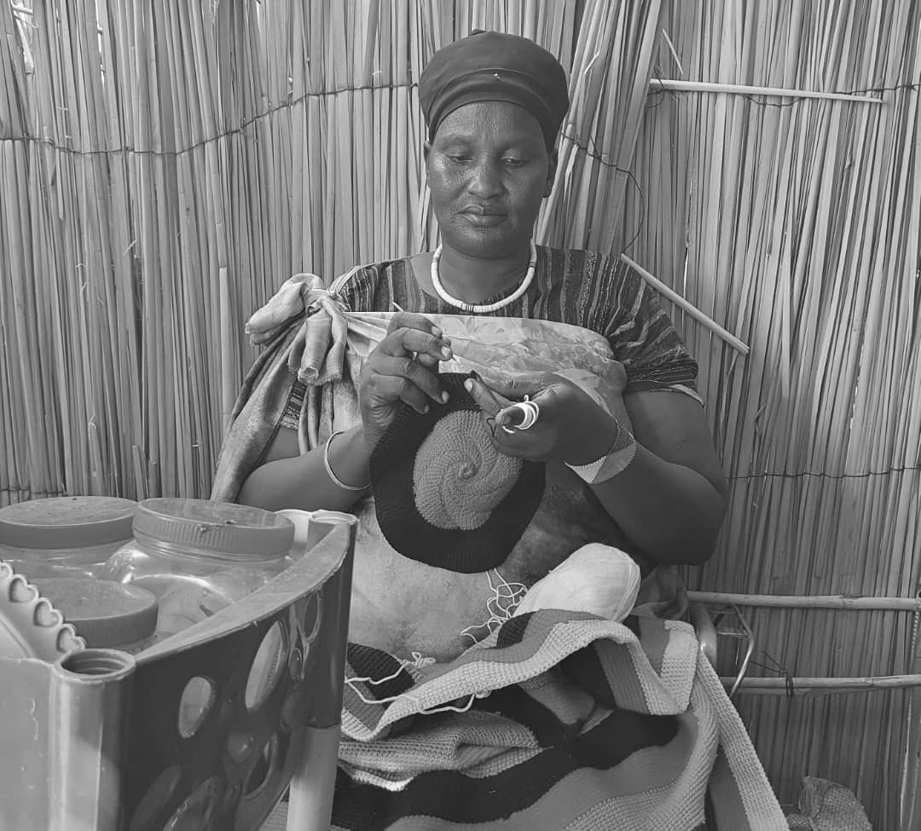
Thank You.
For any questions, please contact me at: programs@adrasudan.org

Slide 37
AOB

