Slide 1


Shelter & NFI Cluster
Coordination Meeting
MS Teams • Sudan • 16th October ‘23

Slide 2
Agenda
• General Updates
• HPC 2024 Consultations
• CCPM Results
• Roundtable on Achievements and Operational Plans
• AOB

Slide 3
General Updates

Slide 4
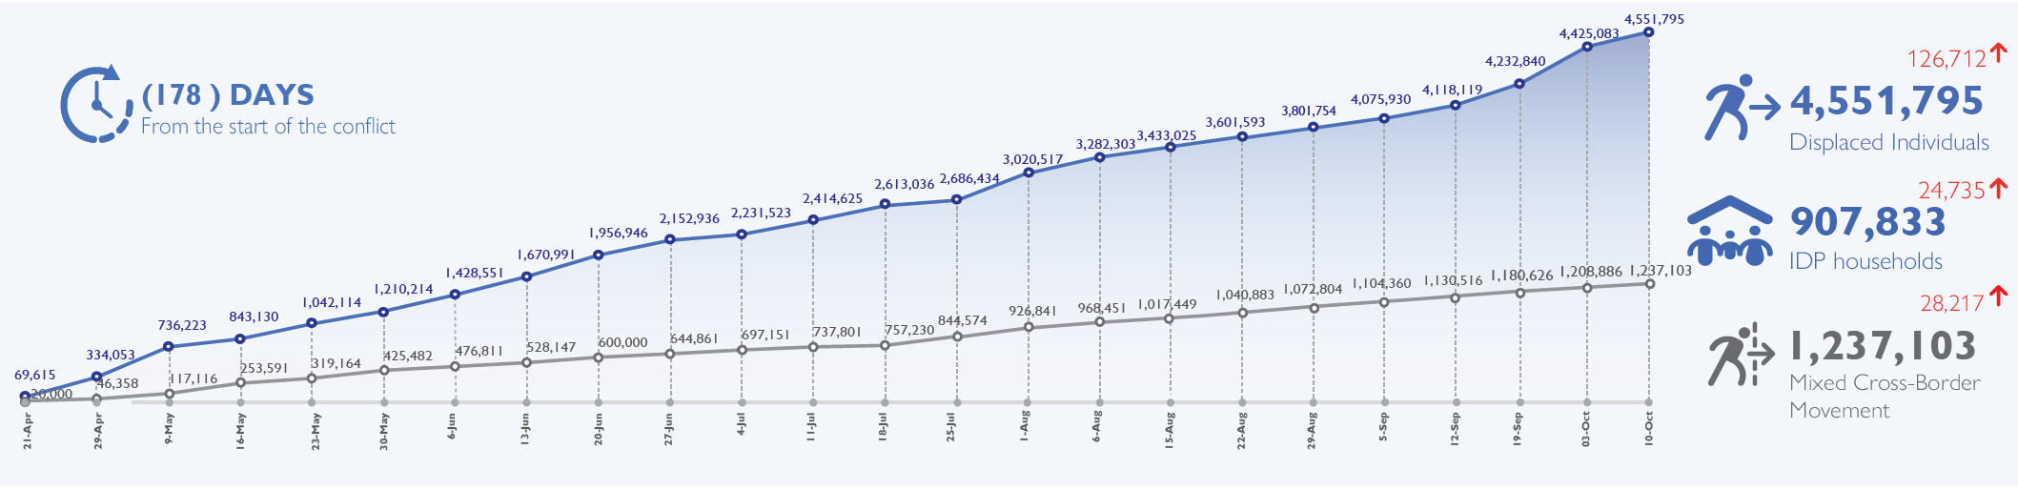
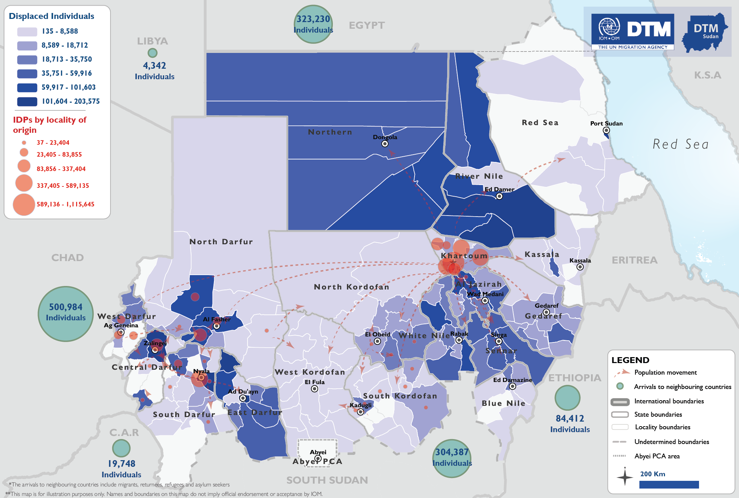
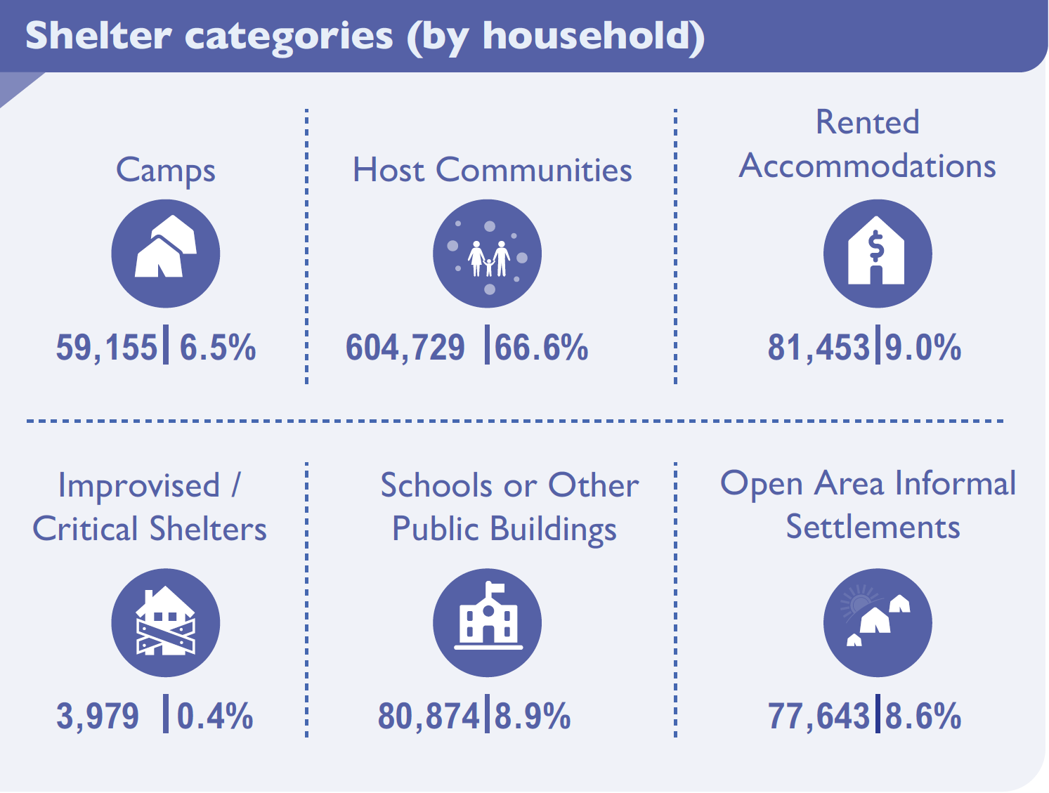
Situation Update
Six months into the SAF-RSF conflict, 5.8 million people have been forced to flee their homes, continuing the same upward trend.
Out of those, the estimated number of IDPs across Sudan is 4.6 million. The current assessment has observed the IDP caseload in all of Sudan’s 18 states. The highest proportions of IDPs have been observed in River Nile (12.66%), South Darfur (11.19%), East Darfur (11.01%), Aj Jazirah (8.07%), Northern (7.97%) and North Darfur (7.37%) states.
While over 1.2 million people have crossed into neighbouring countries.
Source: IOM DTM September 28

Slide 5
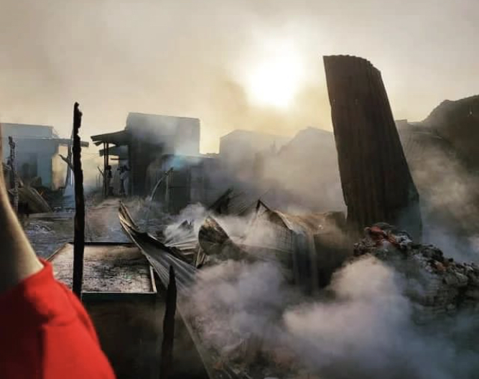
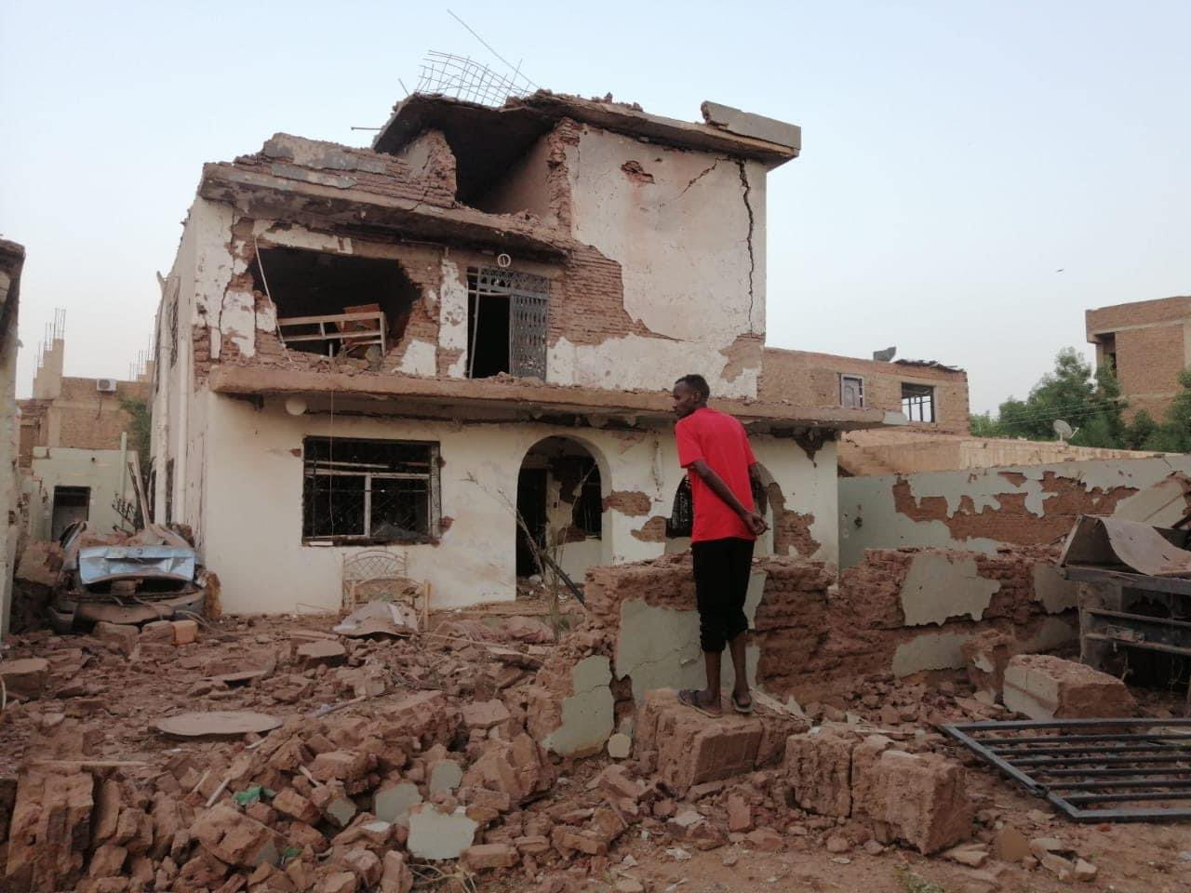
Situation Update
Conflict Expansion: RSF takeover of Al-Aylafoun In Khartoum state causes widespread displacement and expansion eastward into Aj Jazirah towns, impacting movement and supply routes and leading to further reduction of humanitarian staff footprint.
Khartoum: Continuous hostilities, with recent shelling of El Nau hospital in Omdurman.
South Darfur: now 2nd highest IDP hosting state due to severe ongoing clashes, including reports of inter-tribal conflict.
Central Darfur: Shelling in Al Hasahisa IDP camp in Zalingei, causing increased casualties, displacement and supply hinderance.
West Darfur: Some positive developments in El Genina, while concerning threats by RSF militias on Kulbus locality.
Kordofan Region: Escalating confrontations in both South and North Kordofan causing casualties and straining medical infrastructure.
Humanitarian Aid Delivery: 4th consecutive week delay in essential supply movement to Darfur, Kordofan & White Nile states due to insecurity.
Natural Disasters: Heavy rains and flooding affecting 88,000 individuals; cholera and dengue fever spreading.
Education Resumption Concerns: Ministry of Education decision to resume education amidst conflict sparking division; concerns over feasibility and regional disparities.
Tri Cluster Guidance Note on IDP sites Rollout: Initiation of Tri Cluster guidance note on Gathering Sites Rollout at sub-national level; presentation at national Shelter/NFI cluster meeting deferred to end-October meeting due to ongoing HPC and delayed CCCM exercise.

Slide 6
HPC 2024
Boundary Setting, Prioritization & Targeting

Slide 7
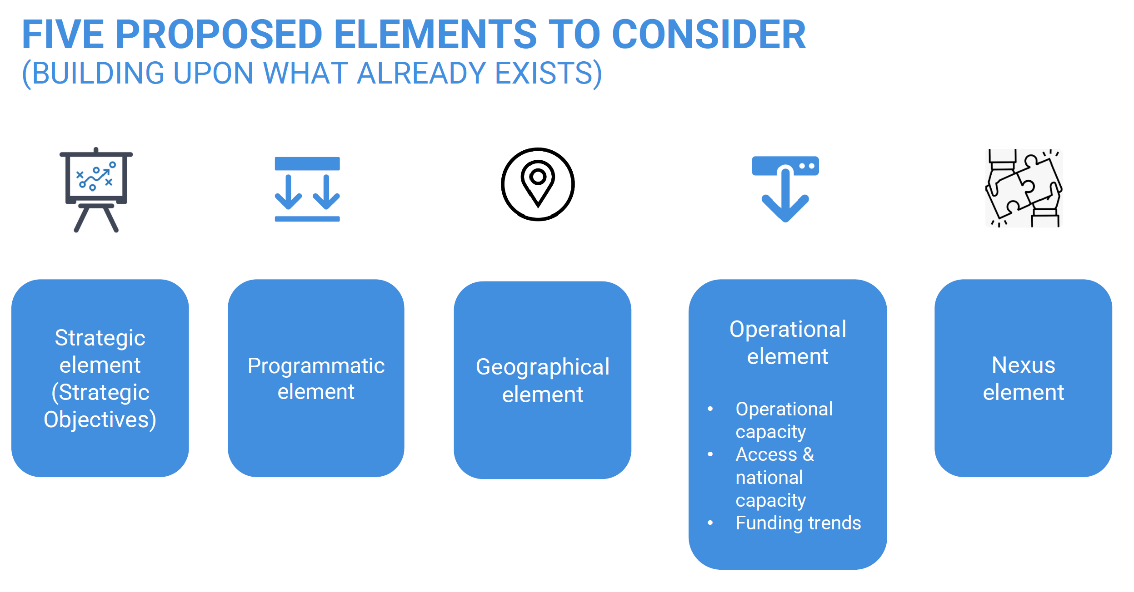
OCHA Boundary Setting

Slide 8
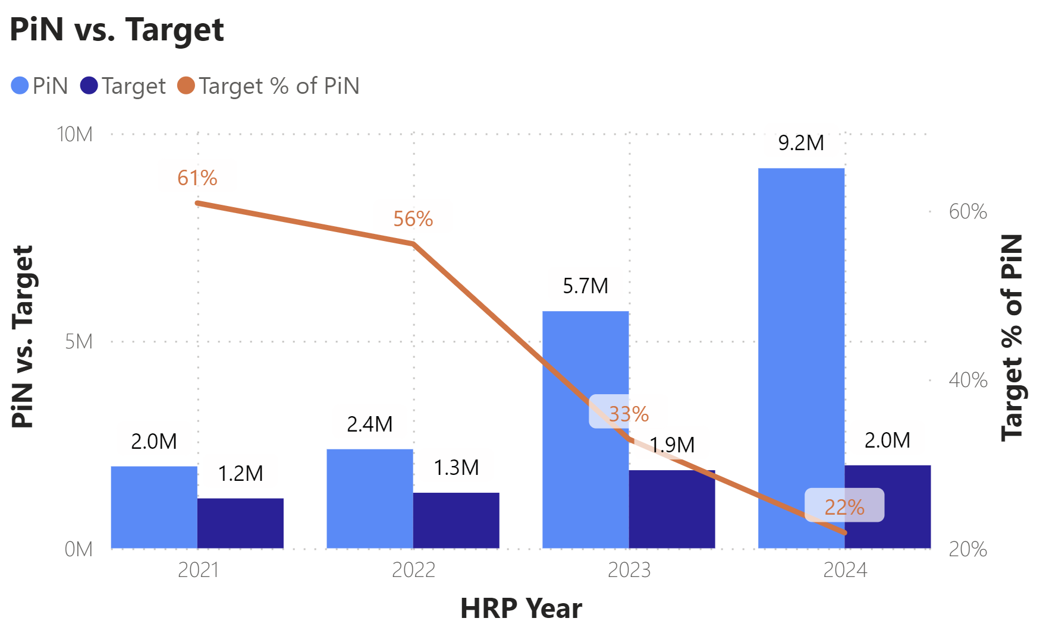
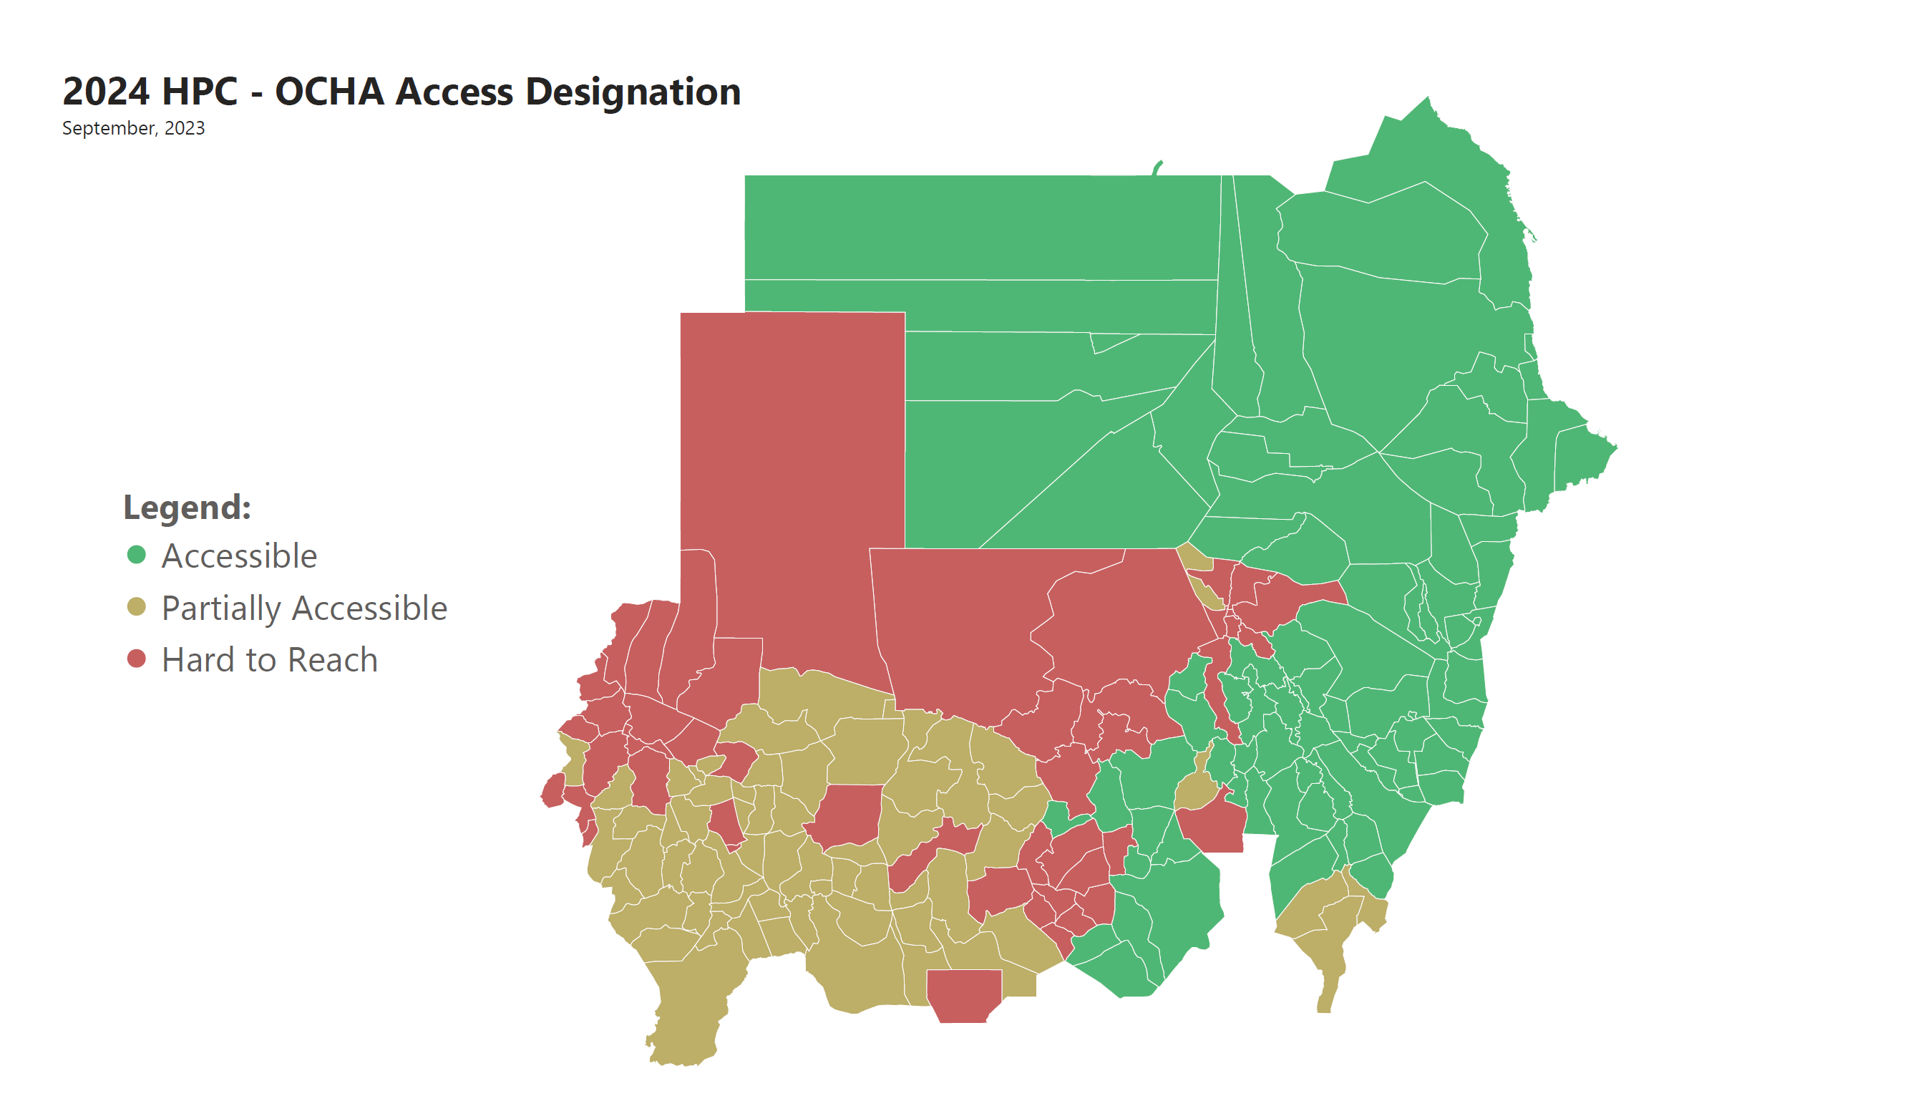
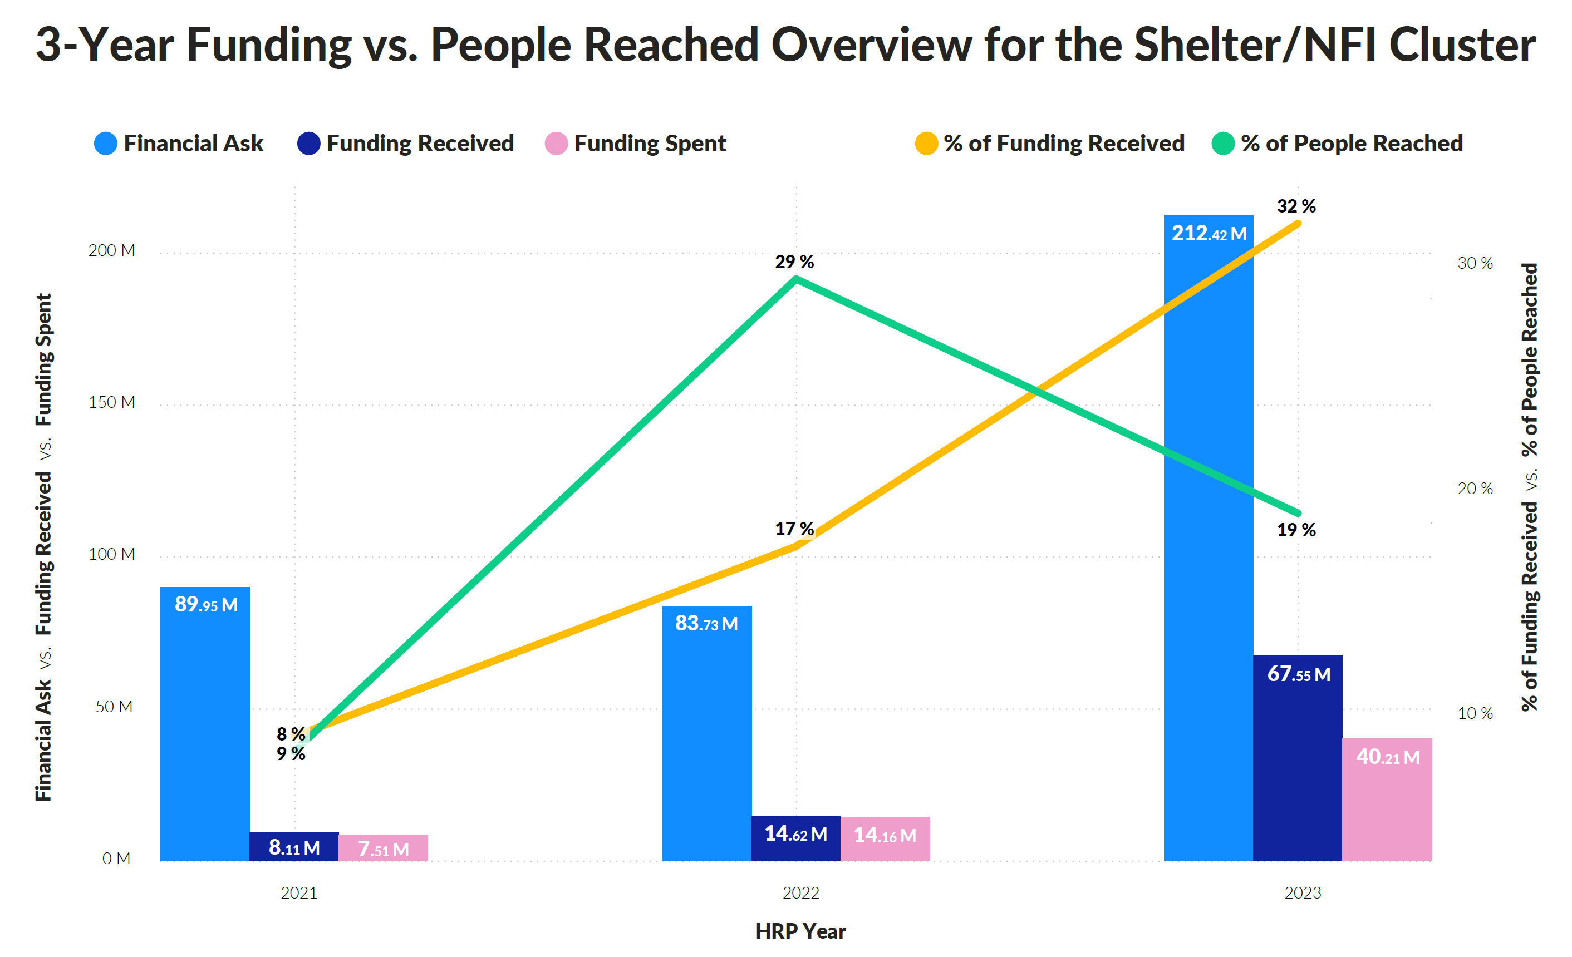
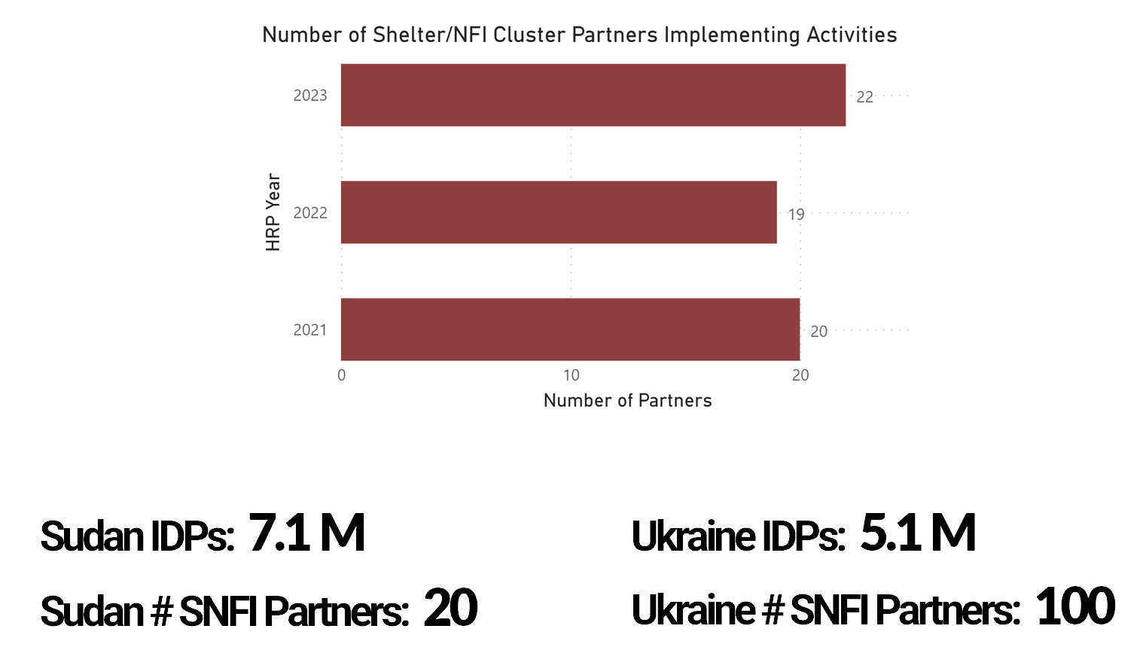
Operational Element

Slide 9
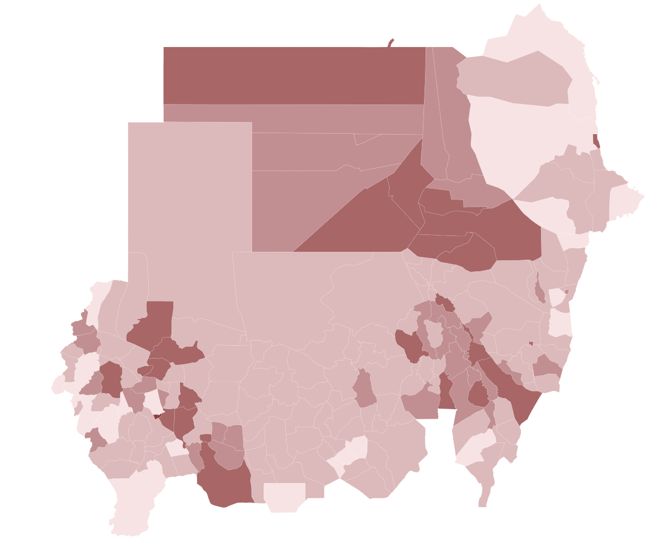
Operational Element
New IDPs Post April 15

Slide 10
HRP ‘24 Results Framework
Objectives:
Provide timely NFI assistance to crisis affected populations.
Enable crisis affected populations to access adequate shelter solutions that provide protection, safety, security, and space to live in a dignified manner.
The concept of “adequacy” means that housing is more than four walls and a roof. It underlines the importance of including a settlement lens, cultural identity, and the availability of services in a shelter response.
2018 Sphere Handbook, Essential concepts in shelter and settlement.
HRP 2024 Activities: | Unit: | Cost:
NFI kit distribution | Household | 200 USD
Establishment of communal shelters | Household | 650 USD
Rehabilitation of collective centers | Household | 500 USD
Tent distribution | Household | 650 USD
Provision of cash/vouchers for NFIs | Household | 250 USD
Provision of cash/vouchers for shelter repair or emergency shelter | Household | 650 USD
Provision of cash for rent | Household | 800 USD
Emergency Shelter Kit (ESK) distribution | Household | 650 USD
General site development | Household | 650 USD

Slide 11
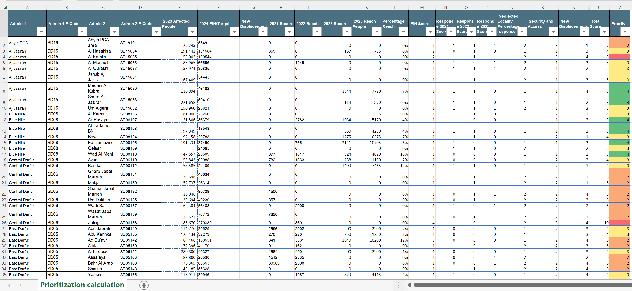
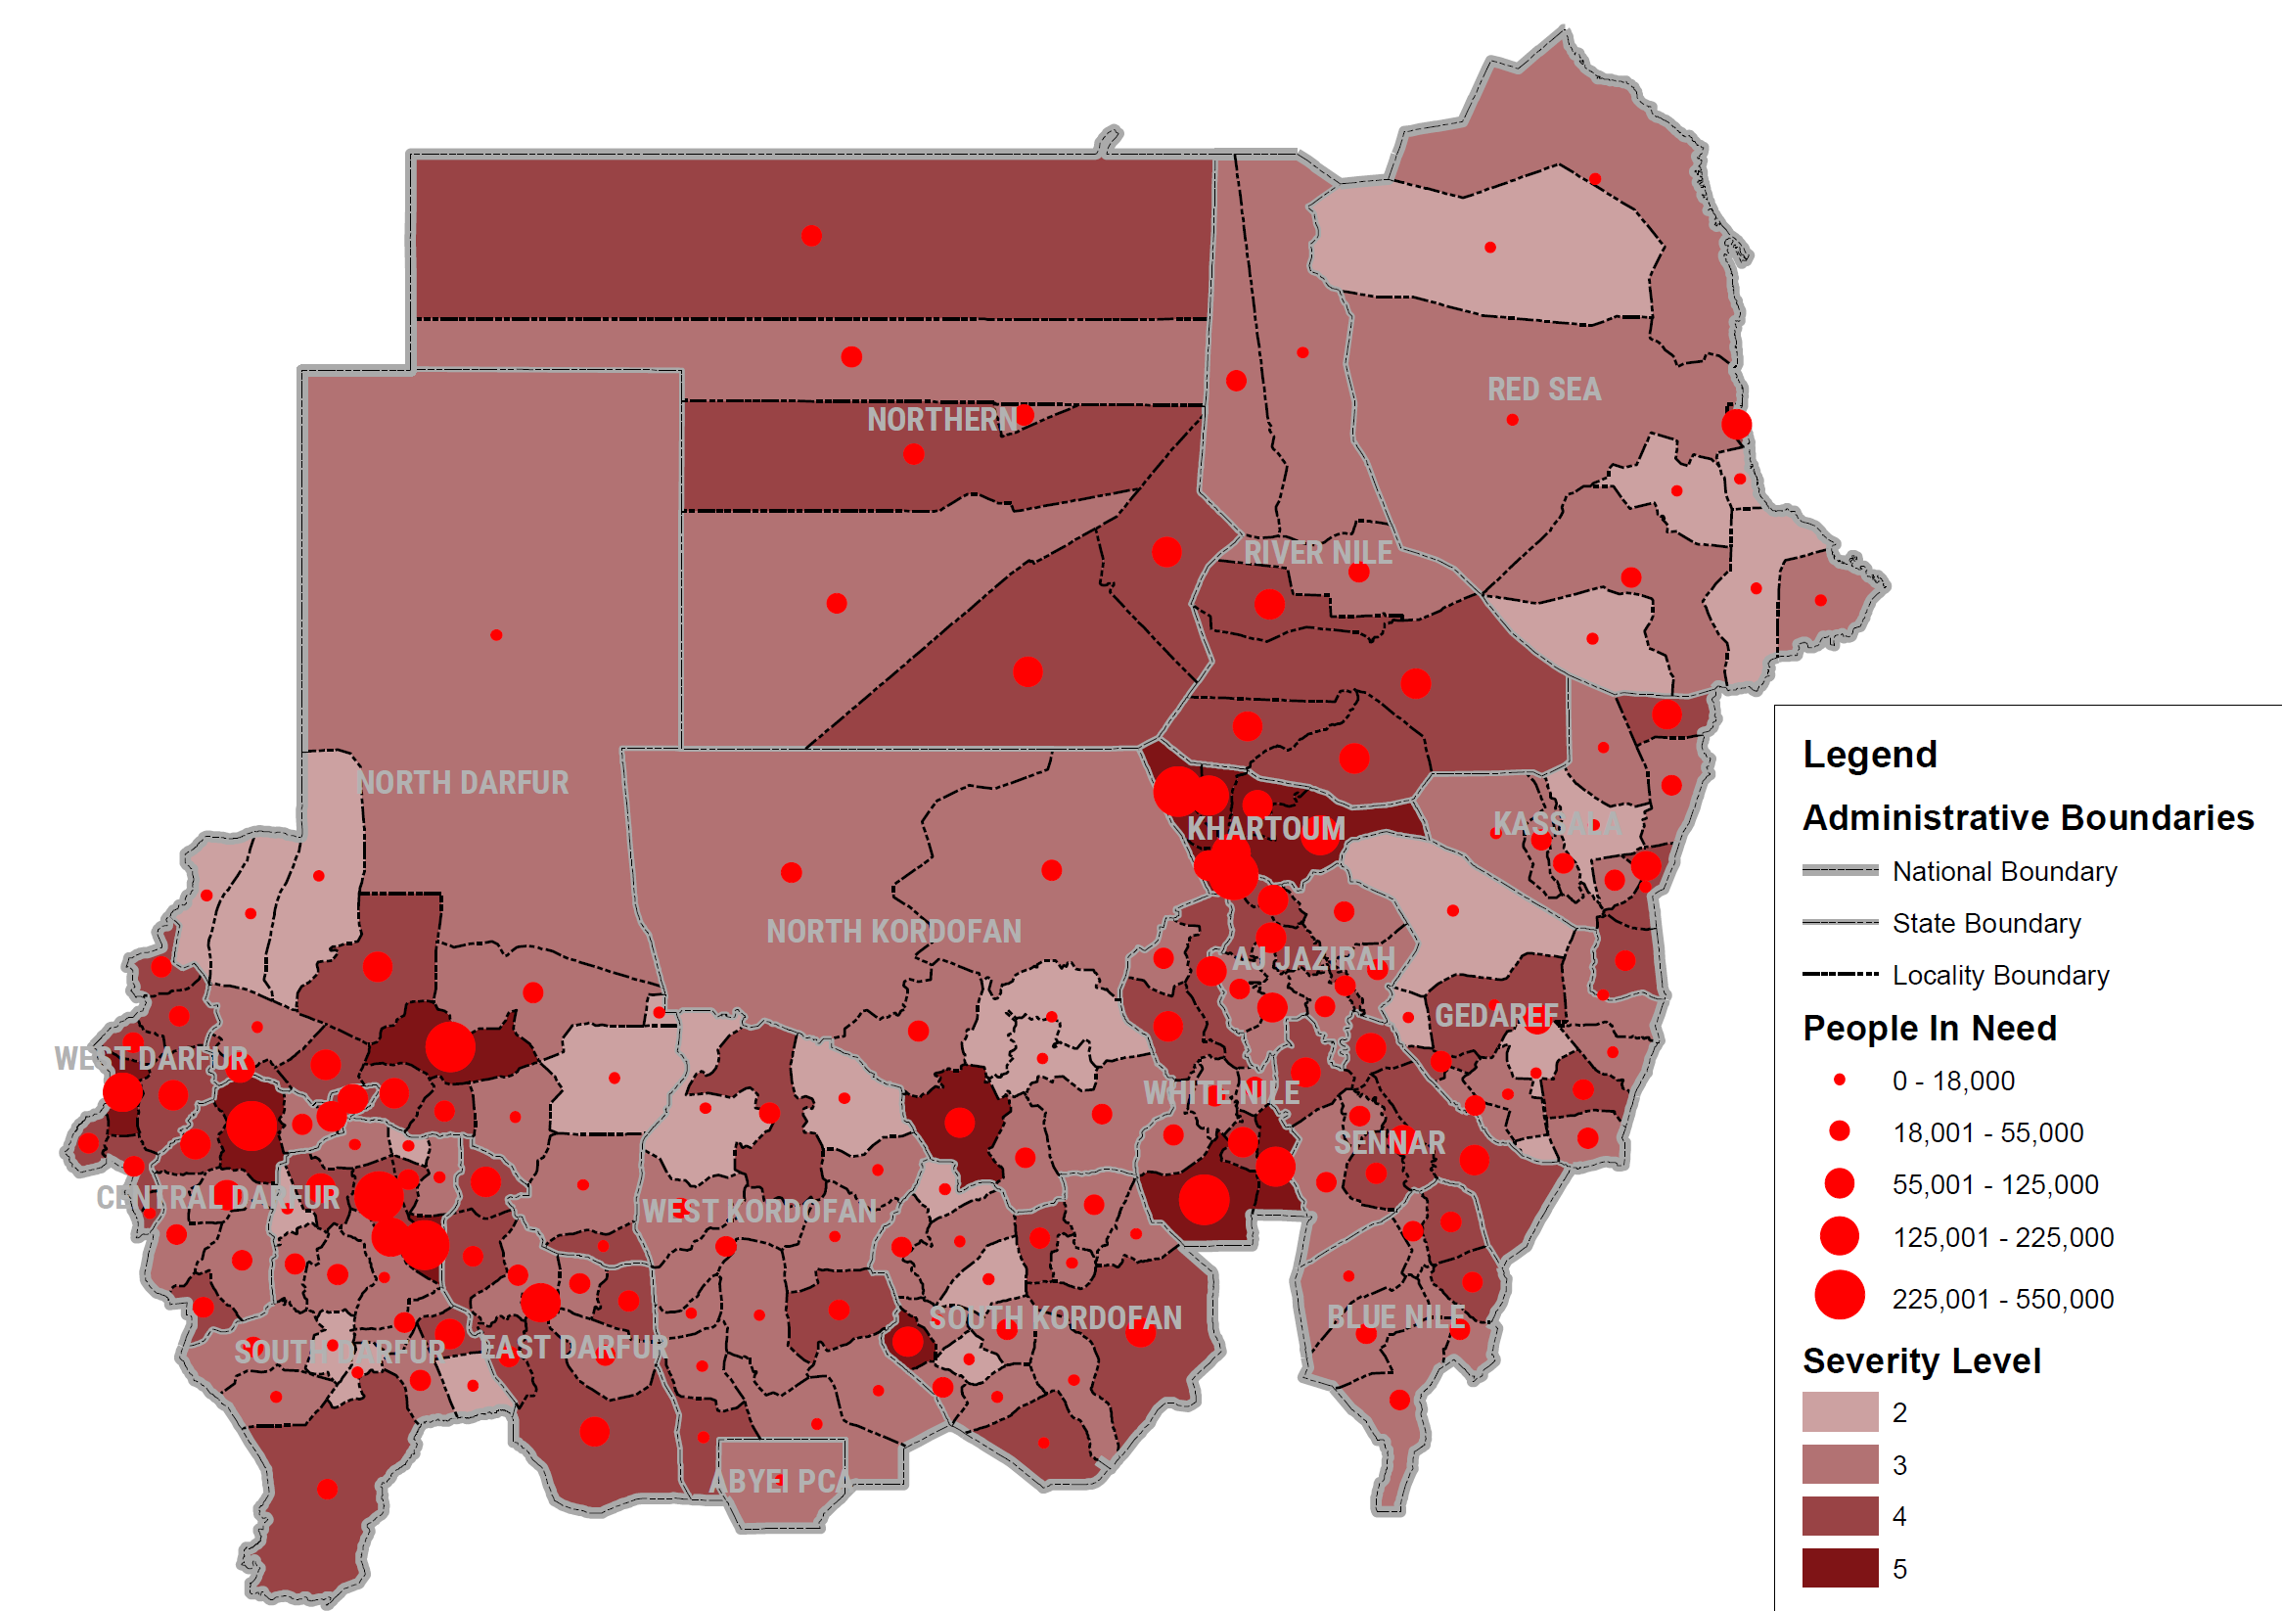
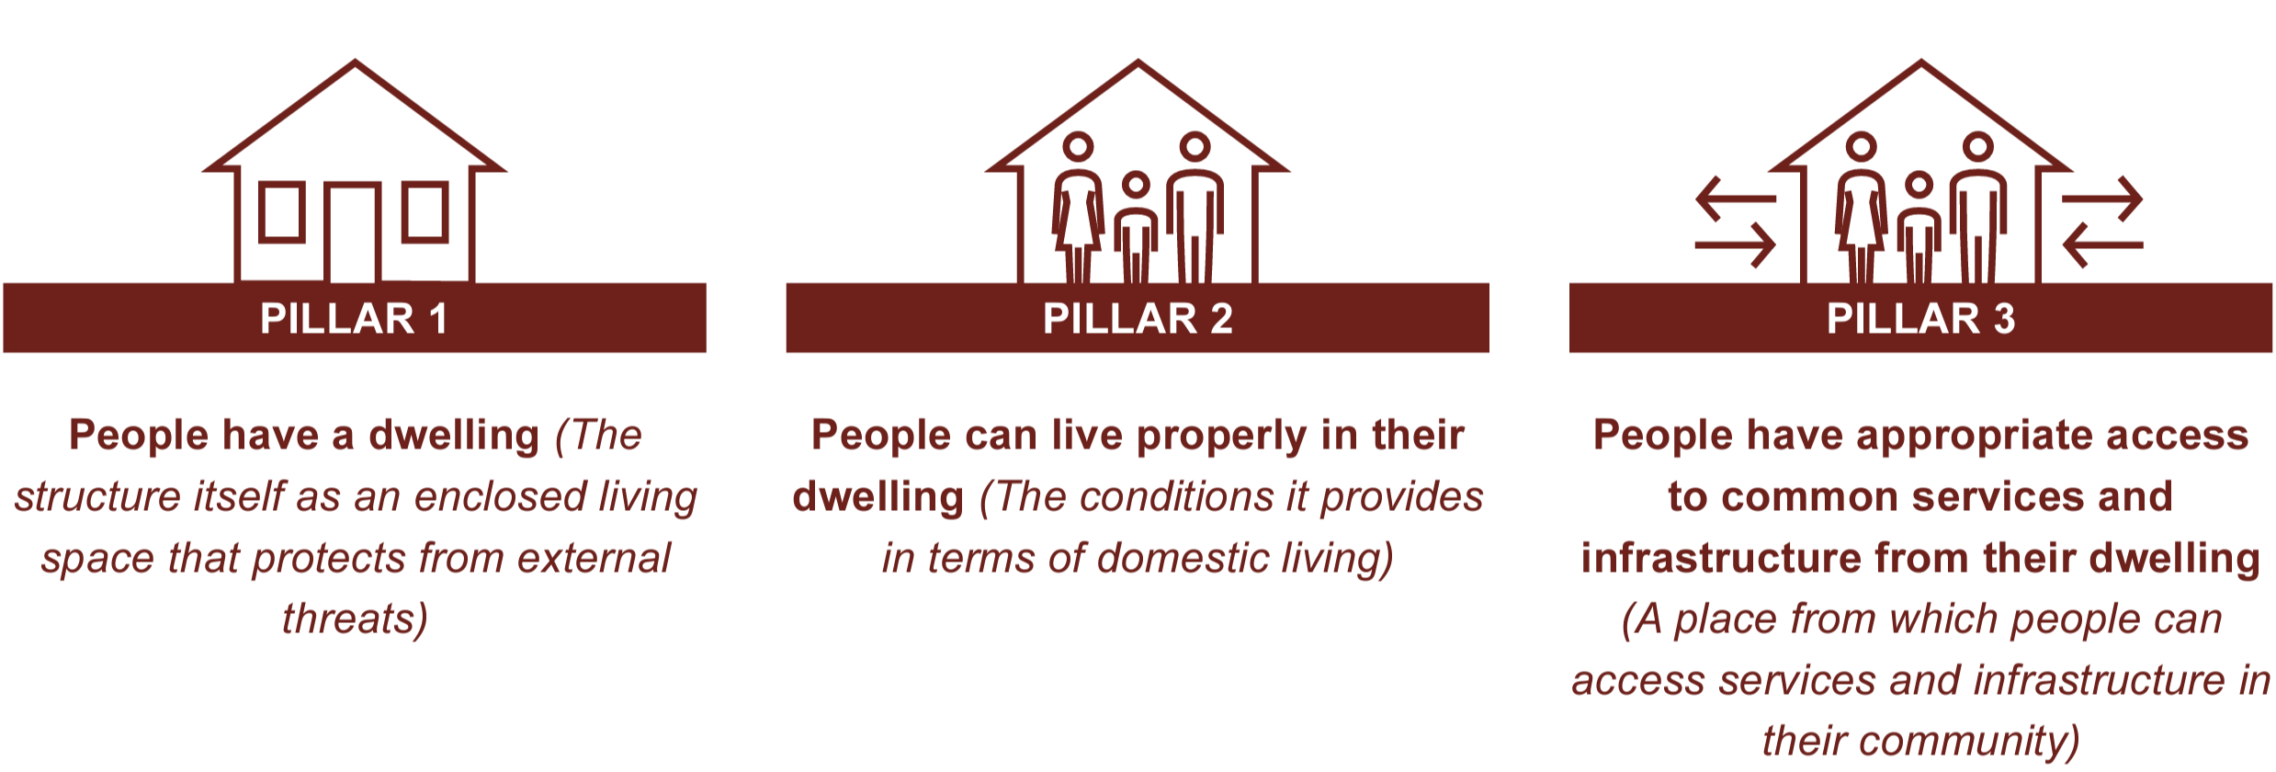
Locality Prioritization
Operational Element = Priority
(Based on ActivityInfo Data + Access & New Displacement)
Geographical Element = Severity
(Based on SSC)
ActivityInfo Data – People Reached from 2023, 2022 and 2021: MAX between Shelter and NFIs delivered at locality level, because we assume that the same family should get both.
Percentage of Target Reached: to determine Neglected Localities.
Access: as designated by OCHA Access WG (September 2023 data).
New Displacement: Magnitude of New Displacement.

Slide 12
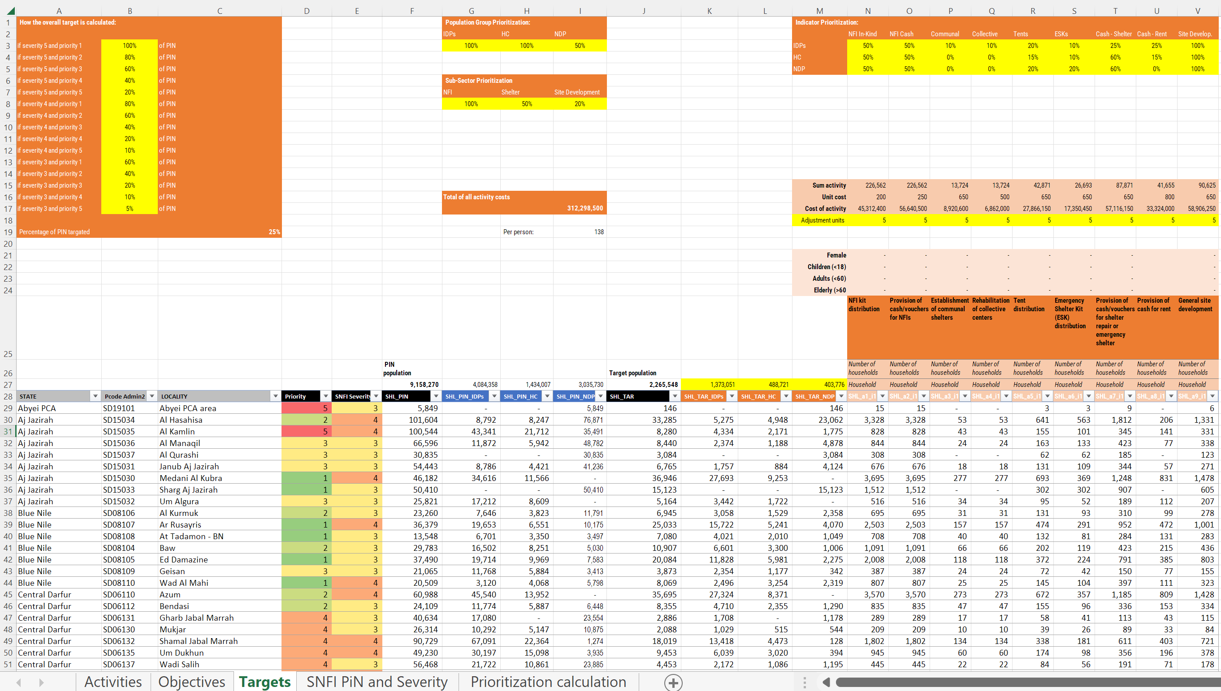
Draft Prioritization & Targeting

Slide 13
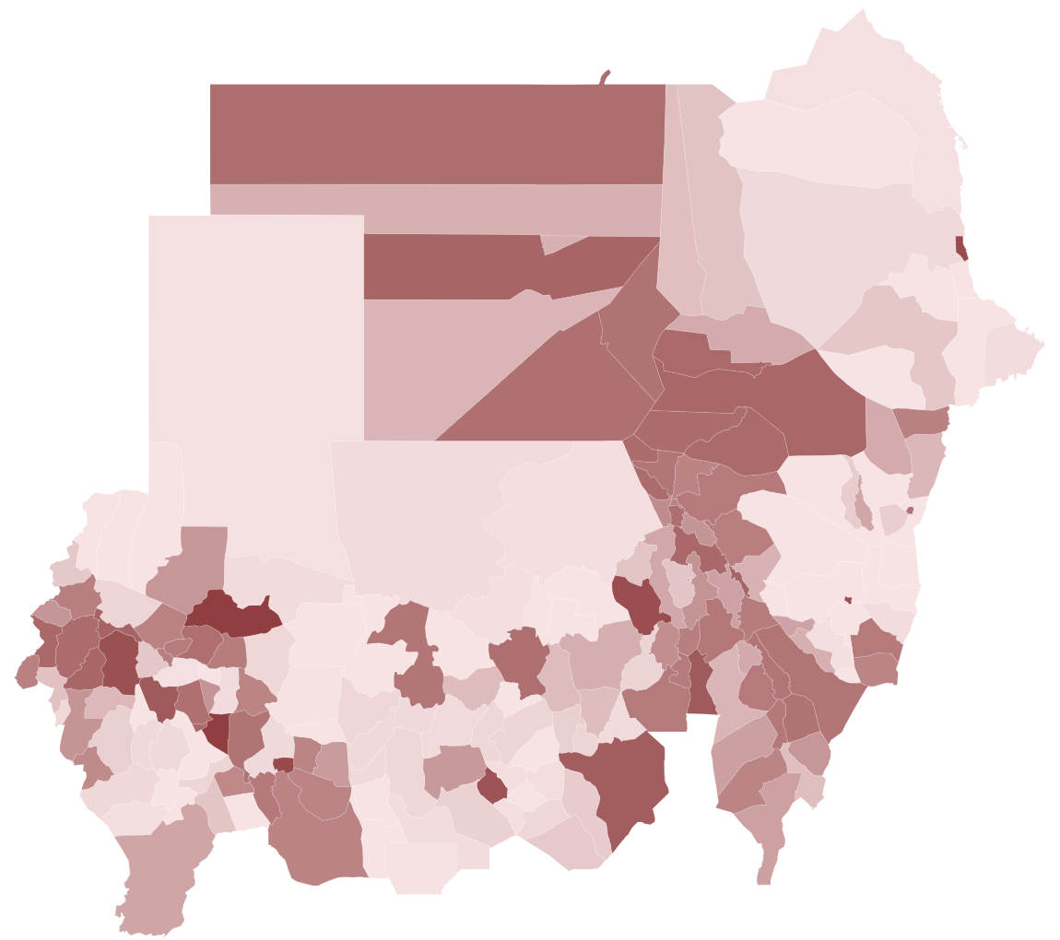
Draft Prioritization & Targeting
PiN: 5.7 M → 9.2 M
Target: 1.9 M → 2.3 M
$$: 212 M → 312 M
Target IDPs:
1.4 M
Target Host Community:
489 K
Target Non-Displaced:
404 k

Slide 14
CCPM
Results

Slide 15
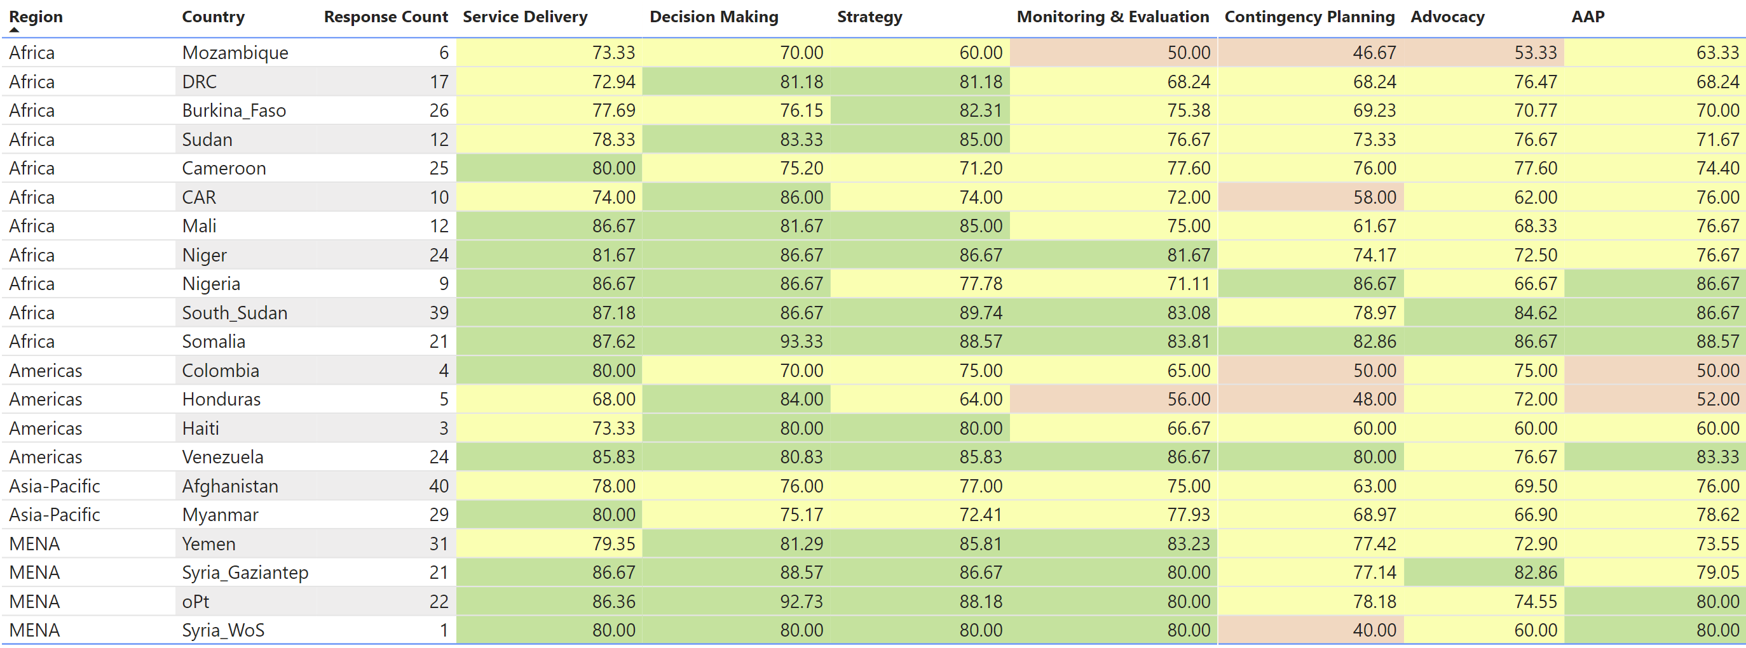
CCPM Results
# Responses:
12

Slide 16
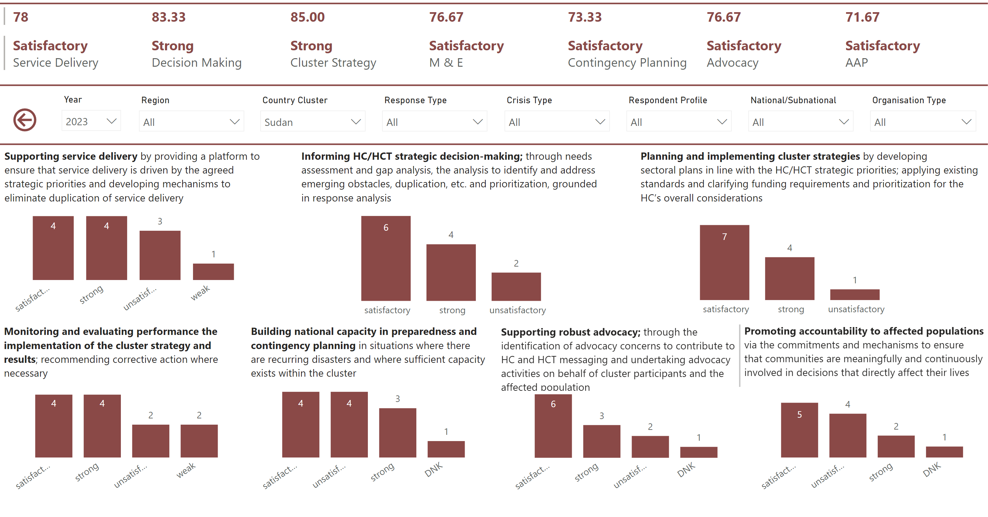
CCPM Results

Slide 17
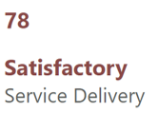
1. Supporting Service Delivery
Organisation Type | Rating | Comment
INGO | unsatisfactory | There seems to be poor information at sub-cluster level on the needs and gaps at IDP locations specifically.
Donor | satisfactory | Need to map services such as warehousing, transportation services etc.
UN | satisfactory | To scale response
INGO | strong | Very good coordination and timely response to issues.
NNGO | satisfactory | Npnp
INGO | strong | Coordination at national level is strong, but at sub-national level our colleagues on the ground report issues with lack of coordination forums.
NNGO | strong | Weekly cluster meeting is conducted and and partner performance is in place
INGO | weak | Focusing only on old partners who have no capacity to intervene in such situation like the current conflict in Sudan
UN | satisfactory | The coordination is going well, biweekly meetings, coordination tools and updates are produced regularly.
NNGO | unsatisfactory | Weak coordination, weak knowledge on organizing the distribution side
NNGO | unsatisfactory | I have attended some distributions of NFIs but the distribution areas was not properly organized, waiting areas are crowded, some beneficiaries reported the basket was not completed (missing some items) the IP who implement the distribution needs to be fully trained and aware of the responsibilities. M&R is required to for every distribution. Many of the beneficiaries served were seen moving out from the hosted locations back to their residence as they are not guanine. Aprper assessment and verification is essential to identify the real needs.
INGO | strong | The cluster has maintained the coordination including through quite challenging times following the increased violence and displacement of many national colleagues / evacuation of internationals. The SC is agile in terms of strategic planning and has a strong technical coordination TWIG that has been productive, collaborative and keeps on working as the needs are there.

Slide 18
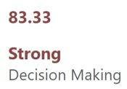
2. Informing Decision Making
Organisation Type | Rating | Comment
INGO | unsatisfactory | Again, the sub-cluster seems not able to provide information on the specific gaps and needs.
Donor | satisfactory | Is ok, more INGOs to be included in the future
UN | strong | Gap analysis Through country operation planning
INGO | satisfactory | Needs to improve on need assessment
NNGO | strong | Np
INGO | strong | Strong focus on evidence, clear explanation of methodologies and high focus on consultations with partners makes strategic decision making centered in reality.
NNGO | unsatisfactory | A needs assessments are happening analyzing the gaps always the respond fund is very week and need additional fund.
INGO | satisfactory | The cluster could not manage to support lopping with donors to get fund for the partners
UN | satisfactory | The coordination team needs support in regard of IM and more building capacity.
NNGO | satisfactory | so far working ok
NNGO | strong | NA
INGO | satisfactory | The minor improvement perhaps is to manage advancing simultaneously separate aspects of the strategy -- and being able to modify and adapt to the changing context.

Slide 19
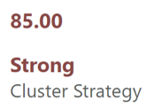
3. Cluster Strategy
Organisation Type | Rating | Comment
INGO | satisfactory | Providing details of kits and specifications and updates.
Donor | satisfactory | Early warning analysis and risks needs more discussion
UN | satisfactory | Involving country team
INGO | strong | Very particpative
NNGO | satisfactory | Np
INGO | satisfactory | Planning is strong, but implementing can be challenging in such a resourceless environment where there is a lot of competition between partners.
NNGO | satisfactory | Yes the sector is developing the plan every year
INGO | unsatisfactory | Only focusing on some states with ease access
UN | strong | Many products show the fact that is planning is going well by the coordination team such as guidelines, technical support, maps, discussion, workshops, documents, ...
NNGO | satisfactory | Ok to some extend
NNGO | strong | NA
INGO | strong | Need to help tailor guidance and good practices that cover several modalities simultaneously.

Slide 20
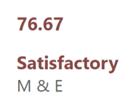
4. Monitoring & Evaluation
Organisation Type | Rating | Comment
INGO | strong | Very good on data analysis.
Donor | satisfactory | Process and quality check to be considered
UN | satisfactory | Involve 3d party
INGO | unsatisfactory | No monitoring system in place
NNGO | strong | Np
INGO | strong | Tools are in place to both monitor coordination performance as well as to evaluate impact and based on that adapt the response if necessary.
NNGO | strong | NA
INGO | weak | They just receiving photos & monitoring reports from the partners without physical monitoring visits during and after the distribution of NFIs items.
UN | satisfactory | it needs some more attention and focus to make sure all partners are considering PDM and other M&E requirements
NNGO | unsatisfactory | This part of the ecercies is very important to measure the impact
NNGO | weak | Based on service provision some issues were observed needs to be addressed
INGO | satisfactory | Go beyond collecting data, we need to analyse to advocate, to learn and integrate the findings.

Slide 21
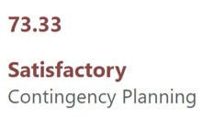
5. Contingency Planning
Organisation Type | Rating | Comment
INGO | DNK | I have not been attending the meetings long enough to have an opinion.
Donor | satisfactory | Needs minor improvement on using cash for NFIs/ES
UN | strong | Good
INGO | unsatisfactory | More training needed
NNGO | satisfactory | Npnp
INGO | satisfactory | The cluster focuses a lot on localization, but preparedness and contingency planning is difficult amidst all the challenges with access and general uncertainty in Sudan.
NNGO | strong | we need to ensure the localization on the cluster sector
INGO | strong | Coordination meetings, minutes reporting and sometimes training packages
UN | unsatisfactory | Due to many constraints, the building capacity and contingency planning needs to be improved
NNGO | unsatisfactory | Capacity building of national partiners is quite important
NNGO | satisfactory | Needs to be improved
INGO | unsatisfactory | On the positive, the TWIG coordinator is a national colleague and is supported to grow in the role. As area of improvement, the cluster could provide more technical support and facilitate more technical exchange by identifying technical capacity on the ground.

Slide 22
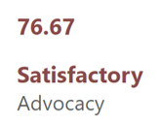
6. Advocacy
Organisation Type | Rating | Comment
INGO | strong | Know what they are advocating for and understand the methodologies.
Donor | satisfactory | Needs more integration with other sectors linked to NFIs/ES
UN | unsatisfactory | Information sharing
INGO | strong | OK
NNGO | unsatisfactory | Npnp
INGO | satisfactory | The cluster has put in place various tools to demonstrate to donors that partners are capable of implementing post April 15, but it would be good if the gap could be presented too, and not only achievements, even though that is very difficult because the number of affected people changes by the week including their locations as people are on the move.
NNGO | satisfactory | NA
INGO | DNK | I have no iead
UN | satisfactory | the coordination team keeps sending a very strong and clear messages on the needs, gaps and with updated partners mapping.
NNGO | satisfactory | satisfied to some extend
NNGO | strong | NA
INGO | satisfactory | Can do more regarding HLP. On the positive, the effort to integrate the updates from the Social Media monitoring have been quite interesting (unsure to what extent these are being useful).

Slide 23
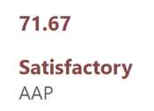
7. AAP
Organisation Type | Rating | Comment
INGO | DNK | Not aware yet
Donor | satisfactory | CFM to be well coordinated among partners
UN | unsatisfactory | Involve beneficiaries
INGO | strong | Excellent
NNGO | satisfactory | Npnp
INGO | satisfactory | The cluster tends to promote partner projects high in community based components and highlights this in strategies. There is a need to improve CFMs.
NNGO | strong | NA
INGO | unsatisfactory | Having enough stocks in areas where already affected by conflicts.
UN | satisfactory | the coordination team keeps sending a very strong and clear messages on the needs, gaps and with updated partners mapping.
NNGO | satisfactory | Needs improvements to promote accountability
NNGO | unsatisfactory | Needs improvement
INGO | unsatisfactory | Given the challenges to access the affected population at the moment, the SC could review the input collected from previous evaluations and analysis to provide some guidance. Not sure I recall there has been an exchange regarding referrals or that members of other clusters come to shelter coordination or vice versa.

Slide 24
Core Functions
Organisation Type | Comment
INGO | More of a detailed matrix at the sub-cluster level on gaps/need would be so much more appreciated and helpful.
Donor | Improvement the sector synergy with other sectors (using NFIs/ES as modality)
UN | Fund raising board from different partners
INGO | No
NNGO | Npnp
INGO | Just to thank the cluster for their efforts and leadership!
NNGO | The call for proposal for new national partners is very week and improvement
INGO | To don't focus on certain partners for long years without encouraging and supporting the active ones in the clusters.
UN | NA
NNGO | No comments
NNGO | No
INGO | Worth to mention the graphic skills of the colleague(s) that made every cover (to make sure these are recognized) and the overall clear and systematic communication.

Slide 25
Meetings
Organisation Type | Frequency | Content | Agenda
INGO | satisfied | satisfied | Key gaps and needs.
Donor | neutral | neutral | Coordination with other sectors, rapid response and early warning agenda
UN | satisfied | very_satisfied | No
INGO | satisfied | very_satisfied | Nothing to add
NNGO | satisfied | very_satisfied | Np
INGO | very_satisfied | very_satisfied
NNGO | very_satisfied | very_satisfied | NA
INGO | unsatisfied_toofrequent | very_satisfied | The cluster should work closely with the donors to reach the prioterized areas in the HRP
UN | satisfied | very_satisfied | NA
NNGO | satisfied | very_satisfied
NNGO | satisfied | satisfied
INGO | satisfied | very_satisfied

Slide 26
Information Sharing
Organisation Type | Rating | Comment
INGO | satisfied
Donor | neutral
UN | satisfied | No
INGO | very_satisfied | Nothing to add
NNGO | very_satisfied | Np
INGO | very_satisfied
NNGO | very_satisfied | NA
INGO | satisfied | To keep all partners updated on how to communicate with the donors easily.
UN | satisfied | NA
NNGO | very_satisfied | Cluster lead is sharing all info related to activities
NNGO | satisfied
INGO | satisfied | Only aspect to improve is the time that it takes to get some information. Whilst aiming for quality and I guess a second person to check or proofread the communications (??) it would be good to find a balance as sometimes the info exchange is needed a bit faster.

Slide 27
HPC Process
Organisation Type | Reporting | HNO | HRP | Project Submission
INGO | na_notme
Donor | neutral | satisfied | satisfied | dnk
UN | satisfied
INGO | neutral
NNGO | satisfied | very_satisfied | satisfied | na_nosubmission
INGO | neutral | very_satisfied | very_satisfied | criteria deadline questions instructions
NNGO | satisfied
INGO | satisfied
UN | neutral | satisfied | satisfied | criteria deadline instructions
NNGO | satisfied | satisfied | neutral | deadline
NNGO | neutral | very_satisfied | very_satisfied | na_nosubmission
INGO | neutral | neutral | neutral | na_nosubmission

Slide 28
TWIG
Organisation Type | Rating | Comment | Knowledge Sharing
INGO | neutral | tech_specs nfi | dnk
Donor | neutral | tech_specs nfi | yes
UN | satisfied | hlp | dnk
INGO | very_satisfied | tech_specs | yes
NNGO | satisfied | tech_specs | yes
INGO | very_satisfied | hlp | yes
NNGO | neutral | nfi | yes
INGO | satisfied | tech_specs | no
UN | neutral | tech_specs hlp | yes
NNGO | very_satisfied | nfi | yes
NNGO | satisfied | tech_specs nfi | no
INGO | very_unsatisfied | hlp | yes

Slide 29
GBV & PSEA
Organisation Type | GBV Rating | GBV Comment | PSEA Rating | PSEA Comment
INGO | dnk | I have not been attending the meetings long enough to have an opinion. | dnk | I have not been attending the meetings long enough to have an opinion.
Donor | strong | well coordinated | neutral | Limited access to data and assessments
UN | strong | No | very_strong | Good
INGO | neutral | Not much is talked about | very_strong | Always discussed
NNGO | strong | Npnp | neutral | Np
INGO | very_strong | It is one of the rare clusters that mainstreams GBV risks in strategies, response plans, and advocates actively in meetings for activities that directly reduce it. | neutral | I am not sure of any PSEA issues being reported hence I am not sure if they are being addressed or not.
NNGO | very_strong | NA | very_strong | NA
INGO | strong | They encourage partners to support the GBV cases during the distribution processes | strong | Organized several PSEA training workshop for the partners
UN | strong | NA | strong | NA
NNGO | strong | 5* | neutral | OK
NNGO | strong | Ok to some extend | neutral | Ok some how
INGO | weak | The assistance provided seems to be limited by funds available capacity and access hindering a more meaningful integration of gender (addressing GBV). | neutral | It is an expectation that agencies are already addressing this

Slide 30
Environment
Organisation Type | Rating | Comment
INGO | dnk | I have not been attending the meetings long enough to have an opinion.
Donor | neutral | Still needs more guidance
UN | strong | Good
INGO | very_strong | Sensitivity on the use of some local materials for shelter
NNGO | neutral | Np
INGO | very_strong | Again environment components are mainstreamed in strategic discussions and in cluster meetings, however in the context of Sudan implementation is another strory.
NNGO | strong | NA
INGO | strong | As usual trying to minimize using other alternatives
UN | strong | NA
NNGO | strong | is addressing the mainstreaming environment
NNGO | neutral | Neutral
INGO | neutral | The SC could help connect to people or agencies that have a strong understanding on local materials.

Slide 31
Cluster Strengths & Improvements
Organisation Type | Strengths | Improvements
INGO | Iva and her team are excellent at presenting data and explaining the methodologies behind the numbers. | Details on gaps/needs at sub-cluster level
Donor | Communication, leadership presence even during the conflict and flexibility to change | Complementarity with others, mapping of preparedness (prepositioning, stocks, assessments)
UN | Coordinations | Fund raising capacity building for partners
INGO | Coordination, TWIG, Information sharing | PLANNING
NNGO | Np | Np
INGO | Strong national coordination. | Sub-national coordination.
NNGO | NA | NA
INGO | Requesting 5Ws and coordination meetings | Build the capacity of the new partners, encourage and distribute the opportunities among all in transparency way,
UN | Regular cluster meeting and sharing information | Shelter design of different shelter types and phases
NNGO | Coordination with Ben, communication prior for starting the activities | Info sharing, capacity building of partners
NNGO | Coordination with all cluster IPs | Capacity building for cluster partners, and to expand to opportunities to include other cluster IP
INGO | We have a strong coordinator (Iva) and the agencies are sharing what they are producing for the use of everyone. There is a strong sense of collaboration (not competition as it is in other cases). | Ensure that the lessons learned today, the tools developed and the experience is passed on (not for this cluster in particular but across countries it can often feel we are starting from zero over and over). Thank you very much for all the work!

Slide 32
Roundtable on Achievements & Operational Plans

Slide 33
Roundtable – Achievements/Ops Plans
Objective: Ensure that our collective response efforts are well communicated to partners, donors, media and general audiences!
Achievements – type of interventions, HH reached, locations, timeframe, etc.
Challenges – looting of supplies, access challenges, etc.
Procurement – quantities of stocks arriving to the country, type of stocks, timeframe, where will the stocks be prepositioned – particularly given the incoming flood season.
Assessments – e.g., needs assessments outlining specifics with respect to Shelter and NFI needs as well as market assessments on NFIs, shelter materials, or Cash for Rent.
Context and impact of interventions – e.g., any successes with respect to cash for rent, how is sustainability achieved, what about tenure security?
Interventions in the host community – with 77% of the population staying in host community – what has been achieved so far? Cash for shelter for the families hosting IDPs can be an option, or preselecting landlords to improve their housing in order for them to subsidize rent for IDPs – this can include negotiating longer-term tenure security.
Etc.

Slide 34
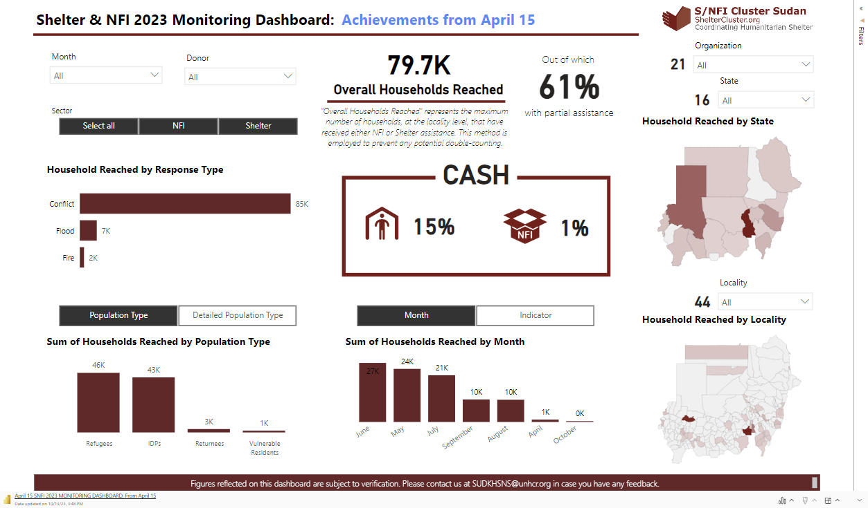
Achievements Public Dashboard

Slide 35
AOB

