Slide 1
Shelter & WASH Working Group Meeting
Thursday 27 July, 10AM
Asia Pacific Alliance for Disaster Management

Slide 2
Agenda
Introductions & Agenda
Information Management
NBRO – resettlement site locations and transitional needs
Displacement tracking matrix (DTM)
District focal point updates
Oxfam assessment of WASH needs
Plan Int. assessment of schools
AOB

Slide 3
Shelter & NFI - progress to date
Targets (in red) are according to working group strategy
25,000 (national damage data, fully and partially damaged)
8000 (based on agency capacities)
2,500 (national damage data – fully damaged)

Slide 4
Shelter & NFI - modality

Slide 5
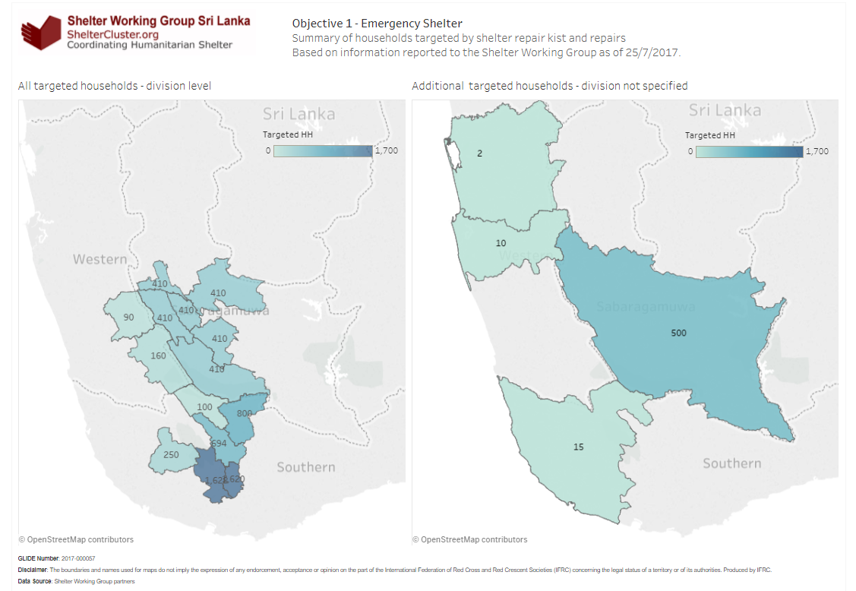
Shelter programming – Objective 1
Targeting is not yet down to divisional level for all activities

Slide 6
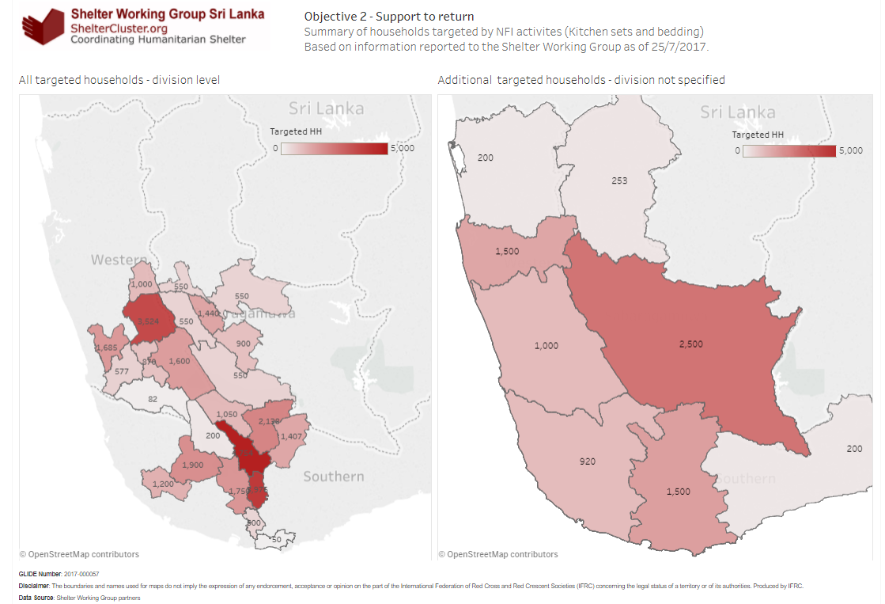
Shelter programming – Objective 2
Targeting is not yet down to divisional level for all activities

Slide 7
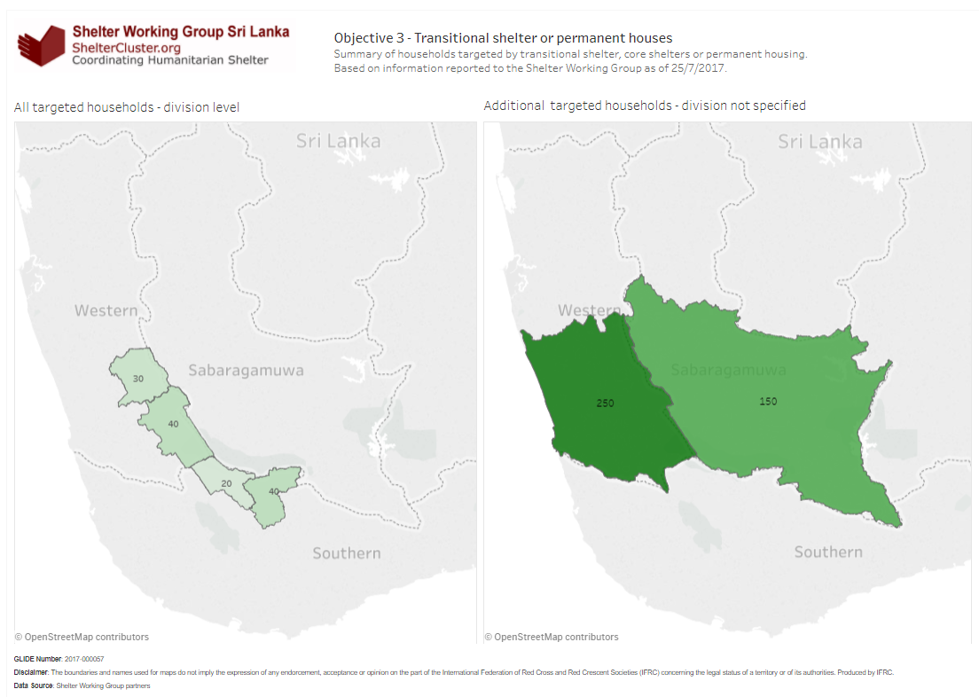
Shelter programming – Objective 3
Targeting is not yet down to divisional level for all activities

Slide 8
Shelter needs – damage data
National level data: DMC website
Up to 28th June covering all flood/landslide affected districts & divisions
Since 23rd July this has been posted again, though does not cover all districts and divisions
District- level data
Collected by SWG from GA offices:
District | Date collected | Date of data set
Matara | 11/07/17 | 28/06/17
Galle | 11/07/17 | 20/06/17
Kalutara | 12/07/17 | 28/06/17
Ratnapura | 18/07/17 | 17/07/17

Slide 9
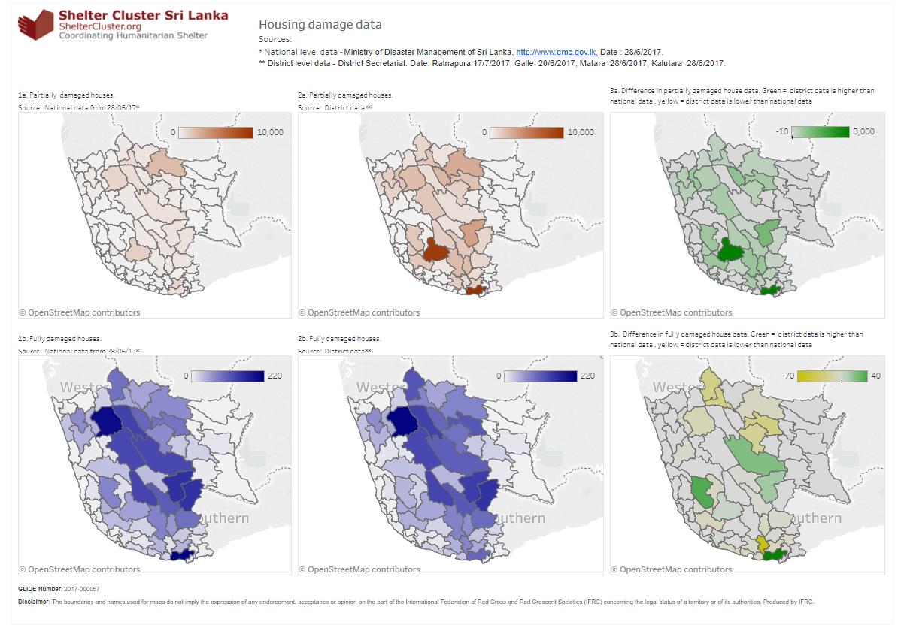
Shelter needs – damage data

Slide 10
Shelter & NFI – gaps
Targets (in red) are according to working group strategy
PLUS: Households facing mandatory relocation for high risk zones without housing damage

Slide 11
NBRO Update on Resettlement Progress

Slide 12
Statistic at Temporary sites;
District | #of Sites | HH | Members
Rathnapura
Kalutara | 7 | 101 | 377
Galle | - | - | -
Matara | 1 | 16 | 66
No of Households at High risk;
District | LS | Total
Rathnapura | 1068 | ~1600
Kalutara | 504 | ~1400
Galle | 92 | ~300
Matara | 200 | ~300

Slide 13
Site Selection Criteria
Possibility to affect another landslide or flood
Soil condition, slope and terrain
Availability of Drinking water and Electricity
Access to town centers and public transportation.
Availability of Social Infrastructure (School, Hospital, Religious and Police)

Slide 14
District | DS Division | No. of lands inspected | No. of Lands Approved | No. of Lands Rejected | Approved land extent (Acres)
 | Balangoda | 10 | 3 | 7 | 12
Ratnapura | Kahawatta | 2 | 1 | 1 | 1
 | Kalawana | 7 | 6 | 1 | 9
 | Kiriella | 3 | 1 | 2 | 10
 | Nivithigala | 2 | 2 | - | 17.5
 | Pelmadulla | 1 | 1 | - | 30
 | Eheliyagoda | 2 | 1 | 1 | 2.5
 | Ratnapura | 7 | 1 | 6 | 0.75
 | Kuruwita | 4 | 3 | 1 | 13
Sub Total |  | 38 | 19 | 19 | 95.75
 | Bulathsinhala | 18 | 5 | 13 | 60
Kalutara | Dodangoda | 2 | 2 | - | 12.72
 | Madurawala | 6 | 4 | 1 | 12.75
 | Mathugama | 5 | 3 | 2 | 10.5
 | Palinda nuwara | 10 | 3 | 7 | 14.18
 | Walallawita | 2 | - | 2 | -
Sub Total |  | 43 | 17 | 25 | 110.15
 | Baddegama | 2 | 1 | 1 | 0.28
Galle | Elpitiya | 3 | 3 | - | 28.5
 | Neluwa | 2 | - | 2 | -
 | Tawalama | 1
 | Walivitiya Divithura | 1 | 1 | - | 30
Sub Total |  | 9 | 5 | 3 | 58.78
 | Kotapola | 2 | 2 | - | 2.5
Matara | Pasgoda | 3 | 1 | 2 | 7
 | Thihagoda | 2 | 1 | - | 2
Sub Total |  | 7 | 4 | 2 | 11.5
Total |  | 97 | 45 | 49 | 276.18

Slide 15
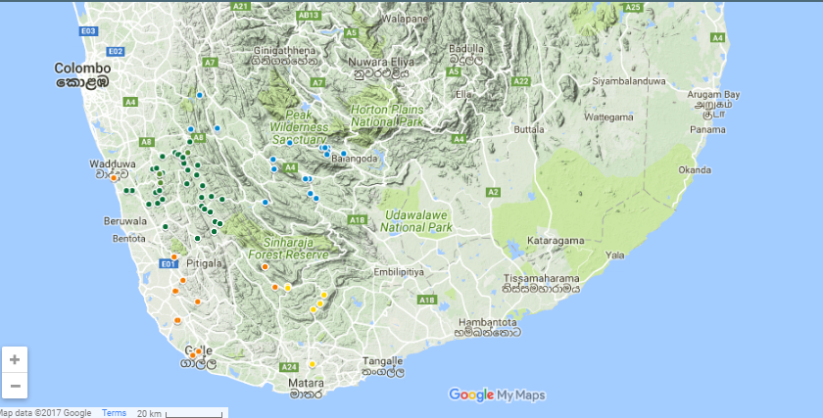
Resettlement Sites

Slide 16
Development of Resilient Communities
Steps | Activities
Geographical and demographical information | Identification of sites suitable for new settlement according to the criteria described in the implementation framework. Acquisition of sites. Identification of beneficiaries (to be resettled). Initiate process of engagement to clarify their needs and concerns Obtain site information (photographs, field visits, maps, etc.) to analyse the geographical / physical conditions of the place.
Concept design | Analyse information and start a concept design for the masterplan Feasibility study to demonstrate how many dwellings can fit in each site. Prepare drawings and discuss with HSPTD team
Consultation with community | Consultation meeting with the people to be resettled to discuss the design and to identify the families that wish /can go to each site
Revisions | Revise masterplan drawings according to people’s comments Issue drawings to all stakeholders for comment or approval
Consultation with stakeholders | Coordinate designs with NBRO Engineers, DS, Survey Department Water and Drainage Board, Electricity Board and other authorities to have their comments
Final design | Revise drawings Presentation to DS and residents Final amendments and issue for approval

Slide 17
Standards for Settlement Development
CAT | Site Category 01 | Site Category 02 | Site Category 03
Units | Less than 25 dwellings | 25 – 50 dwellings | More than 50
Uses | Single detached houses Children park Corner shop | Single detached houses, Semidetached, low rise (G+3) Public open spaces Corner shop Child care centre Place for worship | Single detached houses, Semi- detached houses, Medium rise buildings (G+7) Parks, playground and recreational facilities Shops / restaurants / retail Childcare centre, Education centre Clinic and pharmacy Public transport
Standards for Settlement Development*
*NBRO, Implementation Framework for Resettle Landslides and Flood Victims

Slide 18
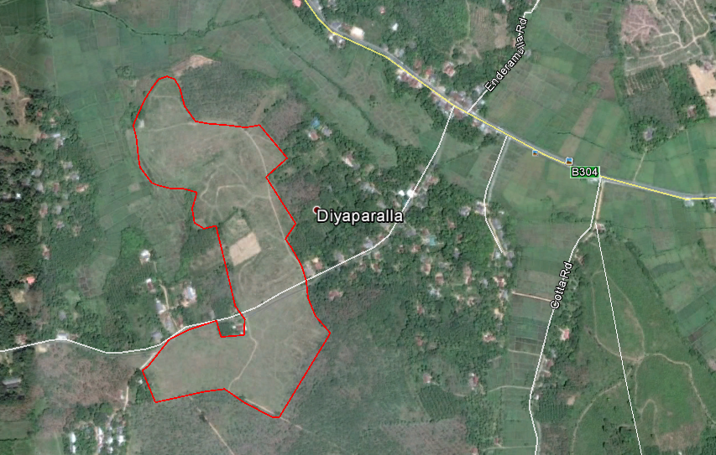
Category 1
Single detached
houses
Children park
Corner shop

Slide 19
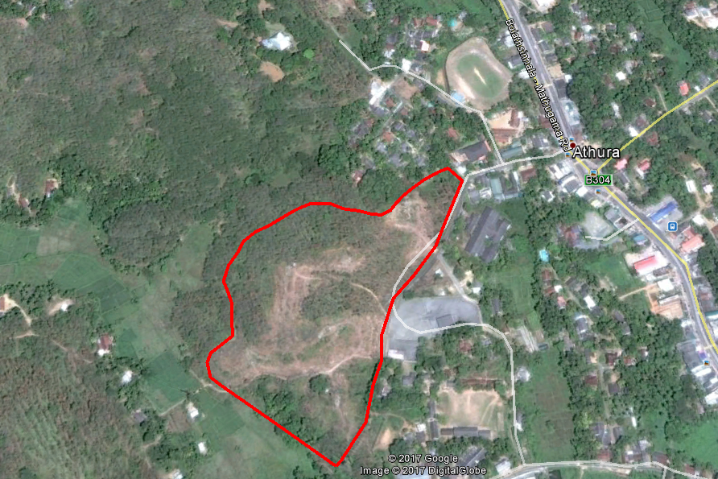
Category 2
Single detached houses,
Semidetached, low rise (G+3)
Public open spaces
Corner shop
Child care centre
Place for worship

Slide 20
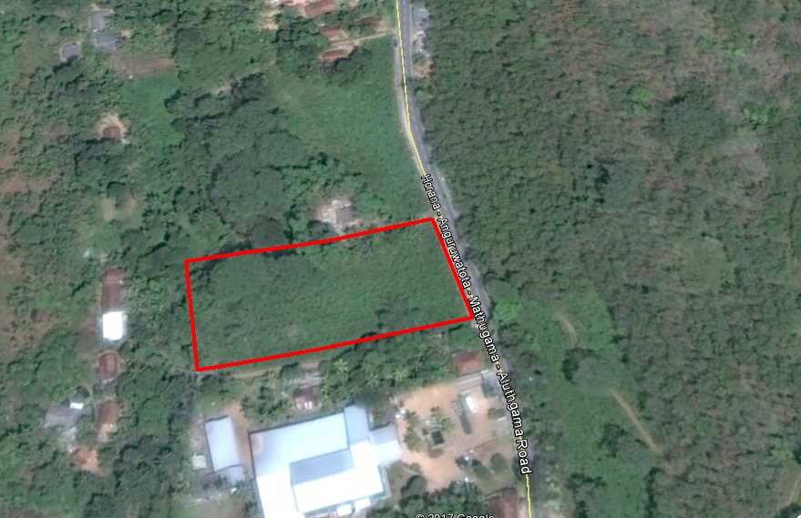
Category 2

Slide 21
TYPE PLANS
NBRO has prepared resilient house plans which are adaptive to landslides and floods, and worked out all the plans according to the “Core House” concept.
MINIMUM STANDARD FOR CORE HOUSE
Minimum floor area of 650 sq. ft.
Resilient foundation and a superstructure (As directed by NBRO)
Two bedrooms
A kitchen
A permanent roof
A water seal toilet and a septic tank
Availability of electricity and water

Slide 22
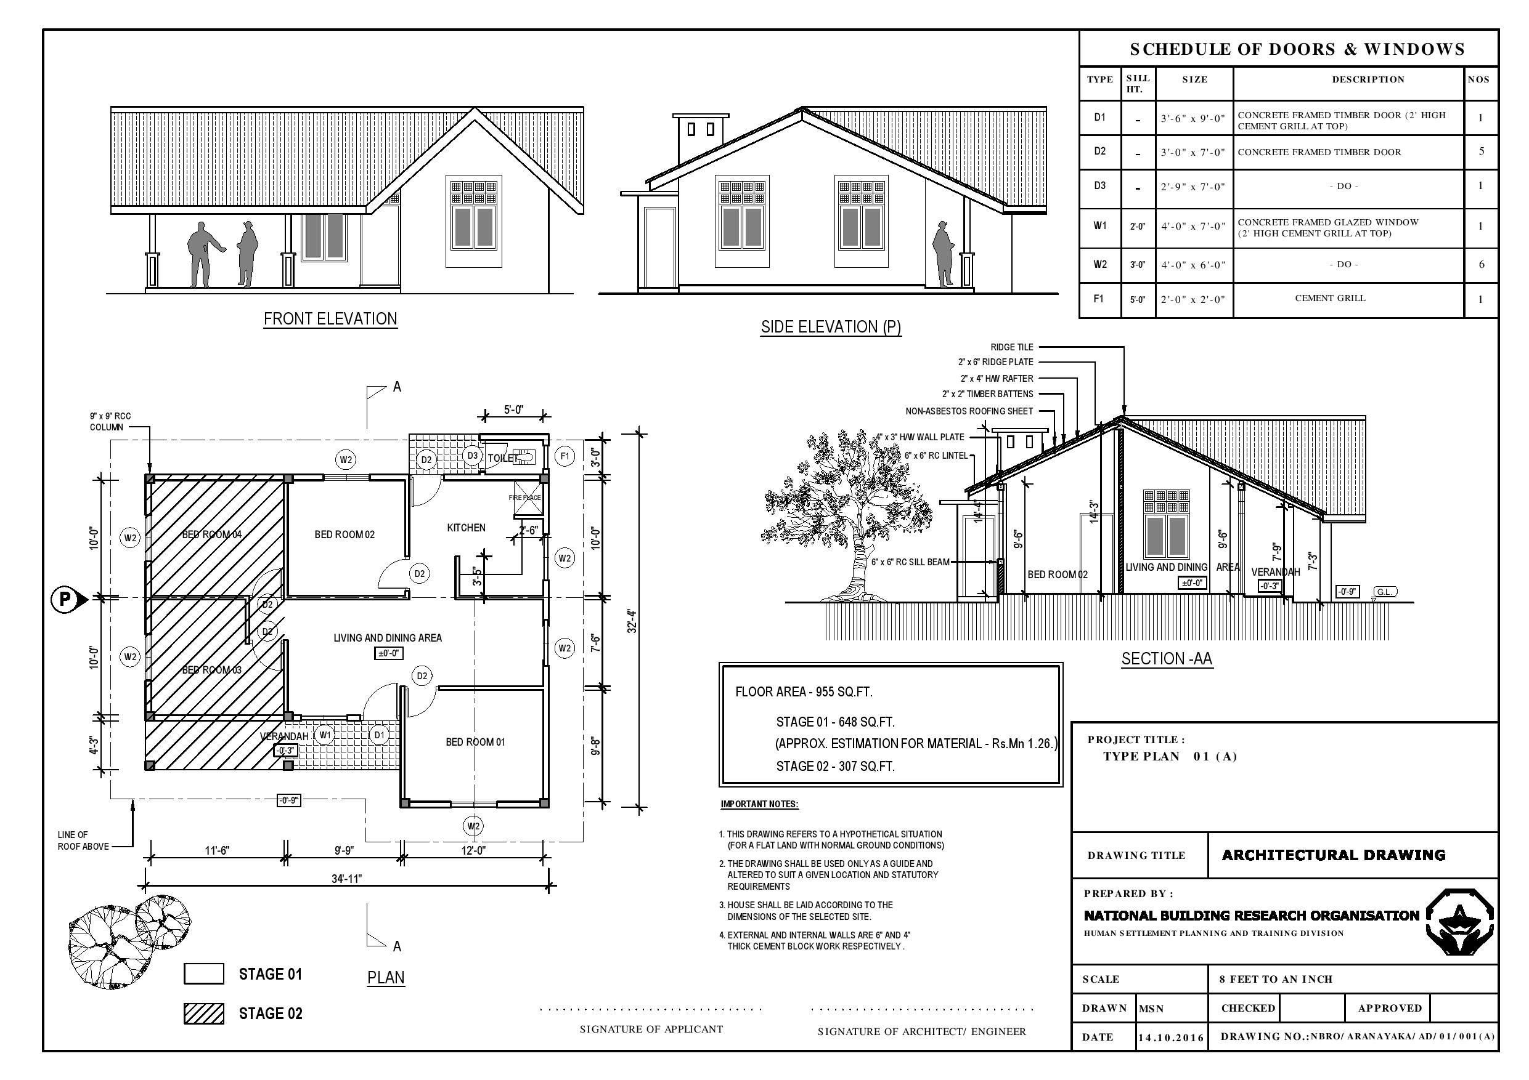
INDIVIDUAL HOUSING

Slide 23
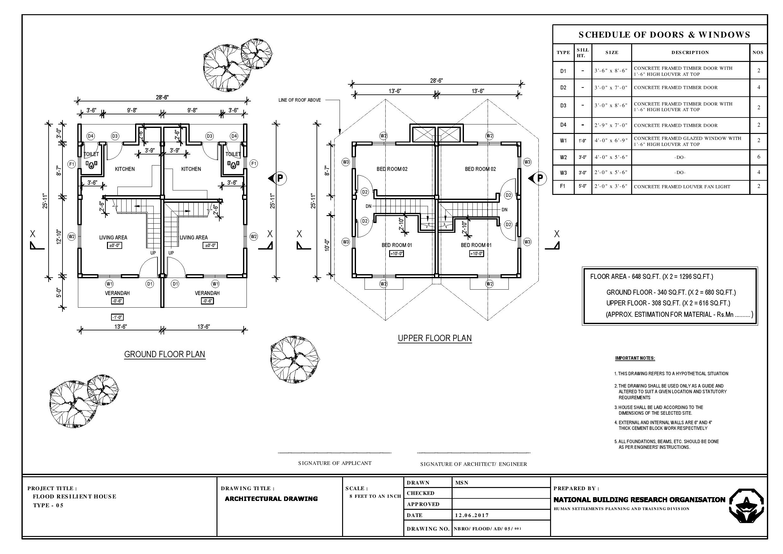
CLUSTER HOUSING

Slide 24
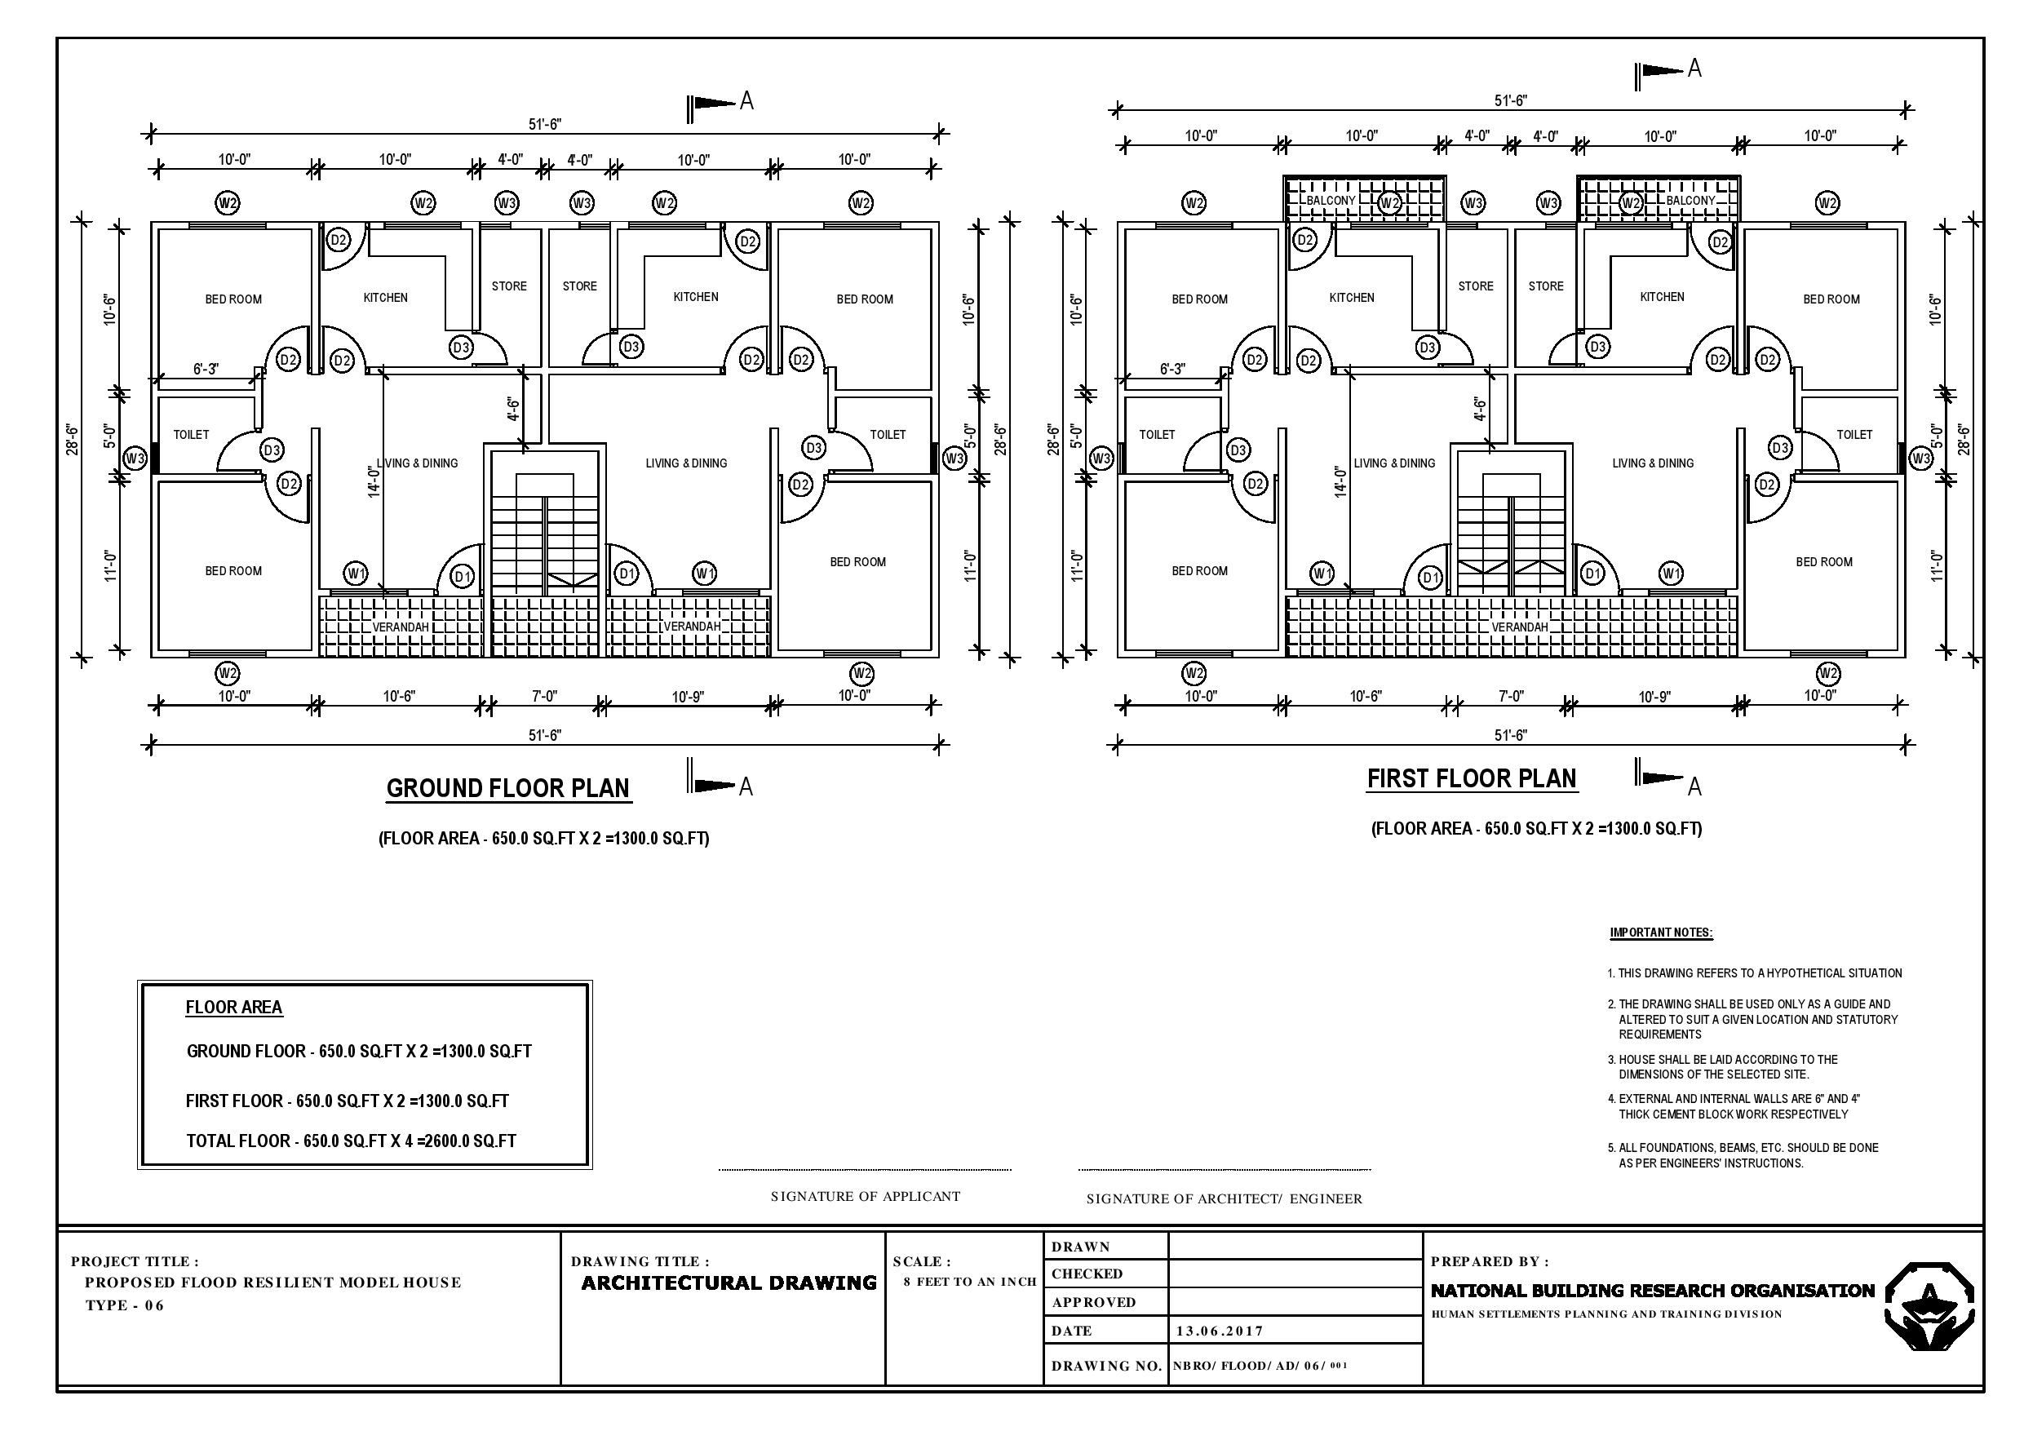

Slide 25


No
Safe Site ?
Yes
No risk
Prohibited zone (high risk)
Restricted zone (medium risk)
Warning zone
(low risk)
Resettlement
Reconstruction in-situ with resilient features
Fully Damaged (>40%)
Partially Damaged (<40%)
Fully Damaged (>40%)
Partially Damaged (<40%)
All: technical support
SUPPORT OPTIONS
Transitional /core shelter?
Transitional/core shelter?
Shelter
Repair Kit/Cash
Transitional/core shelter?
Shelter
Repair Kit/Cash
Govt financial assistance 1.2m on
sites identified by government
Owner selected sites or house:
Govt financial assistance for house purchase (with land) up to 1.6m
Govt financial assistance 1.2m
NITF Insurance
Govt financial assistance 1.2m
NITF Insurance
GOVERNMENT RESPONSE

Slide 26
Prohibited zone (high risk)
Restricted (medium risk)
Warning (low risk)
No risk
Average
Timeline
Resettlement
Reconstruction in-situ with resilient features
Fully Damaged (>40%)
Partially Damaged (<40%)
Fully Damaged (>40%)
Partially Damaged (<40%)
1
2
Evacuation site
Services
In situ
3
$ Installment 1 x LKR 10,000
4
Host family / Rental home
$ Rental support 3 x LKR 7,500
5
6
7
Re-location
Re-construction
8
Govt financial assistance 1.2 – 1.6 m
Govt financial assistance 1.2m
Govt financial assistance 1.2m
9
NITF Insurance
NITF Insurance
10
Land preparation, excavation and completion LKR 150,000
11
Completion up to roof level and supply of timber
LKR 300,000
12
13
Completion of roof
LKR 450,000
GOVERNMENT RESPONSE
14
15
Completion of Core-house – Doors and Windows, Plastering, Finishing and Painting
LKR 300,000
16

Slide 27
Prohibited zone (high risk)
Restricted (medium risk)
Warning (low risk)
No risk
Average
Timeline
Resettlement
Reconstruction in-situ with resilient features
Fully Damaged (>40%)
Partially Damaged (<40%)
Fully Damaged (>40%)
Partially Damaged (<40%)
1
2
Evacuation site
Services
In situ
3
$ Installment 1 x LKR 10,000
4
Host family / Rental home
$ Rental support 3 x LKR 7,500
5
6
HUMANITARIAN
SUPPORT OPTIONS
7
All: technical support
Re-location
Re-construction
8
Transitional /core shelter?
Transitional/core shelter?
Shelter
Repair Kit/Cash
Transitional/core shelter?
Shelter
Repair Kit/Cash
Govt financial assistance 1.2 – 1.6 m
Govt financial assistance 1.2 m
OR
NITF Insurance ?
NITF Insurance
Relocation
Re-construction
9
10
Land preparation, excavation and completion LKR 150,000
11
Completion up to roof level and supply of timber
LKR 300,000
12
13
Completion of roof
LKR 450,000
GOVERNMENT RESPONSE
14
15
Completion of Core-house – Doors and Windows, Plastering, Finishing and Painting
LKR 300,000
16

Slide 28
Displacement Tracking Matrix
(DTM)
https://app.powerbi.com/view?r=eyJrIjoiZThjNmRiZTgtMjY2NC00YTEzLWFhYzMtZTlkODlkMzI4NTllIiwidCI6IjliNWVkNDg5LWZiOWEtNDVmMi04MTBjLTkyNmFlNDdjZjMzOCIsImMiOjEwfQ%3D%3D

Slide 29
District Updates
ToRs finalised
Focal points
  WASH update
    World Vision – Kaluthra
    LEADS – Ratnapura and Matara
    Oxfam – Galle
  Shelter update
    World Vision: Ratnapura
    UN Habitat: Galle & Kalutara
    Save the Children: Matara

Slide 30
Update by Oxfam
Started Latrine damage assessment in Kalutara
4 Camps assessed (Kalutara - 2, Ratnapura - 2)
  Kalutara (Vogan Estate – 54 families & Geekeyanakanda – 10 families)
    Lack of WASH facilities
    Oxfam is working
  Ratnapura (Elapatha – 48 families & Kalathuwava Thikiyakala School ground – 22 familes)
    Elapatha – World Vision is working
    Kalathuwava – Lack of WASH facilities and Oxfam committed to work

Slide 31
Oxfam…
Circulated the Latrine assessment report from PS – Bulathsinhala
Latrine intervention discussion

Slide 32
Ratnapura schools works
By Plan International Sri Lanka
Observations
Damages to the water distribution lines, wells polluted with flood water , water pumps,
Damages the handwashing points / removal of taps, soap trays,
Damages to the toilets (broken doors, taps)
Drainage systems are blocked
Overuse of WASH facilities if the school is used as a camp
Lack /absence/removal of taps, soap trays and absences of cleaning material (disinfectants, brushes, wipers, dustbins)
Poor waste management practices
Debris and water logged locations
Certain schools are still closed
Flood is regular event for most of the schools

Slide 33
Challenges
Lack of detailed data about the damages WASH facilities
Results of Rapid WASH Assessment in schools
Difficulty in verifying flood caused damages
Funds are short term (time factor)
School vacations
Government examinations in August where major constructions are prohibited during the exam period.
Distances among schools
Time limitations for software activities

Slide 34
Web Details
www.sheltercluster.org
https://www.sheltercluster.org/response/sri-lanka-floods-2017
Damage data visualisation:
https://public.tableau.com/profile/methunan#!/vizhome/SriLanka-DamageDataTable/SummaryDamage-District
Damage data table: https://public.tableau.com/profile/methunan#!/vizhome/SriLanka-DamageDataTable/Datatable?publish=yes
DTM: https://app.powerbi.com/view?r=eyJrIjoiZThjNmRiZTgtMjY2NC00YTEzLWFhYzMtZTlkODlkMzI4NTllIiwidCI6IjliNWVkNDg5LWZiOWEtNDVmMi04MTBjLTkyNmFlNDdjZjMzOCIsImMiOjEwfQ%3D%3D

