Slide 1
NWSW Shelter Cluster Meeting
6th April 2022
Teams Meeting

Slide 2
Action Points from Last Meeting
Action Point | Update from Cluster Team/Partners
Shelter Cluster Partners to provide inputs and feedback to Activity matrix | No replies thus far despite reminders circulated; partners to review and to complete during upcoming strategy workshops
Shelter Cluster partners to provide feedback to the Assessment Tracker | No feedback; if no further feedback, will make active on website
Cluster Coordination Performance Monitoring | Completed and circulated to partners
5W Tool | Updates to tool made- request for March reports are due on 9th April; Walk through in today’s meeting

Slide 3
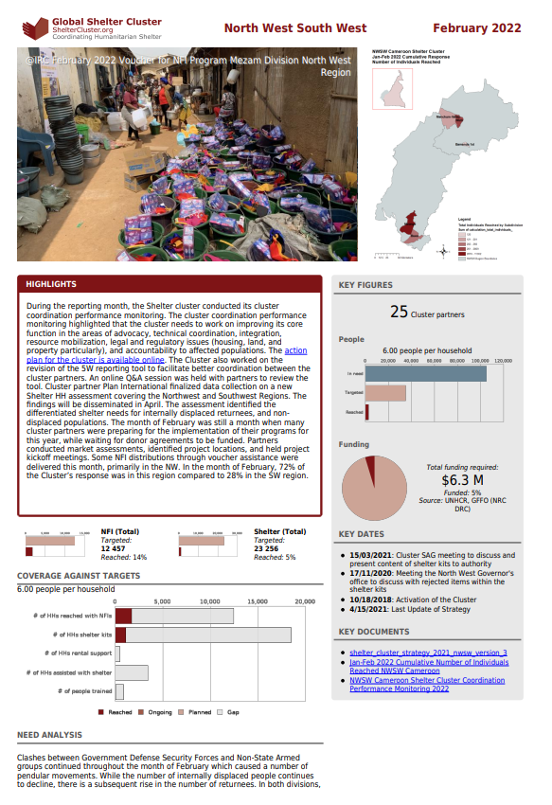
February Factsheet
https://sheltercluster.org/north-west-south-west/factsheets/2022-02

Slide 4
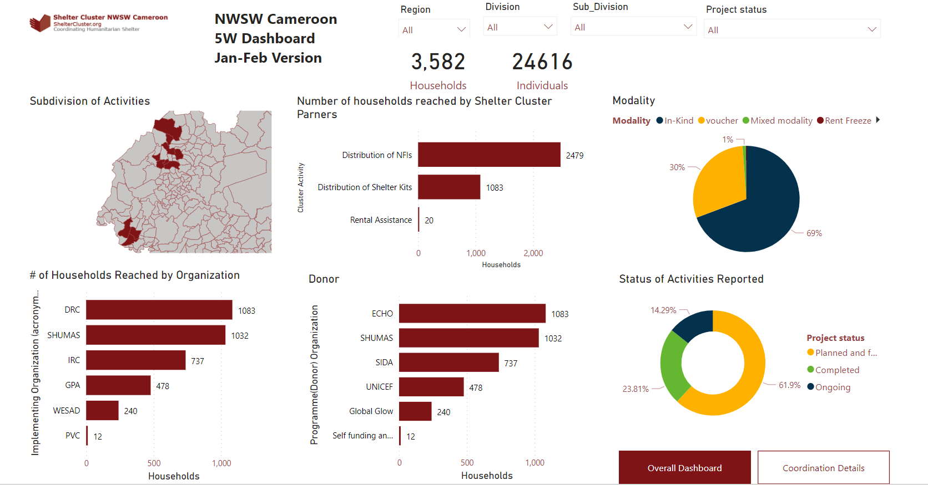
Dashboard for Operational Coordination

Slide 5
5W
Walk through of Kobo tool: https://enketo.unhcr.org/x/q1JyQvk8
One entry per location
New Deadline: 9th April
Please do get in touch if having challenges
Need to report planned activities for improved coordination

Slide 6
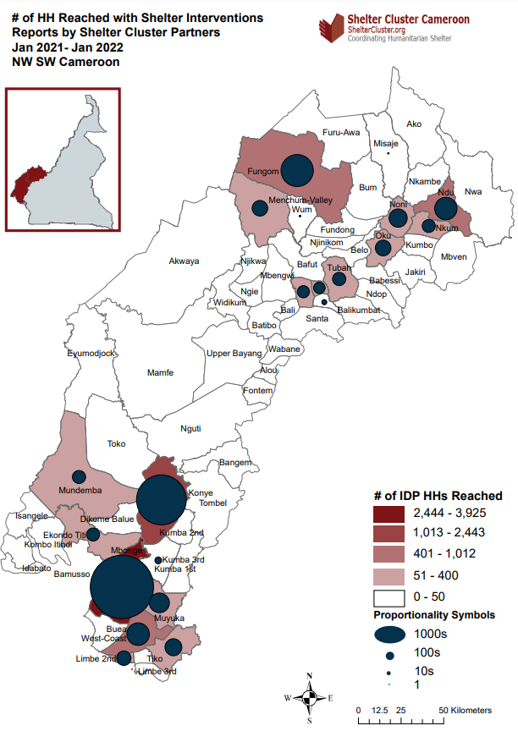
Access Strategy
Presentation of NWSW Access Strategy - Roel
What is the feedback of Shelter Cluster partners on their access issues? How is this impacting our response in Shelter? How in NFI?
(Think back to the analysis of our 2021 Annual Response)

Slide 7
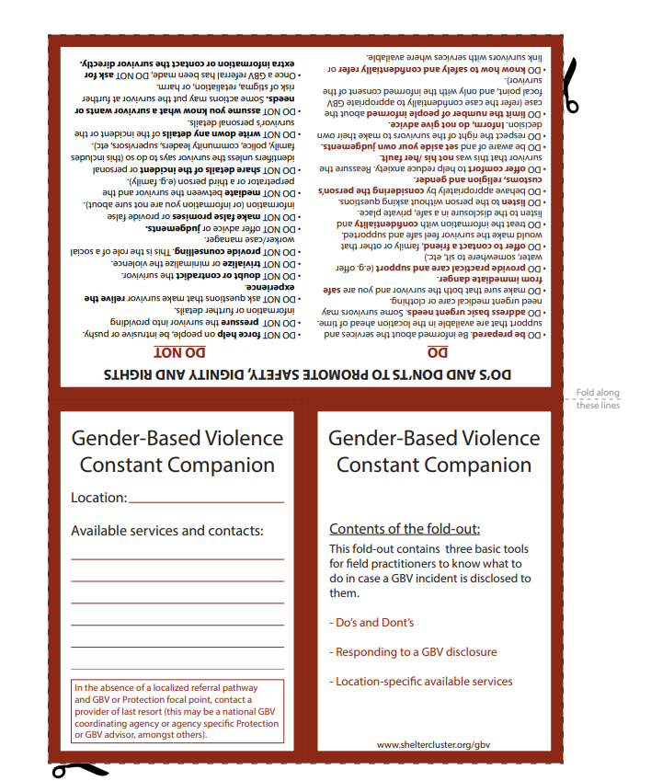
GBV mainstreaming in Shelter Interventions and NWSW Referral pathways
GBV Disclosure in Shelter interventions video
Presentation by GBV AoR on NWSW Cameroon Referral Pathways
Pocket Companion: https://sheltercluster.s3.eu-central-1.amazonaws.com/public/docs/constant_companion-_english-_v6.pdf

Slide 8
Disability Mainstreaming in Shelter Interventions
Presentation by Coordinating Unit of Organizations of Persons with Disabilities

Slide 9
Updates from Agencies

Slide 10
AOB
Microsoft Teams channel for better collaboration

