Slide 1
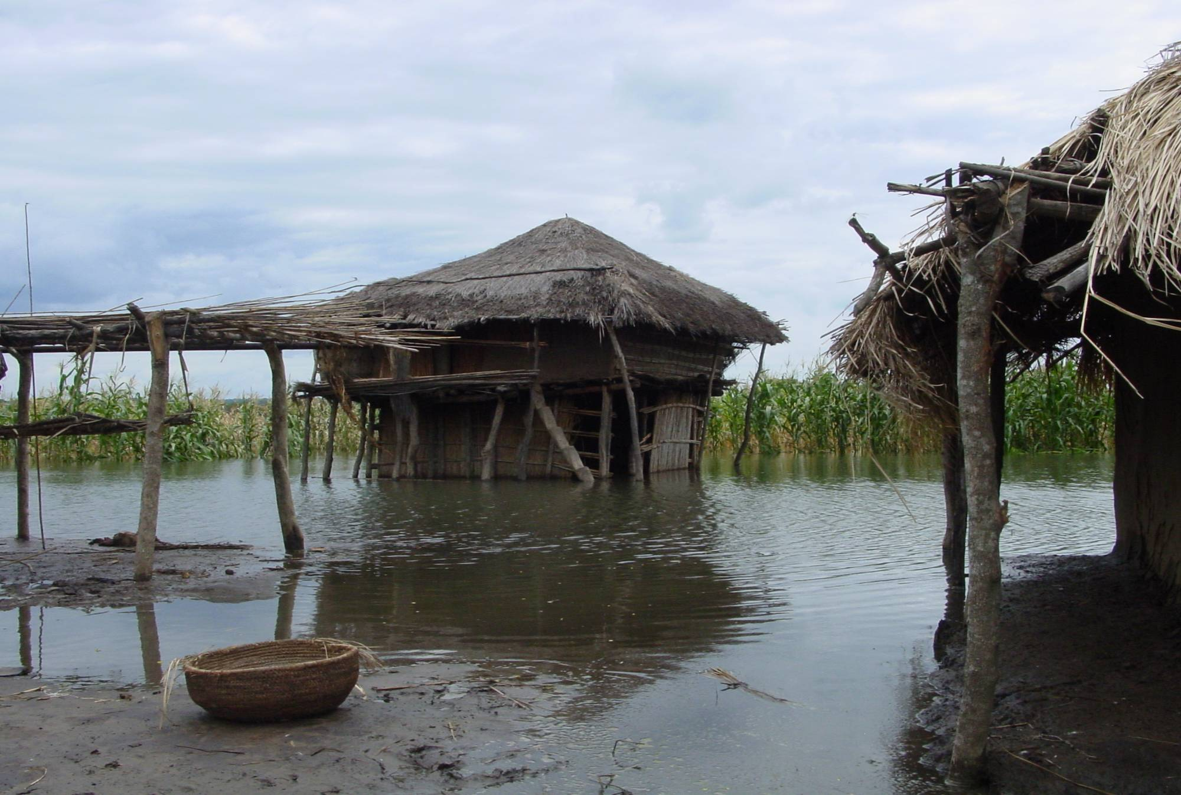
IFRC SHELTER COORDINATION WORKSHOP 2011
CYCLONE GIRI – OCTOBER 2010

Slide 2
Background
IFRC SHELTER COORDINATION WORKSHOP 2011
Made landfall in Rakhine State at 8pm, Friday, 22 October 2010
Comparable in strength to Cyclone Nargis
Cyclone Giri, category 4
Loss of life, less than 100 persons – Nargis over 100,000
Why?
CYCLONE GIRI – OCTOBER 2010

Slide 3
Background
Lesson learnt.............
Two days prior to Giri the Myanmar Red Cross Society (MRCS) and Government began the early warning and evacuation
Most residents were moved either to higher ground, conveniently located within kilometers of the coast, or to strong buildings located close by

Slide 4
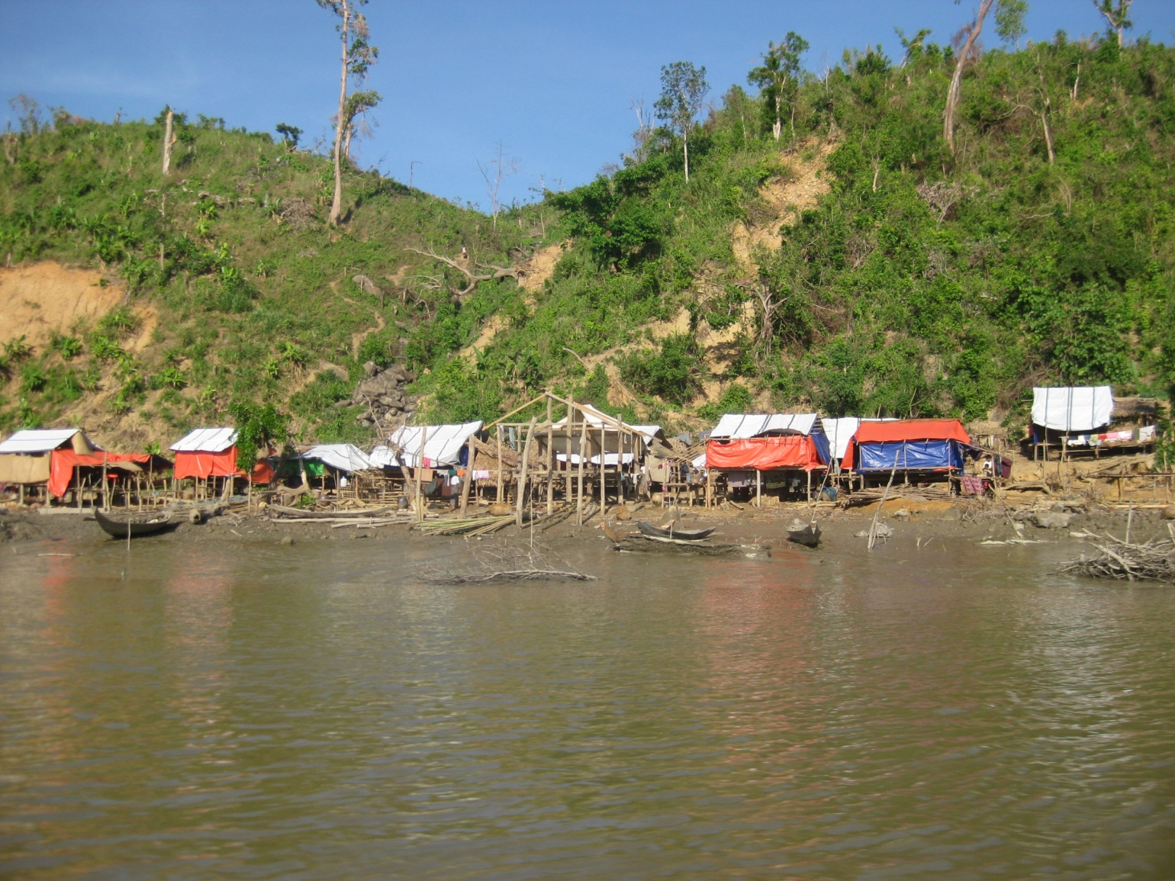
IFRC SHELTER COORDINATION WORKSHOP 2011
CYCLONE GIRI – OCTOBER 2010

Slide 5
Response
IFRC SHELTER COORDINATION WORKSHOP 2011
Like Nargis, Giri occurred just before National elections
Like Nargis, visa applications were ‘delayed’
Low profile response was requested by Government
“Informal” clusters “activated” after 2-3 days
“Formal” clusters activated after 14-15 days
No appeals – CERF/DREF only
No ‘new’ responding agency
CYCLONE GIRI – OCTOBER 2010

Slide 6
Shelter Cluster
IFRC SHELTER COORDINATION WORKSHOP 2011
3 days after Giri, IFRC convened the first ‘informal’ Emergency Shelter and NFI cluster (ESC)
For 3 weeks ESC was managed with existing in-country international staff with support from KL
When the clusters were formally activated, IFRC sent for 2 months, two Myanmar staff with international ESC experience as information managers
IFRC was the only organisation to send a dedicated team
CYCLONE GIRI – OCTOBER 2010

Slide 7
Achievements
IFRC SHELTER COORDINATION WORKSHOP 2011
70% of the affected population had emergency shelter materials by the end of January
~ 50% had non-food items (NFI)
CYCLONE GIRI – OCTOBER 2010

Slide 8
Coordination
IFRC SHELTER COORDINATION WORKSHOP 2011
2 x Myanmar nationals, an important precedent
Supported remotely via the Zone and Global offices
Difficulties with perception of other lead agencies!!
Coordination teams job was further complicated as OCHA/MIMU did not always use and reinforce the cluster as the primary source of information
CYCLONE GIRI – OCTOBER 2010

Slide 9
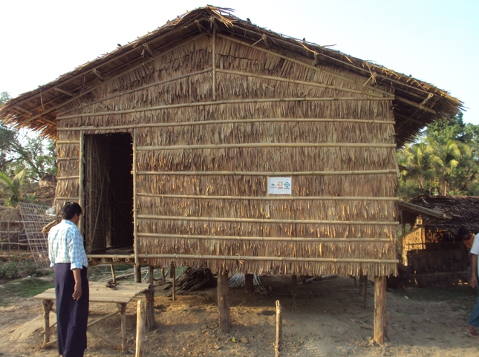
IFRC SHELTER COORDINATION WORKSHOP 2011
CYCLONE GIRI – OCTOBER 2010

Slide 10
Recommendations
IFRC SHELTER COORDINATION WORKSHOP 2011
IFRC must advocate for stronger emergency response protocols that cannot be compromised and stronger humanitarian leadership when deciding to respond in a disaster, this may include advocacy for a separation of the humanitarian and resident coordinator functions particularly when they are in conflict. IFRC must advocate for a “do or don’t” approach to clusters as informal activation risks compromising the agencies’ accountability given confusion over roles and responsibilities.
CYCLONE GIRI – OCTOBER 2010

Slide 11
Recommendations
IFRC SHELTER COORDINATION WORKSHOP 2011
: IFRC needs to stay engaged in ongoing discussions in Geneva to strengthen leadership, management, participation and protocols for inter-cluster coordination (building on the draft Guidance for Inter-cluster Coordination). And ensure this translates to better performance at field level through regular contact with local ESC teams
CYCLONE GIRI – OCTOBER 2010

Slide 12
Recommendations
IFRC SHELTER COORDINATION WORKSHOP 2011
IFRC and shelter partners have developed extensive guidelines and both technical and managerial support material for emergency shelter. The same attention needs to be paid to Non-Food Items (NFI).
CYCLONE GIRI – OCTOBER 2010

Slide 13
Recommendations
IFRC SHELTER COORDINATION WORKSHOP 2011
IFRC can do more to provide the support needed to a national ESC team. A Myanmar team comes with many advantages that address common criticisms of clusters. But these advantages need to be exploited and any disadvantages coped with, including more continuous technical support from the region, more personalized support from the IFRC delegation in Myanmar and the HoD, including the facilitating of good relations with the MRCS, and promoting accountability within the cluster system by direct interaction with the RC/HC, and attending inter-cluster coordination when necessary
CYCLONE GIRI – OCTOBER 2010

Slide 14
Recommendations
IFRC SHELTER COORDINATION WORKSHOP 2011
......... in small or medium disasters where the humanitarian response has few and/or no new actors, is limited in geographic scope and scale, and does not require significant resource mobilisation or advocacy, the need for full cluster coordination team deployment needs to be reviewed........
CYCLONE GIRI – OCTOBER 2010

Slide 15
IFRC SHELTER COORDINATION WORKSHOP 2011
IFRC/ESC must demand effective leadership in emergency protocols (R1) but also inter-cluster meetings, CERF negotiations and addressing disaster-specific coordination problems. When there are issues around perceived lack of leadership (RC/HC and OCHA), or perceived lack of competence of cluster coordinators, regardless of how (in)valid these concerns are a protocol must be in place to manage them. Similarly, the role of the HoD and accountability for (non technical) performance has to be further defined as the Head of Delegation could play an important role in providing essential in-country feedback and guidance on the performance of the coordinator
CYCLONE GIRI – OCTOBER 2010

