Slide 1
Information Management - CoP
Shelter Cluster Website
Coffee Break
05 May 2022

Slide 2
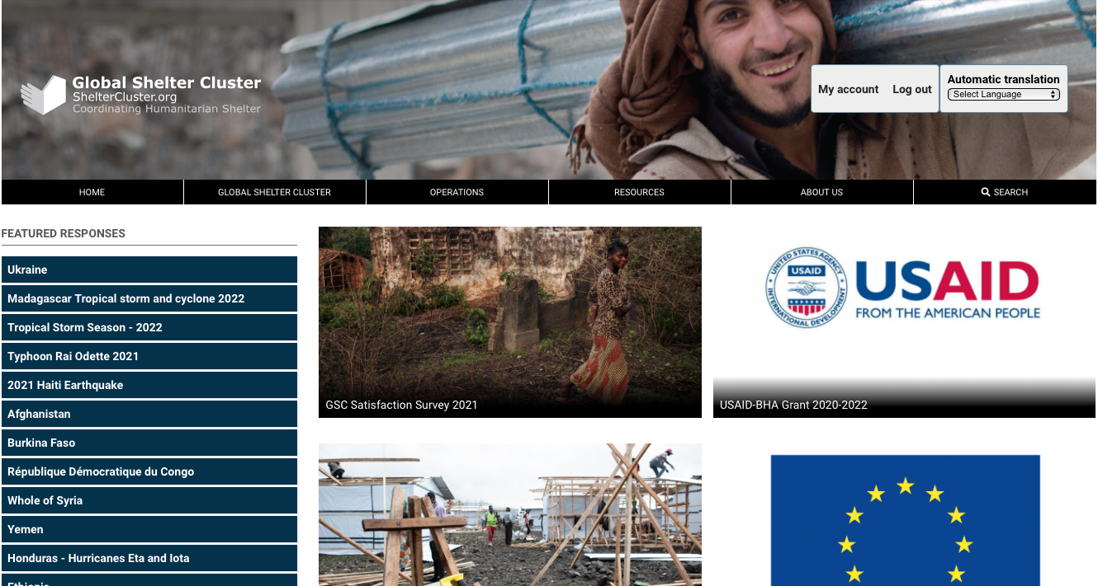
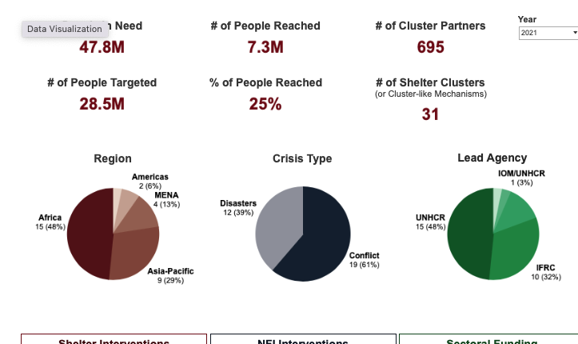
Background
ShelterCluster.org originally developed as a SharePoint Site – 2008
2013-14 migrated to Drupal 7
2019 Announced that Drupal 7 would no longer be supported – migration to Drupal 9 necessary
Security
New features
More sustainable management
Plus….Drupal 7 end of life

Slide 3
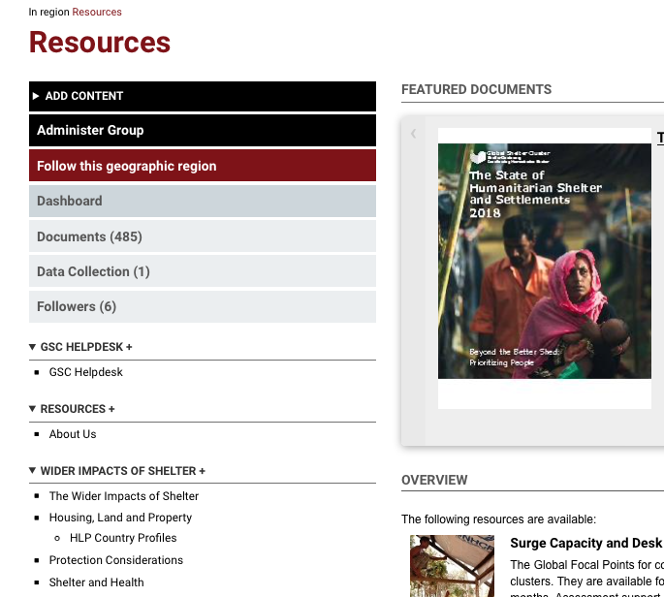
Vision
Vision
Provide at least feature parity
Provide a Knowledge Management platform for the cluster
Act as a tool to support coordination
Be a resource for cluster partners
Components
Website
Mobile App (Android, iOS)
subdomains

Slide 4
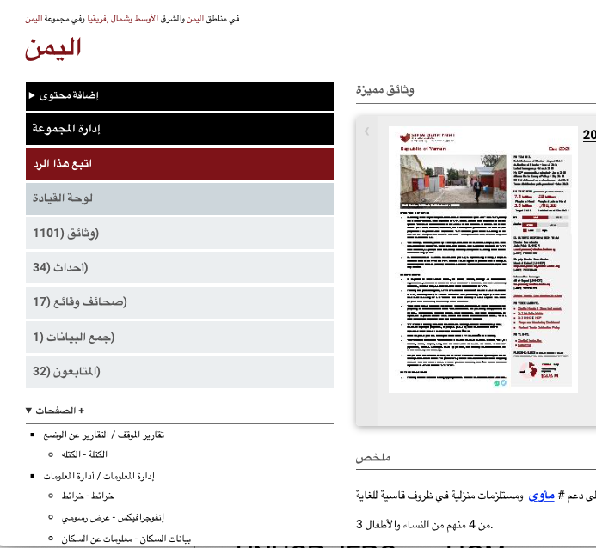
Migration process
Three phased development process
Funding from multiple sources, multiple agencies
Took place from December 2020 to March 2022
Special thanks to Impact Initiatives, UNHCR, IFRC, IOM, CRC, BHA

Slide 5
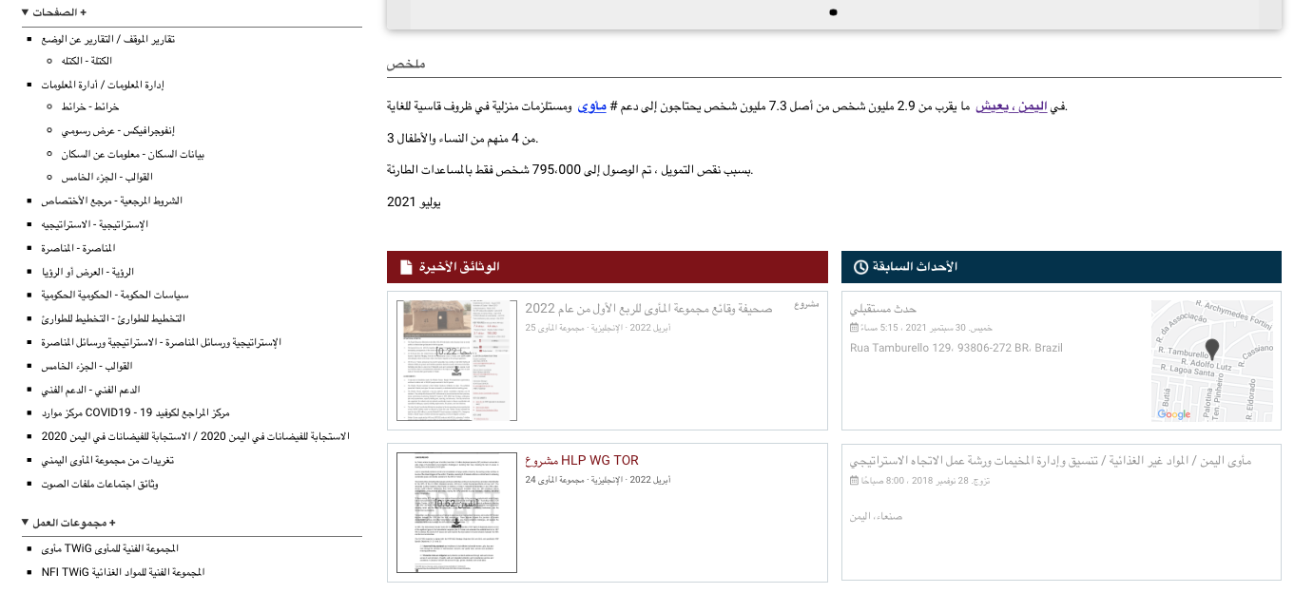
Some Key Site Improvements - Visible
Automatic translation of interface

Slide 6
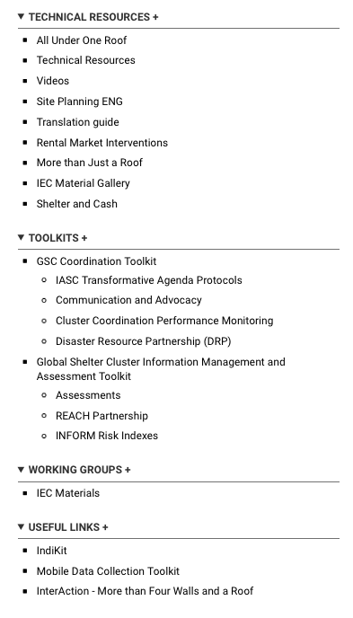
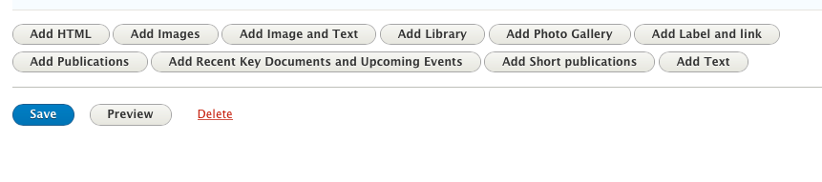
Some Key Site Improvements - Visible
More control over page design and navigation

Slide 7
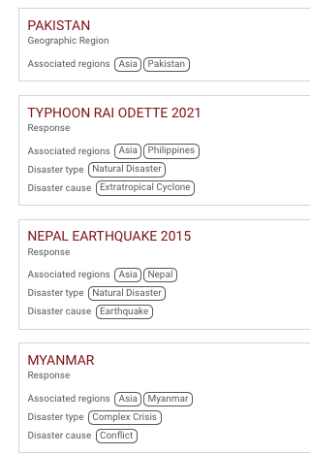
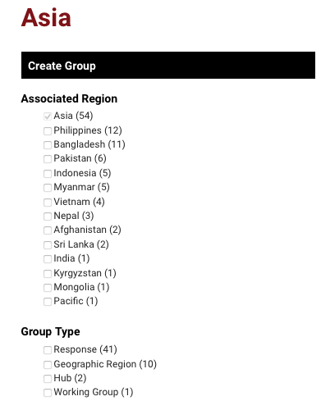
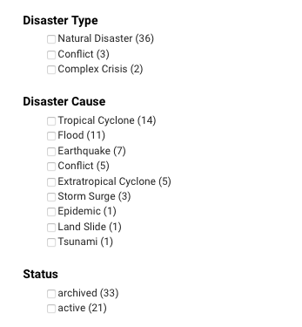
Some Key Site Improvements - Visible
Content organized using taxonomy terms

Slide 8
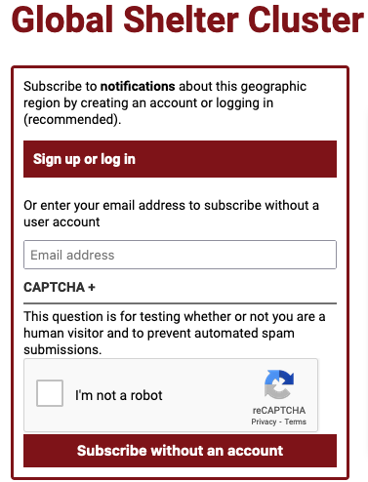
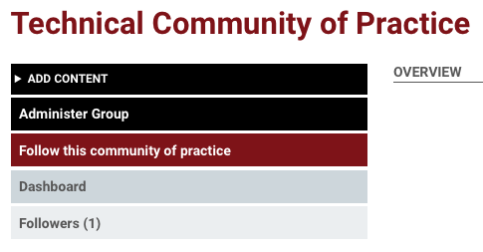
Some Key Site Improvements - Visible
More communication tools and user engagement

Slide 9
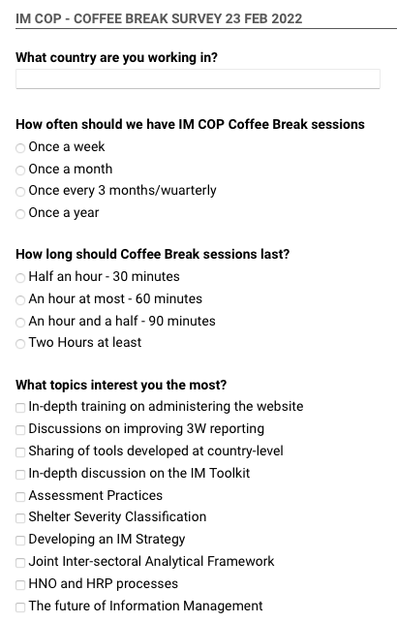
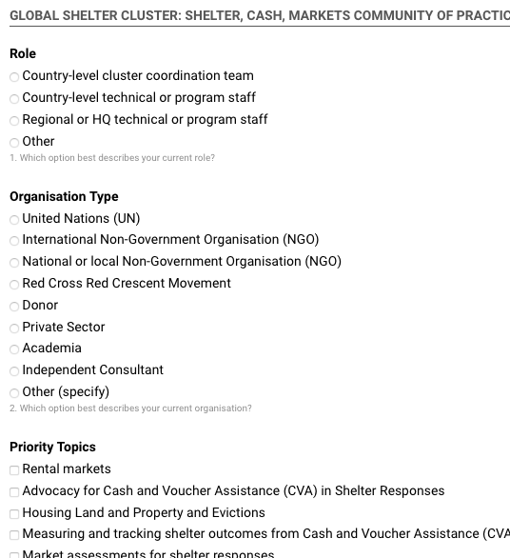
Some Key Site Improvements - Visible
Data collection tools

Slide 10
Some Key Site Improvements - Invisible
Upgradability
Improved usage by mobile devices
Search improvements, speed
Modular site architecture
Flexibility with taxonomy, tagging, etc.
Factsheets, data collection
Fixed many bugs
Continuing
Learning.ShelterCluster.org
IEC.ShelterCluster.org

Slide 11
Possible next steps
Develop a long-term website development strategy
Improve integration with other websites
Simplify process of adding content
More page design modules
Data-driven responses
Possible improvements to mobile app
Refine communication tools
Events and Calendar integration

Slide 12
Discussion and suggestions
Insights and dashboards from Google analytics
Simplify content tagging mechanism
Simplify taxonomy terms
More design features for operation’s homepage
Discussions and two-way communication mechanism
Auto-translation feature is not always accurate and not allowing corrections
Issues and difficulties on the content management and editing
Critical need to continuously maintain the user list and the coordination team

