Slide 1
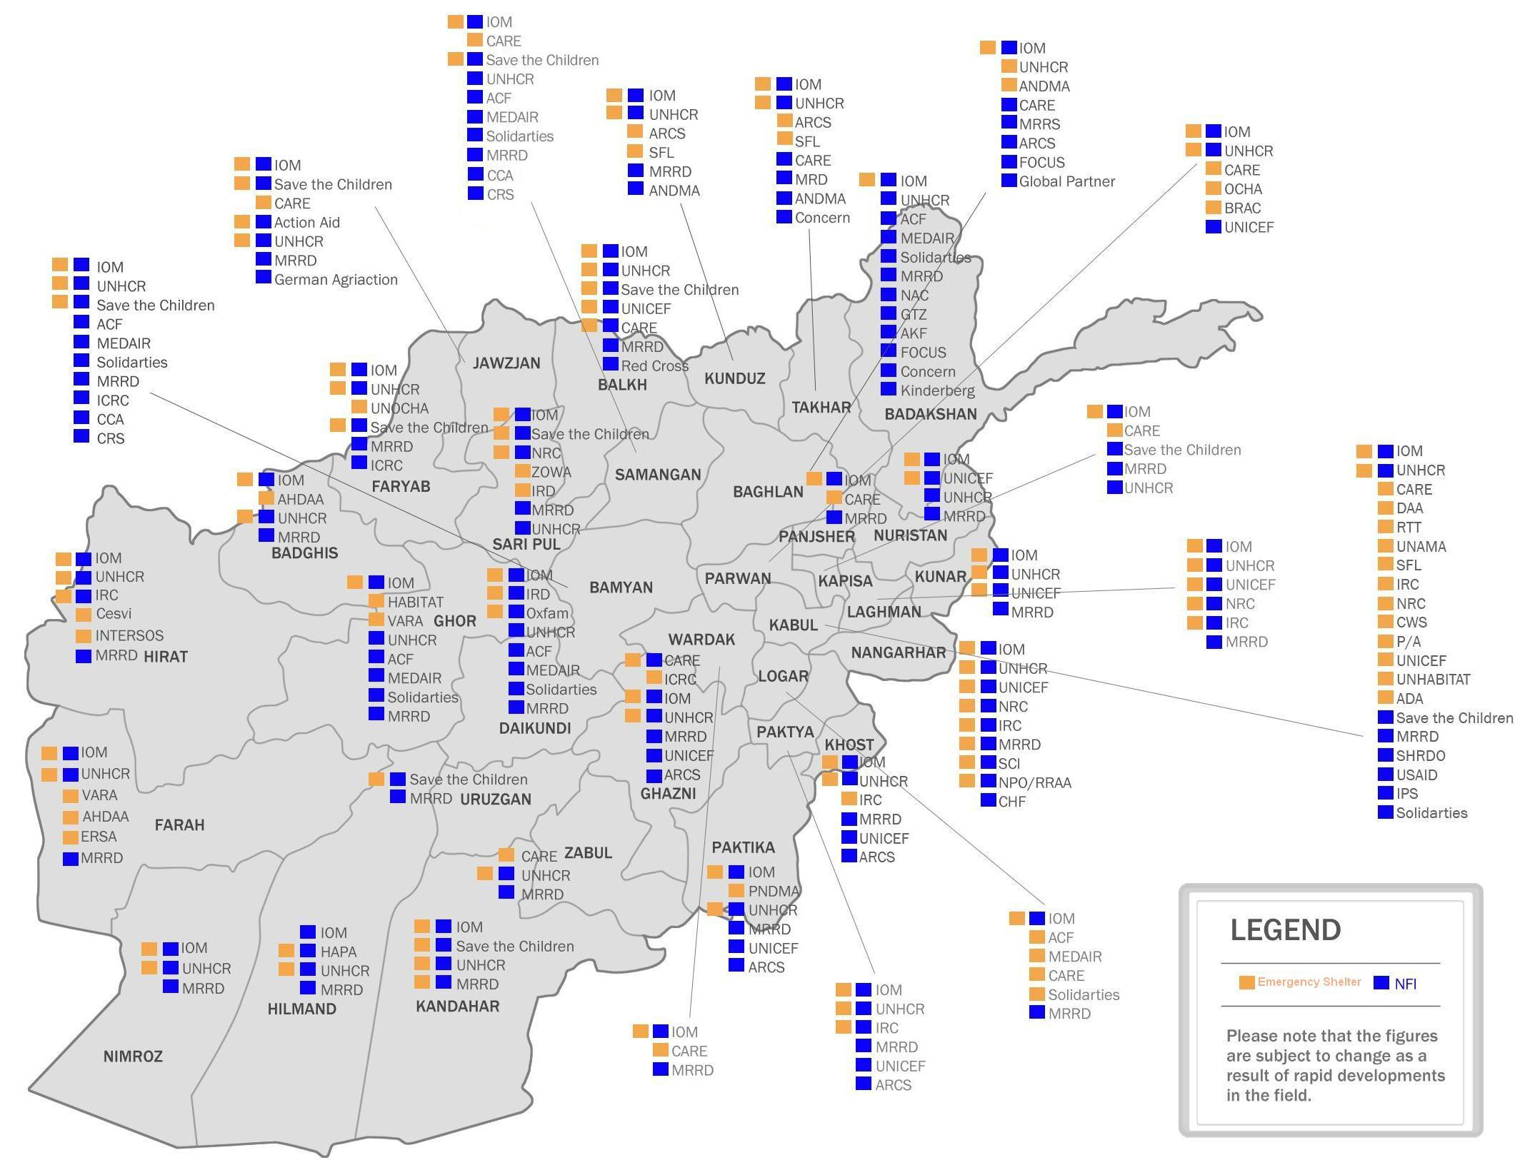
ES and NFIs cluster 3Ws

Slide 2
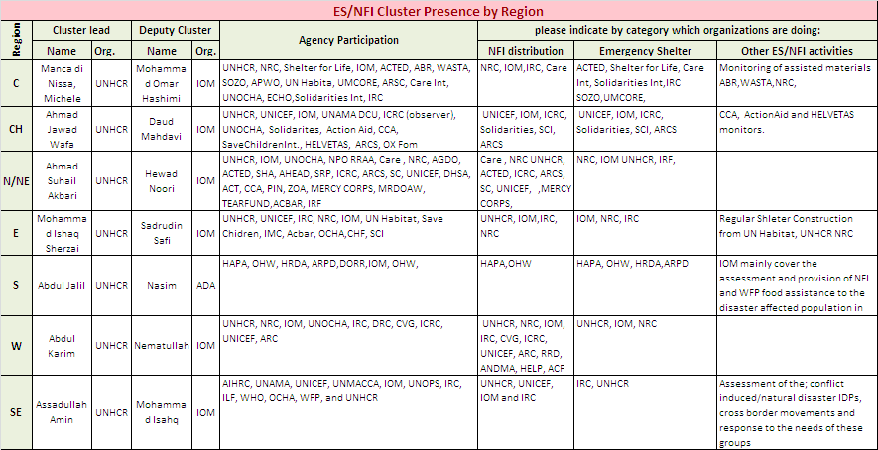
ES and NFIs cluster Presence at the regional level

Slide 3
ES and NFIs cluster - Information/data flow (IDPs)
Info about new conflict or natural disaster displacement received
Info verification and preparation for joint assessment by the ES / NFIs cluster including DoRR/PDMC/ANDMA
Group level Assessment
HoH Assessment
Database
Debriefing
Report, list of IDPs and distribution
Data entry (PMT, HAP)

Slide 4
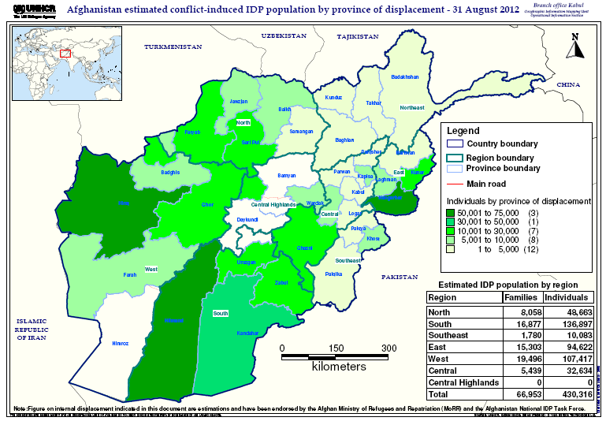
ES and NFIs cluster Needs

Slide 5
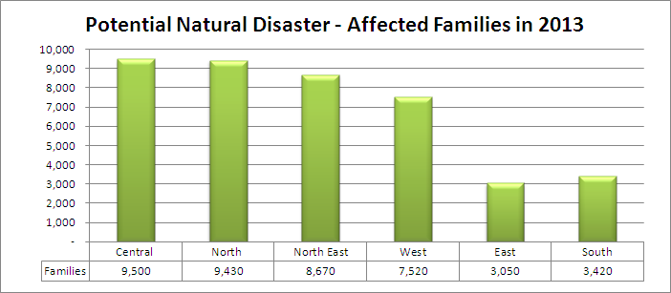
ES and NFIs cluster Needs

