Slide 1
OPS
CAP ONLINE PROJECT DATABASE

Slide 2
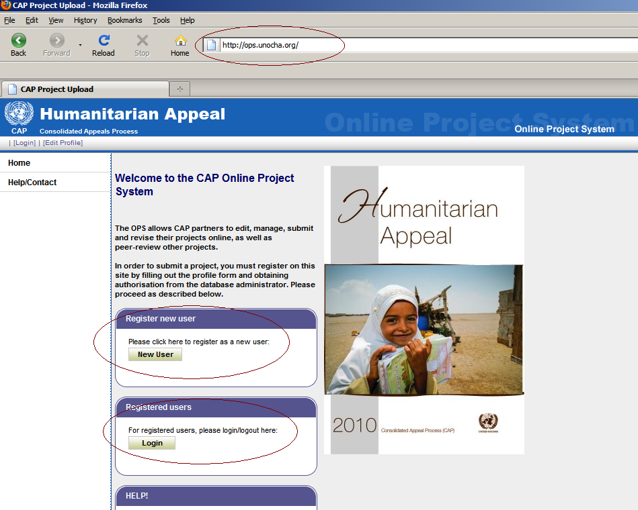
ONLINE PROJECT SYSTEM (OPS)
The OPS allows CAP partners to edit, manage, submit and revise their projects online, as well as peer-review other projects.
Notes:
2

Slide 3
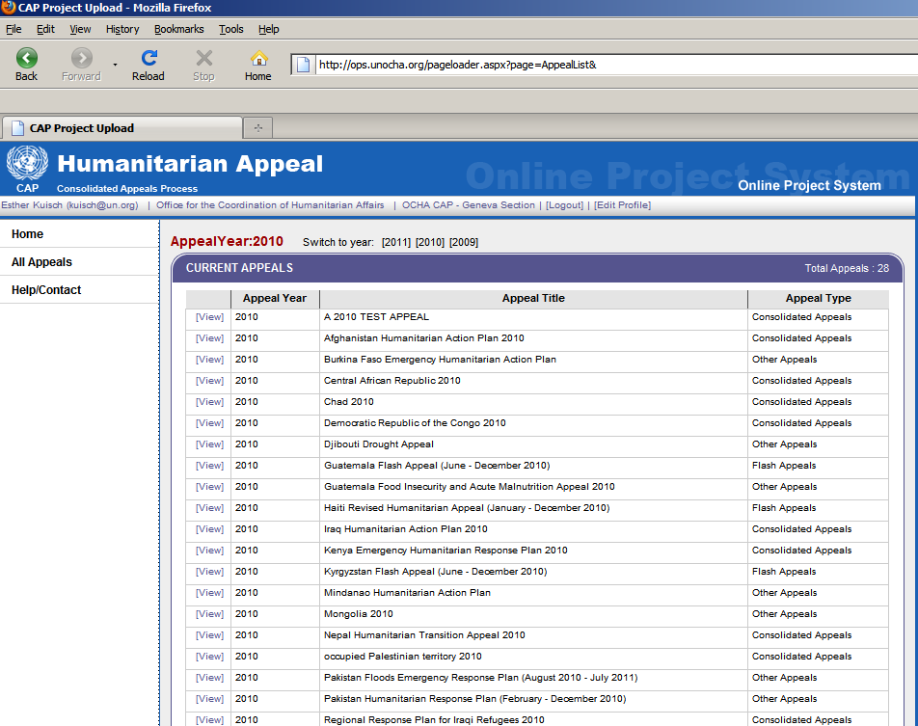
OVERVIEW OF ALL CURRENT APPEALS
Select the appeal in your country by clicking on [View]
Notes:
3

Slide 4
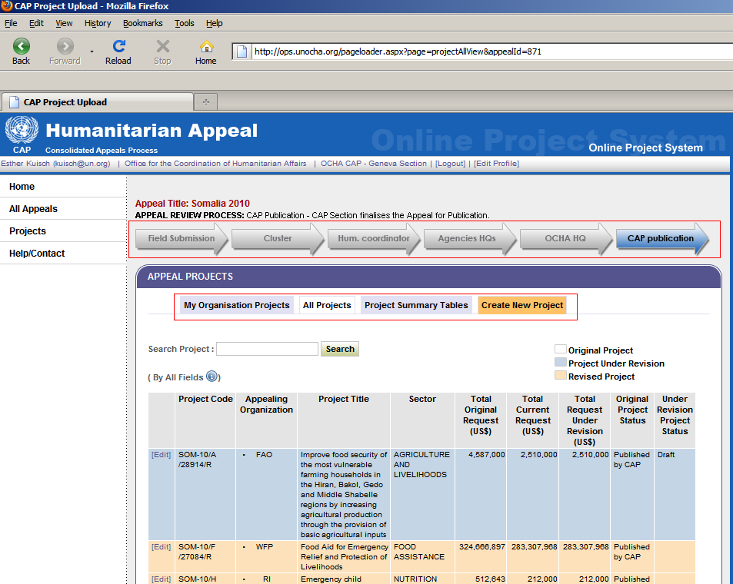
OVERVIEW OF PROJECTS WITHIN AN APPEAL
Overview of projects by your own organisation, all projects, project summary tables by cluster, organisation, project status, location and priority.
Peer review process until CAP publication
Notes:
4

Slide 5
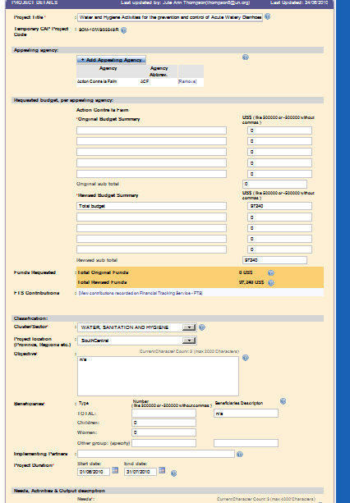
OVERVIEW OF PROJECTS WITHIN AN APPEAL
Create or revise projects of your own organisation and review other projects within your cluster.
Notes:
5

Slide 6
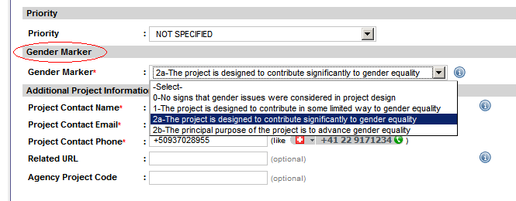
NEW PROJECT FEATURE: GENDER MARKER
Notes:
6

Slide 7
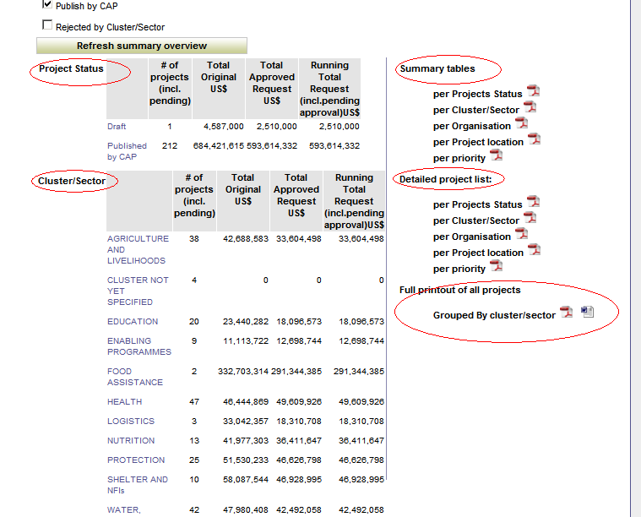
OVERVIEW OF PROJECTS WITHIN AN APPEAL
Summary overview tables
Notes:
7

Slide 8
FTS
FINANCIAL TRACKING SERVICE
http://fts.unocha.org
Notes:
8

Slide 9
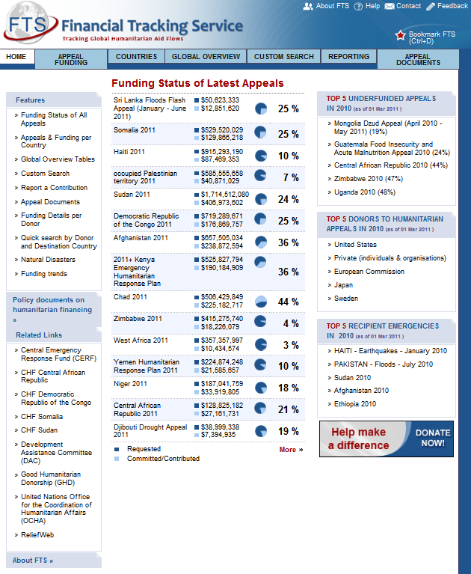
WHAT IS THE FTS?
http://fts.unocha.org
On-line database of humanitarian funding
Contributions to NGOs, UN agencies, Red Cross, affected governments, etc. from all types of donors (including private funding, bilateral donations, etc.)
Notes:
9

Slide 10
WHAT DOES FTS ALLOW YOU TO DO?
Monitor funding status of any appeal: per agency, per sector/cluster, per priority, location, and project – thus highlighting funding gaps.
Monitor humanitarian funding outside the appeal, identify donors and recipient organizations for activities not included in the appeal. Important indicator of inclusiveness of the clusters and CAP process!
Notes:
10

Slide 11
WHAT DOES FTS ALLOW YOU TO DO?
Donor profiles – quick overviews of humanitarian funding by any given donor to a specific country or globally.
Analyze funding trends – global trends by donor, sector/cluster, emergency or recipient agency.
Notes:
11

Slide 12
HOW FTS CAN HELP YOU
Facilitate advocacy efforts: by identifying areas with the greatest resource needs, highlighting neglected emergencies, under-funded organizations, sectors/clusters, and locations in country.
Better targeted fundraising: FTS allows organizations to see which donors are funding what. By analyzing donor interests and funding trends they can better target fundraising efforts.
Save staff time: by providing information and analysis at your fingertips.
Notes:
12

Slide 13
HOW FTS CAN HELP YOU
Coordination: offering information at a glance on which implementing organizations and donors are working in which emergencies, sectors/clusters, locations, and to what scale.
CAP/Flash Appeal visibility: FTS helps to draw attention to the humanitarian needs in emergencies and the funding requirements of implementing organizations. FTS provides visibility for projects by showing both the funding requirements and the project description online.
Notes:
13

Slide 14
MAIN FEATURES
At a quick glance:
Most under-funded appeals
Top donors
Top recipient emergencies
Notes:
14

Slide 15
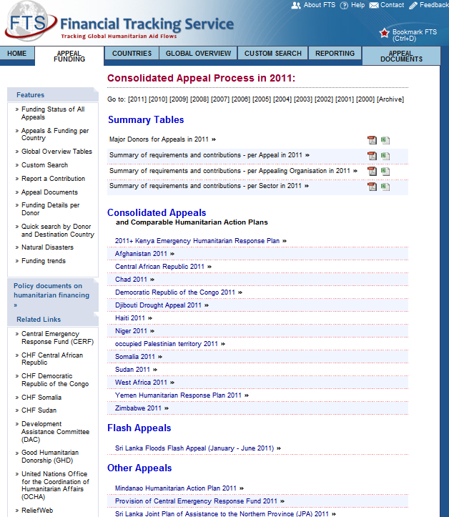
MAIN FEATURES
Funding status of latest appeals
Global overviews
CAPs, FA, other
Full appeal documents
Notes:
15

Slide 16
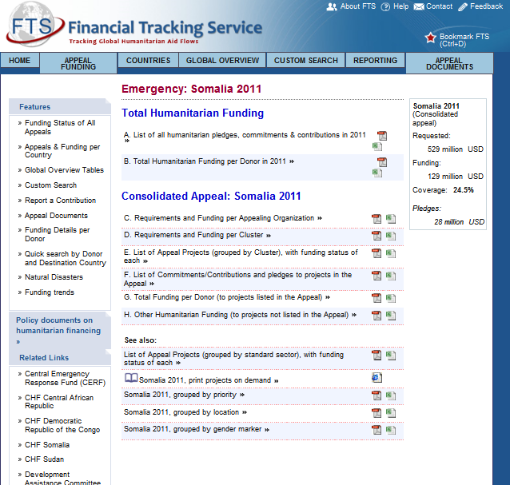
MAIN FEATURES
Emergency pages
Overall funding
Appeal funding
Customized reports
Quick overview
Notes:
16

Slide 17
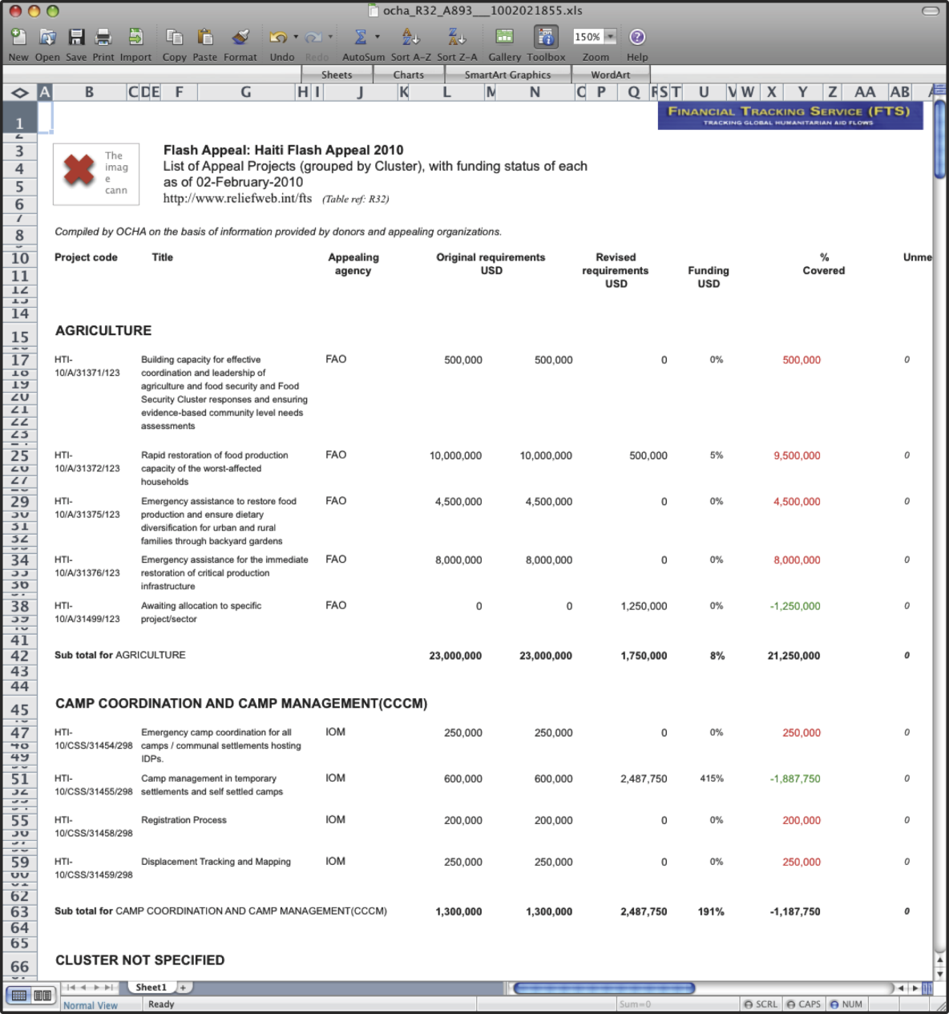
MAIN FEATURES
Detailed report of funding by cluster
View funding status of each appeal project
Compare funding levels by cluster
Hyperlinks to project sheets
Notes:
17

Slide 18
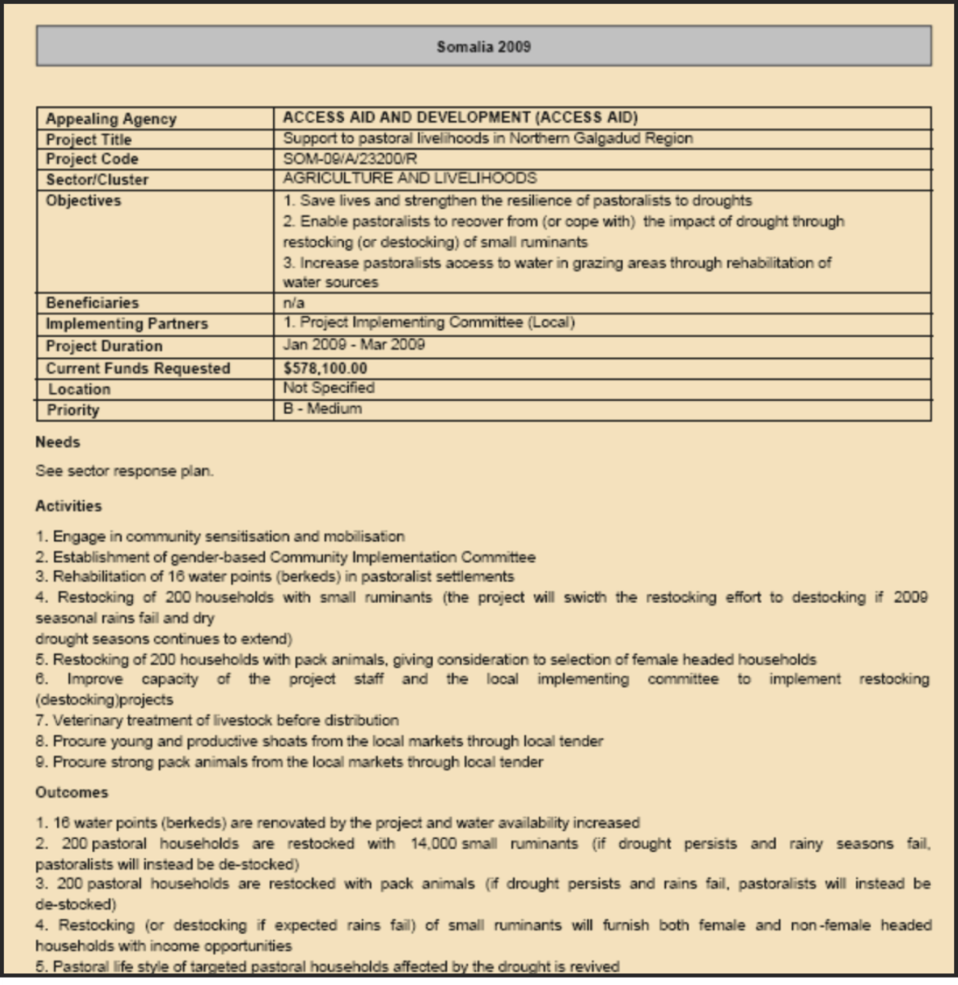
MAIN FEATURES
Project sheets
Interested in a project? Read the full description
Notes:
18

Slide 19
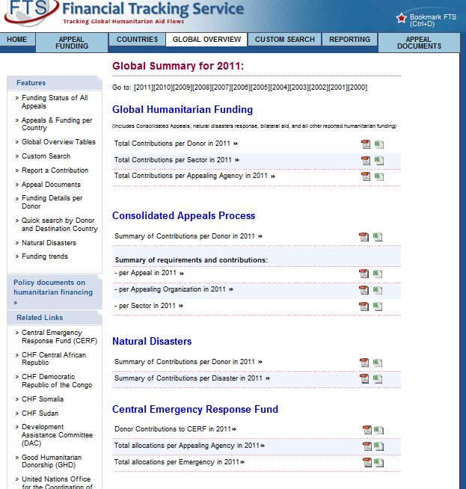
MAIN FEATURES
Global overview
View overall global funding or compare appeals.
See also contributions and allocations from CERF
Notes:
19

Slide 20
MAIN FEATURES
Country-based Pooled Funds
View contributions and allocations from CHFs and ERFs on emergency pages (standard report F) or use the custom search.
Notes:
20

Slide 21
MAIN FEATURES
Notes:
21

Slide 22
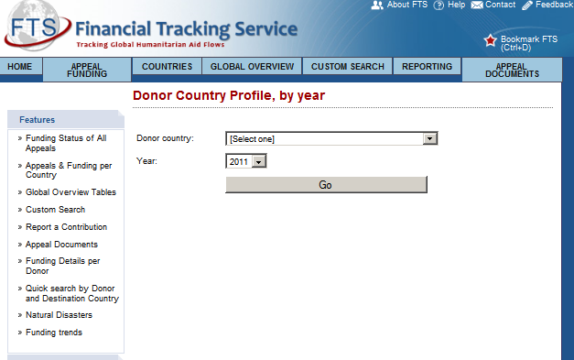
MAIN FEATURES
Want to see what donors are funding?
Donor profiles with breakdown of funding by emergency, sector and recipient agency
Notes:
22

Slide 23
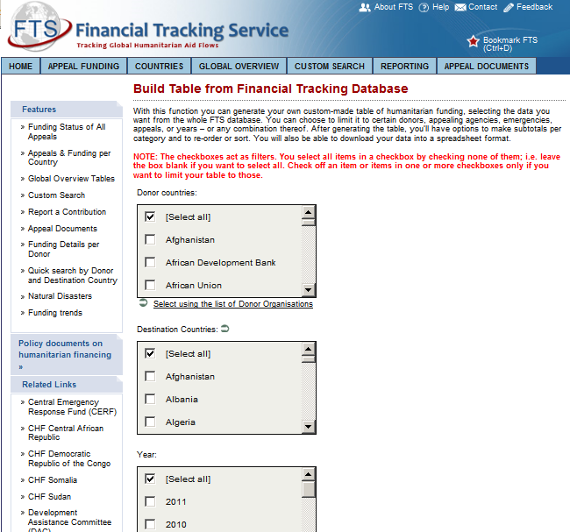
MAIN FEATURES
Looking for something more specific?
Customize your reports
Advanced search for detailed financial analysis
Notes:
23

Slide 24
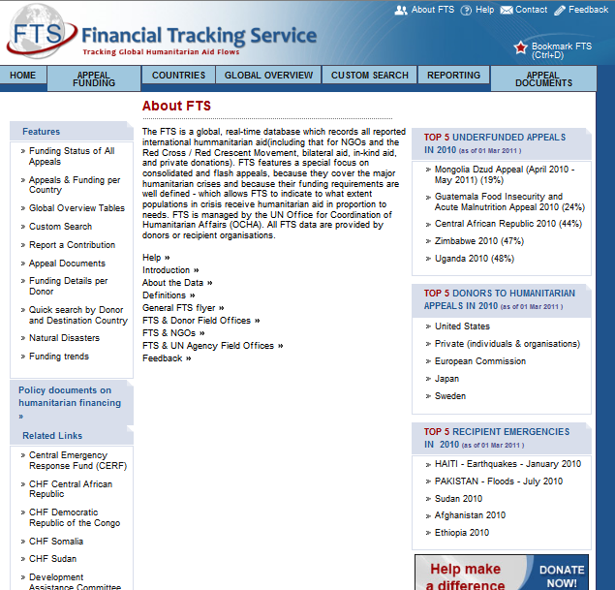
MAIN FEATURES
Need more help?
Have a look at our Help Section
Definitions
Guidance sheets
Notes:
24

Slide 25

WHERE DOES THE INFORMATION COME FROM?
Notes:
25

Slide 26
Time for an exercise!

Slide 27
CONTACTS
FTS --- fts.unocha.org OPS -- ops.unocha.org
Questions ?
fts@un.org Manager, Esther Kuisch-Laroche - kuisch@un.org Phone: +41 22 9173404 Fax: +41 22 9170023

