Slide 1

Greening the shelter response
Mobilising collective efforts towards a greener and climate-smart humanitarian shelter and settlements response
HNPW 2022

Slide 2
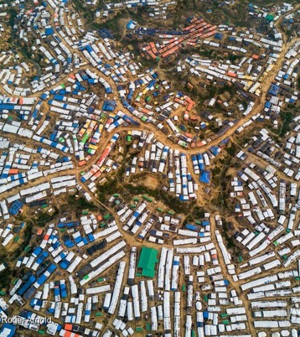
Greening the Global Shelter Response – WHY?
Environmental & Climate Imperatives: Global GG emissions 40% from built environment
Humanitarian commitments (Sphere Standards & Environment and Climate Charter)
Interagency priorities (IASC, agency, system-wide)
Shelter Cluster: Integrated Shelter and Settlement Issues (Inc. NFI, E&E) including issues related to energy consumption at household level
Response to partner and strategy priorities

Slide 3
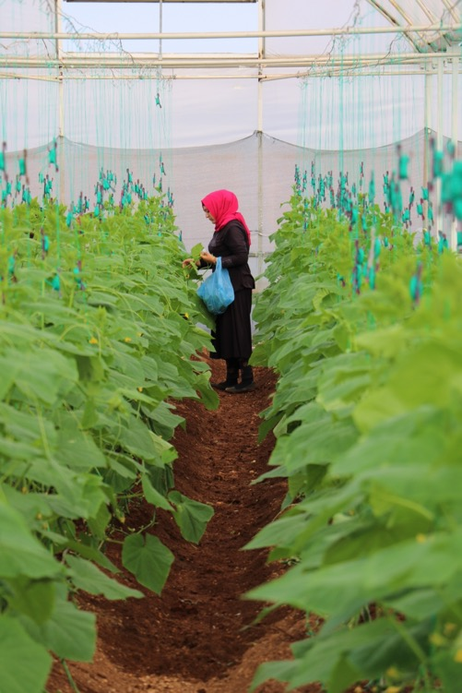
Background: Environment as a GSC priority
Environmentally sustainable Shelter Response = a long-term priority of the Global Shelter Cluster, lead agencies and global partners
Environment Community of Practice: active role for 10 years providing expertise and guidance at global and country level
GSC lobbied for global focal point for environment since 2017
GSC partners led in the development of Sphere Environmental Sustainability Shelter Standard 7
Key role of connecting greening shelter initiatives of lead agencies and global partners
Credit: Francis Moran

Slide 4





Overview
Total Funding: over 930.000 EUR (70% from ECHO, managed by UNHCR)
Co-funding / other sources for greening : from co-lead agencies UNHCR and IFRC, partners and USAID BHA fund and others
Duration of the project : 24 months from 1st of July 2021 to 30th of June 2023
Collective implementation effort:
Notes:
Others sources of funding towards collective greening effort examples : WFP, ICRC, UNHCR and IFRC on global level
Note : this is multi donors initiative so UNHCR will report on all activities identified
5 organizations selected to contribute to the implementation of the ECHO grant
announce that five organizations were selected to contribute to the implementation of the DG ECHO Enhanced Response Capacity of 873,776 EUR of which ECHO is contributing 650,000 EUR (70%) with the remainder being co-funding from UNHCR, IFRC, and the partners who will implement the project.
The call for expressions of interest was launched in June 2021. The GSC received 30 submissions from 12 organizations and consortia. After a rigorous selection process, the following five organizations were selected to contribute to the implementation of the DG ECHO grant:
CANADEM to provide human resources to support the roles of Global Focal Point for Environment and Global Focal Point for Advocacy - these roles are essential for the GSC to make substantial progress toward the 2018-22 Strategy.
World Wide Fund for Nature (WWF) for support to the Environment Community of Practice and the development of five Environmental Profiles that will support field cluster strategies for integrating environmental approaches in shelter responses targeted in conflict contexts.
Federal Institute of Technology of Zurich (ETHZ) for the development of guidance on sustainable energy options.
Catholic Relief Services (CRS) to further processes for localized responses and coordination initiatives, innovative cash approaches for more environmentally-friendly outcomes (a follow up of our successful ‘Cash Champions’ approach) and the development of pilot shelter approaches for environmentally friendly shelter solutions in conflict settings that can be scaled-up across a range of contexts.
CRATerre for the continued development of Local Building Practice Profiles in a range of countries

Slide 5
Greening Approach
Result: Shelter responses become more environmentally sustainable at country and global level
Activity 1: Shelter partners green their response
Activity 2: Environmental research and advocacy available to make country-level shelter responses greener and climate smart
Activity 3: Country-level shelter clusters effectively design and implement greener and climate-smart shelter responses
Global
Country
Notes:
Present an overview of each of these three activities with some examples of progress to date to illustrate each one.

Slide 6





Activity 1: Shelter partners green their response
Green specifications of the most purchased emergency shelter and NFIs: greener without a reduction in their performance.
Recycling and repurposing options of some of the main global shelter solutions (plastic sheeting, blankets, tents, shelter kits, Refugee Housing Units, and others) captured and shared.
Sustainable energy options, including solar, will be better understood and made available to global shelter partners in order to include them better in their responses.
Methodology to measure the CO2 equivalent & plastic footprint of shelter responses.
Link with the Global Logs Cluster and other clusters.

Slide 7
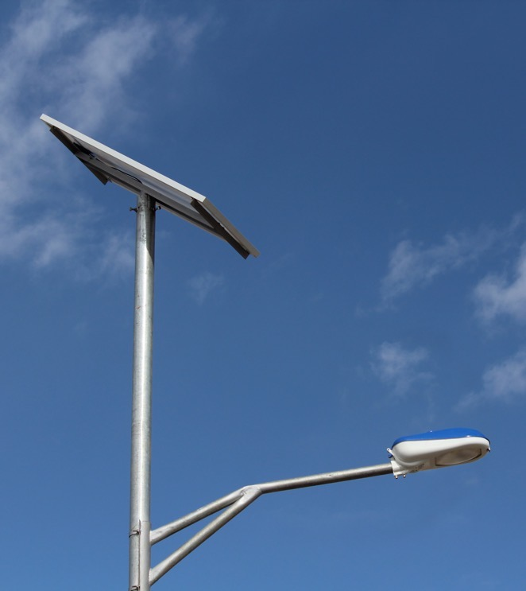
Energy option tool
Aim: support shelter practitioners to make decisions on the best energy options in humanitarian responses
How: provide an overview of available energy options and compare the possibilities for providing energy on household and settlement level (both for conflict and disaster contexts)
Notes:
Under development

Slide 8
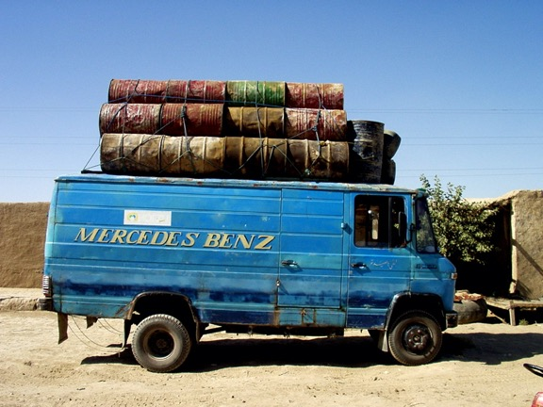
Establishing a Country-level CO2 baseline
Overview:
Aims to set CO2 baseline data at country level
Country cluster partners will be supported in measuring CO2 emissions of their shelter programmes using Shelter Methodology for the Assessment of Carbon (SMAC) tool through training
Activity update:
DRC and Syria have expressed interest for support in monitoring their carbon footprint
Survey to be launched this month to identify other countries to be supported.
Transport of oil in Afghanistan. Credit: OCHA/UNEP JEU

Slide 9
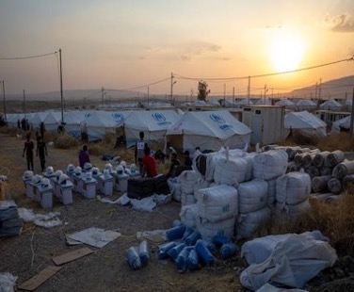
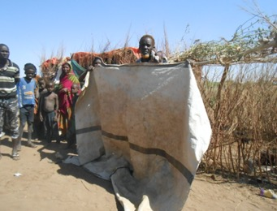
Examples of Collective Global Efforts
Introduction of the UNHCR recycled synthetic medium and high thermal blanket
R&D - Eco-design Tarpaulin Project in Partnership UNHCR-ICRC-IFRC
Introduction of the new UNHCR kitchen set
R&D PP bags Project in Partnership with UNHCR-ICRC-WFP
Notes:
These activities as part of multi donor action wil contribute to indicator 1, 2 and 3 that we will look at in the next slides
Introduction of the UNHCR recycled synthetic medium and high thermal blanket
By deploying the new thermal blankets made from recycled polyester, UNHCR will help save more than 133 million liters of water and salvage more than 525 million plastic bottles (1L size) per year, from going to landfill, while also saving energy consumption and limiting crude oil extraction.
Introduction of the new UNHCR kitchen set
By deploying the newly developed kitchen set UNHCR will prevent an average of 47 tons of single use plastic items and 43 tons of carton waste going into landfills every year. The set is provided in a newly designed polymer container (replacing the old carton box), that can be reused in many ways by our PoC, notably as a food or water container.
R&D - Eco-design Tarpaulin Project in Partnership UNHCR-ICRC-IFRC
The section is currently in the process of evaluating different options that would ensure safe and environmentally sound disposal or repurposing of UNHCR/ICRC/IFRC tarpaulins at the end of their lifespan or due to decommissioning.
R&D – PP bags Project in Partnership UNHCR-ICRC-WFP
Find a more sustainable packaging material to one major packaging material, the polypropylene (PP) woven bag, that is commonly used by most humanitarian organizations for staple food and other commodity packaging.
Segway to Indicators in grant
These activities as part of multi donor action wil contribute to indicator 1 and 2.

Slide 10
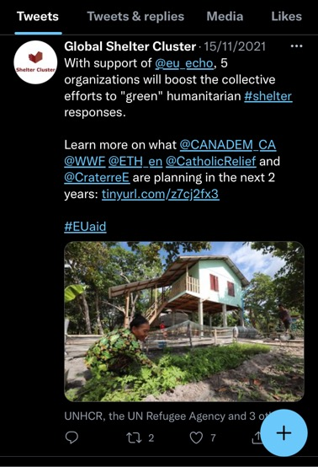



Activity 2: Environmental research and advocacy
Provide the global knowledge needed to help design greener and climate-smart country-level shelter responses.
Research
e.g. Environmental & Shelter Response Profiles
Advocacy tools
Information management

Slide 11
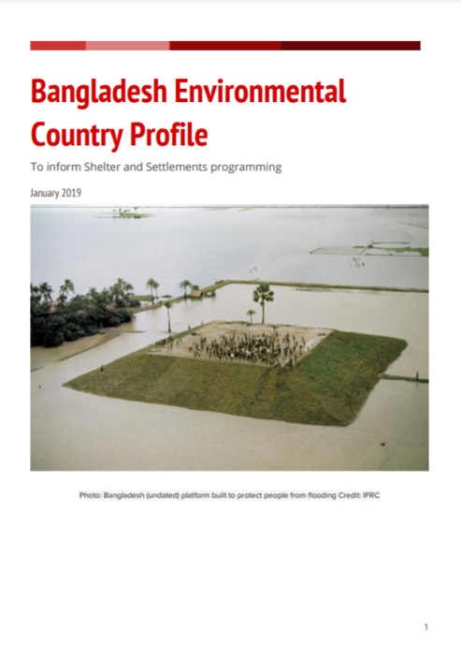
Environmental Country Profiles
Aim: Inform environmentally sustainable shelter programming by making key information about country -level environment/shelter considerations, impacts, concerns and opportunities available and accessible to practitioners as a preparedness measure
Approach: 14 profiles to be developed – 10 ECHO funded and 4 BHA funded – in both conflict and natural disaster locations, building on previous methodology
Progress:
EOI was launched on 14 April to all country shelter cluster coordinators
Submissions received from 7 countries: Afghanistan, DRC, Mali, Nepal, Philippines, Syria and Zimbabwe
Methodology finalised based on Vanuatu 2019 profile
Notes:
Overview of the main threats to the environment, key environmental focal points, an analysis of the different shelter options most-commonly used in country, environmental impact calculators, total life-cycle amount of CO2 produced by these interventions.

Slide 12
Shelter Response Profiles
Resource that provides an in-depth overview of local construction practices, materials and the construction process
Aim: To assist practitioners to develop shelter response strategies that build on local knowledge and empower households to rebuild their own homes within the local context
Approach: 7 profiles will be developed – 5 ECHO funded and 2 BHA funded – in both conflict and disaster locations
Progress:
On-going SRPs development process in 3 countries: Burkina Faso, Venezuela and Yemen
EOI to be launched in June for 4 additional Clusters

Slide 13



Activity 3: Green country clusters shelter responses
Strengthen country-level clusters to use the materials developed in activities 1 and 2
Well-designed market interventions to empower affected population and reduce the environmental impact. Cash champions initiative: capacity and methodology to implement well-designed cash and shelter responses.
Appropriate local solutions and materials: CraTerre, local institutions, mason schools. Local building practices will be mapped and analysed for key responses.
Support countries to identify options for reducing, reusing, repurposing and recycling or other end-of-life alternatives, for local shelter solutions.
Collaborate with institutions with environmental expertise such as BRE to support countries with methods for calculating CO2 emissions of local shelter solutions.
Pilot innovative more environmentally sustainable shelter solutions or approaches.
Link with Logistics Cluster, and others at country level
Notes:
BRE, the world’s leading building science centre: www.bregroup.com

Slide 14
Cash and Markets Champion Support
Overview:
An initiative that will make use of existing tools and processes for market assessment and modality selection while mainstreaming environmental considerations.
Cash Champion will support country clusters in activities such as defining greener cash and markets shelter response strategy, monitoring cash-based shelter responses and/or market assessments
Implemented in two country clusters through ECHO funding
Progress:
EOI was launched on 14 April to all country shelter clusters coordinators
Submissions received from 3 countries: DRC, Syria and Zimbabwe

Slide 15
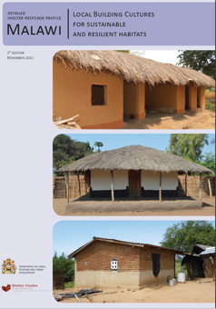







Collective effort to showcase impact on local level
Ongoing Shelter Profile development
Use of SMAC tool as part of a scorecard approach
Burkina Faso
Malawi
Enhanced advocacy
ECHO grant
Different funding source
Notes:
Burkina Faso is already looking into environmental issues because of fragile context, Env. High on the agenda SAHEL context -> opportunity for advocacy is ripe
Note on background SMAC
The Global Shelter Cluster Environment Community of Practice, together with the BRE Trust and WWF/US, have developed the Shelter Methodology for the Assessment of Carbon (SMAC) tool to enable humanitarian operations to assess the level of carbon dioxide equivalents (CO2 eq) of shelter assistance after a disaster. Measuring CO2 eq includes not only CO2 but other gases generated in providing the assistance.
SMAC is based on a cradle-to-grave approach, encompassing material extraction, processing, transport, packaging, use and disposal, in line with industry practice. The tool uses standard environmental product declarations to define the CO2 eq for materials commonly used in humanitarian construction. While primarily focused on shelter, SMAC can also be used for schools, markets or other types of basic construction.

Slide 16
(Some) Next Steps
Co-designing the way forward to define carbon footprint baseline of shelter and settlements response (with ECoP and selected country clusters)
Support selected country clusters in piloting tool and setting baseline
Connect with global level efforts (UNHCR, IFRC, WFP, ICRC, NRC, NORCAP (urban settlements), etc.) e.g. re. change in specs of NFI & measurements of carbon footprint
Environmental Country Profiles: Selection of countries and development and kick off of process
Shelter Response Profiles: Launching EOI for additional countries for SRP development
Identify “showcase” countries where synergies can be sought to demonstrate greater impact

Slide 17

Thank you !
ela.serdaroglu@ifrc.org

