Slide 1
Gender, Diversity and Inclusion Community of Practice
Launch Webinar
24 June 2025
Notes:
Do Menti Poll

Slide 2
Agenda
Min | Item | Speakers
2 min | Opening | Rawan Khoury, Help Age International
5 min | Welcome and launch of the GDI CoP Why it’s important, how it started | Caroline Dewast, Deputy Coordinator, Global Shelter Cluster, IFRC
30 min | Introductions to thematic streams Gender Equity and Inclusion Disability Inclusion Age Inclusion | Joud Keyyali and Janina Engler – Williams, CARE International Leeanne Marshall, Australian Red Cross and Nic Winn, Humanity and Inclusion Rawan Khoury, Help Age International
7 min | What we have done to date | Leeanne Marshall, Australian Red Cross
10 min | Online Menti | Angel Pascual Martin, UNHCR
5 min | Next Steps for CoP and how to engage | Janina Engler – Williams, CARE International

Slide 3
Welcome and Launch of the Gender, Diversity and Inclusion CoP
Caroline Dewast,
Deputy Coordinator, Global Shelter Cluster, IFRC

Slide 4
Background
Formed in 2024, bringing together previous work undertaken in the cluster
Intended to serve as a collaborative platform, for sharing experiences, resources, tools and improving inclusive practice
Currently has three streams (with intention to grow)
  Gender Inclusion and Equity
  Disability Inclusion
  Age Inclusion

Slide 5
Introduction to thematic streams

Slide 6
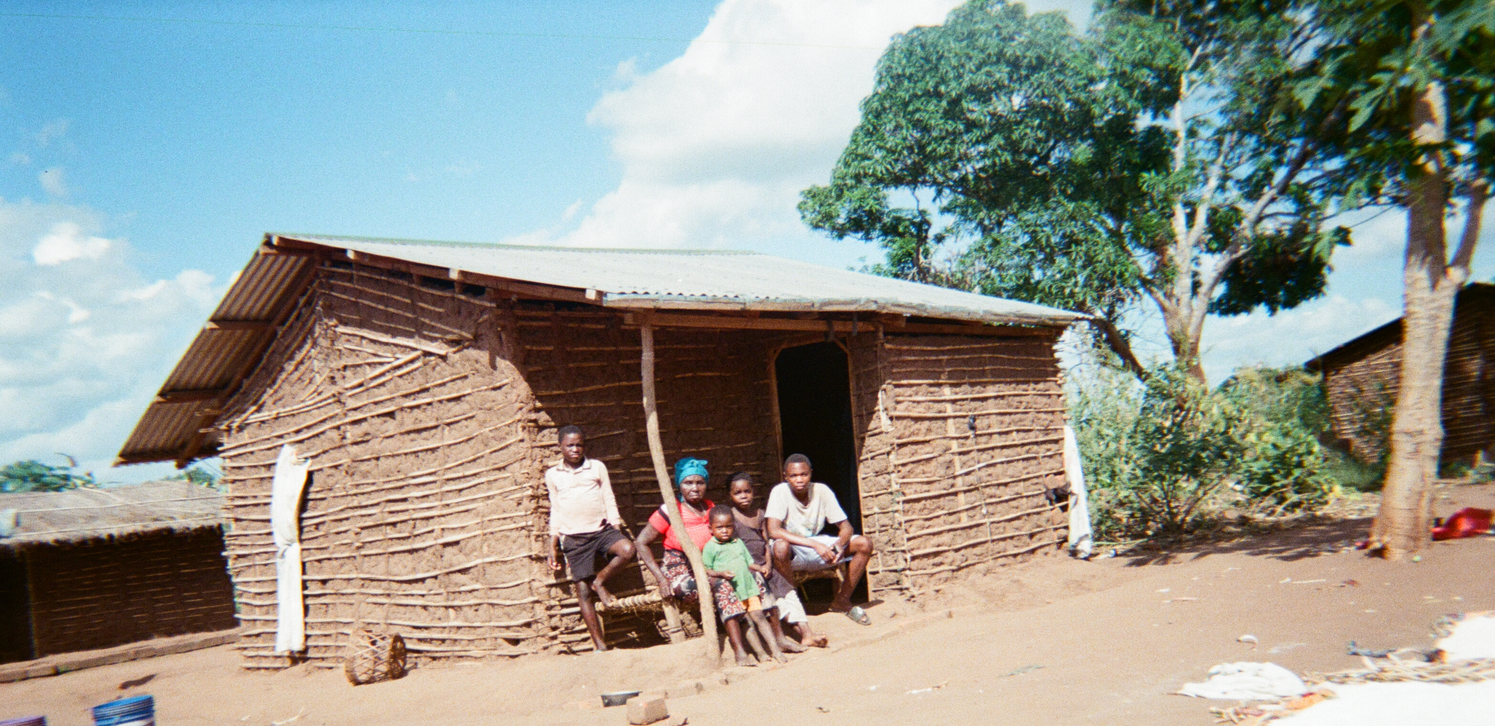
Gender Inclusion and Equity

Slide 7
Resources
Tool/Guide | Description | Link
Gender-Responsive Settlement Model – UN Women (2024) | A practical framework for inclusive and safe temporary settlements, with a gender analysis checklist and design guidance. | Download PDF
Gender-Sensitive Approaches to Disaster Management – IFRC | Practical guidance on gender-sensitive shelter and post-disaster recovery approaches. | Download PDF
CARE Emergency Toolkit: Gender in Shelter Sector | Online tools, checklists, and field guidance for integrating gender into all stages of shelter programming. | View Toolkit
Gender & Shelter: Good Programming Guidelines – CARE (2016) | Comprehensive field guide for gender-responsive shelter programming, design, and monitoring. | Download PDF
Good Shelter Programming: Tools to Reduce GBV Risk – IOM, Shelter Cluster | Practical tools for GBV-sensitive shelter design, site planning, and service delivery. | Download PDF
Intergrating gender-based violence interventions in humanitarian action -IASC | Global standards on preventing GBV through sector-specific shelter responses. | View Guidelines
All Under One Roof: Disability-Inclusive Shelter and Settlements – IFRC | Toolkit on inclusive shelter for people with disabilities, with gender and protection components. | Download PDF

Slide 8
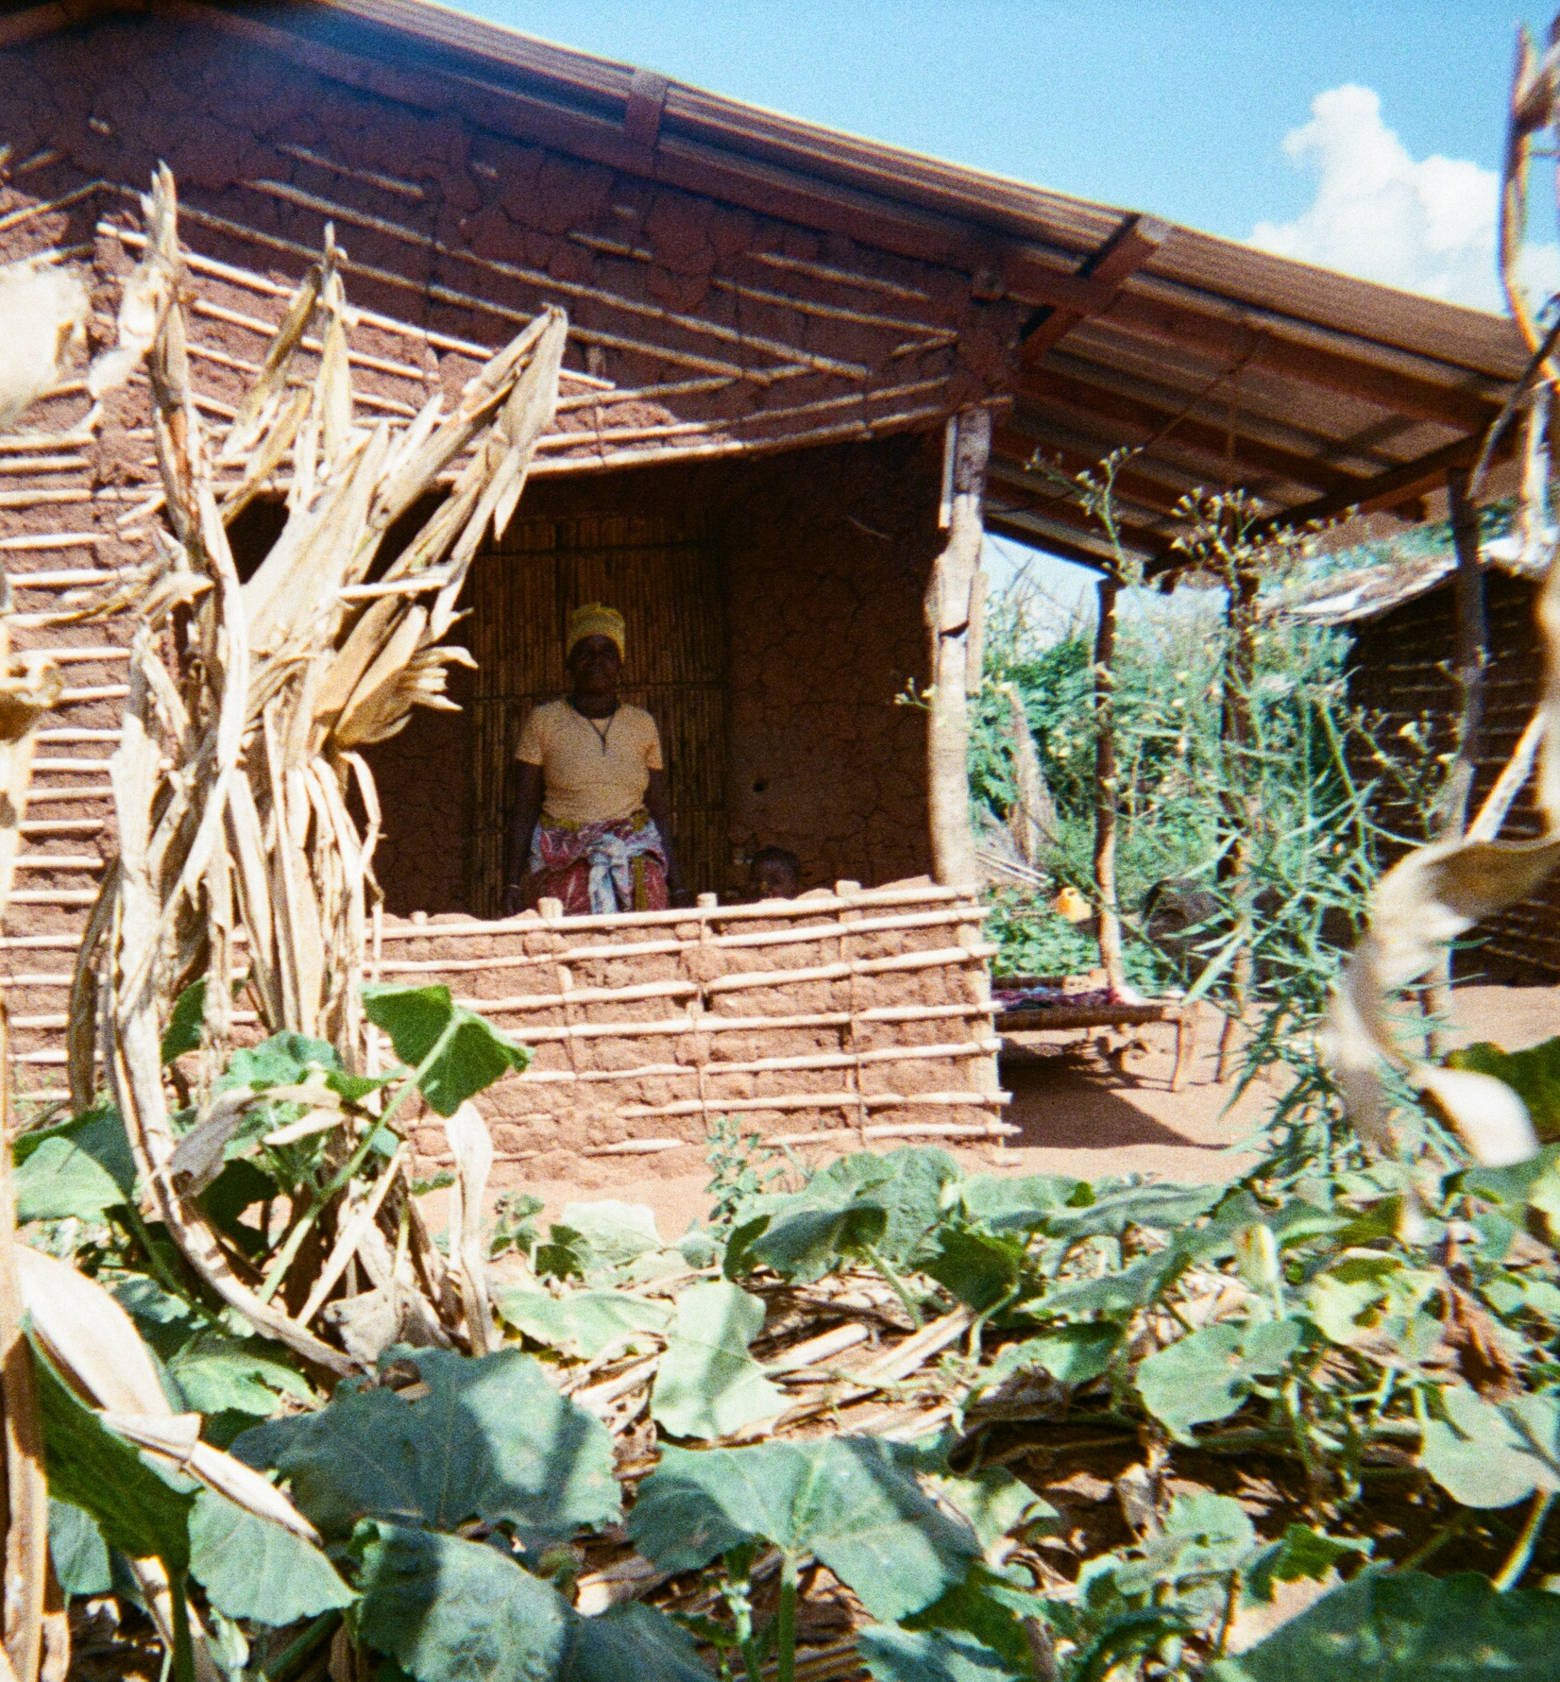
Key Data Highlights
Actual Situation
By 2050, 1.05 billion women and girls are expected to live in slums or informal settlements
(UN Women, 2022 – Gender & Urban Development).
During disasters, women face higher mortality rates due to unsafe housing and limited mobility; in the 2004 tsunami, up to 80% of those who died were women
(Oxfam, 2005 – Tsunami’s Impact on Women).
Globally, only 13% of agricultural landholders are women, limiting their access to safe housing and participation in recovery efforts
(FAO, 2023 – Land Rights Database).

Slide 9
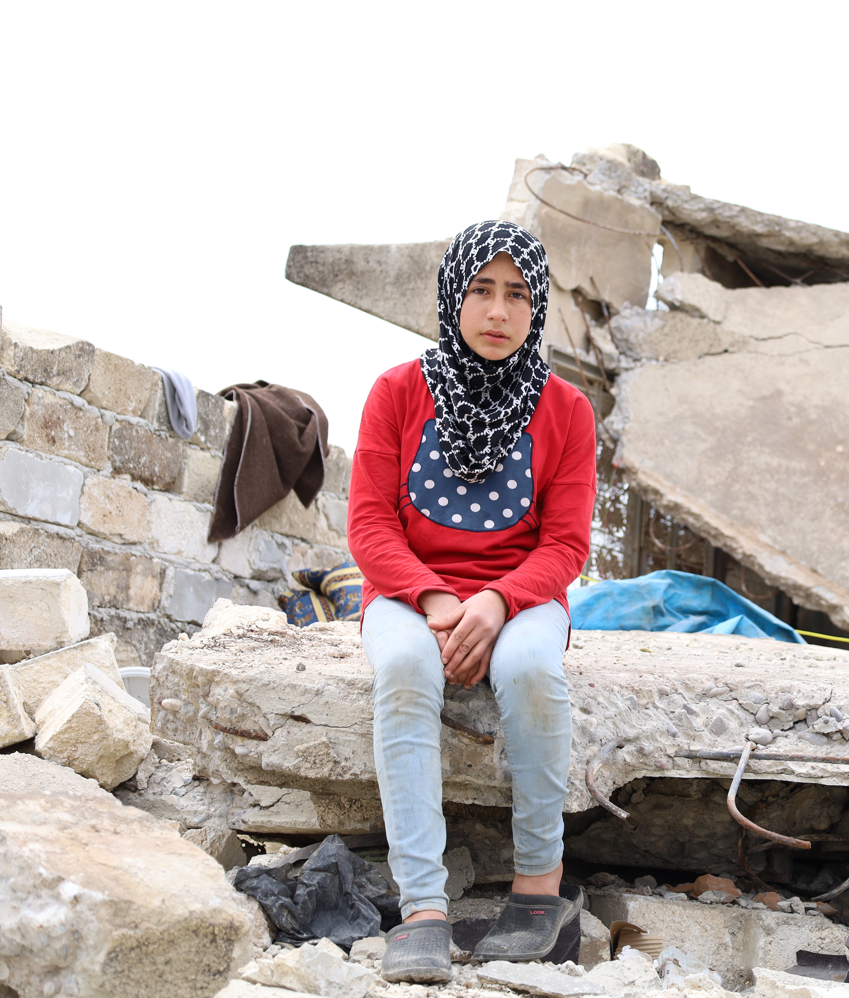
Key Data Highlights
When Shelter Is Inclusive
Addressing trauma, caregiving roles, economic reintegration, and GBV reduce homelessness and improve long-term mental health for women.
((Women’s Health Journal, 2024 – Post-Shelter Outcomes)
Safety in shelter is gender-specific.
(UN Women, 2024 – Gender-Responsive Settlement Model)
Gender-responsive infrastructure saves lives. (Habitat for Humanity, 2025 – G7 Brief)
Inclusion of women and gender-diverse people leads to better shelter outcomes.
(UN Women, 2024 – Regional Model Guidance)

Slide 10
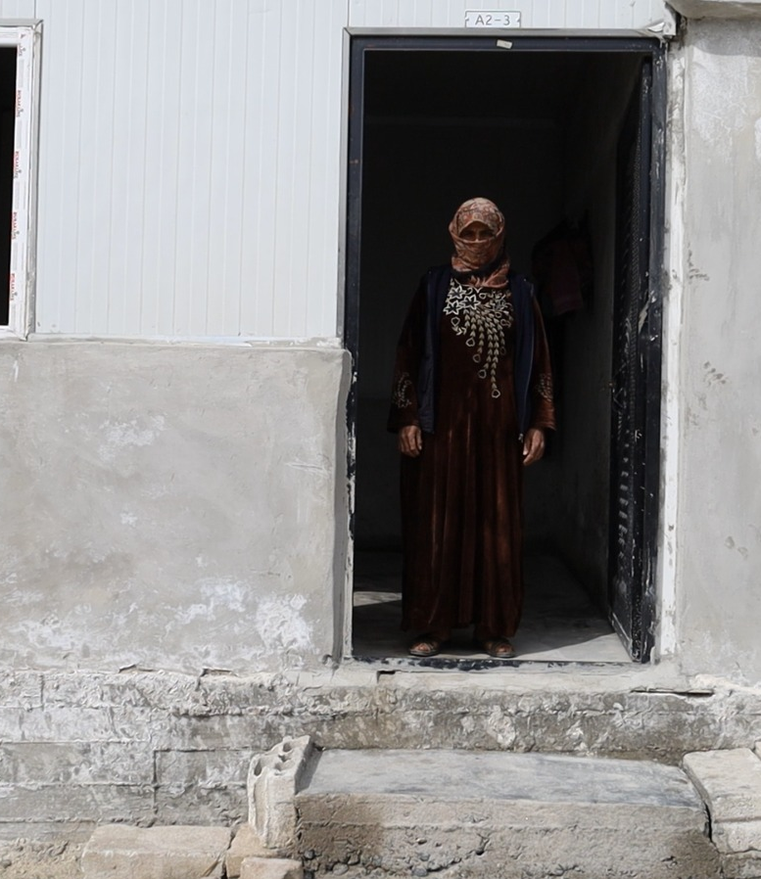
Key Data Highlights
Reality Again!
Over 50 % of women-led aid groups face closure within six months due to foreign aid cuts, jeopardizing their shelter, legal aid, and trauma support for crisis-affected women (UN Women global survey, May 2025)
Multiple UN agencies (WFP, UNHCR, UNICEF) are cutting staff and closing operations, reducing services for displaced women and children (UN agency cost‑cuts, June 2025)
In Afghanistan, support dropped from assisting 772,000 people in 2022 to only 216,000 in 2024, half of whom are women, eroding shelter, health, and education programs (NRC warning, Jan 2025)
Cuts to foreign aid threaten LGBTQI+ organizations worldwide, forcing closures of shelters and cessation of advocacy, legal support, health, and protection services across 42 countries.

Slide 11
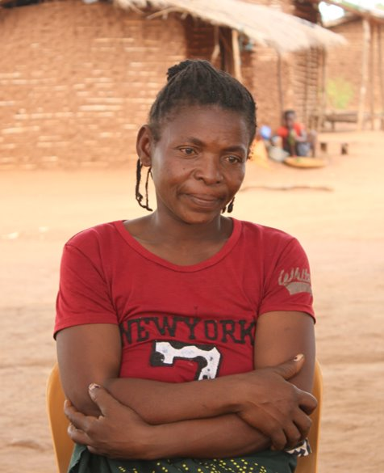
Essefania’s Story
"My whole community was suffering, and I wanted to be part of the solution"
Essefania Cesar Ussene is the sole parent of eight children – her husband died in Palma District during the ongoing armed insurgency in the Cabo Delgado region of northern Mozambique. Essefania and her children now live in a resettlement site in Nacivare, Chiúre District.
CARE implemented a project to build 91 'transitional' shelters in 2024. These two-room homes were designed to be more durable, safe and comfortable than emergency shelters and support people to recover from their forced displacement.​
Essefania took the opportunity to be actively involved in the shelter construction. She was part of a construction committee that CARE trained. Essefania uses the skills she learned to support her children, and is proud she has contributed to better living conditions for the whole community. ​

Slide 12
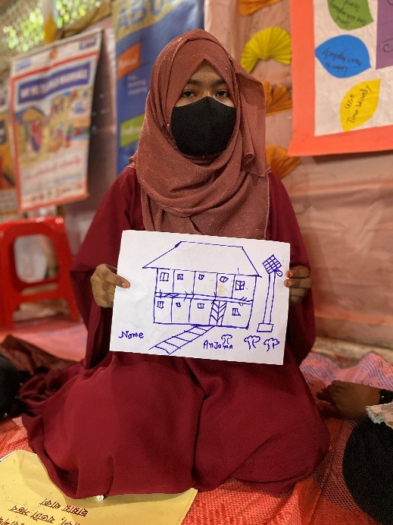
Anjumas Story
Anjuma, 17, lives in Cox’s Bazar Refugee camp, home to over a million displaced people.
Anjuma uses the women and girls safe space that CARE had built in camp 16 regularly:
This safe space is the only place outside my shelter I can come to see my friends, learn new things and relax. The camp is very dangerous so I stay at home a lot, however my shelter is very small and hot with no privacy, so this safe space is very important for me.’
CARE is working to integrate ‘women friendly’ features into a new shelter design after having run several workshops with women and girls like Anjuma. Until then safe spaces like this provide a relief from being trapped in a crowded, inadequate shelter.

Slide 13
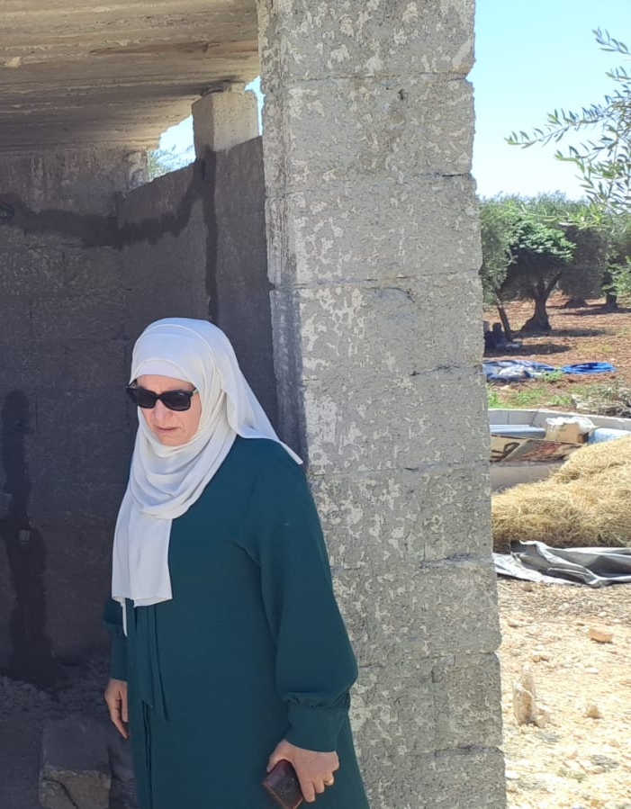
Why a Gender Equity Stream is Needed
To bridge the gap between technical shelter guidance and inclusive practice on the ground.
To improve shelter outcomes for everybody, in particular women and girls.
To address how gender interacts with other identity factors—including age, disability, displacement status, and caregiving roles.
To co-develop intersectional M&E frameworks for shelter programming
To promote inclusive design principles: reflecting caregiving roles, mobility needs, and safety concerns.

Slide 14
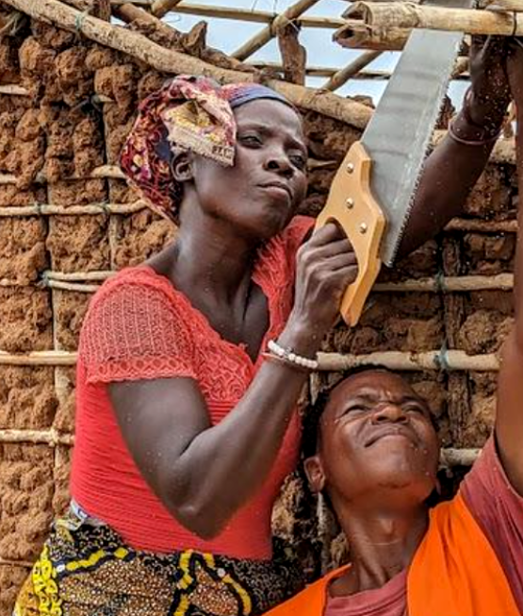
How can we support you?
Share research, case studies and knowledge from the field
Build a repository of gender-sensitive tools, templates, and field-tested practices.
Support local and women-led partners through technical mentoring, feedback, and visibility.
Contribute to cluster coordination and global advocacy, influencing donors and policy frameworks.

Slide 15
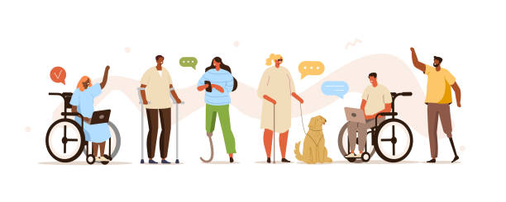
Disability Inclusion
16%
1.3 billion
of global population experience significant disability
80%
25%
estimated living in low and middle income countries
can navigate evacuation procedures independently
Notes:
Talk about what this number means and the importance of including it in our planning to ensure that disability is visible from day one .
An estimated 1.3 billion people experience significant disability. This represents 16% of the world’s population, or 1 in 6 of us.
Disability includes physical, sensory, intellectual, psychosocial, neurological, and cognitive impairments
Many disabilities are invisible or not immediately apparent
🚨 Inequality & Exclusion
Persons with disabilities are more likely to be:
Living in poverty
Excluded from education, healthcare, and employment
Left out of crisis response and recovery
Stigma and inaccessible systems create barriers to participation and safety
Inclusion must go beyond ramps — it's about rights, relationships, and removing barriers
Sheltering is about more than a roof overhead – gateway to
If shelter programs are designed or delivered without consideration for diverse access needs (not just physical) it can reinforce exclusion
When environments are inclusive, they benefit everyone — including older people, pregnant women, children, and people with injuries or chronic illness.
Inclusive programming supports social cohesion, resilience, and equity — key for recovery and long-term development.

Slide 16
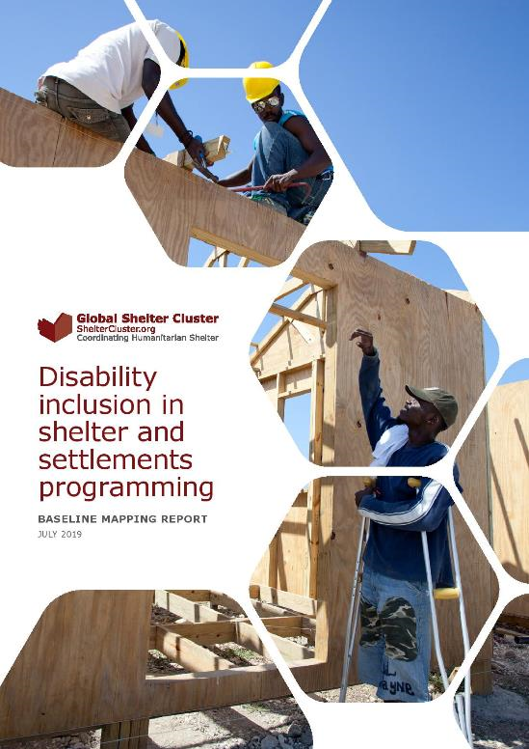
Disability Inclusion
GSC Disability inclusion in shelter and settlements working group (2018 – 2024)
Undertook baseline mapping of sector
Reviewed and updated All Under One Roof: Disability inclusive shelter and settlements in emergencies guidance and training
Developed GSC All Under One Roof hub, with guidance, case studies and other resources.
https://sheltercluster.org/resource/all-under-one-roof
Notes:
Background of working group and what was achieved

Slide 17
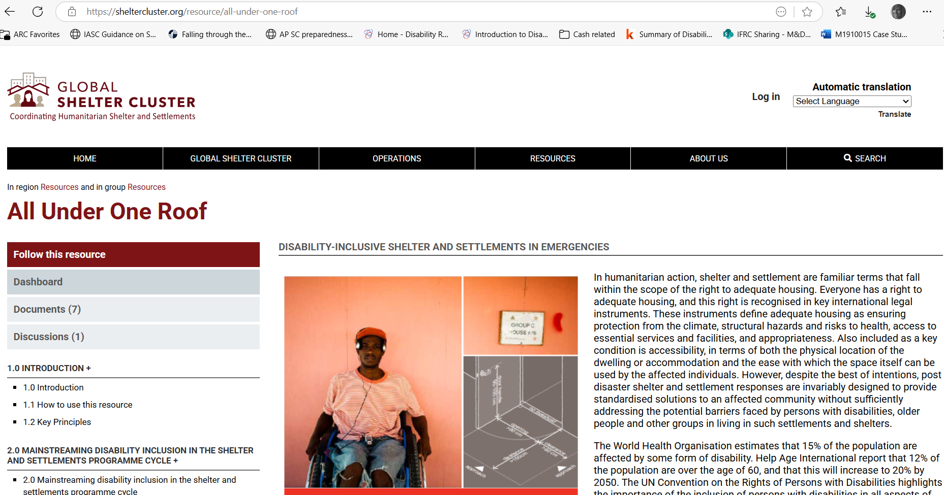
Notes:
Remind everyone of the All Under One Roof

Slide 18


Disability Inclusion
How can we support you?
All Under One Roof hub (updating guidance, case studies, training and learning across contexts)
Sharing capacity strengthening opportunities
Connection to regional platforms
Technical support from Disability Inclusion experts – Humanity and Inclusion and CBM

Slide 19
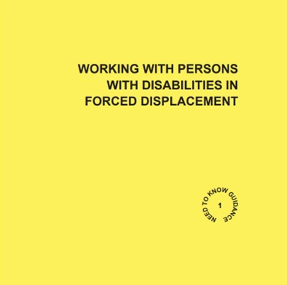
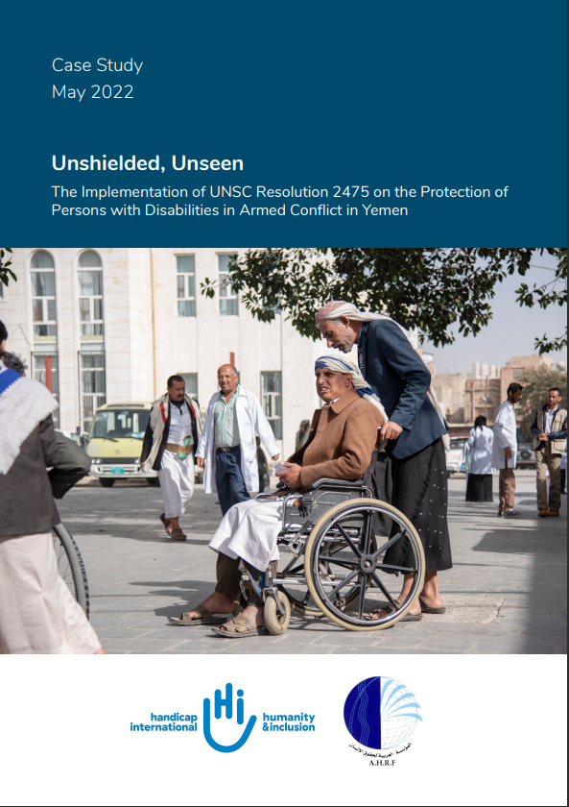
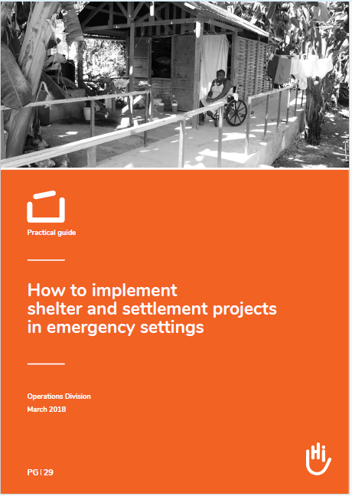
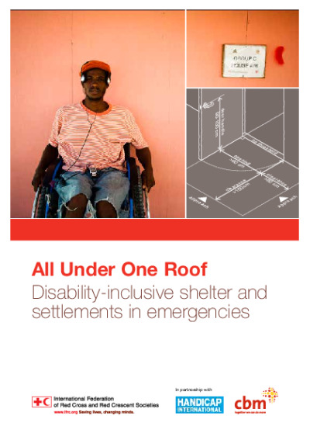
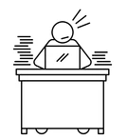
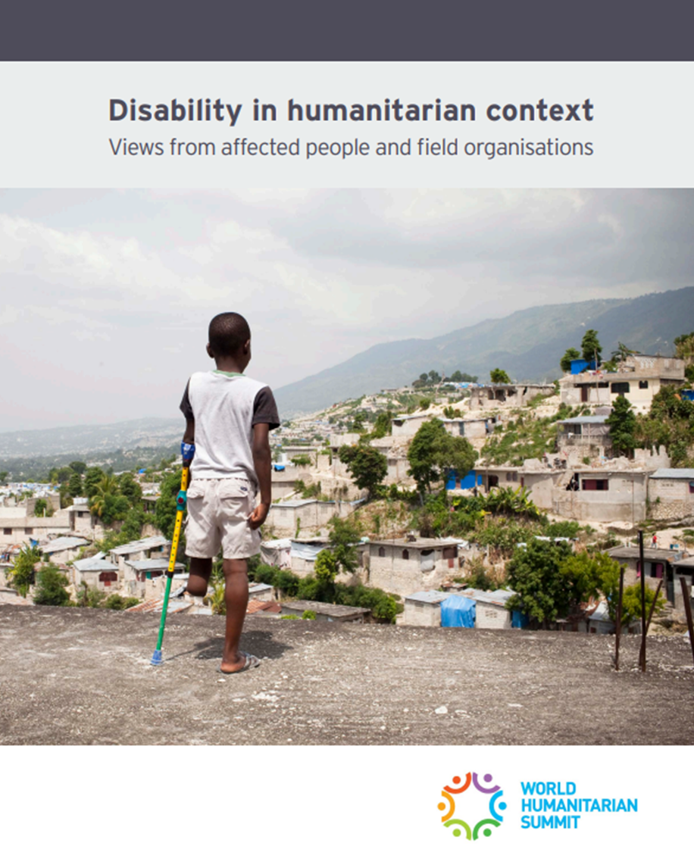
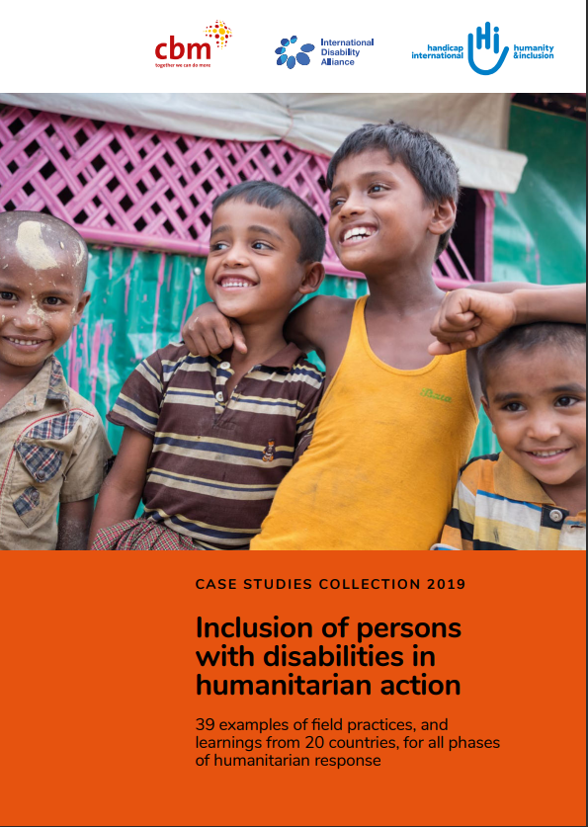
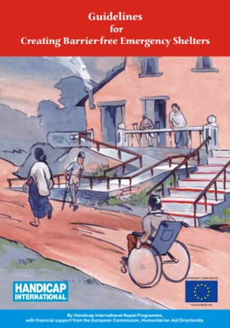
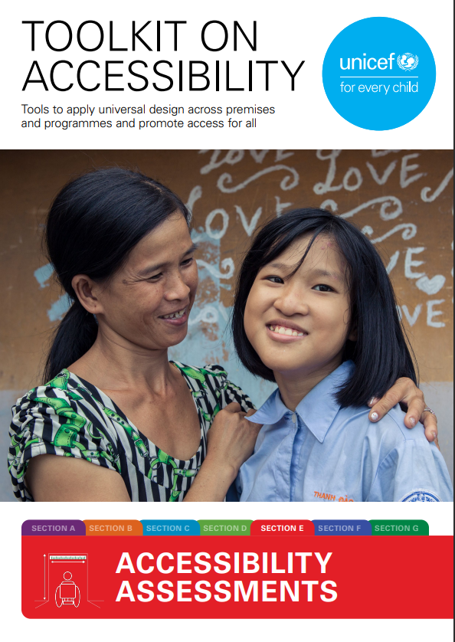
Disability Inclusion
Notes:
How can HI support?
We bring substantial experience in implementing shelter-related activities with a strong focus on disability inclusion. Our team has also contributed to the development of several key guidance documents in this field. However, we recognize that the sheer volume of existing guidance can be overwhelming. It is often challenging and time-consuming to translate these theories and recommendations into practical field activities. This is where we aim to support all partners—by helping to bridge the gap between guidance and real-world application, making implementation more accessible and effective.

Slide 20
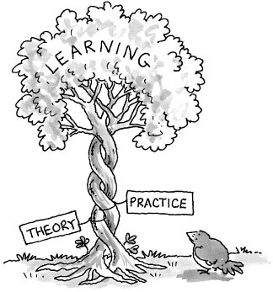
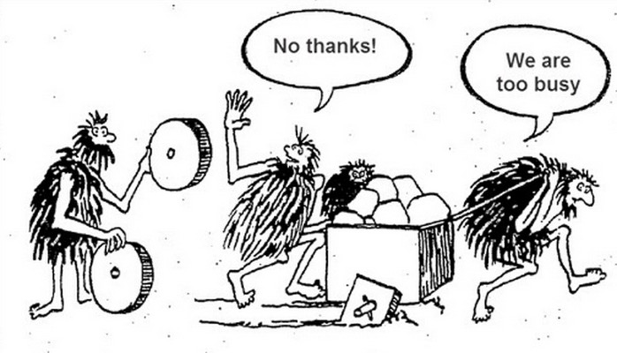
Disability Inclusion
Notes:
Often in the sector we look to reinvent the wheel which ultimately in hindsighjht is found to be inefficient and sometimes ineffective however a by-product of this practice is that we have grown a substantial sectoral tree of learning. By using this tree of learning and facilitiang the sharing knowledge not just from within HI but from the wider sector and beyond. So the idea is not re-invent the wheel but make the most appropriate wheel easier to find.

Slide 21
Disability Inclusion
Programme
Training Support
Design
Implementation
Review
Research
Case Studies
Training Provision
Responsive…
Accessible…
Shared Learning…
Notes:
We are able to provide support across all phases of programming, including both direct training and assistance in developing training materials that partners or national clusters/working groups wish to implement. Additionally, we aim to support partners in creating case studies that offer deeper insights into the challenges and successes of implementing disability-inclusive shelter activities. Our goal is to offer support that is accessible, responsive, and contributes to a culture of shared learning.

Slide 22
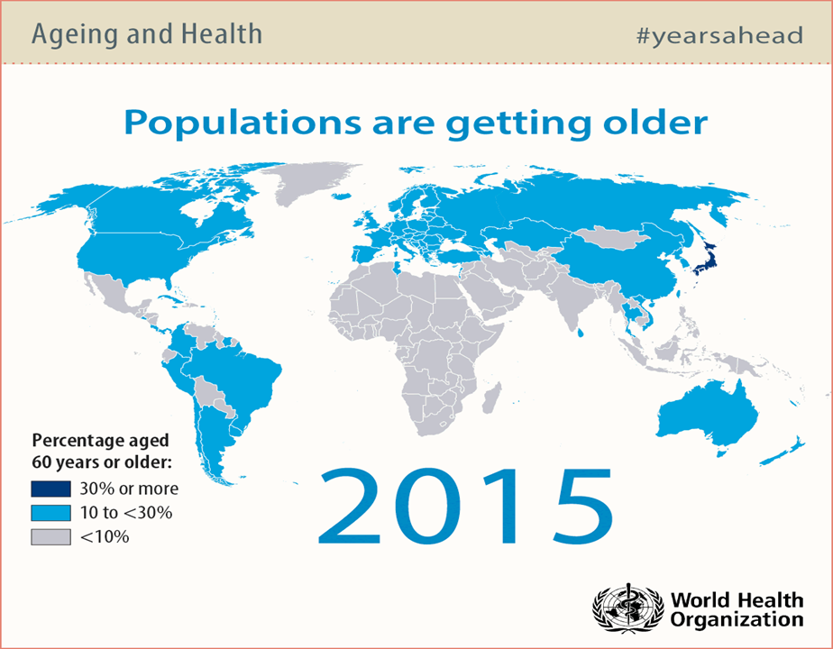
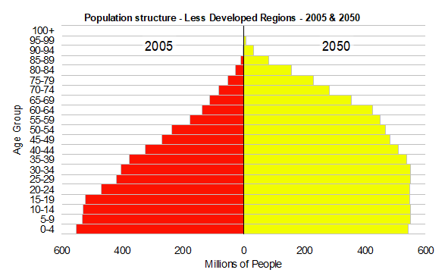
Age Inclusion
Global Statistics
•12.2% of population aged 60+, 2015
•22% of population projected by 2050
Projections show that by 2050 more than 80% of the world’s older people will be living in low- and middle-income countries

Slide 23
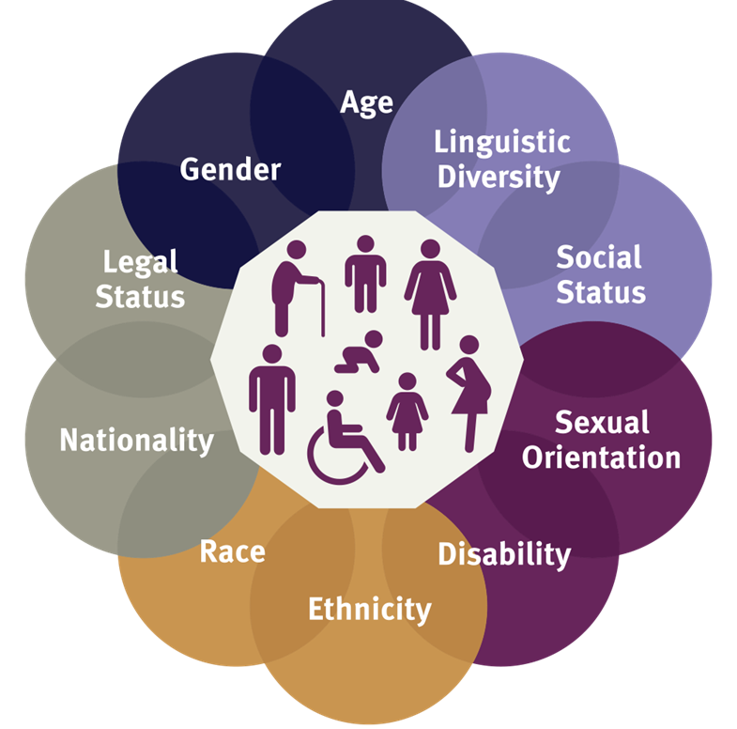
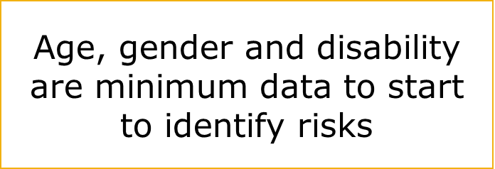
Age Inclusion/ Intersectionality
It is estimated that 46% of older persons have one or more disabilities.
More than 25% of the world’s women are over 50 years old

Slide 24
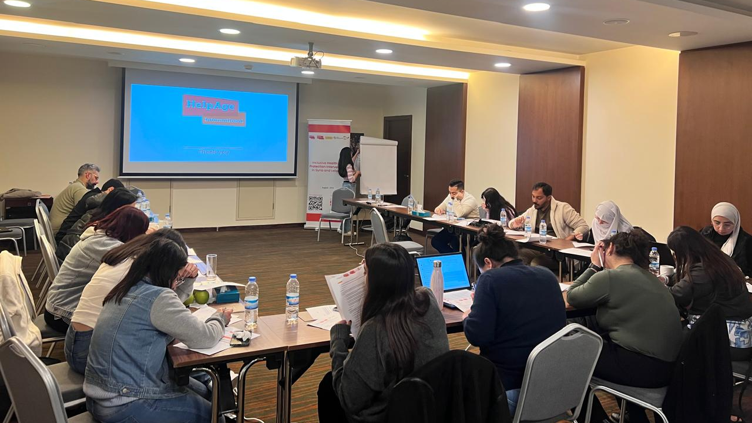
Age Inclusion Specialists
1 Global Age Inclusion Specialist (Global Protection Cluster)
3 Age Inclusion Specialists in the Middle East
  AIS in Syria (Inclusion Technical Working Group)
  AIS in Lebanon (Protection sector/working group)
  AIS in Turkey (Age and Disability Inclusion Task Team)
2 Age Inclusion Specialists in Africa
  AIS in Ethiopia (Protection cluster)
  AIS in Sudan (protection cluster)
2 in Europe
  AIS in Ukraine (Age and Disability Technical Working Group)
  AIS in Moldova (Disability and Age Task Force)
1 in Latin America
  AIS in Venezuela (Protection Cluster)
Influencing the Humanitarian System to be more inclusive of Older People in all their diversities

Slide 25
Age Inclusion
Act as vital resources for older age inclusion knowledge and expertise
Provide training, technical and thematic advice on ageing, protection, and inclusion
Support the meaningful participation of older people/OPAs
Promote the use of SADD data at all levels within the cluster system
Work with other clusters (Shelter, WASH, Health, food security) to promote age inclusive best practices​
Support humanitarian organizations to improve inclusion within organizational programming.
Age Inclusion Specialists
(AIS)

Slide 26
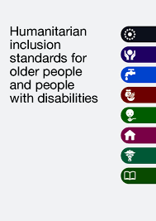
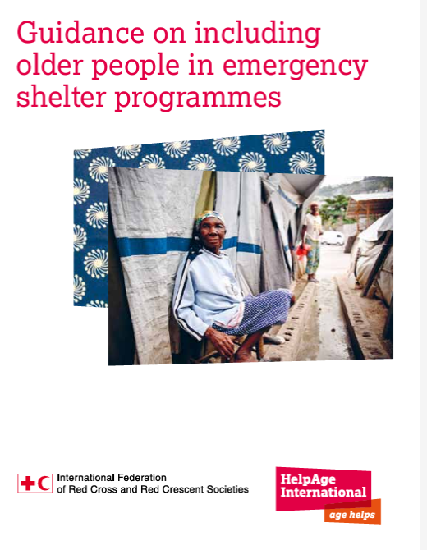
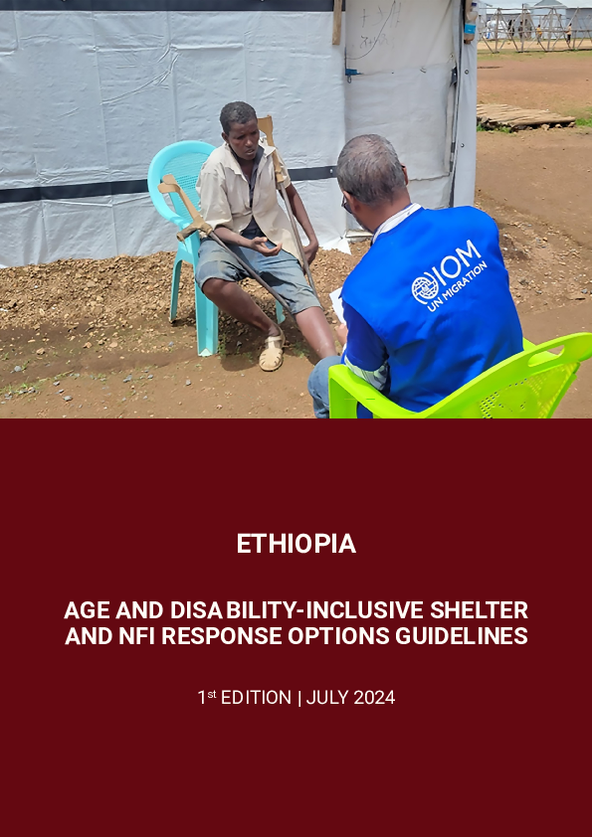
Age Inclusion
How can we support you?
Capacity strengthening initiatives
Technical and advisory support
Sharing research, assessments, documents, and learnings across contexts
Advocate for age disaggregated data collection and analysis

Slide 27
Gender, Diversity and Inclusion CoP -
what we have done to date

Slide 28
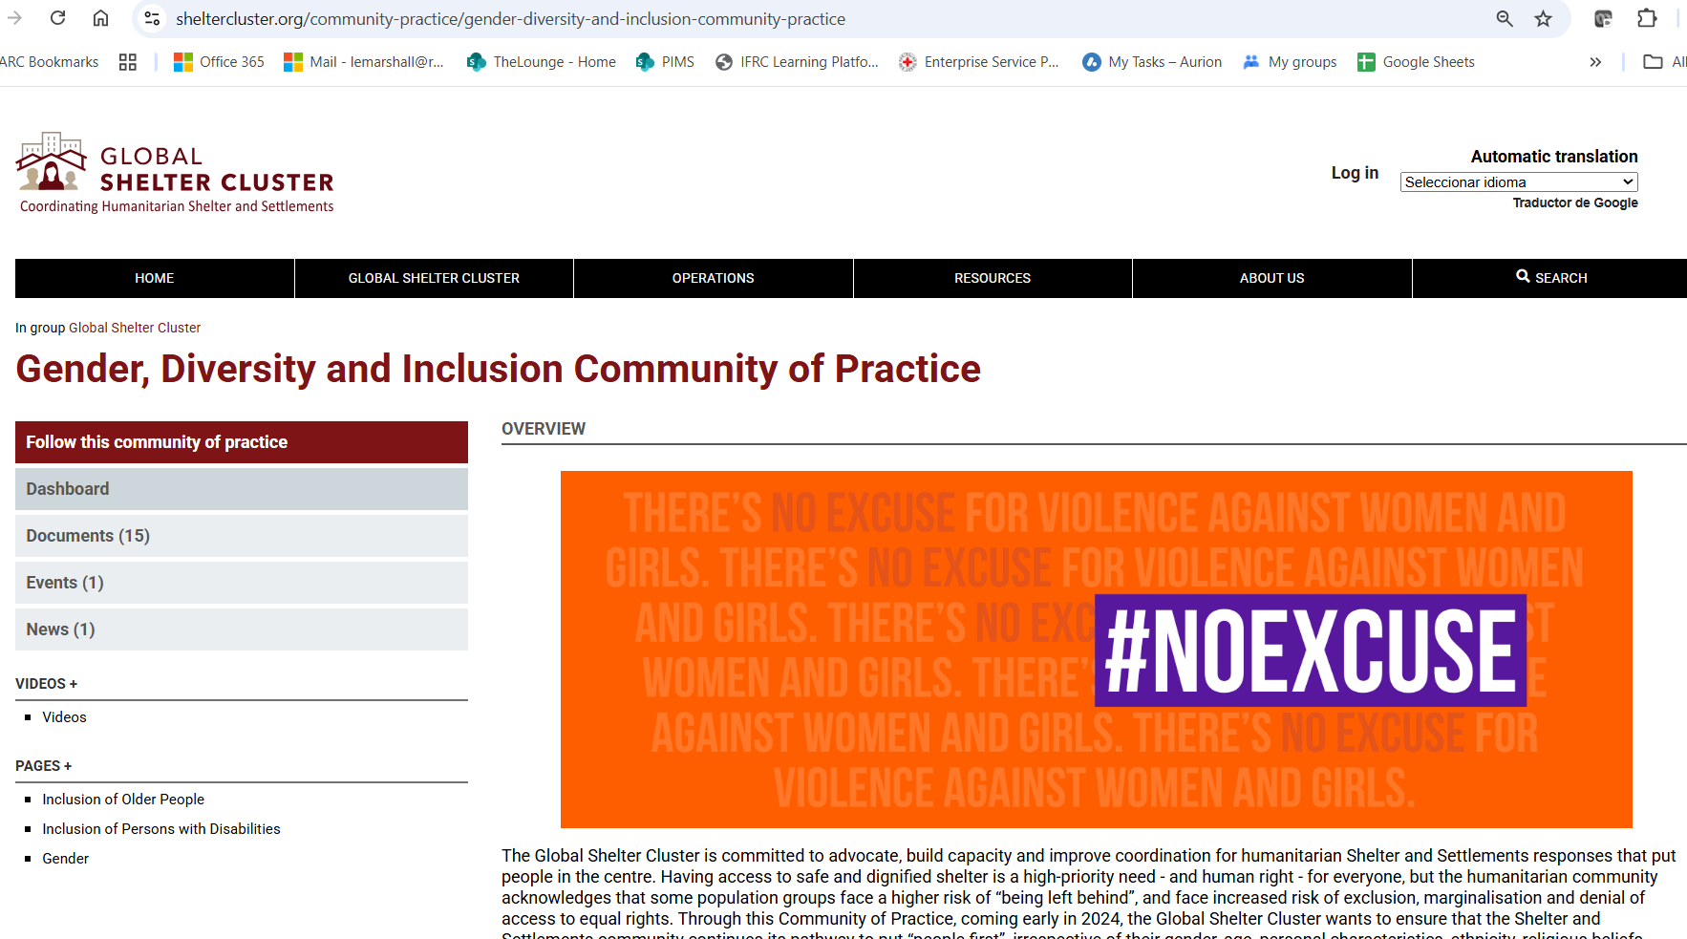
What we have done to date

Slide 29
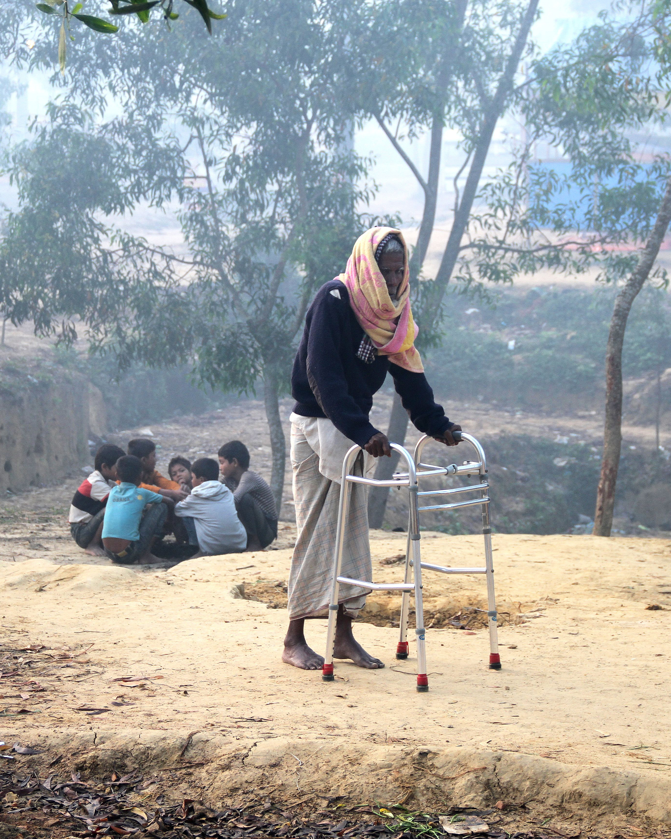
What we have done to date
Survey to assess
Representation of women and persons with disabilities in Shelter Cluster coordination
Partnerships with relevant organisations (WLOs, WROs, OPDs)
Challenges and support needs for gender and disability inclusion
15 clusters participated

Slide 30
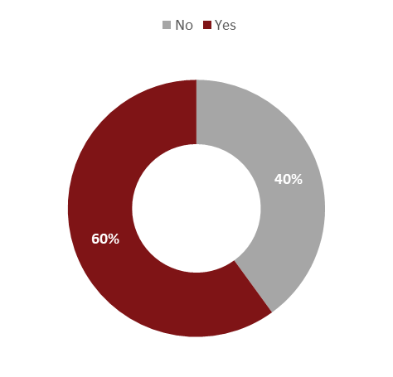
Survey results
Partnerships with Women Led or Women's Rights Organisations
9 clusters have partnerships with WLOs and or WROs (with 5 represented in SAG and in TWGs)
WLOs and WROs engage in needs assessments, capacity strengthening, and project review committees.
9 clusters have a focal point for gender, GBV, PSEA, or protection mainstreaming (or similar) and 8 have focal point that represents the cluster at the GiHa or equivalent forum
Engagement is practical and visible in most of the clusters
Proportion of shelter clusters WLOs and/or WROs as partners

Slide 31
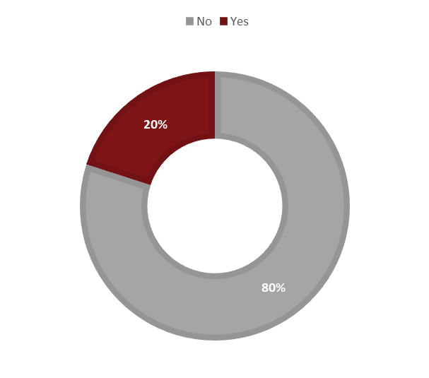
Survey results
Partnerships with Organisations of Persons with Disabilities
Only 3 clusters had partnerships with OPDs, few of those included strategic roles (1 in a SAG)
Some engagement with OPDs (e.g Ukraine) but in many cases engagement was indirect (via separate WG or protection cluster)
Common challenges included difficulty identifying relevant OPDs, lack of funding and staff, and limited interest from OPDs in engaging with the shelter sector directly
Proportion of shelter clusters with partners that are OPDs
Engagement is limited, despite growing awareness of importance of disability inclusion

Slide 32
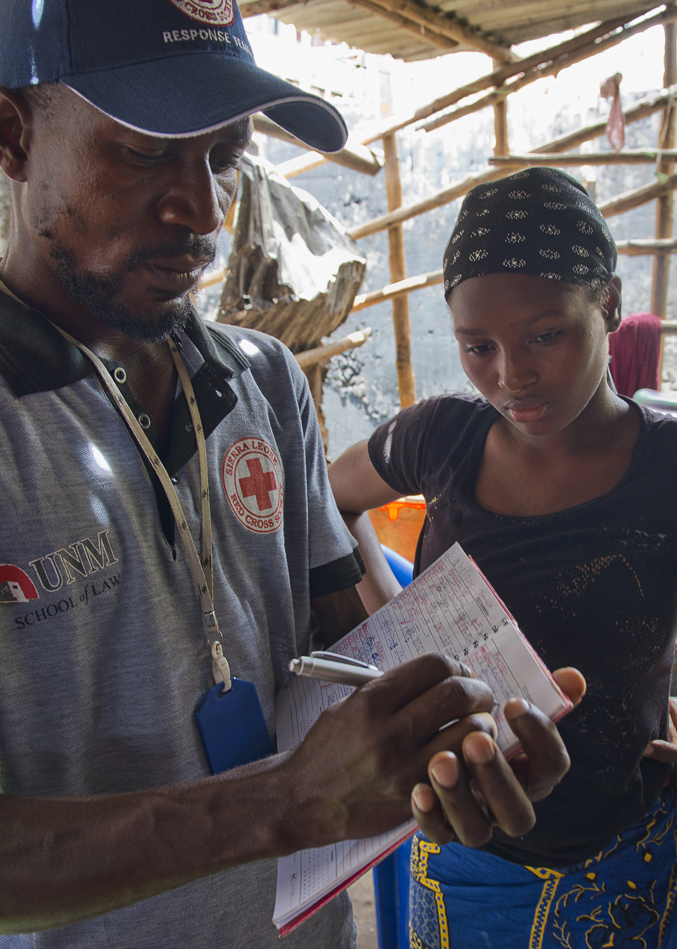
Survey results
Data collection and monitoring frameworks
12 out of 15 clusters reported disaggregating needs assessment data by sex, age, and disability. (Gender and disability questions commonly included, GBV risks less).
11 clusters continue this disaggregation in monitoring.
Most clusters reported engaging with various groups (women, girls, children, persons with disabilities)
Most clusters collecting and using disaggregated data and consulting affected groups, but gaps in consistency and depth

Slide 33
Survey results
Challenges in trying to incorporate cross-cutting issues in cluster work
Lack of resources
Insufficient funding, resources and time
Lack of accountability mechanisms lead to deprioritisation
Competing priorities and decreased engagement outside of emergencies
Operational challenges (sensitivity and customary barriers in GBV risk mitigation)
Lack of expertise and information
The complexity of addressing multiple cross-cutting issues at once
Insufficient capacity or technical expertise to effectively integrate issues, lack of technical guidance and practical tools; limited targeted support
Limited data and information
Focal points can however be an enabler

Slide 34
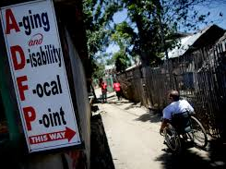
Survey results
Why focal points help
All clusters found it beneficial to have focal points for cross-cutting issues, as they:
Improve coordination
Enhance accountability
Support capacity building
Help mainstream cross cutting issues
Monitor inclusion
© CBM

Slide 35
Positive cluster initiatives
Mozambique: Conducted protection mainstreaming workshop, creating a checklist for key issues and coordinating referrals through a nationwide hotline.
Yemen: Integrated sex, age, gender, and diversity in data collection and established a Protection Mainstreaming Working Group.
Mali: Implemented minimum commitments for gender and protection, including an auto-evaluation questionnaire and an implementation plan.
Ukraine: Collaborated with the gender focal point for rapid gender analysis (RGA).
Chad: Incorporated gender, GBV, and disability inclusion in HNO/HRP strategies; projects must align with these cross-cutting issues to be approved.
Ethiopia: Published Guidelines for Disability Inclusion and scheduled training for late 2024; offered GBV risk mitigation training during distributions.
REDLAC: Organised a session on gender mainstreaming in the Shelter Sector.

Slide 36
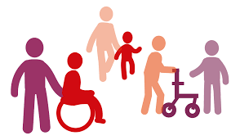
Survey results
Recommendations for incorporating cross cutting issues
Sharing experiences
Developing guidelines
Enhancing integration and mainstreaming
Establishing dedicated focal points
Capacity building and expertise.
The CoP will focus on supporting these recommendations and on understanding what else you would like support on.

Slide 37
Menti – what support do you want/ need from the CoP?

Slide 38
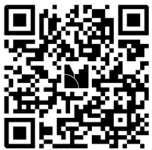
Menti

Slide 39
Next steps and how to engage
Next webinar in 4 months
Topic will be Age Inclusion
Please share any challenges or areas you'd like you to focus on for this and future webinars
We will also review the menti results and provide feedback to webinar participants

Slide 40
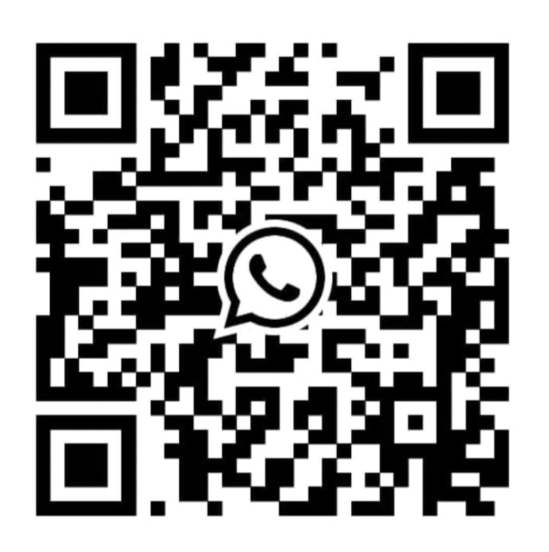
Next steps and how to engage
Follow the Gender, Diversity and Inclusion CoP page on the Global Shelter Cluster website:
https://sheltercluster.org/community-practice/gender-diversity-and-inclusion-community-practice
Access the three streams for specific resources and key contacts:
Inclusion of older people
Inclusion of persons with disabilities
Gender equity and inclusion
Email: gdi@sheltercluster.org
Join the GDI CoP WhatsApp Group

