Slide 1
Documents Management
GSC Website
The Know-How Series

Slide 2
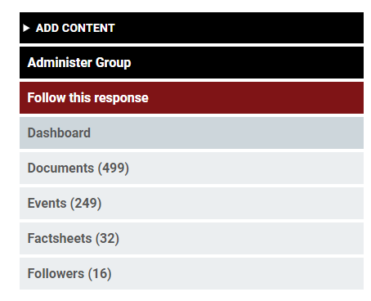
Adding a document
1. From the operation page, click on
ADD CONTENT
from the left sidebar
Note: The user should have proper permissions

Slide 3
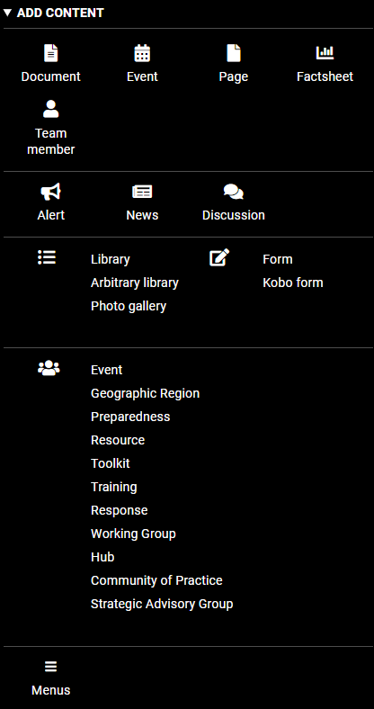
Adding a document
2. click on
Document
from the left sidebar
Note: Different types of content can be added from left sidebar

Slide 4
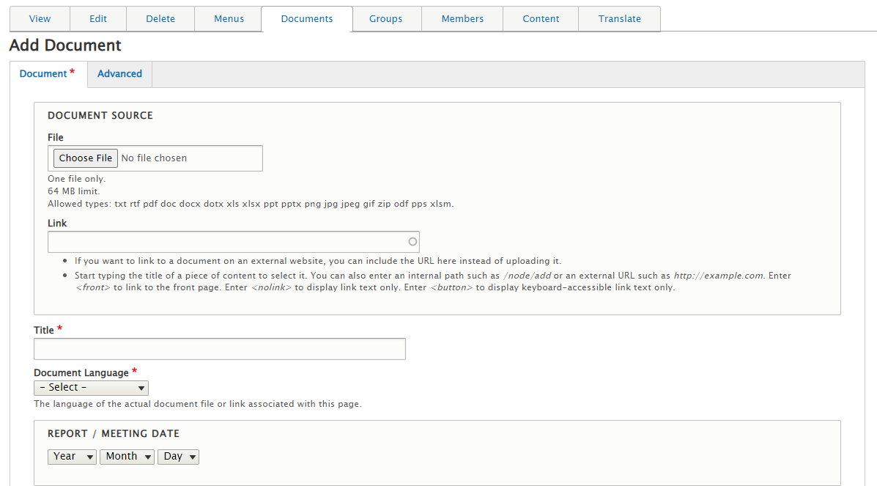

Adding a document
3. Adding document form will appear.
Provide all required information
Note:
Make sure to upload the correct file
Add an image to be used as a thumbnail for your document
Add the relevant tags to your document
4. Once done! Click on Save at the bottom of the page

Slide 5
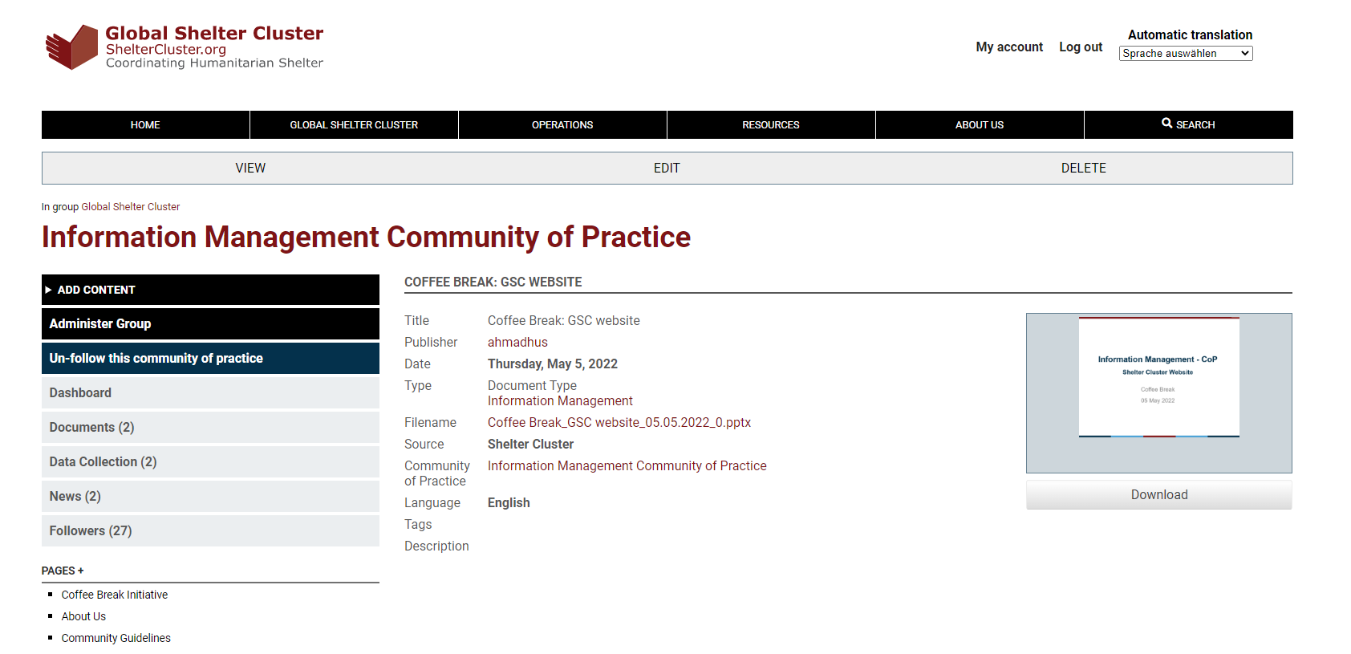
Adding a document
Congratulations! You’re Done!
You will be redirected to the document page!

Slide 6
Editing a document
From the document page, click on EDIT in the top bar
You will be redirected to the document edit form
Edit the details as needed and click on Save at the bottom of the page

Slide 7
Setting a document as Key & Featured
1. From the operation page, click on
Administer Group
from the left sidebar
Note: The user should have proper permissions

Slide 8
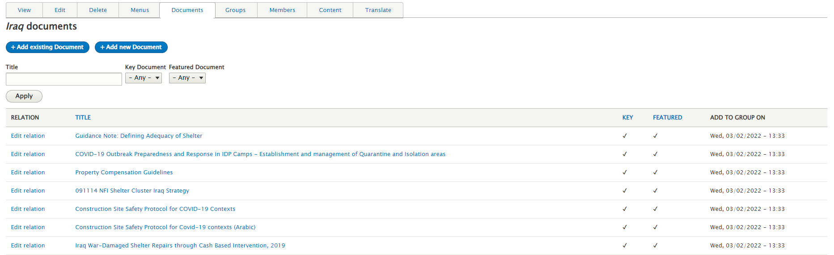
Setting a document as Key & Featured
2. Go to Documents tab
3. Click on Edit relation next to your document

Slide 9
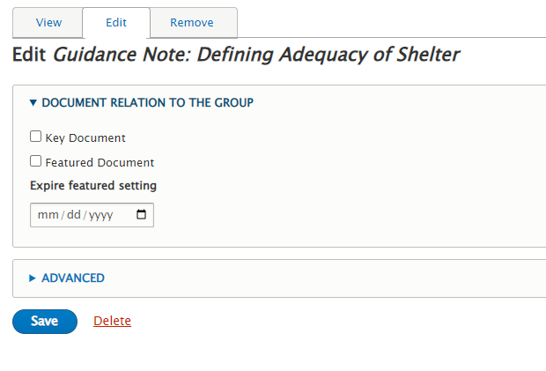
Setting a document as Key & Featured
4. You will be redirected to the following page
5. Tick the boxes Key Document and Featured Document as needed
6. Assign expiry date for the featured setting
7. Click on Save
Congratulations! You’re Done!
You will be redirected to the document page!

Slide 10
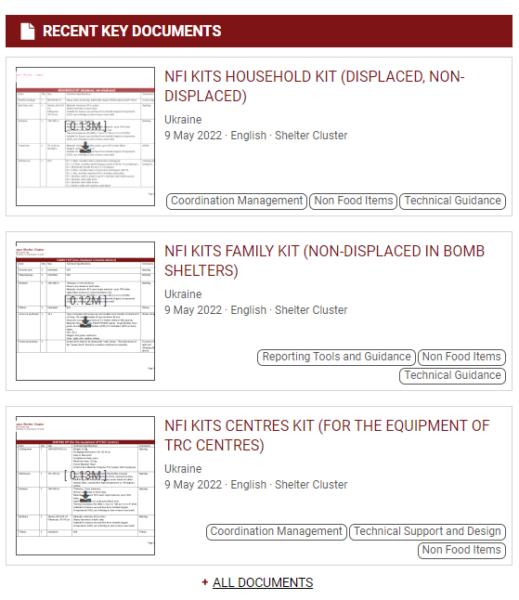
Featured documents: where to find?
Key documents appear on the website homepage in the section RECENT KEY DOCUMENTS
This section shows all key documents from all groups (operations, global, resources, community of practice, etc.)

Slide 11
Key documents: What is good?
Use this feature wisely! Too many key documents is similar to not having any key document
Good Key Documents: updates of factsheets and dashboards, shelter country strategies and reports on national responses, specific thematic tools presented or being used in your country.
Not recommended: Very technical documents related to your response (such as NFI kit compositions and such), updates on specific areas of operations or minutes of meetings, etc.

Slide 12
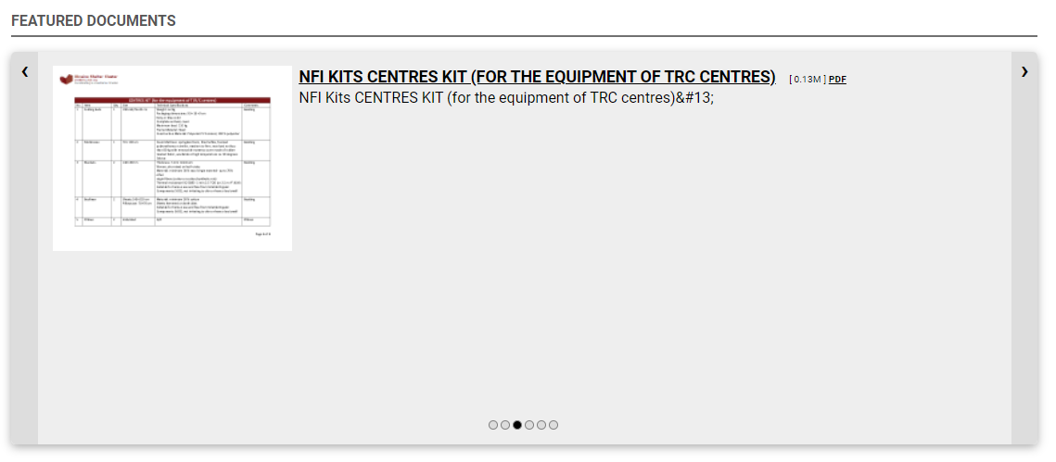
Featured documents: where to find?
Featured documents appear on the top section of the operation page
This section shows all featured documents only from the respective operation.
Featured documents disappear from this section automatically after the expiry date. Don’t worry! They are still there in document list

