Slide 1
Global NFI Developments and Environmental Considerations
C. Kelly
Disaster and Environment Advisor
Green Team
Global Shelter, Land and Site Coordination Cluster
Environmentoperations@sheltercluster.org

Slide 2
Some Concepts
“Sustainable” - “meeting the needs of the present without compromising the ability of future generations to meet their own needs.” (Bruntland Commission)
“Green” -
  Green economy is defined as low carbon, resource efficient and socially inclusive https://www.unep.org/regions/asia-and-pacific/regional-initiatives/supporting-resource-efficiency/green-economy
  Going green means implementing certain lifestyle changes designed to help you live in a more eco-friendly way. It means becoming more environmentally aware and changing your behavior and lifestyle to reduce the amount of pollution and waste you generate. https://www.canyons.edu/administration/committees/sceec/resources/information/going-green.php
  Green Environment (G.E.) is defined as economic operations relating to the production, distribution, and use of commodities and services that, to prevent significant environmental risks and ecological scars, contribute to a long-term increase in human well-being in future generations. https://www.sciencedirect.com/science/article/abs/pii/S2213138822001588
The Four Rs
Reduce
  Need for the item
  The material used in the item
Reuse
Repurpose
Recycle – turn it into something else
And consider packaging & Plastic
Do no harm
Lifecycle Approach – cradle to grave (C2G): you give out something, you should know what will happen to it

Slide 3
Some Lessons
Buying locally is not always greener, can cost more and provide a poorer quality item
  Quality assurance
  Almost identical cradle-to-purchase process as relief commodities
  Taxes
  Impact on local economy
Largest part of C2G environmental impact is in manufacturing, not transport
Local economic impact – local purchasing can be more efficient
Late is too late

Slide 4

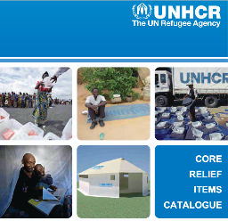
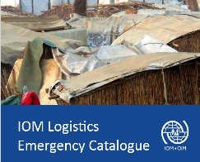
On to the practical
Standards exist for most relief items
Pool sources are available
  IFRC/ICRC Standard Products Catalogue https://itemscatalogue.redcross.int/index.aspx
  UNHCR Core Relief Items Catalogue https://s3.eu-west-1.amazonaws.com/sheltercluster.org/public/docs/UNHCR%20Core%20Relief%20Items%20Catalogue.pdf
  IOM Logistics Emergency Catalogue https://www.iom.int/sites/g/files/tmzbdl486/files/procurement/IOM%20Logistics%20Emergency%20catalogue%20Dec%202016.pdf
Individual agencies also have stocks
Regional stockpiles
United Nations Humanitarian Response Depot Brindisi, also Accra, Dubai, Kuala Lumpur, Panama City- hosts stocks for other agencies as well, e.g., ECHO https://unhrd.org/unhrd-25th-anniversary

Slide 5
What to do to be Green…
Identify what relief commodities you expect to provide
Review the standard specifications
Decide whether you will:
  Buy in advance & stockpile
  Use one of the centralized stockpiles for post event procurement
  Buy internationally and ship in post disaster
  Buy locally/Provide CVA
Consider the C2G impact of the relief items
Consider how to Reduce, Reuse, Repurpose, Recycle

Slide 6

Finally
While Kermit may sing that being green is not easy, with some planning and preparation it can be a lot easier than not being green.

Slide 7
Global NFI Developments and Environmental Considerations
C. Kelly
Disaster and Environment Advisor
Green Team
Global Shelter, Land and Site Coordination Cluster
Environmentoperations@sheltercluster.org

