Slide 1
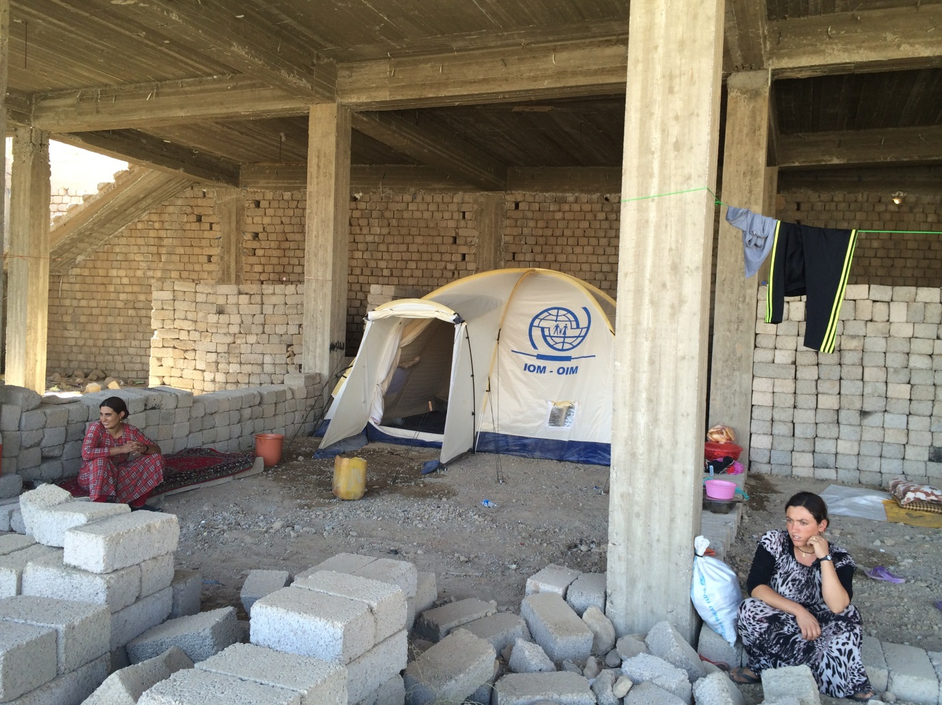
IOM Iraq – Winterization

Slide 2
IOM Options for Winterization Shelter/NFI Interventions
Winterized Full NFI Kits
Supplementary Winter NFI Kits
Winterized Tent Liners
Kerosene (through voucher)
Prefabricated Shelter Units
Sealing-Off/Partitioning Unfinished Buildings
Rental Support
Collective Center support
Drainage, graveling of access roads, and building of plinths for tented sites

Slide 3
Stocks in Erbil Warehouse and Pipeline
In Erbil Warehouse:
8,000 Supplementary Winterization NFI Kits
2,000 Hygiene Kits*
1,750 Kitchen Sets*
2,000 Standard NFI Kits
In Pipeline:
17,000 full winterized NFI kits to be distributed by Erbil Hub
8,000 full winterized NFI kits to be distributed by Basra Hub
7,750 winterized tents (deliveries in Oct-Nov)
2,500 winterized tents (deliveries in Oct)
500 Prefabricated shelter units to be installed in the Dawodiyah Camp in Duhok in coordination with UN-HABITAT

Slide 4
Supplementary Winterization NFI Kit Contents*
Carpet 3X4m | 1
Blanket winter type double layer | 4
Heater Kerosene, Korean made | 1
Hygiene kit (Detergent 5 Kg, / Toothpaste (3.5 Oz.) 2 Tubes / Toothbrush 5 pcs. / Sanitary pad (12 pcs) 3 sets / soap 75 gm 12 pcs. / Razor disposable twin blade (5 pcs) 1 set) | 1
Plastic Sheet 4X5m | 1
*Contents of kit may change due to needs on the ground, procurement conditions, and coordination with partners. IOM kits all NFIs on site and can adapt the contents of a kit if necessary.

Slide 5
Full Winterized NFI Kit Contents
Mattresses, local made, size; 200*80*10 with cover, 2.5 kg | 4
Blanket, winter, high thermal, double-layer, made in China, woolen, size 190cm x 230cm, 3 kg | 4
Kerosene stove, 1 burner (10 wicks) | 1
Kitchen Set: Bowl (3), Melamine Plates (3), Table Spoon (3), Table Knife (3), Table Fork (3), Cooking Spoon (2), Kitchen Knife (1), Plastic Cups (3) | 1
Hygiene kit: Tooth paste tube (2), detergent powder, (5kg), Tooth brush (5), Sanitary pad (30), Soap bar (12), Shaving razor (5) | 1
Kerosene heater, tank capacity 6 Liters | 1
Pillow Vacuumed | 4
Towel, 100% cotton | 4
Plastic Sheet, 4m x 5m | 1

Slide 6
IOM Duhok Team and GEC Priorities
Tents: Priorities for camps (to be coordinated with DMC). GECs will not endorse tents for IDPs residing in schools, and will act on case-by-case basis for out-of-camp tent distribution.
Procedure: GECs will forward requests from Mayors for tent support to humanitarian agencies. In addition, all tent distributions must be endorsed by GECs.
Unfinished Buildings: Most likely interventions will be tents, protective walls/safety barriers and sealing-off and partitioning.
Fuel Voucher: GEC has agreed for IOM to provide fuel voucher support for residents of Shekhan Camp.

