Slide 1
Shelter Cluster Meeting
Bohol Earthquake
18:00, October 21, 2013

Slide 2
Needs v’s response – WWW
Structural surveys
Enumeration surveys
Temporary shelter design
Temporary shelter training awareness raising
Time lines

Slide 3
Discussion on shelter response strategy – types of response

Slide 4
Activity | Materials | Design life
Tents | Family tents | 3 to 6 months
Emergency shelter | Plastic sheeting | Few weeks/months
Temporary shelter | Tarpaulins, salvaged materials, tools, design and technical guidance | 3 to 6 months ??
Transitional shelter | Timber, bamboo, nippa palm, tarpaulins, CGI, design and technical guidance | 6 to 24 months ??
Full recovery – durable shelter | Reinforced concrete frame Timber frame

Slide 5
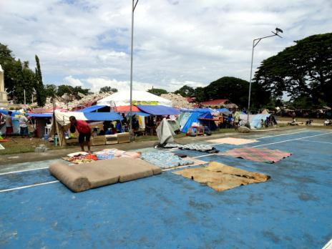
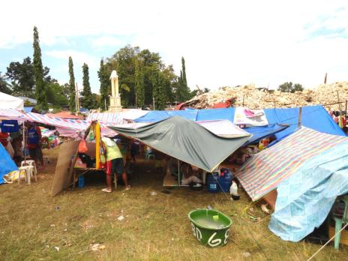
Emergency Shelter

Slide 6
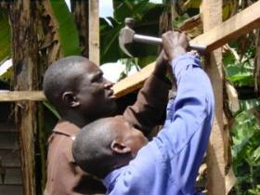
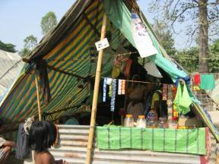
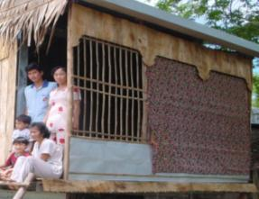
Beyond life saving
Beyond survival, the key considerations are:
health
providing protection from the climate
ensuring privacy, dignity and culture
providing personal safety and security
livelihood support

Slide 7
Temporary Shelter

Slide 8
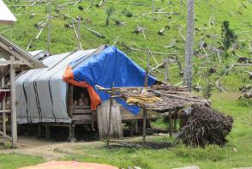
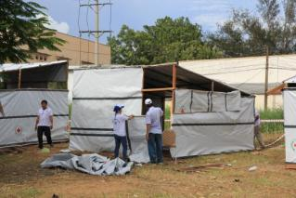
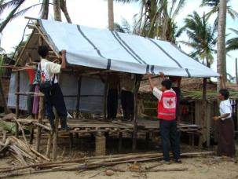
      Temporary shelter –
          basic and rapid but also adequate – must be habitable
          short term - few weeks to a few months
          prioritises speed and limiting costs of the construction
          made of salvaged or bought materials, tarpaulins, etc.
Notes:
Question the participants, ask them to give examples:
Emergency shelter: when it rains, I take shelter under the awning of a store while waiting for the end of the shower.
Temporary shelter: my house was destroyed, so I built a temporary shelter before being able to build a permanent house. I won’t be staying in this temporary shelter for very long….
Transitional shelter: before being able to build a permanent house, I’ll gradually transform my temporary shelter to a transitional shelter. I am improving my temporary shelter to make it more comfortable….
Permanent shelter: my house is my permanent shelter.

Slide 11
Temporary Shelter
Example Option 1

Slide 12
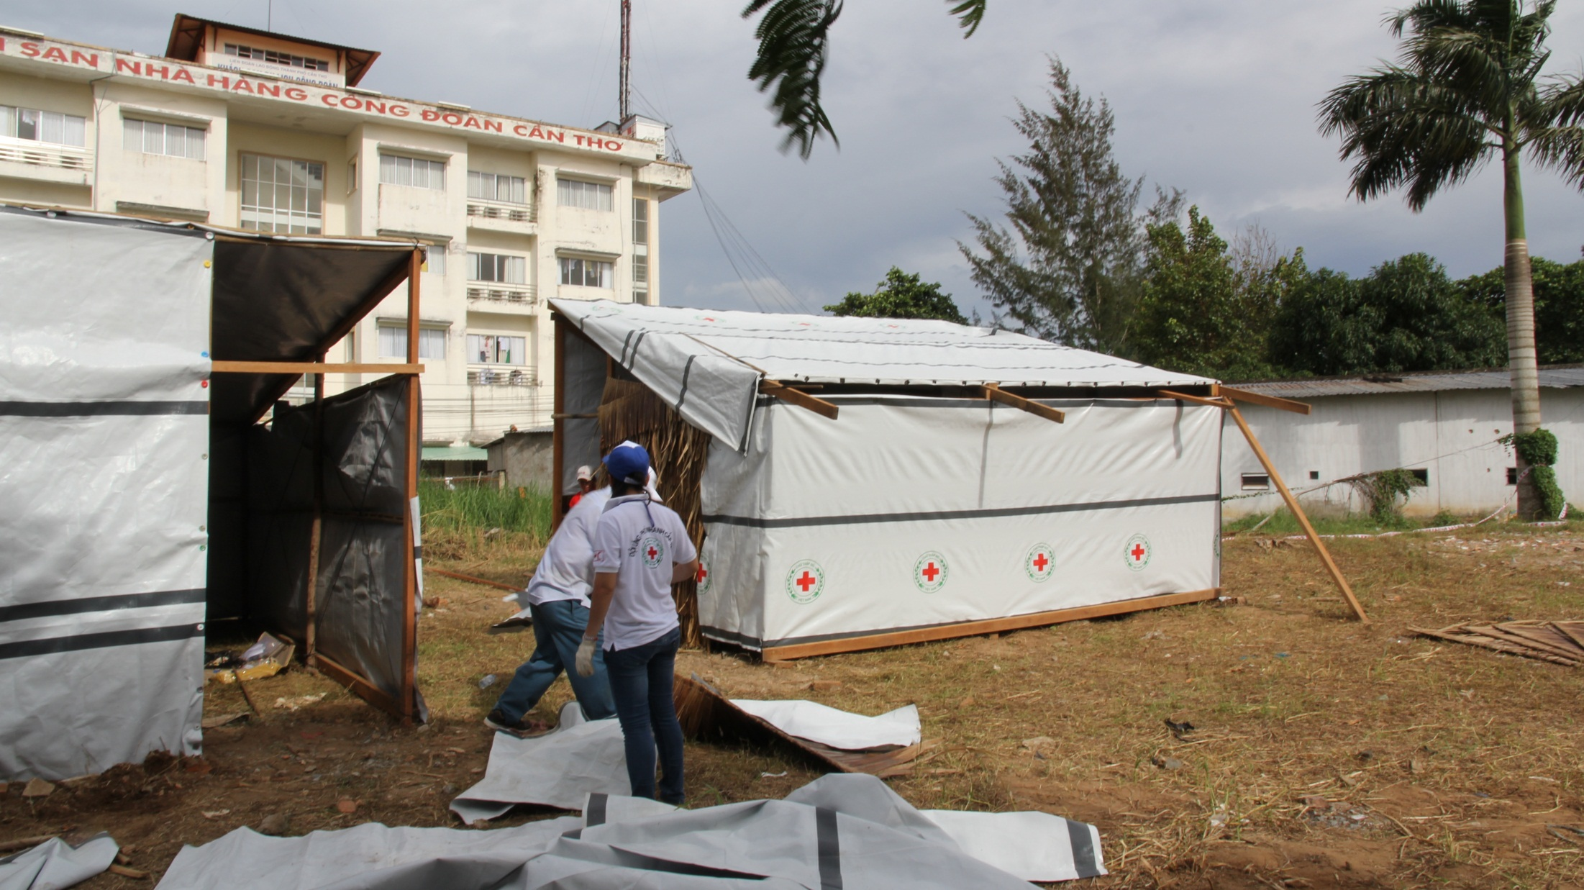

Slide 13
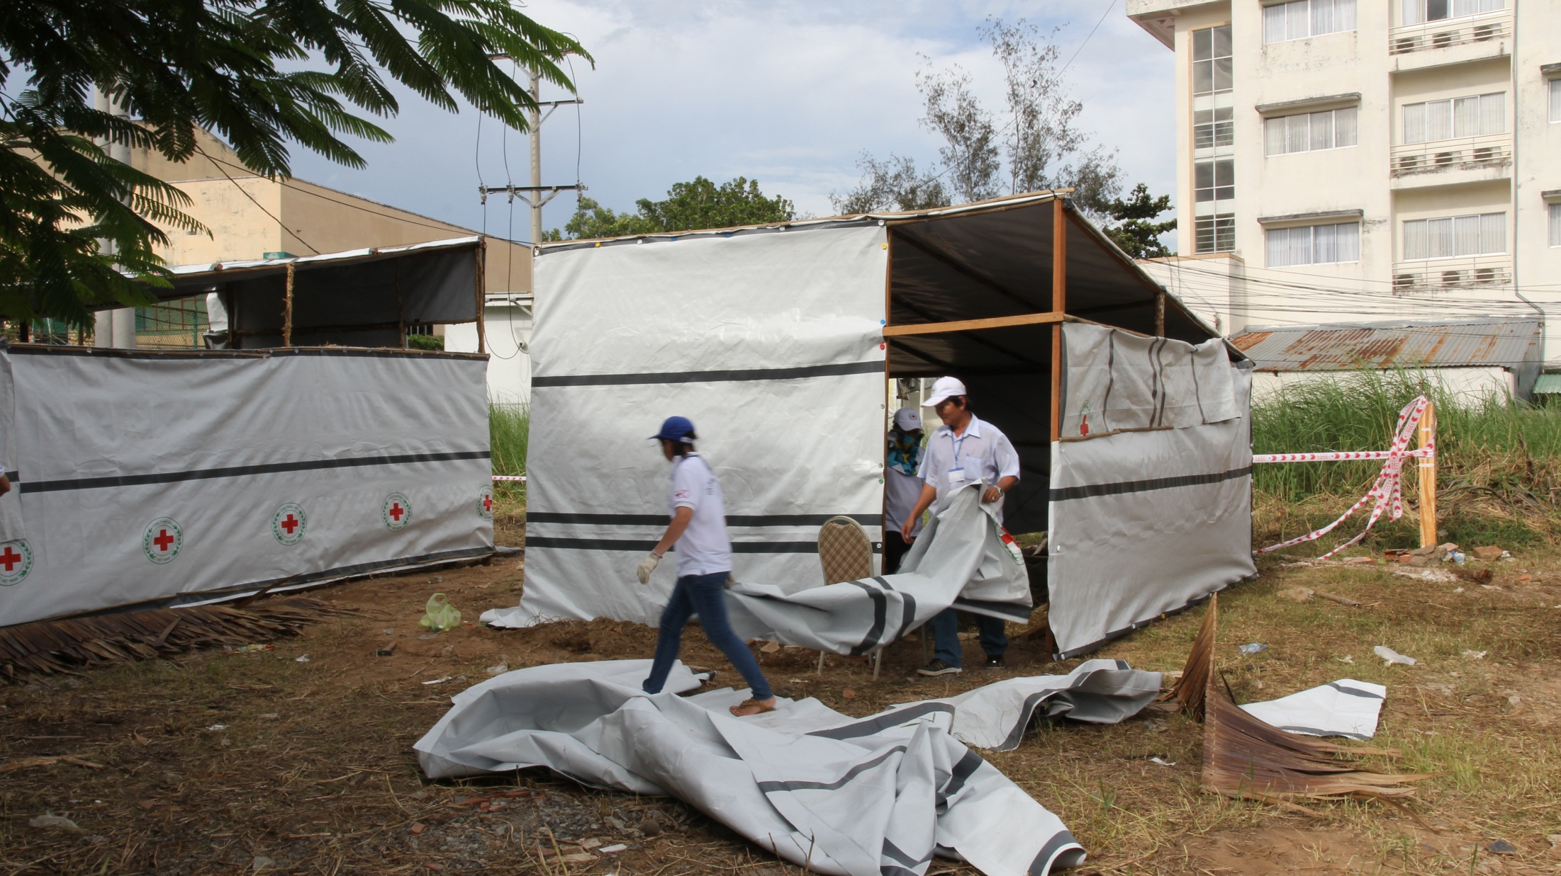

Slide 14
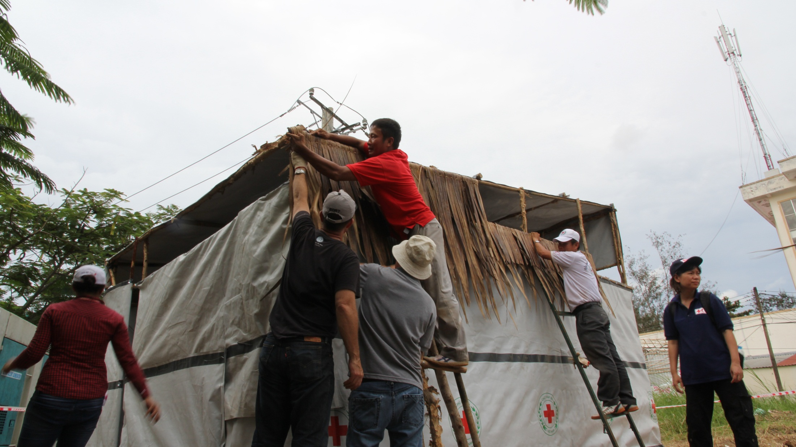

Slide 15
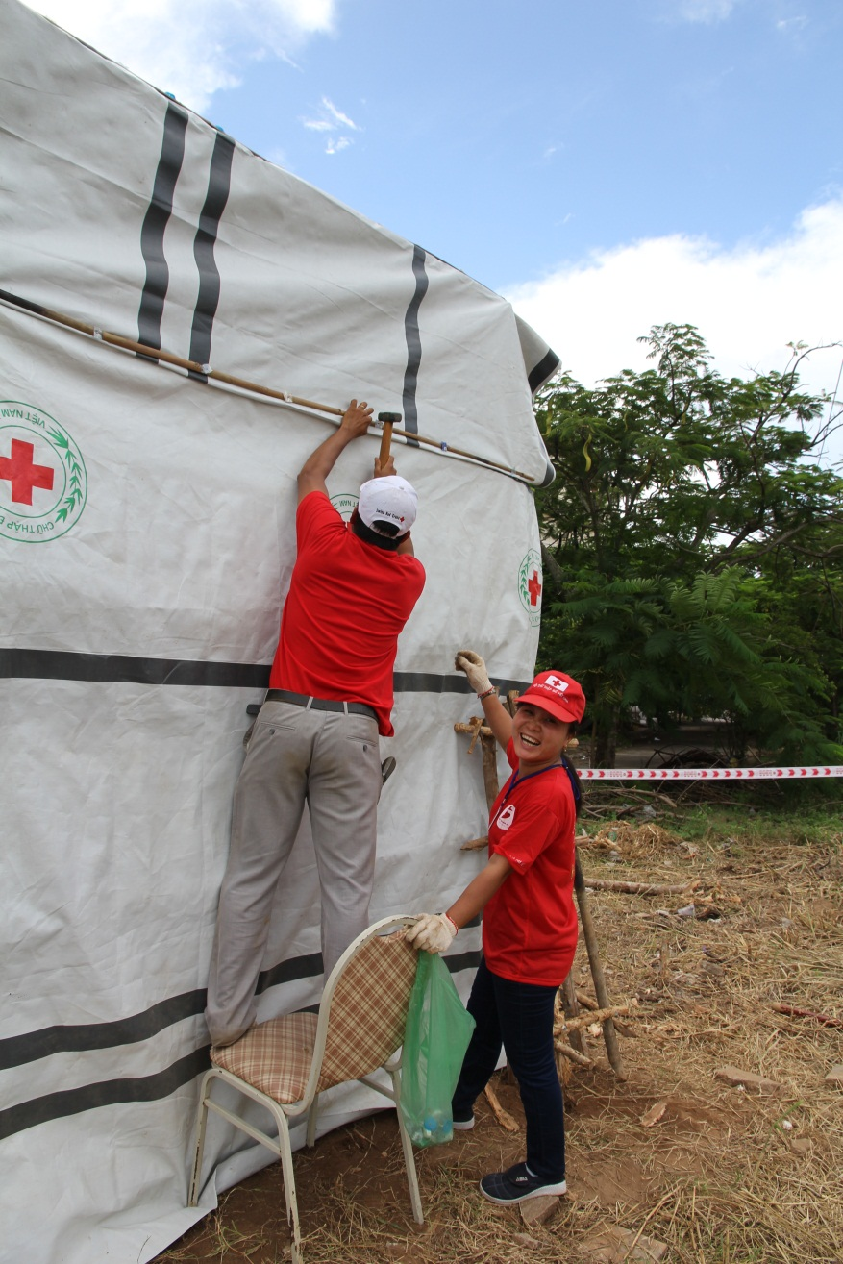

Slide 16
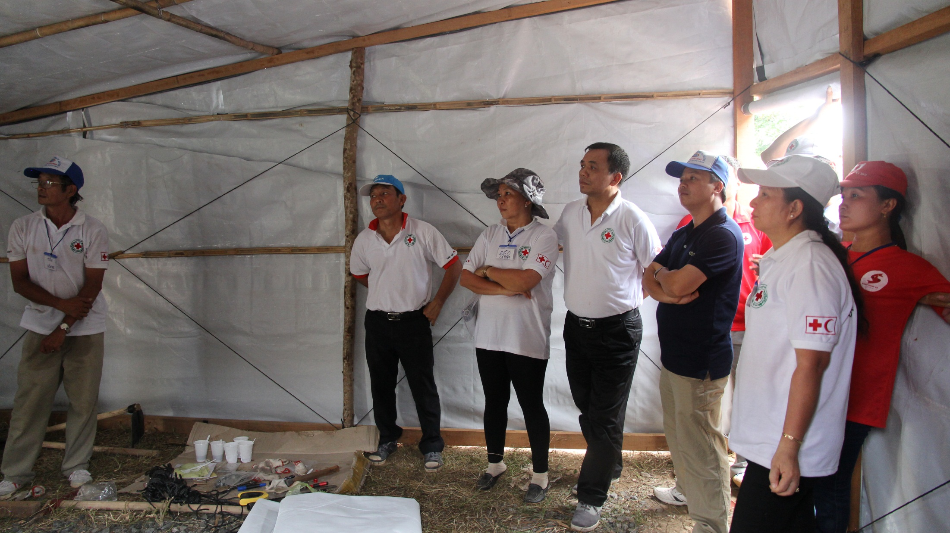

Slide 17
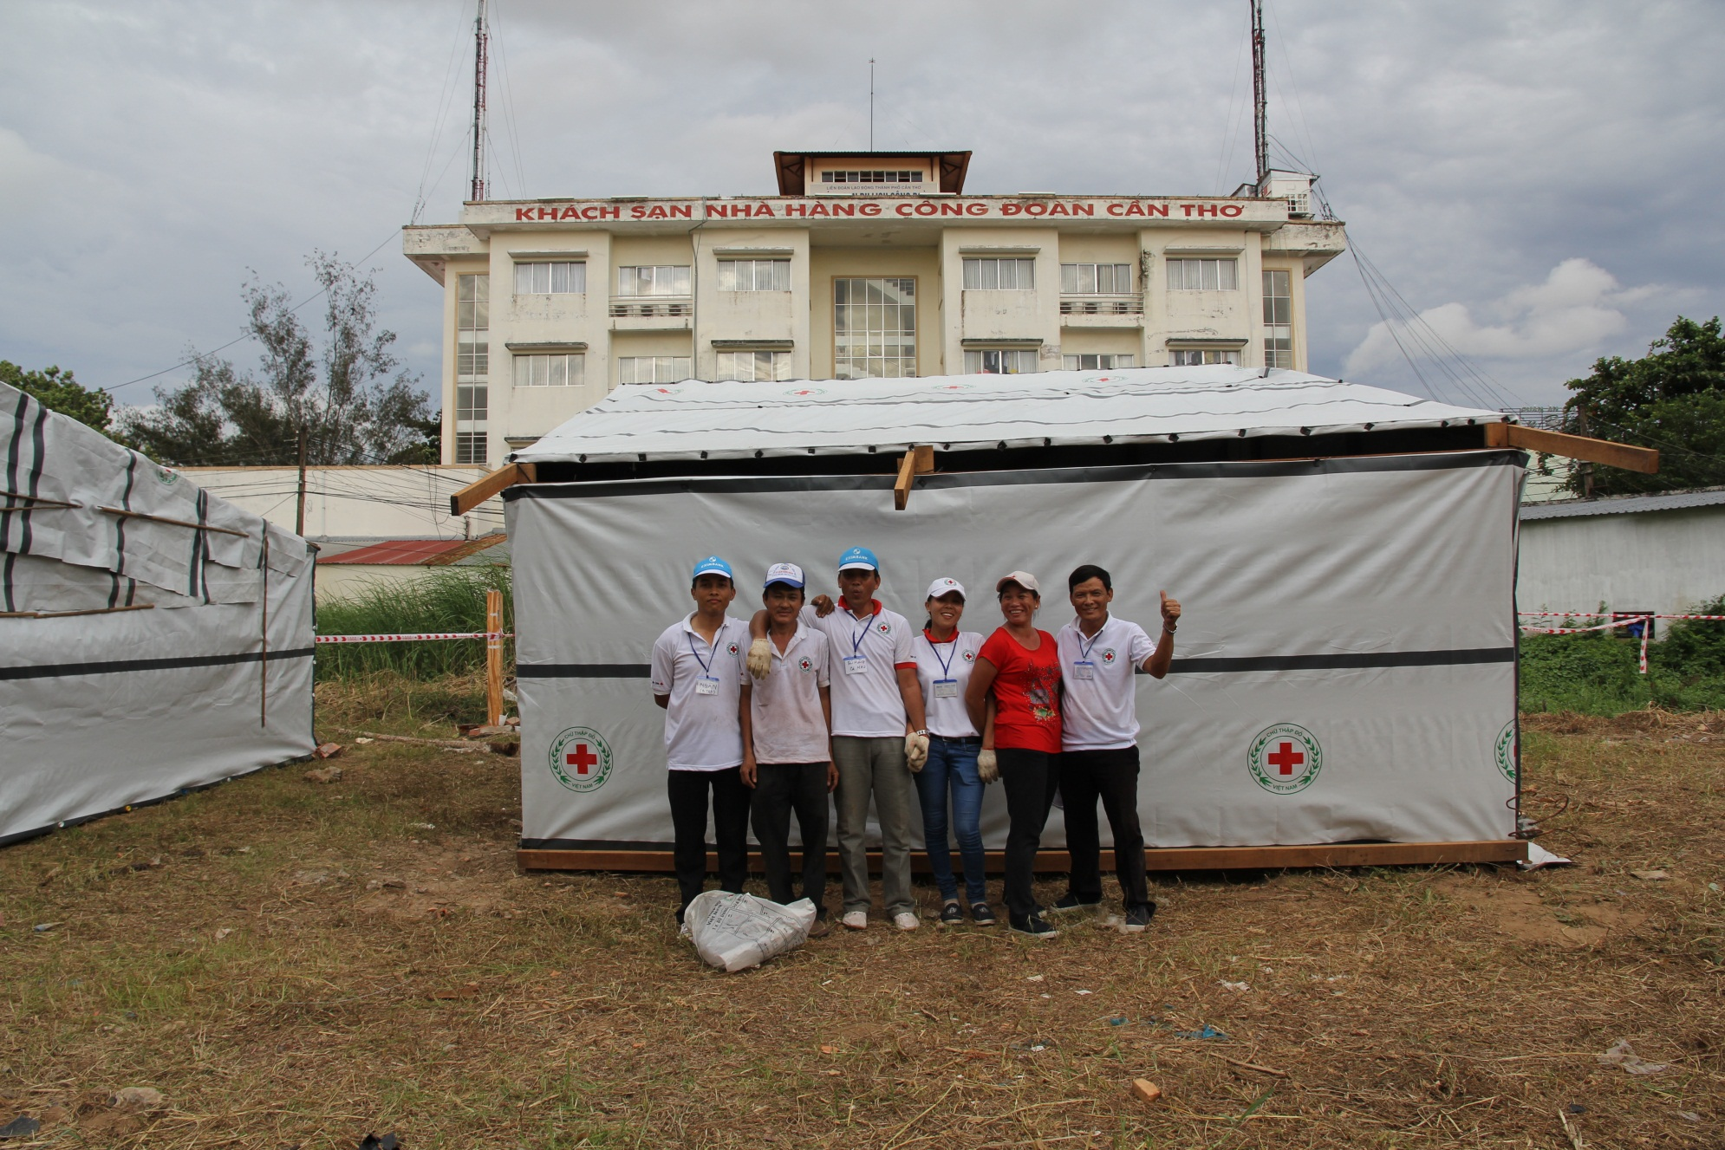

Slide 18
Temporary Shelter
Example Option 2

Slide 23
Transitional Shelter

Slide 24
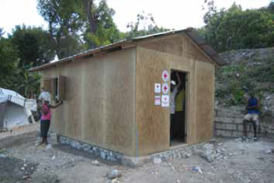
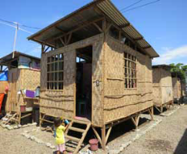
  Transitional shelter –
    a few months to years – more durable than temporary
    designed to facilitate the transition to more durable solutions
    made from materials that can be upgraded or re-used in more permanent structures, or that can be relocated from temporary to permanent locations.
Haiti, 2010
Materials: Wood framed walls with plywood sheathing, metal roofing on wood trusses, concrete slab floor
Anticipated lifespan: 3 – 5 years
cost per shelter: 1,560CHF
project cost per shelter: 2,300CHF
Philippines, 2011
Materials: Concrete footings, coconut wood frame, plywood floor, amaken walls and corrugated iron roof
Anticipated lifespan: 5 years
material cost : US$ 550
Notes:
Question the participants, ask them to give examples:
Emergency shelter: when it rains, I take shelter under the awning of a store while waiting for the end of the shower.
Temporary shelter: my house was destroyed, so I built a temporary shelter before being able to build a permanent house. I won’t be staying in this temporary shelter for very long….
Transitional shelter: before being able to build a permanent house, I’ll gradually transform my temporary shelter to a transitional shelter. I am improving my temporary shelter to make it more comfortable….
Permanent shelter: my house is my permanent shelter.

Slide 25
Transitional Shelter
Example Option 1

Slide 26
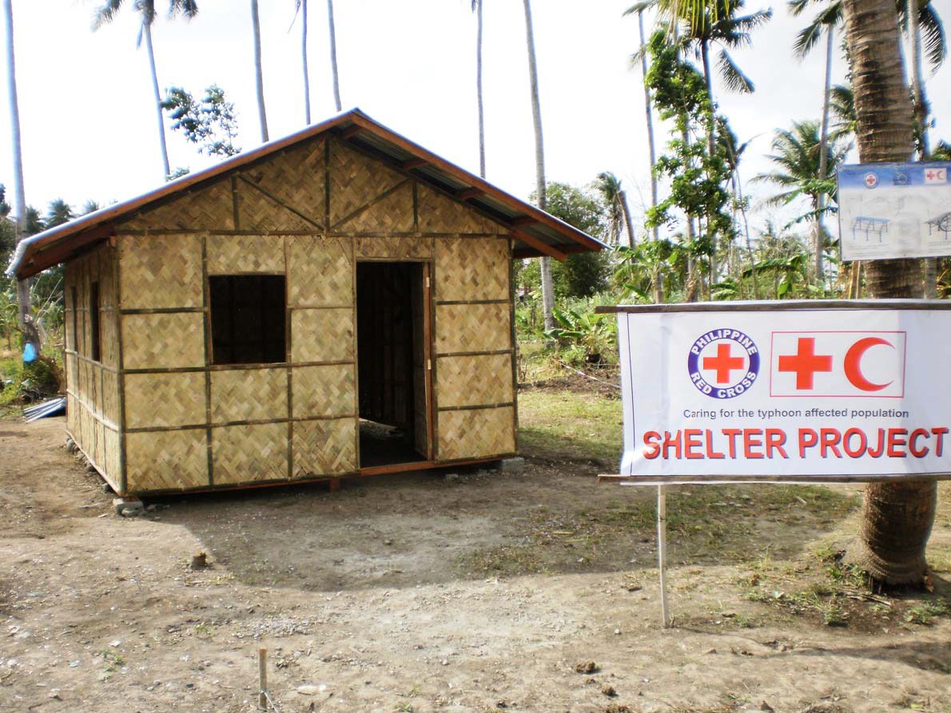

Slide 27
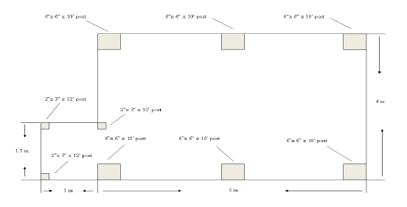

Slide 28
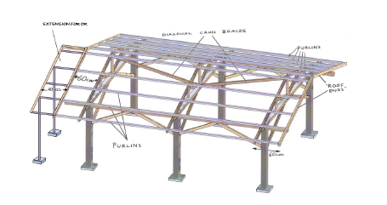

Slide 29
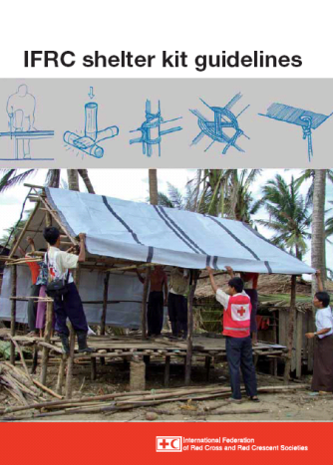
Reference documents
We invite you to read this guide most attentively!
Notes:
Refer to the IFRC shelter kit guidelines to explain the contents.
Emphasize the importance and the quality of the information in this guide.

Slide 30
IFRC shelter kit guidelines
This guide contains information on:
what is the shelter kit
what is an emergency shelter
planning an emergency shelter programme
construction and repairs
the specifics of the shelter kit
examples of emergency shelters
We invite you to read this guide most attentively!
Notes:
Refer to the IFRC shelter kit guidelines to explain the contents.
Emphasize the importance and the quality of the information in this guide.

Slide 31
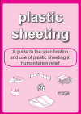
Guide: Plastic sheeting
This guide explains the principal uses of tarpaulins in the construction of family shelters, toilet blocks and infrastructure.
Tarpaulin, by itself, is not a solution for construction. It must be combined with other building materials to create a structure with fastenings for a strong attachment (Lumber, Bamboo, Rope, Tying wire, Nails…)
Give preference to local building materials which are more durable than tarpaulin: palm leaves, banana trees or other, thatch, straw, adobe (especially for the walls)…
Tarpaulin only represents a temporary solution (lifespan of less than 2 years)
The technical sheets are provided in your folder Shelter Techniques!
Notes:
Display fully the Guide – Tarpaulin.

Slide 32

Guide: Timber
This guide provides information on:
  Selection of timber
  Specifications of the timber
  Purchase of the timber
  Utilization of the timber
  And, the distribution of the timber
  as construction material for small to medium sized buildings during humanitarian operations.
  We are committed to the utilization of timber in construction.
The technical sheets are provided in your folder Shelter Techniques!
Notes:
If the time is limited, then do not present this guide. Make reference to this guide during the presentation of the technical file at the end of the day.

Slide 34
Temporary shelter training and awareness raising
A series of basic technical trainings are required to build the capacity of affected populations to make effective use of the emergency materials distributed by cluster partners.
The training is aimed at all technical staff to pilot the construction of two or three design types for temporary shelter.
This training will inform on simple techniques for the application of tarpaulins, nails types, use and correct application. How to best connect timber used and how to fix.

Slide 35
The concept for training, is to gather all operational organisations for the following steps:
  Bring together organisations distributing tarpaulins to develop a common mode of implementation and use f tarpalines.
  Central level training of technical staff to participate in core trainings to construct two types of temporary shelter
    Flat rood
    Pitched roof
  Development of a training package with support guidance leaflets and materials for dissemination at community level
  Development of a timeline for additional trainings to be carried out in Municipalities and Brngys.

