Slide 1
National Shelter and Non Food Items Cluster for Iraq. Wednesday 17 SEPTEMBER 2014 AGENDA: 1. Welcome and introductions 2. Opening remarks 3. Finalisation of National Shelter/NFI Cluster Strategy 4. Update on Sub-National Shelter/NFI Cluster Operational Plan for KR-I 5. AOB

Slide 2
Strategic Points of Engagement
-
+
Stabilization Options
Post Emergency
VIABILITY
IDP in Open Air
PRIORITY
Supported host/rent arrangement
Support to Return (rehabilitation)
Squatted Schools
Improvised Spontaneous sites
Self supported Accommodation (host/rent)
Improved collective shelter
Organized spontaneous sites
Collective Center
Alternative communal shelter
Rented Accommodation
Establishment of camps
Camps
Hosted Accommodation
-
+

Slide 3
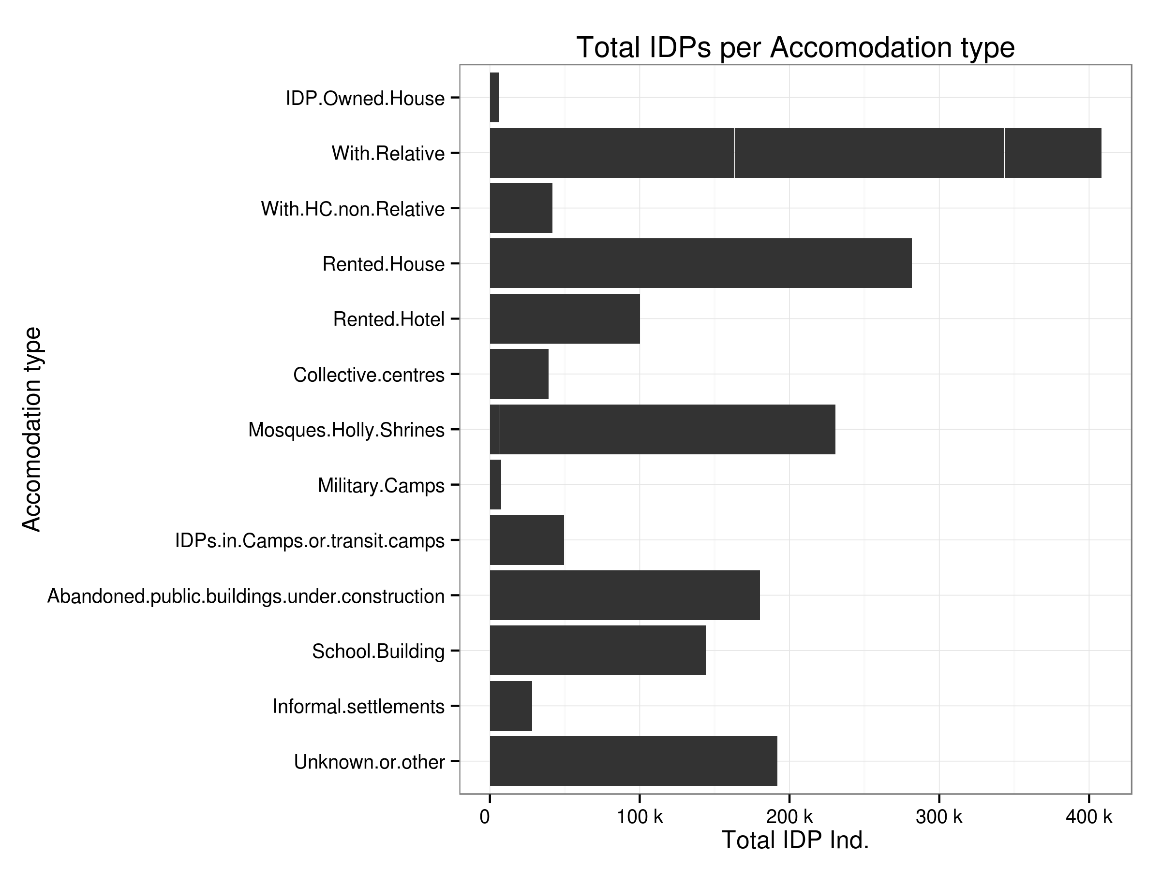
VIABILITY
Data Source: IOM- Displacement Tracking matrix - http://iomiraq.net/dtm-page as of 1 Sept 2014
Note: Figures only depict the situation of IDPs displaced since January 2014.

Slide 4
Planning Scenario:
Planning figure: 1.8 million people displaced across Iraq since January 2014.
Assessments among the 860,000 displaced persons in KR-I have identified 480,000 persons in need of urgent shelter and winterization assistance.
Among the 940,000 displaced across 14 other Governorates, assessments indicate that 70% (660,000 persons) are still in need of humanitarian assistance and with an estimated 30% (200,000 persons) in need of shelter assistance and app. 70% (460,000) lacking basic NFI’s.
Total shelter requirements: 680,000 persons
Total NFI requirements: 940,000 persons
Total Target Population: 1,260,000 persons* (70% of total displaced population)

Slide 5
NATIONAL SHELTER AND NFI STRATEGY FOR IRAQ – DRAFT:
NATIONAL CLUSTER OBJECTIVES - DRAFT :
Respond in a timely manner and mobilize support to assist the Iraqi authorities and civil society to meet the needs for emergency shelter and non-food items of displaced population and affected communities.
Develop immediate, mid-term and longer term operational plans anchored in regional actualities and ensuring coherence and compliance to applicable standards – including mitigating and addressing extreme seasonal climatic conditions.
To strengthen the overall shelter response capacity in a well-coordinated manner (to identify viable shelter options, cover gaps, address vulnerabilities, avoid overlap and ensure resilience leading to durable solutions.)
Monitor and respond with appropriate interventions to address changes in the
displacement situation (secondary displacement) including provision of shelter/NFI
assistance for returnees and their communities.

Slide 6
NATIONAL SHELTER/NFI CLUSTER STRUCTURE – IRAQ - DRAFT.
NATIONAL SHELTER/NFI
CLUSTER COORDINATOR
Information Management Officer
Sub-National Cluster
Coordinator – South/Central
National Technical Task Force
Sub-National Cluster
Coordinator - North
Thematic Working Groups
Thematic Working Groups
SHELTER
SHELTER
NFI
NFI
TBC
TBC
TBC
TBC
Governate W.G
Governate W.G
Governate W.G
Governate W.G
Governate W.G
Governate W.G

