Slide 1
NFI Sector Meeting
October 2024

Slide 2
AGENDA
NFI Sector Update.
Updates the displacement from Lebanon Emergency.
Beginning of Winter Season 2024-2025 update.
Partners update.
Reporting & IM.
AoB

Slide 3
INTRODUCTION

Slide 4
SECTOR STATUS
AS OF JUNE 2024

Slide 5
SECTOR STATUS
AS OF AUGUST 2024
Population by cohort
,7%

Slide 6
SECTOR STATUS
AS OF AUGUST 2024

Slide 7
SECTOR STATUS
AS OF AUGUST 2024

Slide 8
SECTOR STATUS
AS OF AUGUST 2024

Slide 9
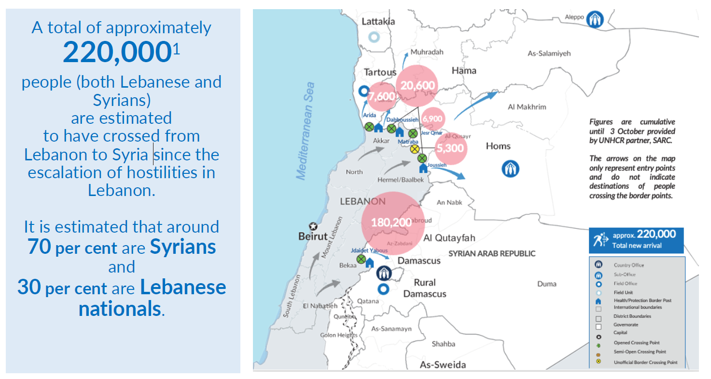
Response to Displacement from Lebanon to Syria
Reporting period: 24 September - 5 October 2024

Slide 10
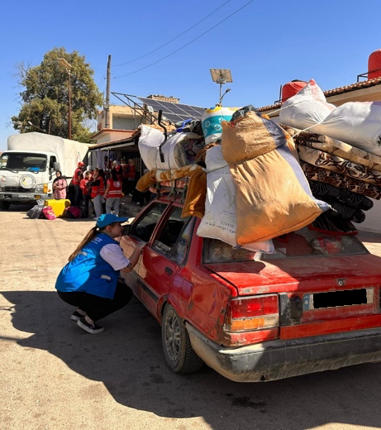
Response to Displacement from Lebanon to Syria
Reporting period: 24 September - 5 October 2024
Urgent Needs:
Protection: Mitigation of protection risks, especially for women and girls.
NFI needs: Distribution of winter items to support families in need, core items will be covered by UNHCR.
Scale-Up of Response: Increased humanitarian assistance to meet the growing needs of displaced populations.
Notes:
Overview of Developments
Launch of Inter-Agency Emergency Appeal: On 7 October, the "SYRIA: Inter-Agency Emergency Appeal for the Influx from Lebanon to Syria" will be launched in Damascus.
Increased Border Crossings: Since 23 September, over 220,000 individuals have crossed the border into Syria, including Syrians, Lebanese nationals, and others.
Expanded UNHCR Presence: UNHCR has expanded its presence at a fifth border crossing, Jesr Al Qmar.
Impact of Airstrikes: Following airstrikes near the Masnaa border point on 4 October, the number of new arrivals through the primary entry point, Jdaidet Yabous, decreased by around 75% on that day.
Recovery of Arrival Rates: However, the rate of arrivals through other border crossings, in Homs and Tartous, returned to previous levels as many had diverted their travel routes.
Ongoing Humanitarian Support: UNHCR and SARC continued to provide bus services to vulnerable new arrivals from the airstrike site to the Syrian border crossing.
Government Waiver Extension: The Syrian Government's decision to extend the waiver for the mandatory exchange of US$100 has facilitated timelier entries for Syrians fleeing Lebanon.

Slide 11
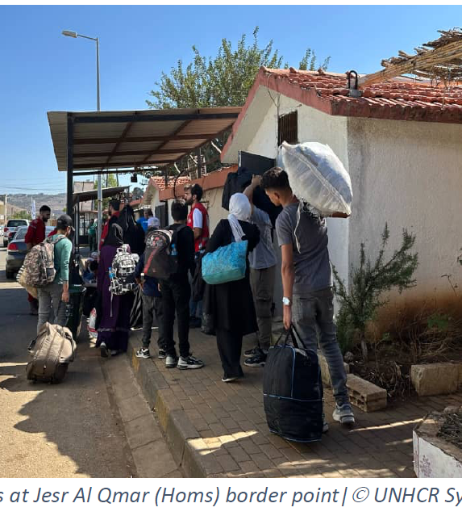
Response to Displacement from Lebanon to Syria
Reporting period: 24 September - 5 October 2024
Hosting Centers for Lebanese Families
Establishment: Local authorities have established hosting centers to provide shelter for vulnerable Lebanese families who have recently arrived in Syria and lack alternative accommodation.
At present, there are more than 40 hosting centers located throughout Damascus, Rural Damascus, Homs, Hama, Idleb, Tartous and Latakia governorates.
Distribution: These centers are located across various governorates, including Damascus, Rural Damascus, Homs, Hama, Idleb, Tartous, and Latakia.
Accommodation: As of 5 October, 1,997 vulnerable Lebanese families (comprising 9,983 individuals) are being accommodated in these hosting centers.
NFI distributions: Partners are actively involved in mitigating risks, particularly for women and girls, and are distributing essential Non-Food items to support these families in need.

Slide 12
LEBANON EMERGENCY RESPONSE
AS OF 2nd OF OCTOBER 2024

Slide 13
LEBANON EMERGENCY RESPONSE
AS OF 2nd OF OCTOBER 2024

Slide 14
WINTER ANALYSIS
Objectives of NFI Sector Winter Analysis;
  Estimate people in need (PiN) of winter NFI assistance
  Determine prioritized target and associated locations
  Determine partner capacity to respond
  Determine gap, resource mobilization needs, and advocacy requirements
  Provide guidance to NFI sector members
  Outline winter reporting requirements
  Outline post-winter PDM structure

Slide 15
WINTER TIMELINE
Winter planning timeline;
July – September 2024
Winter response timeline;
1 October – 31 March 2025
Prioritized response timeline;
Finalize winter assistance by October/ November 2024

Slide 16
WINTER 2024-25 UPDATE
Winter People in Need
Winter Target

Slide 17
WINTER 2024-25 UPDATE

Slide 18
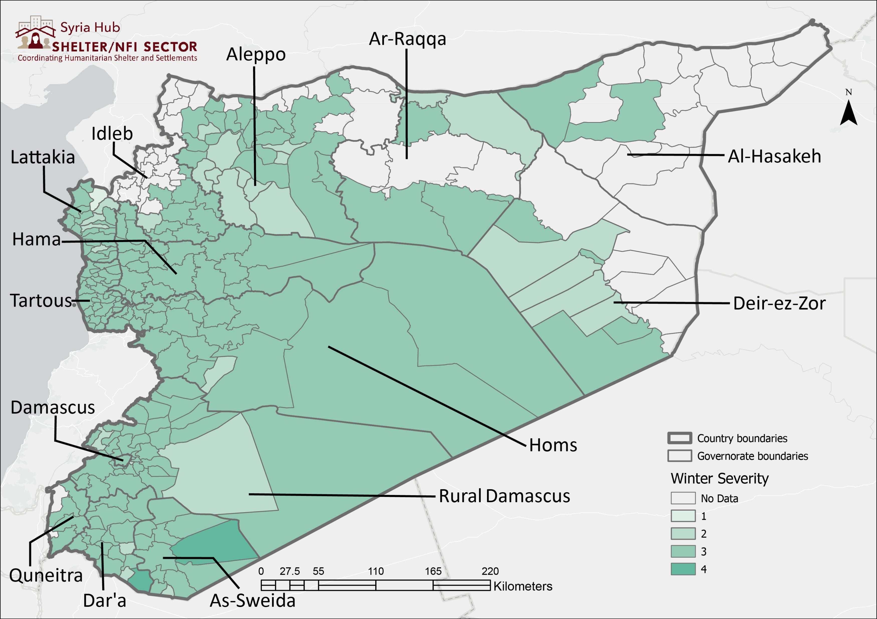
WINTER 2024 -25 UPDATE

Slide 19
PARTNERS UPDATE

Slide 20
REPORTING AND IM
4Ws Report
Avoid the duplication of counting of individuals reached as much as possible and be sure to share data through the Activity info here.
The sector IM has implemented an interactive dashboard here, so please use the link for more details of the SNFI sector response.
The SNFI sector has released the Q2 sector factsheet here, please visit the Global Shelter Cluster web page for more information.
Reporting Frequency
4W’s report is to be completed by all sector partners by the 7th on a monthly basis.
If you have any queries on reporting, please send me an email at habibmu@unhcr.org or via cell phone at +963 933 346 458

Slide 21
AOB

Slide 22
THANK YOU
October 2024
Mahamat Alhadi Ibrahim Yaya
Snr Sector Coordinator
mahamati@unhcr.org
Zina Alkhiami
Assistant Field Officer
alkhiami@unhcr.org
Muhammad Reda Habib
Information Management Associate
habibmu@unhcr.org

