Slide 1
NATIONAL SHELTER CLUSTER MEETING
18 Sept 2024

Slide 2
AGENDA
Introductions
IM Update
Gaza Updates
ACTED/SMWG – Neighbourhood Approach
WB Updates
WeWorld Presentation
Energy Coodinator
AOB

Slide 3
INTRODUCTIONS
National Coordinator - Vacant
Alison Ely – Sub-National Coordinator Gaza
coord2.palestine@sheltercluster.org
Fadi Shamisti – West Bank Coordinator
coord1.palestine@sheltercluster.org
Iyad Abu Hammam – Gaza Coordinator
coord.gaza@sheltercluster.org
Mohammad Aklouk – IMO
im1.palestine@sheltercluster.org
Georges Estephan
im2.palestine@sheltercluster.org
Leandro Fernandez-Jardon – currently in Gaza
Techco.Palestine@sheltercluster.org

Slide 4
NEXT MEETINGS
National Shelter Cluster Meeting (Online)
Wednesday 2nd October, 10:30 – 12:00
West Bank Shelter Cluster Meeting (Online)
Wednesday September, 10:00 – 11:30
Gaza Shelter Cluster meeting (In person)
Sunday 22 September, 10:30 – 12:00, Location TBC

Slide 5
GENERAL UPDATES
Contact list update
HF – deadline for fast track for Gaza was yesterday, deadline for WB is 25th
New updates online
Question – if any partner has experience of using MoveOne please can you let me know

Slide 6
GAZA UPDATES
  Winterisation Shift – focussing on SOKs and the South
  Shelter Cluster is a member of the Flooding temporary taskforce established by OCHA, alongside WASH Cluster and SMWG. The taskforce conducted assessment to 4 sites in Khanyounis, and DeB, and will conduct another assessment to the North.
  Highest tides 19th
  Sudden shocks –
    Mawasi 9th September – thanks to CRS and Bayader for assessing and Ma’an for responding with tents
    Flooding events – tidal – UNRWA and Ma’an
    Al Shawi shelter in the North – CRS responded

Slide 7
GAZA UPDATES
Working on Protection Referral Mechanism with Protection cluster and AoR for shelter needs.
SAG is operational – same agencies as before, for now, proposing to update in the new year.

Slide 8
FENCE ROAD
  There is a lack of goods coming on through Kerem Shalom
  The fence road movement is a temporary option used to clear the backlog currently in Al Arish.
  As per OCHA inter-cluster prioritization guidance, fence road is used for prioritized items that are more susceptible to looting and theft.
  Shelter will be prioritised due to the urgent need for winterisation – the more we can prove we have items to get into Gaza, the more trucks we can ask for.
  Also working on moving items directly from Jordan on the JHCO.
  Timeline:
    Tuesdays - clusters submit prioritised partner items
    Thursday – clusters meet to agree priorities for following week

Slide 9
FENCE ROAD
  Partners must submit their SRFs and truck details as usual to Logs Cluster
  Partners must submit their fence road truck details by TUESDAY AM for the following week so that the Logs cluster can collate and share with the ICCG.
  The cluster is working on a way to plan further in advance, and we will let you know once this is finalized
  Recently we have only been able to put forward tents and SOKs, and bedding sets– please let us know what you have to be moved into the fence road.
  This process is outlined in the document shared on gaza_fence_road_priortisation_process-30-aug-2024,
  Please make sure your logs colleagues are aware of this.

Slide 10
IM UPDATE

Slide 11
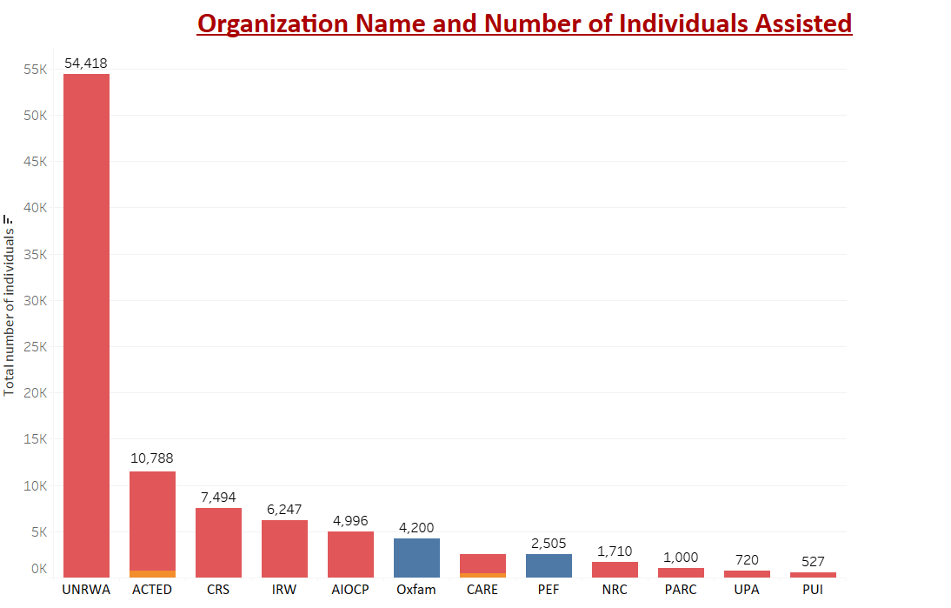

IM Updates- 5Ws Analysis (Aug-Sep)2024

Slide 12
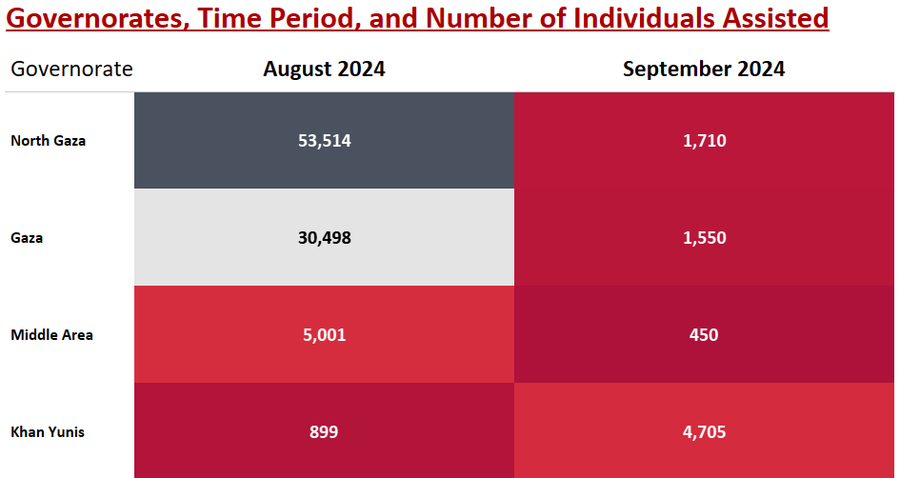

IM Updates- 5Ws Analysis (Aug-Sep)2024

Slide 13
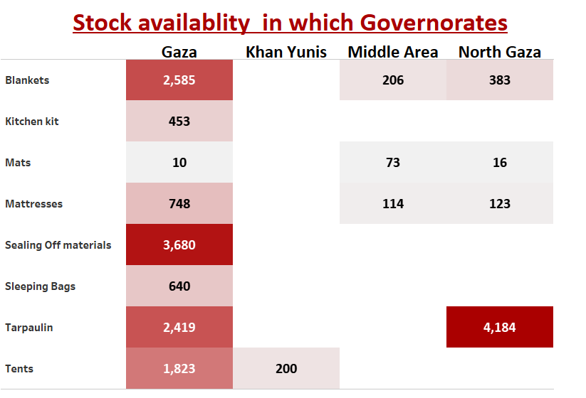
IM Updates- Stock Analysis 2024

Slide 14
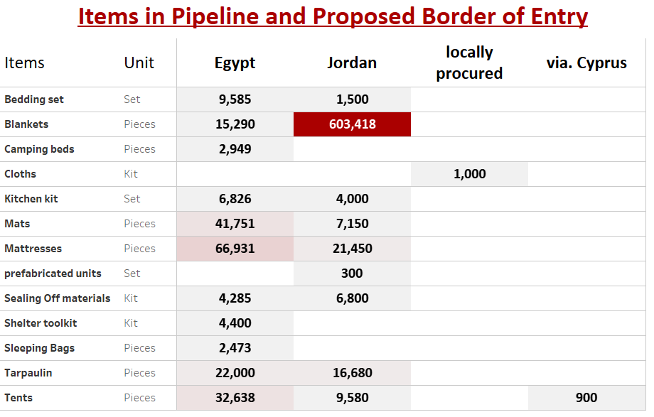
IM Updates- Pipeline Analysis 2024

Slide 15
IM Updates : Damage Figures
Governorate | Totally Destroyed | Severe Damages (Uninhabitable) | Total
West Gaza | 17,000 | 10,300 | 27,300
East Gaza | 16,000 | 9,000 | 25,000
South Gaza | 13,000 | 8,000 | 21,000
North Governorate | 30,000 | 10,000 | 40,000
Middle Governorate | 10,000 | 8,000 | 18,000
KhanYunis Governorate | 40,000 | 17,000 | 57,000
Rafah Governorate | 15,000 | 8,000 | 23,000
Total | 141,000 | 70,300 | 211,300

Slide 16
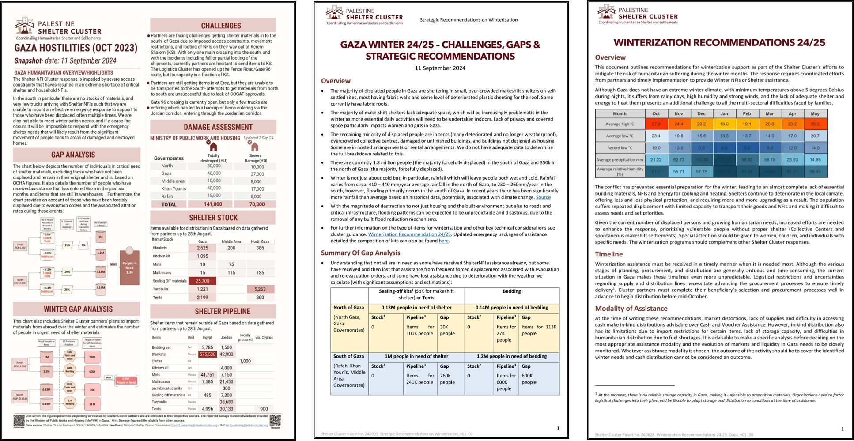
New Technical & IM Products

Slide 17
ACTED/SMWG

Slide 18
WEST BANK UPDATES

Slide 19
North Military Operation Updates
WB UPDATES
Thousands of housing units have been destroyed or damaged in the West Bank due to recent Israeli military operations. Currently, there are two separate centers for registering the affected/damaged/destroyed houses: one for refugees, managed by UNRWA, and another for non-refugee cases, managed by an interministerial committee. Approximately 3,000 housing units are estimated to have been damaged.
The next step is to check and verify both lists to consolidate a final, accurate record of affected households.
UNRWA has started providing rental assistance to displaced refugee families, while ACTED is covering non-refugee cases.

Slide 20
North Military Operation Updates
WB UPDATES
Ongoing discussions are taking place on how to involve cluster members in the West Bank in the damage assessment process and to address any shelter repair gaps for both refugees and non-refugees.
The cluster team is working to align responses for refugees and non-refugees, ensuring equality in assistance. Additionally, the team is developing clear guidelines for categorizing shelter damage and determining compensation values and ceilings.
Partners may face a funding shortfall for regular demolition and settler violence response efforts.
A group of cluster members is working to finalize the guidelines for cash-based shelter response.

Slide 21
OCHA triggers first week of September Updates
WB UPDATES
On 8-9-2024 trigger for Jenin
  Date of incident 28-8
  28 HH displaced
On 7th September trigger for Tulkarem
  Date of incident 2nd September
  55 HH displaced
On 7th September trigger in Jenin
  43 HH displaced
  Date of incident 2nd September

Slide 22

WB UPDATES
The number of demolish incidents from Jan-Sep 17 2024 recorded 391.
The number of demolished structures from Jan-Sep 17, 2024, recorded 1268.
June and July incidents recorded 44% from the total demolished structures since beginning of 2024
Most heated governorate were Jerusalem with 272 demolished structure, followed by Jericho with 178 demolished structure , followed by Hebron with 159 demolished structure

Slide 23
WB UPDATES
Notes:
6% increase in demolished structures in 2024 compared to 2023
Demolition : Any natural and Human -made disasters of the loss of essential structures/assets resulting from all types of demolition incidents and natural hazards.
The Demolished structures trend is accelerating since 2020 .
The massiveness of the incidents as well as each incident is including more demolished structures .
% of the increase demolished structure from 2020 compared to 2021 was 5%
% of the increase demolished structure from 2021 compared to 2022 was 5%
% of the increase demolished structure from 2022 compared to 2023 was 18%
% of the increase demolished structure in Q1 2023 compared to Q1 2024 was 36%

Slide 24
WB UPDATES
2022-2023-2024 comparison
Notes:
An increase in demolition structures was recorded form 959 demolished structure in 2022 compared to 1180 in 2023. ​
The massiveness of demolition in each incident is increasing as well .
July was the most heated month in 2024 so far .
June and July incidents recorded 40% from the total incidents since beginning of 2024

Slide 25
WB UPDATES
2022-2023-2024 Comparison
Notes:
An overview of 2022 and 2023 trends as we can witness an increase in trends in general between the two years, noting the accelerated trends after the 7th of October as by comparing October and November of 2022 with 2023 we notice a huge increase by 40%, 31% respectively.
June and July incidents recorded 44% from the total demolished structures since beginning of 2024

Slide 26
WB UPDATES

Slide 27
Area C analysis
WB UPDATES
Notes:
The assisted HH until august 2024 was 681 HH which exceeded last year assisted HH which was 621 HH by 9%.

Slide 28
WEWORLD

Slide 29
ENERGY

Slide 30
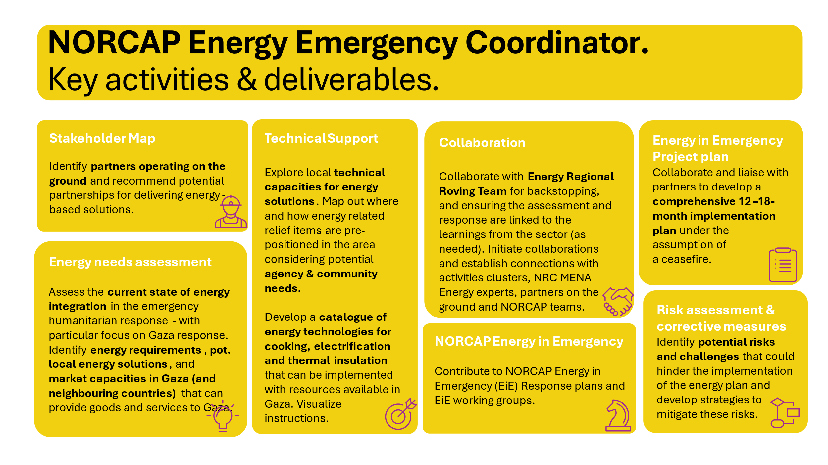
Energy

Slide 31
AOB

