Slide 1
Shelter Sector Türkiye Earthquake Response 1st March 2023
Repair and Retrofit
Technical Working Group (TWiG)

Slide 2
Agenda
1.0 Introductions
2.0 Review of preliminary MIRA (with respect to Shelter Needs)
3.0 Round table to understand proposed/ongoing agency programming
4.0 Areas for development through the TWiG going forward
5.0 0ther TWiGs in the Shelter Sector
6.0 AOB

Slide 3
1.0 Introductions

Slide 4
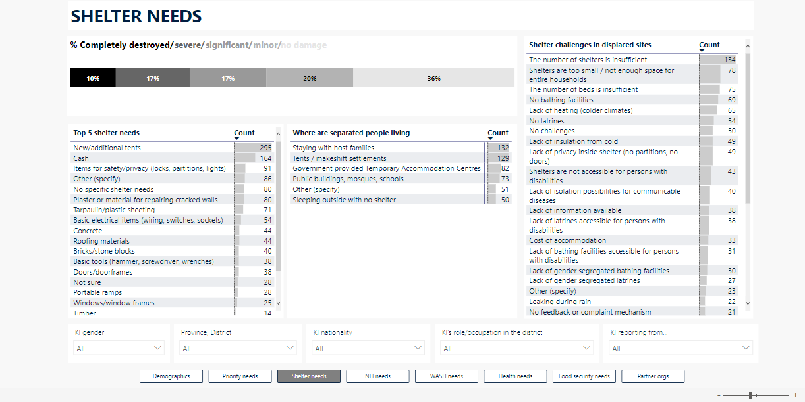
2.0 Review of preliminary MIRA (with respect to Shelter Needs)

Slide 5
3.0 Round table to understand proposed/ongoing agency programming

Slide 6
4.0 Areas for development through the TWiG going forward

Slide 7
5.0 Other TWiGs in the Shelter Sector

Slide 8
6.0 AOB

