Slide 1

Shelter Cluster Meeting
Bohol Earthquake
10am, October 19, 2013

Slide 2

Attendance
DSWD - chair
IFRC – co chair
UNDP – early recovery cluster
IOM – CCCM cluster
Habitat for Humanity
Helping Hands
CRS
World Vision
Philippines Red Cross

Slide 3
Situational Update: 19th of October
Shelter Affected Populations@ as at 19th October 2013
  Bohol - 8,664 collapsed and
  25,065 partially damage houses
  Total = 33,730
  Cebu - 15 collapsed and
  8,223 partially damaged houses
  Total = 8,238
Grand total for shelter damage - 34,567
  8,680 collapsed
  25,887 partially damaged

Slide 4
Activity | Materials | Design life
Tents | Family tents | 3 to 6 months
Emergency shelter | Plastic sheeting | Few weeks/months
Temporary shelter | Tarpaulins, salvaged materials, tools, design and technical guidance | 3 to 6 months ??
Transitional shelter | Timber, bamboo, nippa palm, tarpaulins, CGI, design and technical guidance | 6 to 24 months ??
Full recovery – durable shelter | Reinforced concrete frame Timber frame

Slide 5
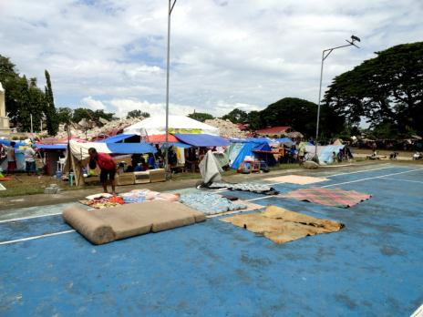
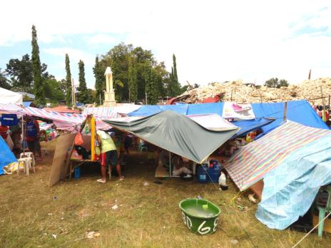
Evacuation Sites - open spaces, public spaces

Slide 6
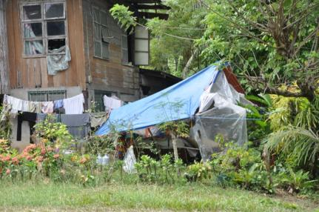
Home based sites – family living in temporary shelter beside their collapsed or damaged houses

Slide 7
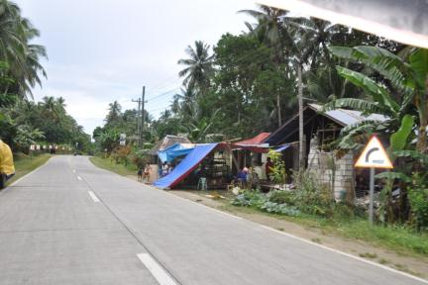
Community base - small collection of families close t their properties

Slide 8
Building status | Definition | Status | Emergency Phase | # | Transitional Phase | Self recovery | Most vulnerable | Recovery
 |  |  |  |  |  | # | #
Collapsed | Collapsed | Not habitable | Tents ?? | 8,665 | Transitional shelter |  |  | Rebuild
 |  |  | Emergency shelter ?? |  | Transitional shelter
Damaged | Damaged beyond safe repair Structural integraty comprimised and cannot be repaired | Not habitable assume - 95% ?? | Tents ?? | 23,815 | Transitional shelter |  |  | Rebuild
 |  |  | Emergency shelter ?? |  | Transitional shelter
 | Damaged but can be safely repaired Structural integraty not comprimised and can be repaired | Habitable assume -5% ?? | Emergency shelter ?? | 1,250 |  |  |  | Repair
 |  |  | Emergency shelter ?? |  |  |  |  | Retrofit
 | Superficial damage | Habitable | No support | - |  |  |  | Repair
Totals |  |  |  | 33,730 |  | - | - | -

Slide 9
Example of shelter definitions and corresponding design life of each shelter response
Activity | Materials | Design life
Tents | Family tents | 3 to 6 months
Emergency shelter | Tarpaulins, salvaged materials, tools, design and technical guidance | 3 to 6 months ??
Transitional shelter | Timber, bamboo, nippa palm, tarpaulins, CGI, design and technical guidance | 6 to 24 months ??
Full recovery – durable shelter | Reinforced concrete frame Timber frame

Slide 10
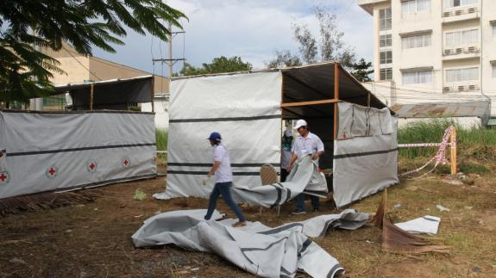
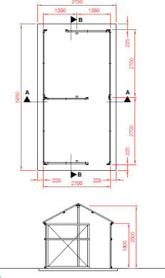
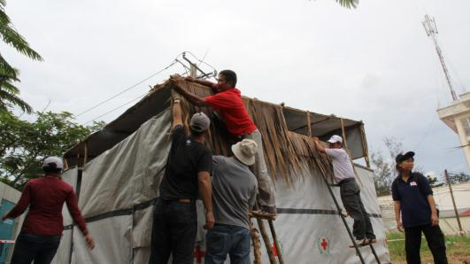
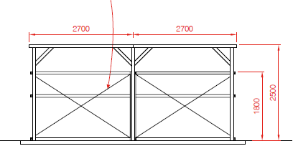

Slide 11
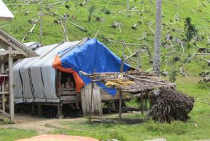
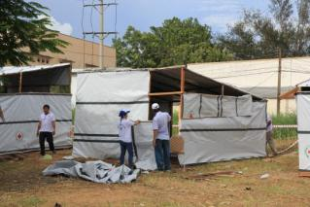
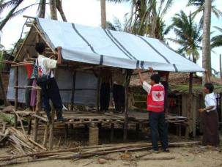
      Temporary shelter –
          basic and rapid but also adequate – must be habitable
          short term - few weeks to a few months
          prioritises speed and limiting costs of the construction
          made of salvaged or bought materials, tarpaulins, etc.
Notes:
Question the participants, ask them to give examples:
Emergency shelter: when it rains, I take shelter under the awning of a store while waiting for the end of the shower.
Temporary shelter: my house was destroyed, so I built a temporary shelter before being able to build a permanent house. I won’t be staying in this temporary shelter for very long….
Transitional shelter: before being able to build a permanent house, I’ll gradually transform my temporary shelter to a transitional shelter. I am improving my temporary shelter to make it more comfortable….
Permanent shelter: my house is my permanent shelter.

Slide 12
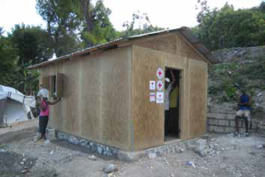
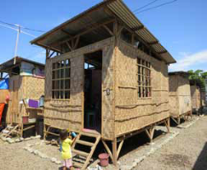
  Transitional shelter –
    a few months to years – more durable than temporary
    designed to facilitate the transition to more durable solutions
    made from materials that can be upgraded or re-used in more permanent structures, or that can be relocated from temporary to permanent locations.
Haiti, 2010
Materials: Wood framed walls with plywood sheathing, metal roofing on wood trusses, concrete slab floor
Anticipated lifespan: 3 – 5 years
cost per shelter: 1,560CHF
project cost per shelter: 2,300CHF
Philippines, 2011
Materials: Concrete footings, coconut wood frame, plywood floor, amaken walls and corrugated iron roof
Anticipated lifespan: 5 years
material cost : US$ 550
Notes:
Question the participants, ask them to give examples:
Emergency shelter: when it rains, I take shelter under the awning of a store while waiting for the end of the shower.
Temporary shelter: my house was destroyed, so I built a temporary shelter before being able to build a permanent house. I won’t be staying in this temporary shelter for very long….
Transitional shelter: before being able to build a permanent house, I’ll gradually transform my temporary shelter to a transitional shelter. I am improving my temporary shelter to make it more comfortable….
Permanent shelter: my house is my permanent shelter.

Slide 13
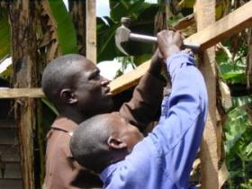
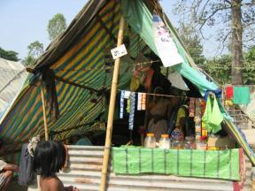
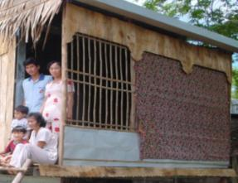
Beyond life saving
Beyond survival, the key considerations are:
health
providing protection from the climate
ensuring privacy, dignity and culture
providing personal safety and security
livelihood support

Slide 14
Example of time line – how long will it take to gain full recovery?
 | 2013 |  |  | 2104 |  |  |  |  |  |  |  |  |  |  |  | 201……
 | Oct | Nov | Dec | Jan | Feb | Mar | Apr | May | Jun | Jul | Aug | Sep | Oct | Nov | Dec | Jan | ……. | ……. | Dec
Season | Rains |  |  |  |  |  |  |  |  |  |  |  | Rains
Tents
Emergency | xxx
Temporary shelter
 |  |  |  |  |  |  |  |  |  |  |  |  |  |  | How long?
Transitional shelter |  |  |  |  | ?? |  |  |  |  |  |  |  |  |  |  | ?? | ……. | ……. | ??
 |  |  |  |  |  |  |  |  |  |  |  |  |  |  | How long?
Recovery shelter |  |  |  |  | ?? |  |  |  |  |  |  |  |  |  |  | ?? | …… | ……. | ??

Slide 15
Inter cluster cooperation
UNDP – early recovery cluster
Rubble removal and salavaging materials
Tools for construction tools for demolition
Building structural surveys
IOM – CCCM cluster
WASH – temporary period for household water and sanitation

Slide 16
What are the immediate needs for shelter
  Tents
  Tarpaulins
  Building tools and fixings - rope, wire, nails, tools (hammers, saws, plyers, etc)
  Clean up/demolition tools – help to salvage materials (Alternative to above materials - cash for materials)
  Cash for work – building shelters, clean up/demolition

Slide 17
Priorities for the shelter cluster
Set up WWW – who what where when to track needs and identify gaps.
Agree standards for equitable and appropriate emergency response
Priorities the municipalities – look at vulnerabilities
Carry out a detailed Assessment
REACH Assessment: Next two weeks to get a better profile of the affected communities.
Joint assessment with CCCM/Early Recovery (some WASH)
GIS - mapping
Support the family access cards

Slide 18
Priorities for the shelter cluster
Structural assessment/survey of houses
Which are safe
Which need to be demolished – unsafe
  set criteria for survey and assessment to certify housing
  develop TOR for team
  Identify people:
    government municipality and survey engineers
    institution of structural engineers/building surveyors
    universities/colleges

Slide 19
Priorities for the shelter cluster
Provide a design and technical guidance for the temporary shelters
  Tarpaulins, salvaged materials
  Training/awareness raising for municipality staff/DSWD/Agencies staff
  Community:
    e.g. NASA groups

Slide 20
Organisation | Municipality | Barangay | Type of shelter relief: tarpaulins, tents, NFI's, building materials, cash | Specification of materials - size, type | Number of items | Number of families | Status - planned, on going, complete | Start Date
Gap |  |  |  |  |  | 31,530
Total required |  |  |  |  |  | 33,730
Total accounted for |  |  |  |  |  | 2,200
DSWD |  |  | Plastic sheeting | Blue sheets |  |  | On-going
Municipalities |  |  | Plastic sheeting | Blue sheets |  |  | On-going
Philippines Red Cross |  |  | Tarpaulins | IFRC standard 6x4 tarps | 1,000 | 500 | Planned | 20/10/2013
 |  |  |  | IFRC standard 6x4 tarps | TBC | TBC | Planned
World Vision |  |  | Tents | 8x10 | 200 | 200 | Planned | TBC
IOM |  |  | Tents | Shelter box | 1,000 | 1,000 | Planned | TBC
 |  |  | Tarpaulins |  | TBC | TBC | Planned
CRS |  |  | Tarpaulins | TBC | 1,000 | 500 | Planned | TBC
Habitat for Humanity
Care
Plan
Christian Aid

Slide 21
Challenges:
Damaged Infrastructure
Isolated Municipalities
Landslides
Rainy Season has started
Ongoing Aftershocks
Changes in Displacement status- people are moving

Slide 22
Next Steps
Shelter Cluster Action:
We will email contact list
We will have space on the sheltercluster.org
We will be developing a 3 - WWW coordination framework.
We will be issuing Maps, GIS data as part of the
We will issue Detailed Assessment Data
Shelter cluster meeting will be held on Monday 21st evenging

Slide 23
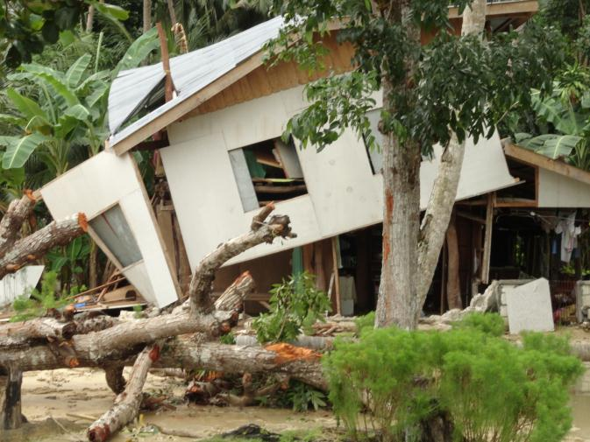

Slide 24
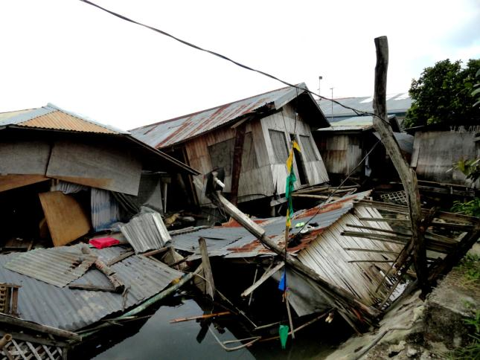

Slide 25
