Slide 1
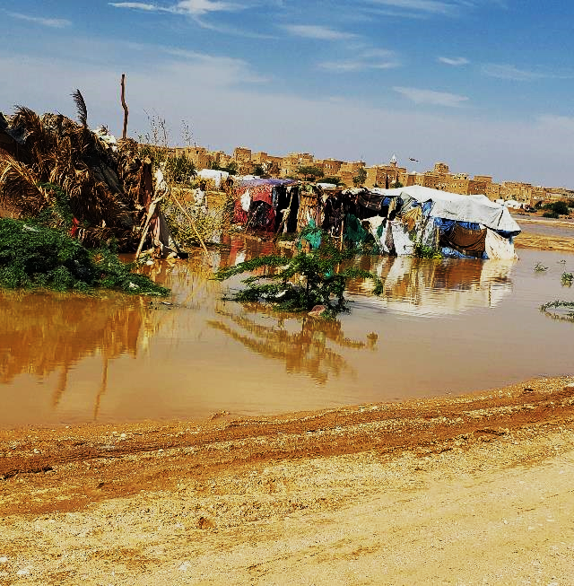





Eng. Jamal Ahmed Ali BAHAJ
Executive Director, Yemen Al Khair for Relief and Development (YARD)
Saving Lives in Yemen – Climate-Resilient Actions in Conflict Settings.
Global Platform for Disaster Risk Reduction (GPDRR 2025)
Geneva, Switzerland
June 2–6, 2025
info@yard-yemen.org
www.yard-yemen.org
Notes:
https://yard-yemen.org

Slide 2
Content
3
12
Yemen’s Risk Context
Human Impact Story – Samiara
5
13
The Cost of Inaction
Local Solutions That Scale
7
14
YARD’s DRR Interventions
The Case for Prevention (DRR)
8
15
Results – Lives Saved
Call to Action – Break the Cycle

Slide 3

Yemen’s Risk Context
Protracted Conflict & Displacement:
Over 4.5 million Yemenis have been displaced by conflict, often multiple times.
Escalating Climate Threats:
Climate change is driving more frequent and severe flooding, striking the most vulnerable.
High Exposure:
More than 570 informal IDP sites are located in wadis and low-lying lands with no drainage infrastructure.
Unsafe Settlements:
Due to land constraints, camps were built without planning. Even moderate rains can trigger lethal flooding.
Notes:
https://yard-yemen.org

Slide 4

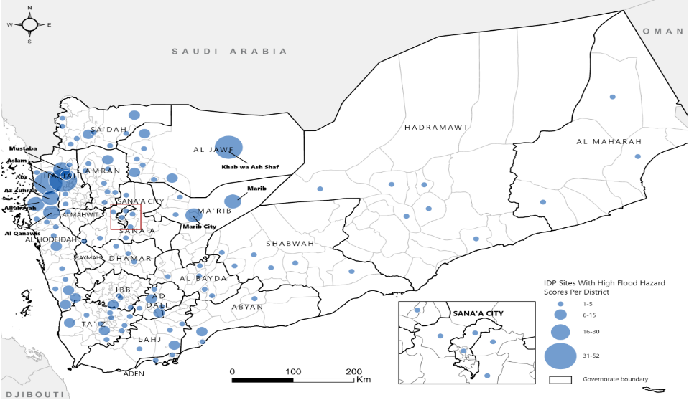
Results – Lives Saved
Around of 571 IDP sites under high flood risk
Notes:
https://yard-yemen.org

Slide 5

The Cost of Inaction
Human Toll:
Repeated floods cause injury, loss of life, and trauma for displaced families already in crisis.
Aid Dependency:
Emergency responses are launched year after year—tents, food, and medicine for the same families.
Financial Drain:
Humanitarian actors spend millions each year on reactive flood responses, far exceeding the cost of DRR measures.
Development Setback:
Without prevention, affected communities remain in crisis and humanitarian funds are exhausted.
Notes:
https://yard-yemen.org

Slide 6
The Cost of Inaction
Technical Assessment and Solutions:
Feasibility Assessment:
Relocation
Cost
Community Intentions
HLP
Mitigation measures
Gabion Walls
Soil Barriers
Drainage Channels
Notes:
https://yard-yemen.org

Slide 7
YARD’s DRR Interventions
Mitigation Measures
Advocacy & Coordination
Constructed drainage channels, cleared culverts, and reinforced shelters to redirect floodwater and reduce exposure.
Engaged with Shelter Cluster and local authorities to push for safer land and integration of DRR into response plans.
01
02
03
04
Risk Assessments
Site Upgrades
YARD mapped flood-prone sites using NEAT+, community surveys, and satellite data.
Reorganized shelter layouts and elevated key infrastructure to minimize water pooling and damage.

Slide 8
YARD Case Study: AlHazm Drainage Channel
Technical Assessments
Identified flood-prone areas and vulnerabilities.
Earthen Embankments
Strengthened site protection against future floods.
Community Training
Equipped local committees with tools for long-term maintenance.
2,500-Meter Drainage Channel
Diverted floodwaters to prevent site inundation.
Al-Mahzam AlSharqi
IDPs Site
Notes:
https://yard-yemen.org

Slide 9
Results – Lives Saved
Flood Averted:
In Al-Hazm, newly built 2.5 km drainage channels prevented flooding during the latest heavy rains.
Families Protected:
Hundreds of displaced families stayed safe in areas that previously flooded each year.
DRR Capacity Built:
Local teams now lead trenching, channel maintenance, and emergency preparedness in their own IDP Sites.
A Scalable Model:
YARD’s work is replicable low-cost, community-driven, and fast to implement even in fragile settings.
Notes:
https://yard-yemen.org

Slide 10
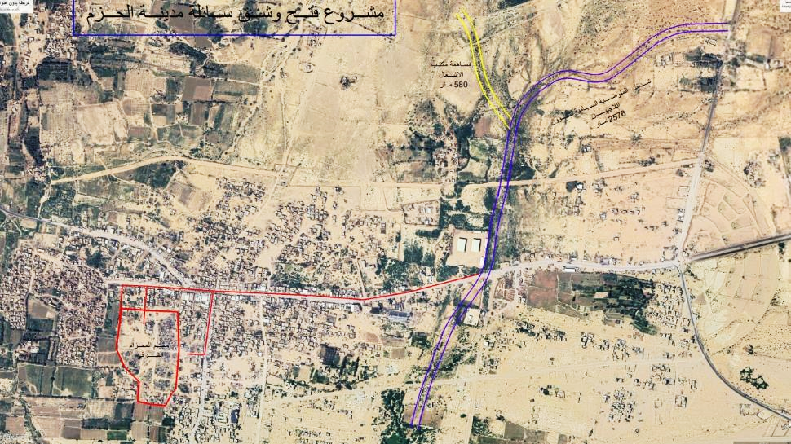
YARD Case Study: AlHazm Drainage Channel
The Location of The Drainage Channel (2,500-meter) - AlHazm district
Notes:
https://yard-yemen.org

Slide 11
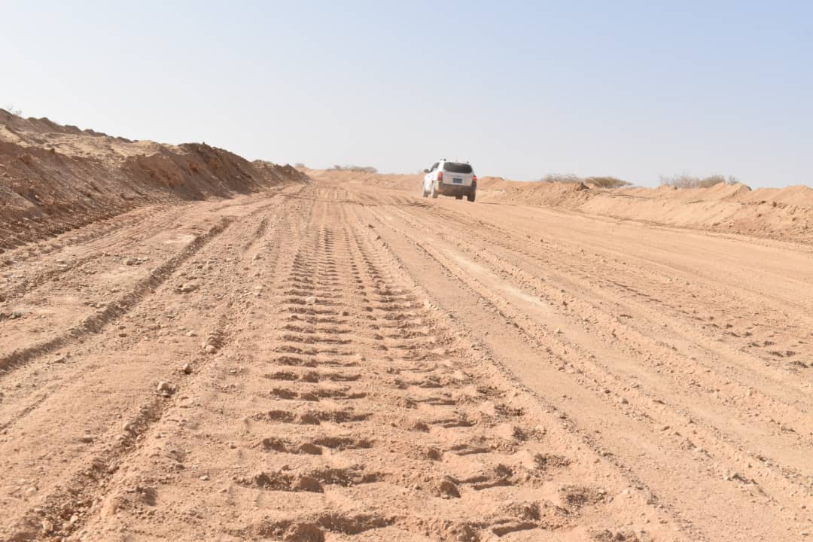
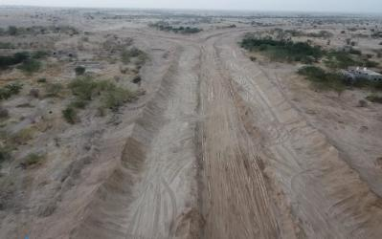
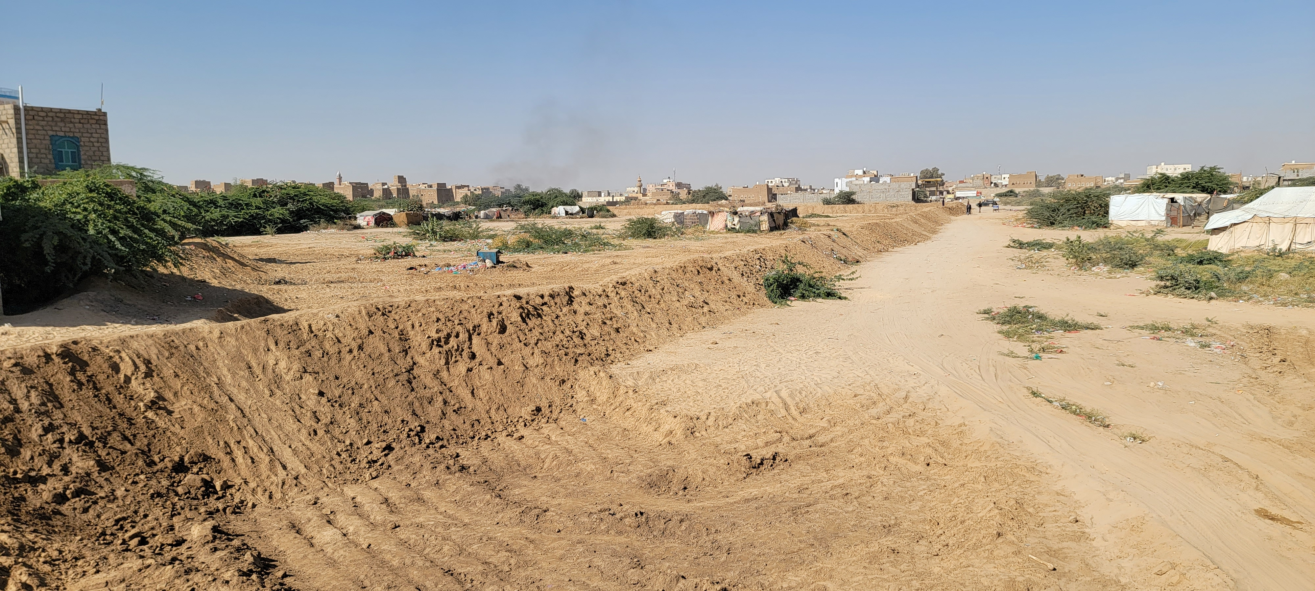
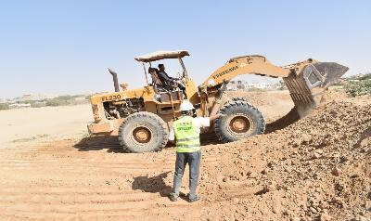
Results – Lives Saved
YARD: AlHazm district (2,500-meter) - Drainage Channel
Notes:
https://yard-yemen.org

Slide 12
Human Impact Story — Samaira
Meet Samiara
Mid‑Night Flash Flood
Protection Works
in Action
Preparedness
Champion
A 35‑year‑old mother of five, displaced by conflict and now living in AlMahzam Al‑Sharqi IDP site.
In Spring 2024, heavy rains triggered a flash flood just after midnight. Samaira fled with her children to the nearest elevated school; certain they would not survive.
That same month, YARD’s 2.5 km diversion channel and perimeter sand berm diverted the torrent—sparing her shelter and preventing camp‑wide displacement.
Today, with YARD’s support, Samaira has rebuilt her shelter on raised ground and now leads a community preparedness group—organizing clean‑ups, maintaining the drainage system, and raising alerts.
“Now I sleep with peace of mind. That trench and those barriers protect my children.
I no longer fear the floods.” — Samiara
Her story proves a core lesson: with modest resources and technical guidance, community‑based disaster‑risk reduction is achievable—even in conflict settings.
Notes:
https://yard-yemen.org

Slide 13
Local Solutions That Scale
1
2
3
Community-Led Action
DRR committees—including women—lead flood warning and mitigation activities in camps.
Practical Engineering
Local labor and context-appropriate materials were used to construct earthen embankments and trenches.
Ownership & Sustainability:
Engagement from displaced communities ensures upkeep, relevance, and rapid scale-up.
Notes:
https://yard-yemen.org

Slide 14
The Case for Prevention (DRR)
1. Proven ROI
2. Fragile State Gap
Every $1 invested in DRR saves between $6 and $15 in avoided losses and emergency costs.
Less than 2% of global humanitarian funding goes to DRR leaving places like Yemen behind.
3. Now, Not Later
4. Protecting Progress
Even in conflict zones, risk reduction is both possible and essential to save lives and preserve dignity.
DRR safeguards education, livelihoods, and health systems core pillars of resilience.
Notes:
https://yard-yemen.org

Slide 15
Call to Action – Break the Cycle
Integrate DRR:
All shelter, WASH, and protection interventions must include conflict-sensitive risk reduction.
Fund Local Capacity:
Invest in frontline organizations like YARD—trusted by communities and ready to act.
Include Fragile States:
Global DRR and climate finance must prioritize the most vulnerable—displaced people in conflict zones.
Join Us:
Support safe land allocation, build DRR into every project, and amplify survivor-led solutions like Fatima’s.
Notes:
https://yard-yemen.org

Slide 16
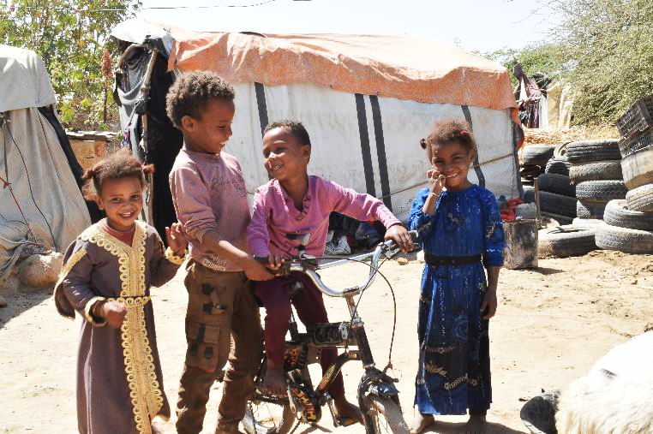


“These children have survived war. They should not have to survive floods too.
Protecting them is not charity, it’s responsibility.”
Thank You
Together, let's build resilience and save lives.
info@yard-yemen.org
GPDRR 2025 – Geneva
www.yard-yemen.org
Notes:
https://yard-yemen.org

