Slide 1
Shelter, Cash and Markets CoP
5 April 2022
Quarterly meeting #4

Slide 2
Agenda
Introductions/ overview (5 mins)
Overview of Market Based Programming (with MiC)(10 mins)
Presentation of draft guidance note (with MiC) (5 mins)
Discussion of shelter based markets (15 mins)
Updates and sharing – CVA in Ukraine operations (15 mins)
AoB (5 - 10 mins)

Slide 3
Market based programming

Slide 4
Market-Based Programming for Shelter
Chris Paci, REACH
Markets in Crises COP Advisory Committee
5 April 2022

Slide 5
What is the MiC COP?
The Markets in Crises COP, founded in 2014, is a community of over 2,800 practitioners engaging with markets in emergency and recovery contexts.
  Our members hail from over 120 countries, representing NGOs, multilateral agencies, academic institutions, donors, and the private sector.
  We share ideas, experiences, and resources with the aim of improving market-based programming (MBP) in emergency, recovery, and development contexts.
MiC is in the midst of a three-year plan (2021-2023) to expand its scope, scale, and impact.
  A key element is the development of a learning agenda supporting the broader adoption of market-based programming.
  Current areas of focus are core MBP fundamentals, climate change, and shelter.
MiC and the Shelter, Cash & Markets COP are currently working together to develop a joint guidance note on MBP in shelter markets.

Slide 6
Key market terminology
Market: Any system of exchange between two or more actors for goods, services, money, etc.
  Not necessarily tied to a physical space; markets can be decentralized or even virtual
  Many different types of markets: commodities, services, labour, etc.
Marketplace: A physical location (or virtual platform) where exchanges take place
Supply chain: The chain of relationships linking all market actors involved in moving a product from the producer to the consumer
Market system: All of the actors in a market, their relationships, the services and support they rely on, and the environment in which they operate

Slide 7
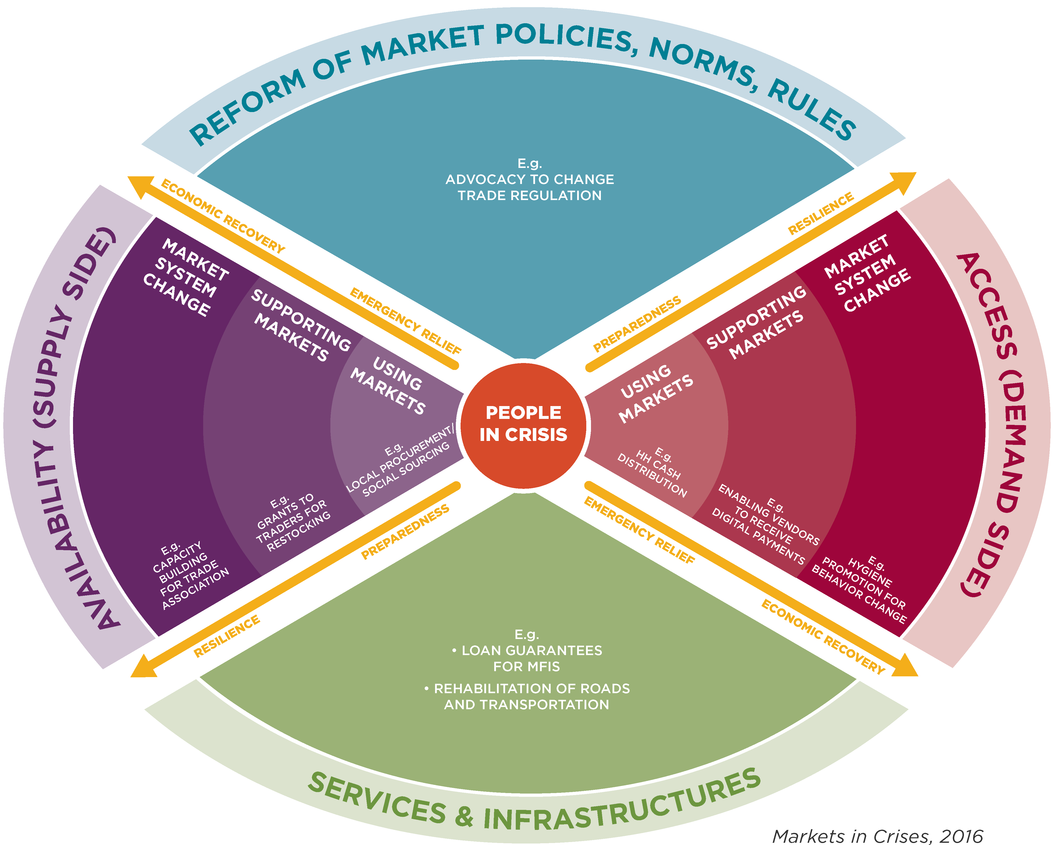
What is market-based programming?
MBP covers all types of projects that engage with market systems:
  Using markets (e.g. HH CVA, local procurement efforts)
  Supporting markets (e.g. increasing supply chain capacity, enabling new payment modalities)
  Market system change (e.g. capacity building for suppliers, behavioral change to shift patterns of demand)
CVA is the most commonly proposed type of MBP, but not the only type.
At a minimum, all programming in crises should be “market-aware.”

Slide 8
What is market-based programming?
MBP programs can engage with market systems at several key points:
  On the supply side, addressing issues of availability
  On the demand side, addressing issues of access to goods
  Working to improve key market infrastructure and services
  Advocating for the reform of market policies, norms, and rules

Slide 9
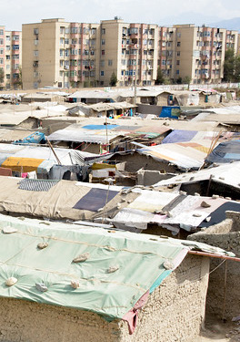
How does MBP apply to shelter?
Obtaining adequate shelter represents one of the largest financial burdens faced by most households.
Nearly every aspect of this process interacts with market systems in some way:
  Housing and rental markets
  Markets for HH NFIs (heating fuel, weatherproofing, etc.)
  Markets for tools and construction materials
  Markets for labour and basic services
Humanitarian actors risk undermining existing market systems and livelihoods if our programmes bypass/replace them rather than working with them.

Slide 10
How does MBP apply to shelter?
MBP, including CVA, can often be a strong alternative to in-kind SNFI distributions.
  Ideal when local market systems and supply chains remain reasonably intact
  Also highly useful when market functionality is limited but clear bottlenecks can be identified
  Can also provide transitional and longer-term solutions to strengthen market systems to the point where outside aid may no longer be needed
Well-designed MBP will have multiplier effects throughout the targeted market systems:
  Creating income-generating opportunities
  Preserving livelihoods • Improving local infrastructure
  Meeting a community’s basic shelter needs

Slide 11
How does MBP apply to shelter?
MBP, including CVA, can often be a strong alternative to in-kind SNFI distributions.
  Ideal when local market systems and supply chains remain reasonably intact
  Also highly useful when market functionality is limited but clear bottlenecks can be identified
  Can also provide transitional and longer-term solutions to strengthen market systems to the point where outside aid may no longer be needed
Well-designed MBP will have multiplier effects throughout the targeted market systems:
  Creating income-generating opportunities
  Preserving livelihoods • Improving local infrastructure
  Meeting a community’s basic shelter needs

Slide 12
Guidance note: MBP and Shelter Programming
Goal: To provide an overview of how market-based programming can be integrated into all stages of a shelter response (emergency, recovery, development).
Sections of the guidance note:
  What is MBP?
  The MBP framework and basic terminology
  How can MBP be applied to shelter responses?
  Key types of shelter markets
  Market complexity in shelter
  Examples of MBP for shelter
  Key links and resources
Does this seem sufficient? Are there other sections you would find useful?

Slide 13
Shelter Markets

Slide 14
Updates/ sharing on use of CVA in Ukraine operations

Slide 15
AOB

Slide 16
Next Meeting: July 2022
Focus/ theme?
Part of GSC meeting?

