Slide 1
WB SHELTER CLUSTER MEETING
18 Feb 2024

Slide 2
Meeting Agenda
Overview of Current Needs: Update on the needs of displaced families in Jenin, Tubas, and Tulkarem.
Coordination and Reporting: Discussion on coordination layers and reporting mechanisms.
SNFIs Response and Preparedness: discussion of 3-month SNFIs response plans and preparedness to support displaced families and vulnerable people.
WB – SAG activation
Partners' Updates : Ongoing and Planned Activities: Partners are requested to come prepared to present ACF presentation
AOB

Slide 3
1. Overview of Current Needs: Update on the needs of displaced families in Jenin, Tubas, and Tulkarem
Housing Units Destructions:
Across various refugee camps, hundreds of shelters have been destroyed or burned, rendering them uninhabitable. Additionally, thousands of shelters have sustained varying levels of damage. However, no field assessments have been conducted due to access restrictions and security conditions.
Displacement Figures:
40,000+ people displaced from Jenin, Tulkarm, Nour Shams, and Far’a camps.
Military operations: Ongoing in Tulkarm and Jenin; ended on 12 February in Tubas, including Far’a camp.
Displacement Rates:
Jenin Camp: ∼95% of the population displaced.
Nour Shams Camp: ∼90% of the population displaced.
Tulkarm Camp: ∼80% of the population displaced.
Fara’a Camp: ∼50% of the population displaced.

Slide 4
1. Overview of Current Needs: Update on the needs of displaced families in Jenin, Tubas, and Tulkarem
Displacement Locations:
Jenin:
44 families (173 IDPs) are sheltering in 4 collective centers.
The majority are displaced within Jenin city, the American University, and 12 villages, including: Burqin, Kufr Ra’i, Kufr Qud, Qabatiya, Deir Ghazaleh, Beit Qad, Al-Jalameh, Arrabeh, Ya’bad, Al-Yamoun, Kufr Dan, Bizzariya.
Living Conditions: According to the latest assessments, 82% of displaced families are living in rented accommodation, while others are staying with relatives. There has been a rise in the number of IDPS relocating to collective centers over the past few days.
Tulkarm:
57 families (300 IDPs) are sheltering in 6 collective centers.
Most are displaced within Tulkarm city and 9 villages, including: Ramin, Bal’a, Beit Lid, Shwaikeh, Iktaba, Kufr Al-Labad, Izbet Al-Jarad, Izbet Abu Yasin, Zinnabeh.
Tubas:
The majority of displaced families are in Tubas city and neighboring villages, including: Wadi El-Far’a, Tammun, Aqqaba, Sanur, Yasid, Talluza, Maithalun, Az-Zababida

Slide 5
1. Overview of Current Needs: Update on the needs of displaced families in Jenin, Tubas, and Tulkarem
Identified Needs and Gaps:
Provision of Essential NFIs:
Bedding Kits: Highly requested by host families, those in collective centers, and individuals renting unfurnished homes, with a focus on privacy improvements (e.g., tarps). Recent surveys also identified a need for mats based on case-specific requirements.
Gap: 10,000 bedding kits (mattress, blanket, pillow)-individual kit
Dignity Kits: Highly required by specific vulnerable groups.
Gap: 10,000 dignity kits
Kitchen Kits: Due to the loss of belongings during displacement, there is a critical need for kitchen kits and cooking stoves.
Gap: 5,000 kitchen kits
Conditional Rental Cash Support:
Average Monthly Rental Cost: $600 - $650 ( IDPs moved to collective centers due to their inability to pay rental costs)
Integration of in-kind NFIs with cash rental support is recommended, or additional cash can be provided to cover basic NFI needs.
Support for Families in Collective Centers:
Focused and tailored support for families residing in collective centers ( preferred multi-sectoral response)
Provision of privacy materials (e.g., tarpaulins).
Essential NFIs distribution.

Slide 6
1. Overview of Current Needs: Update on the needs of displaced families in Jenin, Tubas, and Tulkarem
Completed and Ongoing Responses:
UNRWA: Distributed 1,000 bedding kits.
We World: Distributed 1,000 bedding kits, with an additional 1,000 to be distributed in the coming days.
PARC: Plans to distribute 500 bedding kits in Jenin and 500 bedding kits in Tulkarem.
ACF: Distributed 50 kitchen kits, 20 gas/cooking stoves, and 30 electric heaters.
PRCS: distributed 460 mattresses and 607 blankets in addition to few dignity and kitchen kits.
Planned/Proposed Assessments:
It was agreed during the last OCHA-NWB coordination meeting to conduct a multi-cluster assessment for collective centers, along with a representative sampling of families living in rented accommodation, villages, and with relatives.
Please let me know if you have the capacity, commitment and resources to participate.
The cluster is coordinating with UNRWA to support their shelter damage assessment and expedite the process when conditions allow for field assessments. In the meantime, please check internally if you are willing and have the technical capacities (e.g., engineering) to participate. The cluster will confirm with UNRWA regarding this type of support.

Slide 7
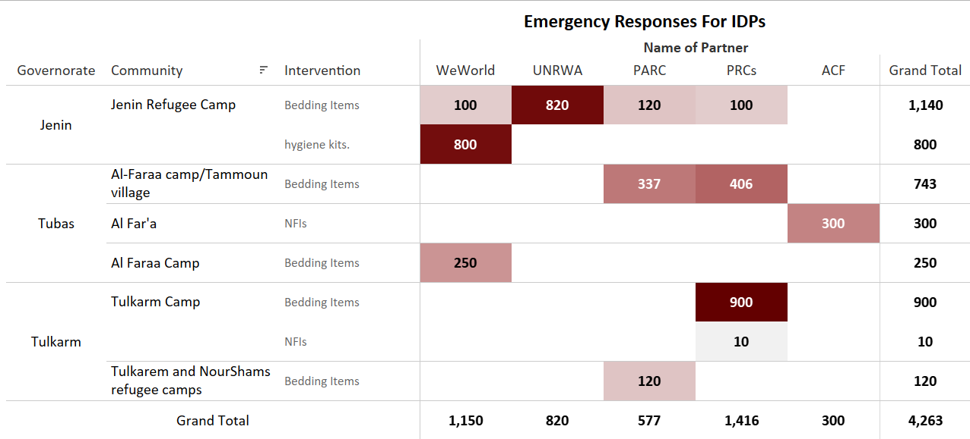
Data extracted from 4Ws template

Slide 8
2. Coordination and Reporting: Discussion on coordination layers and reporting mechanisms.
As the majority of displaced families are registered refugees, UNRWA takes a leading role in coordinating responses to prevent overlap and duplication.
Governorate Interministerial Committees: These are government bodies at the governorate level, comprising members from various ministries. They provide assistance to displaced families, mainly focusing on food and water distribution.
ICCG This group includes all clusters to coordinate responses, identify key urgent needs, and set priorities.
Cluster: The Cluster oversees partners' responses, tracks activities, and coordinates efforts. Therefore, it is essential for partners to report planned, ongoing, and completed activities using the 5Ws link. 4Ws Responses Reporting and Tracking Link
All the above coordination mechanisms are crucial for ensuring effective and organized assistance. The Cluster will serve as the focal point and facilitate coordination for any partner planning to deliver assistance or would like to know the gaps and priorities.

Slide 9
3. SNFIs Response and Preparedness: discussion of 3-month SNFIs response plans and preparedness to support displaced families and vulnerable people.
IACP Scenarios Planning Figures humanitarian impact
The humanitarian impact of one or multiple scenarios unfolding concurrently lead to massive, forced displacement of Palestinians populations.
Under those scenarios, it can be expected for:
Forced displacement of 160,000 Palestinians from 182 communities located partially or totally in Area C and East Jerusalem.
Forced displacement of 80,000 Palestinians refugees from 9 refugee camps in the West Bank, including East Jerusalem.
As part of the IACP, each cluster partner is requested to update their emergency capacities using the following link: https://opt-fivewsplus.azurewebsites.net/EPM_Login.aspx
Username: Partner’s email address
Password:OCHA@opt#2024
If you encounter any technical issues, please contact @Mohammed Aldarawsha

Slide 10
4. SNFIs Response and Preparedness: discussion of 3-month SNFIs response plans and preparedness to support displaced families and vulnerable people.
Response activities (1-2 Weeks) | PiN | Target population | Funding requirement ($)
Provision of essential NFIs (such as bedding kits, dignity kits, etc.) | 240,000 | 60,000 | 5,600,000
Provision of SOKs (including plastic sheets, tarps, tape, etc.) | 160,000 | 50,000 | 1,000,000
Support displaced families in collective centers with temporary partitions to ensure privacy and access to essential NFIs | 10,000 | 5,000 | 750,000
Response activities (2 weeks -90 days) | PiN | Target population | Funding requirement ($)
Provision of essential NFIs (such as bedding kits, dignity kits, etc.) | 180,000 | 40,000 | 3,750,000
Distribution of winterized family tents | 160,000 | 50,000 | 6,000,000
Distribution of prefabricated units | 160,000 | 5,000 | 7,000,000
Immediate repair of light shelter damage | 100,000 | 10,000 | 5,000,000
Conditional rental support for prioritized families for three months | 100,000 | 10,000 | 3,000,000

Slide 11
4. WB – SAG activation
Meeting Schedule:
Quarterly Meetings: Focus on strategic directions.
Ad-hoc Meetings: Based on emerging needs.
Nomination/Election Process: Now open.
Proposed Composition:
2 National NGOs (NNGOs)
2 International NGOs (INGOs)
1 or 2 UN agencies
1 Government representative
Observers (OCHA, PRCS)

Slide 12
5. Partners update
Partners' Updates : Ongoing and Planned Activities: Partners are requested to come prepared to present ACF presentation

Slide 13
THNAK YOU

