Slide 1
Shelter Cluster Orientation
31 Oct 2013

Slide 2
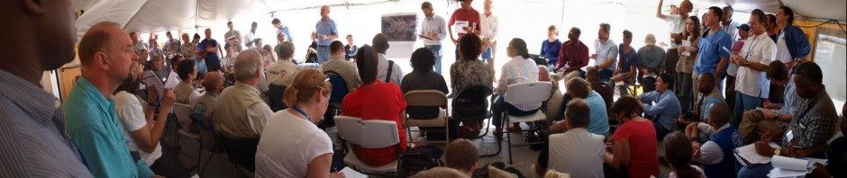
More meetings!?

Slide 3
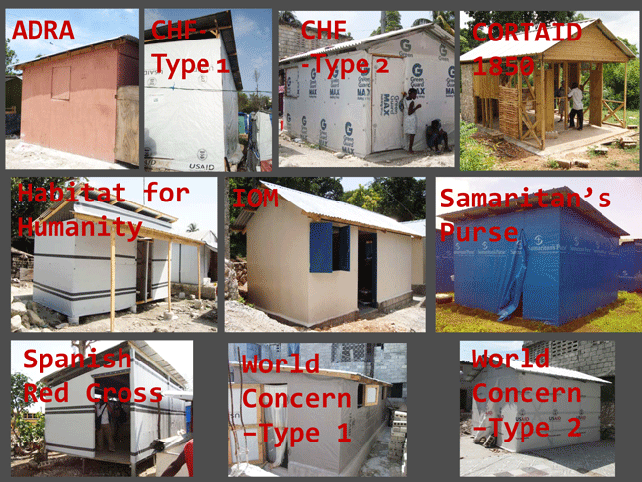
The cluster should lead to improved equity, standards, etc…..?!

Slide 4
What are the clusters core functions
The core functions of the cluster ensure coordination around each element of the humanitarian programme cycle. There are 6 core functions:
Supporting service delivery that is driven by the agreed strategic priorities and avoids duplication.
Informing strategic decision-making of the HC/HCT for the humanitarian response through coordinated needs assessment and analysis.
Planning and strategy development for the sector, in accordance with existing standards and guidelines and including clarifying funding requirements, prioritisation and the cluster’s contribution to overall humanitarian funding considerations.
Advocacy, both identifying concerns and undertaking advocacy activities.
Monitoring and reporting on the implementation of the cluster strategy.
Contingency planning/preparedness/capacity building in situations where there is a high risk of recurring or significant new disasters (and where there is capacity to do this).
Remember: Each cluster is also responsible for integrating early recovery from the outset in the humanitarian response and account for cross-cutting issues (gender, age, diversity, HIV/AIDS, environment).

Slide 5
Intercluster
WASH
CCCM
Early Recovery
Protection
Health
Livelihoods
etc

Slide 6
Scope of the shelter cluster
Coordination services: All issues related with shelter:
  emergency
  transitional
  shelter support to host families
  camp planning
  HLP
  urban design
Time frame
  commitment to emergency phase
  This can be extended if funds are available, and appropriate staff is available

Slide 7
Core outputs
Assessment report – currently we use REACH
Strategy document –
  which covers inputs to the appeals – CERF/FLASH/HAP
Standards and guidance report
Who what where and when (WWWW)

Slide 8
Typical shelter cluster structure
Shelter Coordination Team:
Coordinator – Patrick Elliott (IFRC, funded by ECHO
Information Manager – Neil Bauman (Canadian Red Cross, funded by ECHO)
Technical Coordinator – David O’Meara (UNHCR, funded by ECHO)
Technical Support – Eve Leonard (British Red Cross)
  This is our surge team.
  This team will be replaced with a longer term team during the weekend of 9/10th Nov

Slide 9
We have JD’s and TOR’s for these positions

Slide 10
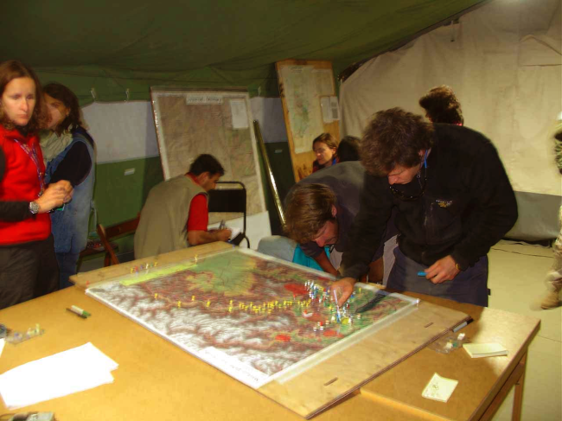
Information Management
Service for the cluster to perform various data collection and analysis functions
Tracking of
  shelter needs,
  cluster capacity,
  outputs, and outcomes
Produce
  maps,
  tables, and
  communicate information to inform decision making

Slide 11
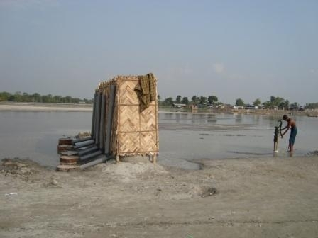
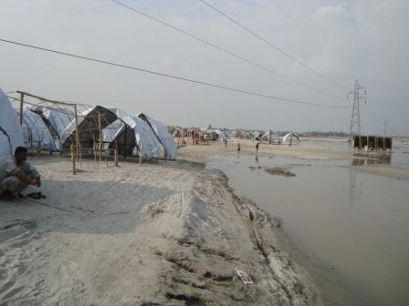
  Technical role
  Setting standards and guidance biased on best practice
  Emergency and transitional designs
  IEC materials
  Training
  Site selection
  Hazards
  Climate
  Local construction materials and practice
  Physical security
  Sustainability
Notes:
Talking Points
These are some of the major issues which need to be considered when putting together the technical elements of an ESC strategy
Understand that prior to a coordination teams arrival some of these things may (or may not) have been addressed, settlements will have commenced
Insert Nepal flooding photo (hazards)
Local knowledge/practices and therefore societies/groups are vital to gaining broader (and Government) acceptance.
Questions and Discussion
• Ask the participants to identify which issues are primarily engineering issues, and which are social issues. Challenge them to think about ways in which all of the issues have a social/cultural element.
Ask the co-ordinators (or information managers) to come up with questions which would elicit information from a technical specialist about each of the issues. Make sure that the questions are concrete, and not just ‘have you thought about the climate?’
How can buildings be improved, do they need to be improved, does the population WANT them to be improved?

Slide 12
IEC materials
Emergency shelter
Build back safer - timber frame repairs
Safety awareness – salvaging & demolition
Awareness of damage masonry houses for repairs

Slide 13
IEC materials – emergency response

Slide 15
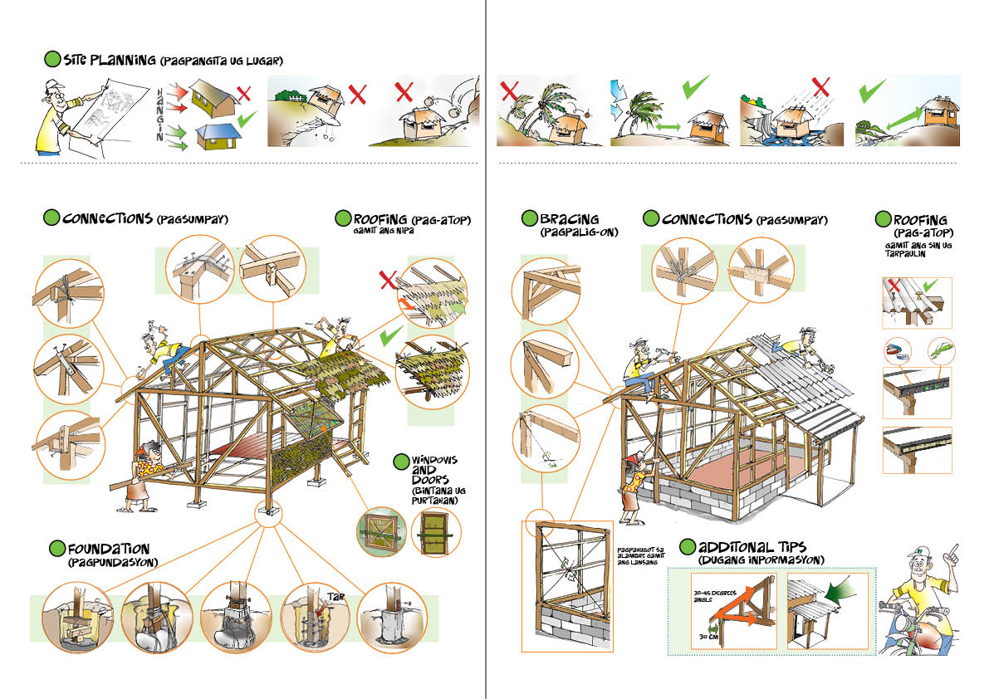

Slide 16
Bohol EQ - Needs
Assessment Information
  DSWD damage data
  REACH assessment
Damaged Houses |  |  |  |  |  | Displaced HH
Total # Damaged or destroyed Houses |  | # Totally Destroyed |  | # Partially Damaged Houses |  | #HH Inside Evacs | #HH Outside Evacs | Total HH Displaced | % of HH Displaced
67,800 | 27.0% | 12,672 | 5.0% | 55,128 | 22.0% | 17,867 | 54,397 | 72,264 | 28.8%

Slide 17
Capacity
Row Labels | Appealed for | Confirmed pipeline | Ongoing | Grand Total
INT01: Tarp - 1 per HH | 8000 | 18800 | 14000 | 40800
Adra | 4000 |  |  | 4000
Caritas | 4000 |  |  | 4000
CRS |  |  | 3000 | 3000
IOM |  | 12000 |  | 12000
JICA |  | 4800 |  | 4800
PRC/IFRC |  |  | 11000 | 11000
Save the Children |  | 2000 |  | 2000
INT02: Tarp - Laminated |  |  | 2000 | 2000
DSWD |  |  | 2000 | 2000
INT03: Family Tent | 1700 | 700 | 6228 | 8628
Disaster Aid Intl/BMFI |  | 150 |  | 150
JICA |  | 100 |  | 100
Plan |  | 150 |  | 150
PRC/IFRC | 1700 | 300 |  | 2000
ShelterBox |  |  | 1000 | 1000
World Vision |  |  | 5228 | 5228
INT09: Transitional Shelter | 2000 | 300 |  | 2300
BMFI |  | 300 |  | 300
Habitat for Humanity | 2000 |  |  | 2000
INT10: Tarp - 2 per HH |  |  | 2200 | 2200
Plan |  |  | 2200 | 2200
Grand Total | 11700 | 19800 | 24428 | 55928

Slide 18
Outputs
Outputs tracked by agency and location
Intervention Type | (Multiple Items)
Sum of HH receiving assistance to date
Row Labels | Total
Antequera | 74
Buenavista
Calape
Carmen
Catigbian | 77
Clarin
Danao
Inabanga
Loon | 1910
Maribojoc | 150
Sagbayan | 816
Sagbayan
San Isidro
Sevilla
Sikatuna
Tubigon | 1186
Grand Total | 4213

Slide 19
Capacity - Summary
Prefabricated tents - families
Current ongoing distributions = 6,228
Confirmed coming for distribution in the next days = 700
Total = 6,928 families – should be complete by 15th Nov
Tarpaulins – families (only one per family)*
Current ongoing distributions =16,200
Confirmed coming for distribution in the next days = 18,800
Total =35,000 families – should be complete by 15th Nov
Reported complete as of 29th Oct
Total number of families supported with at least one tarp or one prefabricated tent = 4,213 families
* as more stock comes in may need to increase to two

Slide 20
Gaps and Coverage
Projected and current gap
Needs |  |  | Capacity |  | Output |  | Gap
Total # Damaged or destroyed Houses | # Totally Destroyed | # Partially Damaged Houses | Confirmed tents or tarps planned | Projected coverage | Number of HH supported with tents or tarps to date | Current Coverage | Gap in projected coverage | Gap in current output
67800 | 12672 | 55128 | 44228 | 65.23% | 4213 | 6.21% | 23572 | 63587

Slide 21
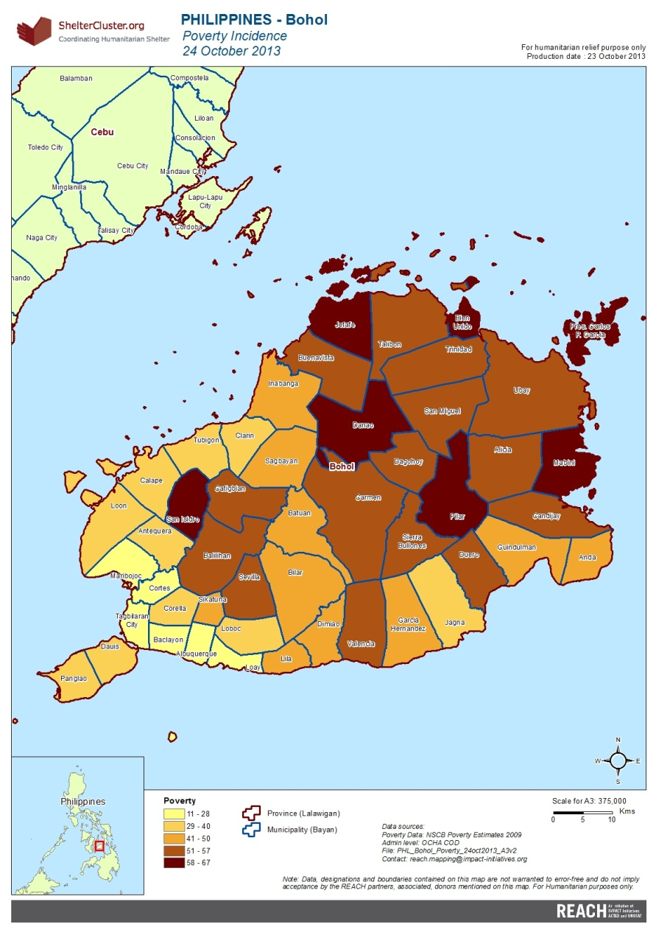
Visualization and Communication
Tables, Maps
Website
www.sheltercluster.org

Slide 22
Bohol Earthquake shelter cluster strategy

Slide 23
Housing stock definitions | The following are the definitions of housing stock.
# | House type definitions | Total | Notes
 | Single story timber and bamboo frame, timber and bamboo cladding, nippa palm roof.
 | Single story timber frame, timber cladding, CGI roof.
 | Single story timber frame, part low masonry part timber cladding, CGI roof.
 | Single story reinforced concrete frame and masonry walls. CGI roof.
 | Two story, ground floor reinforced concrete frame and masonry walls, first floor timber frame and timber cladding, CGI roof.
 | Two or more story, ground floor and first floor reinforced concrete frame and masonry walls, CGI roof or flat reinforced concrete roof
 | Apartment two or more story reinforced concrete frame.

Slide 24
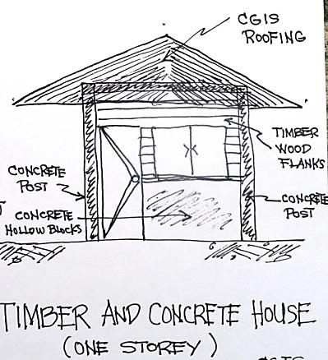
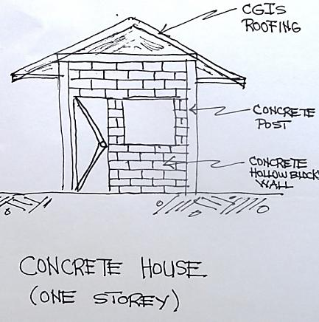
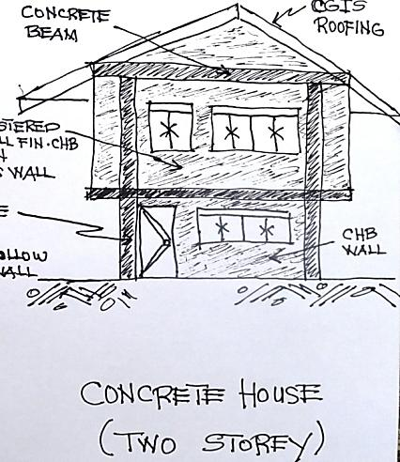
Timber Frame
Concrete House (one Storey)
Concrete House Two Storey

Slide 25
Damage definitions | The following are the definitions of housing damage.
# | Damage definitions | House status | Total
 | Collapsed | Not habitable.
 | Damaged beyond repair | Not habitable. Structural integrity compromised and cannot be repaired.
 | Damaged but can be safely repaired. | Possibly not habitable. Structural integrity not compromised and can be repaired
 | Superficial damaged | Habitable No structural damage or only superficial damage
 |  | Total

Slide 26
Damage definitions | The following are the intervention definitions
INT# | Intervention Name | Description/Specification | Notes and standards
INT01 | Emergency shelter solutions – household level or family level | Emergency shelter solutions that compliments materials already provided by local government, private organisations, community based organisations and civil society in general. Design life not less than 6 months. | SPHERE applies
 |  | Tools and fixings – see annex two for detailed specifications Hammer, saw, rope and tying wire, nails
 |  | Tarpaulins - International standard apply, (IFRC, UNHCR, UNICEF, ICRC, MSF, and OXFAM), see annex two for details
 |  | Technical guidance and training IEC materials, training at Barangay level and supervision and monitoring
 |  | Cash grants - primarily for emergency shelter materials Cash for work
INT02 | Tents – complete pre made tenss | Family tents | International standards apply (IFRC, UNHCR), see annex two for details
INT03 | Bunkhouses
INT04 | Demolition tool kit - community level | Tools: Sledge hammer, crow bar, pick axe, hack saw
INT05 |  | Structural surveys | Damaged houses only
INT06 |  | Transitional shelters | Limited number

Slide 27
Time scale
Phase | Activities | 15-Oct | 21-Oct | 28-Oct | 04-Nov | 11-Nov | 18-Nov | 25-Nov | 02-Dec | 09-Dec | 16-Dec | 23-Dec | 30-Dec | 06-Jan
 | Season | Rains
 | Flash appeal |  |  |  |  |  |  |  | Rev
Emergency | Distribute NFI's
 | Distribute tents
 | Distribute emergency shelter
 | REACH assessment
ER | House damage assessment
 | House structural surveys
 | House demolition, etc |  |  |  |  |  |  |  |  |  |  | 12 months…
 | Construct transitional shelters |  |  |  |  |  |  |  |  |  |  | 12 months…
Recovery | Construct permanent housing |  | ??

Slide 28
Phases
Emergency
Transitional - early recovery
Recovery

Slide 29
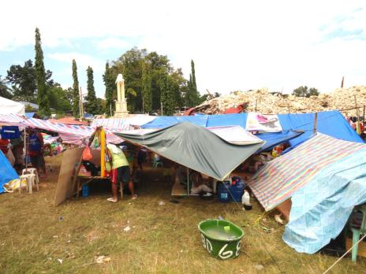
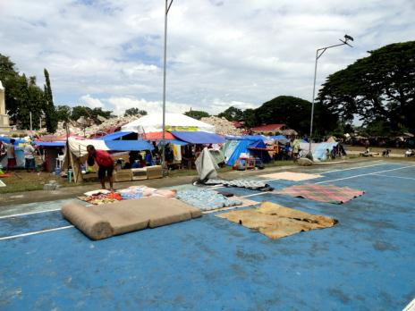
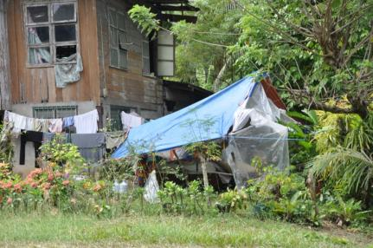
Emergency
  First response - Local community/church groups, civil society, private organisations
  Host families
  Second - International community with stock in country
  Third - International community with confirmed funding stock imported
  Fourth - International community with funding subject to appeals

Slide 30
Emergency
  Two types of response so far
  Tarpaulins
  Prefabricated tents:
  Shelter box
  World Vision
  Red Cross
  Disaster International
Tarpaulins (mainly one per family)
Community – may only last 8 wks
DSWD – may only last 8 wks
Red Cross – 6 mths
IOM – 6 mths
JICA – 6 mths
Plan
World Vision
Note:
Where there is a need the short life span tarps may need to be replaced
Where there is a need families may require two tarpaulins

Slide 31
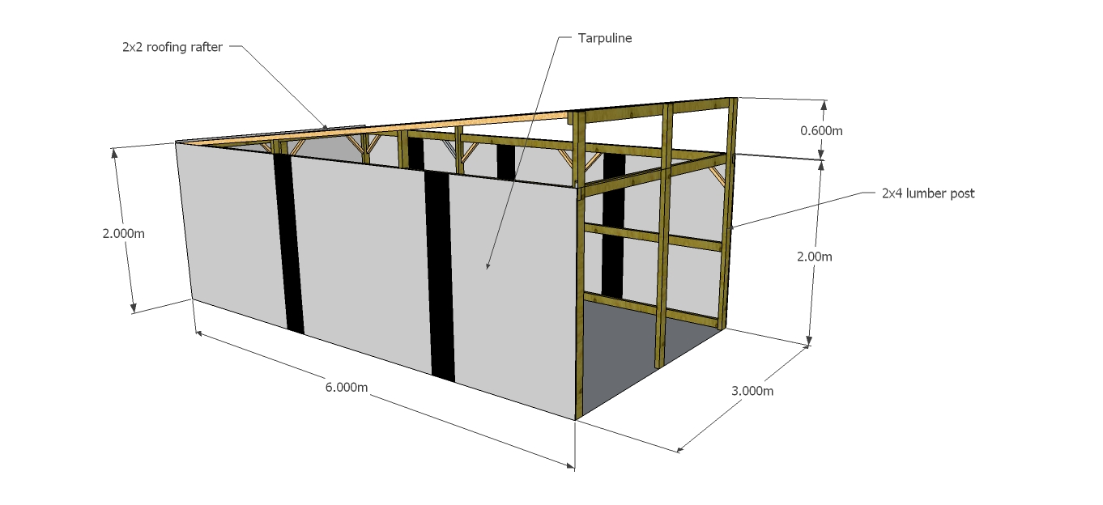
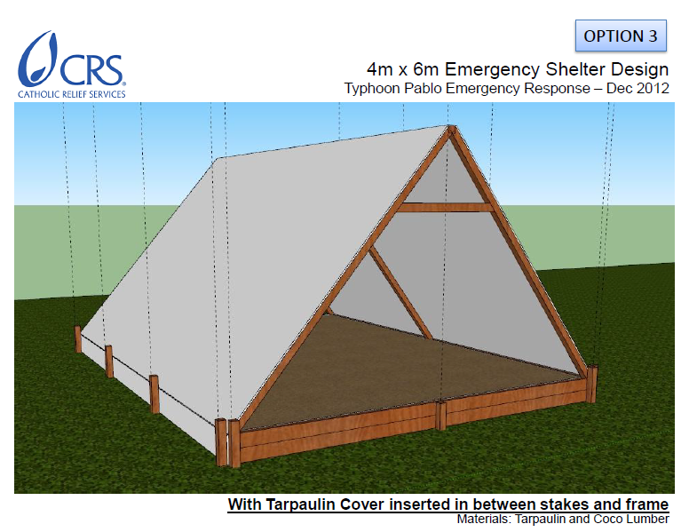
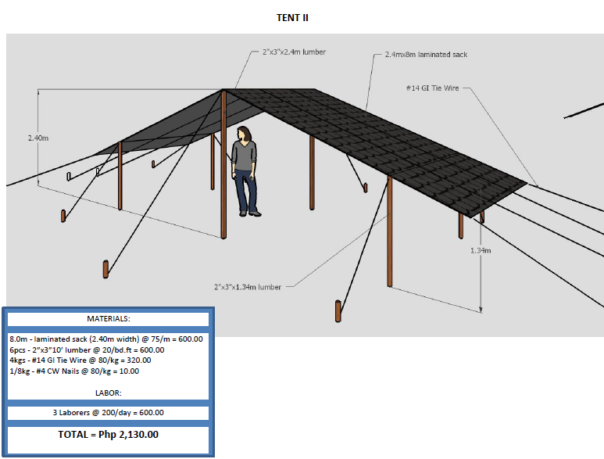
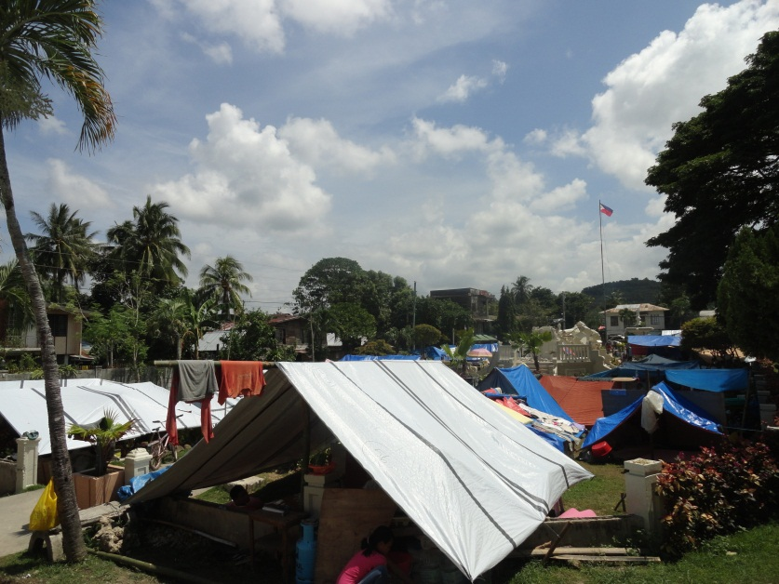

Slide 32
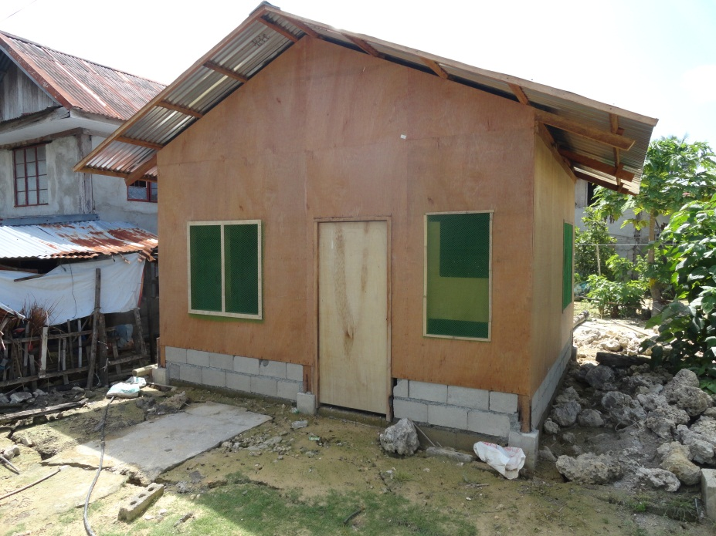
Early recovery
  Depends on the capacity of the family
  Depends on the house type
  Depends on the house damage or destroyed
  Hazard areas - risk mapping
Many families have already started their own early recovery
Demolishing their houses and either rebuilding a permanent house or in the short term building ‘transitional’ house
Repairing their damage houses
However, many families with limited capacity are and will continue to live in tents or tarpaulins for several months to come

Slide 33
Basics of the response
1. Demolition and recovery kits:
Support for families to demolition their destroyed houses and clean their sites
Kits - hand tool – community and individual
Support to salvage and recycle
Support to transport waste and dump
The tool kit, e.g.
Sledge hammer and claw hammer
Bolar – local crow bar
Crow bar – jemmy
Cold chisel
Hack saw (+blades) and timber
Shovel
Wheel barrow and rice sacks
Cash for work
Personnel protection
Advocate for agencies to consider demolition projects:
Back hoe
Trucks
Community mobilisation
Cash for work
Environmental

Slide 34
2. Repairs - timber and concrete houses (for houses which are safe to repair):
Advocate/ guaidance on what is safe and what is not safe to repair
Support to repairs
3. New build - mainly concrete (for totally destroyed houses or those not safe to repair)
Transitional period between emergency and permanent solution
  Supporting host families
  Renting solutions
  Transitional shelter solutions
  Alternative housing solutions for the transitional period
Permanent housing solutions
4. Relocations – where necessary due to results hazards support relocations mainly

Slide 35
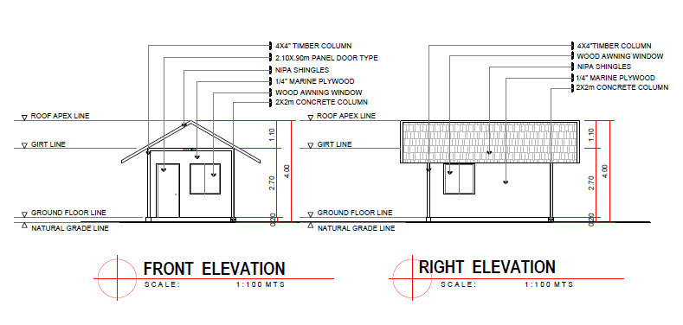
HOUSING SCHEME 1
FOR THE EARTHQUAKE-AFFECTED FAMILIES

Slide 36
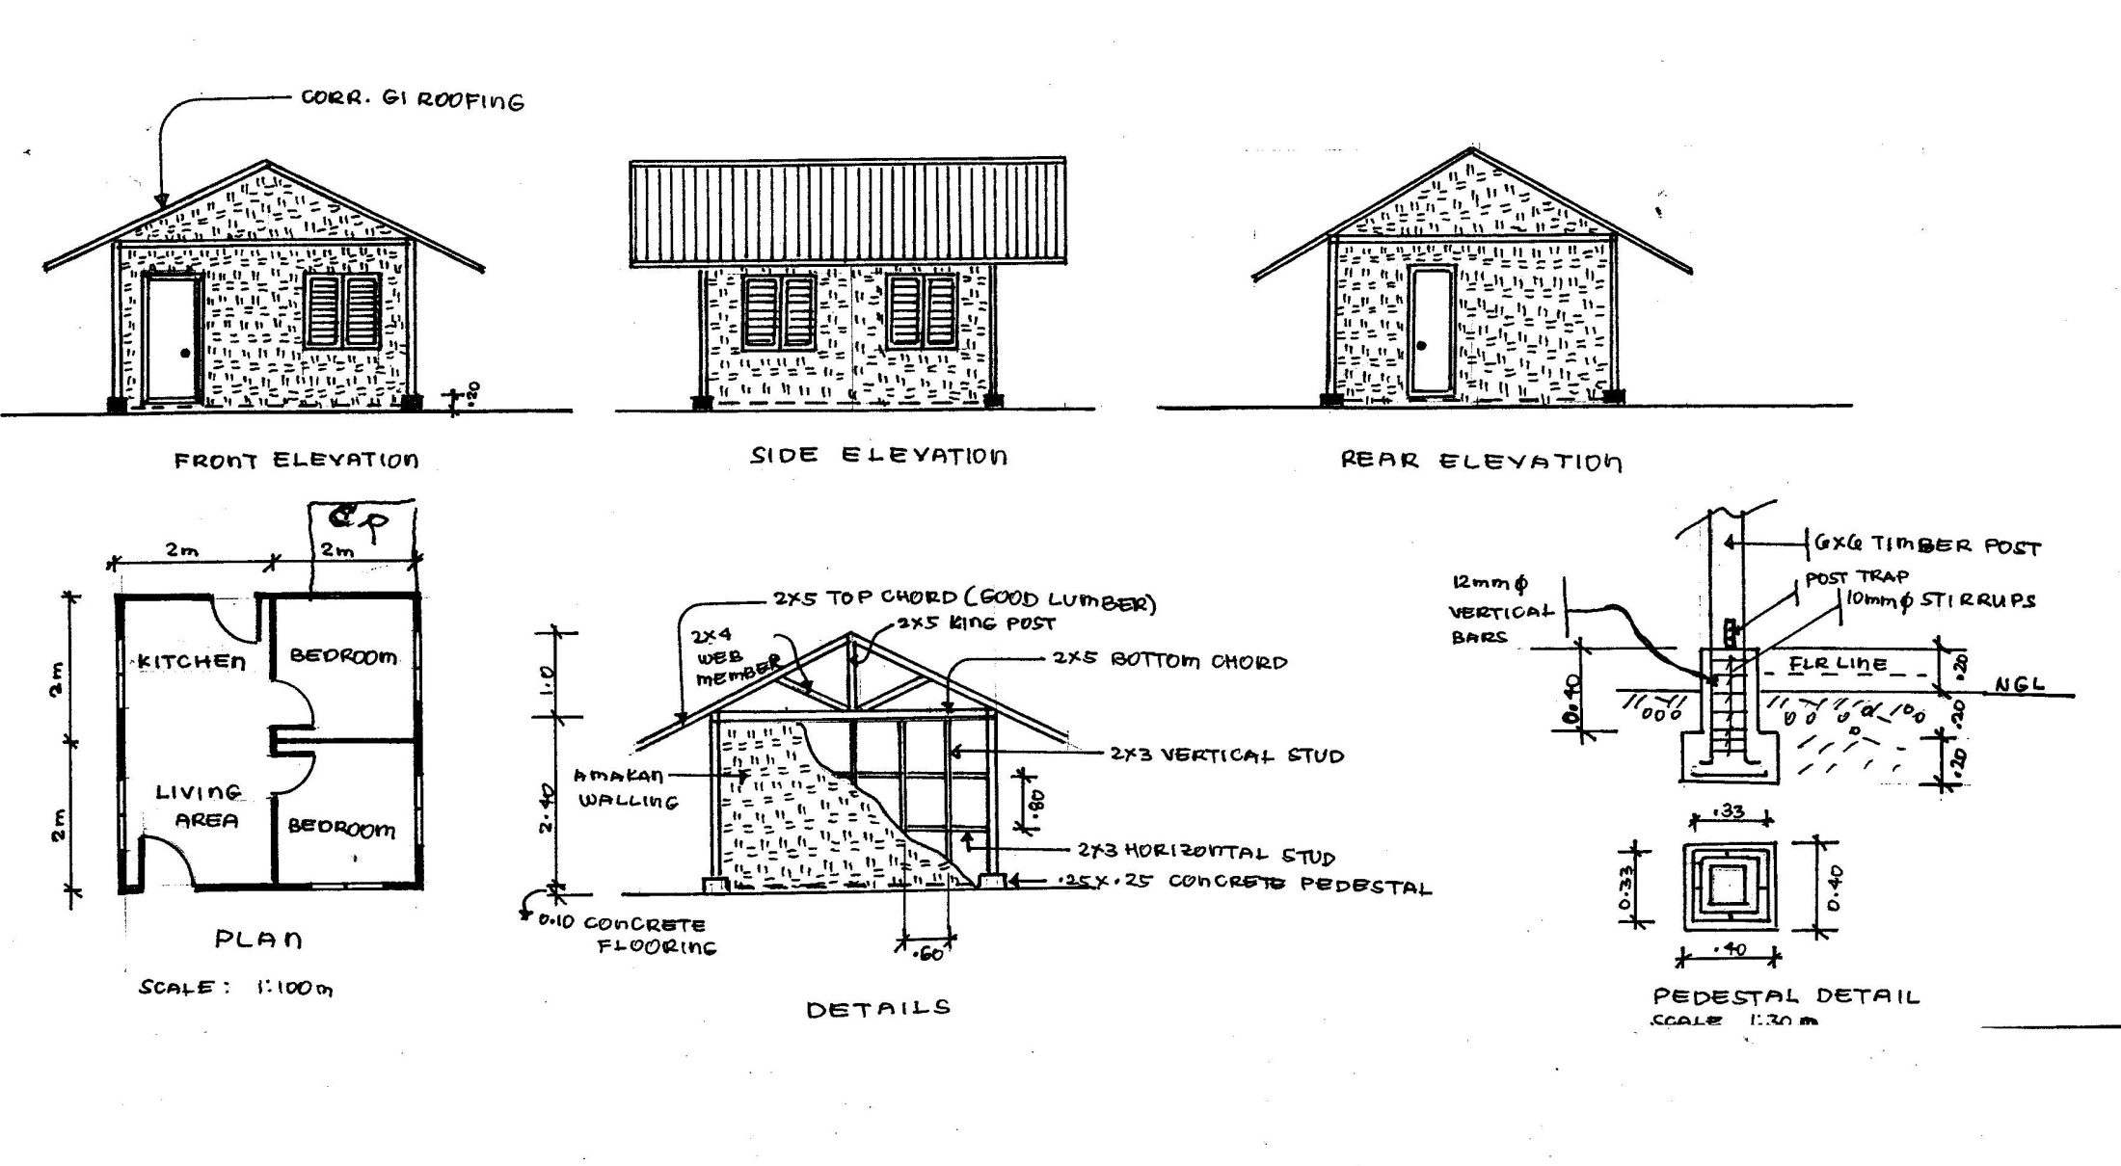
HOUSING SCHEME 2
FOR THE EARTHQUAKE-AFFECTED FAMILIES

Slide 37
Questions

