Slide 1

Shelter Subnational Sector Homs
Ad hoc meeting
5 November 2024

Slide 2
Agenda of the meeting
AGENDA ITEM 1
01
Welcome and introduction
AGENDA ITEM 2
02
Updates from the sector coordinator in Homs
AGENDA ITEM 3
03
Hosting centers
AGENDA ITEM 4
04
Shelter response plan for the influx
AGENDA ITEM 5
05
AGENDA ITEM 6
Regular activities
06
AOB

Slide 3
Agenda of the meeting
AGENDA ITEM 1
01
Welcome and introduction
AGENDA ITEM 2
02
Updates from the sector coordinator in Homs
AGENDA ITEM 3
03
Hosting centers
AGENDA ITEM 4
04
Shelter response plan for the influx
AGENDA ITEM 5
05
Regular activities
AGENDA ITEM 6
06
AOB

Slide 4
Updates from the sector coordinator in Homs
1
2
3
4
SYNAT
Tracking of influx
Reporting
PSEA
Syria Need Assessment Tool
AHCT tracking tool
Activity info
For all members
Inter sector assessment tool
Syrians and Lebanese
Regular and emergency
Physical presence
Status:
enumerators are collecting data from KII
Shared on weekly basis
Biweekly
Tentatively 20 NOV

Slide 5
Updates from the sector coordinator in Homs
1
2
3
4
SYNAT
Tracking of influx
Reporting
PSEA
Syria Need Assessment Tool
AHCT tracking tool
Activity info
For all members
Inter sector assessment tool
Syrians and Lebanese
Regular and emergency
Physical presence
Status:
enumerators are collecting data from KII
Shared on weekly basis
Biweekly
Tentatively 20 NOV

Slide 6
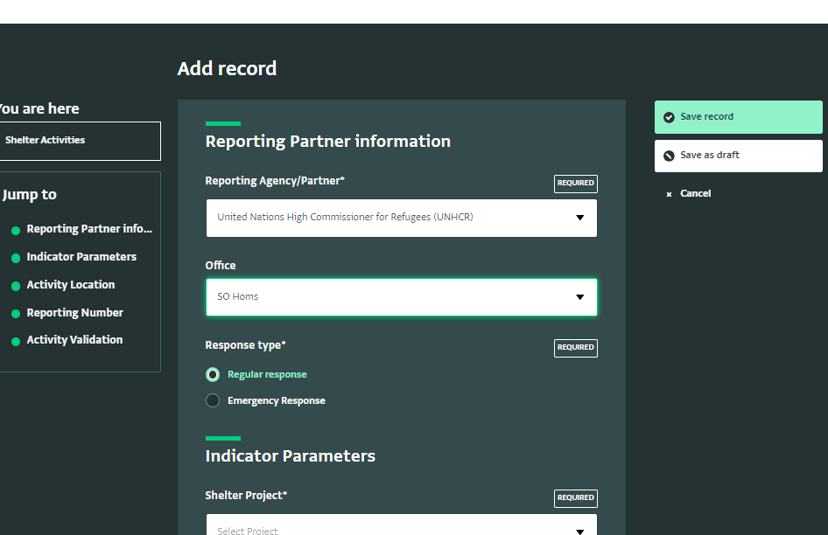

Slide 7
Hosting centers: Updates up to 4 Nov 2024
Name of the hosting center | # families | Response
Mahmoud Othman | 5 | UNHCR: garbage containers and trach bins
Abdul Rahman Shattour | 6 | PUI: WASH, lights, maintenance UNHCR: garbage containers and trach bins
Mar Elias Church | 50 | HEKS: WASH, lights, maintenance UNHCR: garbage containers and trach bins
Maryam AlAdraa Church | 18 | HEKS: WASH, lights, maintenance UNHCR: garbage containers and trach bins
AlArd Center | 19 | UNHCR: garbage containers and trach bins
Total | 98

Slide 8
Shelter response plan for the influx (Refugees and Syrian returnees)
Agency | Intervention | Units | Location | Status
UNHCR | Minor shelter repair | 500 | Homs city, AlRastan, | Planned
UNHCR | Caravans at the boarder points | 4 | Jousieh, Dabousieh, Jesr Kumar | Ongoing
HEKS- EPER | Maintenance of the hosting centers | 2 | 2 Hosting centers in Rableh | Completed
PUI | Maintenance of the hosting centers | 1 | Abdul Rahman Shatour | Tender
UNHCR | Support for the immigration departments at the Boarder points | 3 | Trolleys, ICT equipment, Acs | Ongoing
PUI | Support for the immigration departments at the Boarder points | 3 | Fire extinguishers, fans, waiting chairs, garbage containers, office chairs… | Ongoing

Slide 9
Shelter response plan for the influx (Refugees and Syrian returnees)
Agency | Intervention | Units | Location | Status
PUI | Trash bins | 350 | Hosting centers in Homs and Hama | Ongoing
PUI | Garbage containers | 55 | Hosting centers in Homs and Hama | Ongoing
NRC | Maintenance of the hosting centers | 1 | Teachers training center in AlBayadah/Homs city | Tender (implementation will be pending the use of the center)

Slide 10



Organization | UNHCR
Intervention | Minor shelter repair
target | 50
Location | Homs city/Alkhaledya
Progress | 0%
Organization | Dier AlRahebat
Intervention | Common space maintenance
target | 40
Location | Homs city (Baba amro, AlKhaledyah, AlSultanya)
Progress | 100%
Organization | SIF
Intervention | Minor shelter repair
target | 450
Location | Homs city (AlBayada, AlSabeel, Dier Balbeh) and Mahin
Progress | 15%
دير الراهبات
Organization | CCS
Intervention | Minor shelter repair
target | 220
Location | Homs city and AlQusair
Progress | 35% for 75 houses
Organization | Dier AlRahebat
Intervention | Maintenance of public park
target | 1
Location | Homs city (AlKhaledyah)
Progress | Ongoing
Organization | Dier AlRahebat
Intervention | Shelter repair
target | 96
Location | Homs city (Baba amro, AlKhaledyah, AlSultanya)
Progress | 100%
Regular activities
d

Slide 11
Regular activities
Organization | Dier AlRahebat
Intervention | Maintenance of public park
target | 1
Location | Homs city (AlKhaledyah)
Progress | Ongoing
Organization | UNHCR
Intervention | Minor shelter repair
target | 50
Location | Homs city/Alkhaledya
Progress | 0%
Organization | SIF
Intervention | Minor shelter repair
target | 450
Location | Homs city (AlBayada, AlSabeel, Dier Balbeh) and Mahin
Progress | 15%
Organization | Dier AlRahebat
Intervention | Shelter repair
target | 96
Location | Homs city (Baba amro, AlKhaledyah, AlSultanya)
Progress | 100%
Organization | CCS
Intervention | Minor shelter repair
target | 220
Location | Homs city and AlQusair
Progress | 35% for 75 houses
d
Organization | Dier AlRahebat
Intervention | Common space maintenance
target | 40
Location | Homs city (Baba amro, AlKhaledyah, AlSultanya)
Progress | 100%
دير الراهبات

