Slide 1
Shelter Sector Meeting
October 2024

Slide 2
AGENDA
Status of shelter sector response
Updates on HPC 2025
Displacement from Lebanon
Reporting & IM
AoB

Slide 3
INTRODUCTION

Slide 4
SECTOR STATUS
AS OF JUNE 2024

Slide 5
SECTOR STATUS
AS OF AUGUST 2024

Slide 6
SECTOR STATUS
AS OF AUGUST 2024

Slide 7
SECTOR STATUS
AS OF AUGUST 2024

Slide 8
SECTOR STATUS
AS OF AUGUST 2024

Slide 9
UPDATES ON HPC 2025
HNO 2025
Shelter Sector is adopting ‘Delphi Methodology’ to update/validate PiN and severity scores at sub-district level.
The expert panels are formed at governorate levels.
The deadline for entries is Thursday 10 Oct.
Final outcomes will be shared with the sector partners to support their shelter plans for 2025.

Slide 10
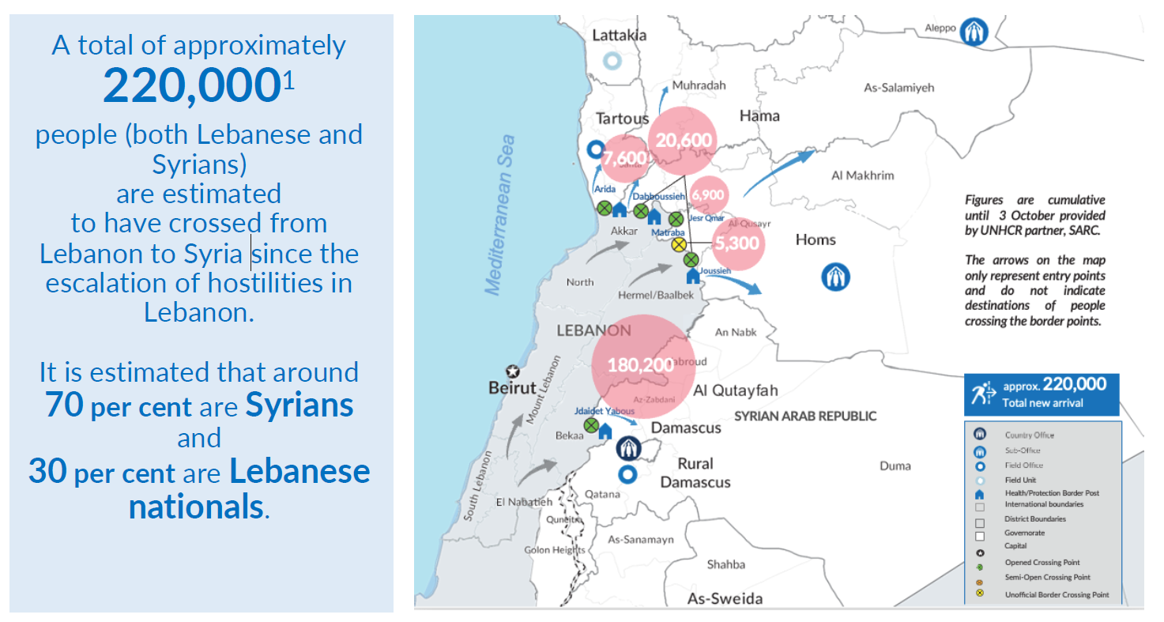
DISPLACEMENT FROM LEBANON
Displacement from Lebanon to Syria
Reporting period: 24 September - 5 October 2024
UNHCR Syria Flash Update #9

Slide 11
DISPLACEMENT FROM LEBANON
Hosting Centers
Local authorities have established hosting centers to provide shelter for vulnerable Lebanese families who have recently arrived in Syria and lack alternative accommodation.
So far, 30 facilities identified, with 13 of them operational and hosting families, majority are Lebanese.
Current accommodation: 2,199 HH – 11,043 ind.
    Distribution of Hosting Centers:
    1 in Damascus
    2 in rural Damascus
    3 in Tartous
    9 in Lattakia
    3 in Idleb
    7in Homs
    5 in Hama
17 CS are empty (capacity 1,543 HH).
Cleaning and maintenance works have been done or are ongoing, while minor repairs are planned for the coming weeks.

Slide 12
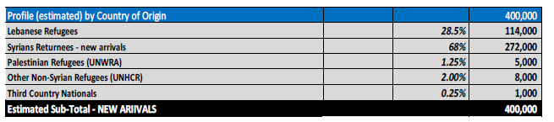
DISPLACEMENT FROM LEBANON
Inter-Agency Flash Appeal
Planning Assumptions:
Projection of new arrivals crossing the border is expected to reach approximately 400,000.
Around 60% (approximately 240,000) are expected to require support within the country.
Host population: It is estimated that approximately 80,000 individuals will need humanitarian support.
The maximum target population is expected to reach 480,000 people.
The target over 6 months period is 320,000 individuals

Slide 13
DISPLACEMENT FROM LEBANON
Inter-Agency Flash Appeal
Shelter Priorities:
Most displaced individuals are hosted by Syrian families, both these hosts and their communities are prioritized for support with NFIs and cash-based interventions (CBIs) to help sustain host arrangements.
Support vulnerable households in rented properties with cash-based interventions to avoid forcing them into collective shelters.
Support semi-permanent shelter construction and repair damaged homes for returnees and host communities.
Expand NFI distributions of bedding, clothing, and cooking supplies, focusing on the most vulnerable. Provide winterization kits (heaters, blankets, plastic sheeting) to ensure shelters are prepared for winter.
Collaborate with the WASH sector to ensure all active hosting centers have adequate sanitation and water systems.

Slide 14
REPORTING & IM
4Ws Report
Avoid the duplication of counting of individuals reached as much as possible and be sure to share data through the Activity info here.
The sector IM has implemented an interactive dashboard here, so please use the link for more details of the SNFI sector response.
The SNFI sector has released the Q2 sector factsheet here, please visit the Global Shelter Cluster web page for more information.
Reporting Frequency
4W’s report is to be completed by all sector partners by the 7th on a monthly basis.
If you have any queries on reporting, please send me an email at habibmu@unhcr.org or via cell phone at +963 933 346 458

Slide 15
AOB
SHF – 1st Standard Allocation
The SNFI envelope is $3.5 million.
6 projects with shelter component were submitted by 5 INGOs and 1 NNGO.
Shelter projects valued $1.5 million, while NFI projects valued at $2.4 million. There was a need to reduce $400k to meet the envelop.
Two vetting committees were held on August 11th , all projects passed.
The comments are being addressed by the partners.

Slide 16
THANK YOU
October 2024
Mahamat Alhadi Ibrahim Yaya
Snr Sector Coordinator
mahamati@unhcr.org
Baria Alkafre
Assc Shelter Officer
alkafre@unhcr.org
Muhammad Reda Habib
Information Management Associate
habibmu@unhcr.org

