Slide 1
Purpose of the Assessment
“Is there a viable alternative to tents in Puntland as a transitional shelter solution?”
This is Phase 1, Phase 2 will be more field testing in Bossaso.
Tents will always have their place in Somalia.

Slide 2
Q: List in priority order of importance – what are your most important concerns for your shelter:
CONCERN / ISSUE | TOTAL SCORE | AVERAGE SCORE | FEMALE SCORE | FEMALE AVERAGE | MALE SCORE | AVERAGE MALE
Fire | 21 | 2.1 | 16 | 2.7 | 5 | 1.3
Theft | 29 | 2.9 | 13 | 2.2 | 12 | 3
Leaks / flooding | 30 | 3.0 | 18 | 3 | 12 | 3
Privacy | 35 | 3.5 | 19 | 3.2 | 16 | 4
Ventilation | 41 | 4.1 | 17 | 2.8 | 24 | 6
Heat | 42 | 4.2 | 27 | 4.5 | 15 | 3.8

Slide 3
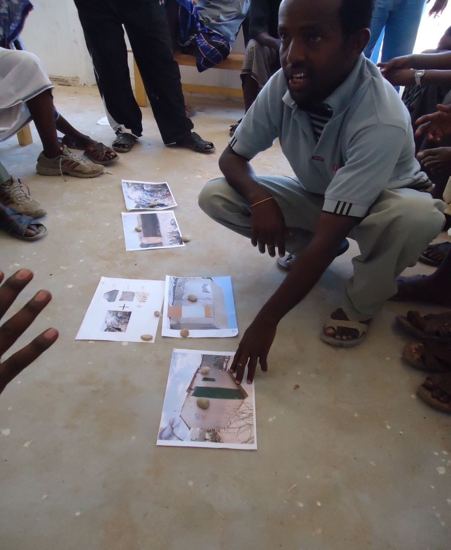
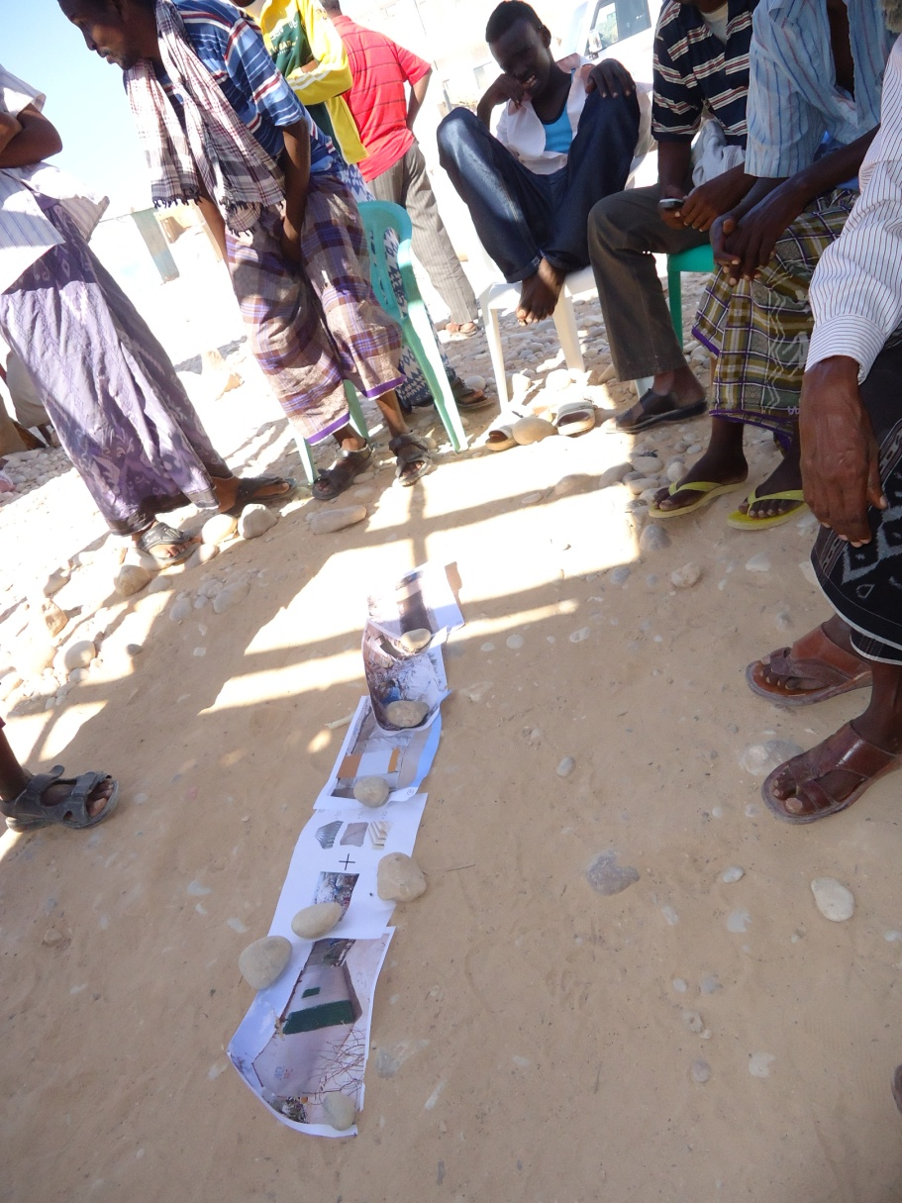

Slide 4
Rank | M1 | M 2 | M 3 | M 4 | F 1 | F 2 | F 3 | F 4 | F 5 | F 6
1 | CGI | CGI | CGI | CGI | CGI | CGI | CGI | CGI | CGI | CGI
2 | Mat | Mat | Mat | Tent | Tent | Mat | Tent | Tent | - | Tent
3 | Tent | Tent | Tent | Mat | Mat | - | Mat | - | - | -
4 | Hessian | Hessian | Hessian | Hessian | Hessian | - | - | - | - | -
5 | Buul | Buul | Buul | Buul | Buul | - | - | - | - | -

Slide 8
Advantages of CGI
Protection
Fire
Durability – 1.5 year vs up to 5 years
Time of implementation
Quality Assurance
Livelihoods – Tent = $450, 9% in Somali Economy
– CGI = $650, 50+% in Somali
Insulation
Durable Solution??

